Slide 1
Current photocathode lifetime at FLASH and European XFEL
Sven Lederer & Siegfried Schreiber (DESY)
Laura Monaco & Daniele Sertore (INFN – Milano, LASA)
European Workshop on Photocathodes for Particle Accelerator Applications
Paul Scherrer Institut (PSI), Switzerland
11 – 13 September 2019

Slide 2
Outline
European XFEL – overview
FLASH – overview
Cathode transfer and handling
  At FLASH
  At European XFEL
Current photocathode lifetime
  At European XFEL
  At FLASH
Summary

Slide 3
European XFEL – overview
Photon
Beamlines
Undulators
Experiments
Bunch
Compression
Main
Linac
Collimation
Beam Distribution
RF Gun
Injector
SASE2
SASE1
5 MeV
150 MeV
600 MeV
2 GeV
17.5 GeV
0.05 – 0.4 nm
SASE3
3.3 km
0.4 – 4.7 nm
Laser driven RF-gun
3 bunch compressors
97 1.3 GHz superconducting accelerator modules
  Maximum beam energy 17.5 GeV
Up to 600 kW beam power
Three variable gap undulators
  SASE1 and SASE2
    175 m magnetic length
    0.05 – 0.4 nm wavelength (25 keV – 3 keV)
  SASE3
    105 m magnetic length
    0.4 – 4.7 nm wavelength (3 keV – 0.26 keV)

Slide 4
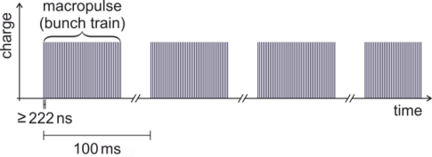
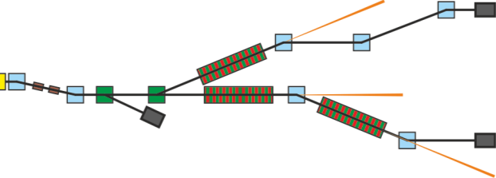
European XFEL – overview
Courtesy Lars Froehlich (DESY)
L. Froehlich et. Al, “MULTI-BEAMLINE OPERATION AT THE EUROPEAN XFEL”, FEL2019.
Special beam distribution system
Fast (4.5 MHz) in vacuum magnetic stripline kicker - TLD kicker
2 Lambertson septa
Slow (tens of µs) magnetic stripline kicker – beam distribution kicker
From gun to the first TLD kicker, the beam forms a train of up to 2700 equidistant bunches.
The TLD kickers can send an arbitrary number of the incoming bunches to the TLD This can be decided individually for each bunch.
Typically once per train the distribution kickers can change their state from on to off or vice versa so that a part of the remaining bunches is directed to SASE2 and the other part to SASE1/3.
  During ramp-times bunches have to be send to the TLD
All settings can be changed from macropulse to macropulse (i.e. at 10 Hz).
Example of a bunch pattern
SASE2
T5D
TLD
SASE1
SASE3
w/ soft kick in SASE1
TLD
SASE2
T4D
SASE1
TLD
SASE3

Slide 5
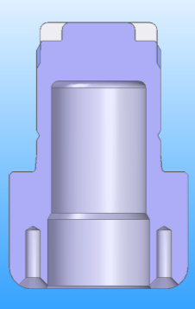
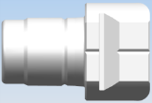
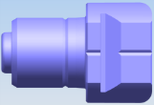
European XFEL – overview
Main parameters and requirements
RF-gun 1½ cell 1.3 GHz normal conducting
  Max. accelerating gradient 60 MV/m
  RF pulse length (flat top) 650 μs
Macro pulse repetition rate 10 Hz
Bunch repetition frequency within pulse 4.5 MHz
Bunch charge 20 pC–1 nC
Slice emittance ( 50 MV/m, 500 pC) 0.6 mm mrad
Up to 27000 bunches per second (2700 10 Hz)
Two drive laser systems, operating at 257 nm and 266 nm
Cathode plug
  Original INFN cathode plug design, used at European XFEL and FLASH
  For comparison, new INFN/Fermilab cathode plug design
    used e.g. at APEX-gun @ LBL, CLARA @ STFC , LCLS II @ SLAC, REGAE and SINBAD @ DESY
  Differences only in the front region, therefore
    100 % compatibility in preparation and transfer systems
Photocathode material Cs₂Te

Slide 6
FLASH – overview
See Siggis talk

Slide 7
Cathode transfer and handling

Slide 8
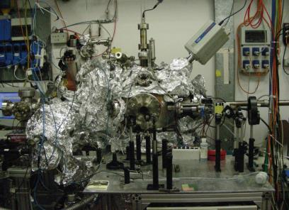
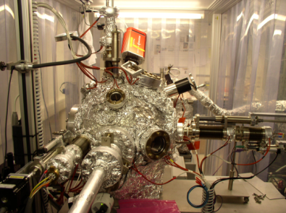
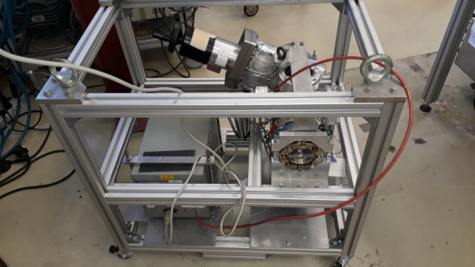
Cathode transfer and handling
LASA preparation system
DESY preparation system
Cs₂Te Photocathodes produced at
  DESY or
  INFN – Milano, LASA
Transfer to FLASH or European XFEL by means of battery buffered UHV transport boxes
Even though the transfer systems at FLASH and European XFEL are not equal they are 100 % compatible
Courtesy D. Sertore
Transport box

Slide 9
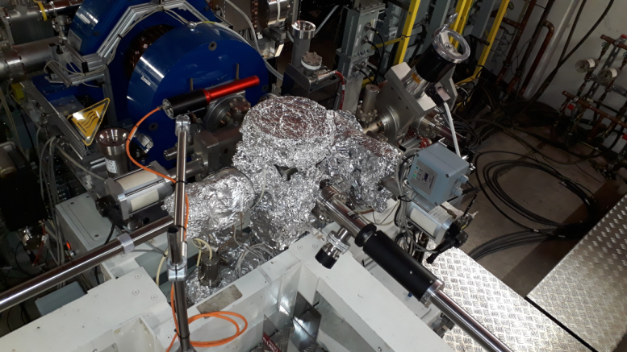
Cathode transfer and handling
FLASH – transfer system
Central chamber
System works reliable since years
  Nevertheless based on the experience some modifications were implemented in cathode carriers, transport boxes and the transfer system of European XFEL
RF-gun
Transport box
Magnetic drive to move the carrier
Magnetic drive insert cathodes into RF-gun

Slide 10
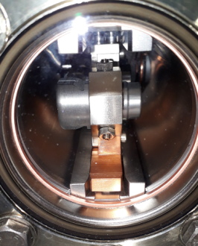
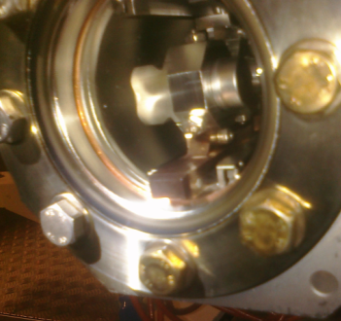
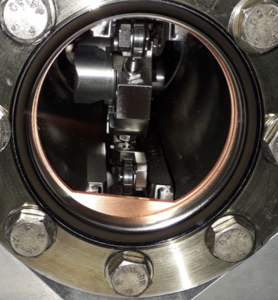
Cathode transfer and handling
Minor changes
Originally standard on loading side of the transport boxes gaskets used
Carrier accidentally moved until view port of transport box
  High risk of catastrophic air inrush
Implementation of a special gasket that protects the viewport by blocking the carrier movement

Slide 11
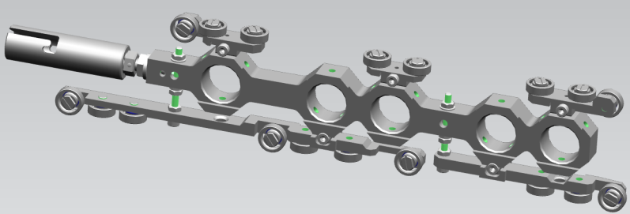
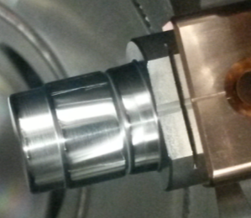
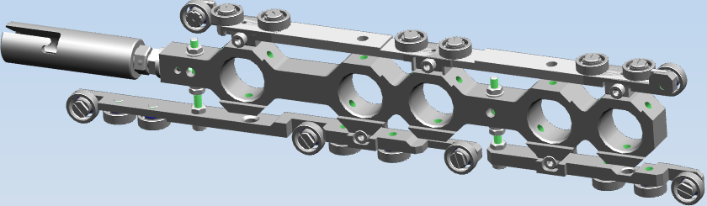
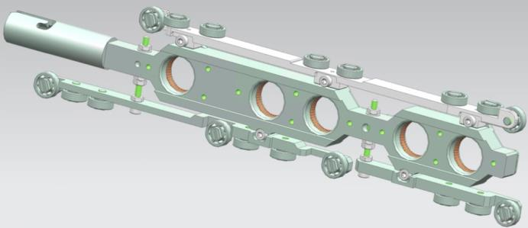
Cathode transfer and handling
Upgrades on cathode carriers
4th generation carrier
Scratches (particulate creation) on cathode plugs by spring plungers
Combined the upper ball bearing supports to ease alignment and reduce risk of loose supports
6th generation carrier
Spring plunger replaced by springs (contact stripes)
5th generation carrier
Bayonet not screwed any more -> cannot loose

Slide 12
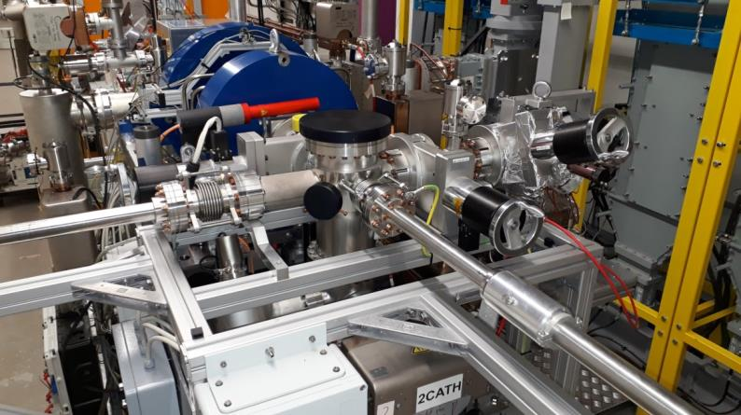
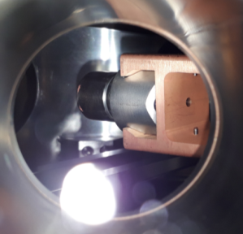
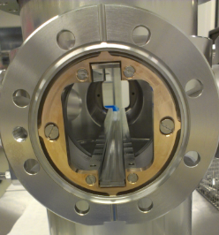
Cathode transfer and handling
European XFEL – transfer system
System 100 % compatible to FLASH
Improvements
  Easier alignment between chambers (rails)
  Improved visibility in the central chamber by means of a side view port
    positioning of the pincer much easier
  Rails exchangeable
Upper rail of the central chamber
Lower rail of the central chamber

Slide 13
Cathode transfer systems
Known possible issues
Bayonet not correctly fixed
  Risk: Loss of carrier
  Relatively simple to resolve by pushing the carrier carefully back into the transport box
Loose of magnetic coupling of manipulators
  Risk: In worst case closure of valves while actuators or not removed
  Usually relatively simple to resolve by moving the carrier to a fixed position and recouple the magnets of the actuator
Since over ten years at FLASH and 4 years at European XFEL no problem with the cathode systems which could not be solved
  Key factors:
    No automation or interlocks
    Only experienced personal
    At least two persons to ensure 4 eye principle

Slide 14
Current photocathode lifetime

Slide 15
Current photocathode lifetime
QE measurement procedure
Always comparable conditions
On-crest accelerating field 52 MV/m
Launch phase 38° w.r.t. zero crossing
Charge measurement by toroid at RF-gun exit
Laser energy measured by
  Calibrated joulemeter (FLASH)
  Cross-calibrated photo diode (European XFEL)
Transmission of vacuum window and reflectivity of in-vacuum mirror taken into account
QE is obtained from linear fit in not space charge dominated regime (independent from laser spot size for homogeneous cathodes).

Slide 16
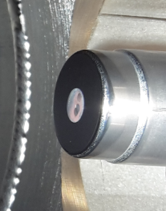
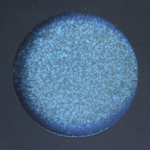
Current photocathode lifetime
European XFEL – cathode #680.1
Prepared Sep-2015
In operation since Dec-2015, up to now for more than 1300 days
Total charge extracted up to now: 20.7 C
No plans for exchange

Slide 17
Current photocathode lifetime
European XFEL – cathode #680.1
Majority of extracted charge up to now dumped
Accelerator running with high bunch number to easy stabilization / feedbacks
Users choose bunch number and pattern as they want – thanks to the beam distribution and timing system
Experiments
SASE2
SASE1
SASE3

Slide 18
Current photocathode lifetime
FLASH – cathode #73.3
Prepared May-2013
Operated from Feb-2015 to Dec-2018 for a record of 1413 days
Total charge extracted up to now: 24.4 C

Slide 19
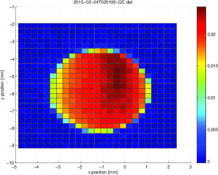
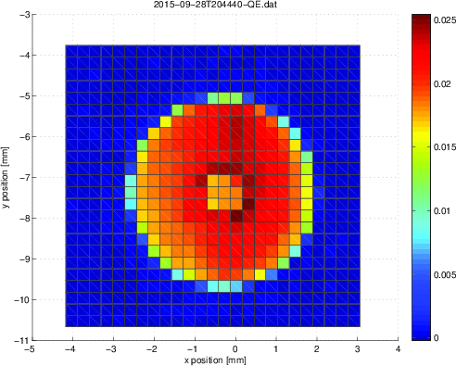
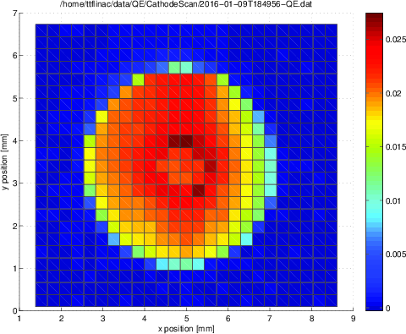
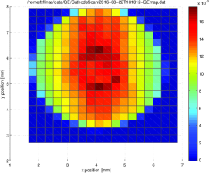
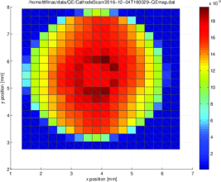
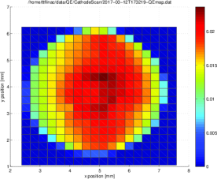
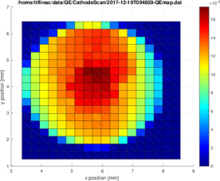
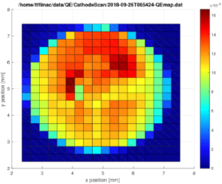
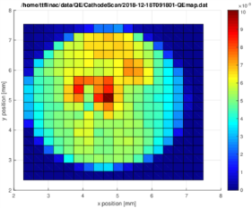
Current photocathode lifetime
n.b. scaling is different,
cathode diameter always 5 mm
FLASH – cathode #73.3
4-Feb-2015, QE=11.4 %
28-Sep-2015, QE=8.4 %
9-Jan-2016, QE=7.7 %
QE-map: laser scanned linear vertically and horizontally, in steps of 85 μm
Laser spot size σ = 25 μm
Measured charge is color coded in nC
Initial fast QE degradation at the operational laser spot position
Afterwards rejuvenation at this point
Finally high QE spots
    → Reason for exchange
22-Aug-2016, QE=4.4 %
04-Dez-2016, QE=7.8 %
12-Mar-2017, QE=9.64 %
19-Dez-2017, QE=9.8 %
26-Sep-2018, QE=3.5 %
18-Dec-2018, QE=4.4 %

Slide 20
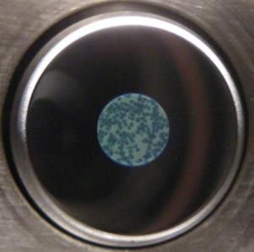
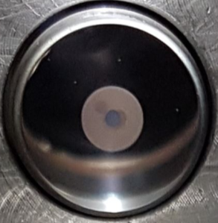
Current photocathode lifetime
FLASH – cathode #73.3
Photos of cathode #73.3 in the transport box
  Left: after production in 2013
  Right: after usage at FLASH in Dec-2018
  Image shows no hint for high QE spots, as identified in the past
Laser was strongly misaligned
Laser position during standard operation

Slide 21
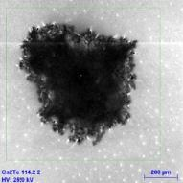
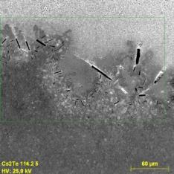
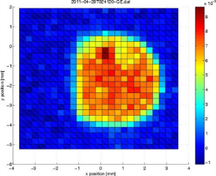
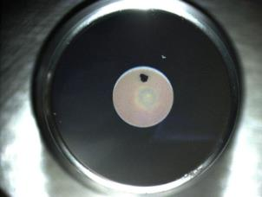
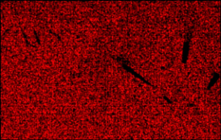
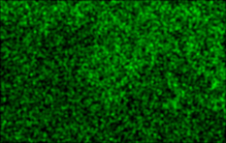
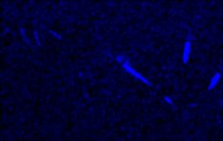
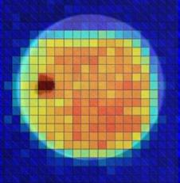
Current photocathode lifetime
FLASH
SEM images of the suspicious are
Cathode #114.2 operated at FLASH in 2011
High QE spot
Missing Cs₂Te film?!
Elemental mapping by EDX
Mo
Te
Cs
Thickness of Cs₂Te film seems to be less in the center of the spot → different color
Higher QE measured during QE maps might result from
  Lower work function of Cs w.r.t Cs₂Te

Slide 22
Current photocathode lifetime
FLASH – cathode #105.2
Prepared Jun-2013
Operated since December 2018 as replacement for #73.3
Total charge extracted up to now: 5.0 C
Remarkable high QE

Slide 23
Summary
Cathode handling and transfer at FLASH and European XFEL works reliable but is continuously improved
At FLASH and European XFEL currently no life time issues of Cs₂Te photocathodes

