Slide 1

Efficient energy recovery @ ESS
2019-11-28

Slide 2
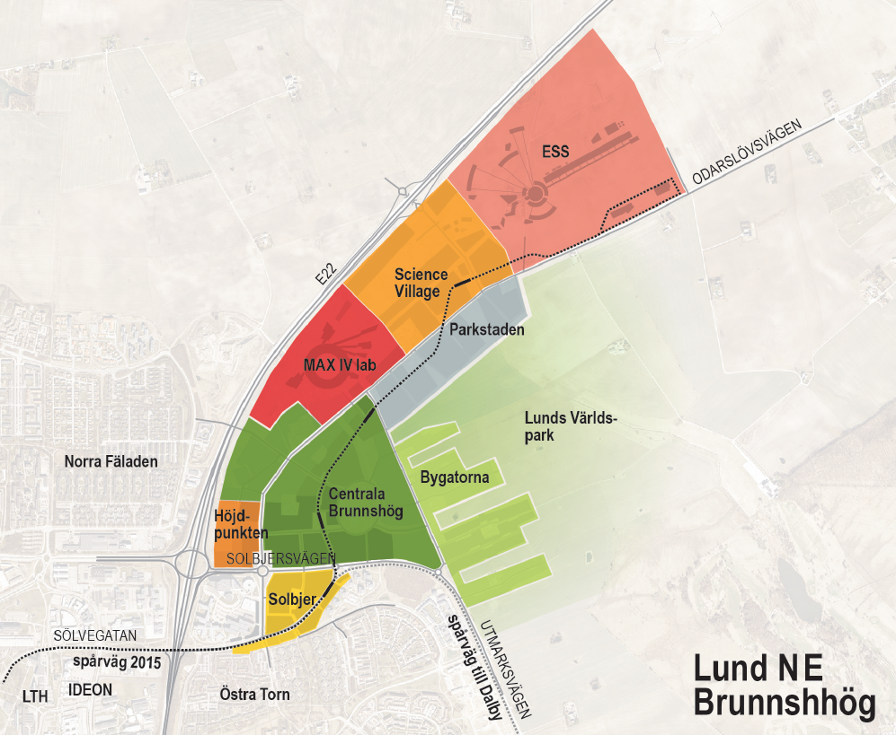
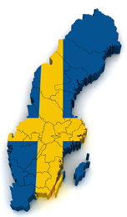

Back-up´s
New city area Brunnshög in Lund, Sweden

Slide 3




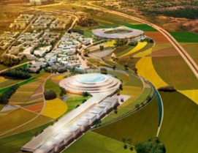
Unique energy vision - One of the factors in the selection of Sweden and Lund as home for ESS
    Competence and higher education
    Synergies with research facility nearby
    Accessibility
      Responsible
      Renewable
      Recyclable
    Unique energy and sustainability ambitions
    Site integrated with city

Slide 4

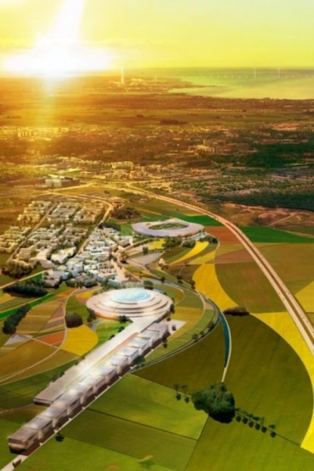
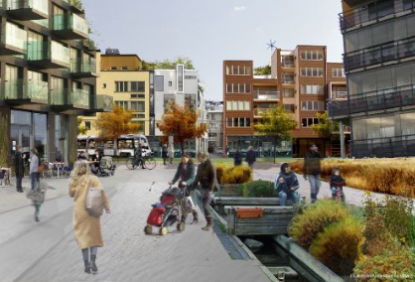
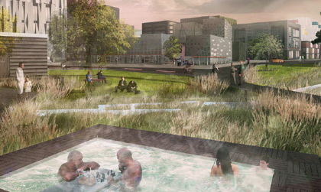
Lund municipality with high ambitions for Brunnshög
    40 000 people to live and work in the area
    World's best research and innovation environment
    International destination for science, culture & recreation
    European model for sustainable city development
    Local energy production 50% higher than consumed (”city as power plant")
    Transportation: Max 1/3 car, Min 2/3 public or bike

Slide 5

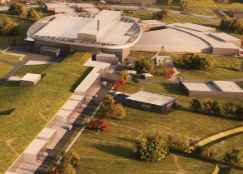

Concept enables efficient heat recycling at ESS
Cooling production
Surplus heat
Heat recovery
High temp: > 80^{O}C
Heat pumps
Cooling machines
District heating
Medium temp: 55^{O}C
High temp ~ 80⁰C
Medium/low temp: 31^{O}C
Low temp: 16^{O}C
Low temp ~ 20⁰C

Slide 6
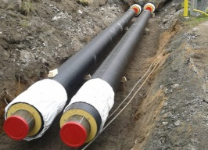
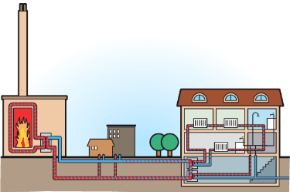


Existing local heat market and infrastructure suitable for recovering ESS high temperature surplus heat
100
TWh
Helsingborg
Landskrona
Eslöv
Lomma
Lund
Notes:
Värmen kommer till fastigheten i form av vatten som värmts upp i ett centralt värmeverk. Det heta vattnet transporteras i rör under högt tryck. Vattnet är mellan 70 och 120 grader varmt.
Fjärrvärme är den vanligaste uppvärmningsformen i Sverige. Mer än hälften av alla bostäder och lokaler värms med fjärrvärme.
I dag är största delen av den energi som tillförs värmeproduktionen förnybar.
De största posterna tillförd energi till fjärrvärmeproduktionen var 2013:
• Biobränslen: 44 procent.
• Avfall: 19 procent.
• Rökgaskondensering: 9 procent.
• Spillvärme: 7 procent

Slide 7

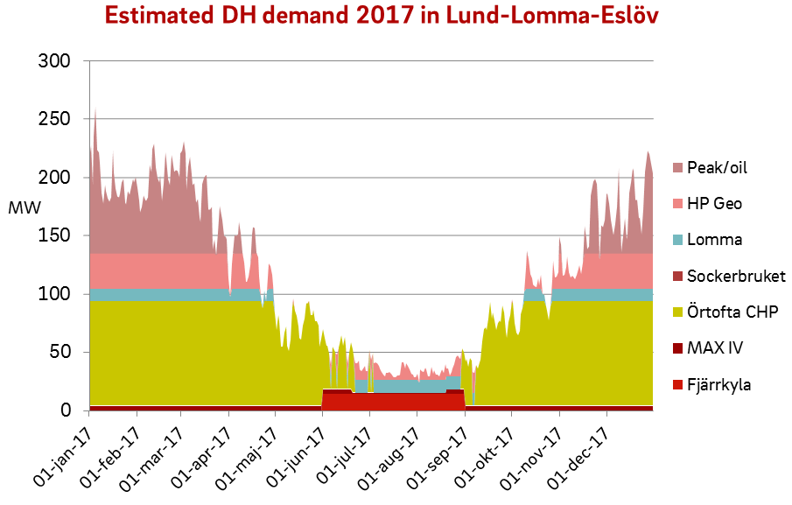
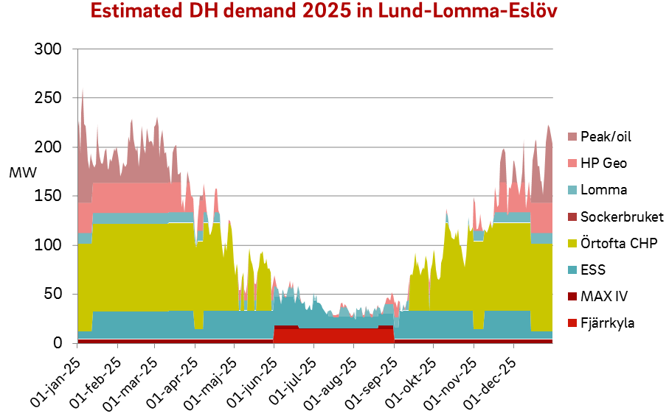
Existing local heat market and infrastructure suitable for recovering ESS high temperature surplus heat
Fossil fuel
Fossil fuel
Oil
GSHP
Bio heat plant
Ind. surplus heat
Biomass CHP
ESS
MAX IV
District cooling surplus heat
High temp surplus heat from ESS will reduce CO2 emission

Slide 8
Concept enables efficient heat recycling at ESS
Cooling production
Surplus heat
Heat recovery
High temp: > 80^{O}C
Heat pumps
Cooling machines
District heating
Medium temp: 55^{O}C
High temp ~ 80⁰C
Medium/low temp: 31^{O}C
Low temp: 16^{O}C
Low temp ~ 20⁰C

Slide 9
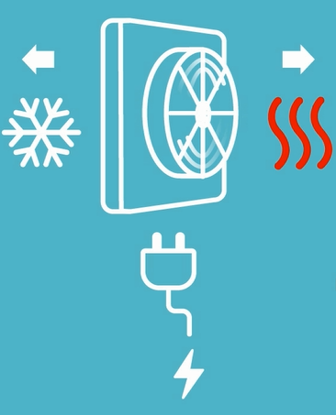
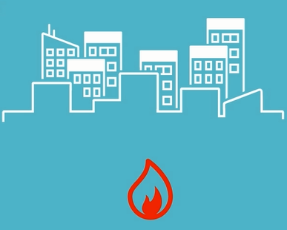
Cooling equipment expels excess heat
Simultaneous heat demand – Fulfilled by combustion

Slide 10
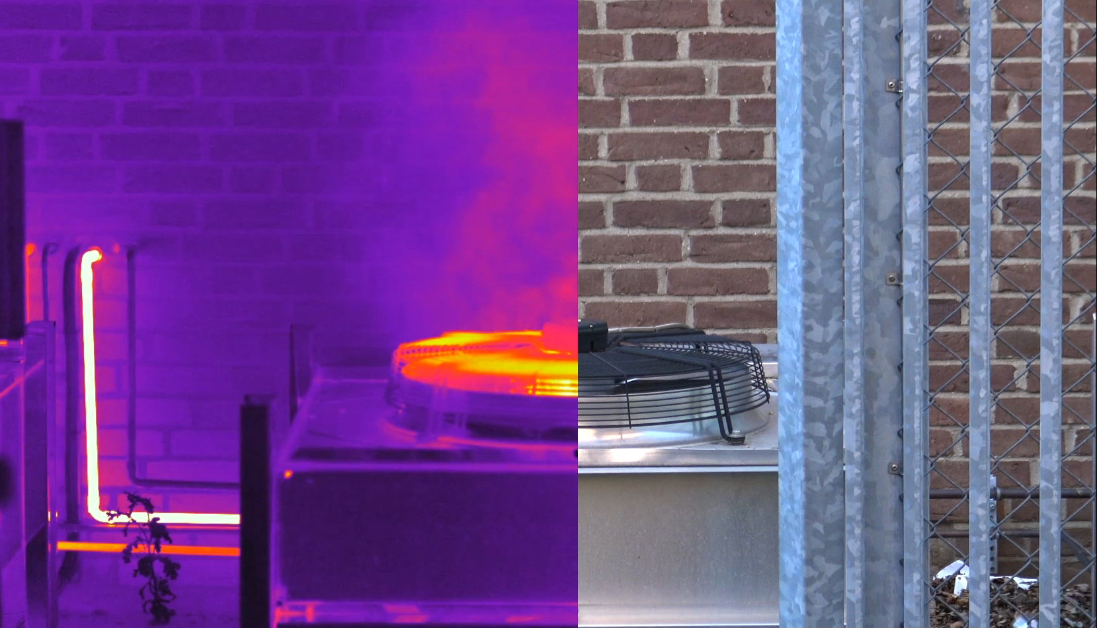
Conventional cooling
Infrared spectrum
Visual spectrum

Slide 11


Combining benefits of well-known systems/components
Shared energy for a sustainable city

Slide 12

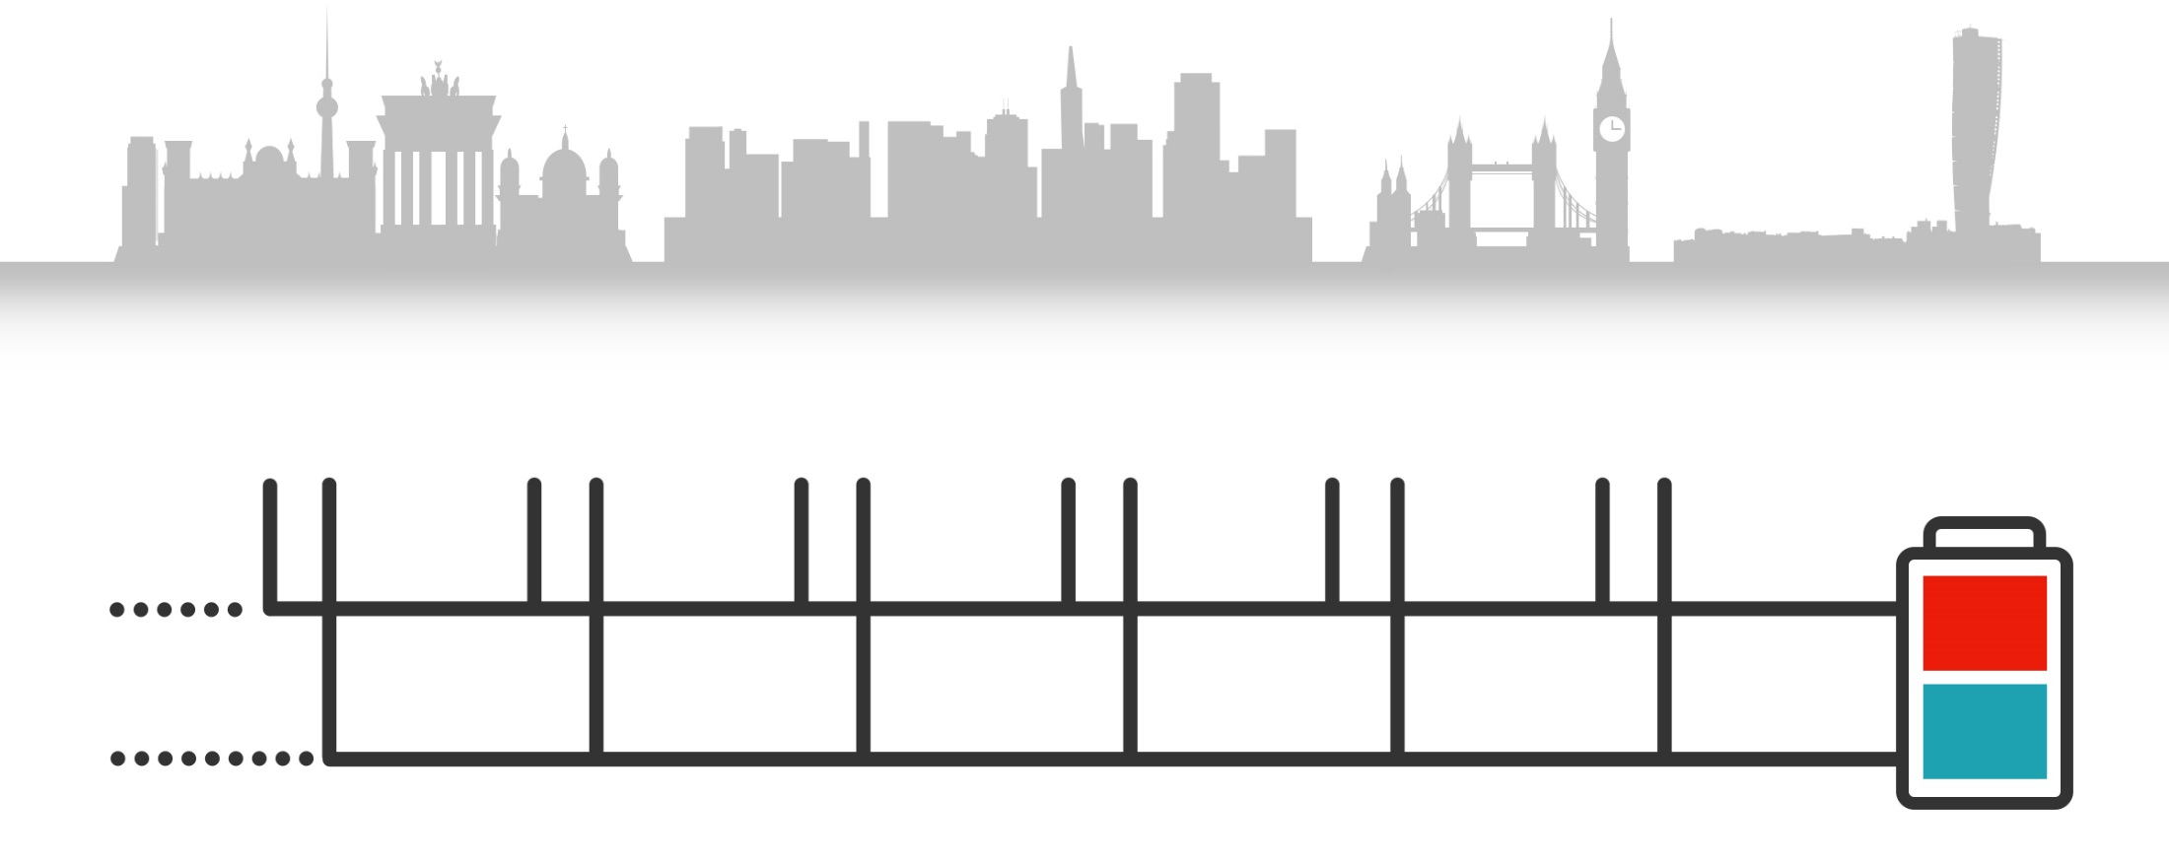



The most energy efficient heating and cooling solution
Cheaper to build - one grid serves 2 utilitites
Cheaper to operate
How ectogrid™ works
Buildings connected to the same system provide each other with heating and cooling.
~15-40 ^{O}C
~5-30 ^{O}C

Slide 13
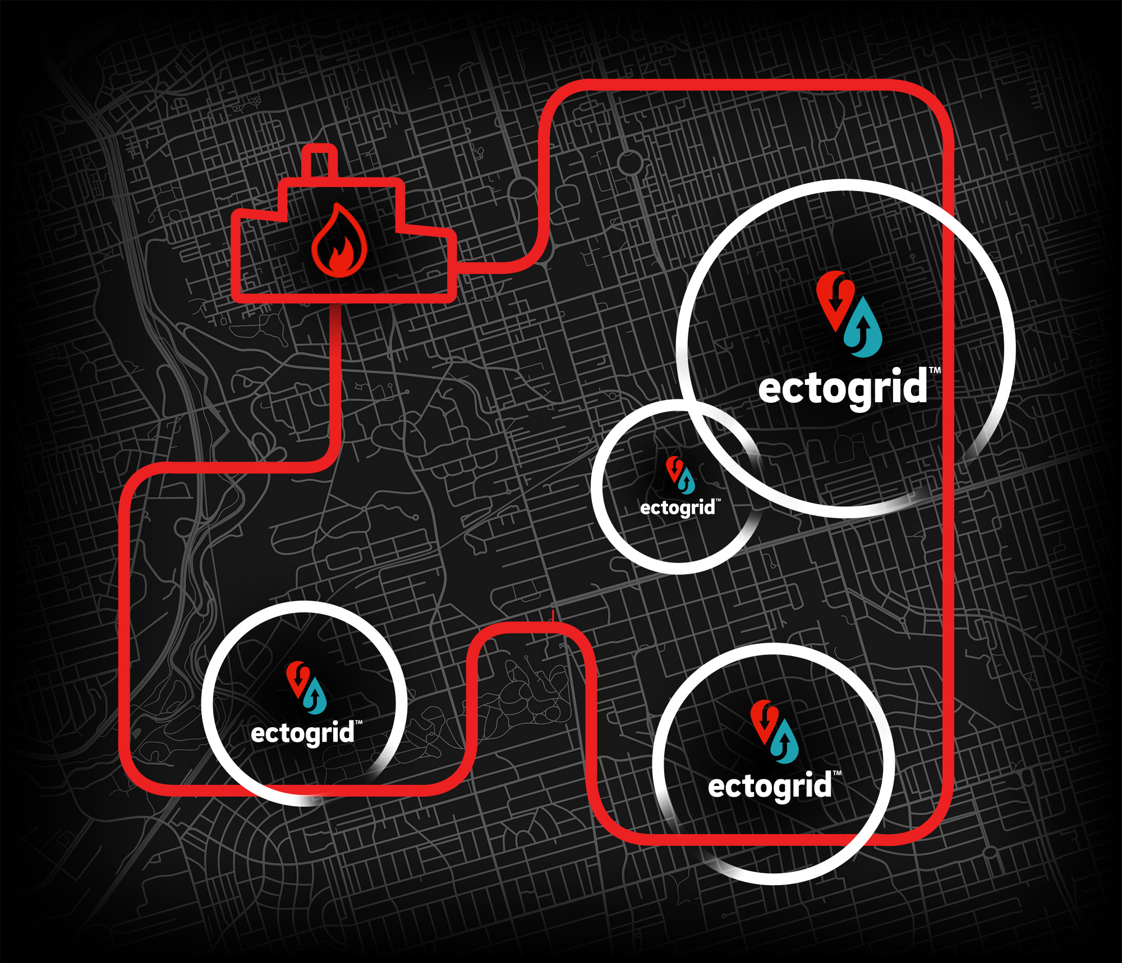
Hybrid solutions complementing existing infrastructure

Slide 14

ectocloud™
- Looping energy

Slide 15














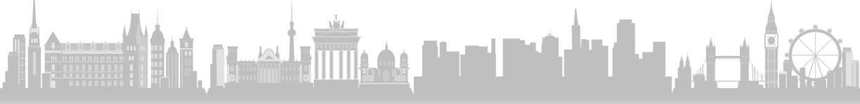
ectocloud™

Slide 16


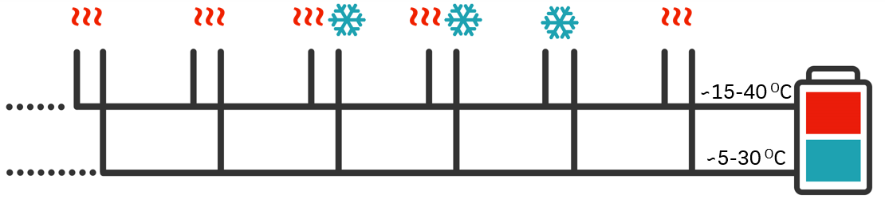
Thermal storage capacities in ectogrid™
Building climate shells
Acccumulator
Water in pipes
Surrounding earth (uninsulated pipes)
Notes:
Växelvarmt, jobbar med mkt låga temp., delar spillvärme- och spillkyla med grannar, inget centralt pumparbete, inga distributionsförluster, utnyttjas för energilagring

Slide 17
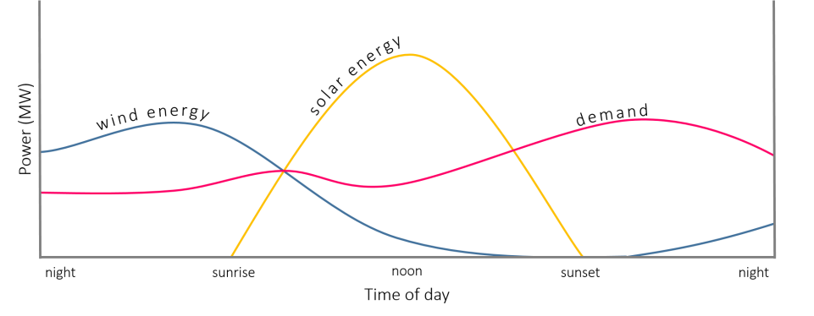
ectogrid™ enables flexibility due to thermal storage capacities
  Example
  Charging possible
  Decharging wanted
  Solar energy
  Wind energy
  Overall Demand
  Power (MW)
  ectogrid™ consumption
  Night
  Sunrise
  Noon
  Sunset
  Night
  Time of the day

Slide 18
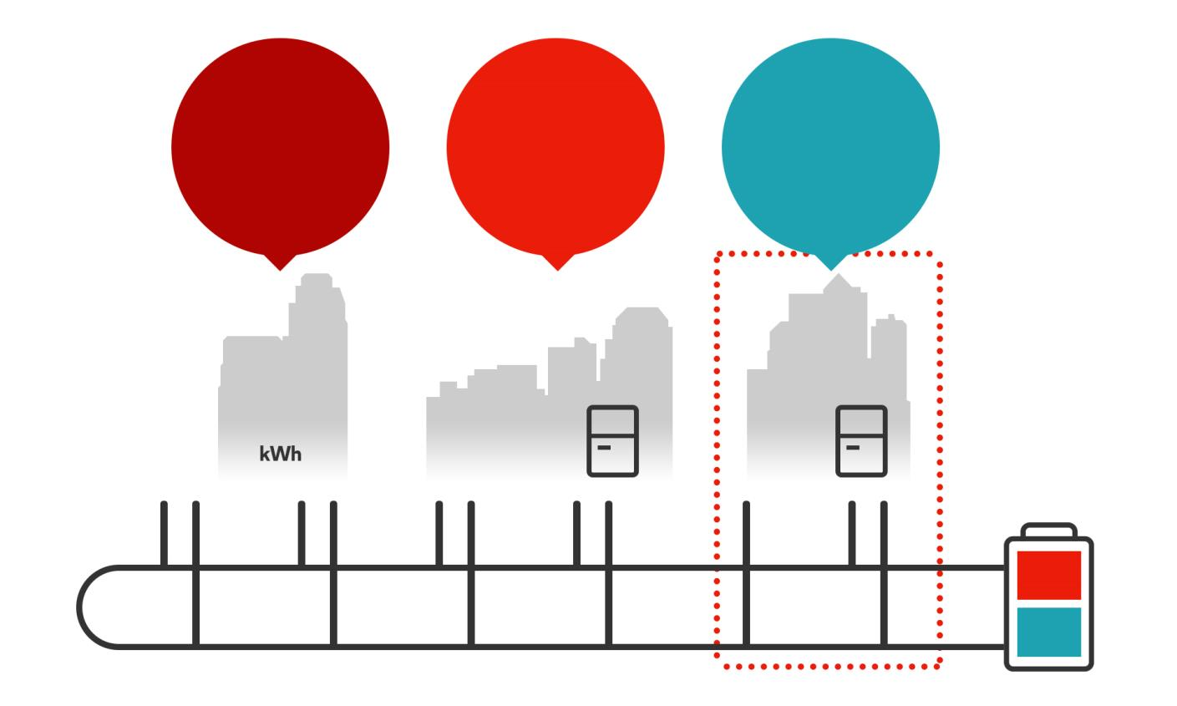
Different business models to fit customers needs
Purchase
energy
Own your
equipment
Share the
investment

Slide 19




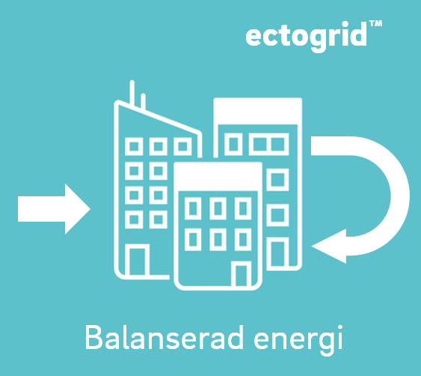

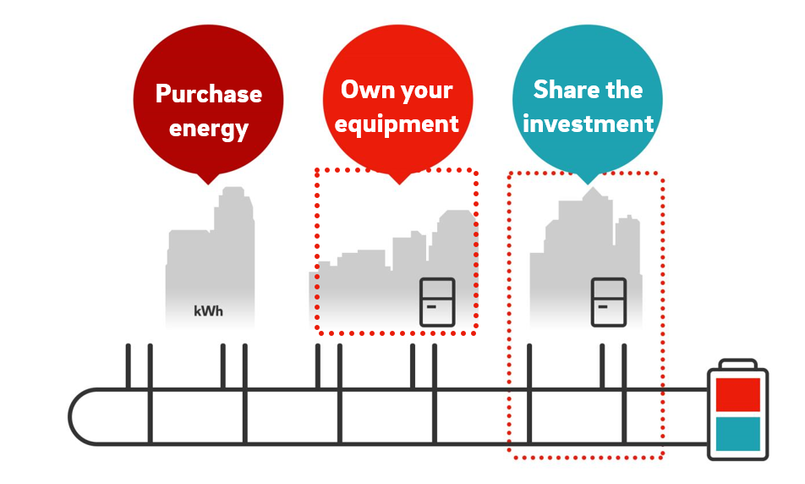
ectogrid™ an innovative concept - examples

Slide 20
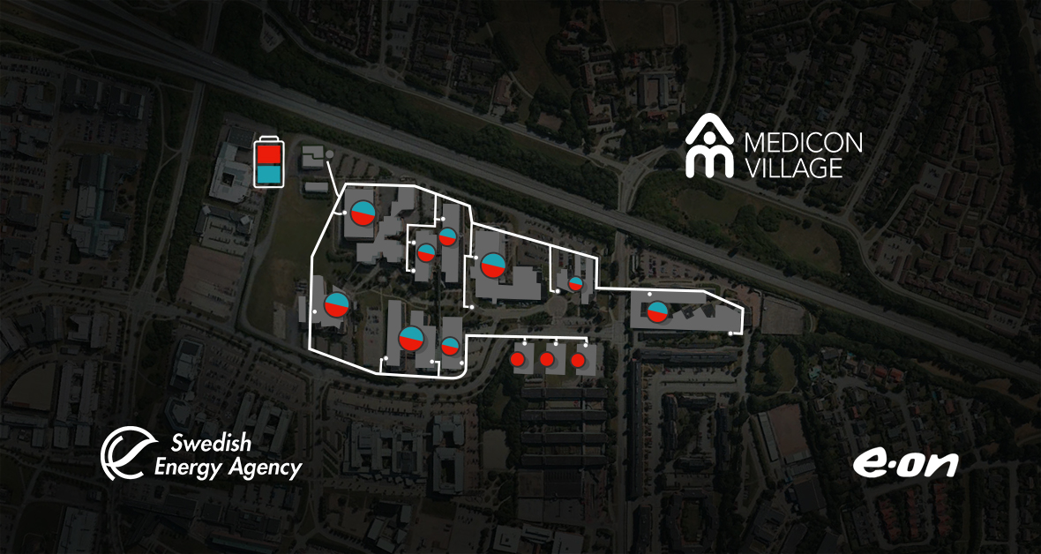
Worlds first ectogrid™ implemented at Medicon Village Science Park in Lund

Slide 21

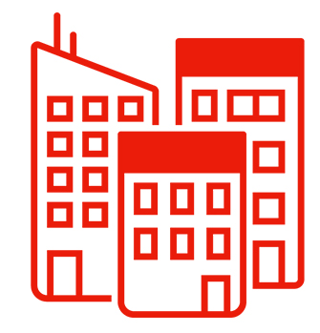
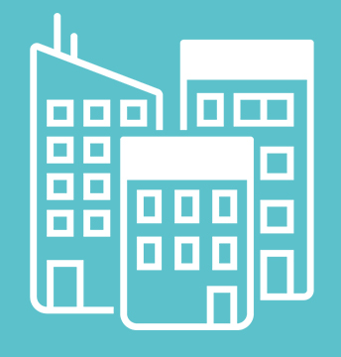
District heating/
District cooling
ectogrid™
District
heating
10 GWh
Balanced energy
11 GWh
District
cooling
4 GWh
Supplied
energy
3 GWh
Supplied energy
Balanced energy

Slide 22
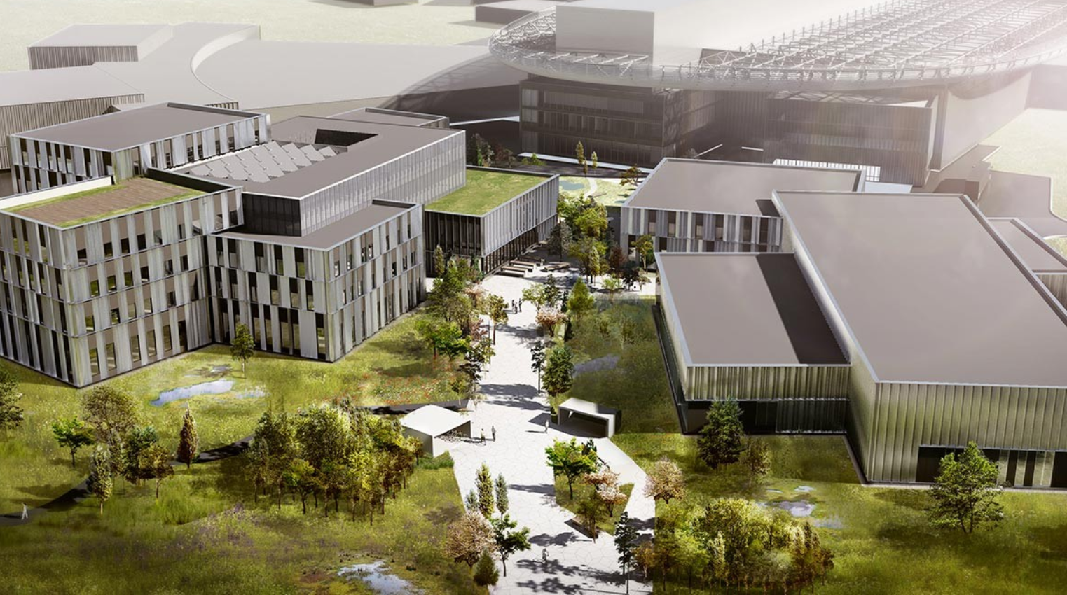


ectogrid™ to be implemented at ESS Campus utilizing 16^{O} C surplus heat
” Making ESS energy efficient and one of the most sustainable research facilities in the world is core of our sustainability vision. The selection of the innovative ectogrid™ concept is fully in line with this”
Kent Hedin, Head of Conventional Facilities, ESS

Slide 23
Concept enables efficient heat recycling at ESS
Cooling production
Surplus heat
Heat recovery
High temp: > 80^{O}C
Heat pumps
Cooling machines
District heating
Medium temp: 55^{O}C
High temp ~ 80⁰C
Medium/low temp: 31^{O}C
Low temp: 16^{O}C
Low temp ~ 20⁰C

Slide 24
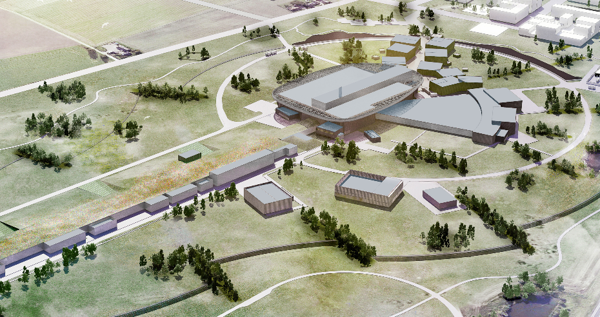
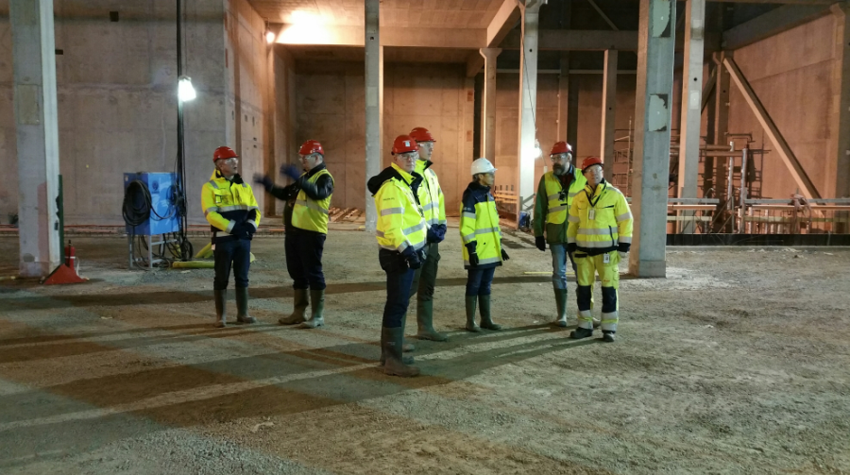
Construction of cooling production and heat recovery starts now!
Purchase
energy
Own your
equipment
Share the
investment

Slide 25
Thank you!
sonny.stromberg@eon.se
+46 70 541 51 15

