Slide 1
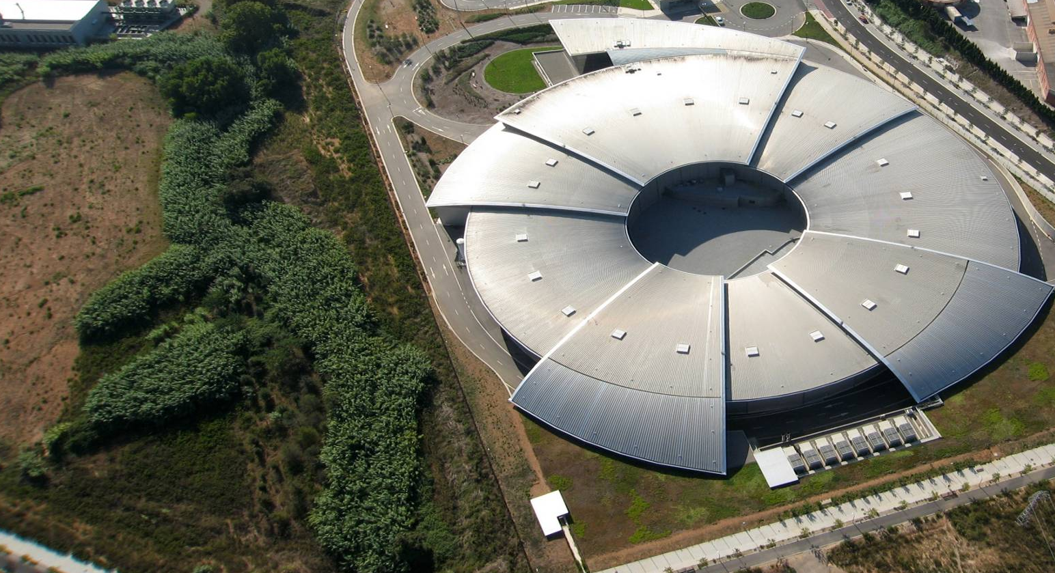
Energy Management at ALBA Synchrotron Light Source
J.Casas / L.Fuentes / I.Serra

Slide 2
1. ALBA today, and evolution to ALBA-II.
Outline
2. Energy supply to ALBA.
3. Alternatives to the current situation.
4. Conclusions.

Slide 3
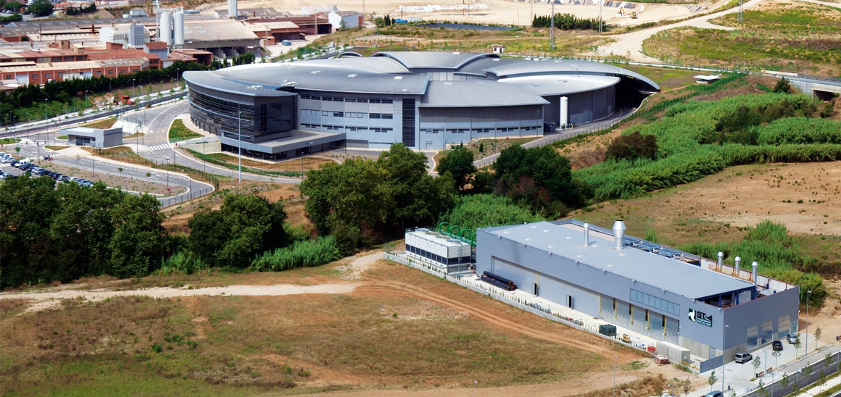
ALBA is a Research Infrastructure
1. ALBA today, and evolution to ALBA-II.
National public institution with 50% national + 50% regional funding (MINCIU and GenCat Ministry of Economy and Universities)
National and international (21%) staff
National and international (35%) users
National and international collaborations
+300 experiments/year
+1500 publications
+7500 yearly public visits
2100 international users
2500 national users
2200 user visits/year
+150 trained students

Slide 4
1. ALBA today, and evolution to ALBA-II.
2003
Project approval
2014
Phase II starts
2016
8th BL in operation
Phase III starts
2006
Construction start
2012
Operation start
Phase I: 7BLs
Prehistory linked to HEP community: a Tau-charm was the first proposal (‘90s) for building a large research infrastructure in Spain, later on evolved into a synchrotron light source, well suited to Spanish scientific community needs
2019
8 Operating BLs
4 BLs in construction
(+1 to start now)

Slide 5
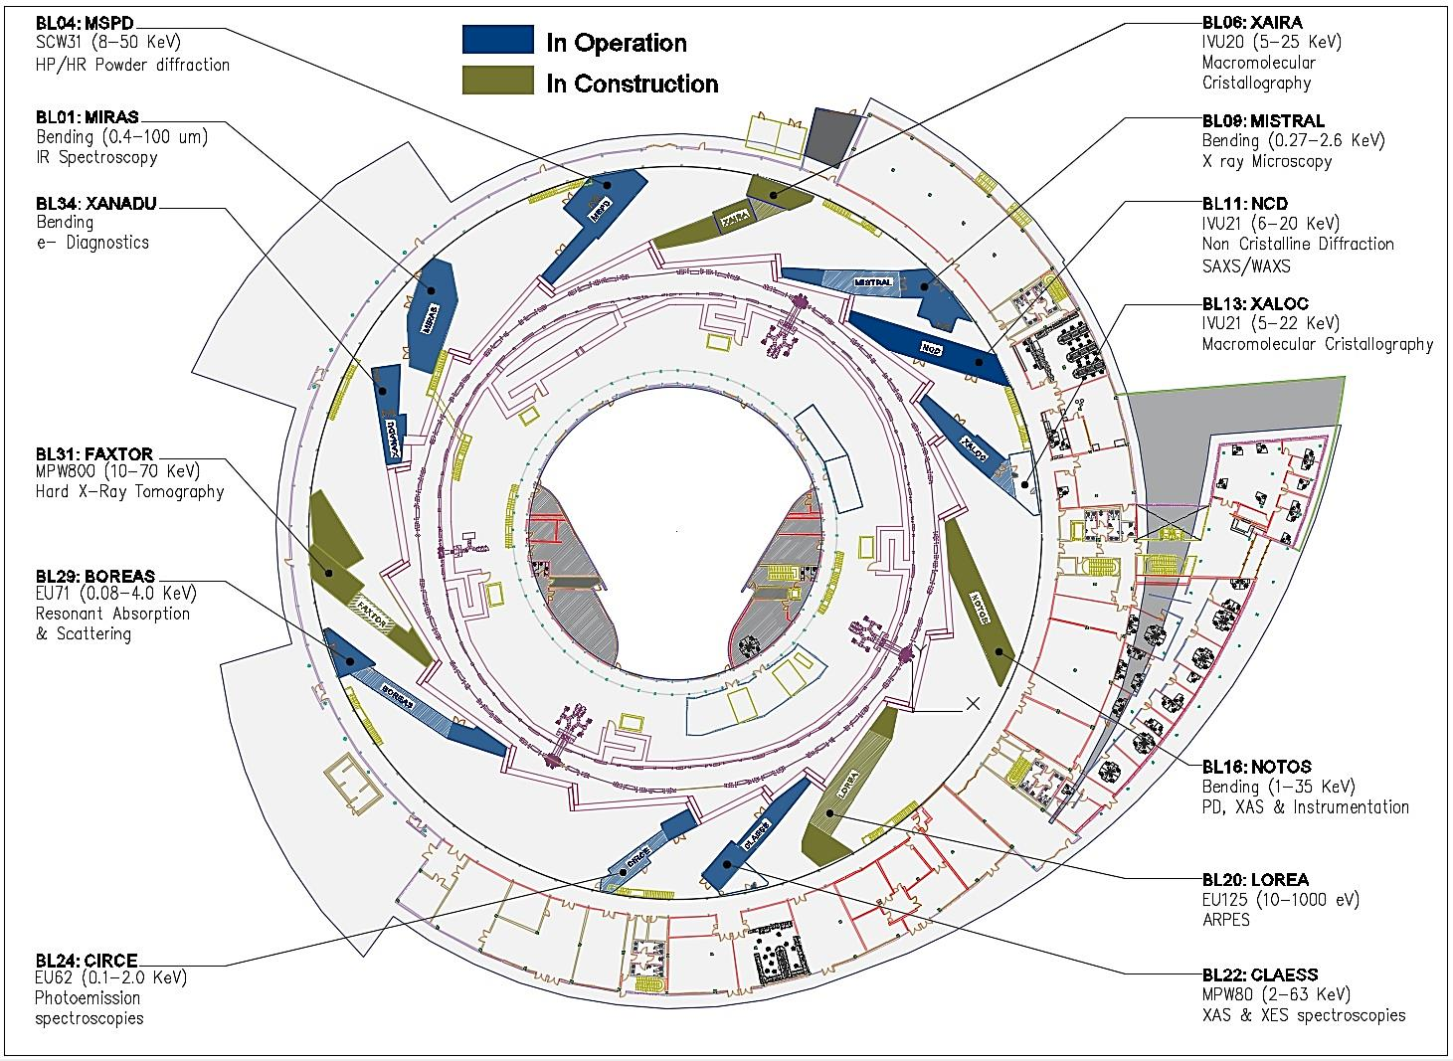
1. ALBA today, and evolution to ALBA-II.
UAB

Slide 6
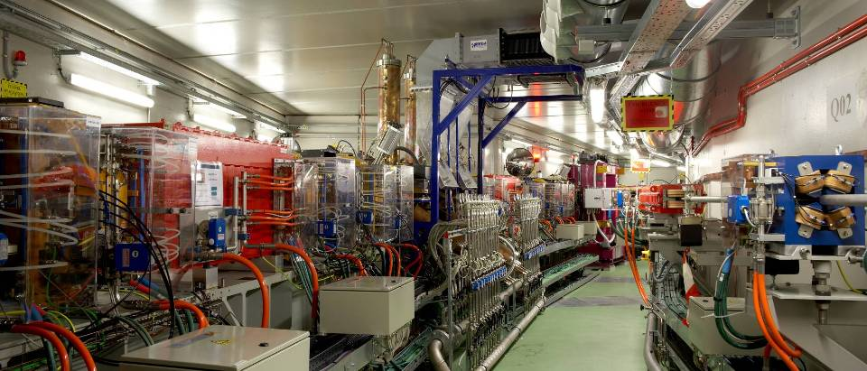
Large infrastructure based on e- accelerator
1. ALBA today, and evolution to ALBA-II.
First (and up to now unique) large accelerator infrastructure in Spain
Bending
RF cavities
In vacuum undulator
Synchrotron:
Energy = 3 GeV
C = 270 m
Emittance = 4 nmrad
Synchrotron Ring
3 GeV
Booster
0.1 – 3 GeV

Slide 7
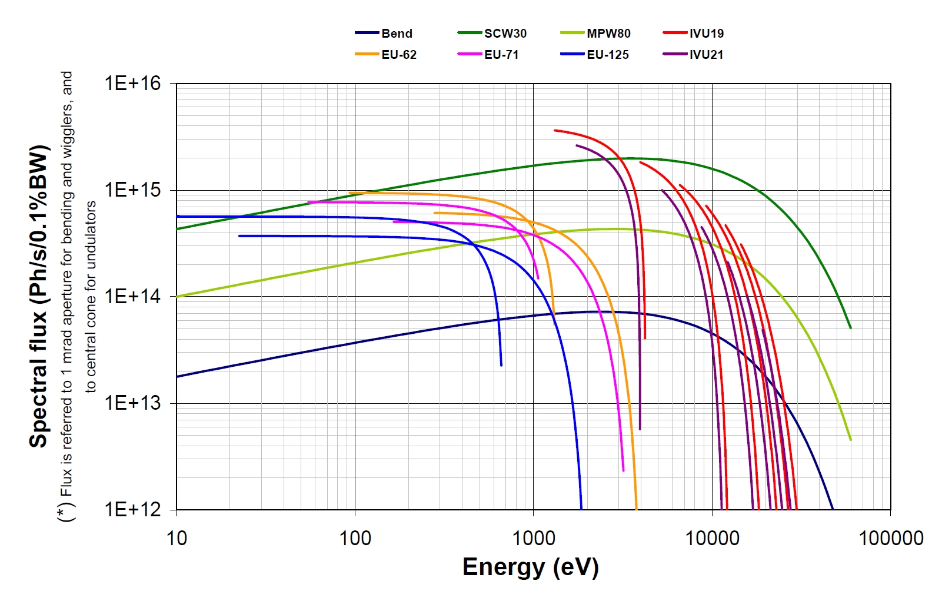
1. ALBA today, and evolution to ALBA-II.
Photon sources: Insertion Devices and Bending Magnets
Bends (critical energy 8.6 keV)
1 SCW (2.1 T)
1 Multipole wiggler
Undulators
2 IV undulators
3 EU undulators
Covering from IR, through soft
X-rays up to hard X-rays at 60 keV

Slide 8
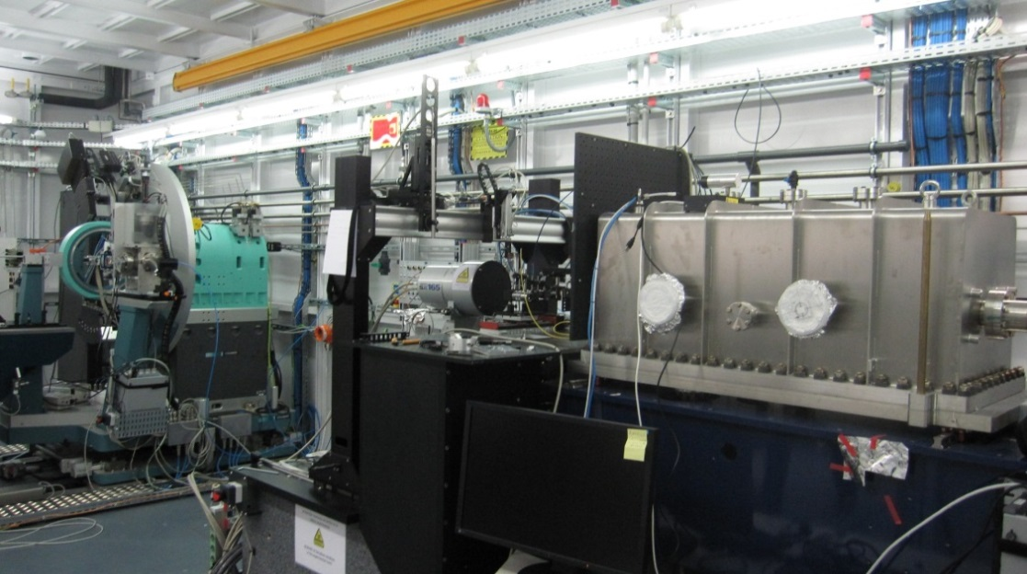
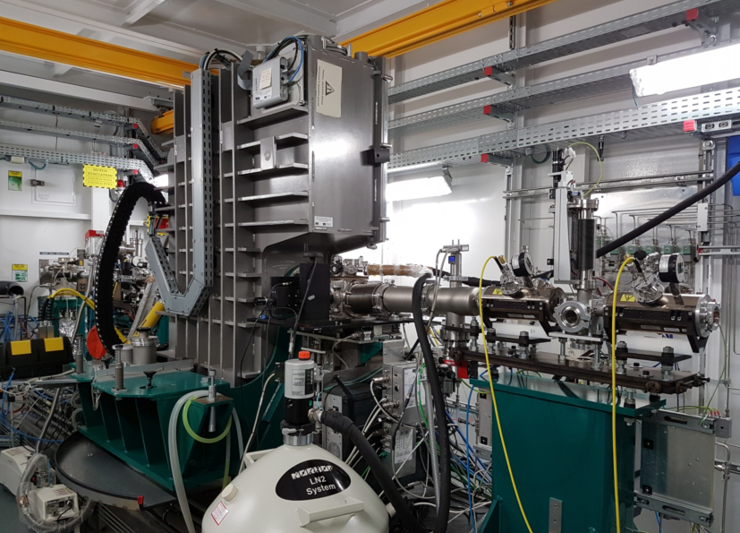
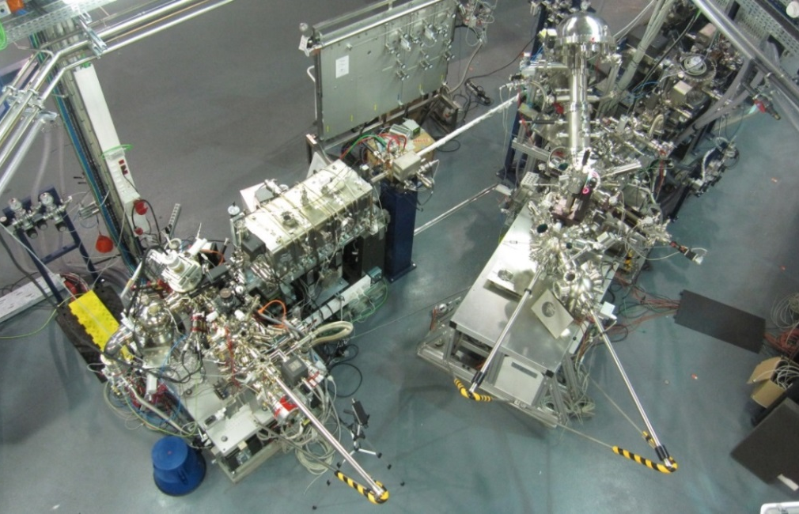
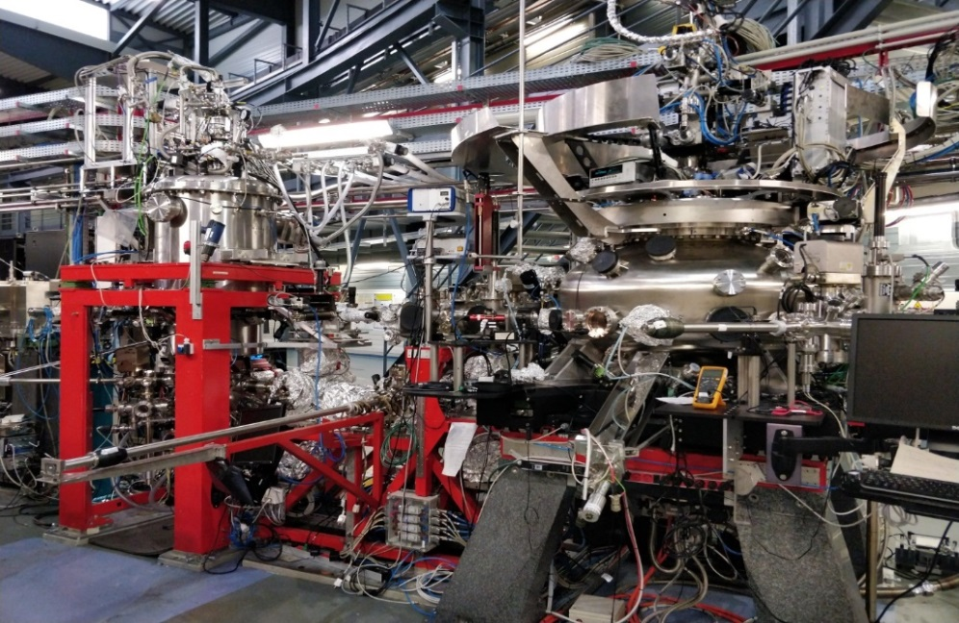
1. ALBA today, and evolution to ALBA-II.
Four Beamlines mainly dedicated to Chemistry, Physics - Condensed Matter
Material science, Cultural heritage, 8 to 50 keV
Material science, Catalysis, Cultural heritage, 6 to 64 keV
MSPD: Material Science Powder Diffraction
HP & HR stations
CLAESS:
Absorption & Emission Spectroscopies
Nanomagnetism, Surface and materials science, Catalysis, 0.1 to 2 keV
Nanomagnetism, Surface science, 0.08 to 4 keV
  CIRCE: PhotoEmission Electron Microscopy and
  Near Ambient Pressure Photoemission
BOREAS REsonant Absorption and Scattering

Slide 9
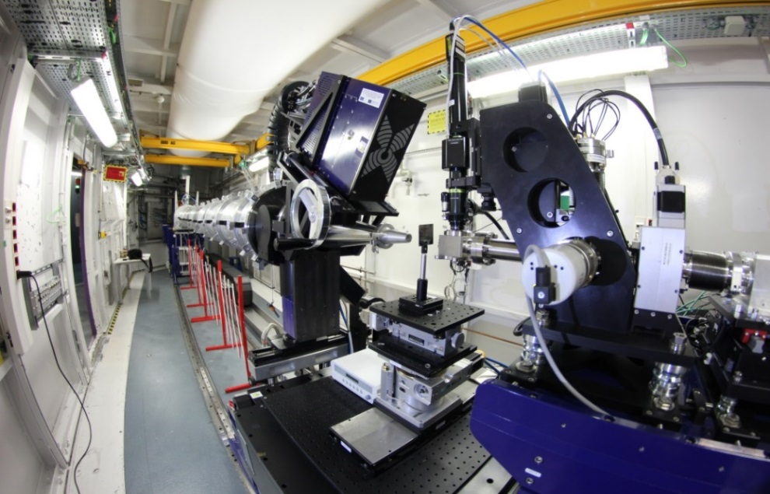
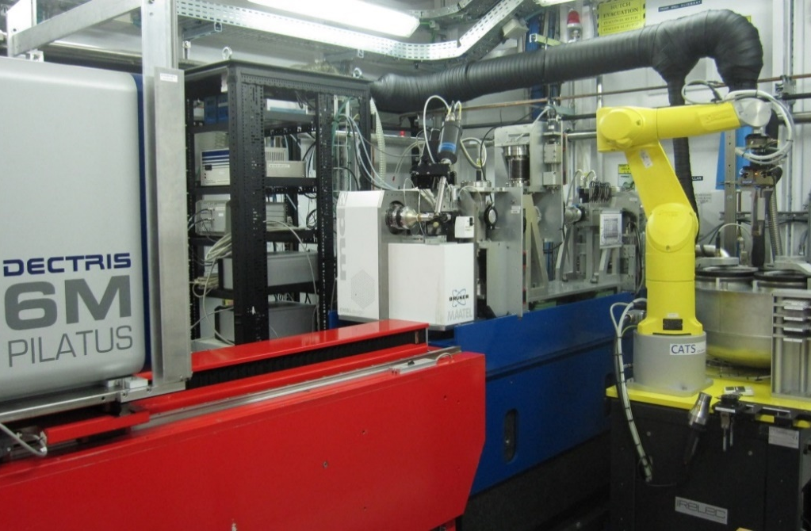
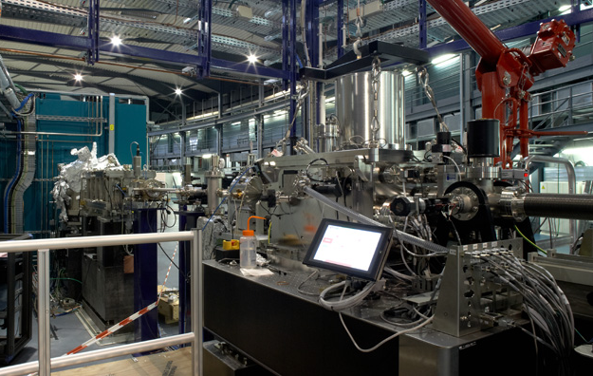
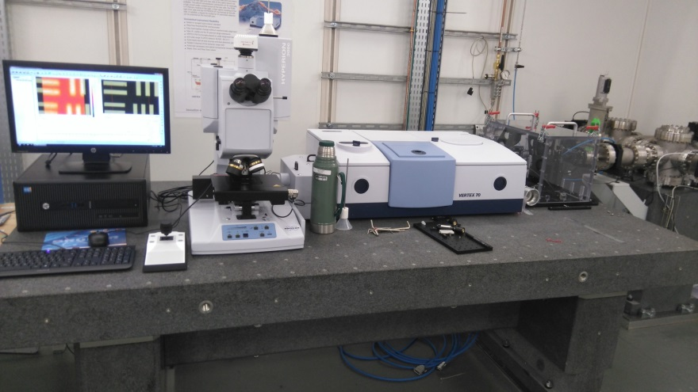
1. ALBA today, and evolution to ALBA-II.
Four beamlines mainly dedicated to Life Sciences
Biosciences, Polymers, Materials science, 6,5 to 13 keV
Biosciences, Proteins, drugs, 5 to 22 keV
NCD – SWEET, Non crystalline diffraction,
SAXS, WAXS and GISAXS
XALOC, Macromolecular Crystallography
Bioscience, Nanomagnetism, 0.27 to 1.2 keV
Bioscience, Material Science, Cultural Heritage, IR 10-100 um
MISTRAL, Cryo nano-tomography
MIRAS, IR spectroscopy

Slide 10
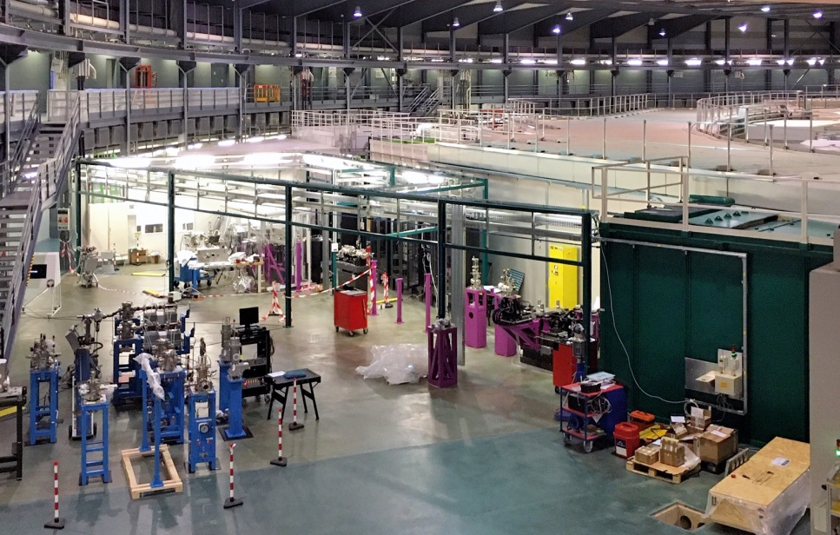
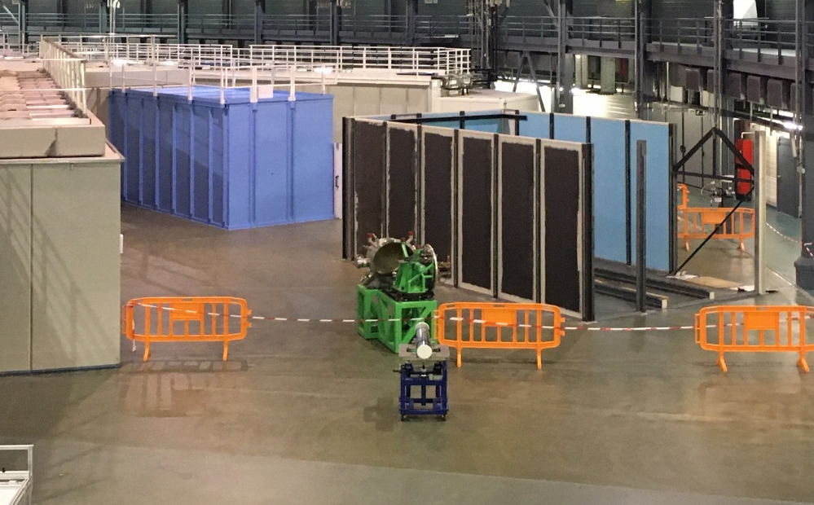
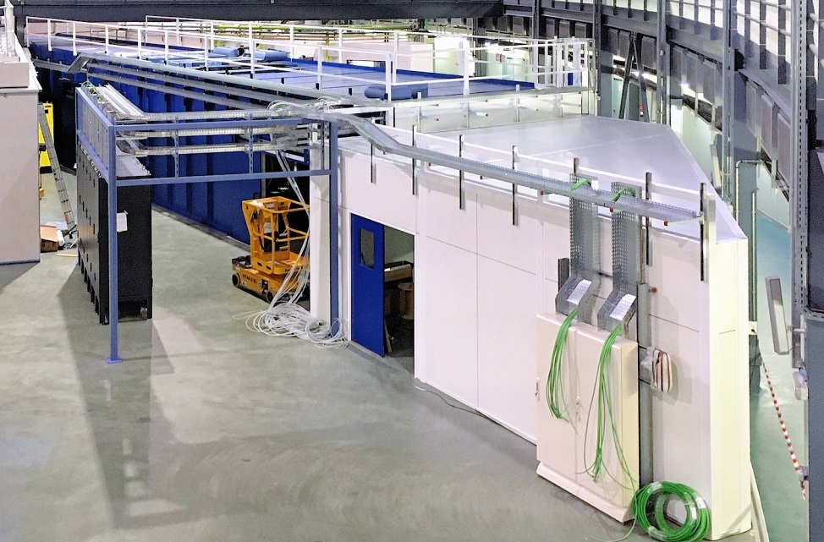
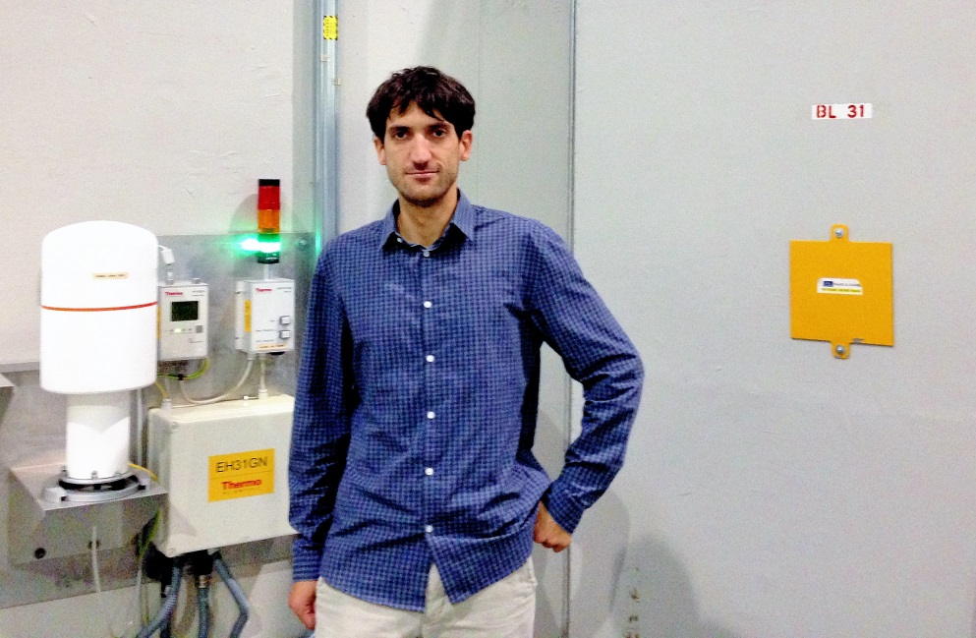
1. ALBA today, and evolution to ALBA-II.
Four beamlines in construction at different stages
Electronic structures, Materials science, 0.01-1 keV
Biosciences, Proteins, drugs, 4 to 22 keV
XAIRA, Microfocus Macromolecular Crystallography
LOREA, Angle resolved photoemission
Material science, catalyisis, instrumentation, metrology,, 4.8 to 30 keV
Fast X‐ray radioscopy, real time tomography hard X-ray 10 to 70 KeV
NOTOS, HP, Absorption and Instrumentation Development
FAXTOR, Fast X-ray radioscopy & real time tomography

Slide 11
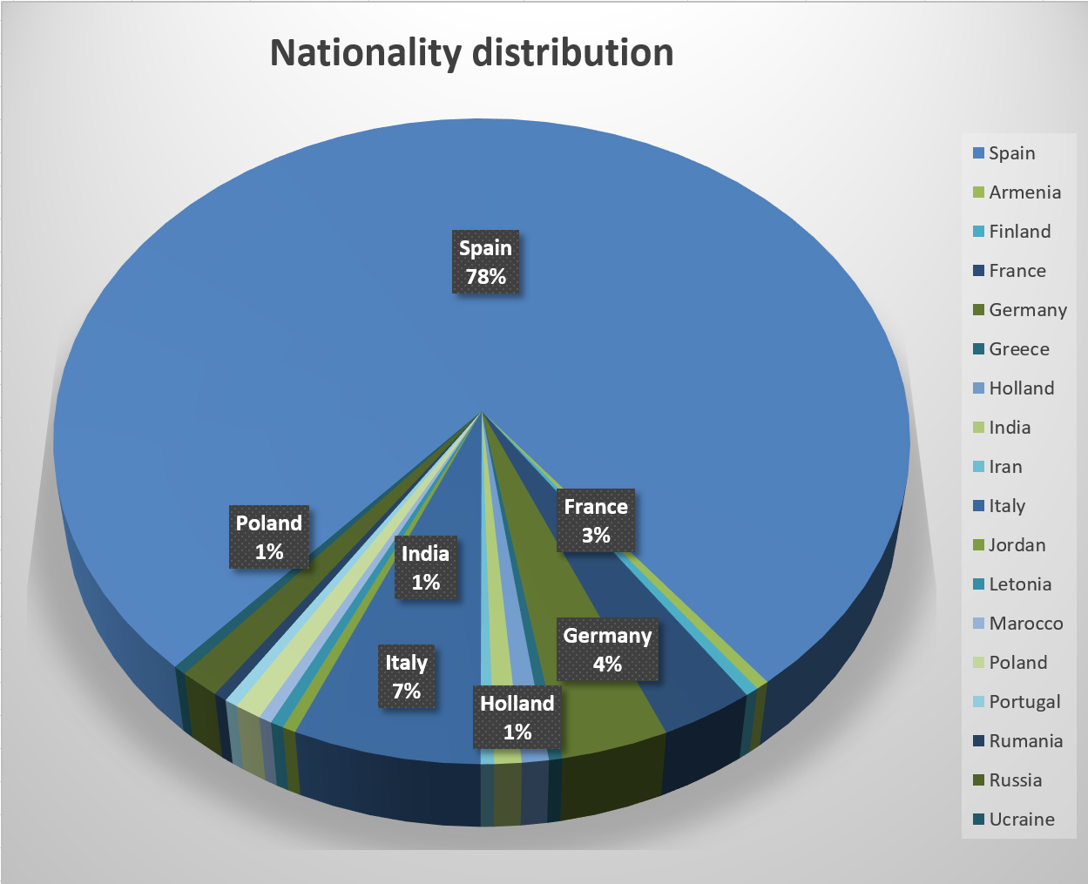
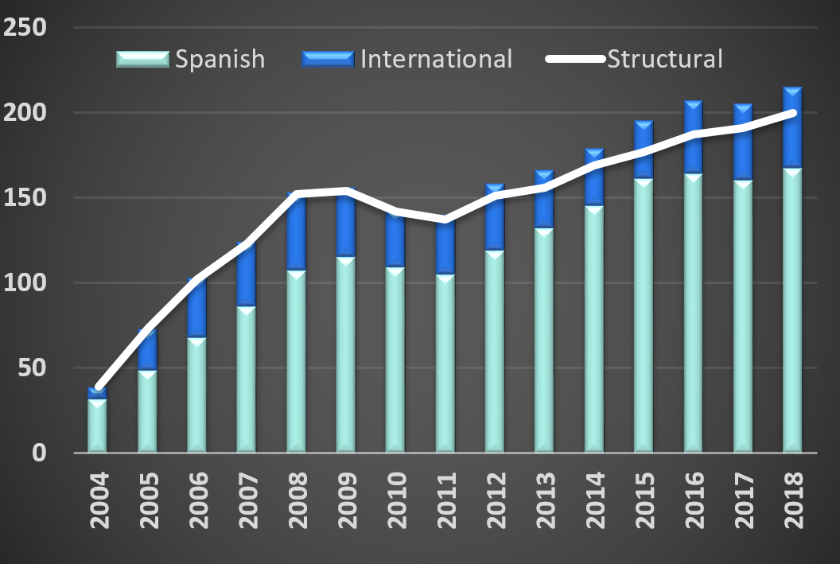
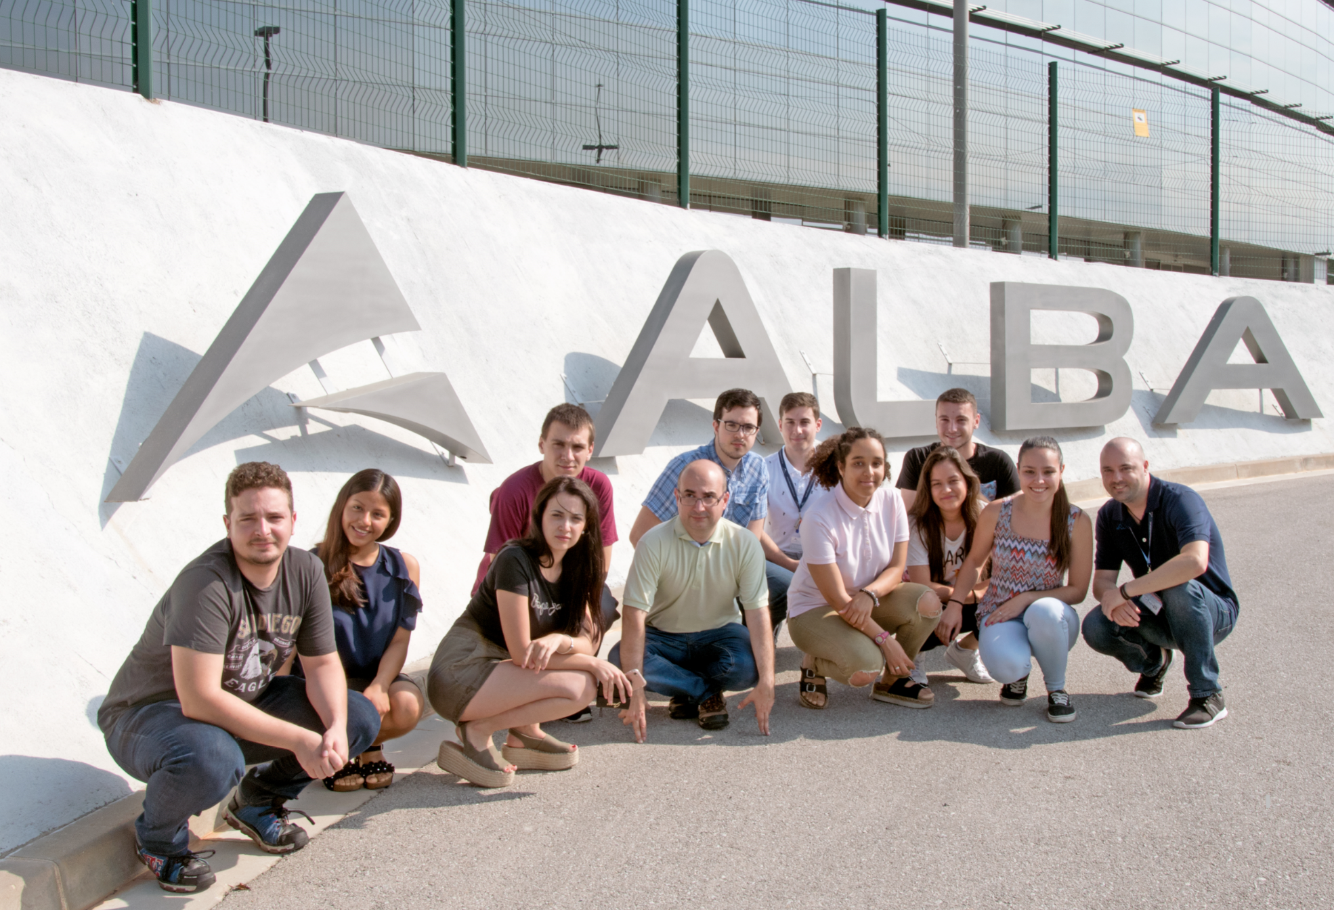
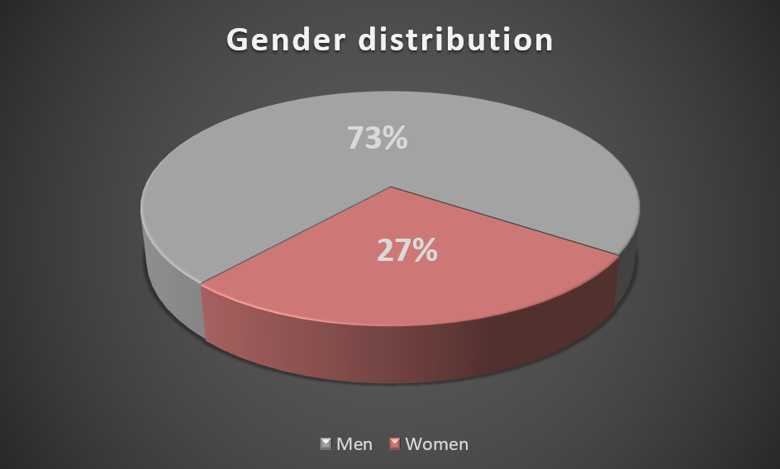
Staff
1. ALBA today, and evolution to ALBA-II.
PhD Students (15-20 ). Cofunding with partner institutions and EU projects
University (degree/master). Internships (10-12 )
FP program (12 )

Slide 12
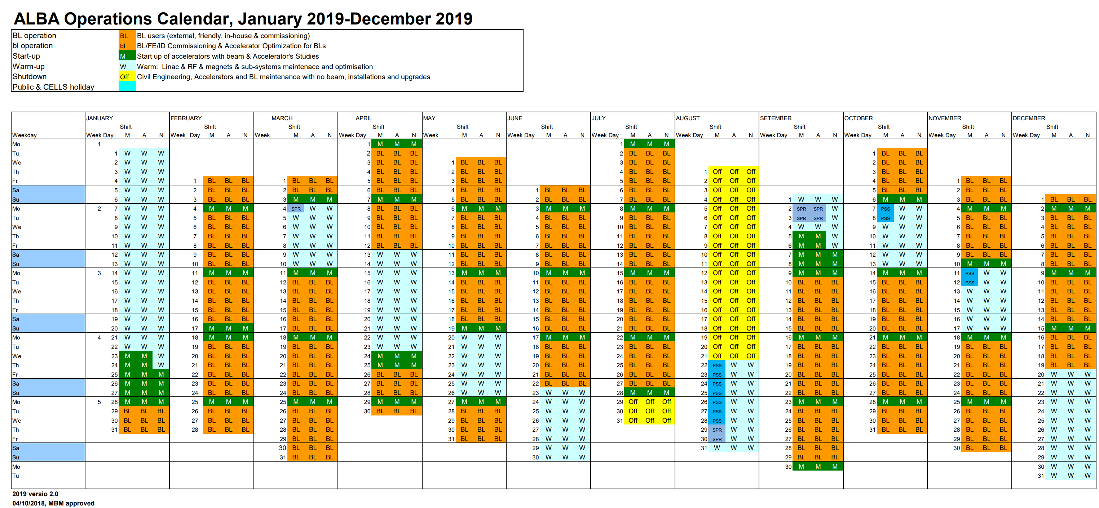
Operation – almost 6000h/year
1. ALBA today, and evolution to ALBA-II.
Status Days
Shutdown (basic systems on) 95
Shutdown (all systems off) 24
Machine days 52
BEAMLINES operation 194

Slide 13
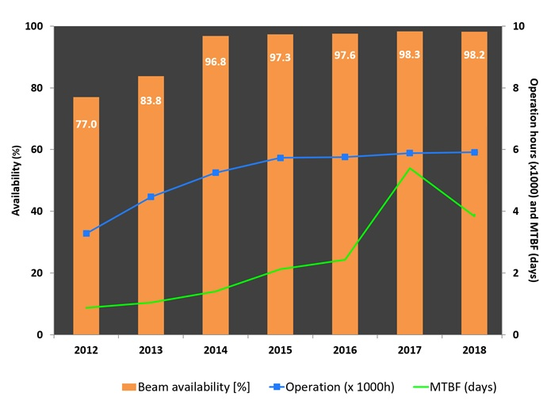
Availability since the start of the operation
1. ALBA today, and evolution to ALBA-II.
Mean Time Between Failures above 4 days since 2017. Thanks to
Sound design and realization of the whole infrastructure and its systems, from the low-tech ones to the most advanced
Usage of preventive maintenance
Spare system availability optimized within budget constraints
Availability of maintenance teams 24/24 for all technical systems with quick reaction capacity based also on on-call organization.

Slide 14
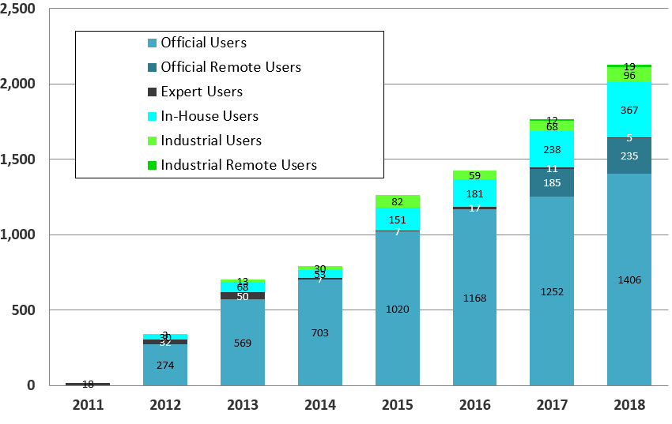
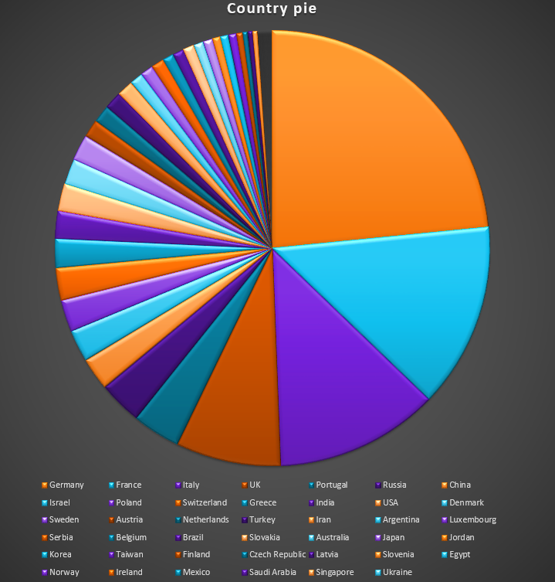
1. ALBA today, and evolution to ALBA-II.
User evolution through the history

Slide 15
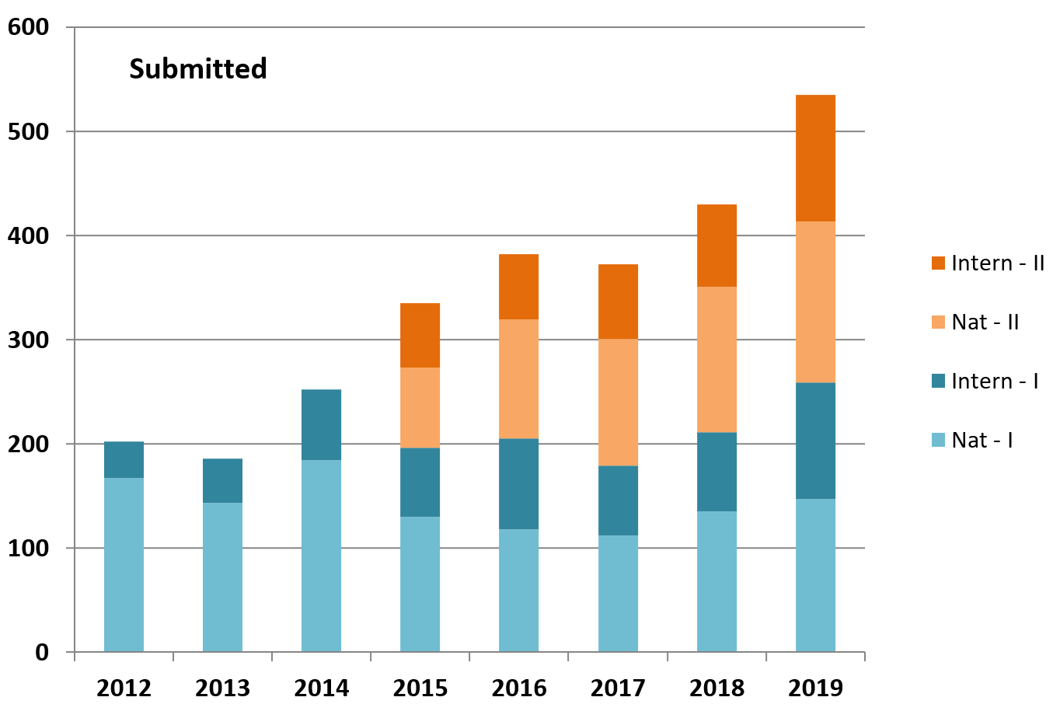
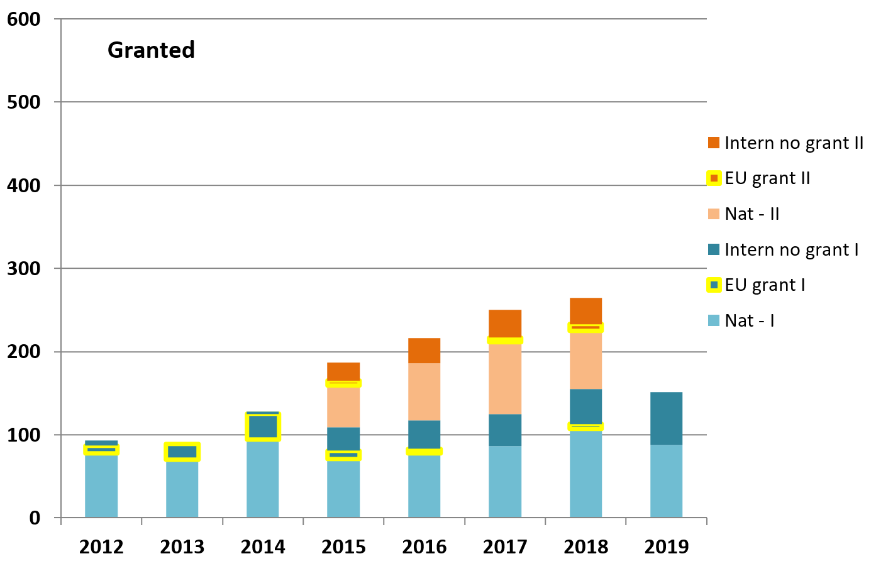
Academic proposals granted through competitive calls - free access
1. ALBA today, and evolution to ALBA-II.
Average overbooking factor = 1.8 About 2/3 national, 1/3 international
Call 2019-I evaluated in October
Record number of received proposals

Slide 16
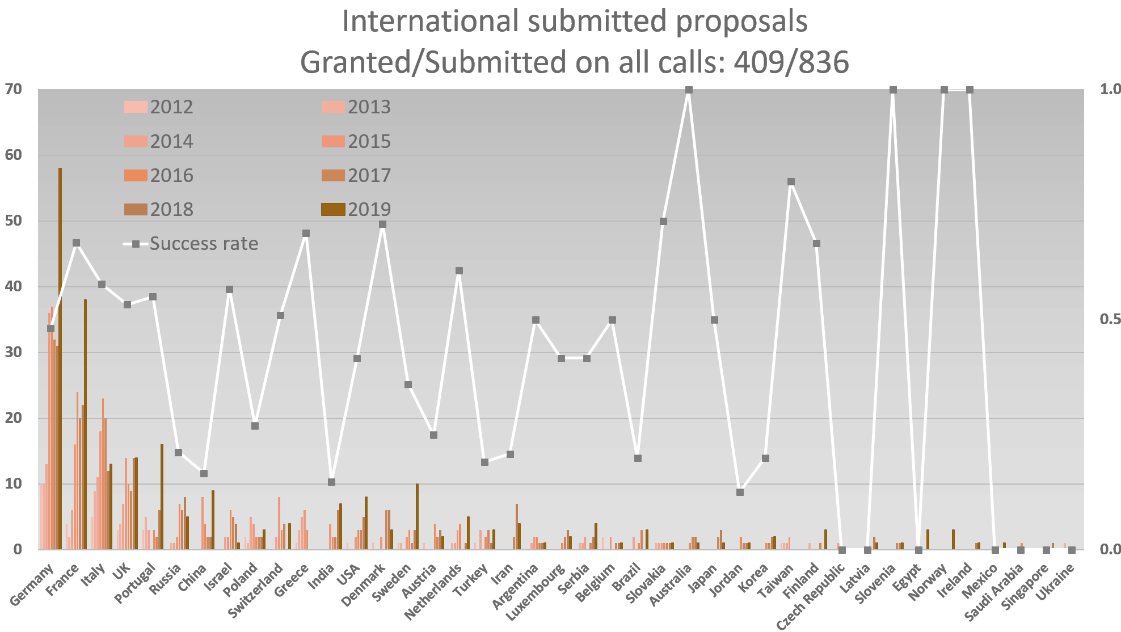
International proposals per country
1. ALBA today, and evolution to ALBA-II.

Slide 17
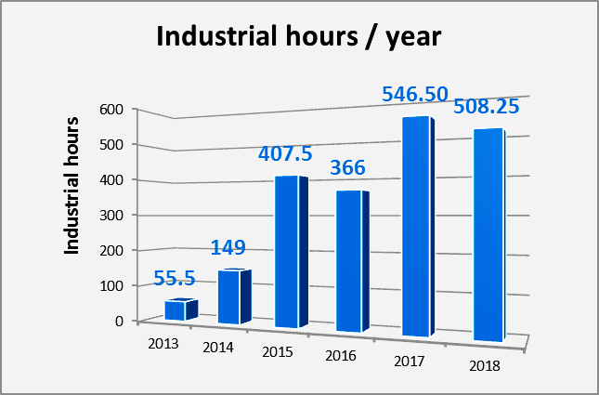
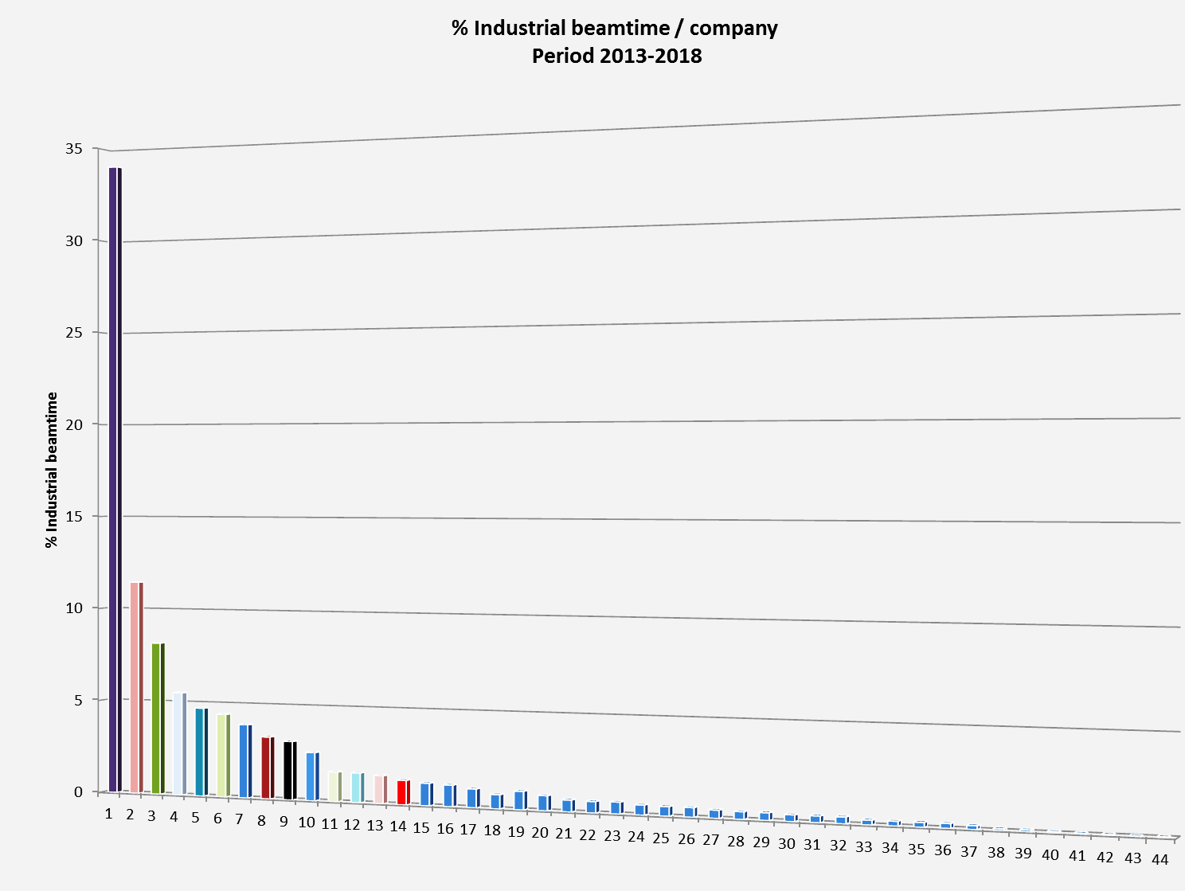
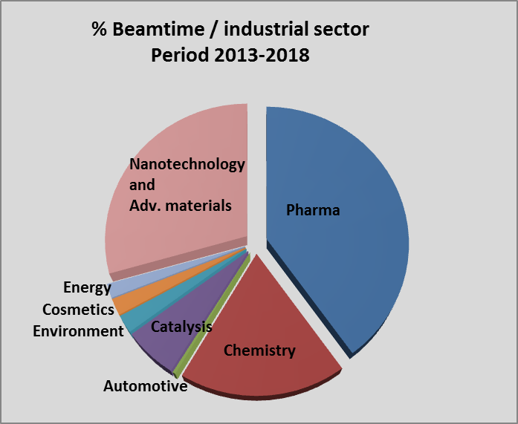
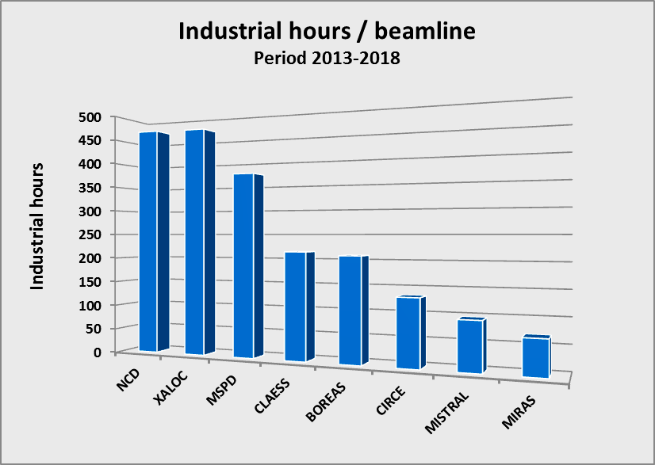
1. ALBA today, and evolution to ALBA-II.
Industrial Beam-time. Historical

Slide 18
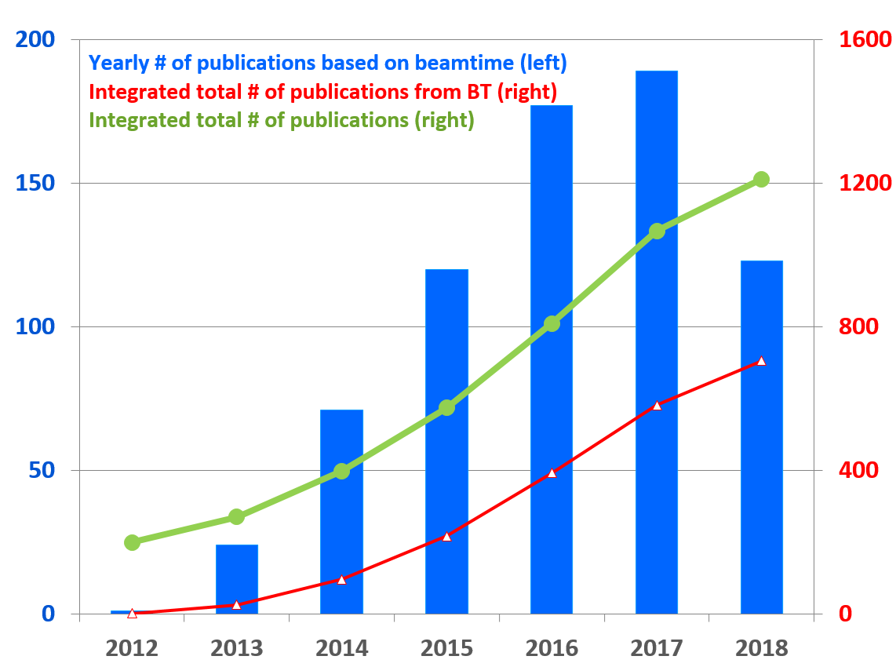
Productivity
1. ALBA today, and evolution to ALBA-II.
Peer reviewed publications per BL

Slide 19
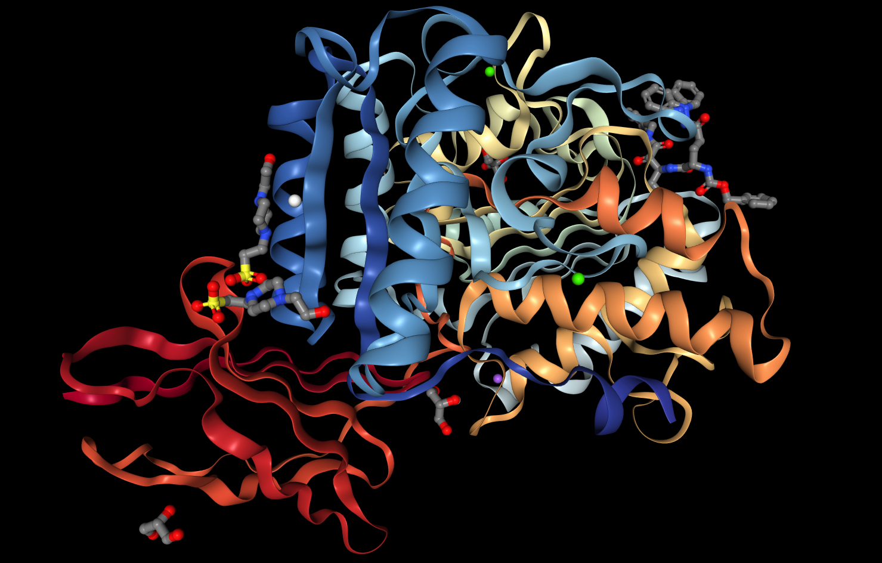
1. ALBA today, and evolution to ALBA-II.
We resolve protein structures
XALOC: macromolecular
crystallography diffraction
DOI: 10.2210/pdb6I9A/pdb
Porphyromonas gingivalis gingipain K (Kgp) in complex with inhibitor KYT-36

Slide 20
1. ALBA today, and evolution to ALBA-II.
2030
ALBA II
2020
11 Operating BLs
5 BLs in construction
2028
16-20 Operating BLs
Preparing ALBA II
2017-2020 Strategy Plan
In progress
Next decade fully exploiting the initial infrastructure by increasing number of BLs and add addional platforms (as Advanced Microscope Center)
Upgrade to more brilliant source

Slide 21
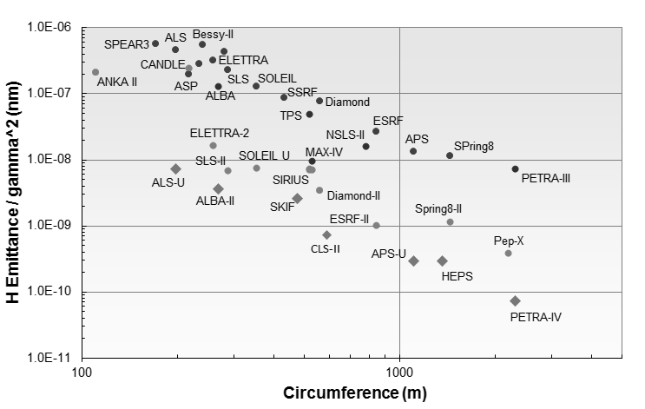
1. ALBA today, and evolution to ALBA-II.
DBA/TBA
MBA
+ technology
On-axis inj.
+ technology

Slide 22
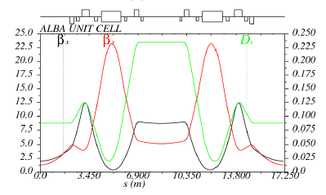
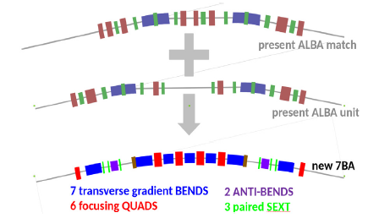
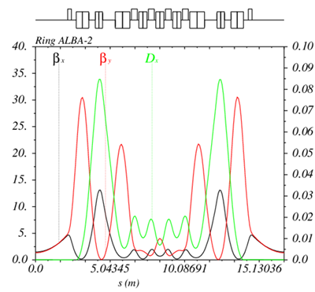

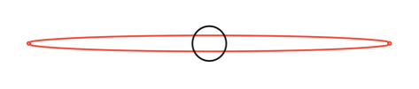
1. ALBA today, and evolution to ALBA-II.
Study baseline: a hybrid 7BA + Anti Bend cell preserving circumference and energy.
ε_{x}= 160 pm∙rad (reduction factor ~30)
16 identical cells - 16 straight sections
L_{SS}= 4.35 m
β_{x}= β_{y}= 1.5 m
Comparative beam sizes
Red – ALBA Present
Black – ALBANext 15% & 100% coupling

Slide 23
2. Energy supply to ALBA.
1. ALBA today, and evolution to ALBA-II.
3. Alternatives to the current situation.
4. Conclusions.

Slide 24
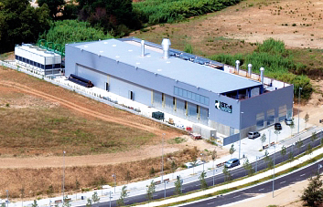
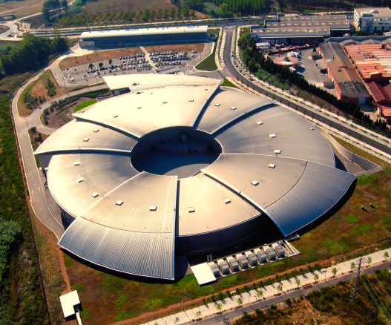
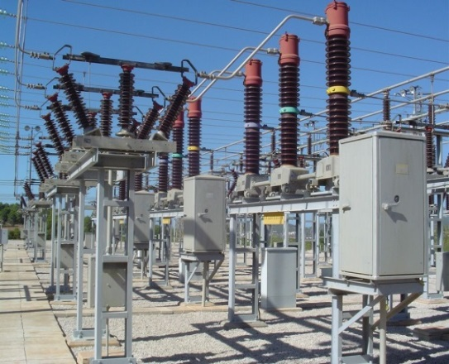
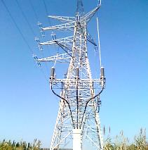
2. Energy supply to ALBA.
Co-generation plant ST4
ALBA Synchrotron
Electricity
(1 X 25KV)
Natural Gas
Thermal Energy (hot)
Thermal Energy (cold)
700 m
ET1 (25KV to 420V / 2+2+2+1.6+2 MVA; machine)
(25KV to 420V / 2+1.6+0.8+1 MVA; building)
ET2 (25KV to 420V / 1.25 + 0.8 MVA; offices)
ET3 (25KV to 420V / 2 MVA; RF Lab)
Electricity
(2 X 25KV)
1800 m
(2 X 25KV)
Electricity
1800 m
Sub-station ST1
(220KV to 25KV / 20 MVA)
(200 KV)

Slide 25
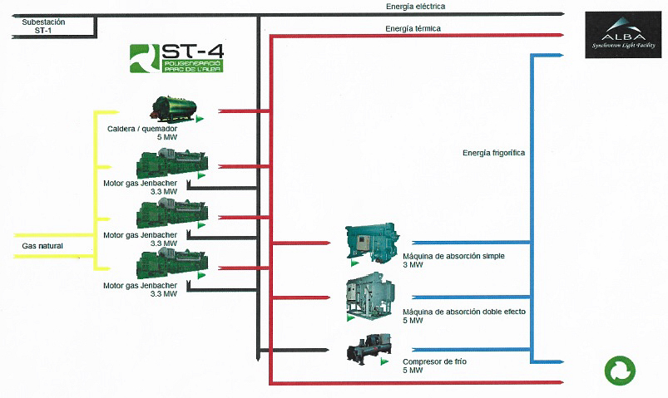
2. Energy supply to ALBA.
Electricity
Thermal Energy
Thermal Energy
Thermal Energy
5 MW Heater
Energy
recovery
Thermal Energy storage
3.3 MW Jenbacher gas engine
Natural Gas
3.3 MW Jenbacher gas engine
3 MW simple Absorption machine
3.3 MW Jenbacher gas engine
5 MW double Absorption machine
5 MW Chiler

Slide 26
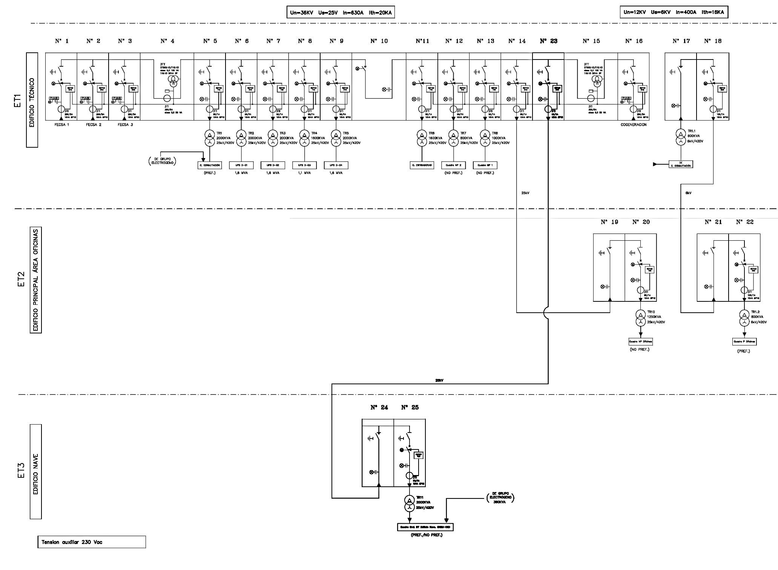
2. Energy supply to ALBA.
Machine 7.6 MVA
Building 3.4 MVA
( 2 MVA )
( 1,2 MVA )
Offices 2.05 MVA
( 0,3 MVA )
design capacity
(actual power)
RF Lab. 2 MVA
( 0,1 MVA )

Slide 27
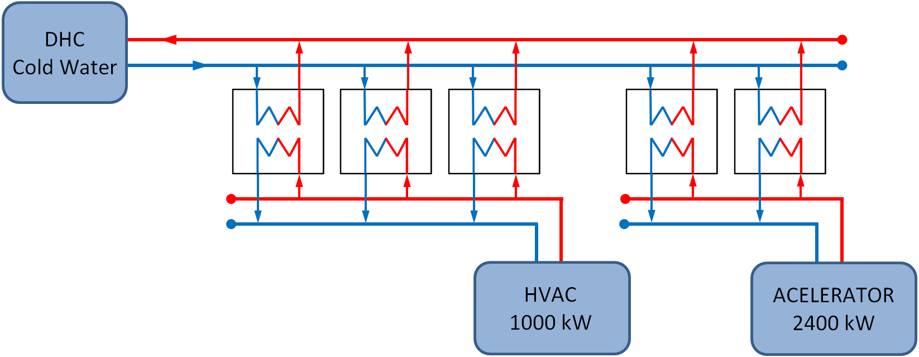
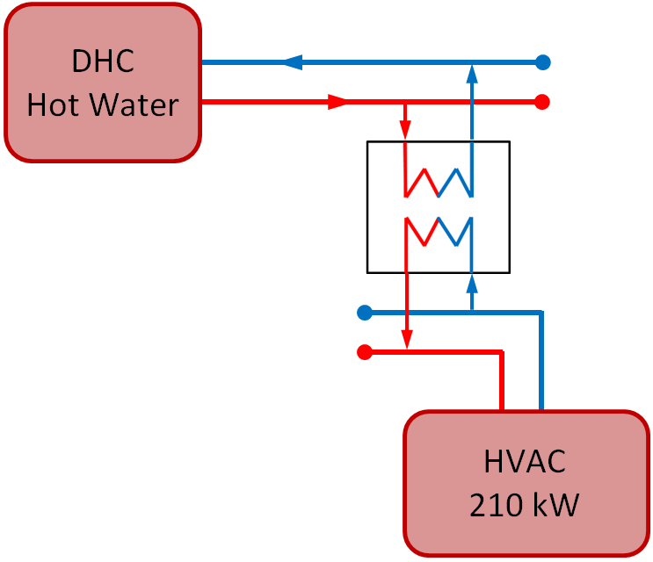
2. Energy supply to ALBA.
6ºC
11ºC
6ºC
11ºC
6ºC
11ºC
6ºC
16ºC
6ºC
16ºC
7ºC
12ºC
7ºC
12ºC
7ºC
12ºC
22ºC
27ºC
22ºC
27ºC
1000 KW
2400 KW
(880 KW)
(2100 KW)
95ºC
80ºC
As a redundant system, we can produce chilled water in-house.
The required increase of power is 1.2MW to produce 3 MW (conversion factor of 2.5).
50ºC
40ºC
design capacity
(actual power)

Slide 28

2. Energy supply to ALBA.
Energy consumption.

Slide 29
3. Alternatives to the current situation.
2. Energy supply to ALBA.
4. Conclusions.

Slide 30
3. Alternatives to the current situation.
Energy bill (as it is).
At day 0, there was an overestimation of the required power and the overall energy consumption.
ALBA should be able to re-negotiate the contracted power term, but that would impact ST4’s credit line.
We have a deal: we do not pay penalties for not reaching the minimum power consumption, but we keep the excess of contracted power term.
(15 % of ALBA’s running cost !!!)

Slide 31
3. Alternatives to the current situation.
Energy bill (as it should be).
Same invoice correcting the effect of the over-estimation at day 0 (and not the best possible contract).
The invoice should be -10% what it is.

Slide 32
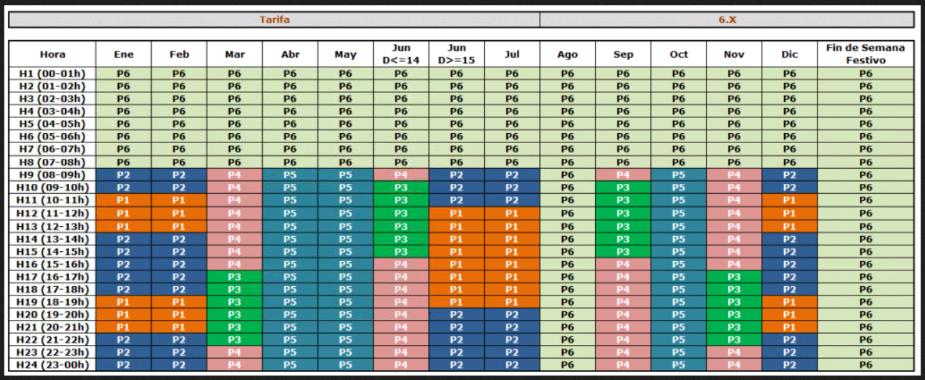
3. Alternatives to the current situation.
Energy bill after full disconnection from ST4
(We buy electricity only, and the cold/hot water is produced in-house).
The extra energy required would be 8.855.131 KWh
(per year), and the extra power 1.2 MW.
This means a Conversion Factor of 2.498 (each KW of electricity produces 2.498 KW of thermal energy)
The cost of the power and the energy has been estimated after a very recent quotation provided by one energy supplier. Figures in the table are the equivalent flat-rate yearly cost that would produce the same equivalent overall cost. This option would provide -7% savings (with respect to the AISB numbers, -17% with respect to the AII numbers)

Slide 33
3. Alternatives to the current situation.
Energy bill after partial disconnection from ST4
(We buy to ST4 the cold/hot water only. We buy the electricity to a “standard” supplier).
This seems a crazy idea, but it is not. ST4 need to sell thermal energy to keep a “co-generation efficiency” over a legal minimum that allows them to sell electricity.
There are not so many thermal energy consumers.
In this case, savigs would be -10% with respect to AISB.
(about -20% with respect to AII).

Slide 34
3. Alternatives to the current situation.
Keep going as today. The co-generation plant
supplying electricity and thermal energy to ALBA
Very good availability of the supply
We have triple redundancy.
No investments required
Good price for the thermal energy
Very high price for the electricity
Full disconnection from ST4. Thermal energy
produced in-house.
Very good price for the electricity
High cost for the in-house prduced thermal energy
Availability of the supply ?
Less redundancy
Investment required (thermal storage & control)
Thermal energy from the co-generation plant but
electricity from a standard supplier.
Very good price for the electricity
Very good price for the thermal energy
No investments required
Availability of the supply ?
Less redundancy

Slide 35
4. Conclusions.
3. Alternatives to the current situation.

Slide 36
4. Conclusions.
With a Conversion Factor of 2.498, the in-house produced thermal energy at an hypotetic very good cost for the electricity can not beat the cost of the thermal energy form the co-generation (even at the high price we pay !). With the present cost of the electricity (from a “normal” supplier) the equilibrium point would be around a Conversion factor of 2.785 .
When the decision to go for a co-generation plant was taken, the cost of the electricity in Spain was very high ! Now, we
have an overcost with respect to a regular suplier but who knows in the future....
We have a very bad contract with the co-generation plant, with no possibility to revise the expected
consumption, and with no possibility to adapt the contracted power ! This penalizes us more than the market or any
technical/technological aspect.
The co-generation plant provides a very good availability of the service, and extra redundancy.
The co-generation plant is in a bad situation because cost of rights for CO₂ emissions has increased dramatically the last year (from 8€/Ton up to 23€/Ton). This cost is not included in the formula from which our price is updated every year. Bad contract on their side also.
The spanish law allows the cogeneration plant to have x tons of CO₂ emissions, being x a function of the thermal energy
sold, and with a minimum co-generation efficiency (electrical energy over electrical + thermal energy). ALBA is by far the
largest thermal energy consummer connecte to the plant. Would it be nice in the future to be able to buy only the
thermal energy co-generated with the electricity that others buy... dreaming is free !

Slide 37
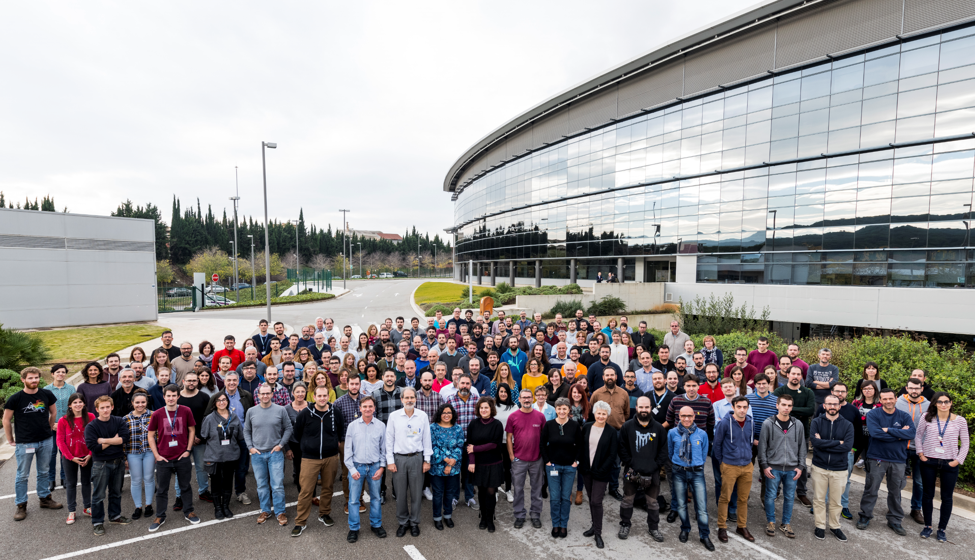
On behalf of ALBA team Thanks for your attention !

