Slide 1
ATHOS Front-End Installation
Claude Pradervand :: Beamline Instrumentation :: Paul Scherrer Institut
SwissFEL Progress Meeting 25. September 2018

Slide 2
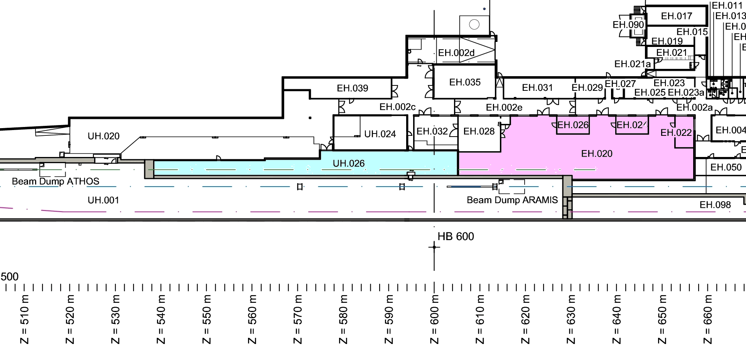
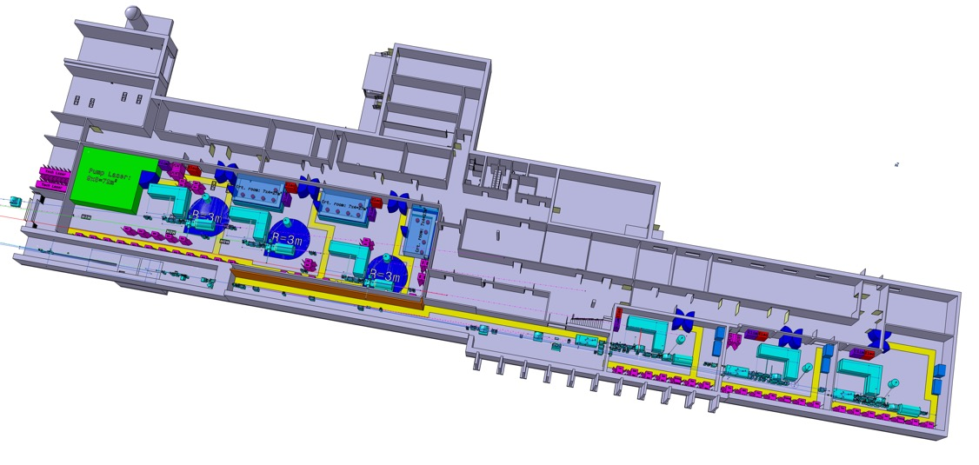
Overview ATHOS
Pump laser
infrastructure
Phase 1: hard x-ray
beamline ARAMIS
Phase 2: soft x-ray
beamline ATHOS
Pump laser
infrastructure
(1st floor)
Endstation
Alvra
Endstation
Bernina
Endstation
Cristallina

Slide 3
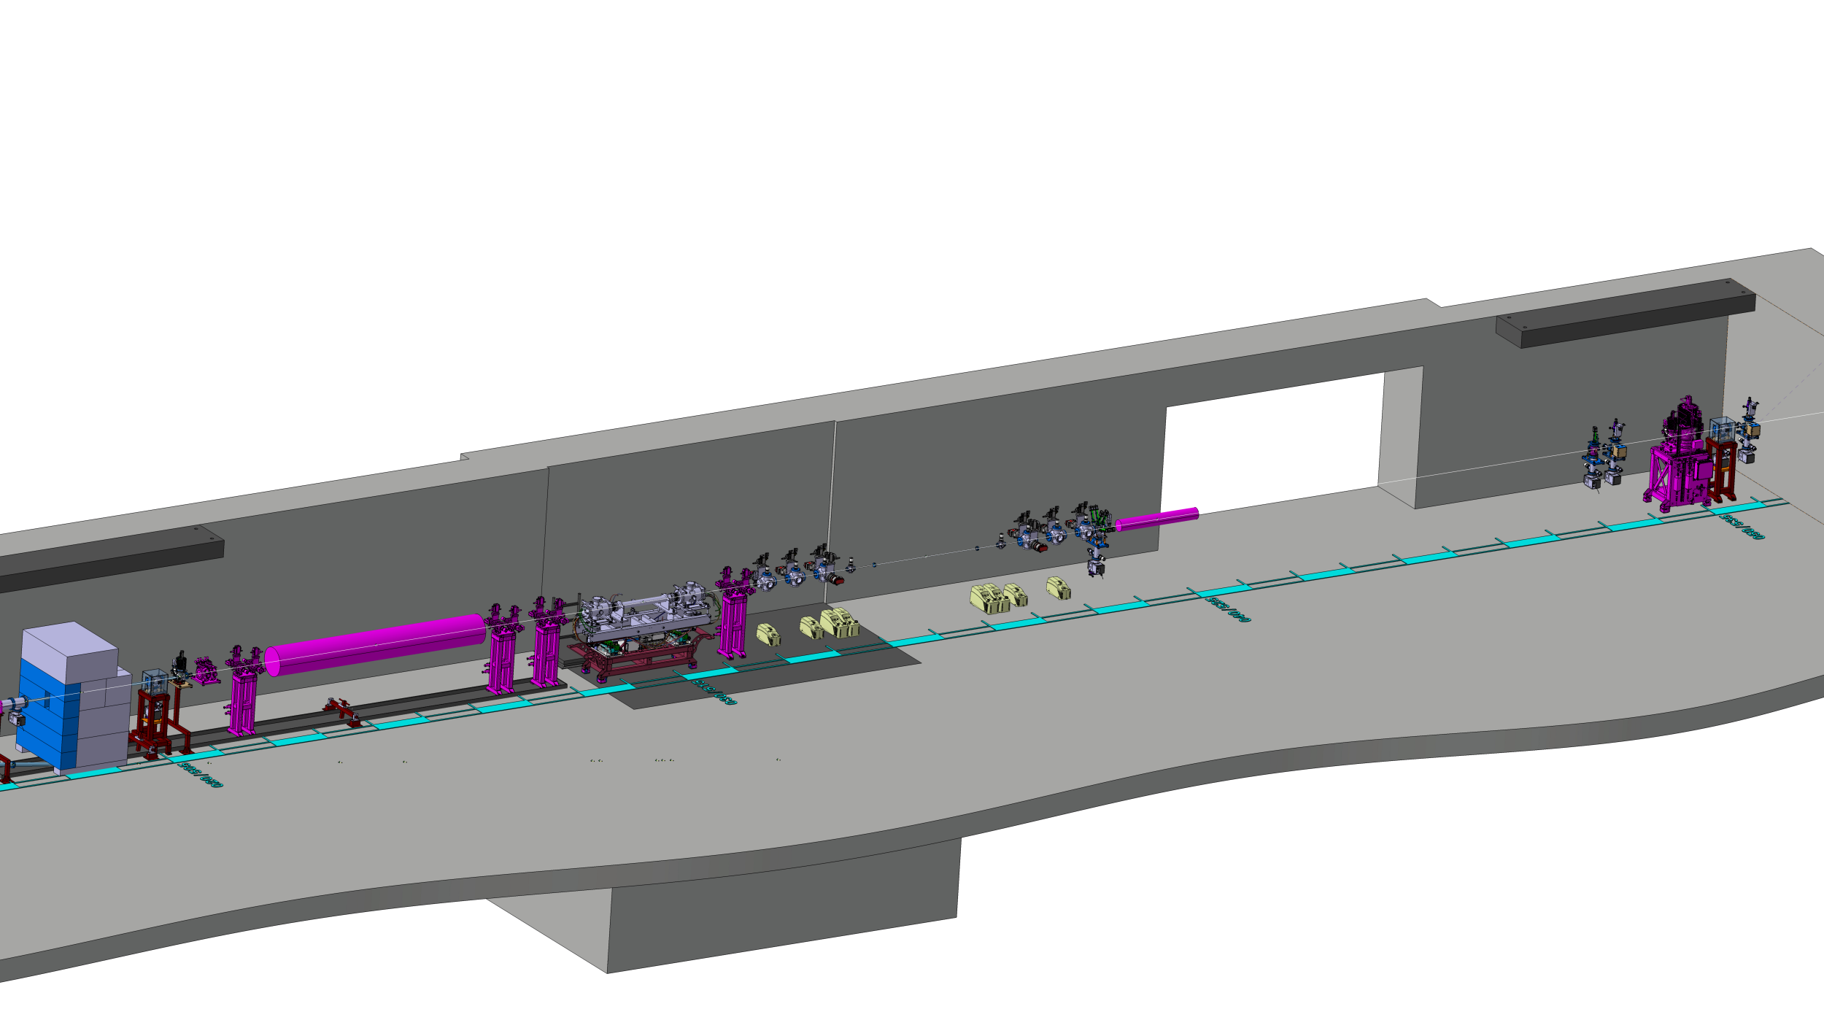
ATHOS Front-End Layout
Beam Stopper
Collimator
Screen & Diode
Diffusor
Screen
Gas Attenuator
Gas Monitor
Photon Ionisation Gas Spectrometer
Aperture
Photon Shutter
Collimator

Slide 4
ATHOS Front-End Layout
Device | Short | Meter from electron source | Meter from photon source | Note
Photon Source Point |  | 485m | 0m
Fast Valve |  | 504m | 19m | wie ARAMIS
Collimator | SCOL | 505m | 20m | wie ARAMIS
Photon Shutter | OPHS | 505.5m | 20.5m | wie ARAMIS
Aperture | OAPU | 506m | 21m | wie ARAMIS
Photon Ionisation Gas Spectrometer | PIGS | 509.3m | 24.3m | neu
Gas monitor | PEPG | 514.5m | 29.5m | fast wie ARAMIS
Gas Attenuator | OGAT | 520m | 35m | neu
Diffusor (for Beam Stopper) | ODIF | 524.5m | 39.5m | neu
Door |  | 525.5 - 530.5m | 40.5 - 45.5m
Diode | PDIM | 533m | 48m | wie ARAMIS
Screen | PSCR | 533.4m | 49.8m | fast wie ARAMIS
Beam Stopper | SBST | 534.8m | 49.8m | wie ARAMIS
Collimator | SCOL | 535.5m | 50.5m | wie ARAMIS
Screen | PSCR | 536m | 51m | fast wie ARAMIS
Tunnel Wall |  | 536.4m | 51.4m | wie ARAMIS
Nutzbare Länge ~28m

Slide 5
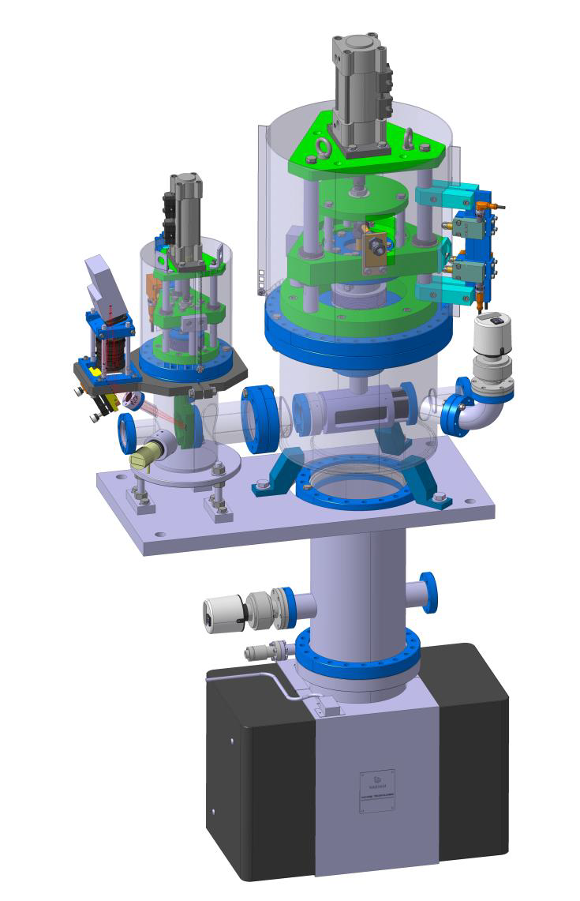
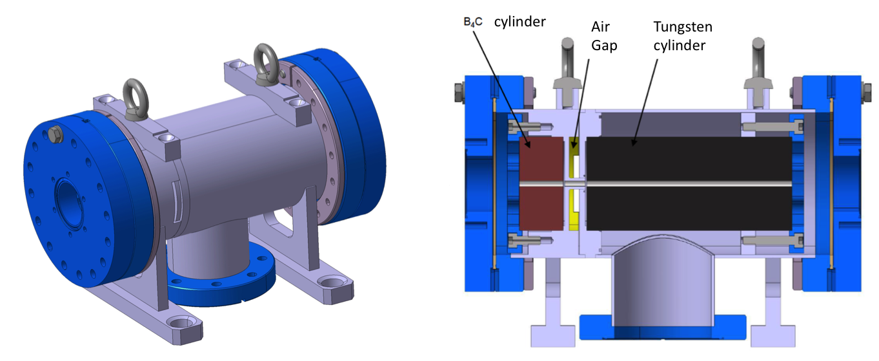
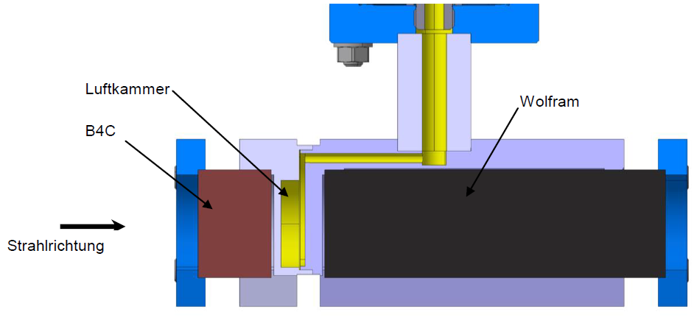
Safety Components
Collimator
Beam Stopper

Slide 6
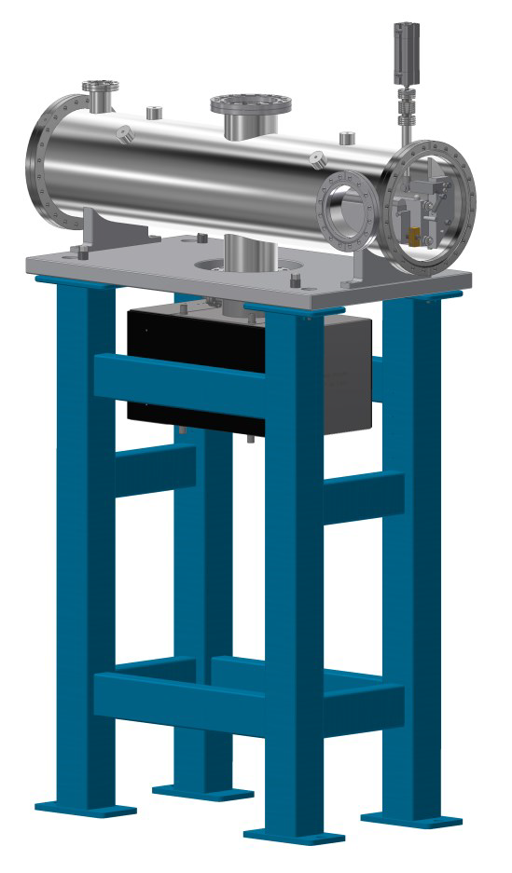
Beam Diffusor
Fächert den Strahl auf, damit er gestoppt werden kann
Dient als Schutz für den Beam Stopper

Slide 7

Gas Spectrometer (PIGS)

Slide 8
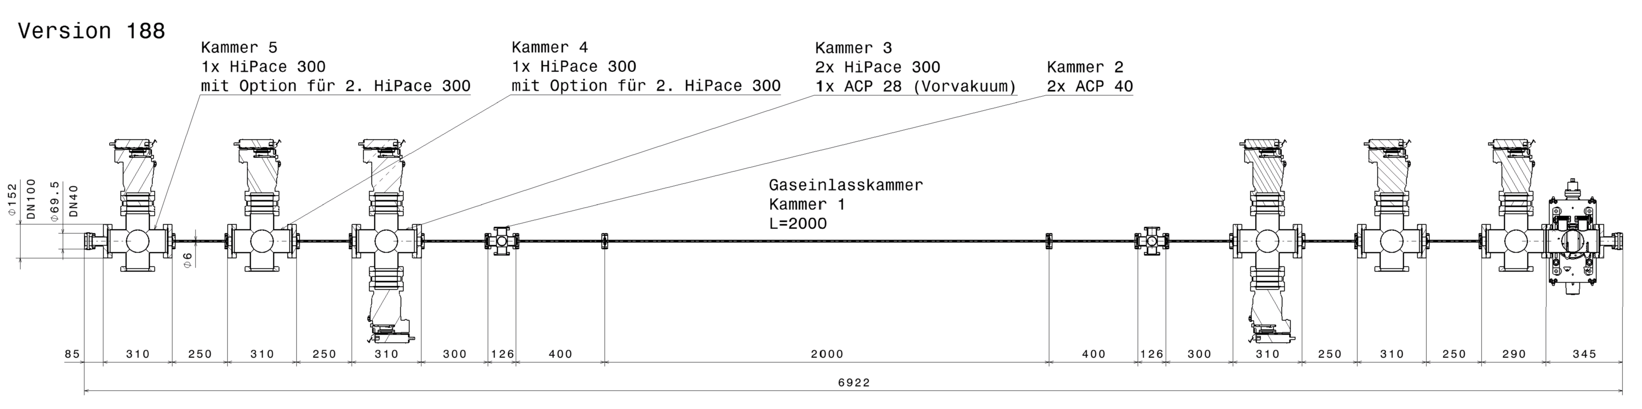
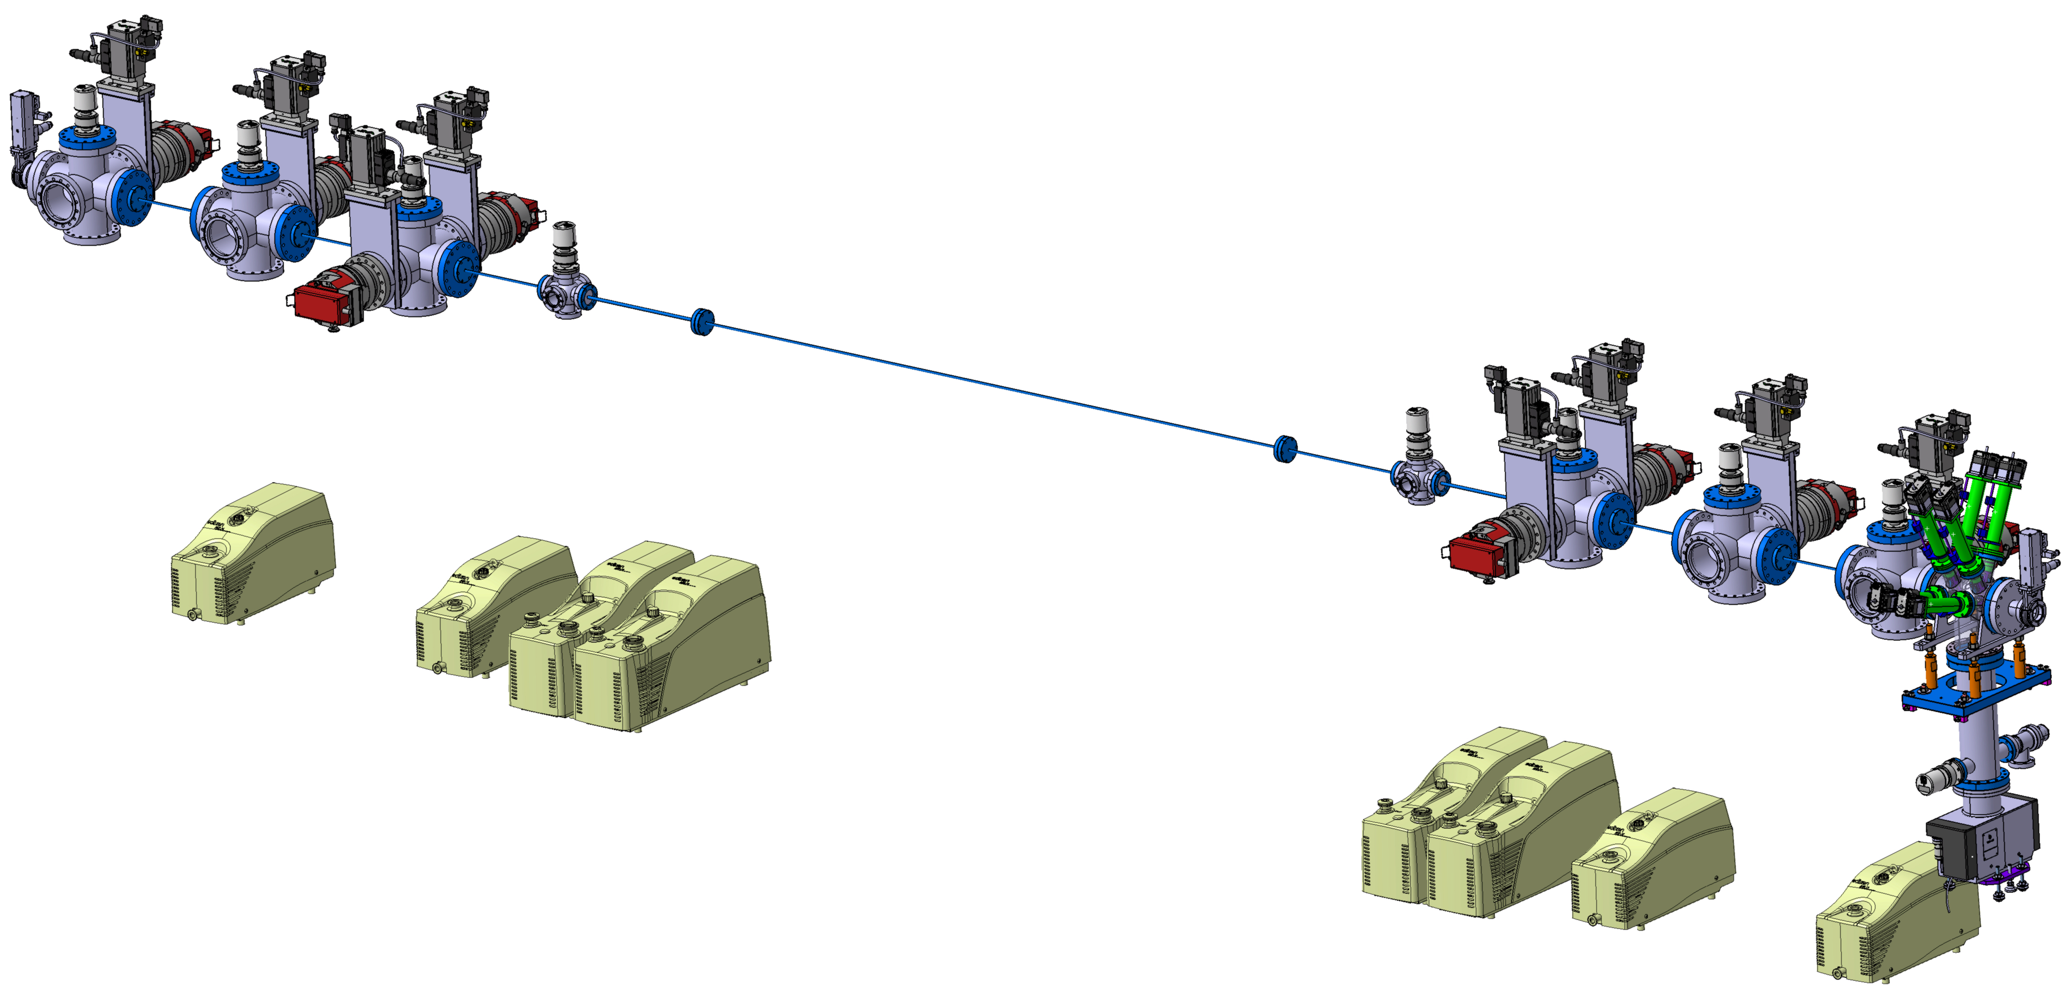
Gas Attenuator (OGAT)
Blenden-Durchmesser [mm] | Blendenlänge [mm] | P1 [mbar] | P2 [mbar] | freie Weglänge f. Stickstoff (P1) [m] | Knudsen-zahl Kn | Strömungs-typ | Knudsen Faktor Z | Leitwert Funktion f | C für langes Rohr [l/s] | Gasstrom qpV [mbar l/s] | erf. Saugvermögen [l/s] [m^3/h]
6 | 250 | 7.1E-08 | 6.4E-11 | 8.3E+02 | 1.38E+05 | molekular | 1.000 | 1.00 | 0.0891 | 6.35E-09 | 100.0 | 360.1
6 | 250 | 9.6E-05 | 7.1E-08 | 6.1E-01 | 1.02E+02 | molekular | 0.997 | 1.00 | 0.0889 | 8.56E-06 | 120.0 | 431.9
6 | 300 | 1.8E-01 | 9.6E-05 | 3.3E-04 | 5.46E-02 | Knudsen-Strömung | 0.816 | 2.16 | 0.1607 | 2.89E-02 | 300.0 | 1080.1
6 | 400 | 2 | 1.8E-01 | 3.0E-05 | 4.92E-03 | viskos | 0.811 | 15.79 | 0.8791 | 1.6000 | 8.9 | 32.0
Blendendurchmesser: 6mm
Gaseinlass: 2mbar
Gesamtlänge: 6.922m
Enddruck: 6.4 x 10⁻¹¹ mbar
Enddruck bei ACP40G: 1.8 x 10⁻¹ mbar
Saugvermögen/Gasstrom: tief angesetzt
Pumpenkonfiguration:
1. Stufe 2x ACP40G, 2. Stufe 2x HiPace 300P, 3. Stufe 1x HiPace 300P, 4. Stufe 1x HiPace 300P
Courtesy: Colette Rosenberg

Slide 9
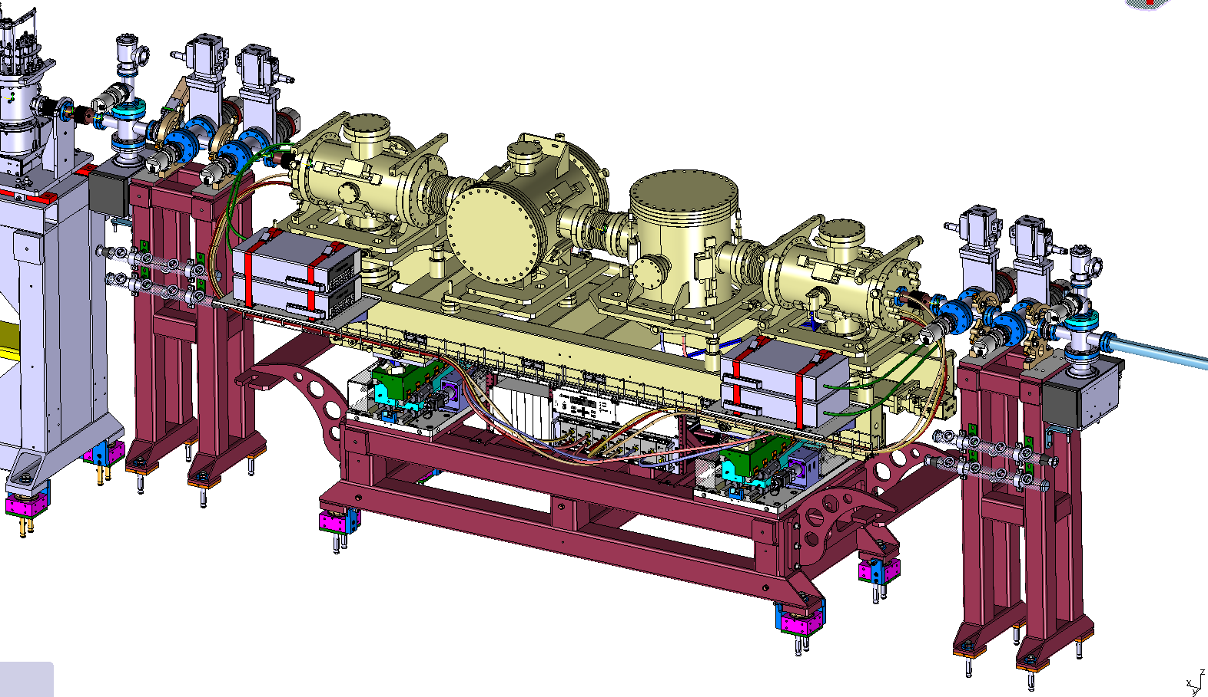
Diagnostics
Gas Monitor
Gas Monitor from DESY (XFEL)
Frame with movers by PSI

Slide 10
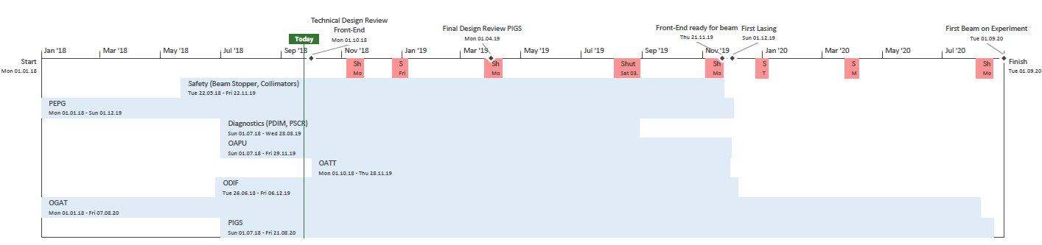
ATHOS Front-End Installation
Milestone Front-End ready
Milestone First Lasing
First Beam in Experiment
2018 |  |  |  | 2019 |  |  |  |  |  |  |  |  |  |  |  | 2020
9 | 10 | 11 | 12 | 1 | 2 | 3 | 4 | 5 | 6 | 7 | 8 | 9 | 10 | 11 | 12 | 1 | 2 | 3 | 4 | 5 | 6 | 7 | 8 | 9 | 10 | 11 | 12
Preparation Work
Phase 1
Safety Components
Gas Monitor
Diode/Screens
Solid State Attenuator
Aperture
Phase 2
Gas Attenuator
Gas Spectrometer
Beam Diffusor
Shutdowns

Slide 11
Challenges
Installation and Commissioning work only during shutdowns and machine days (8x ~2 days) possible
Various Gases Gas Spectrometer, Gas Monitor and Gas Attenuator required
Vacuum system much more complex than at ARAMIS (many gas paths, differential pumping stages)
3 new Components introduced
First Lasing end of 2019
Question:
When would you like what device? What are your priorities?

Slide 12
Wir schaffen Wissen – heute für morgen
Questions?

Slide 13
Prioritäten
Device | Description | Note | Prio | Installation
SBST ,OPSH, SCOL | Beam Stopper, Photon Shutter, Collimator | Waiting for offers (end Aug), ready to order | 1 | Aug ‘19
PSYS |  | First draft of Schutzkonzept | 1 | Aug ‘19
PEPG | Gas Monitor | Monitor Ordered, Work on Support will start in Sept | 1 | Aug ‘19
PSCR | Screens | Need redesign | 2 | Aug ’19
PDIM | Diode |  | 2 | Aug ’19
OAPU | Aperture | Ordered, Jan ’19 in house | 3 | Nov ’19
ODIF | Diffusor | Offers received, 6 mo. delivery | 4 | Nov ’19
OGAT/OATT | Gas Attenuator | Concept near completion, start finalizing design | 5 | Nov ’19
PIGS | Gas Spectrometer |  | 6 | 2020

Slide 14
Übersicht ATHOS
1st construction phase
2013 – 2016
2nd construction phase
2018 – 2020
ATHOS 0.65 – 5 nm
user
stations
BC1
BC2
2.6 – 3.4 GeV
Injector
Linac 1
Linac 2
Linac 3
0.35 GeV
2.0 GeV
3.0 GeV
2.1 – 5.8 GeV
ARAMIS 0.1 – 0.7 nm
  Main parameters
  Wavelength: 1 Å – 5 nm
  Photon energy: 0.24 – 12.4 keV
  Pulse duration: 1 – 20 fs
  e⁻ Energy 5.8 GeV
  e⁻ Bunch charge 10 – 200 pC
  Repetition rate 100 Hz
ARAMIS
Hard x-ray FEL, λ = 1 Å (1.8 – 12.4 keV)
Linear polarization, variable gap undulators
Operation modes: SASE & self-seeded
First users 2018
ATHOS
Soft x-ray FEL, λ = 0.65 – 5 nm (240 – 1’930 eV)
Variable polarization Apple X undulators
Operation modes: SASE (CHIC) & self-seeded
First users 2021

Slide 15
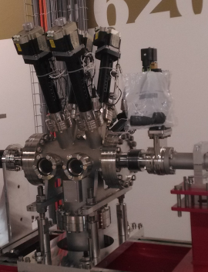
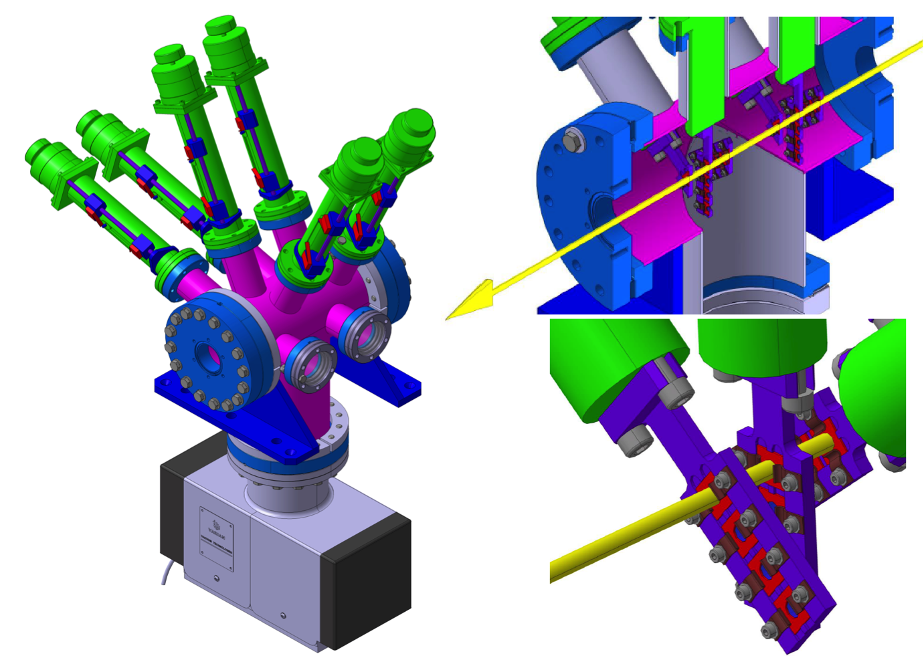
Solid State Attenuator
ARAMIS Design
6 actuators
4 foils per actuator

