Slide 1
Comparison measurements wire scanner vs. screen
R. Ischebeck, G. L. Orlandi, C. Lombosi :: Paul Scherrer Institut
Morning shift 27.09.2018

Slide 2
Measurement setup
Beam optics setup with
S10BC01-MQUA100 and S10CB01-MQUA040, E. Prat
Tight beam focus and scan around beam waist by
S30CB15-MQUA430 (z=431.49m)
  Recorded screen:
  SARCL01-DSCR170 (z=452.55m)
  Stack of 10 images
Scanned wire:
SARCL01-DWSC160 (z=452.31m)
Scan of 4 cycles
Focusing quad is 20 m upstream to observation point, no correction
for beta function is necessary to compare the two measurements
Charge 10 pC
Bunch energy 5.2 GeV at the screen
Common Gaussian fit results and standard deviation are shown on the plots

Slide 3
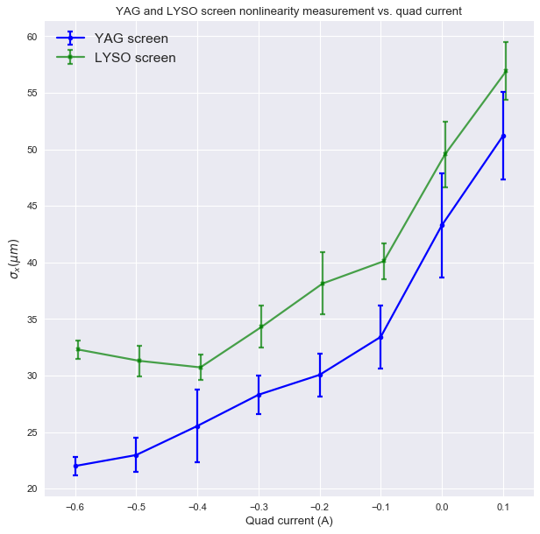

Slide 4
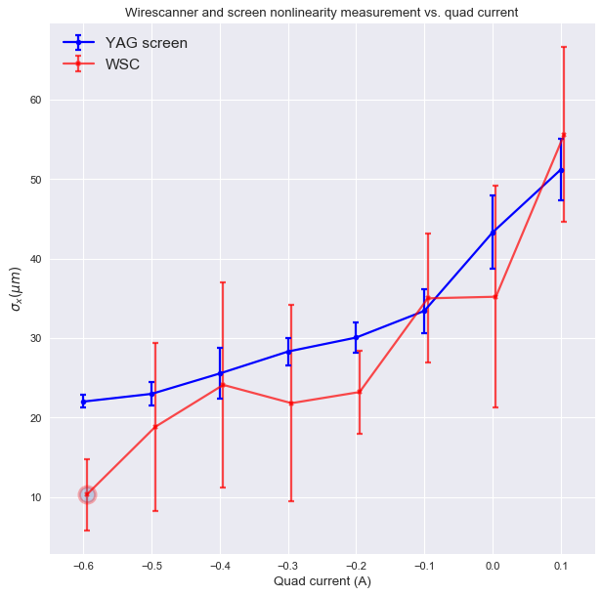

Slide 5
Conclusion
Comparing YAG and LYSO crystals shows that smaller transversal beam size can be measured by YAG crystal
Statistics was different for YAG (stack of 10), WSC (4 cycles), thus SNR not yet comparable
Calibration of PMT for WSC measurements was done at the first point (smallest beam), increased SNR is expected for larger beams
Ischebeck, Orlandi, Voulot, Gobbo, Prat, Hermann, Lombosi
https://elog-gfa.psi.ch/SwissFEL+commissioning/7962

