Slide 1
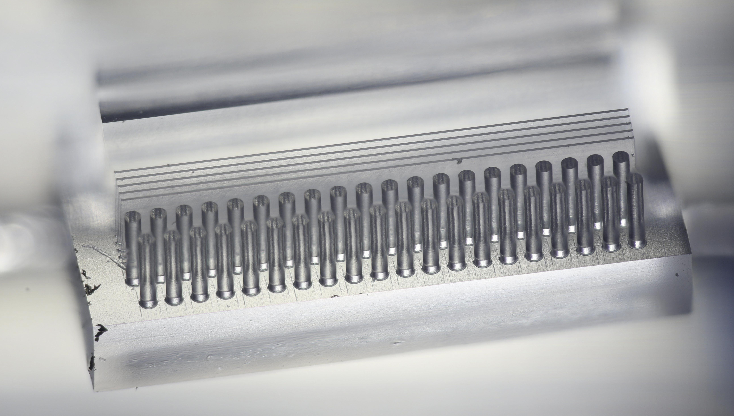
ACHIP Wakefield Experiments
July 22 and Sept 24 2018
S. Bettoni, B. Hermann, R. Ischebeck, C. Lombosi, E. Prat
SPM :: Oct 8, 2018

Slide 2
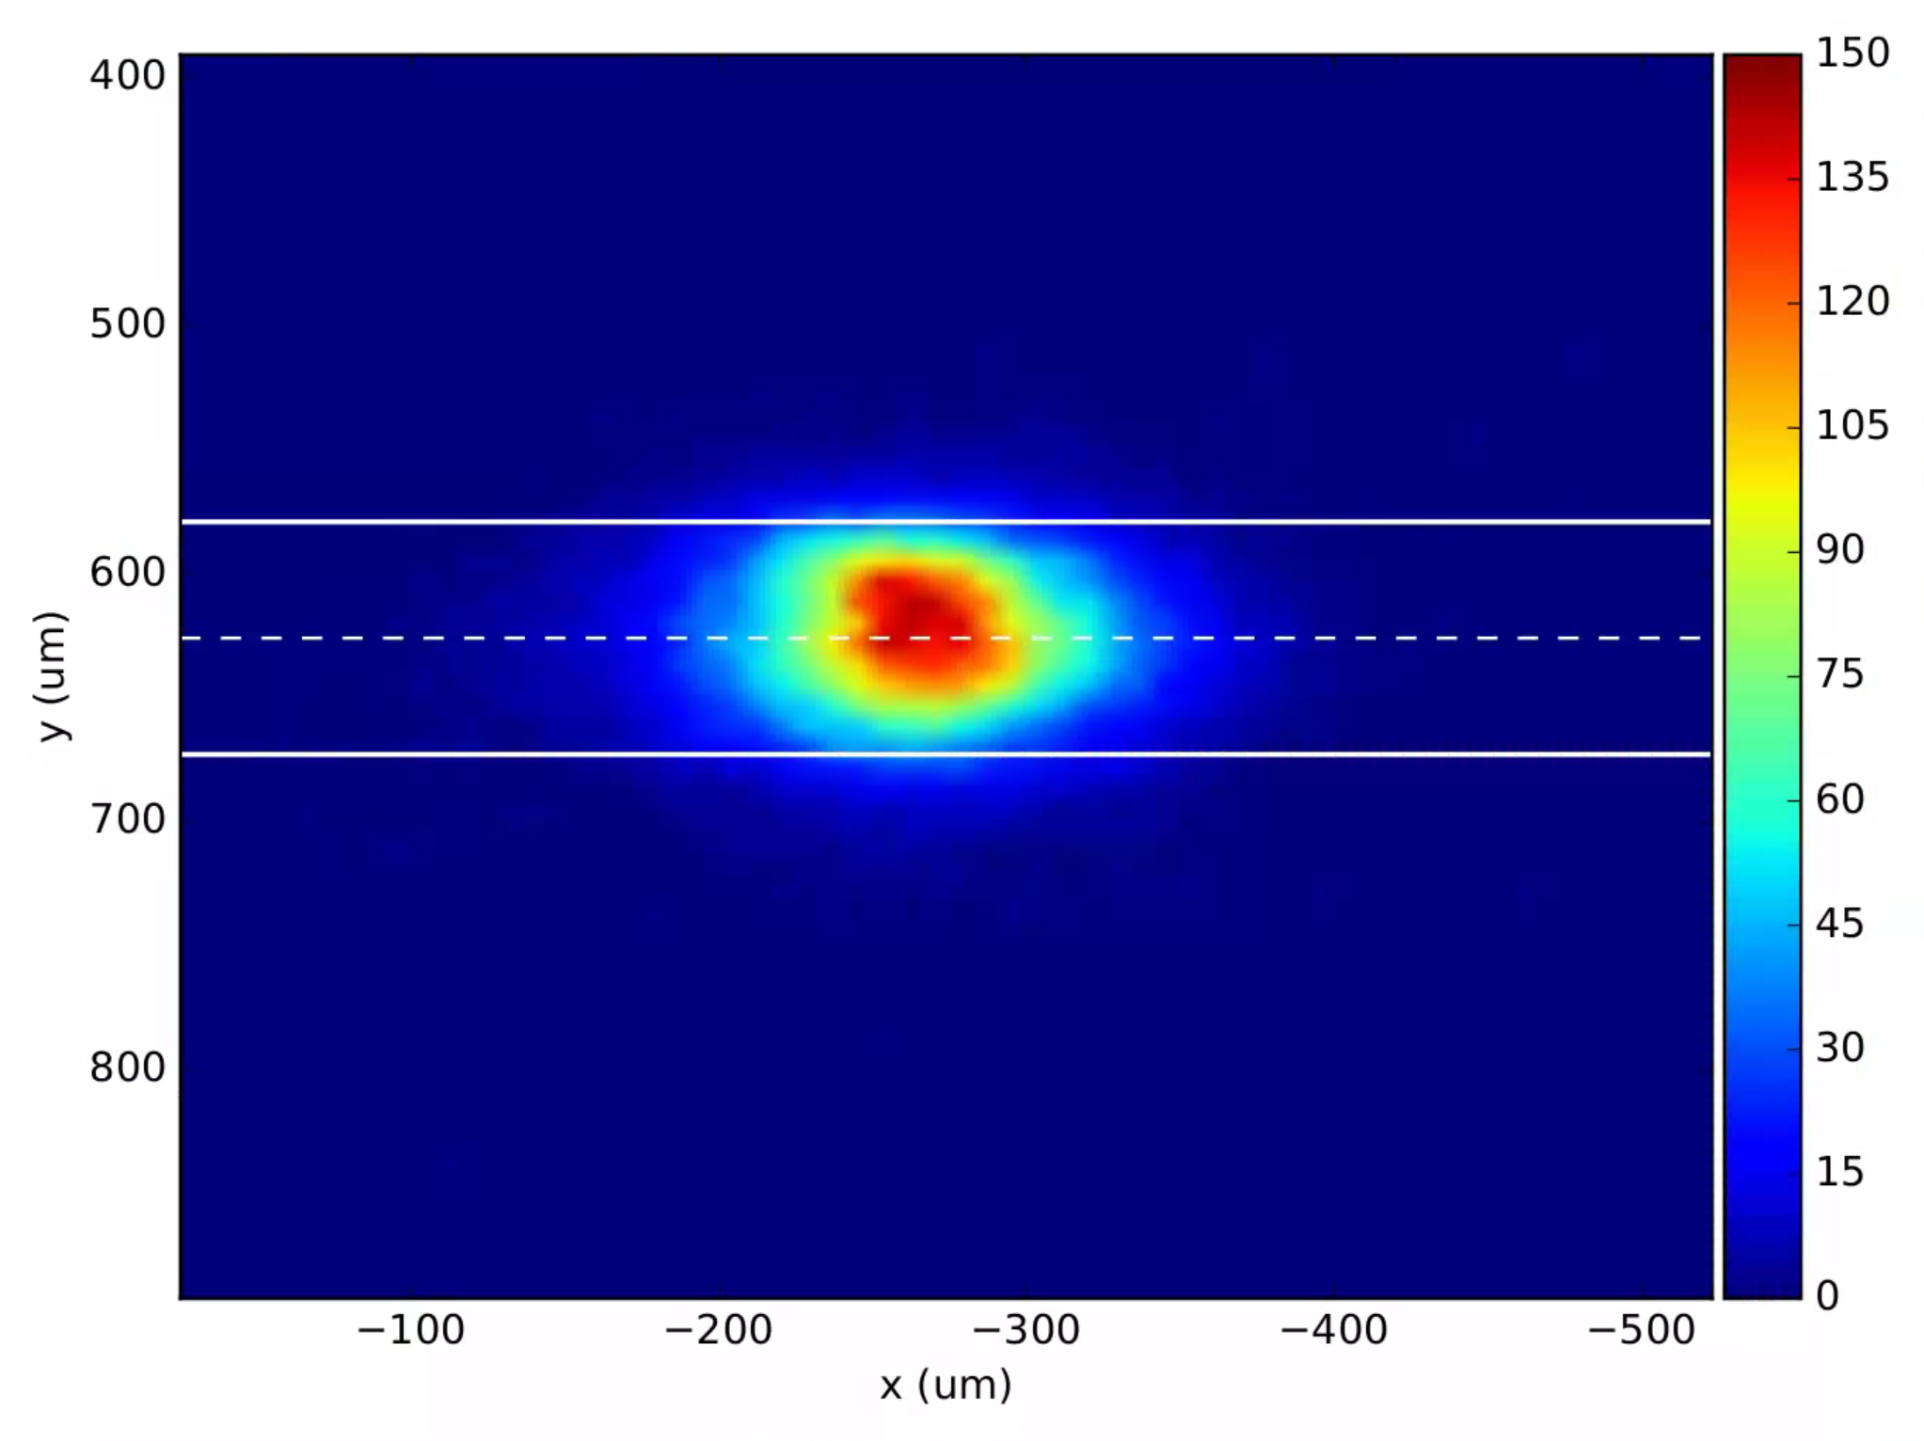
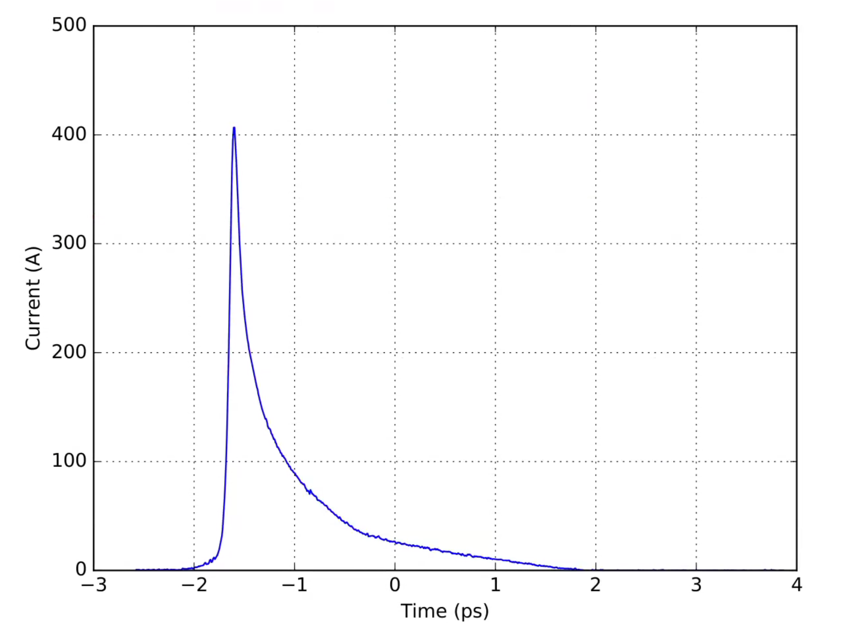

July 22 Experiment
ELOG
https://elog-gfa.psi.ch/SwissFEL+commissioning/7121
Beam size @ IP
Measured emittance:
$ε_{X}=200 nm, ε_{Y}=190 nm$
Focus: $σ_{X}=43 μm, σ_{Y}=31 μm$
12 % of charge outside of aperture
($93.75 μm$)
Compression
X-band cavity off, non-linear compression
210 fs (FWHM) peak followed by ps-tail

Slide 3
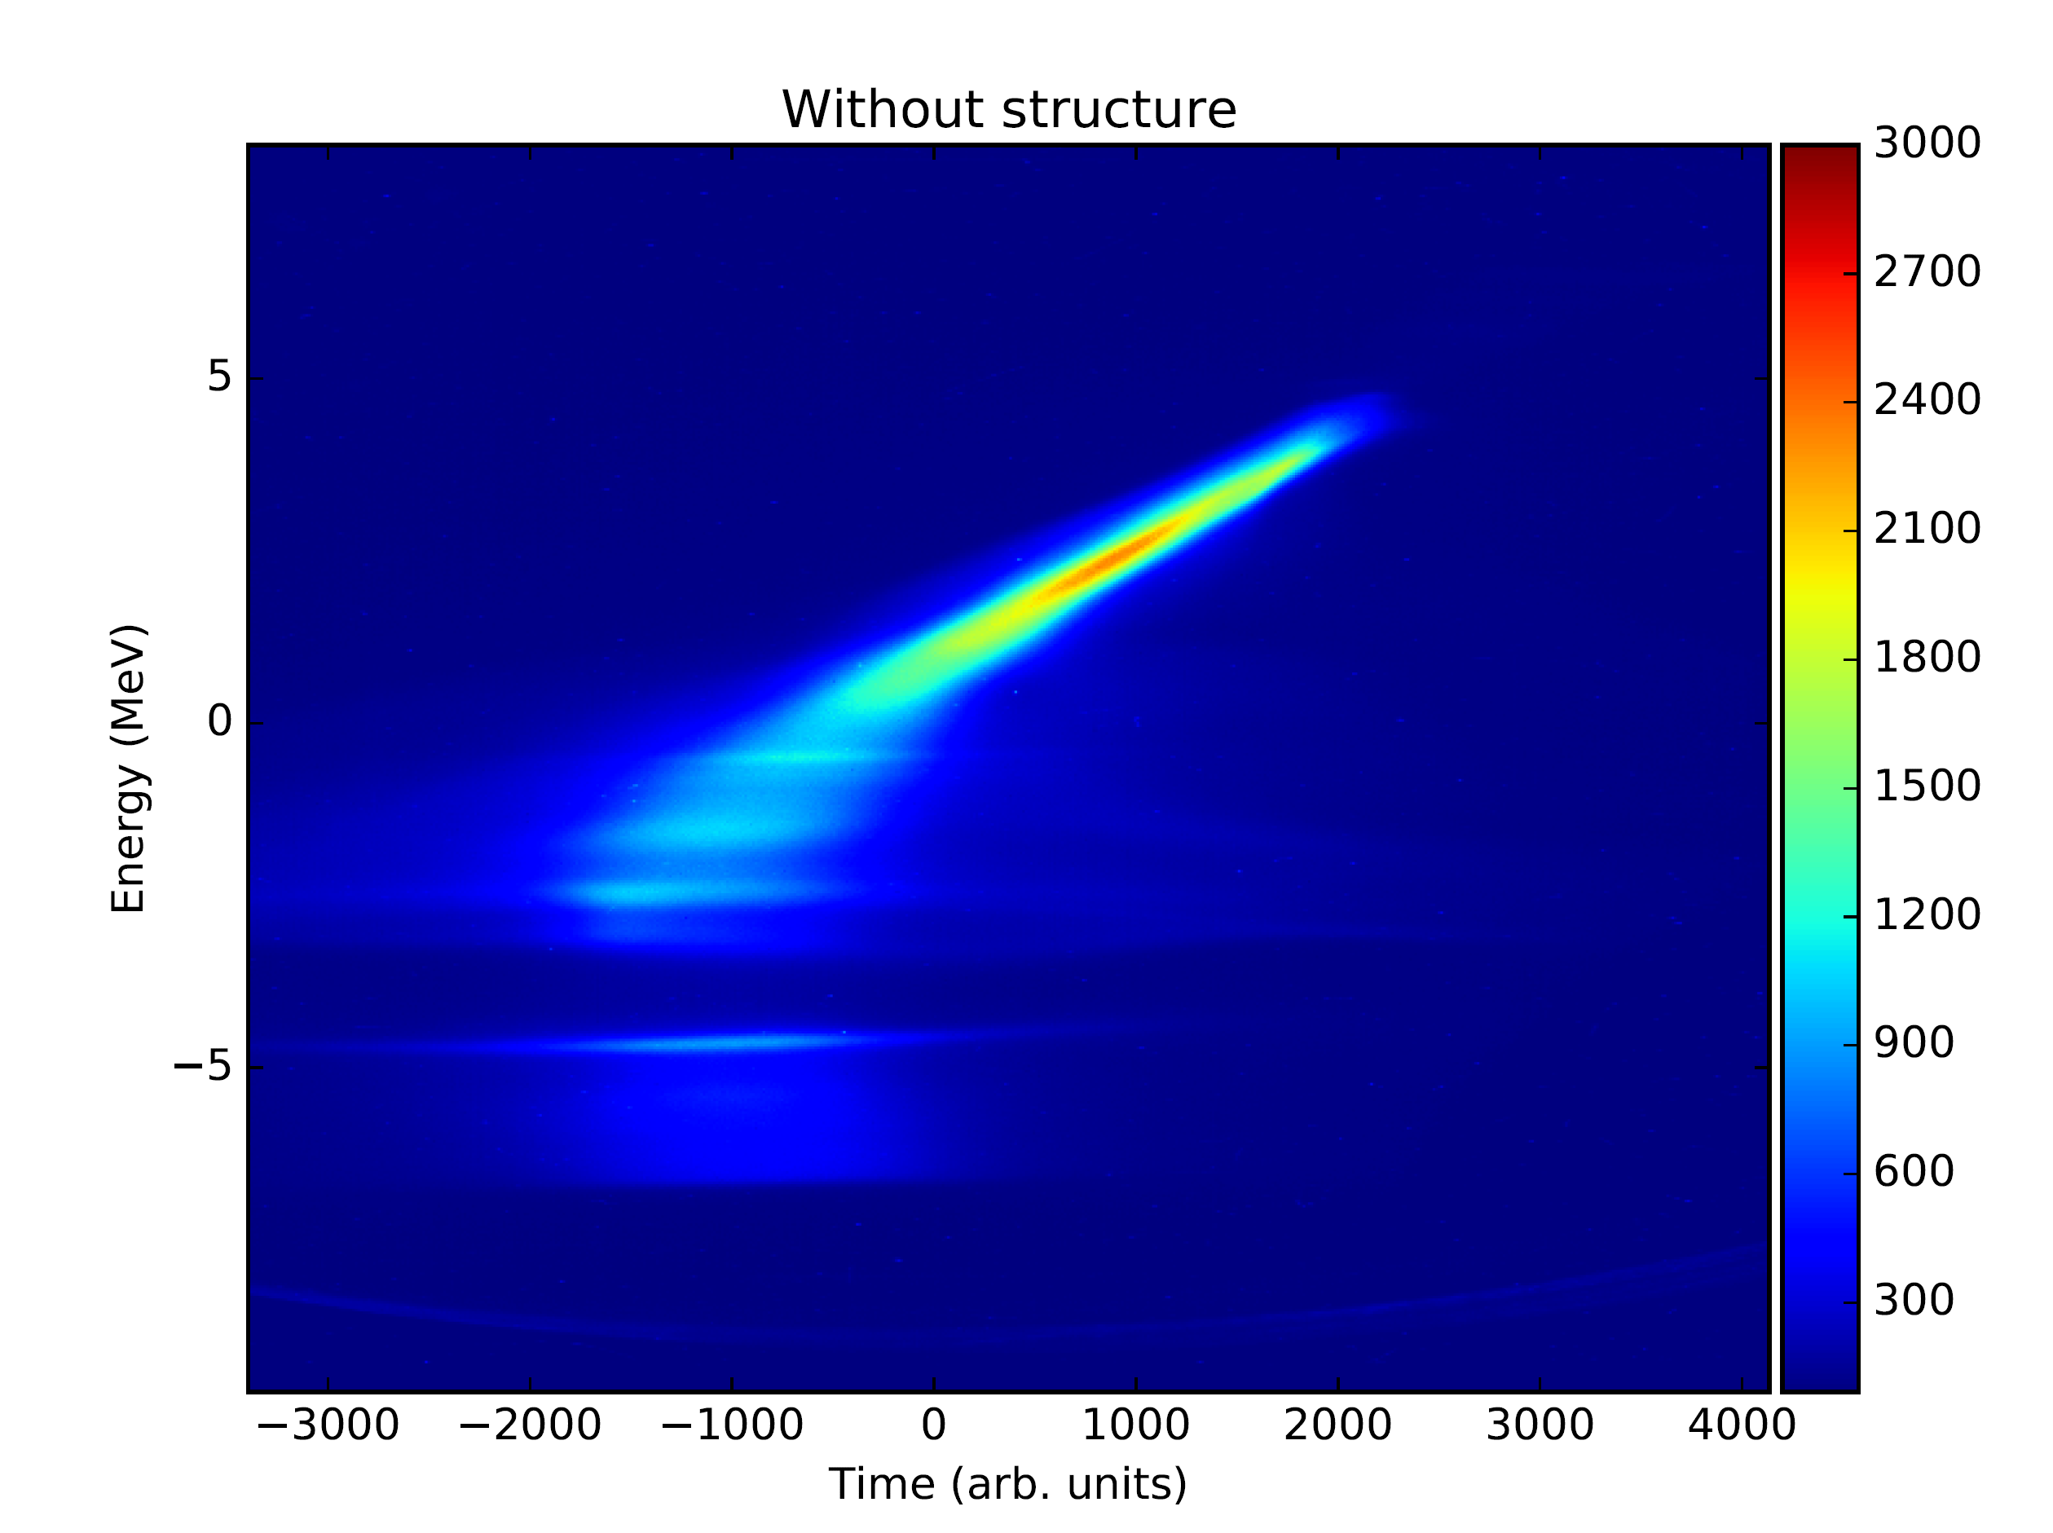
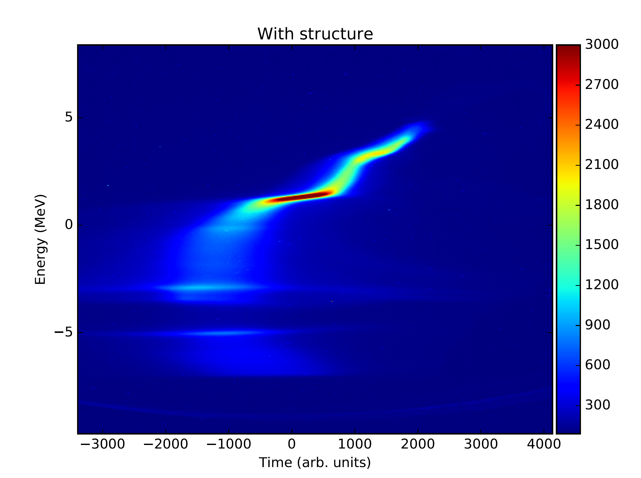
July 22 Experiment
Spectrometer setup
Injector spectrometer
TDC located before ACHIP chamber, not useable (streaked beam would be to large)
→ Create streaking field by orbit-offset (2 mm) in two C-Bands
tail
head

Slide 4
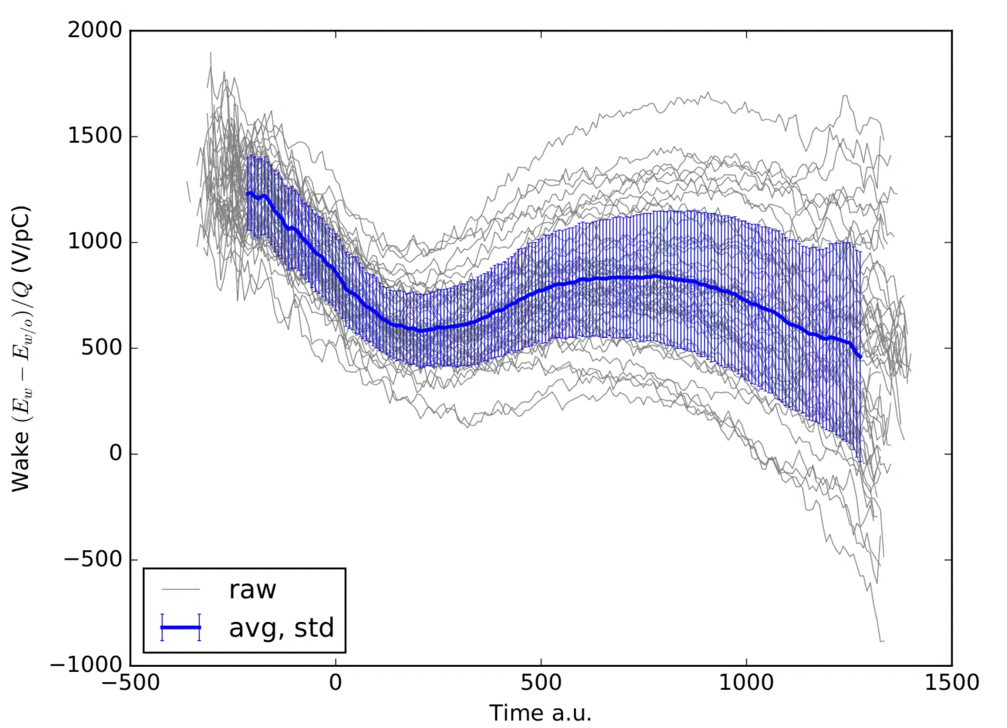
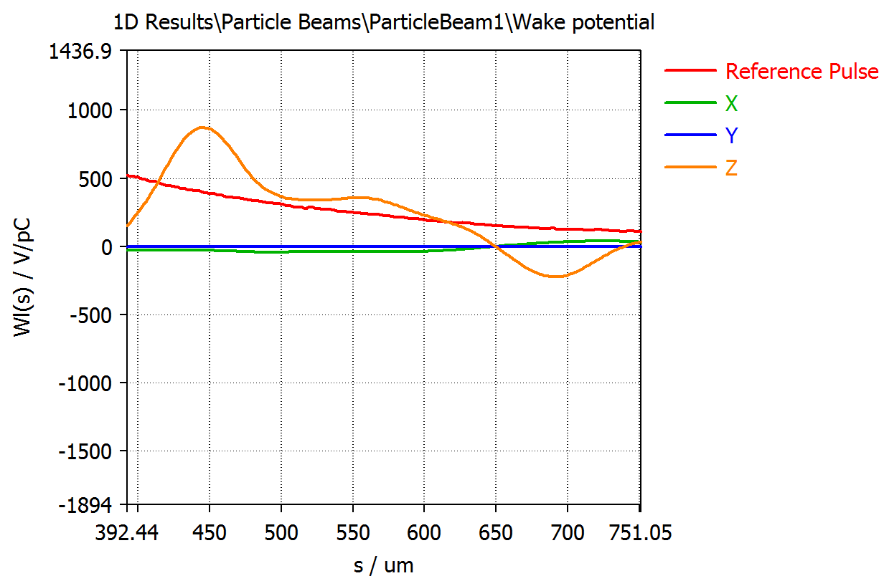
July 22 Preliminary Analysis
Difference between Energy (COM) vs “Time” (wakepotential):
CST Simulation
250 keV energy gain!
(in 3 mm)
200 pC
Tim axis uncalibrated…
time/pixel unknown (non-linearity)
t0, offset
Simulation of C-band streak

Slide 5
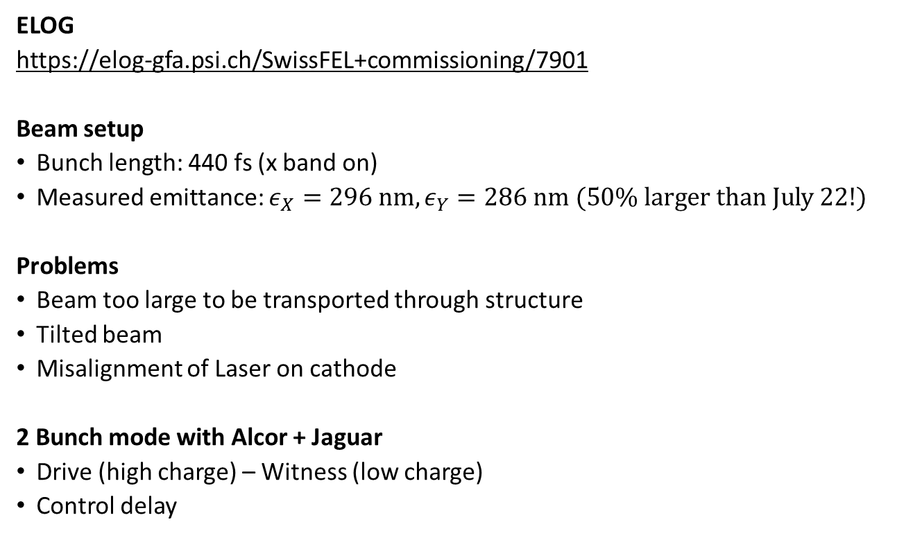
Sept 24 Experiment
ELOG
https://elog-gfa.psi.ch/SwissFEL+commissioning/7901
Beam setup
Bunch length: 440 fs (x band on)
Measured emittance: $ε_{X}=296 nm, ε_{Y}=286 nm (50\% larger than July 22!)$
Problems
Beam too large to be transported through structure
Tilted beam
Misalignment of Laser on cathode
2 Bunch mode with Alcor + Jaguar
Drive (high charge) – Witness (low charge)
Control delay

Slide 6
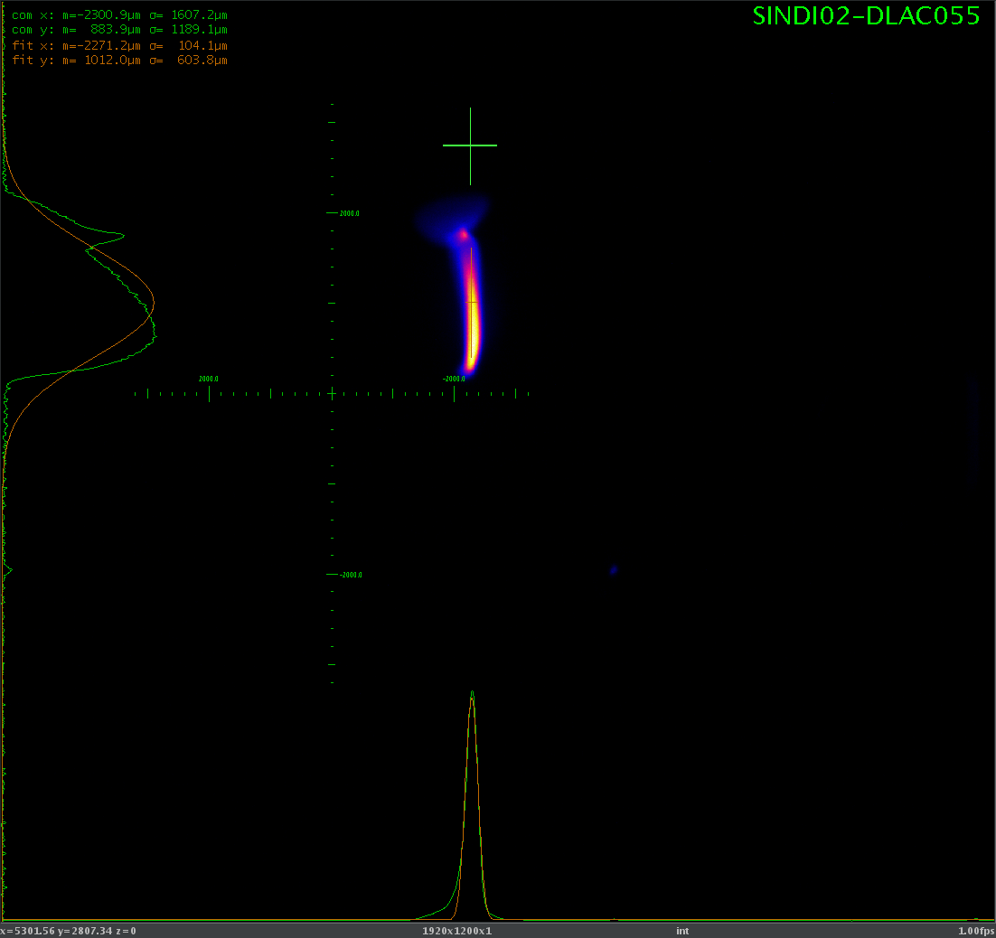
Sept 24 Experiment, 2 Bunch

Slide 7
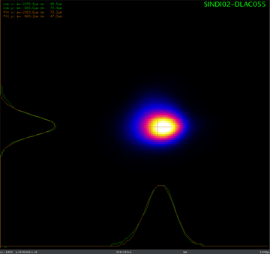
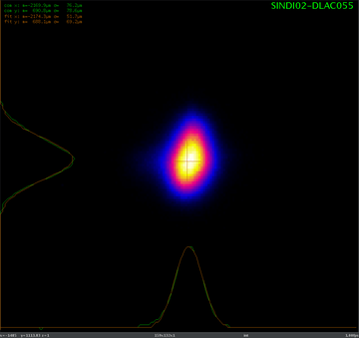
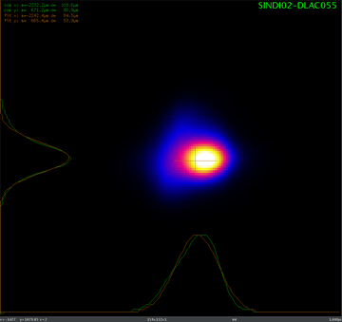
Sept 24 Experiment, 2 Bunch
Alcor 150 pC
Jaguar 20 pC
Both (170 pC)
Orbit and focus not identical for both bunches
Chromaticity due to time/phase difference
Space charge effects different
More time and laser group needed to properly set up both lasers.

