Slide 1
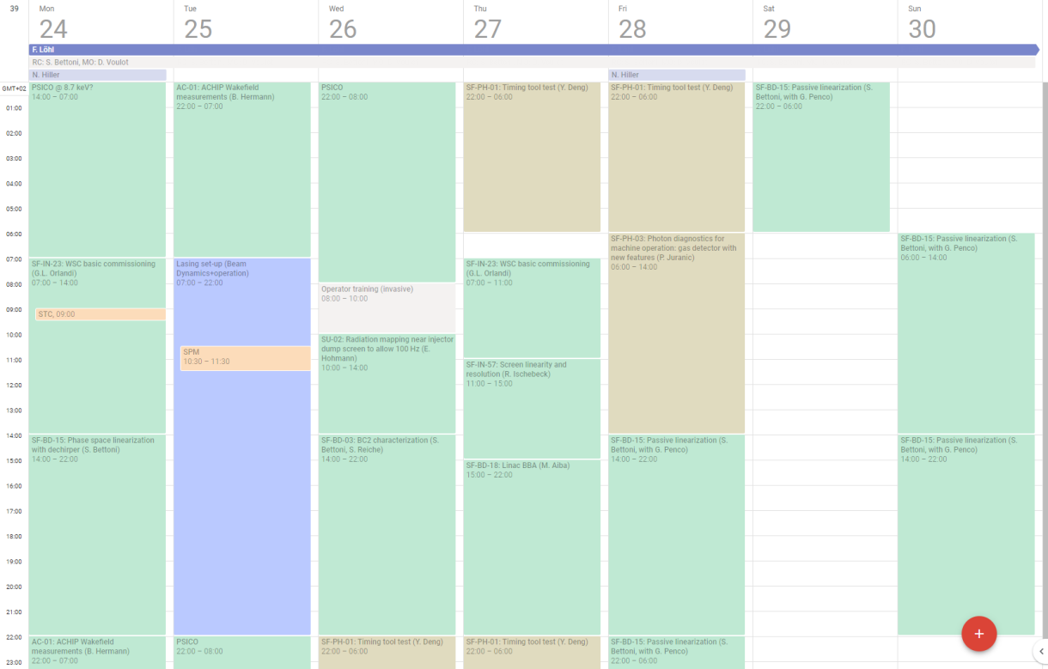
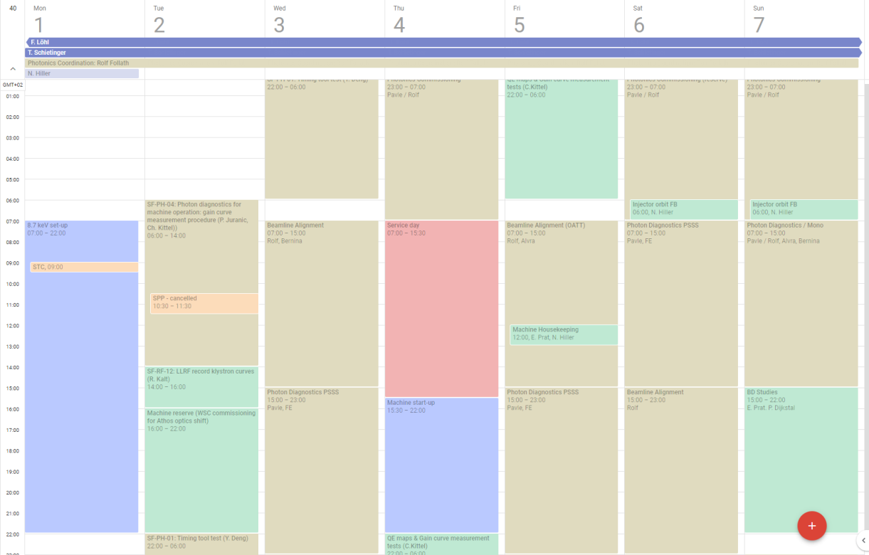
Operation overview of the last two weeks:
Week 39: machine development: Beam Dynamics, Beam diagnostics, Photonics tools for operation
Week 40: photonics, 3 MD shifts, service day
Actually a lot of time was devoted to machine set-up: 2 MD shifts cancelled on Tuesday to set-up the machine

Slide 2
Lessons learnt:
The planning should reserve enough time for setting-up: the set-up should not take place during the MDs
Time is also needed for machine housekeeping and debugging problems:
  Linac phasing
  Laser checks
  Orbit feedback investigation
  …
Difficult to have ambitious MD programme when the RC has to take part in MD shifts (need more RC or time to train the operators)

Slide 3
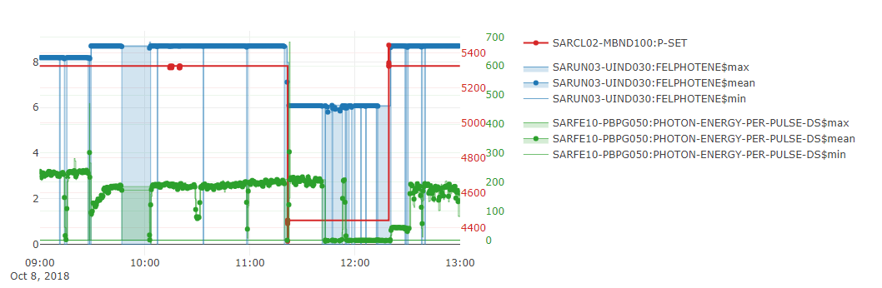
FEL scaling is getting more reliable:
Monday 8.10, within 3h:
  From a running machine at 8.2 keV, 230 uJ
  Scale undulator K: 8.7 keV -> 195uJ
  Change energy and scale optics: 5.8 keV -> 210uJ
  Restore 8.2 keV settings -> 195 uJ (without optimising)

Slide 4
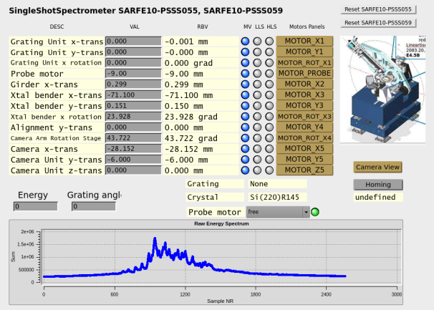
Orbit feedback problem:
Orbit feedback does not converge in injector
Seems to be a configuration problem, BPMs seems to be ok
Could revert to Masamitsu’s tool in some case
Need to be consolidated and documented
Photon diagnostics commissioning:
First measurement with the spectrometer PSSS
Improvement of the gas detector HAMP signal

