Slide 1
SwissFEL Wire-Scanners (WSC):
Status WSC-High-Level Application (WSC-HL-App)
G.L. Orlandi, A. Gobbo
WSC-HL-App, p-shell code manages:
WSC measurement settings: wire selection, BLM and BPM, number of cycles and sampling points, scanning interval and speed (also depending on the machine rep.rate)
BS-READ acquisition of motor-encoder and BLM readouts;
Interface with MPS to exclude readout of selected BLM from the MPS beam-losses budget (thanks to D. Llorente);
optimization of PMT-gain, scanning interval and speed (automatized procedure, see “Calibration” button on the WSC-HL-App main panel);
on-line display of the beam profile acquired during the scan;
beam profile analysis (Gauss-fit and RMS);
raw data and analysis results saved in the ELOG (SwissFEL commissioning data).

Slide 2
How to proceed with a WSC measurement?
1) Open “WSC-HL-App main panel” (Panel WireScan).
From the Launcher, Diagnostics➔Wire-Scanner➔ select a WSC from a list;
To open the panel for “optimization of the scanning parameters” (calibration), click on button “Calibration”➔ panel “WireScanCalibration” pops up.
2) Panel WireScanCalibration. Start optimization of the scanning parameters: PMT-Gain, scanning range and speed are automatically evaluated.
Select wire (X1,Y1,X2,Y2) or set of wires (Set1, Set2), optional modify default values (initial scanning range, number of points, initial PMT-Gain, range-factor)➔ click on button “Start”.
Once “Calibration” procedure is completed ➔ optimized scanning parameters are directly acquired by the “WSC-HL-App main panel” (Panel WireScan).
3) Back to Panel WireScan to start the measurement. Select wire or set of wires, define number of points and number of cycles ➔click on button “Scan”.

Slide 3
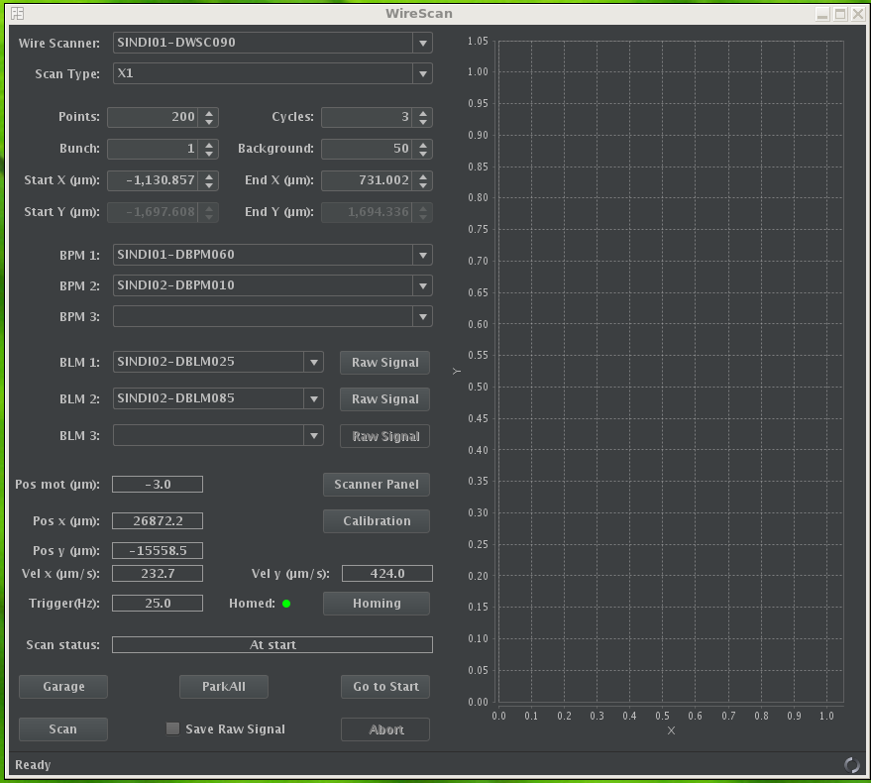
Open “WSC-HL-App main panel”.
From the Launcher, Diagnostics➔Wire-Scanner➔ select a WSC from a list;
click on button “Calibration” : panel to optimize PMT-gain, scanning range and speed pops up

Slide 4
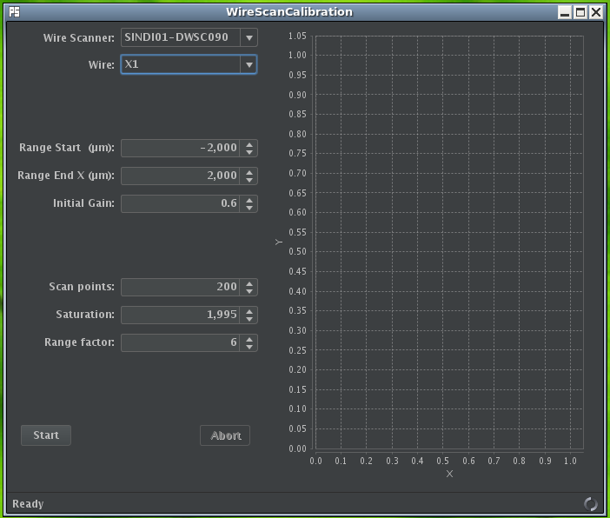
Panel WireScanCalibration:
Click on button “Start”➔
Automatized optimization procedure starts:
Make a first scan and Gauss-fit of the acquired profile to find centroid of the beam profile;
Code automatically set wire at the centroid position and optimize PMT-gain up to 90% of saturation level;
New scan is automatically performed with optimized PMT-Gain;
Obtained beam profile is Gauss-fitted ➔ optimum scanning range
(-6xsigma_Gauss, + 6xsigma_Gauss)

Slide 5
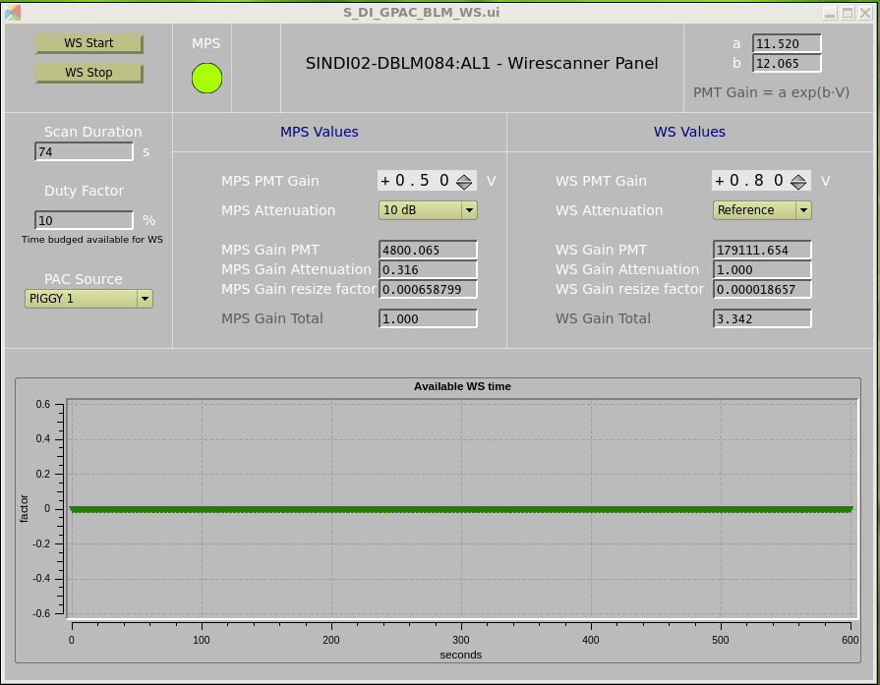
WSC-HL-App interfaces with MPS to exclude readout of selected BLM from the MPS beam-losses budget (thanks to D. Llorente).
By default, a WSC measurement is allowed to run only for 6 min. over 1 hour (see “Duty Factor”)
Mismatch between default value of the “Duty-factor” and the effective time of a scan makes a scan session to fail!

Slide 6
WSC Aramis phase-1: 22 WSC units. 20 WSCs installed to date.
PREFIX | NAME | V-C | s(m) | RACK | INSTALLATION | MOTOR SN | STATUS
SINDI01 (*) | SINDI01-DWSC090 | C16 | 84 | 1.Z084.68 | 19.05.2016 | 13098-002 | BS-READ=OK EMITTANCE MEASUREMENTS READY
S10DI01 | S10DI01-DWSC010 | C16 | 110 | 1.Z099.72 | 19.05.2016 | 13098-007 | BS-READ=OK
S10CB03 | S10CB03-DWSC440 | C16 | 125 | 1.Z099.72 | 19.07.2016 | 13098-022 | BS-READ=OK
S10CB05 | S10CB05-DWSC440 | C16 | 144 | 1.Z153.70 | 19.07.2016 | 13098-008 | BS-READ=OK
S10CB07 | S10CB07-DWSC440 | C16 | 164 | 1.Z153.70 | 04.08.2016 | 13098-009 | BS-READ=OK
S10BC01(*) | S10BC01-DWSC030 | C16 | 184 | 1.Z216.70 | 04.08.2016 | 13098-012 | NO BS-RECORD OF ENCODER READ-OUT (EVR=OK)
S20CB01 | S20CB01-DWSC440 | C16 | 229 | 1.Z216.70 | 24.05.2016 | 13098-004 | NO BS-RECORD OF ENCODER READ-OUT (EVR=OK)
S20SY01 | S20SY01-DWSC070 | C16 | 263 | 1.Z255.70 | 11.08.2016 | 13098-005 | NO BS-RECORD OF ENCODER READ-OUT (EVR=OK)
S20SY02 | S20SY02-DWSC160 | C38 | 273 | 1.Z255.70 | 10.01.2017 | 13098-018 | NO BS-RECORD OF ENCODER READ-OUT (EVR=OK)
S20SY03(*) | S20SY03-DWSC090 | C16 | 294 | 1.Z310.65 | 11.08.2016 | 13098-003 | BS-READ=OK ATHOS OPTICS MATCHING READY
S30CB01 | S30CB01-DWSC440 | C16 | 304 | 1.Z310.65 | 23.08.2016 | 13098-017 | BS-READ=OK
S30CB05(*) | S30CB05-DWSC440 | C16 | 340 | 1.Z310.65 | 08.01.2018 | 13098-024 | BS-READ=OK FOIL=GARAGE
S30CB09 | S30CB09-DWSC440 | C16 | 377 | 1.Z400.63 | 08.09.2016 | 13098-011 | BS-READ=OK
S30CB13 | S30CB13-DWSC440 | C16 | 413 | 1.Z400.63 | 22.06.2017 | 13098-013 | BS-READ=OK
SARCL01(*) | SARCL01-DWSC160 | C16 | 452 | 0.Z469.59 | 10.01.2017 | 13098-016 | BS-READ=OK EMITTANCE MEASUREMENTS READY
SARCL02 | SARCL02-DWSC270 | C16 | 462 | 0.Z469.59 | 23.08.2016 | 13098-021 | BS-READ=OK
SARMA02 | SARMA02-DWSC060 | C8 | 492 | 0.Z469.59 | 08.09.2016 | 13098-010 | BS-READ=OK
SARUN08(^) | SARUN08-DWSC010 | C8 | 530 | 0.Z539.58 |  |  | installation postponed
SARUN20 | SARUN20-DWSC010 | C8 | 587 | 0.Z563.60 | 22.06.2017 | 13098-015 | BS-READ=KO EVR=?; NO FIBER=?
SATSY03 | SATSY03-DWSC110 | C16 | 326 | 1.Z339.67 | 03.08.2017 | 13098-025 | TO BE CALIBRATED & TIMING-NETWORK
SATDI01 | SATDI01-DWSC065 | C16 | 342 | 1.Z339.67 | 03.08.2017 | 13098-019 | TO BE CALIBRATED & TIMING-NETWORK
SATDI01 (^^) | SATDI01-DWSC290 | C16 | 356 | 1.Z339.67 |  |  | removed to install the dechirper
SATBD01 | SATBD01-DWSC110 | C16 | 493 | 0.Z489.57 |  |  | former SATMA01-DWSC060 z=381m
(*) with calibration foil; (^) installation postponed; (^^) removed

Slide 7
Conclusion
Optimized and automatized version (1.0) of the WSC-HL-App is ready to be tested and operated by users….
….feed-back and suggestions from the users will help to improve the application…
….wire-scanners (see table) needed for emittance measurements and Athos optics matching are operational….
…have fun !!!

