Slide 1
Fast & Automated Parameter Tuning
using Bayesian Optimization
Nicole Hiller
Franziska Frei
Johannes Kirschner
Mojmir Mutny
Manuel Nonnenmacher
Rasmus Ischebeck
Andreas Krause
SwissFEL Progress Meeting
23.10.2018

Slide 2
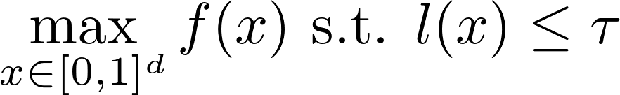
Constraint Black-Box Optimization
Photon Pulse Energy (fast HAMP signal)
Electron Losses
SwissFEL Parameters
e.g. BPM Offsets
Evaluations are noisy and expensive.
Invest computation to decide which points to pick.

Slide 3
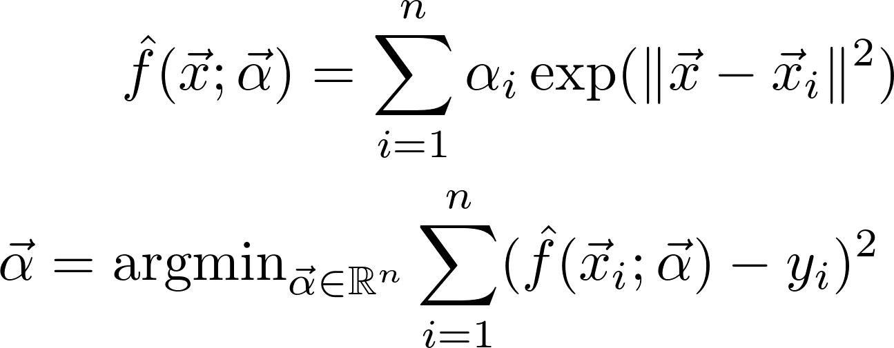
Bayesian Optimization
Estimate using kernel regression:
Use uncertainty estimates (confidence intervals) to trade off exploration and local optimization.
Notes:
use for efficient optimization e.g. discard regions based on a statistical suboptimality certificate

Slide 4
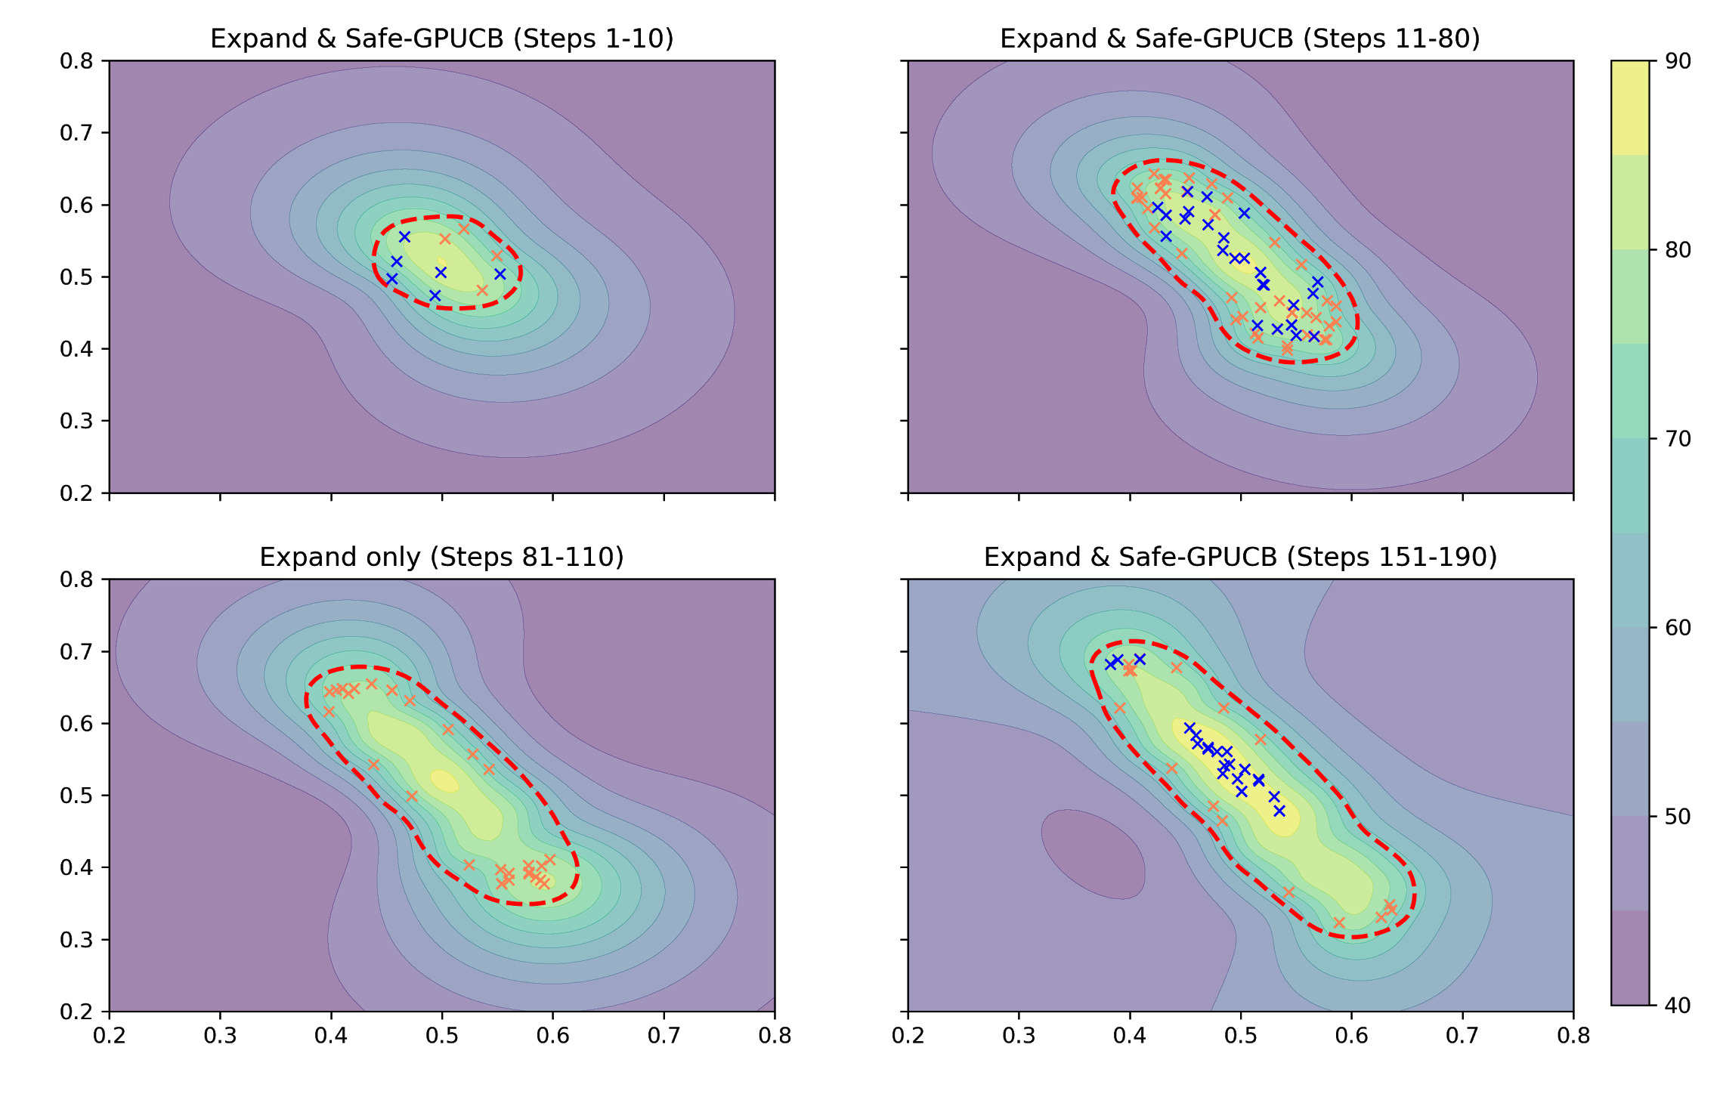
Bayesian Optimization at SwissFEL

Slide 5
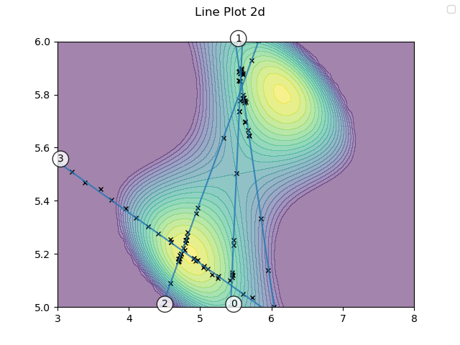
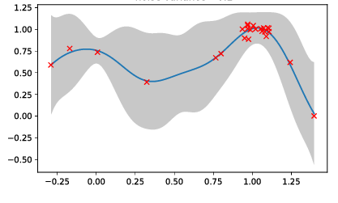
Line Bayesian Optimization

Slide 6
Progress so far
Setup Optimization-Framework in Python
  Safety Constraints on Losses
Promising initial results with 2-5 Parameters
  Matching & Gun Quadrupoles
Some initial challenges we addressed:
  Beam failures, Slow Signals, Feedback
With Master student (Manuel):
  Extend to more parameters: Line Bayesian Optimization
  Select hyperparameters automatically

Slide 7
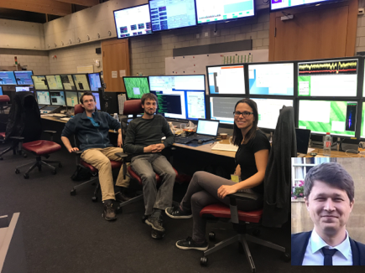
Results - Shift on Sun 23-Sep’18
Shift dedicated to undulator orbit optimization
5 Parameters: BPM target positions in SARUN06-10 horizontal
12 Parameters: BPM targets positions in SARUN 06-10, 12 in horizontal and vertical
Mojmir Mutny, Johannes Kirschner, Nicole Hiller & Manuel Nonnenmacher
Test of different algorithms for 5 parameters (detuned signal from 60 µJ to 20 µJ)
  2x: Line Bayesian Optimisation followed by Greedy Maximization)
  2x: Nelder mead (simplex optimisation)
  1x: Greedy line search
  1x Manual tuning (Nicole on the knobbox)
One run with 12 parameters of Line Bayesian Optimisation
Test of GUI for live-visualization

Slide 8
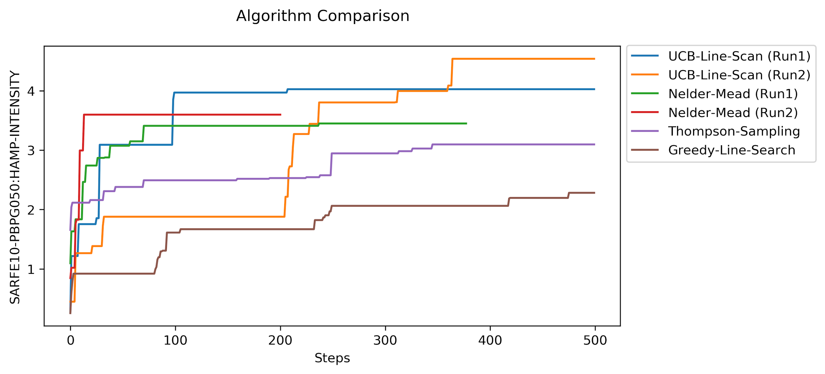
Results - Shift on Sun 23-Sep’18
Nelder mead starts very fast and then gets stuck in local optimum!
Bayesian Line Optimisation reaches optimum reliably

Slide 9
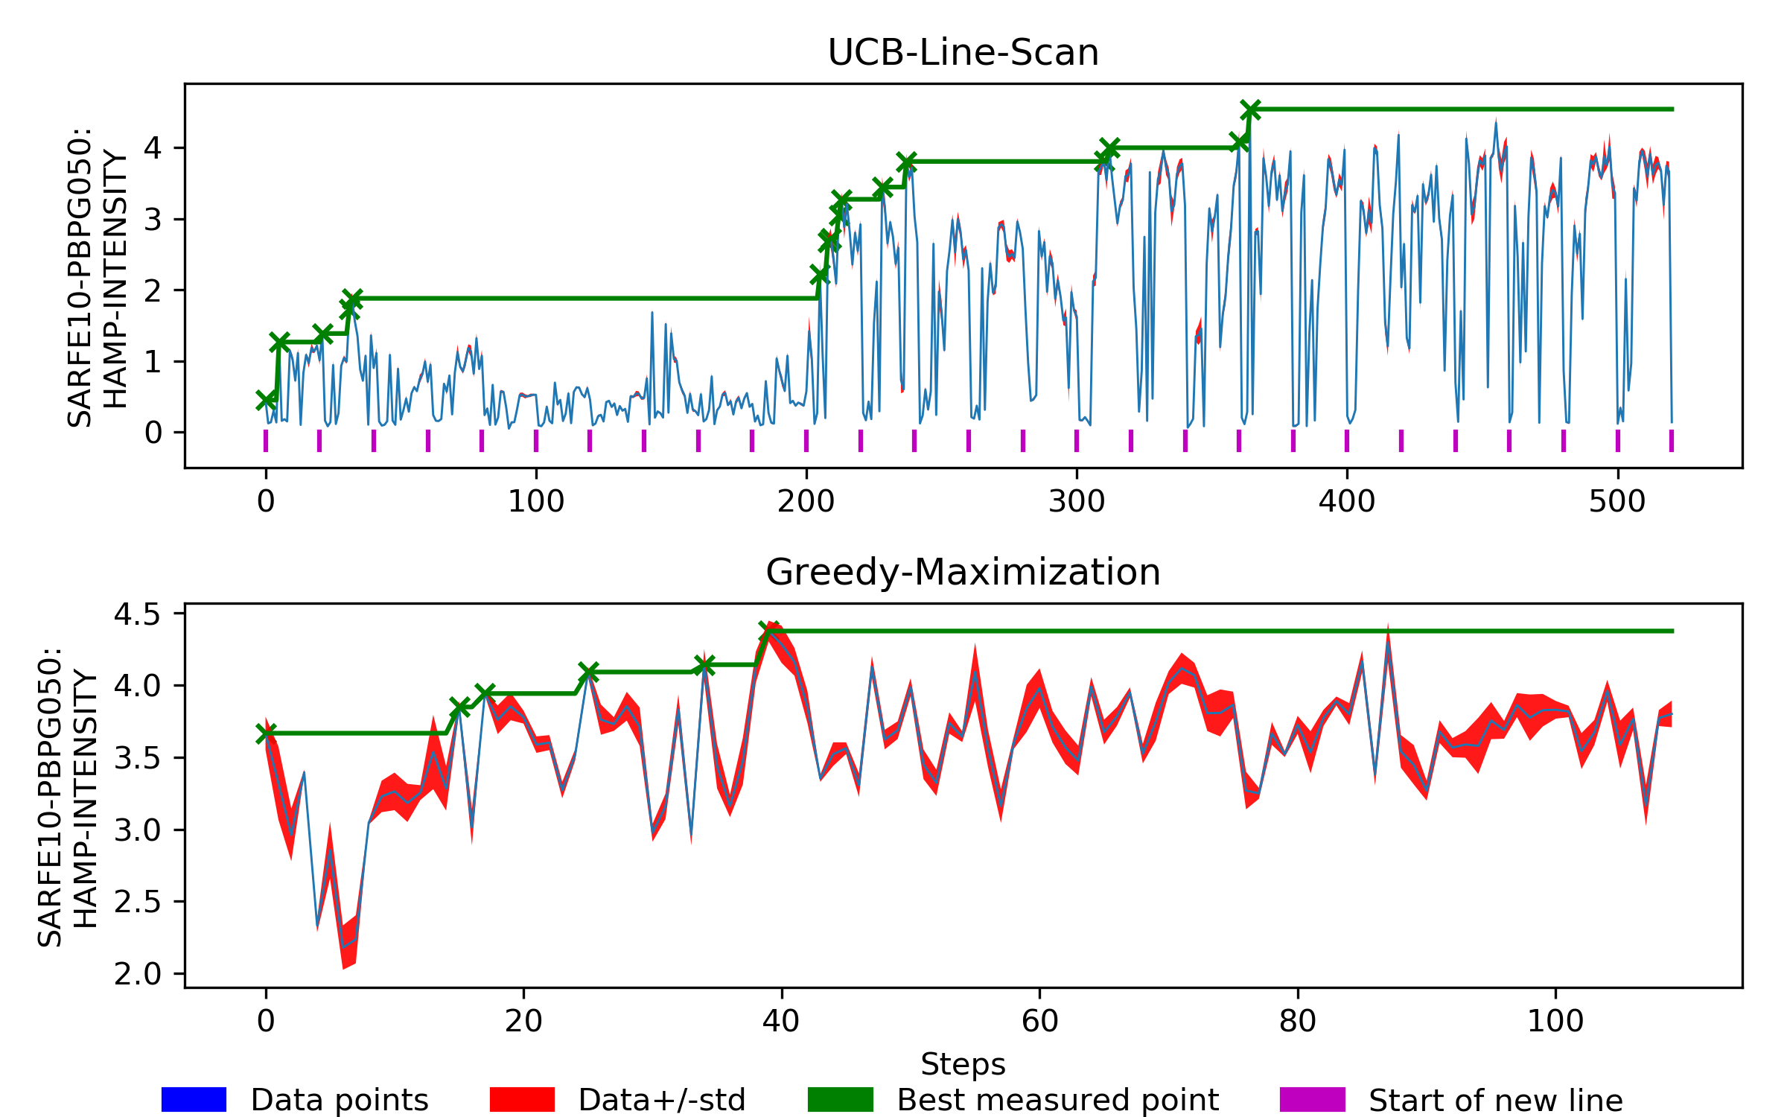
Results - Shift on Sun 23-Sep’18
Bayesian Line Optimisation (5D, run 2)
Target function: fast gas detector signal (HAMP)
10-shot mean + STD
FEL signal is recovered fully and even improved slightly

Slide 10
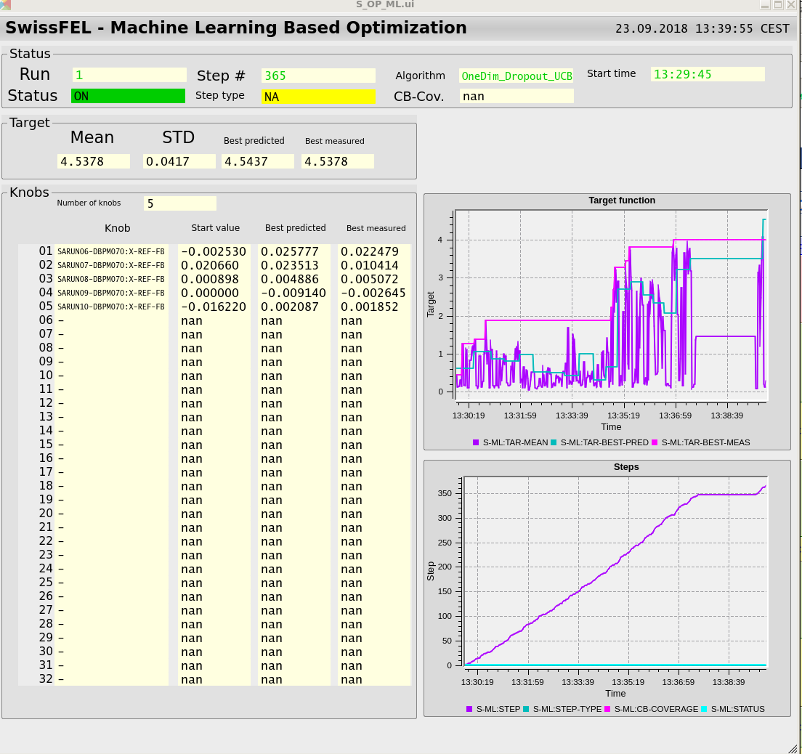
Results - Shift on Sun 23-Sep’18
Progress plot: Current measured, best predicted, best measured
Bayesian Line Optimisation
Status of optimiser
5 Knobs: horizontal orbit for SARUN06-10
350 steps ~ 7 min
Step counter

Slide 11

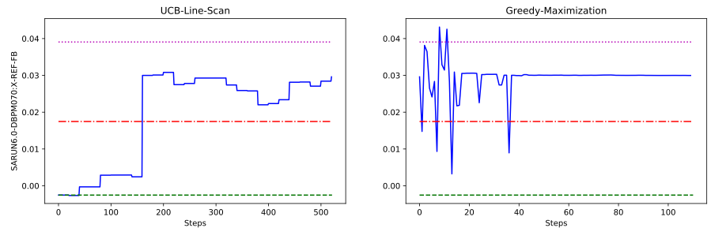
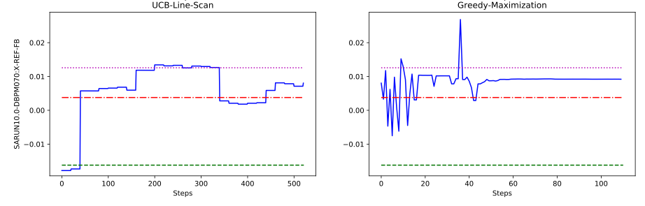
Results - Shift on Sun 23-Sep’18
SARUN06 X-Pos
SARUN10 X-Pos
Optimisation recovers FEL signal
At first glance, greedy maximization does not seem to improve much

Slide 12



SwissFEL Parameter Tuning
 | Operators | Random Walk | Nelder- Mead | Bayesian Optimization
Fast
Noise
Safe
Uses Data
Global
Many Parameters
Icons from icons8
Notes:
Why is this not an "out-of-the-box" approach (yet)? Hyperparameter, Not easy to use in high dimensions ( > 5), Success stories, SLAC

Slide 13
Outlook
Improve algorithms
  Reduce Number of Evaluations
  Selecting Hyperparameters
  Heteroscedastic Noise
Faster convergence
  Combine Nelder-Mead and Bayesian Optimization
  Subspace Detection
Systematic Benchmarking
Create an easy to use tool for control room
ETH: Work on theory behind optimization

Slide 14
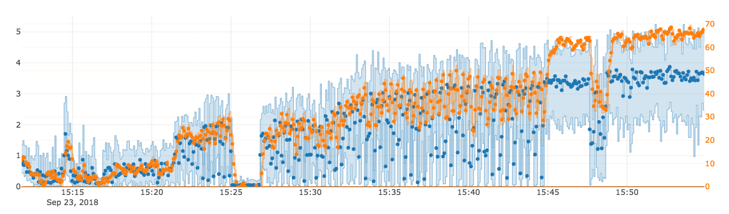
How can we progress?
Offline Algorithm Development and Testing
Dedicated Shifts for Benchmarking
Live Tuning during Machine Setup
Tuned 12 BPM target positions from almost no signal.
Start of coordinate scans
Greedy opt for fine-tweaking
RF failure
Start of opt.
µJ
Stopping after 1300 steps
Slow gas detector signal
Fast gas detector signal

Slide 15
Backup

Slide 16
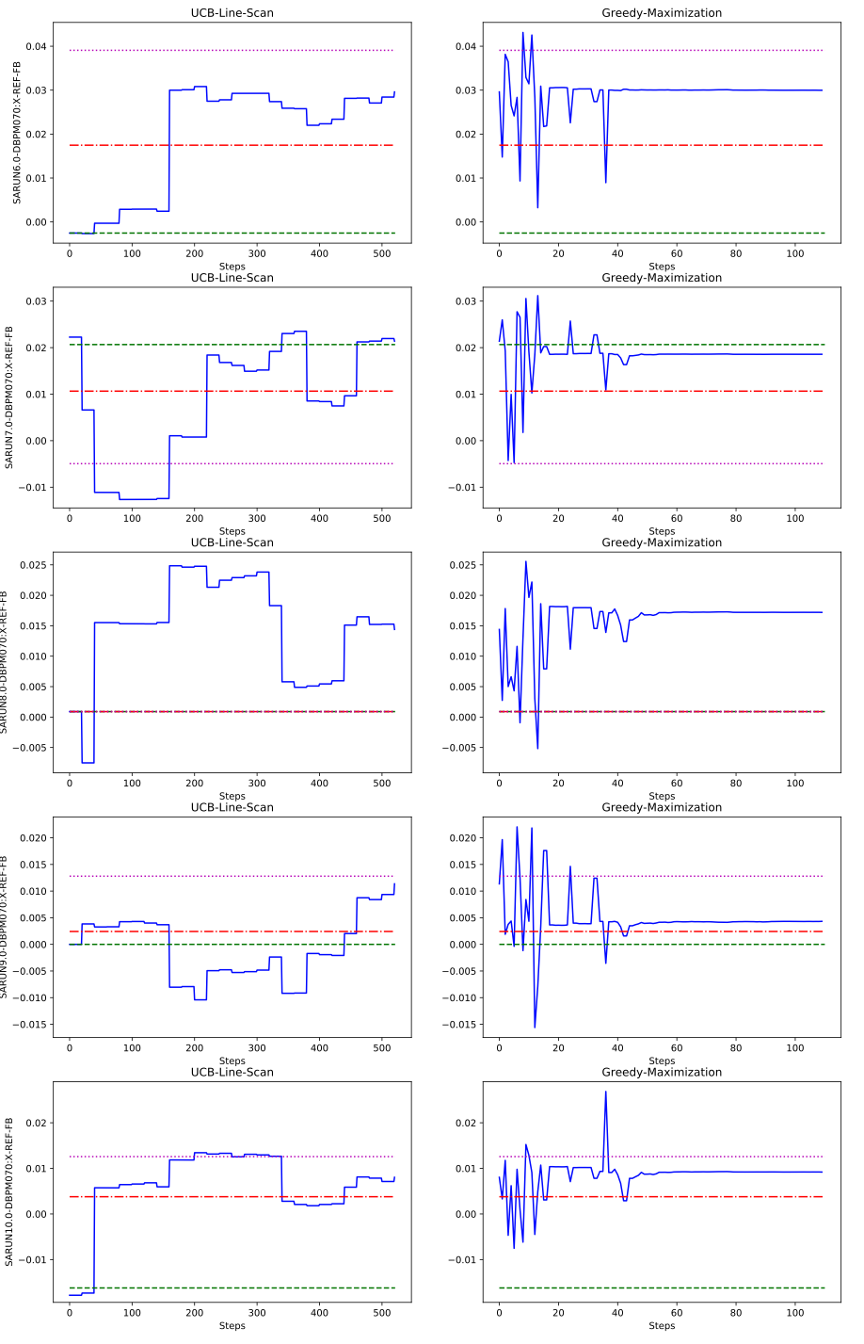
Results - Shift on Sun 23-Sep’18
Plots for all 5 Parameters
We do not come back to exactly the same settings prior to detuning, but we do recover the FEL signal and even gain some

Slide 17
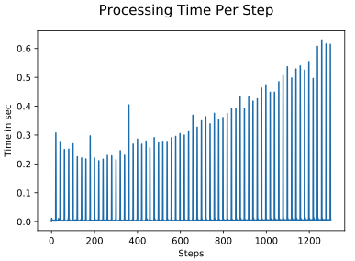
Results - Shift on Sun 23-Sep’18
For 12 parameter optimisation
Step to start a new random direction takes longest

