Slide 1
Laser heater at SwissFEL
S. Bettoni
A.Dax, M.Huppert, C. Vicario

Slide 2
Outlook
Laser heater characterization and calibration:
  Longitudinal and transverse overlap laser- e- beam
  Induced energy spread
  Heating of the bunch: shaping and uniformity along the bunch (at the injector)
Microbunching at the injector:
  Structures along the pulse for several compression factors
  Effect of the laser heater
Impact of the laser heater at the end of the machine (feed-backs closed):
  Heating along the bunch (at the injector)
  FEL intensity as a function of the LH intensity
  Some considerations about the measurements setup
Bunch generated using the stretched Alcor:
  Scan of the pulse length vs charge
  Structures along the pulse for several compression factors
  Effect of the microbunching on the monitors in the compression feed-backs
KAs beams
  Slice energy spread as a function of the compression factor and slice energy spread at the injector
  Microbunching
Impact of the laser heater at the end of the machine(feed-backs open):
  Heating along the bunch (at SARCL)
  FEL intensity as a function of the LH intensity
Conclusions
Jaguar
Stretched Alcor (Gaussian)

Slide 3
Outlook
Laser heater characterization and calibration:
  Longitudinal and transverse overlap laser- e- beam
  Induced energy spread
  Heating of the bunch: shaping and uniformity along the bunch (at the injector)
Microbunching at the injector:
  Structures along the pulse for several compression factors
  Effect of the laser heater
Impact of the laser heater at the end of the machine (feed-backs closed):
  Heating along the bunch (at the injector)
  FEL intensity as a function of the LH intensity
  Some considerations about the measurements setup
Bunch generated using the stretched Alcor:
  Scan of the pulse length vs charge
  Structures along the pulse for several compression factors
  Effect of the microbunching on the monitors in the compression feed-backs
KAs beams
  Slice energy spread as a function of the compression factor and slice energy spread at the injector
  Microbunching
Impact of the laser heater at the end of the machine(feed-backs open):
  Heating along the bunch (at SARCL)
  FEL intensity as a function of the LH intensity
Conclusions
Jaguar
Stretched Alcor (Gaussian)

Slide 4
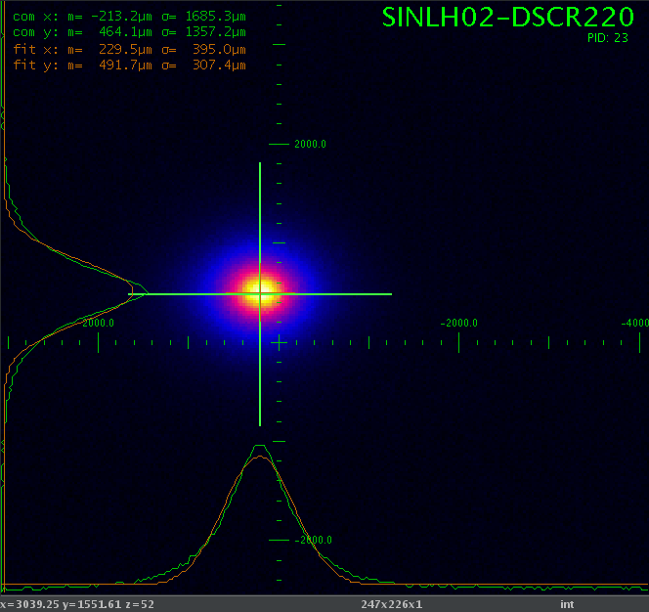
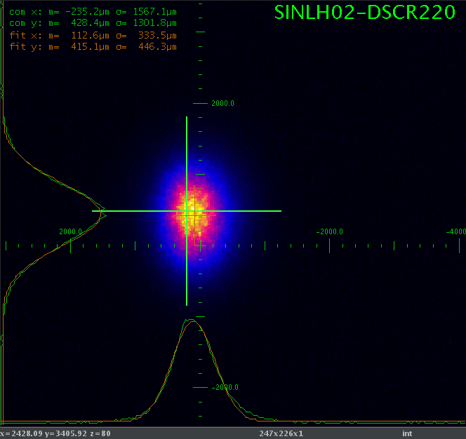
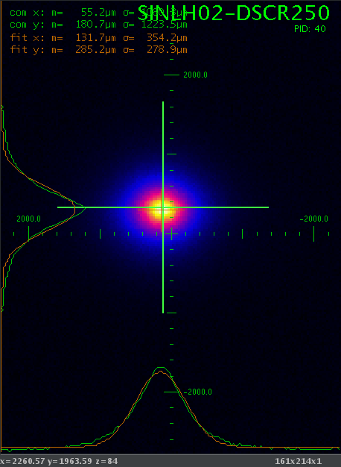
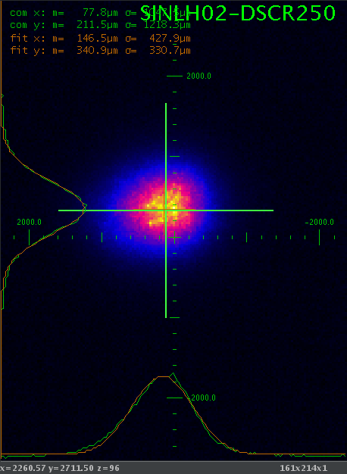
Transverse laser vs e- alignment
Enabled the feed-back for e- and laser (?)
Both beams observed on the Chromox screen
Only e-
Only laser
DSCR220
DSCR250
Beam sizes difference (photons vs e-):
 | DSCR220 | DSCR250
X | 38% | 20%
Y | 45% | 18%

Slide 5
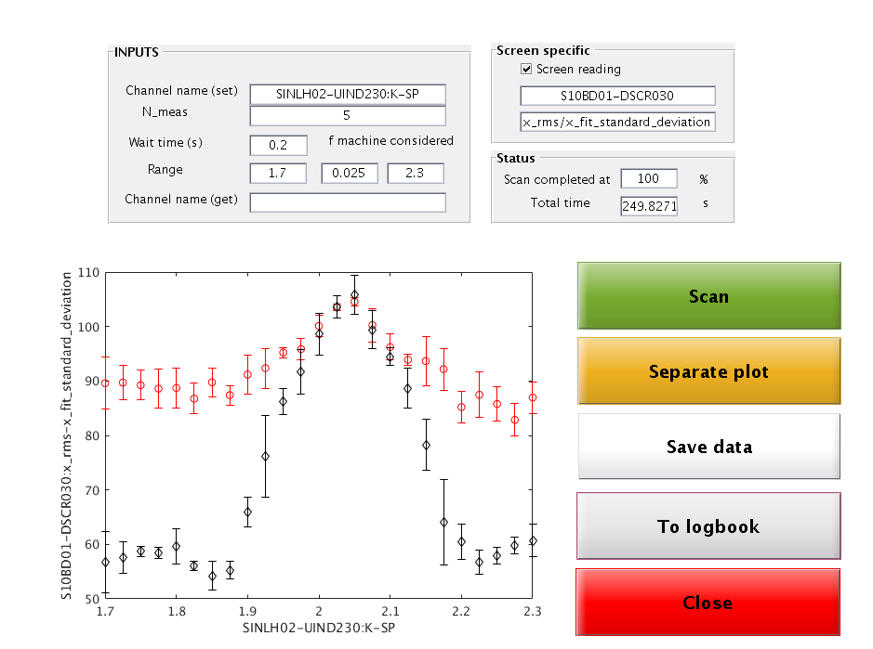
K optimization
Scan of the K of the undulator looking at the induced energy spread
Scan performed using the Alcor laser to heat the beam
sinc(K) expected

Slide 6
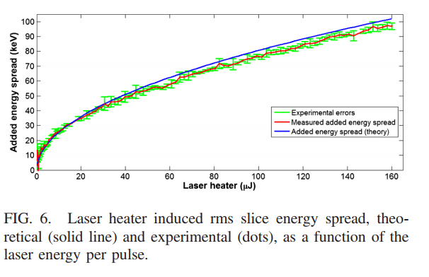
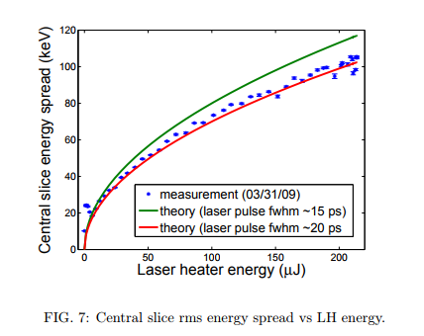

Beam heating
$$∆E=σ_{x} ∙\frac{E_{0}}{D_{x}} where σ_{x}= \sqrt{{σ_{LH ON }}^{2}−{σ_{LH OFF }}^{2}}$$
FERMI
SWISSFEL
SwissFEL
Core beam
Projected beam
LCLS
Baseline energy reader
LH laser: Jaguar
Injector laser: Alcor

Slide 7
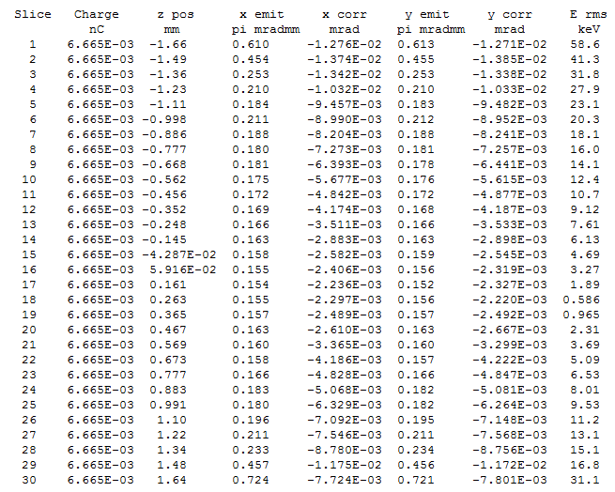

Slice energy spread at the injector
Increasing laser energy
Granularity of the induced energy spread: step size<0.5 keV
$$∆E∝sqrt\left(P_{Laser}\right)$$
DE ~ 6.4 keV for P_{Laser} = 0 uJ

Slide 8
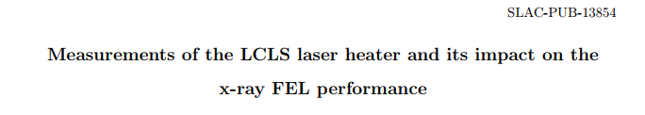
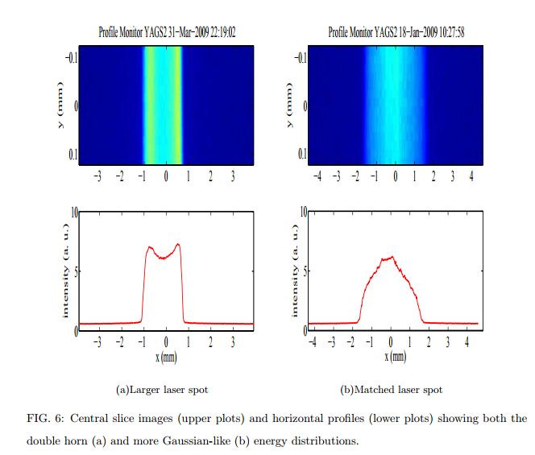
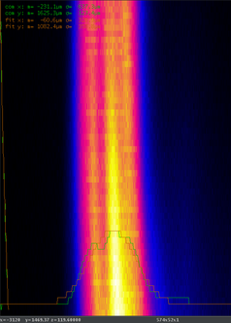
Beam heating along the bunch
Check if the laser and the e- beam spot size are at the correct values (transverse)
SwissFEL
It seems that we have already a good “heating shape”
Another day tried with other 2 beam sizes, and the best heating with the first one

Slide 9
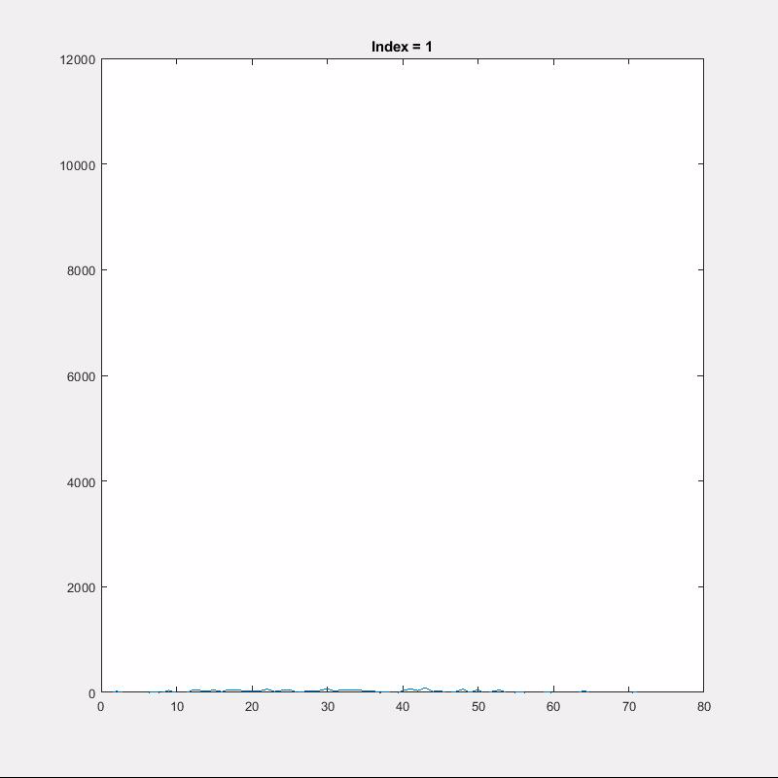
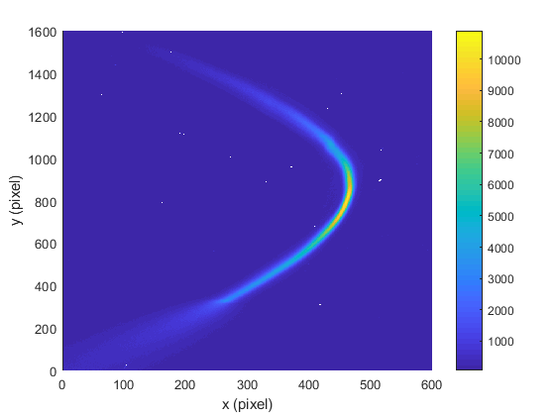
LH AND injector laser: analysis
To determine the heating along the bunch:
  I cut in y
  I compute the profile in x at each selected y
  I determine sigma_x (proportional to energy spread via dispersion)
N slices = 100

Slide 10
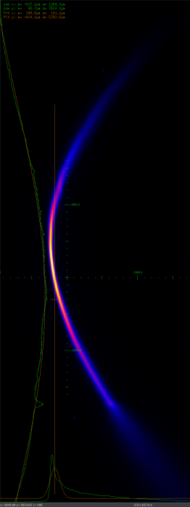
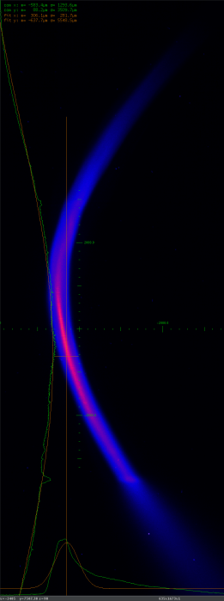
Heating along the bunch (LH-Jaguar)
More precise analysis:
  I cut in y
  I compute the profile in x at each selected y
  I plot the sigma_x (proportional to energy spread via dispersion)
LH laser: Jaguar
Injector laser: Alcor
LH off
LH on

Slide 11
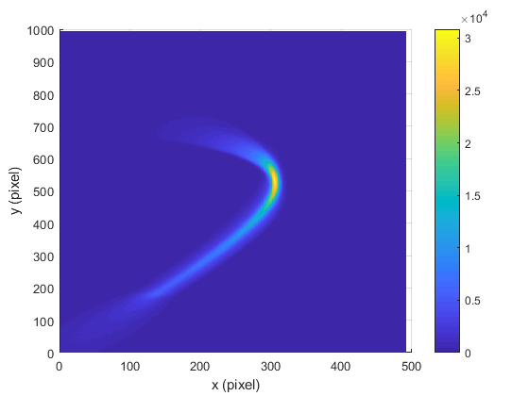
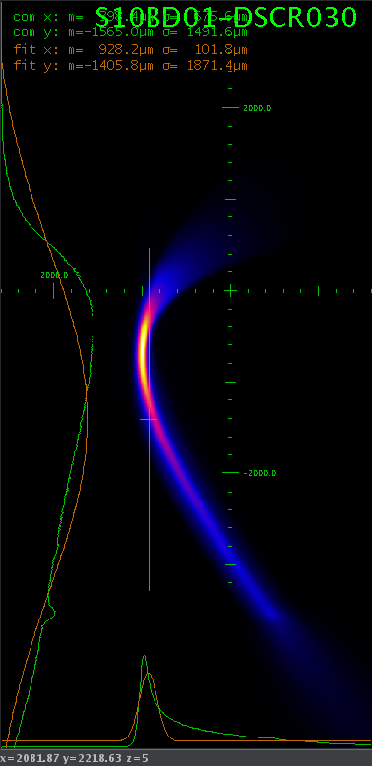
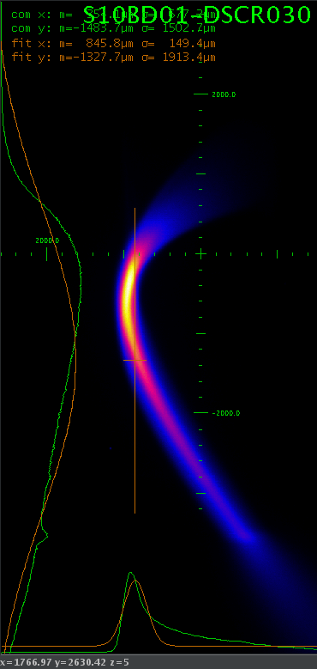
Heating along the bunch (LH-Alcor)
I cut in y
I compute the profile in x at each selected y
I do Gauss fit
LH laser: Alcor
Injector laser: Alcor
LH off
LH on
Uniform heating along the bunch

Slide 12
Outlook
Laser heater characterization and calibration:
  Longitudinal and transverse overlap laser- e- beam
  Induced energy spread
  Heating of the bunch: shaping and uniformity along the bunch (at the injector)
Microbunching at the injector:
  Structures along the pulse for several compression factors
  Effect of the laser heater
Impact of the laser heater at the end of the machine (feed-backs closed):
  Heating along the bunch (at the injector)
  FEL intensity as a function of the LH intensity
  Some considerations about the measurements setup
Bunch generated using the stretched Alcor:
  Scan of the pulse length vs charge
  Structures along the pulse for several compression factors
  Effect of the microbunching on the monitors in the compression feed-backs
KAs beams
  Slice energy spread as a function of the compression factor and slice energy spread at the injector
  Microbunching
Impact of the laser heater at the end of the machine(feed-backs open):
  Heating along the bunch (at SARCL)
  FEL intensity as a function of the LH intensity
Conclusions
Jaguar
Stretched Alcor (Gaussian)

Slide 13
Structures vs compression
Change the compression factor at BC1 and I measure at the injector spectrometer
I change the compression factor (fixed R56), so I modify the equivalent time step on the spectro screen
→ same “read” frequency → the f of the structure scales exactly with the compression factor

Slide 14
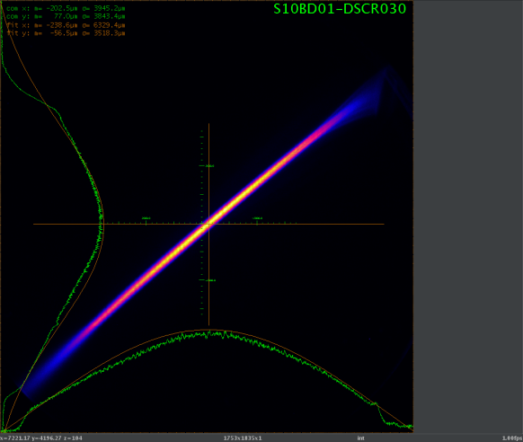
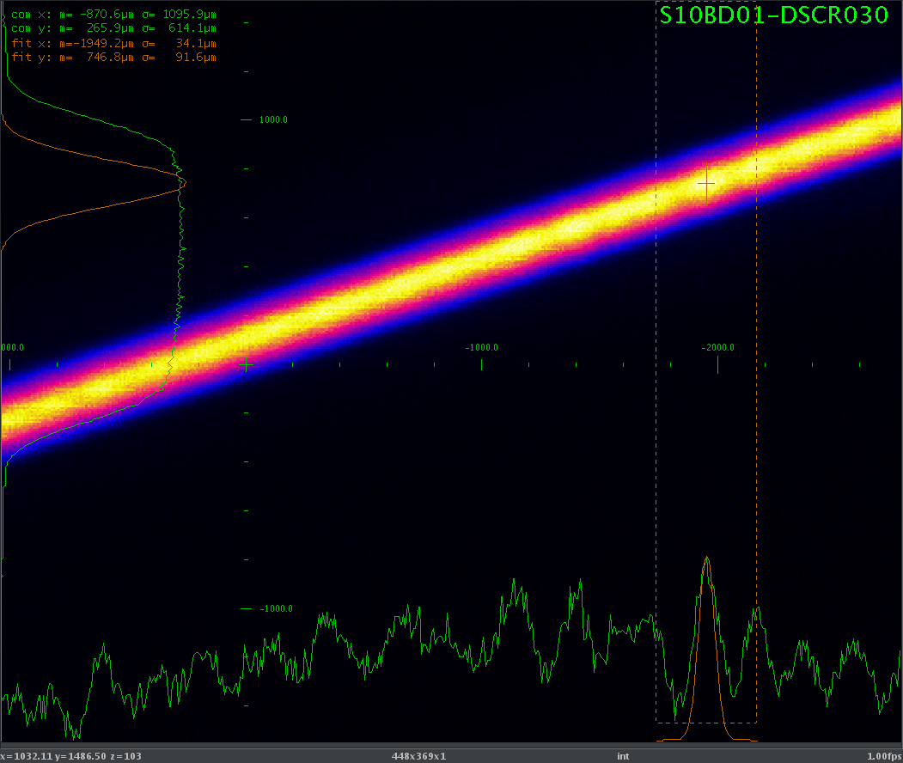
Longitudinal phase space injector
Peak current ~160 A from 14 A: CF = 11.5
Q = 200 pC, E = 300 MeV
S10BD01-MQUA010: 14.428 A
We observe some structures with the Jaguar, but only in energy, not in time

Slide 15
Energy vs time correspondence
The structures are tilted to be perpendicular to the x (energy) axis
A way to retrieve the time (and frequency) information
2.5 ps (p2p) corresponds to 240 pixel at the TDC screen
The bunch length does not change between the TDC screen and the spectrometer screen
At the spectrometer screen 2000 pixels correspond to 2.5 ps
7.4% amplitude modulation
One pixel corresponds to 1.25 fs at the spectrometer screen
I use this info to compute the frequency of the modulation

Slide 16
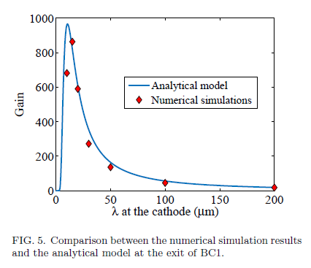
Comparison to model
I normalize the profile to have integral 200 pC
I remove the smoothed profile
I compute the equivalent current modulation and fft
I select the window of integration
I multiply the wavelength by the compression factor at BC1 to compute that at the cathode
Assumed compression factor = 10
ANALYSIS
MEASURMENTS RESULTS
SIMULATIONS
Cs2Te has a response time ~1 ps (1 THz-300 um), so all the components with periodicity<300 um are expected to be damped more than with copper
With Cu different dynamics expected (response time ~few hundreds fs): more structures at wavelength<300 um expected

Slide 17
LH off vs LH on
Assumed compression factor = 10
MEASURMENTS RESULTS
SIMULATIONS
The laser heater efficiently damps the modulations (we do not know the distribution of the noise on the initial distribution)
Comment about the resolution: 1.25 fs → 0.37 um. If I want 5 points to define the modulation → 1.85 um visible → 18.5 um at the cathode

Slide 18
Time plane
It seems to be “only” some noise in time

Slide 19
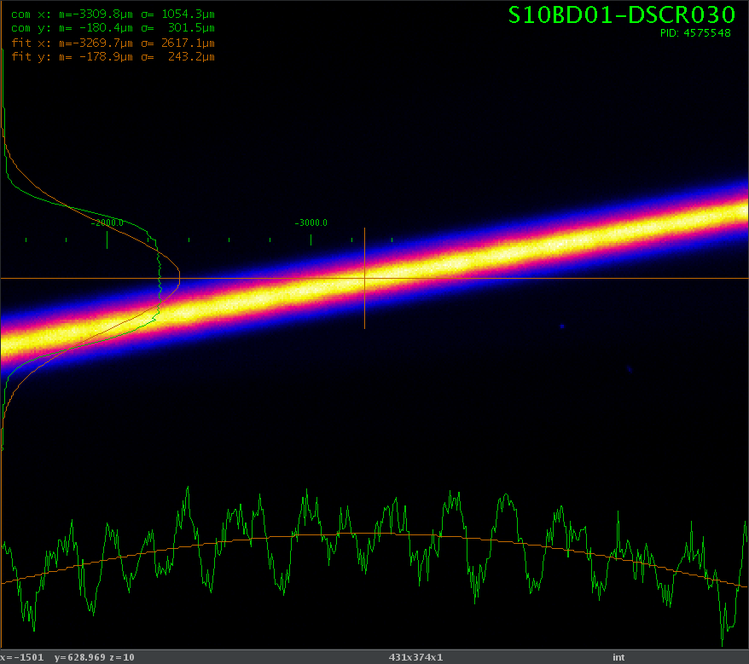
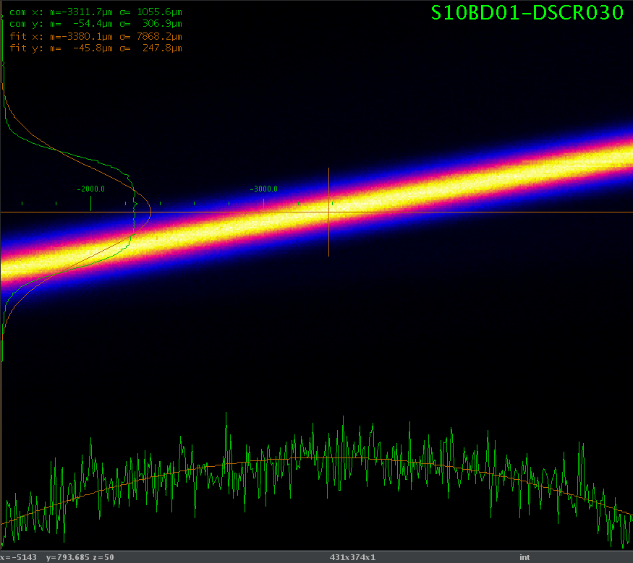
Laser heater impact: more in detail
Zoom (change of the ROI) on the bunch at the injector spectrometer
Scan of the LH laser energy for different filters (large step size) and changing the wave plate (fine tuning)
LH off
LH on

Slide 20
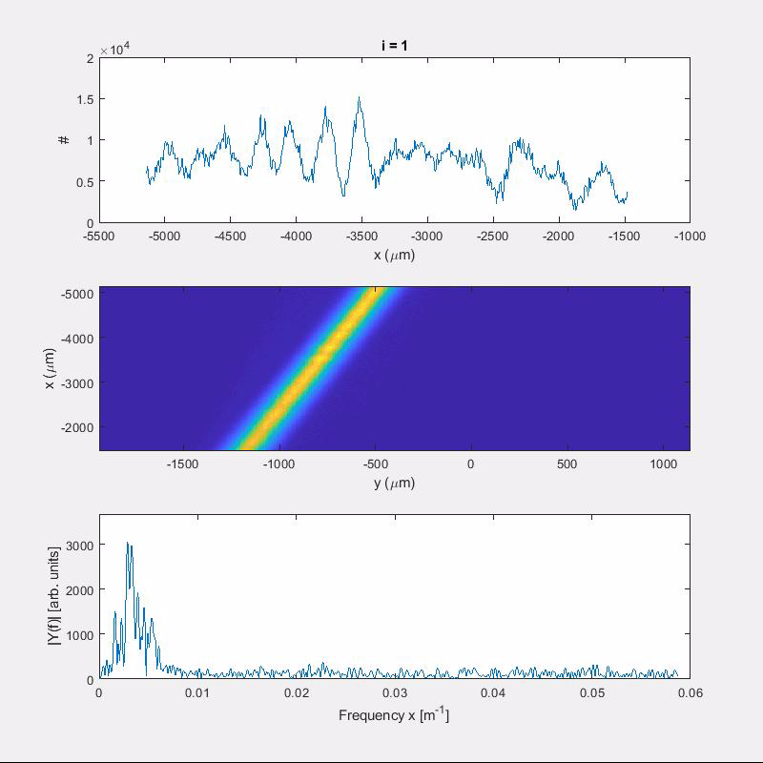
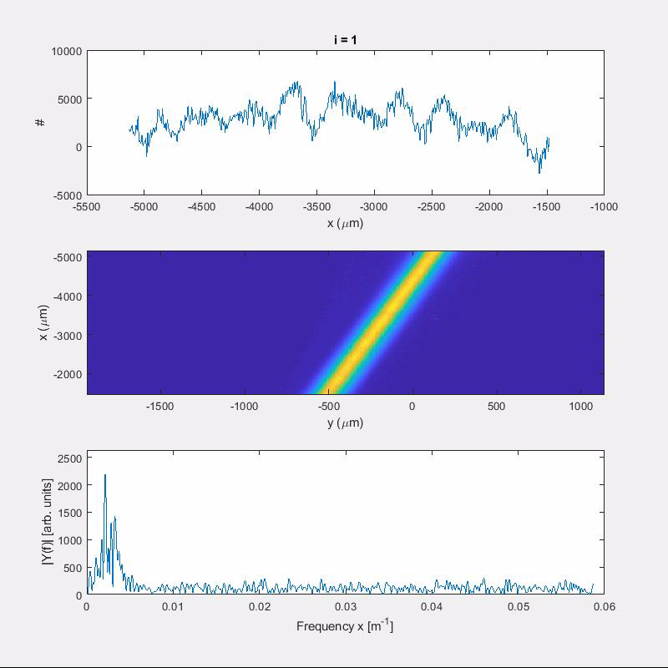
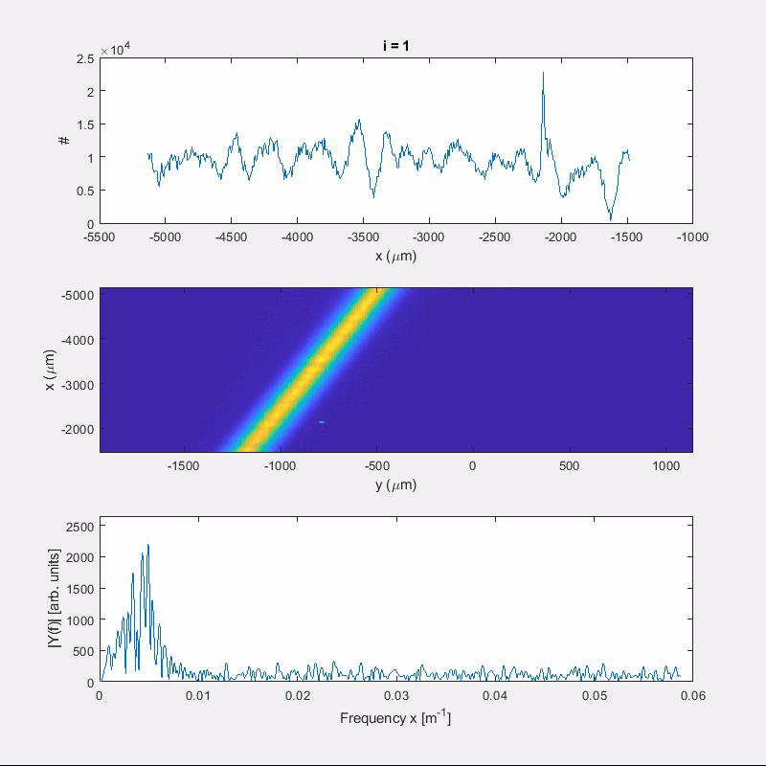
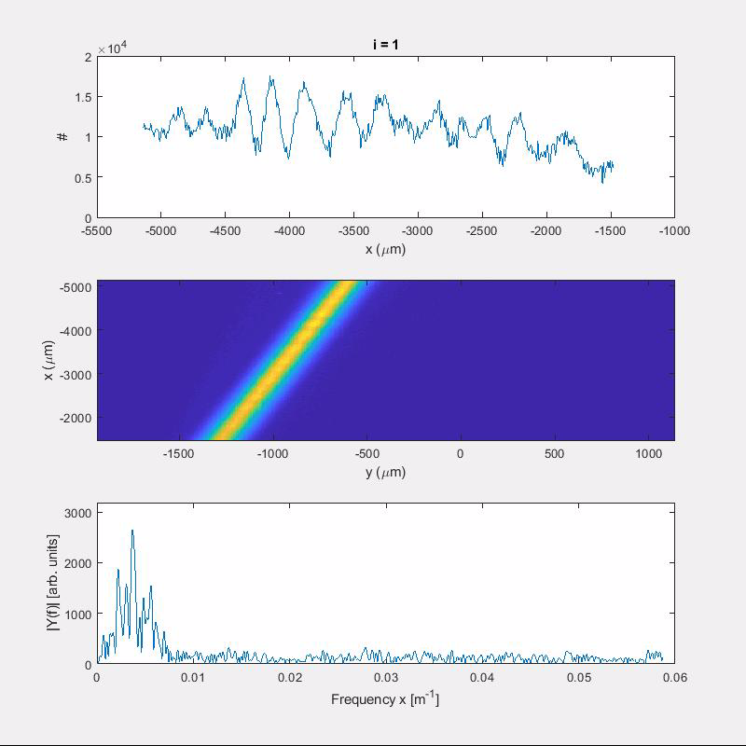
Modulations vs LH intensity-energy plane
ND = 0.5
ND = 0
ND = 4
ND = 2

Slide 21
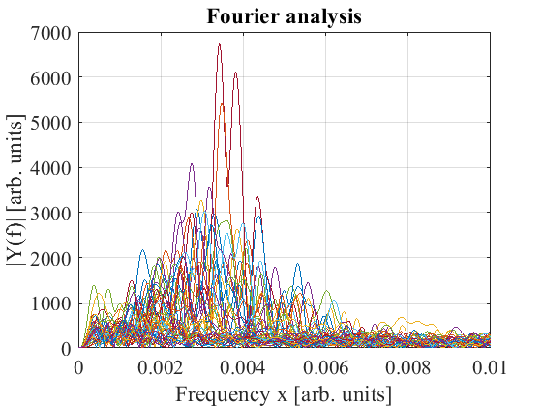
Modulations vs LH intensity-energy plane
Filter ND = 0.5
Filter ND = 0
Filter ND = 0.5
Dependency on the intensity of the laser heater
Overlap among the different cases
Filter ND = 2
Filter ND = 4

Slide 22
Modulations vs LH intensity-time plane
Filter ND = 0
Filter ND = 4
Filter ND = 4
Some noise observed: not related to the LH on or off

Slide 23
Outlook
Laser heater characterization and calibration:
  Longitudinal and transverse overlap laser- e- beam
  Induced energy spread
  Heating of the bunch: shaping and uniformity along the bunch (at the injector)
Microbunching at the injector:
  Structures along the pulse for several compression factors
  Effect of the laser heater
Impact of the laser heater at the end of the machine (feed-backs closed):
  Heating along the bunch (at the injector)
  FEL intensity as a function of the LH intensity
  Some considerations about the measurements setup
Bunch generated using the stretched Alcor:
  Scan of the pulse length vs charge
  Structures along the pulse for several compression factors
  Effect of the microbunching on the monitors in the compression feed-backs
KAs beams
  Slice energy spread as a function of the compression factor and slice energy spread at the injector
  Microbunching
Impact of the laser heater at the end of the machine(feed-backs open):
  Heating along the bunch (at SARCL)
  FEL intensity as a function of the LH intensity
Conclusions
Jaguar
Stretched Alcor (Gaussian)

Slide 24
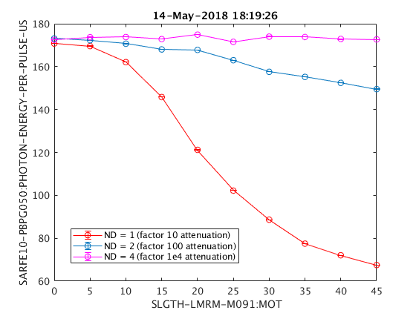
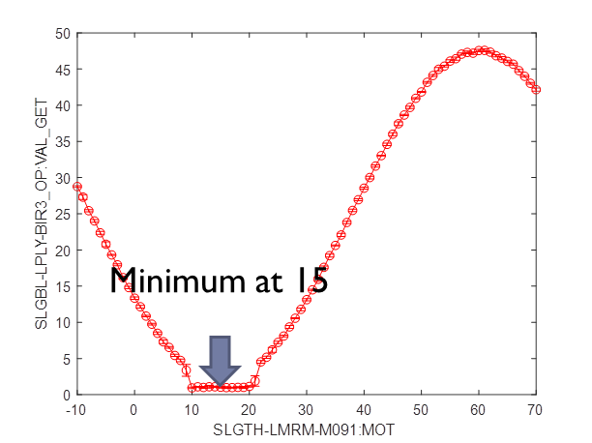
LH and lasing
May
In both cases not positive effect of the LH on the lasing
July

Slide 25
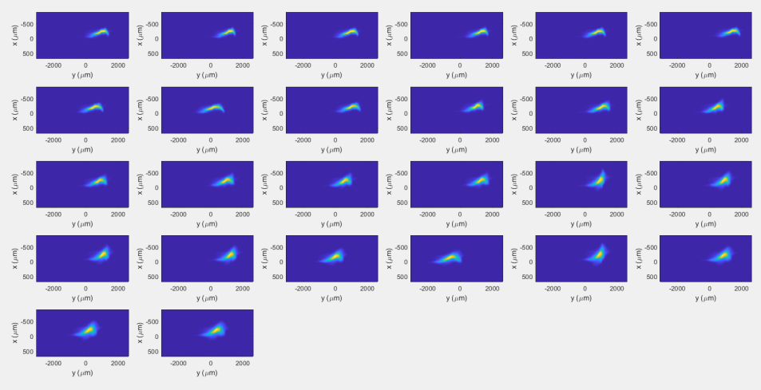
Heating at the end of the machine
Measurement of the slice energy spread at SARCL02:
  Scan over the energy of the LH laser intensity
  Scan over the filters
3 kA beam
Index increasing

Slide 26
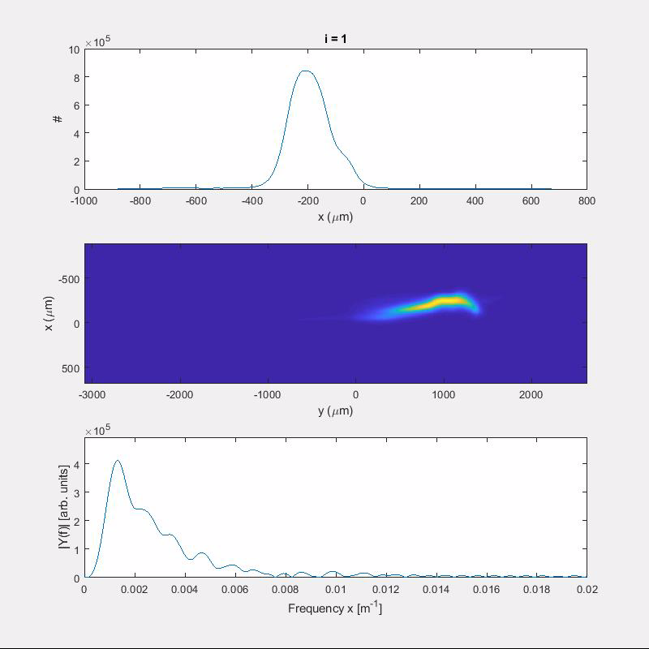
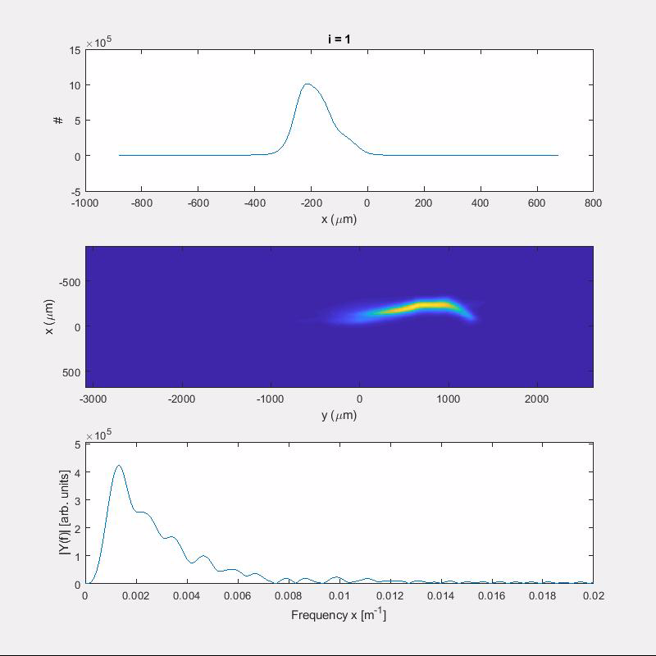
Heating-end of the machine-E plane
Filter ND = 1
Filter ND = 0.5

Slide 27
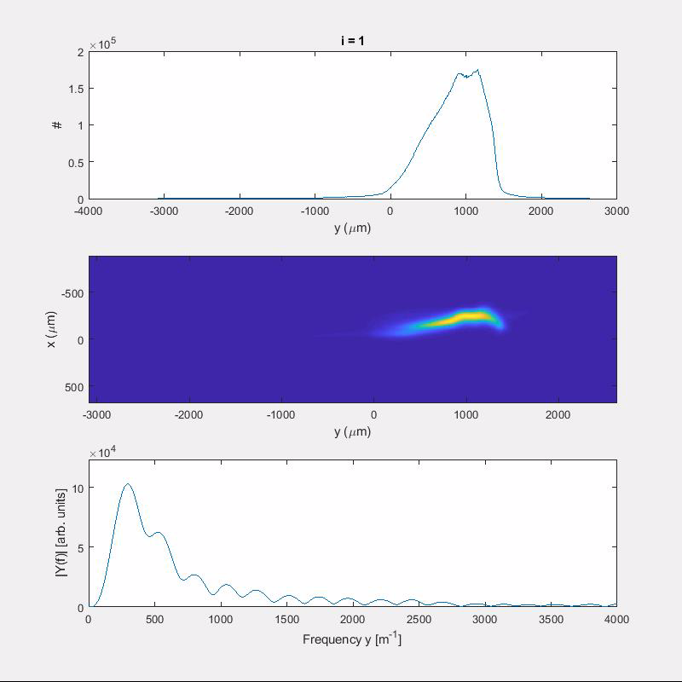
Heating-end of the machine-t plane
Filter ND = 1
Filter ND = 1
Filter ND = 0.3

Slide 28
Heating along the bunch-end of the machine
I cut in y (time) direction
I compute the profile in x (energy) at each selected y
I compute a Gaussian fit
I plot the sigma of the fit
I artificially shifted the plots
Kind of uniform heating along the bunch length
Increase of the energy spread at the head of the bunch increasing the laser intensity

Slide 29
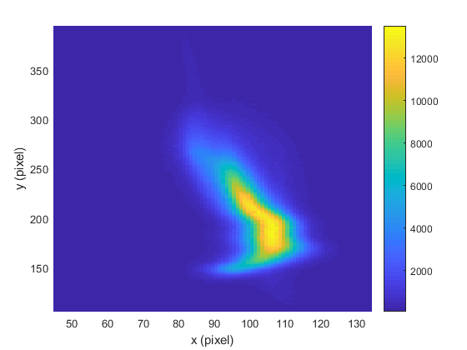
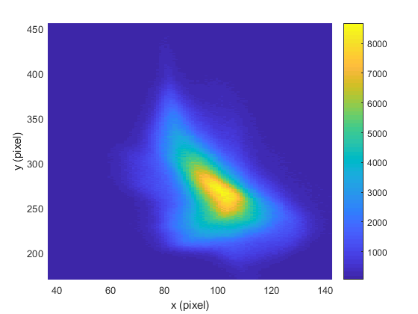
Large intensity of the LH laser
Index = 1
Index = 26
Observed a kind of explosion of the beam at the head increasing the intensity of the laser heater

Slide 30
Bunch length change during the scans
The LH damps the structures along the bunch
The reading of the compression monitor is reduced (not readable from Archiver-to be checked)
The compression feed-back (only BC1 in May and both in July) compress more the bunch
We move away from the optimum point for lasing (tapering, CSR kick, wakefield, …)

Slide 31
Outlook
Laser heater characterization and calibration:
  Longitudinal and transverse overlap laser- e- beam
  Induced energy spread
  Heating of the bunch: shaping and uniformity along the bunch (at the injector)
Microbunching at the injector:
  Structures along the pulse for several compression factors
  Effect of the laser heater
Impact of the laser heater at the end of the machine (feed-backs closed):
  Heating along the bunch (at the injector)
  FEL intensity as a function of the LH intensity
  Some considerations about the measurements setup
Bunch generated using the stretched Alcor:
  Scan of the pulse length vs charge
  Structures along the pulse for several compression factors
  Effect of the microbunching on the monitors in the compression feed-backs
KAs beams
  Slice energy spread as a function of the compression factor and slice energy spread at the injector
  Microbunching
Impact of the laser heater at the end of the machine(feed-backs open):
  Heating along the bunch (at SARCL)
  FEL intensity as a function of the LH intensity
Conclusions
Jaguar
Stretched Alcor (Gaussian)

Slide 32
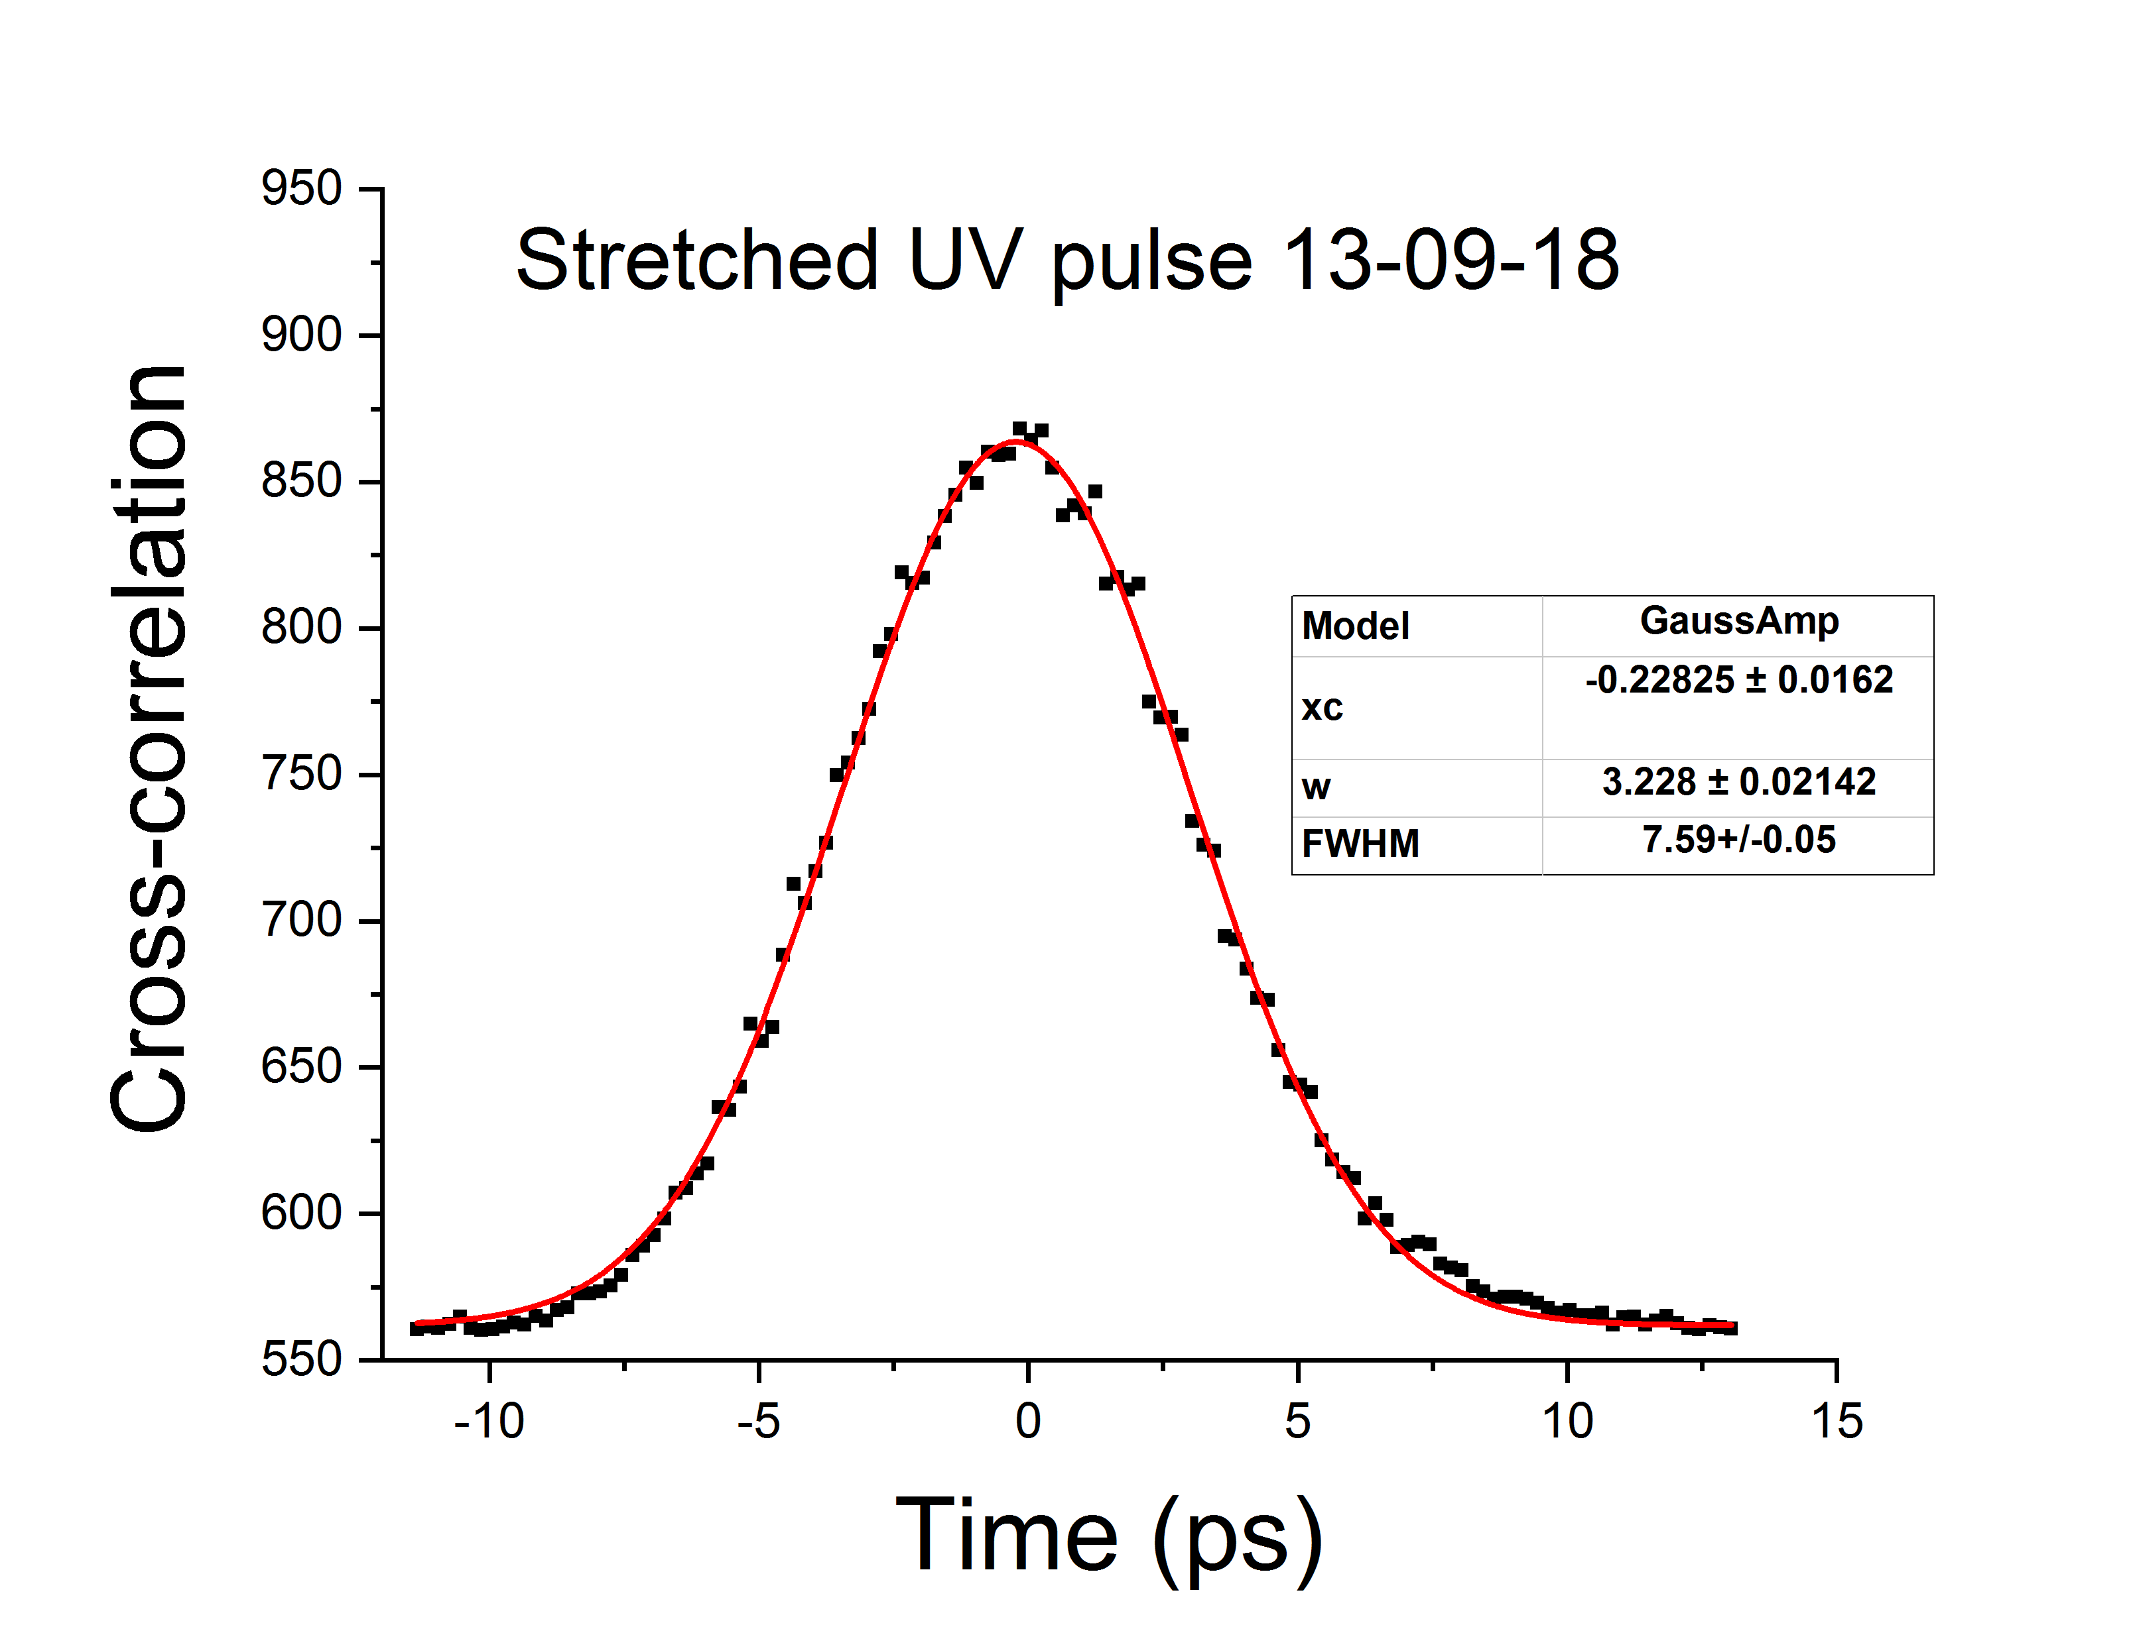
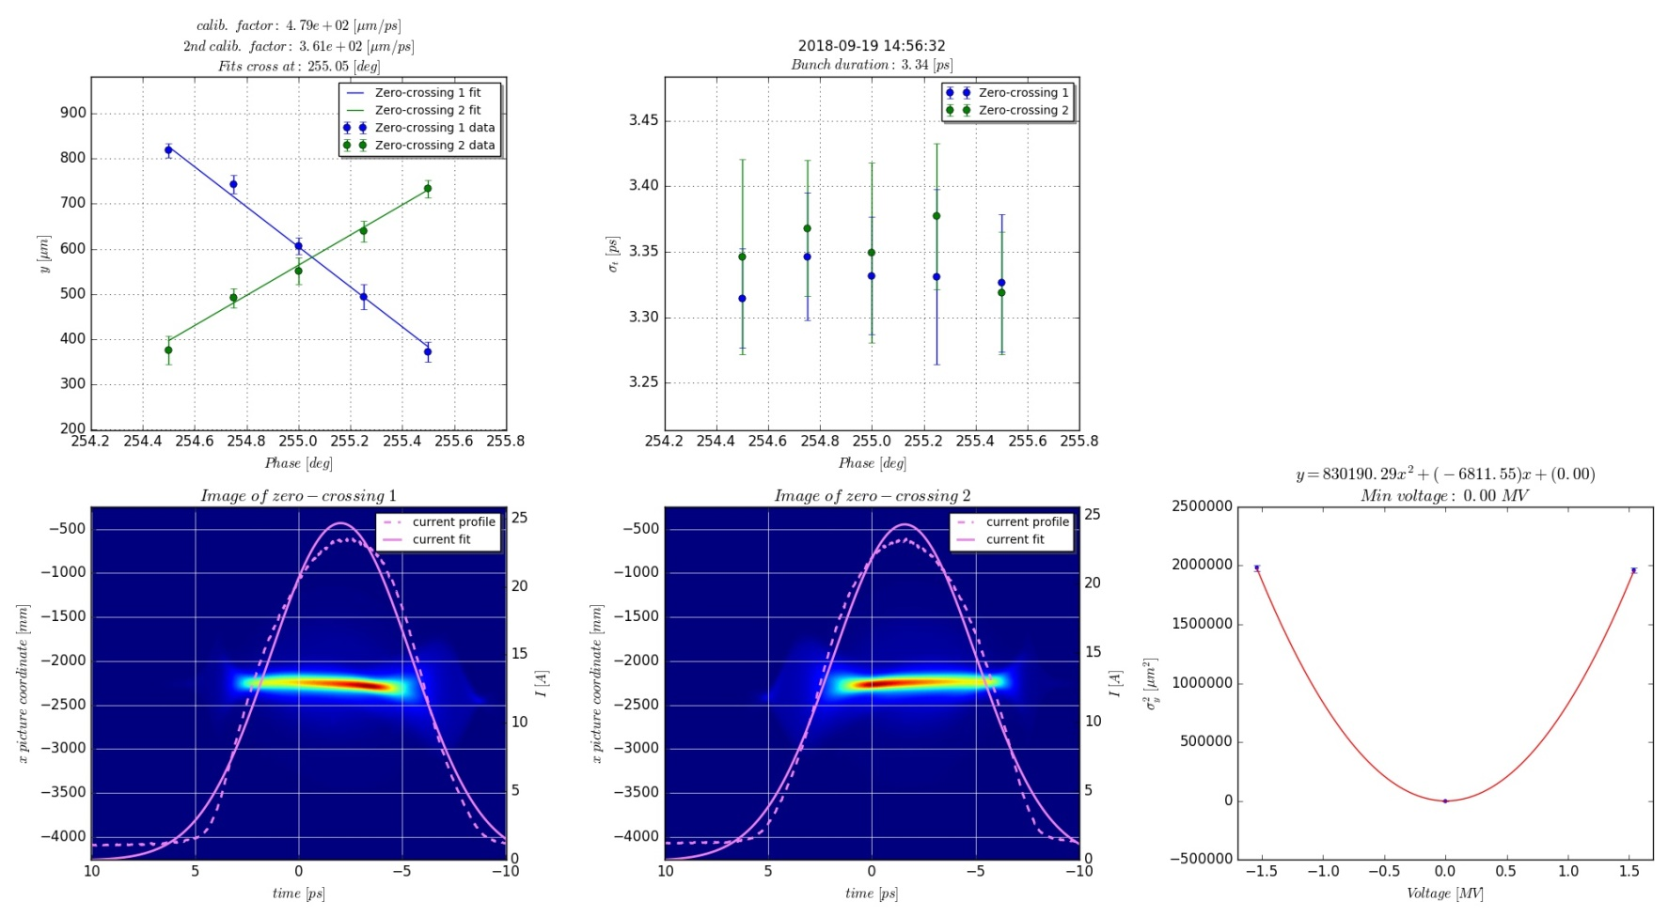
Bunch and laser at BC1 (uncompressed)
Q = 200 pC, BC1 straight, 90 degs in SINSB03/04, no SINXB, E = 300 MeV
Similar length as the cross-co measurement (different with Jaguar)

Slide 33
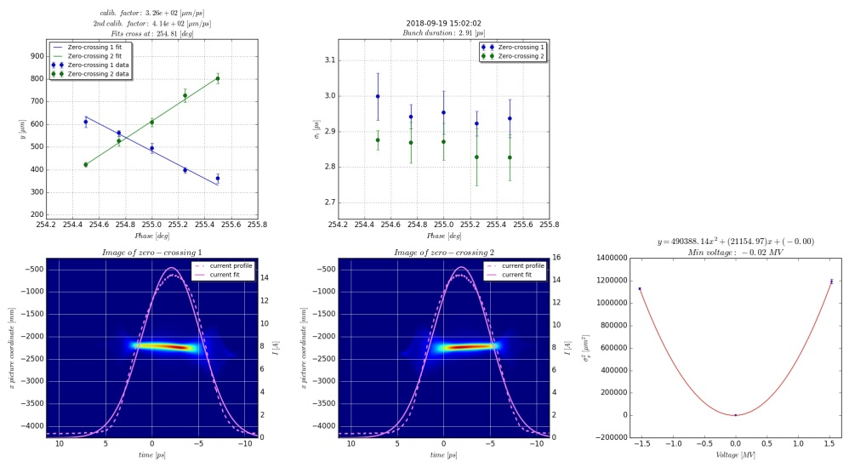
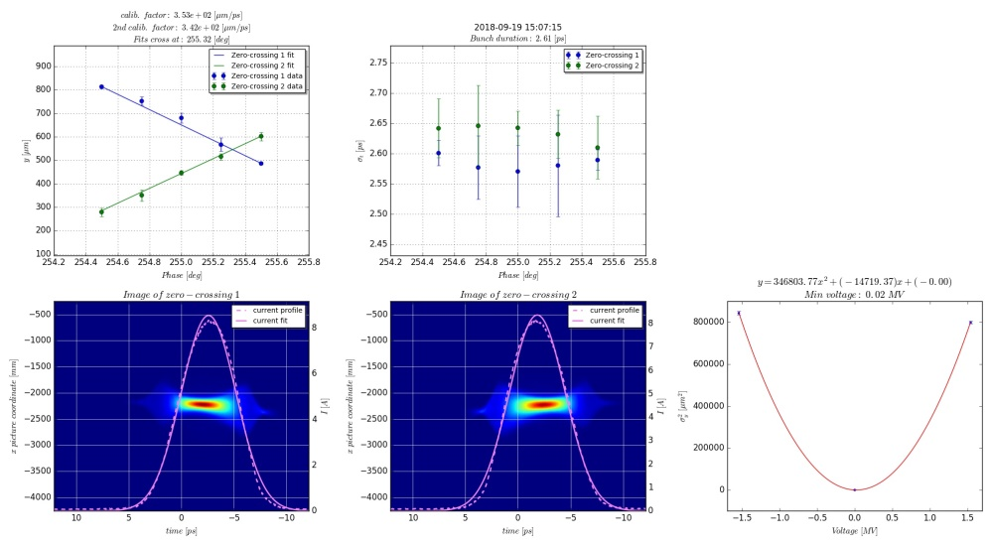
Pulse length for several charges
Q = 100 pC
Q (pC) | Sigma_t (ps)
200 | 3.34
100 | 2.91
50 | 2.61
Cross co | 3.23
Q = 50 pC

Slide 34
Some halo?
Observed some halo or screen effect?
Uncompressed bunches, BC1 straight, beam on crest
Q = 200 pC
Q = 100 pC
Q = 50 pC

Slide 35
Several bunch lengths, profiles
I scan the compression factor and I measure the longitudinal current profile
Sigma_t = 170 fs
Sigma_t = 620 fs
Sigma_t = 250 fs
Sigma_t = 1.37 ps

Slide 36
LH off/LH on
I do the fft of the longitudinal profile removed the smoothed part
Less pronounced the structures compared to the Jaguar laser at similar compression factor
LH off
LH on

Slide 37
Outlook
Laser heater characterization and calibration:
  Longitudinal and transverse overlap laser- e- beam
  Induced energy spread
  Heating of the bunch: shaping and uniformity along the bunch (at the injector)
Microbunching at the injector:
  Structures along the pulse for several compression factors
  Effect of the laser heater
Impact of the laser heater at the end of the machine (feed-backs closed):
  Heating along the bunch (at the injector)
  FEL intensity as a function of the LH intensity
  Some considerations about the measurements setup
Bunch generated using the stretched Alcor:
  Scan of the pulse length vs charge
  Structures along the pulse for several compression factors
KAs beams
  Effect of the microbunching on the monitors in the compression feed-backs
  Heating along the bunch
  Slice energy spread as a function of the current
Impact of the laser heater at the end of the machine(feed-backs open):
  Heating along the bunch (at SARCL)
  FEL intensity as a function of the LH intensity
Conclusions
Jaguar
Stretched Alcor (Gaussian)

Slide 38
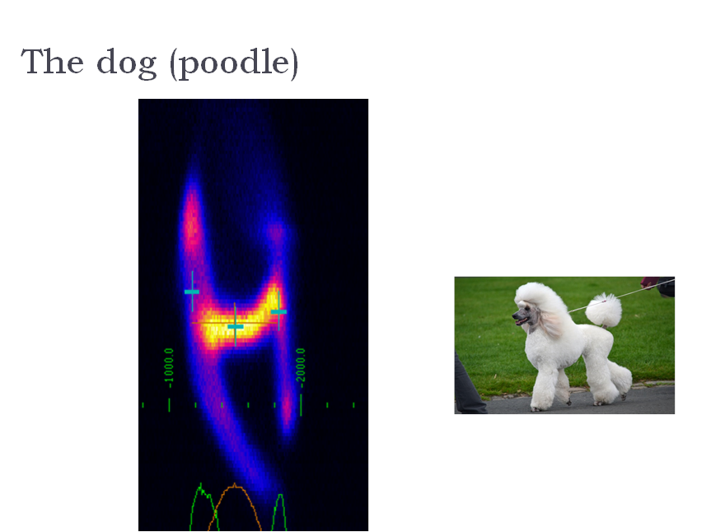
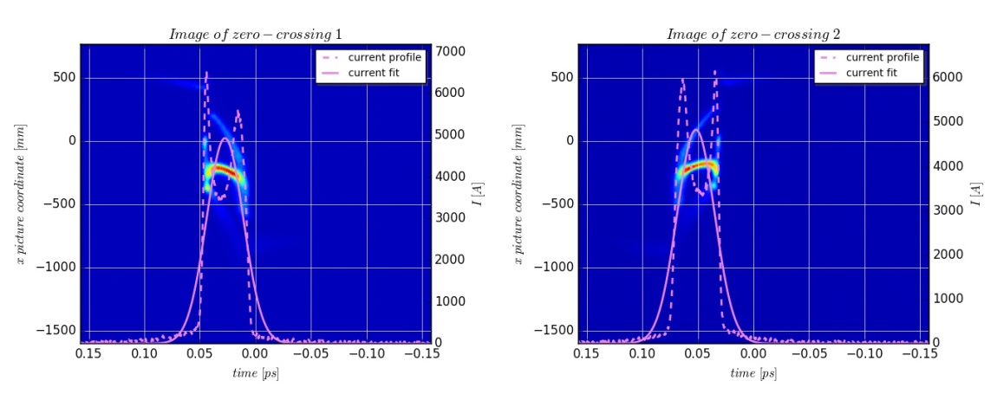
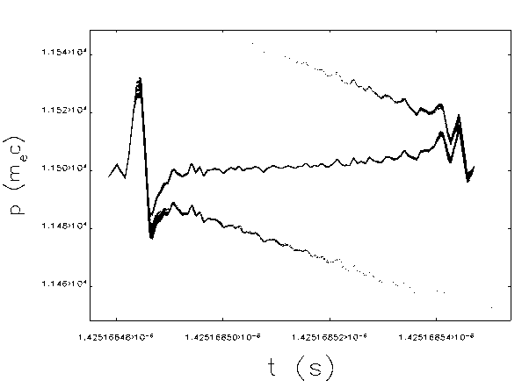
Beam in SARCL02
Elegant simulations
E
t

Slide 39
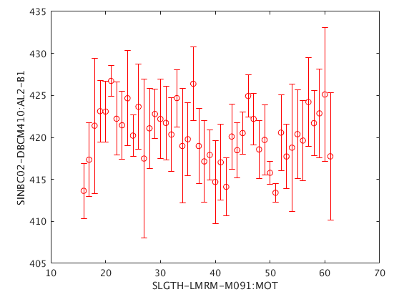
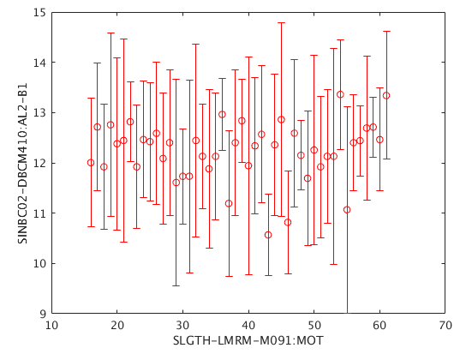
Compression monitors: BC1
For sigma_t = 0.17 ps and 1.37 ps I scan the compression monitor reading in BC1 vs the laser heater energy:7981 and 7982
No appreciable effect

Slide 40

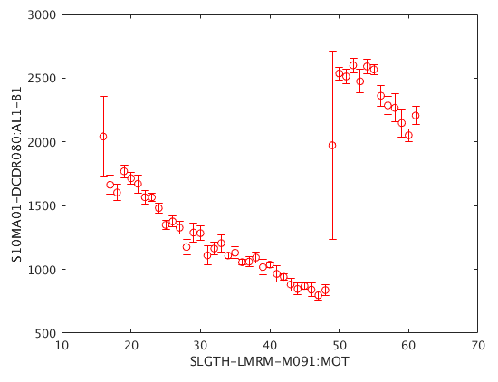
Compression monitors: BC2
Set-up the 3 kA beam and scan of the energy of the laser LH intensity
Sensitive at BC2
Filter automatically inserted during the scan

Slide 41

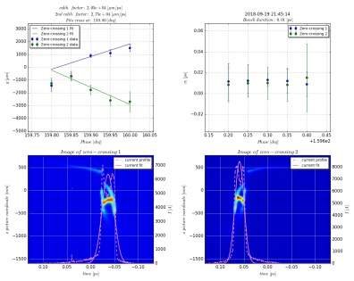
kAs beam
I change the compression factor (nominal peak current and more) to try to enhance the microbunching structures
I = 3.2 kA, FWHM ~92 fs
I = 5.5 kA, FWHM ~33 fs
Not appreciable enhancement observed

Slide 42
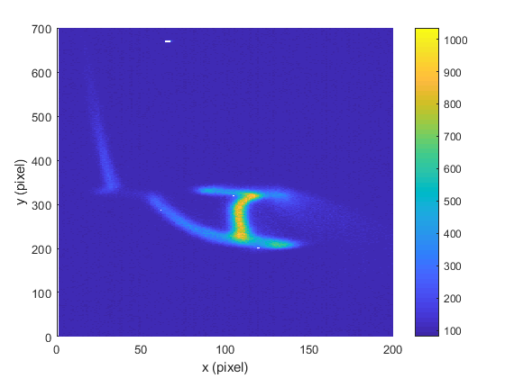
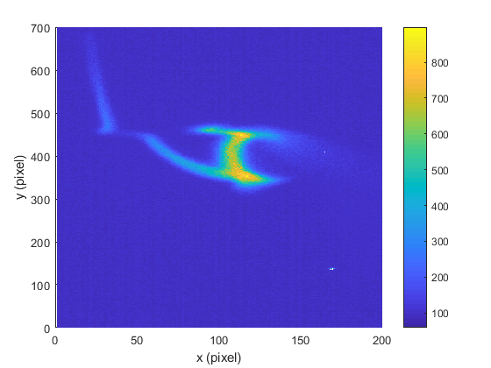
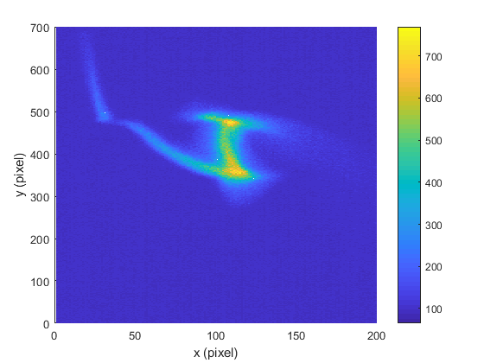
Heating along the bunch-SARCL02
Verify that we are still heating uniformly the beam along its length
Point 1: minimum LH intensity
Point 12: intermediate
I do not do the fit if the intensity is below a threshold
Point 23: high LH intensity

Slide 43
Outlook
Laser heater characterization and calibration:
  Longitudinal and transverse overlap laser- e- beam
  Induced energy spread
  Heating of the bunch: shaping and uniformity along the bunch (at the injector)
Microbunching at the injector:
  Structures along the pulse for several compression factors
  Effect of the laser heater
Impact of the laser heater at the end of the machine (feed-backs closed):
  Heating along the bunch (at the injector)
  FEL intensity as a function of the LH intensity
  Some considerations about the measurements setup
Bunch generated using the stretched Alcor:
  Scan of the pulse length vs charge
  Structures along the pulse for several compression factors
  Effect of the microbunching on the monitors in the compression feed-backs
KAs beams
  Slice energy spread as a function of the compression factor and slice energy spread at the injector
  Microbunching
Impact of the laser heater at the end of the machine(feed-backs open):
  Heating along the bunch (at SARCL)
  FEL intensity as a function of the LH intensity
Conclusions
Jaguar
Stretched Alcor (Gaussian)

Slide 44




Compression settings-SARCL02
Feed-back = 1519 (lasing)
Feed-back = 2000
Feed-back = 2550
Feed-back = 3500

Slide 45
Slice energy spread
For the different compression factors measured the slice energy spread at SARCL02
Resolution limit ~ 1 MeV
Assumed dispersion = 0.1 m (corrected from previous slide plots)
New optics with D = 0.4 m to improve the resolution

Slide 46

FEL scans-lasing beam
I measure the FEL intensity (fast signal) as a function of the laser intensity of the LH
Scan repeated for several filters
I ~ 1 kA

Slide 47
FEL scans at feed-back 3500
I measure the FEL intensity (fast signal) as a function of the laser intensity of the LH
Scan repeated for several filters

Slide 48
Conclusions
  Microbunching instability seems to be smaller than expected assuming instantaneous photoemission:
    Spectral analysis shows qualitative agreement with the model response of the machine
    Analysis at SARCL02 did not show evidence of structures neither in energy nor in time (resolution limited?)
    Some structures visible using SRM and they are damped using the LH
  Laser heater commissioning:
    Setup completed:
      Longitudinal and transverse alignments done
      Induced energy spread as a function of the laser energy measured
    The system produces uniform heating along the bunch : measurements at injector spectrometer and at SARCL02
    The system is powerful enough to dump the energy structures (step size also good-less than 0.5 keV)
    Repeated the measurements using the stretched Alcor instead of the Jaguar: similar conclusions, but for Jaguar less pronounced structures (to be checked again for confirmation)
  Effect of the laser heater on the microbunching instability:
    FEL intensity is not increased by the laser heater: scans repeated for several peak currents and lasers
  More measurements:
    More “straight forward” measurements:
      Measurements at SARCL02 using new optics x4 dispersion to improve the resolution, useful also for compression scans
    More demanding but “answering” measurements:
      Spectral content and FEL scan using a copper cathode
Microbunching instability is less detrimental than expected from simulations, where 0 response time cathode were assumed

Slide 49
Conclusions
  Microbunching instability seems to be smaller than expected assuming instantaneous photoemission :
    Spectral analysis shows qualitative agreement with the model response of the machine
    Analysis at SARCL02 did not show evidence of structures neither in energy nor in time (resolution limited?)
    Some structures visible using SRM and they are damped using the LH
  Laser heater commissioning:
    Setup completed:
      Longitudinal and transverse alignments done
      Induced energy spread as a function of the laser energy measured
    The system produces uniform heating along the bunch : measurements at injector spectrometer and at SARCL02
    The system is powerful enough to dump the energy structures (step size also good-less than 0.5 keV)
    Repeated the measurements using the stretched Alcor instead of the Jaguar: similar conclusions, but for Jaguar less pronounced structures (to be checked again for confirmation)
  Effect of the laser heater on the microbunching instability:
    FEL intensity is not increased by the laser heater: scans repeated for several peak currents and lasers
  More measurements:
    More “straight forward” measurements:
      Measurements at SARCL02 using new optics x4 dispersion to improve the resolution, useful also for compression scans
    More demanding but “answering” measurements:
      Spectral content and FEL scan using a copper cathode
Microbunching instability is less detrimental than expected from simulations, where 0 response time cathode were assumed

Slide 51

Measurements at SITF (with stacking)
Comparison Cu vs Cs2Te for different compression factors with the stacking
16 stacks
Cu
MEASUREMENTS
MEASUREMENTS
8 stacks
Cs2Te
SIMULATIONS

Slide 52
Answers possible with Cu cathode
More intense microbunching instability at lambda~50 um or smaller wavelengths
Positive effect of the LH on FEL or not?
Best scenario: Cs2Te damps the microbuching in the range of frequency of high gain
Worst scenario: Cs2Te increases the slice energy spread
Instability is damped (at the e- emission), and we do not need LH to heat it
We have already high energy spread from the beginning
EXAMPLE PLOT

Slide 53
LH more or less intense
Less laser intensity
More laser intensity

Slide 54
“Equivalent” current profile
About 10 A over 135: 7.4%

Slide 55






Some comments about Alcor
Uncompressed bunch very well optimized (optimizer by Martin)
If the optimization has to be done looking at the compressed bunch some modifications to the code are necessary (stabilization of the bunch)
t
In this condition along the machine longitudinal phase space strongly deformed, like observed at SITF (LSC+compression). Possible to see the energy structures generated by the stacking.
Time
Energy
Energy
Wavelength of the modulations:
  16 stacks → 187.5 um
  8 stacks → 375 um
  32 stacks → 93.8 um
LH off
LH on

Slide 56




Comparison Alcor vs Jaguar
Alcor
Energy spread to be multiplied by 9 (assumed dispersion = 0.9 m but it is 0.1 m)
Jaguar

Slide 57




Compression settings-SARCL01
I check if the bunch length/peak current are correct at SARCL01
SARCL02
SARCL01
Feed-back at 3500
Feed-back at 2550

Slide 58
Stacking wavelengths
Number of stacked pulses | Wavelength (um)
128 | 23.4
64 | 46.9
32 | 93.8
16 | 187.5
8 | 375.0

Slide 59

Pulse profile and response time

Slide 60
Slice energy spread vs peak current (July)
I change the compression factor and I measure the slice energy spread along the bunch

Slide 61
Slice energy spread @ injector
I average over ±5 slices around the central slice
I remove the contribution of the intercept
From the compression factor I compute the expected slice energy spread at the injector
Blue: 3.9 ± 0.4 keV
Red: 4.20 ±0.07 keV

Slide 62


Bunch compression (Jaguar)
Semi-analytical approach implemented in the machine (Dohlus et al., PRST-AB):
  Set-up of the desired compression factor
  Tuning of the 2nd order demonstrated
Measured peak current (A)
Target peak current (A)

Slide 63


Estimation of the DE_0
I fit the induced energy spread as a function of the laser energy, and I compute the expected energy spread
$$∆E∝sqrt\left(P_{Laser}\right)$$
The result indicates ~6 keV

Slide 64




Beam heating optimized (May)
LH off
LH on
y
y
E
E
TDC off
t
t
E
E
TDC on

Slide 65



Multi-stage bunch compression
Computation of the RF settings to compress the beam and shape the current profile known the current profile beam correlations (δ∗) and the machine energy profile (E*)
RF settings (unknowns)
Machine-beam parameters
Method which allows shaping the current profile:
  Knob 1: controls the compression factor
  Knob 2: controls the location of the peak current along the bunch
  Knob 3: controls the concavity

Slide 66



Compression factor control
  Computed the RF settings given the machine and beam settings to have a given compression factor
  Discrepancy < 4% at compression factor of 12 (slightly better than the nominal 10) between set and obtained compression factor (if phases in the injector are properly set: error <0.1 deg)
  Energy at the compressors and downstream kept constant
  Quadrupoles scaled between SINSB04 and BC1 scaled: optics invariant
  Quadrupoles scaled between BC2 and S10CB08 (energy feed-back): optics invariant
Possible scans during the FEL optimization (starting setup)
Time
Energy

Slide 67



Second order current control
Knob2₀+Δ
knob2₀
Knob2₀−Δ
Time
Energy

Slide 68
Modulations vs LH intensity-time plane
Filter ND = 0
Filter ND = 4
Zoom
Same height and spread of the “modulations”: noise or not enough resolution

Slide 69


LH on and off-heating
Lasers:
  Photoinjector: Alcor
  Laser heater: Jaguar
  index_y_start = 700; index_y_end = 1000; index_y_step = 25;
Pixel
700
800
900
Reconstructed the intensity variation of the Jaguar profile

