Slide 1

Michael Böge, Accelerator Physicist, Paul Scherrer Institut
Introduction
2nd RULe Topical WS on Injection and Injection Systems, 04/01/19

Slide 2

https://indico.psi.ch/event/6972
Page <number>
Notes:
<number>

Slide 3
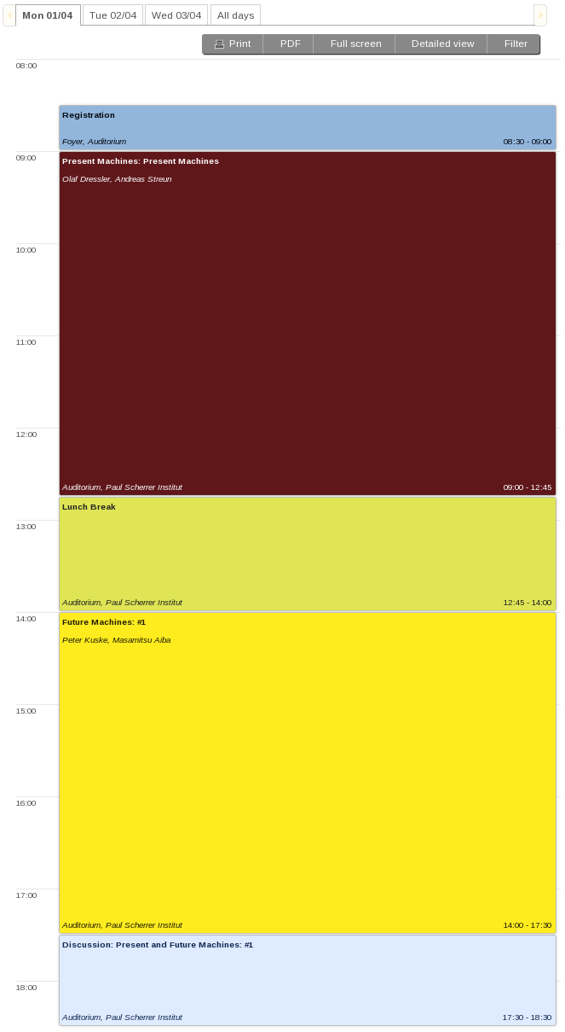
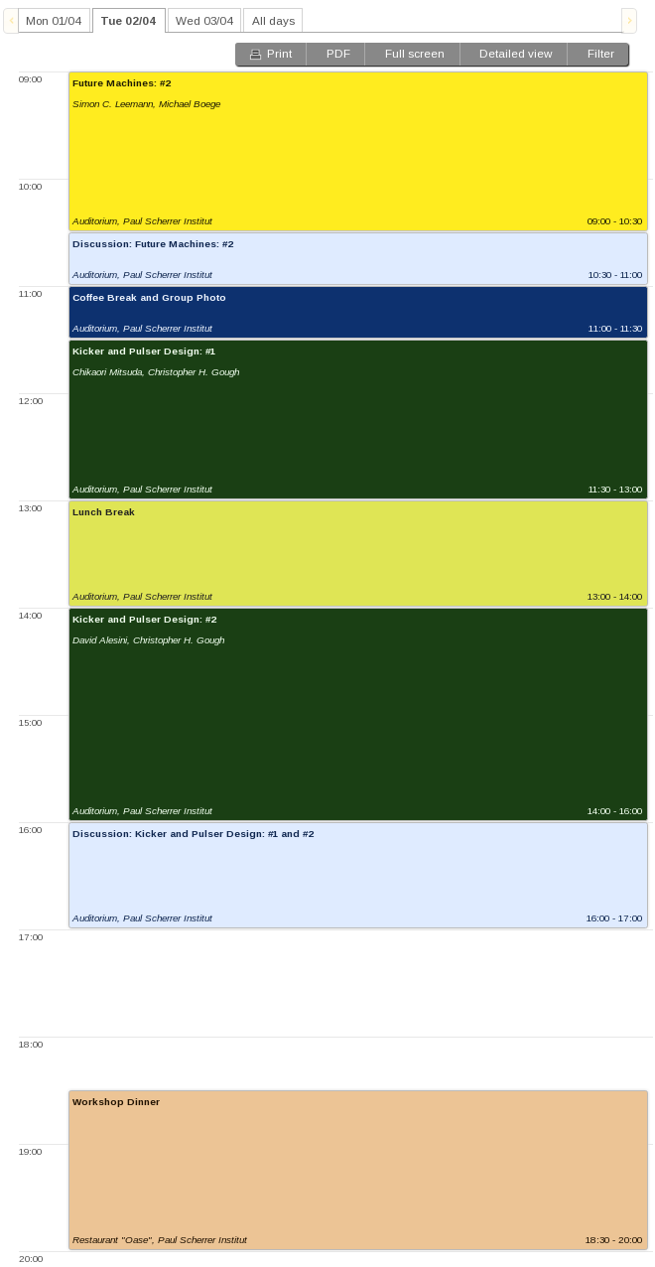
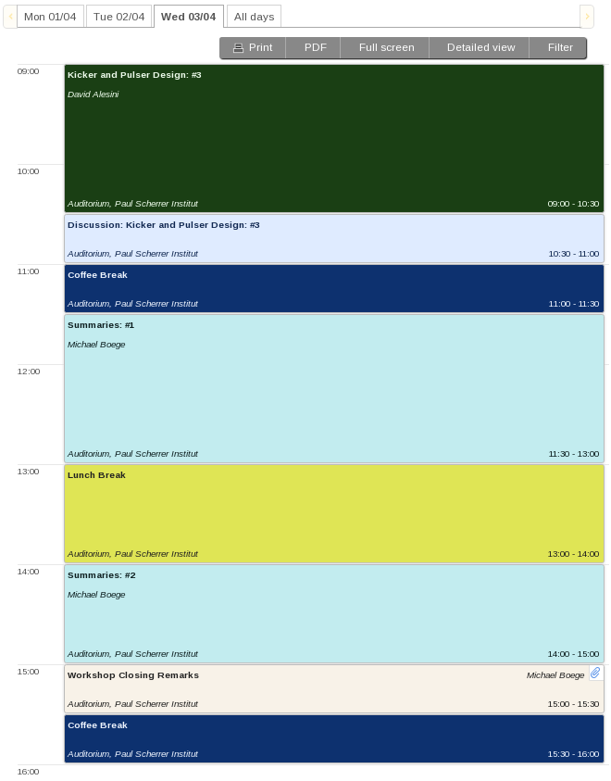
Outline of the Workshop
Monday:
- Present Machines
- Future Machines #1
Tuesday:
- Future Machines #2
- Kicker&Pulser Design #1-#2
Wednesday:
- Kicker&Pulser Design #3
- Summaries
Page <number>

Slide 4
Responsibilities
Responsibilities of chairmen:
Sessions start on time
Book keeping of session time (all talks have 25+5 min)
Talk uploads before sessions
Summarizing the sessions
Taking notes of the corresponding discussion sessions (→ two chairmen)
Presentations on Wednesday (prolonged coffee break for final preparation)
Responsibilities of speakers:
Stay well in the time of 25 min
Upload your presentation before the session or provide the talk on a memory stick so that we can upload the talk (or use your own notebook which is highly depreciated).
Talks need to be online for participants and for the chairmen for summary preparation.
Page <number>
Notes:
<number>

Slide 5
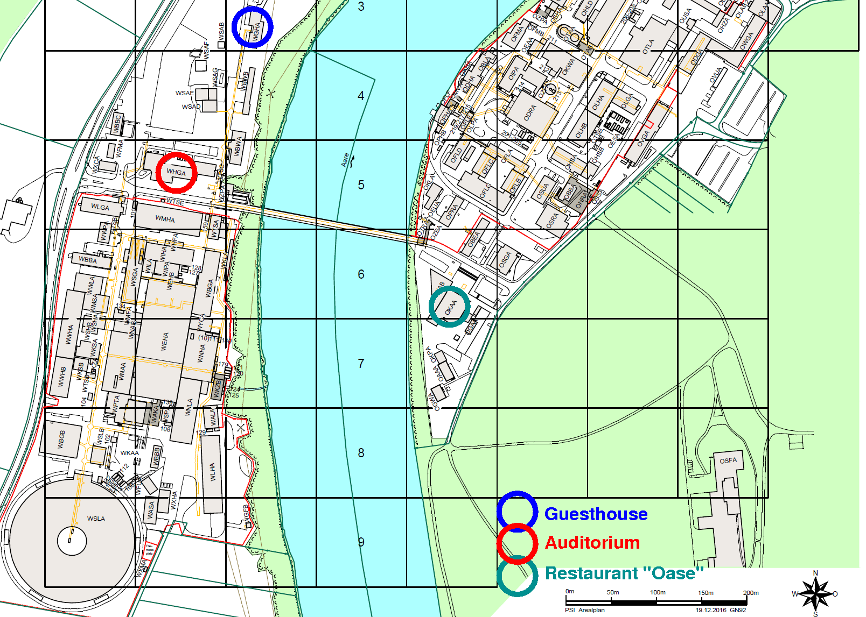
Organisational Matters
Coffee & Food:
Coffee is served before the first session in the morning to wake you up :-)
One coffee break in the morning and one in the afternoon (Tuesday morning group photo during coffee break)
Buffet lunch is served in the foyer of the auditorium
Dinner takes place at the OASE restaurant at PSI on Tuesday 6:30pm-8pm:
OASE open 5pm – 8pm
Page <number>
Notes:
<number>

Slide 6

Wir schaffen Wissen – heute für morgen
AND NOW ENJOY THE WORKSHOP !
Page <number>
Notes:
<number>

