Slide 1

Fast pulse waveforms for different injection schemes using kicker pulsers
Dr Rob Littlewood
April 2019
Rob.Littlewood@sydortechnologies.com

Slide 2
Introduction
Introduction to Sydor & Kentech Partnership
How did we get here….
General overview of Injection Schemes from a waveform point of view
  Swap out – multi bunch
  Swap out single bunch
  Longitudinal possibilities
Summary of what is possible today

Slide 3
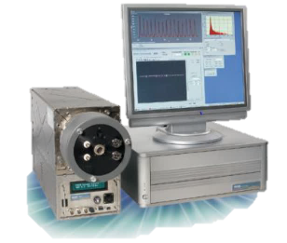
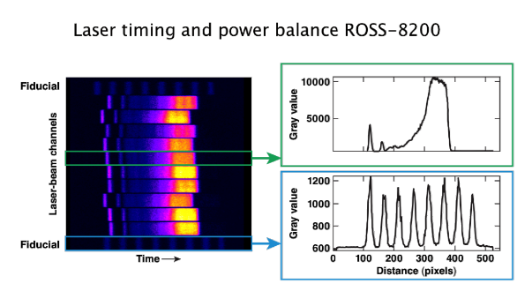
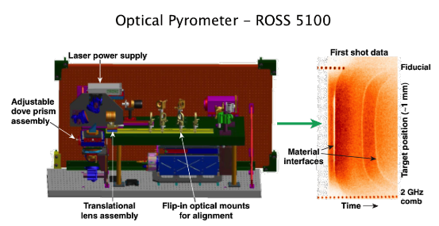
Sydor - History
Started in 2004 with Tech Transfer of ROSS Streak Cameras from LLE.
Wide ranging novel applications (cameras/detectors/imaging/ballistic sciences)
Foster partnerships with companies and public institutions
  Access SBIRs and Grants

Slide 4

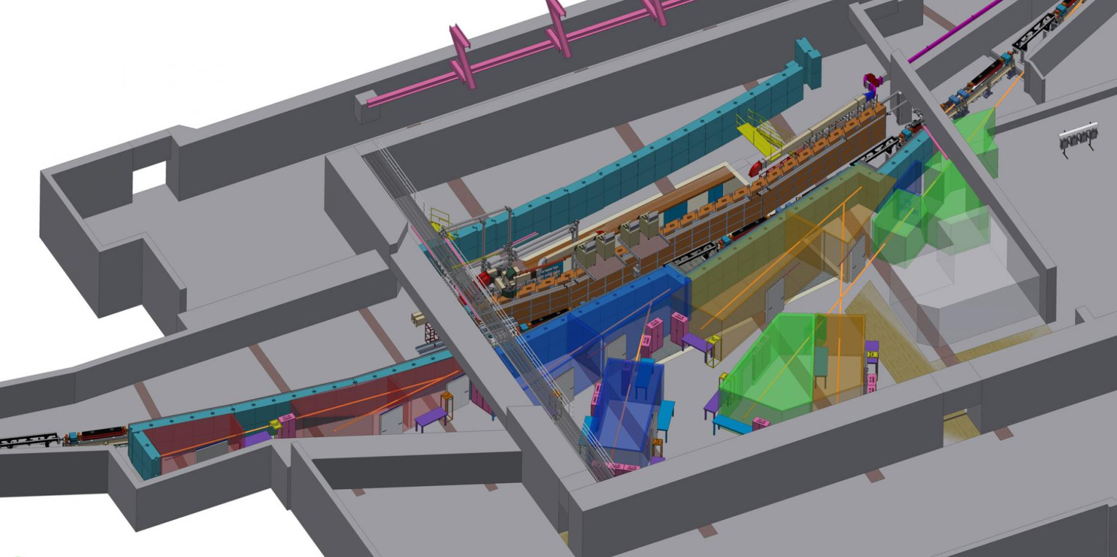


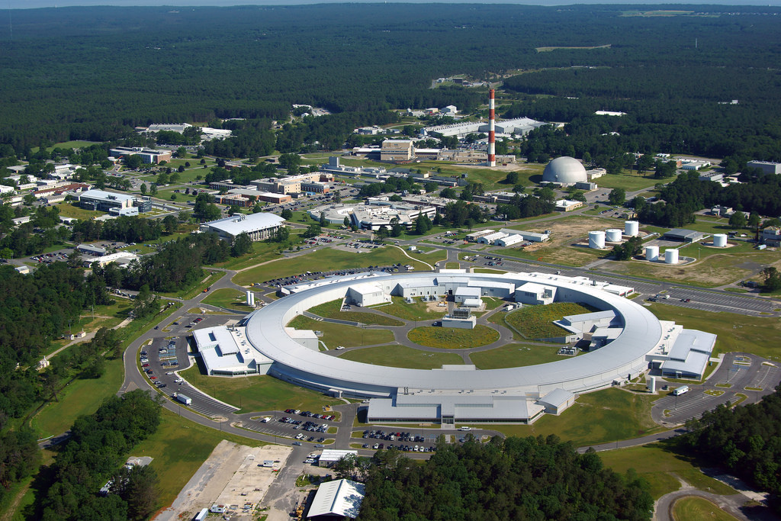
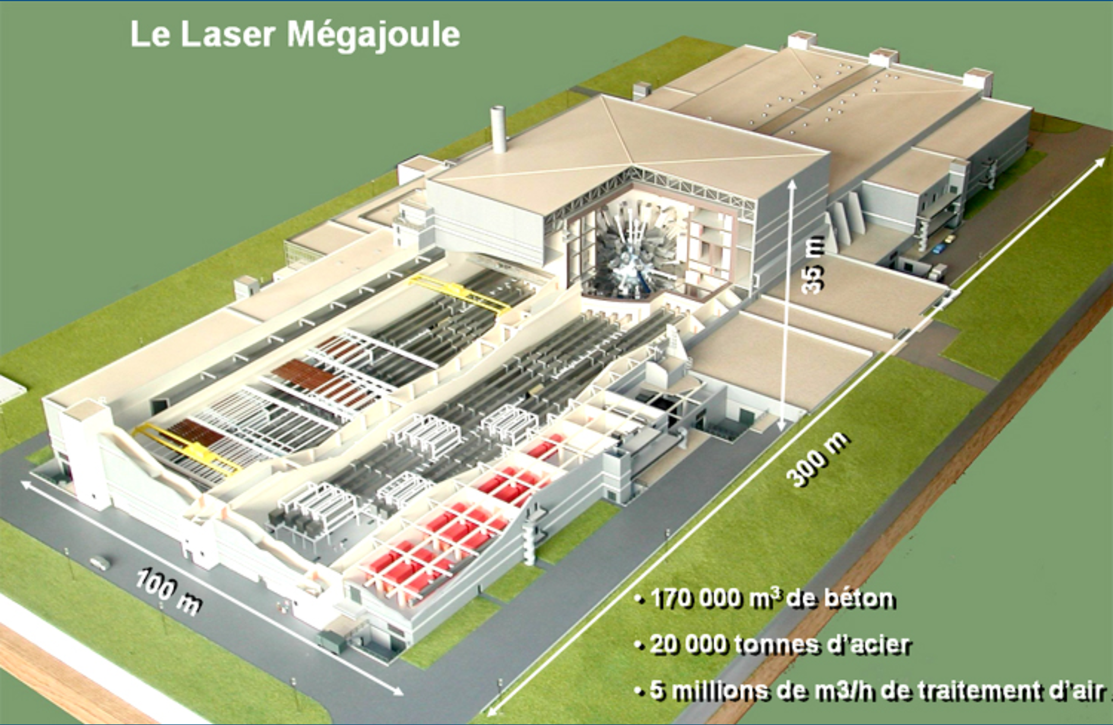

Sydor – Customers/Partners
  Lawrence Berkley National Lab
  Cornell/CHESS
  U of R LLE OMEGA
  Lawrence Livermore Labs
  Brookhaven National Lab/NSLS-II
  CEA – Laser Megajoule
  AWE

Slide 5
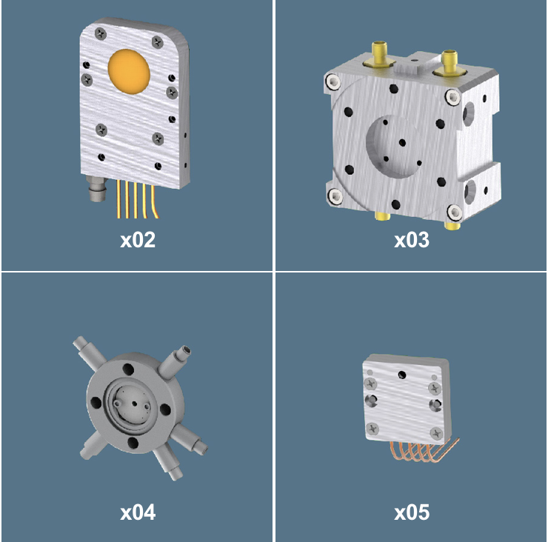
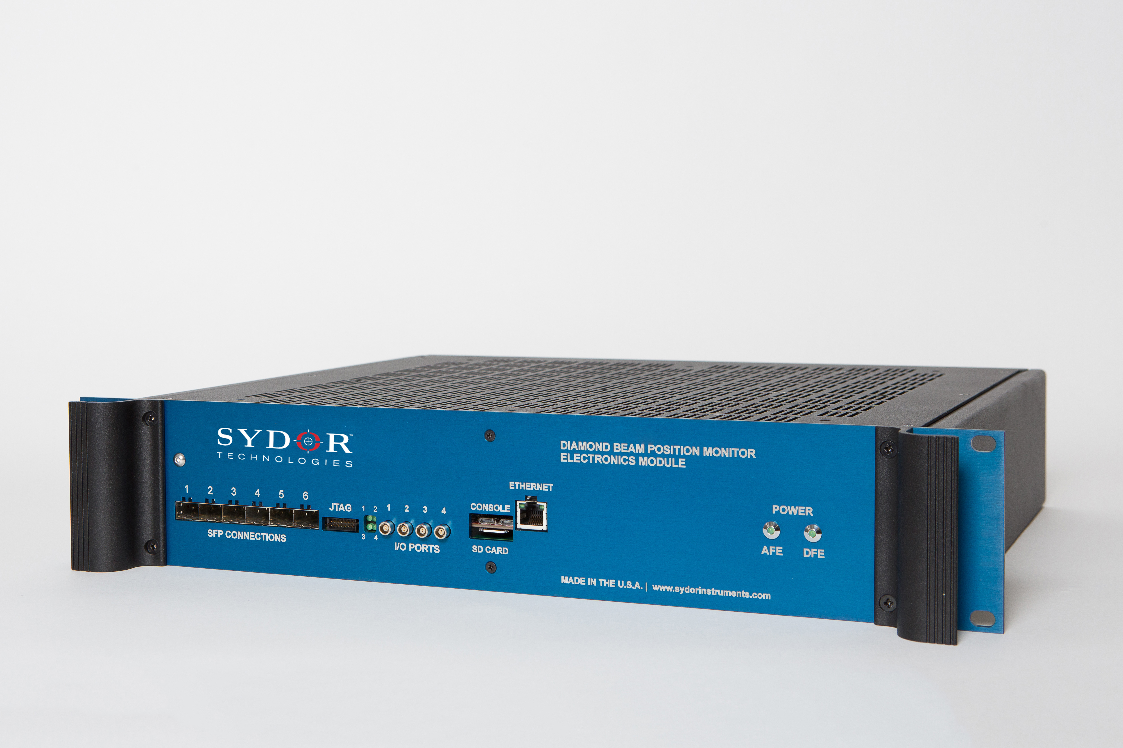
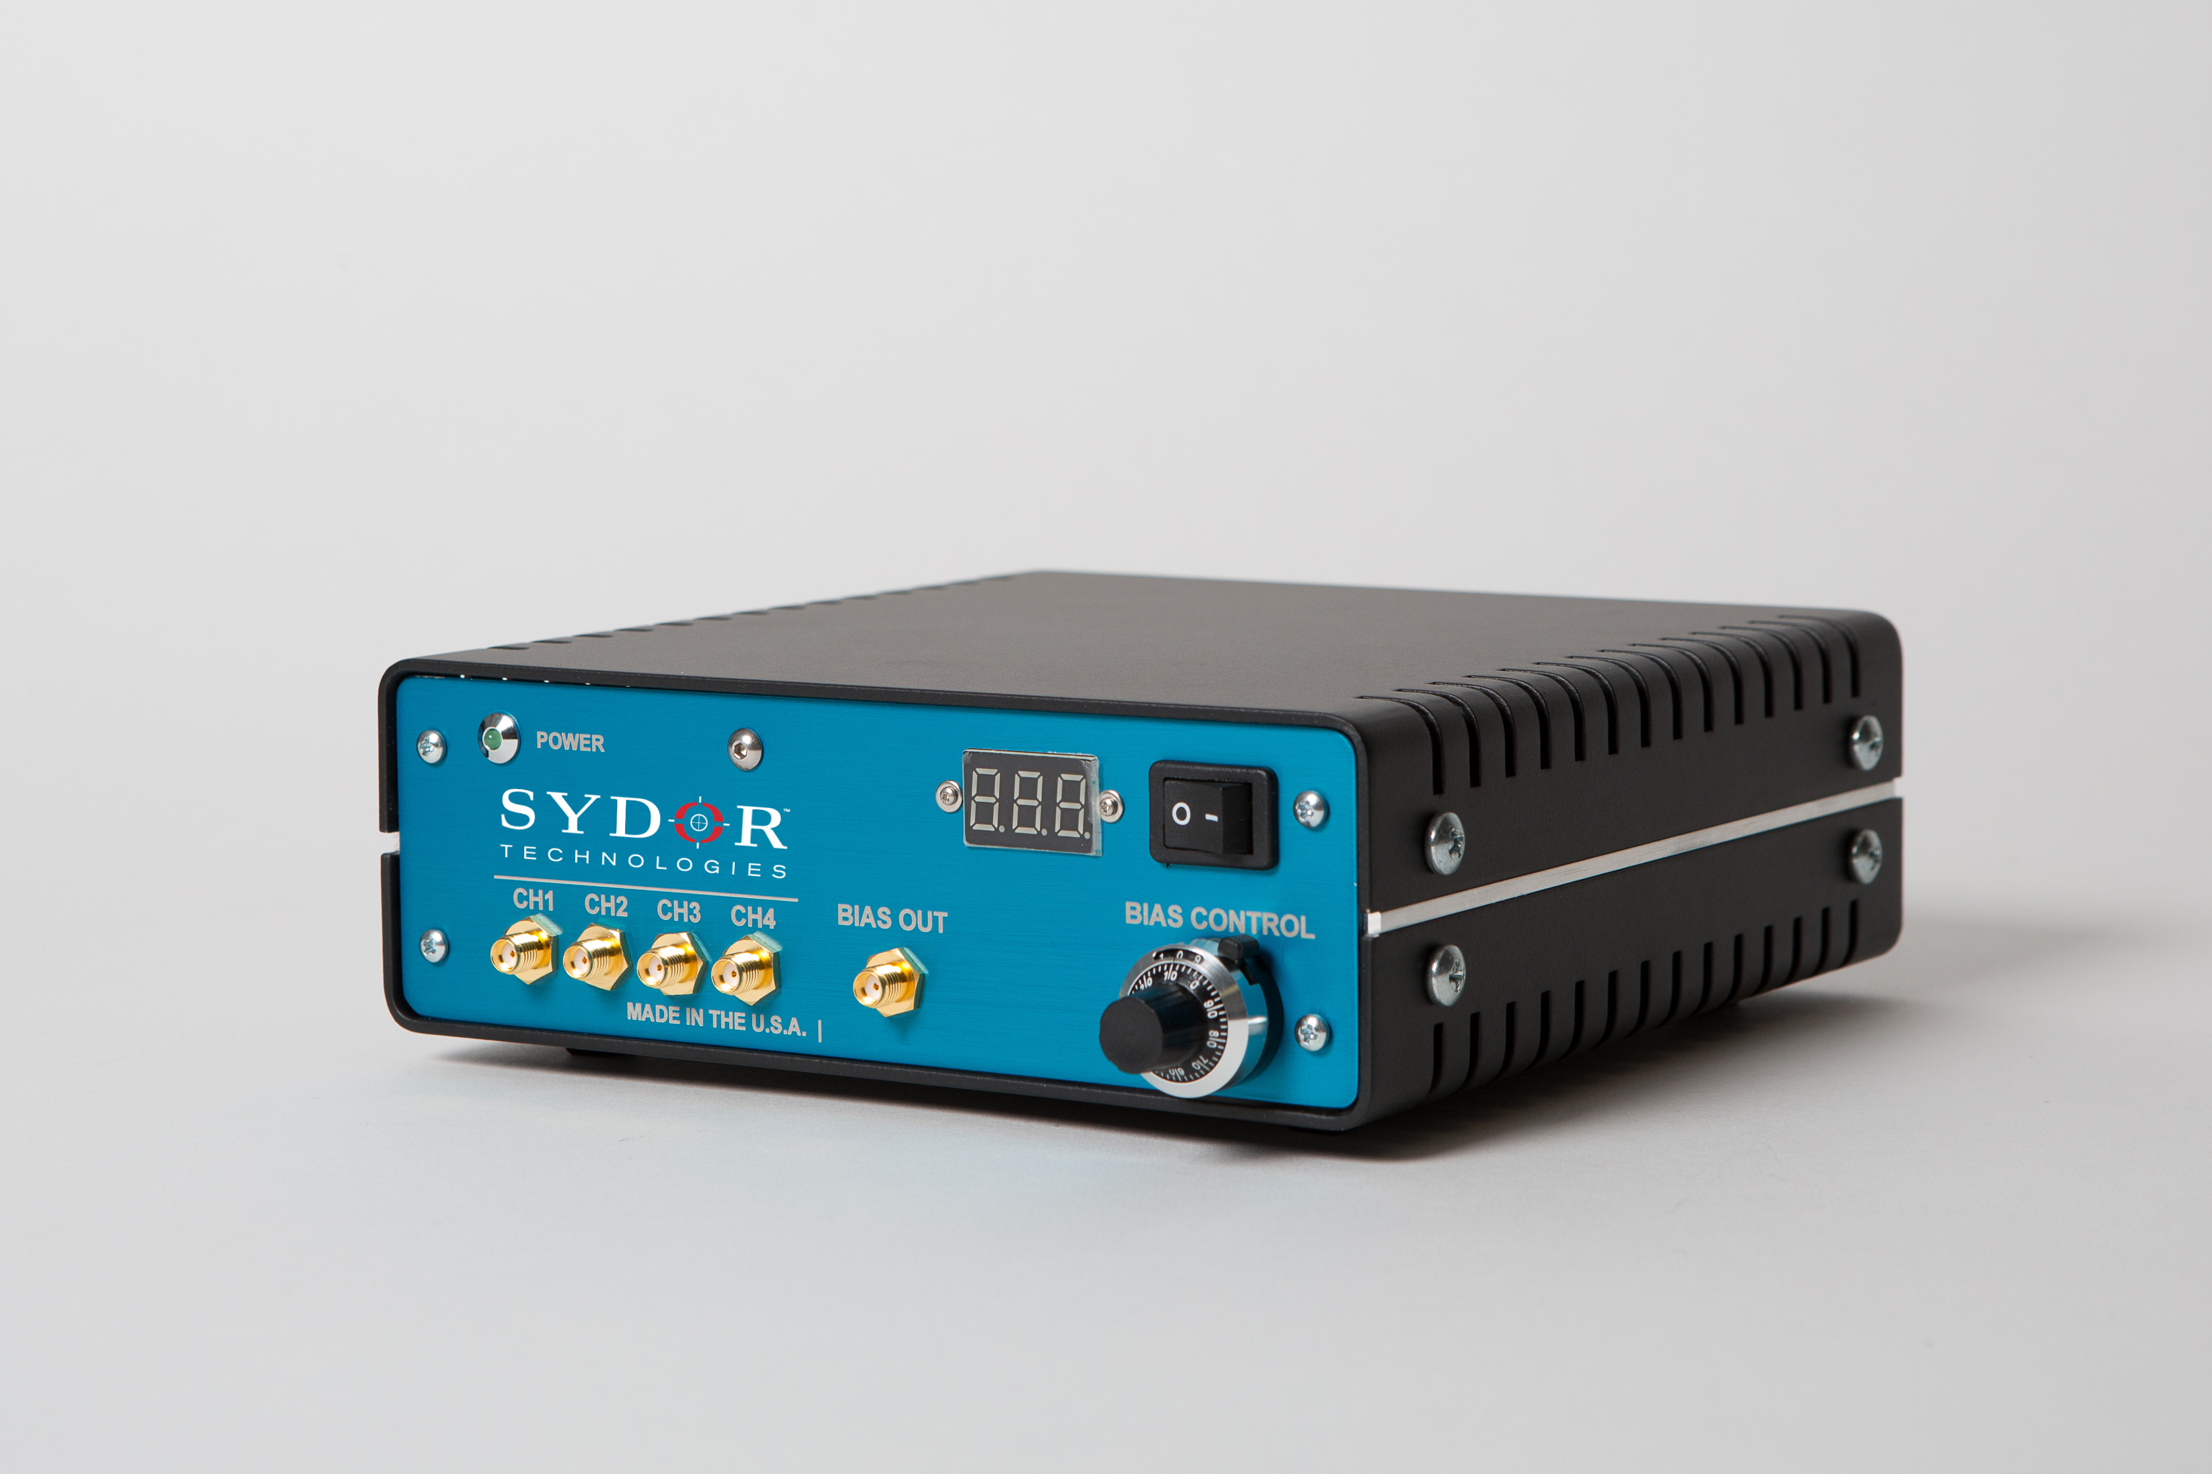
Sydor – Customers/Partners
  Lawrence Berkley National Lab
  Cornell/CHESS
  U of R LLE OMEGA
  Lawrence Livermore Labs
  Brookhaven National Lab/NSLS-II
  CEA – Laser Megajoule
  AWE

Slide 6
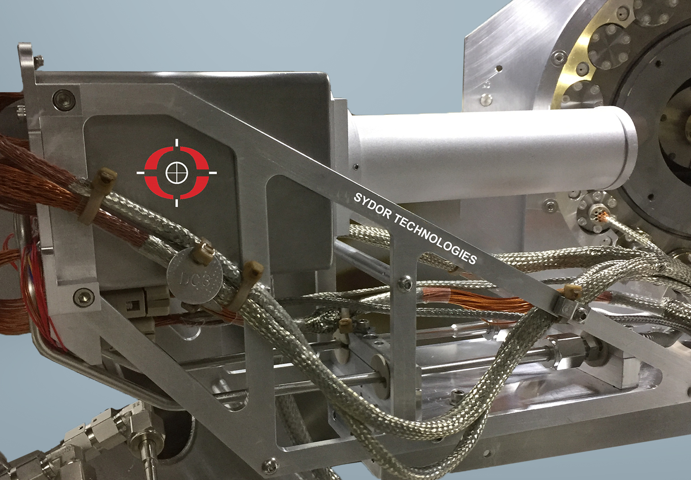
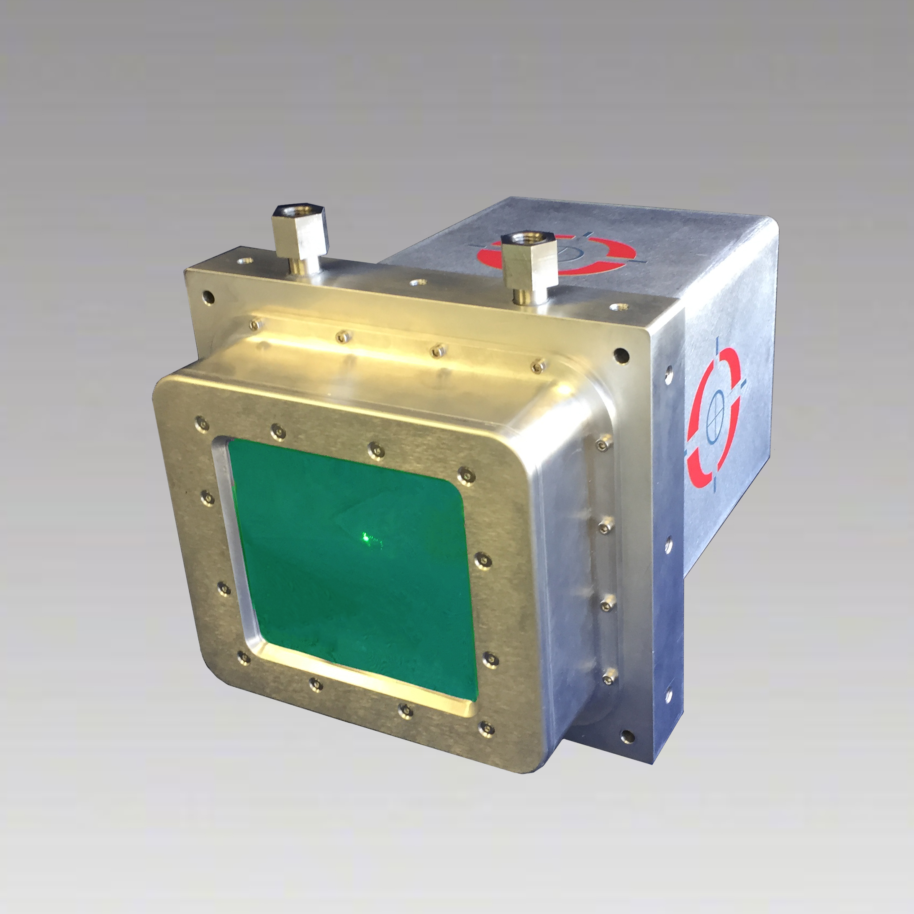
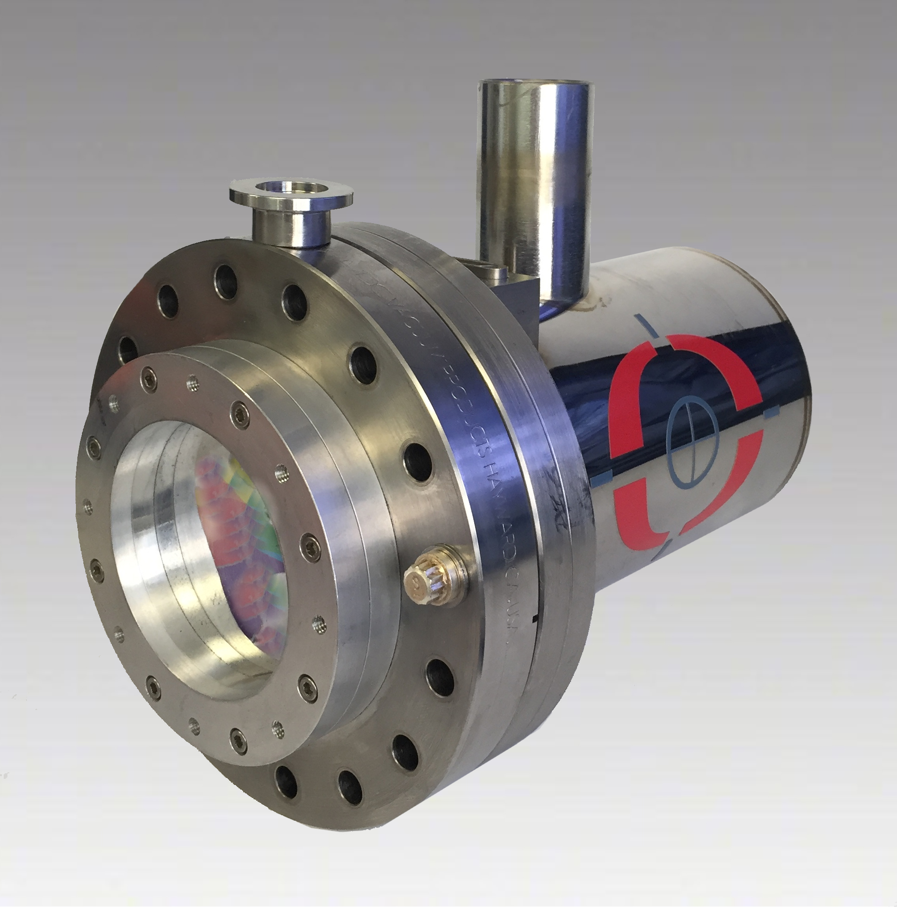
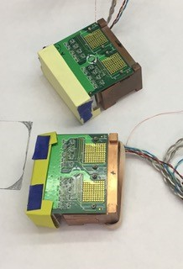
Sydor – Customers/Partners
  Lawrence Berkley National Lab
  Cornell/CHESS
  U of R LLE OMEGA
  Lawrence Livermore Labs
  Brookhaven National Lab/NSLS-II
  CEA – Laser Megajoule
  AWE

Slide 7
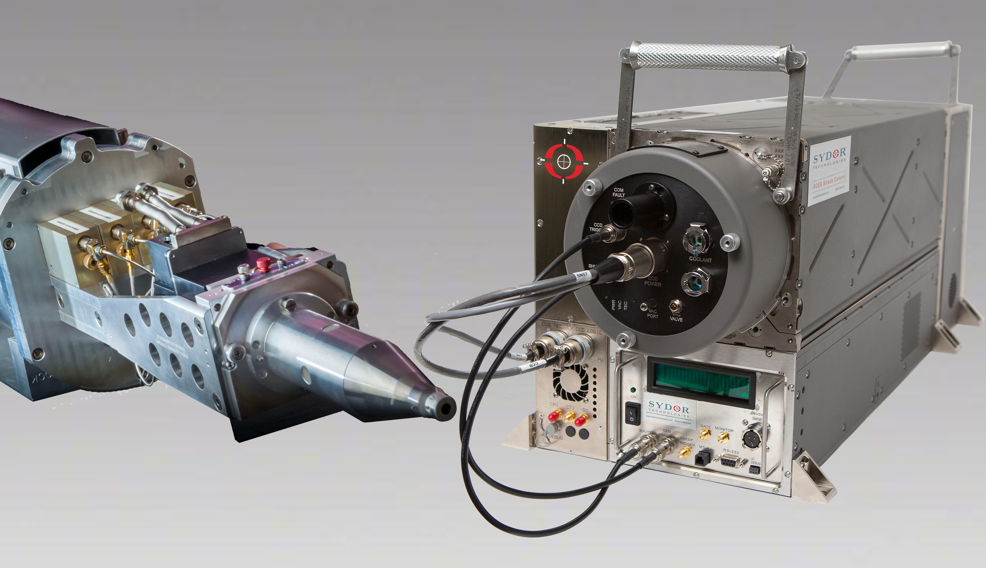
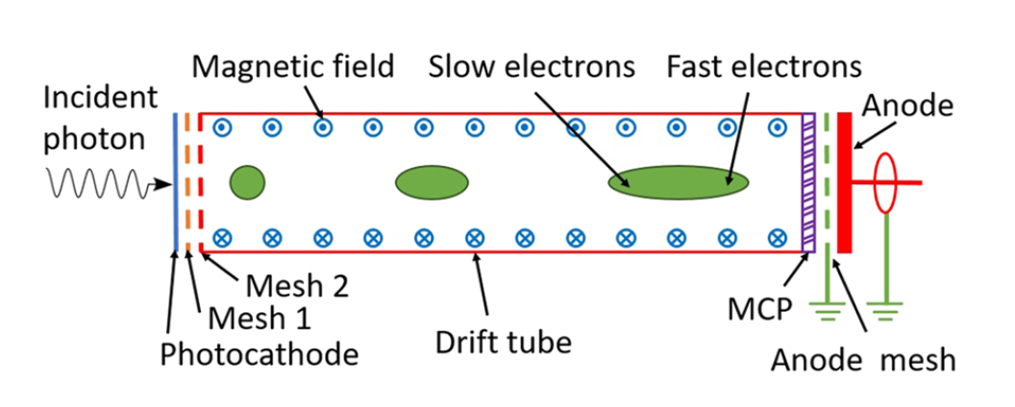
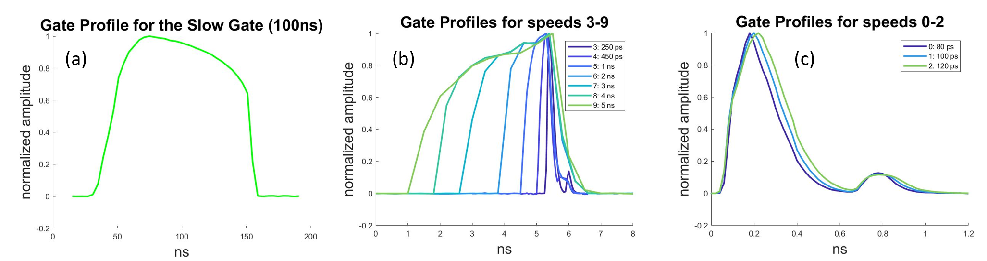
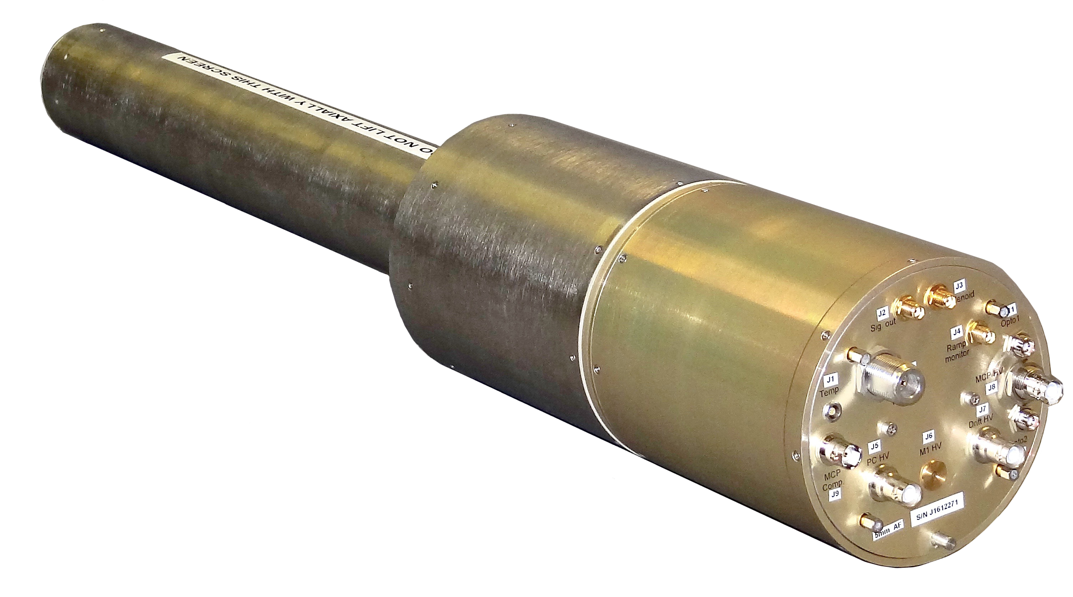

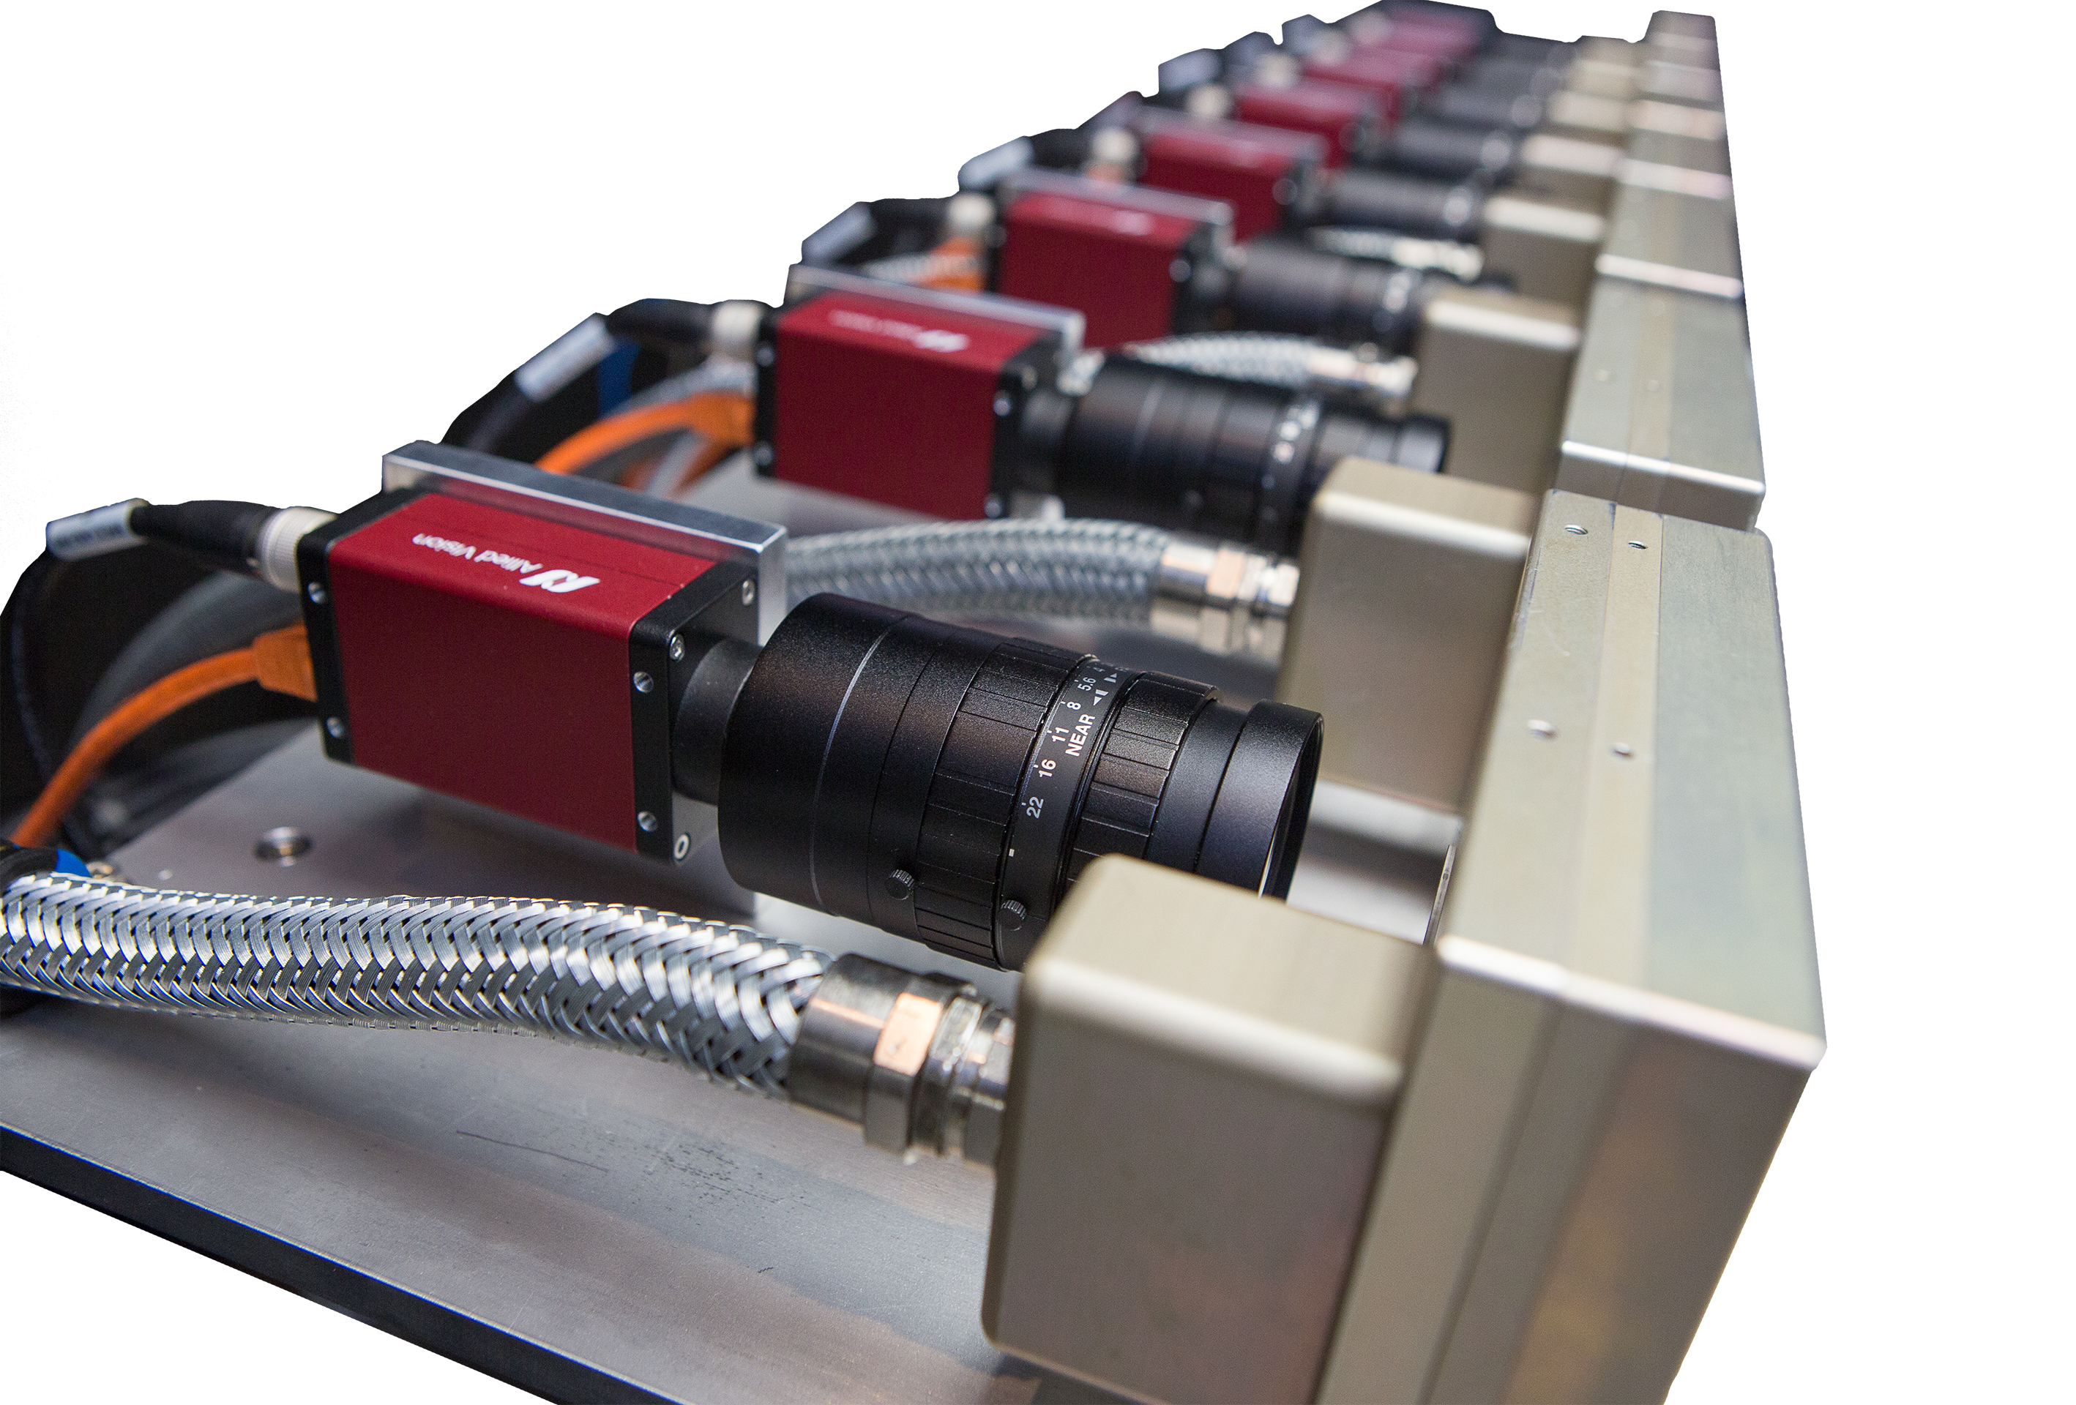
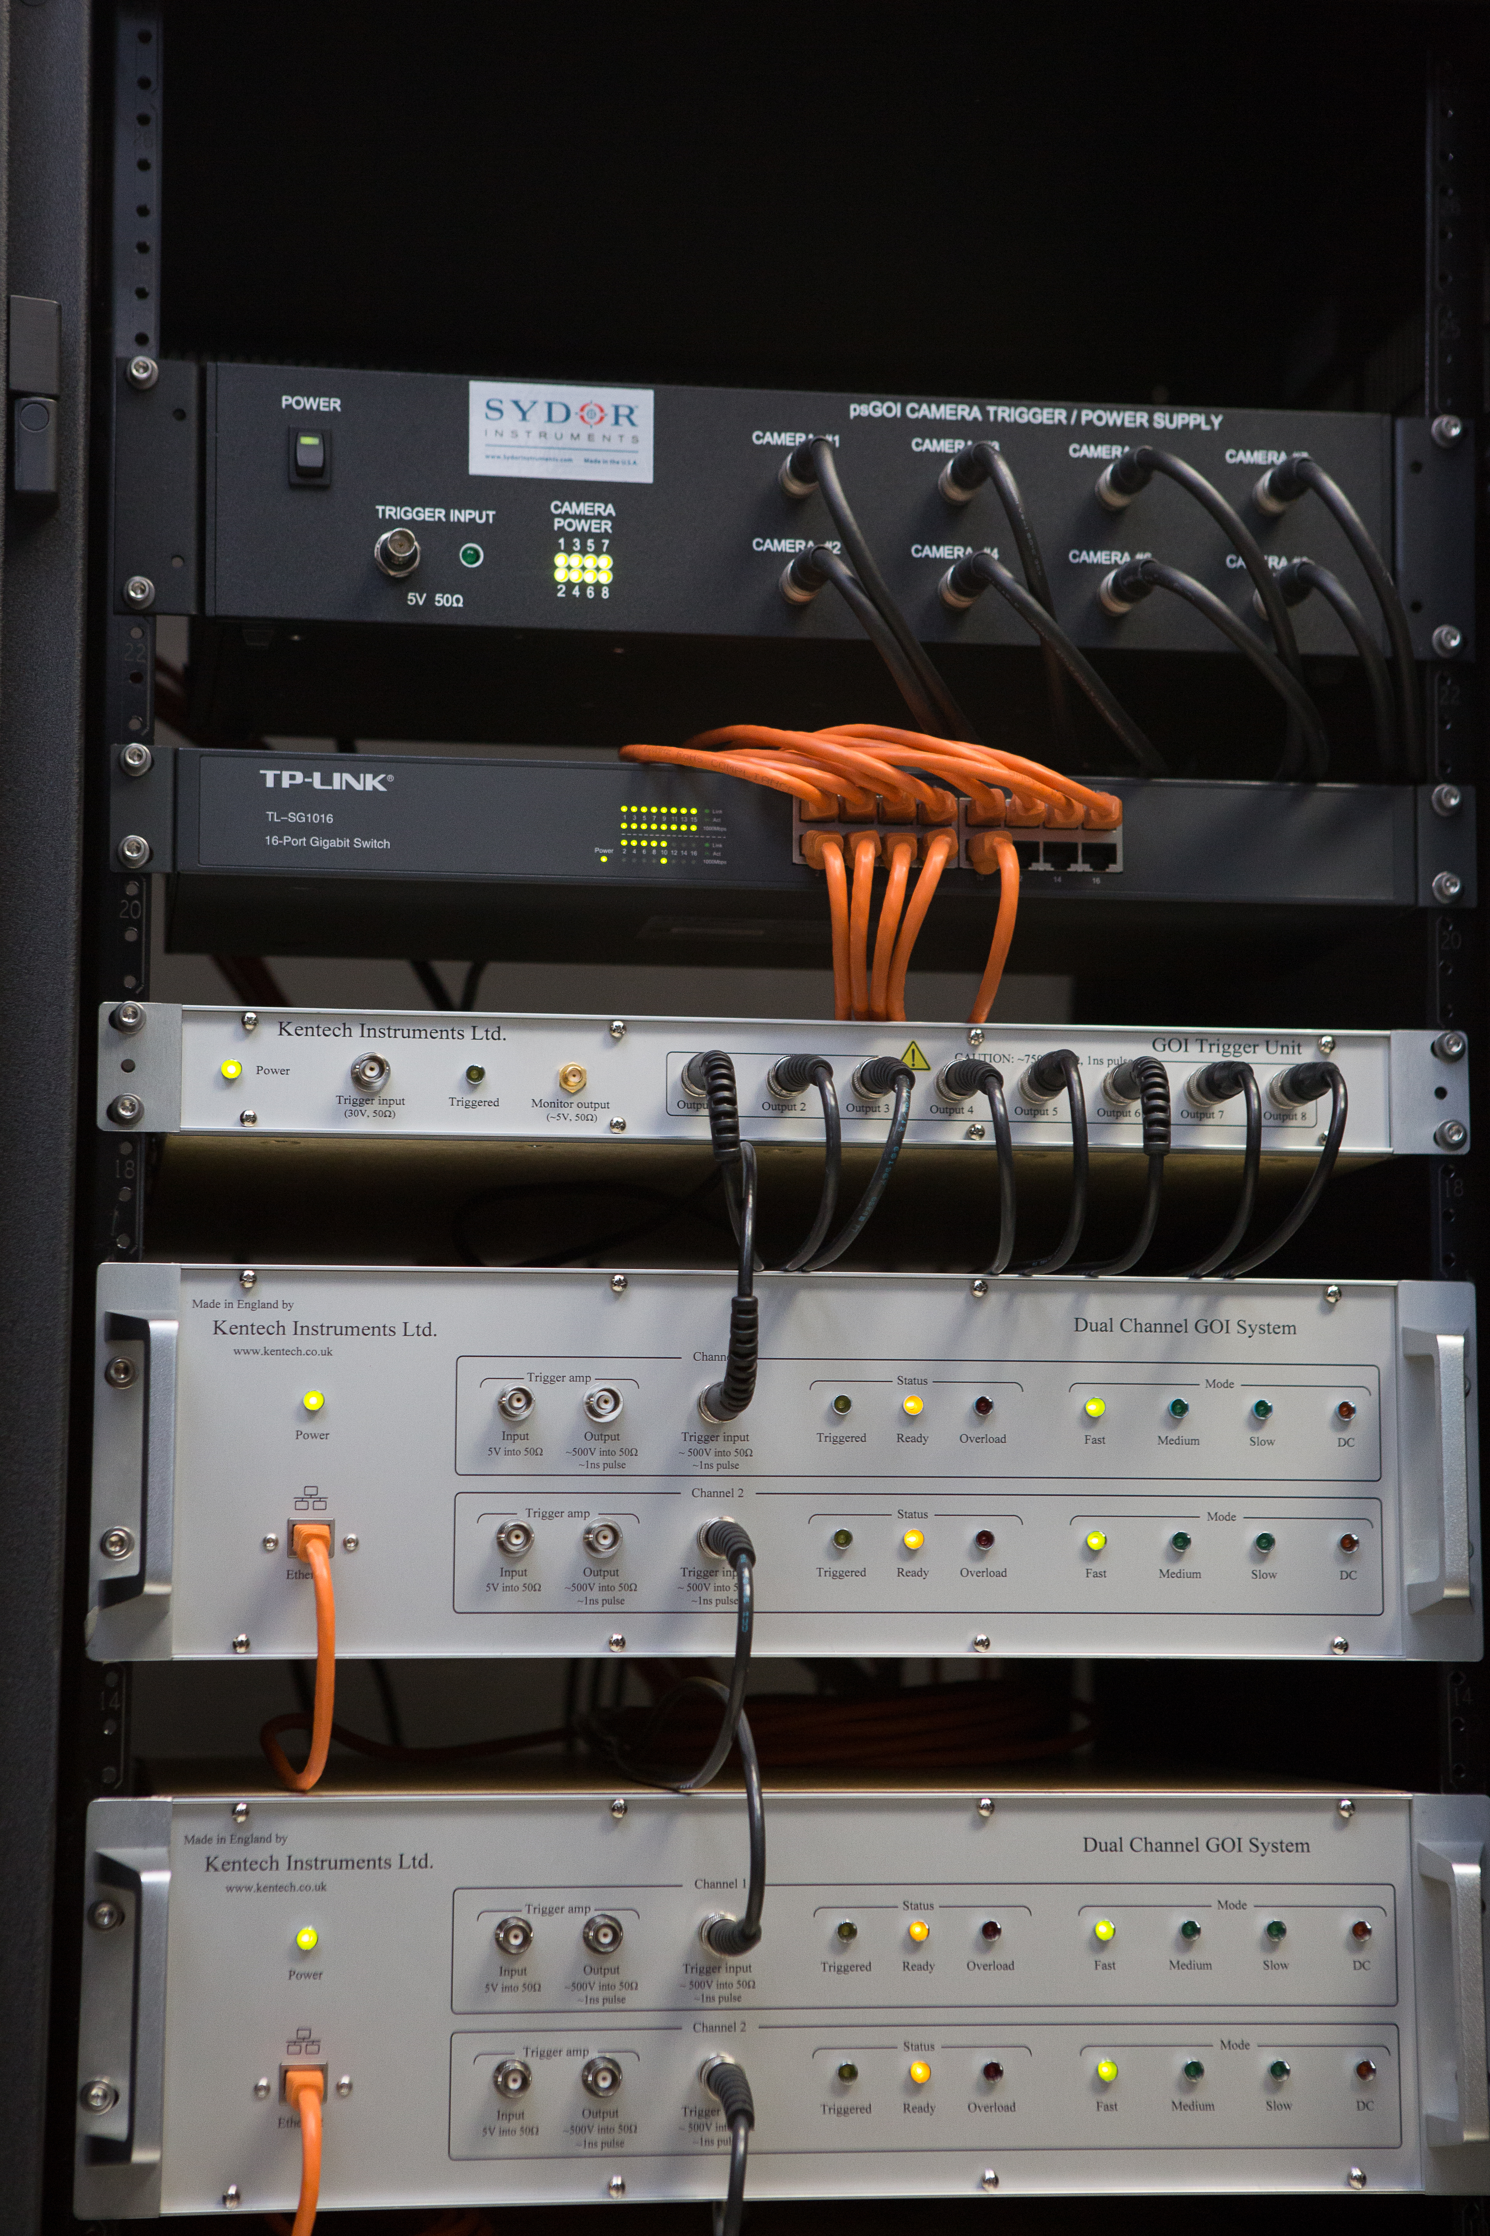

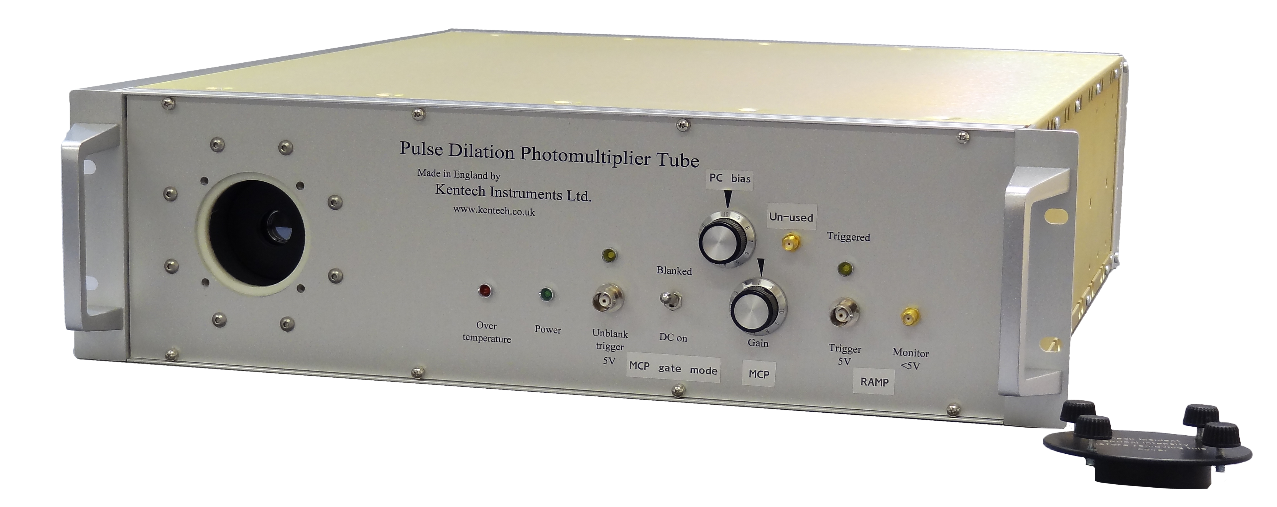
Sydor – Customers/Partners
  U of R LLE OMEGA
  Lawrence Livermore Labs
  Brookhaven National Lab/NSLS-II
  CEA – Laser Megajoule
  AWE

Slide 8
Why are these imaging people here…?
Sydor & Kentech have been working on the single bunch, ‘Swap-Out’ Kicker design at APS
The original desire at APS was to use a flat top waveform, but using a Gaussian shape pulse which delivered the equivalent deflection of the bunch in the kicker has been developed, and will provide comparable deflection performance.
Sydor’s approach leans towards gaussian shape pulses for a number of reasons

Slide 9
Some different schemes (we have heard of….)
Swap Out
Single bunches
Multiple bunches
Longitudinal Injection (with damping)
Single bunches
Psuedo-Single-Bunch (PSB)
X-FEL Pulse Picking

Slide 10
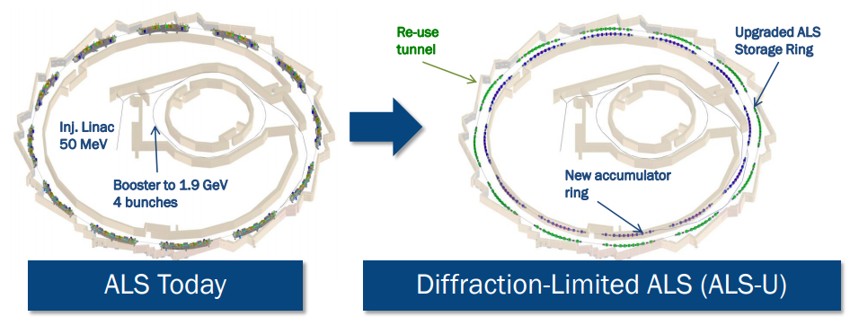
Some different constraints….
Re-use RF system
  Bunch Spacing (influences timing of kicker)
Re-use Architecture
  Size/diameter of building
  Concrete tunnels
  How much deflection do I need??
  How much space do I have to create the deflection?? (Length of Kicker, Voltage Drive)
What can the drive electronics produce…??

Slide 11
In an ideal world…
Swap Out
Single bunches
Multiple bunches
100’s KV’s !!!
Longitudinal Injection (with damping)
Single bunches
Psuedo-Single-Bunch (PSB)
X-FEL Pulse Picking

Slide 12
Introduction
1
:
ns
2ns bunch spacing (~0.6m)
0
1
2
3
4
5
6
7
8
9
0
0
1
2
3
4
5
6
7
8
9
0
1
2
3
4
5
6
7
8
9
0
1
2
3
4
5
6
7
8
9
0
1
2
3
4
5
6
7
8
9
0
1
2
3
4
5
6
7
8
9
0
1
2
3
4
5
6
7
8
9
0
1
2
3
4
5
6
7
8
9
0
1
2
3
4
5
6
7
8
9
0
1
2
3
4
5
6
7
8
9
0
1
2
3
4
5
6
7
8
9
0
Kicker
300mm
Stripline Kicker is 300mm long
Bunches travel from left to right at speed of light (c)
Spacing between bunches (T_b) is 2ns

Slide 13

Bunch Spacing
0
1
2
3
4
5
6
7
8
9
0
ns
Kicker
300mm
Stripline Kicker is 300mm long
Bunches travel from left to right at speed of light (c)
Spacing between bunches (T_b) is 3ns

Slide 14
Bunch Spacing
Bunches to be Kicked
Kicker
300mm

Slide 15
In the real world…
To build FLAT TOP waveforms with ns scale rise times and many Kilo Volts Amplitude generally use:
  Avalanche based pulsers
  Need to use opening and closing switches (more potential to arc faults/feedback problems)
  Parts are heavily over driven (prone to failure)
  Almost guaranteed to fail at some point…
  Any failure is catastrophic
  We end up with ringing (need to allow ‘space’ in the timing)
  Pulse to pulse noise is significant
  ‘Flat Top’ is not truly flat
100’s KV’s !!!

Slide 16
Bunch Spacing
Bunches to be Kicked
Kicker
300mm

Slide 17
Bunch Spacing
Bunches to be Kicked
Kicker
300mm

Slide 18
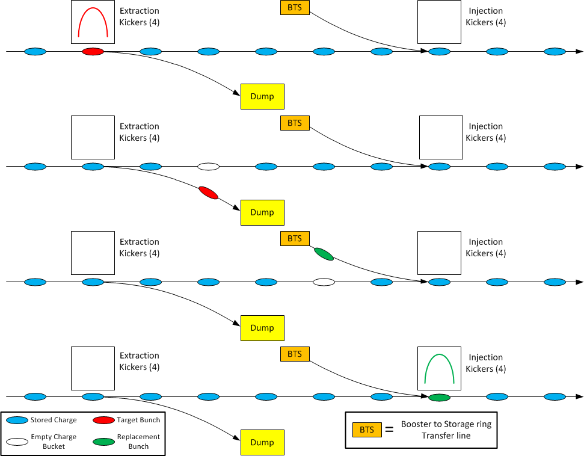
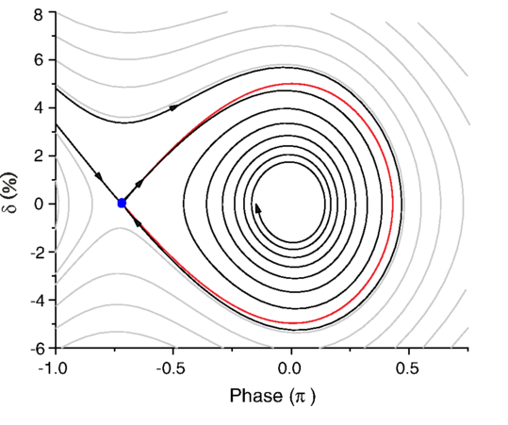
Single bunch kicking
Swap Out (single bunch)
Longitudinal
F. Lenkszus, APS
M. Aiba,* M. Böge, PSI
DOI: 10.1103/PhysRevSTAB.18.020701

Slide 19
Single bunch kicking
Offers an opportunity to move away form flat top profiles
Quai-Guassian shape waveforms
  Sum up lots of very fast switching devices with clever timing (redundancy built-in)
  Only use closing only switches (much more reliable)
  Allows ‘health monitoring’ and predictive maintenance (Any failures cause minimal change in amplitude)
  Very smooth curves
    very good pulse to pulse repeatability
    Very low post pulse fluctuations

Slide 20
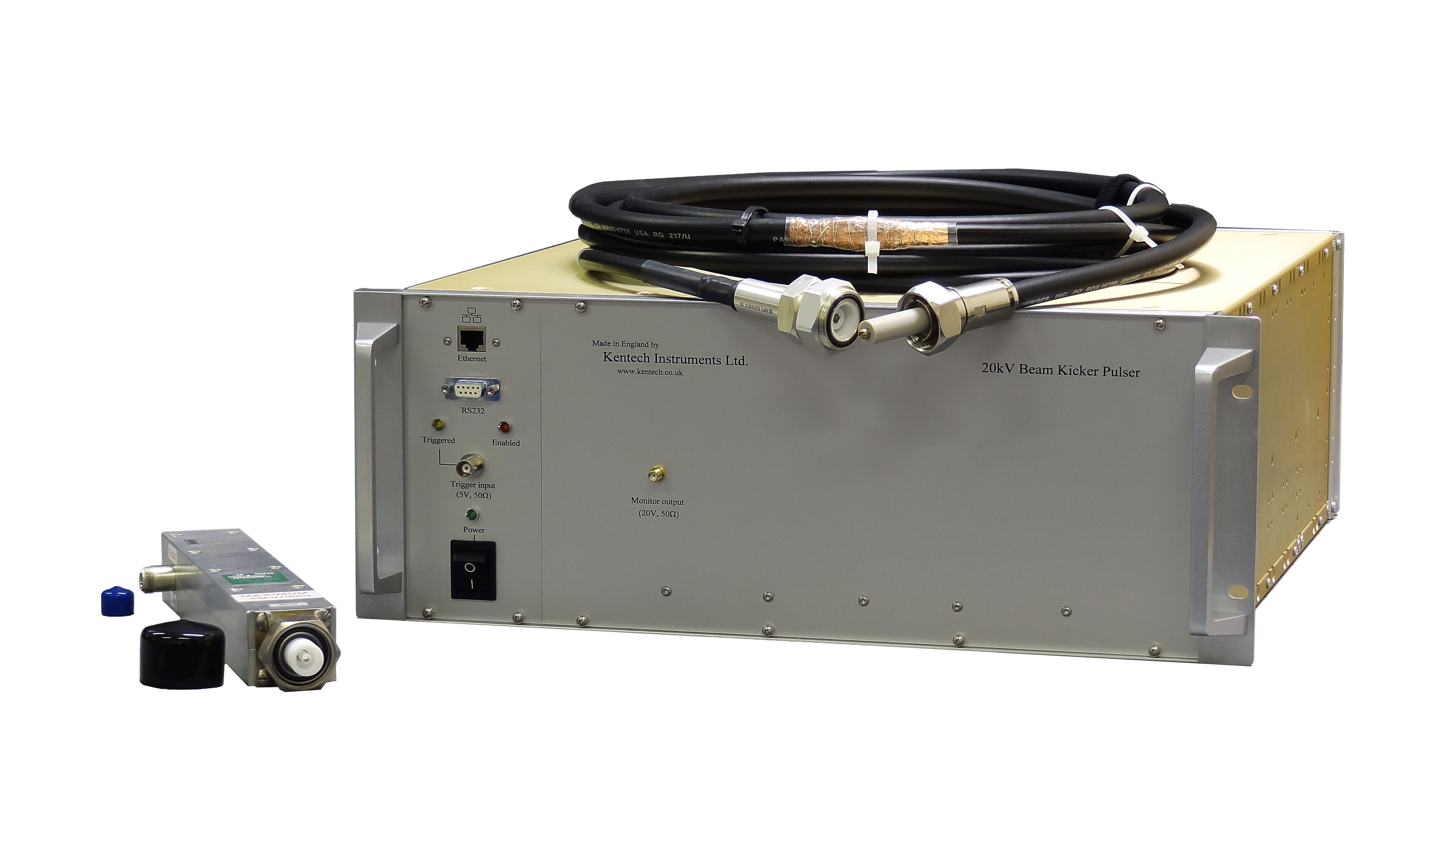
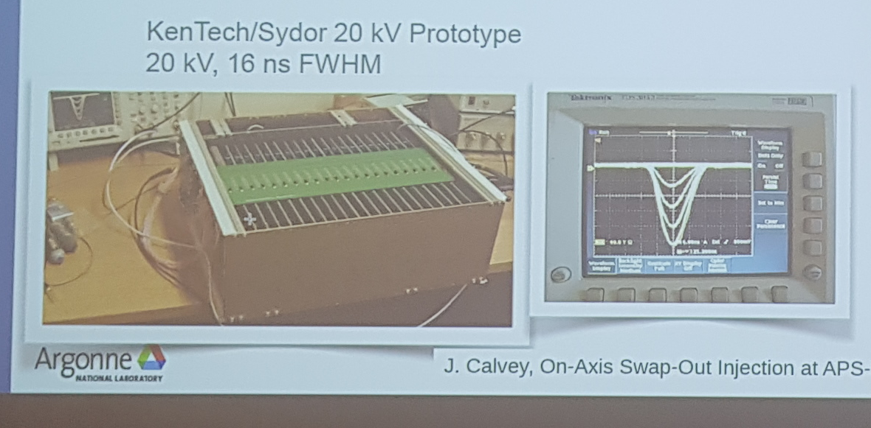
Single bunch kicking
Offers an opportunity to move away form flat top profiles
Quai-Guassian shape waveforms
  Sum up lots of very fast switching devices with clever timing (redundancy built-in)
  Only use closing only switches (much more reliable)
  Creates ‘graceful failure modes’
  Allows ‘health monitoring’ and predictive maintenance (Any failures cause minimal change in amplitude)
  Very smooth curves
    very good pulse to pulse repeatability
    Very low post pulse fluctuations

Slide 21
Single bunch kicking
Data Courtesy of Ju Wang APS

Slide 22
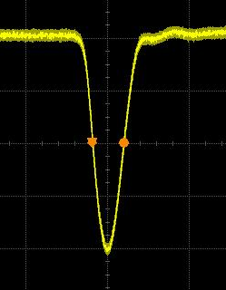
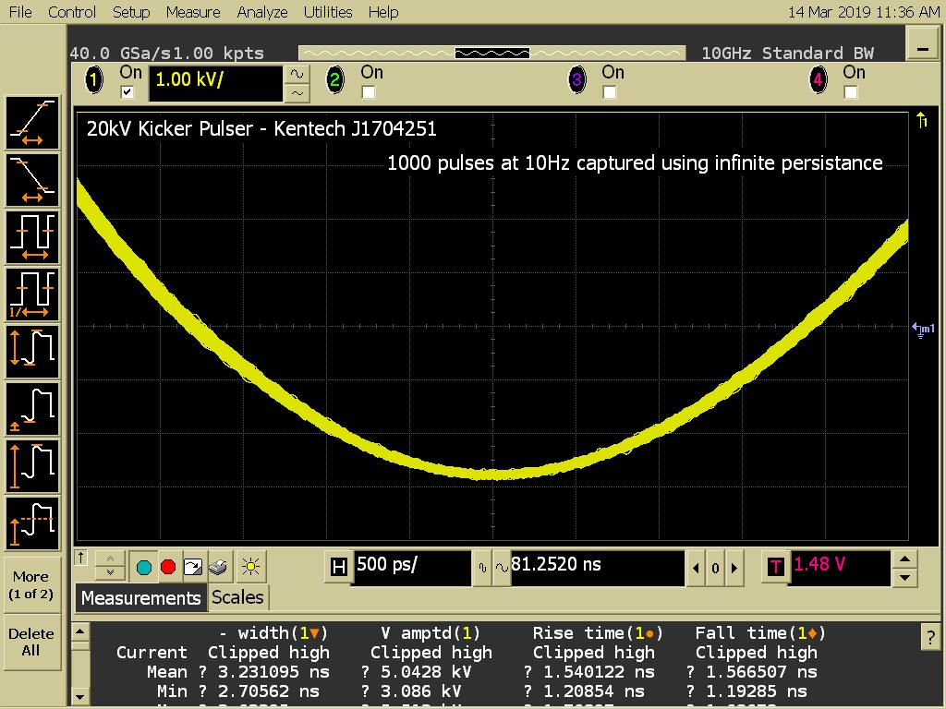
Gaussian Repeatability

Slide 23
Gaussian Repeatability
For this example Amplitude pulse to pulse RMS is <0.25% (<50V out of 20+KV!)
Actually this is probably just the noise in the scope, true measurement is hard to make….

Slide 24
Introduction
1
:
ns
0
1
2
3
4
5
6
7
8
9
0
0
1
2
3
4
5
6
7
8
9
0
1
2
3
4
5
6
7
8
9
0
1
2
3
4
5
6
7
8
9
0
1
2
3
4
5
6
7
8
9
0
1
2
3
4
5
6
7
8
9
0
1
2
3
4
5
6
7
8
9
0
1
2
3
4
5
6
7
8
9
0
1
2
3
4
5
6
7
8
9
0
1
2
3
4
5
6
7
8
9
0
1
2
3
4
5
6
7
8
9
0
6ns bunch spacing (~1.8m)
Kicker
300mm
Stripline Kicker is 300mm long
Bunches travel from left to right at speed of light (c)
Spacing between bunches (T_b) is 6ns

Slide 25
Bunch Spacing
1
:
ns
0
1
2
3
4
5
6
7
8
9
0
0
1
2
3
4
5
6
7
8
9
0
1
2
3
4
5
6
7
8
9
0
1
2
3
4
5
6
7
8
9
0
1
2
3
4
5
6
7
8
9
0
1
2
3
4
5
6
7
8
9
0
1
2
3
4
5
6
7
8
9
0
Kicker
300mm
Stripline Kicker is 300mm long
Bunches travel from left to right at speed of light (c)
Spacing between bunches (T_b) is 6ns

Slide 26
Transit Time
1
:
ns
0
1
0
1
2
3
4
5
6
7
8
9
0
Kicker
300mm
Based on length of kicker and speed of light the time a bunch takes to transit through the kicker (T_k) is 1ns

Slide 27
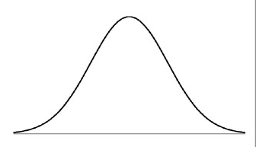
Kicker Pulse travel
1
:
ns
0
1
2
3
4
5
6
7
8
9
0
1
0
1
2
3
4
5
6
7
8
9
0
1
2
3
4
5
6
7
8
9
0
1
2
3
4
5
6
7
8
9
0
1
2
3
4
5
6
7
8
9
0
1
2
3
4
5
6
7
8
9
0
1
2
3
4
5
6
7
8
9
0
1
2
3
4
5
6
7
8
9
0
1
2
3
4
5
6
7
8
9
0
1
2
3
4
5
6
7
8
9
0
1
2
3
4
5
6
7
8
9
0
1
2
3
4
5
6
7
8
9
0
Kicker
Pulse travelling through the kicker moves in the opposite direction (right to left) also at speed of light (c)

Slide 28
0-0 Time
1
:
ns
0
1
2
3
4
5
6
7
8
9
0
1
0
1
2
3
4
5
6
7
8
9
0
1
2
3
4
5
6
7
8
9
0
1
2
3
4
5
6
7
8
9
0
1
2
3
4
5
6
7
8
9
0
1
2
3
4
5
6
7
8
9
0
1
2
3
4
5
6
7
8
9
0
1
2
3
4
5
6
7
8
9
0
1
2
3
4
5
6
7
8
9
0
1
2
3
4
5
6
7
8
9
0
1
2
3
4
5
6
7
8
9
0
1
2
3
4
5
6
7
8
9
0
Kicker
0-0 time
To ensure the pulse only influences one bunch it must rise from zero and fall to zero again in between adjacent bunches. We will call this time the max 0-0 time.

Slide 29
0-0 Time
1
:
ns
0
1
2
3
4
5
6
7
8
9
0
1
0
1
2
3
4
5
6
7
8
9
0
1
2
3
4
5
6
7
8
9
0
1
2
3
4
5
6
7
8
9
0
1
2
3
4
5
6
7
8
9
0
1
2
3
4
5
6
7
8
9
0
1
2
3
4
5
6
7
8
9
0
1
2
3
4
5
6
7
8
9
0
1
2
3
4
5
6
7
8
9
0
1
2
3
4
5
6
7
8
9
0
1
2
3
4
5
6
7
8
9
0
1
2
3
4
5
6
7
8
9
0
Kicker
~10ns
The max 0-0 time can be calculated from the bunch spacing and the transit time through the kicker (*excluding allowance for jitter and pulse bunch width):
max0-0 = 2 x T_b – 2 xT_k

Slide 30
Interaction Time
1
:
ns
0
1
2
3
4
5
6
7
8
9
0
1
0
1
2
3
4
5
6
7
8
9
0
1
2
3
4
5
6
7
8
9
0
1
2
3
4
5
6
7
8
9
0
1
2
3
4
5
6
7
8
9
0
1
2
3
4
5
6
7
8
9
0
1
2
3
4
5
6
7
8
9
0
1
2
3
4
5
6
7
8
9
0
1
2
3
4
5
6
7
8
9
0
1
2
3
4
5
6
7
8
9
0
1
2
3
4
5
6
7
8
9
0
1
2
3
4
5
6
7
8
9
0
Kicker
2ns
The width of the kicker waveform that will influence the bunch whilst it is transiting through the kicker can be calculated as:
T_w = 2 x T_k

Slide 31
Interaction Time Summary
2ns
Avrg
This means that the bunch being deflected sees the average of the pulse over 2 x 1ns = 2ns
To get the same deflection of the bunch that a flat top waveform pulse would give, we must drive the peak amplitude higher than the required square wave, but the average over the 2 ns must be equal to the flat top amplitude.

Slide 32
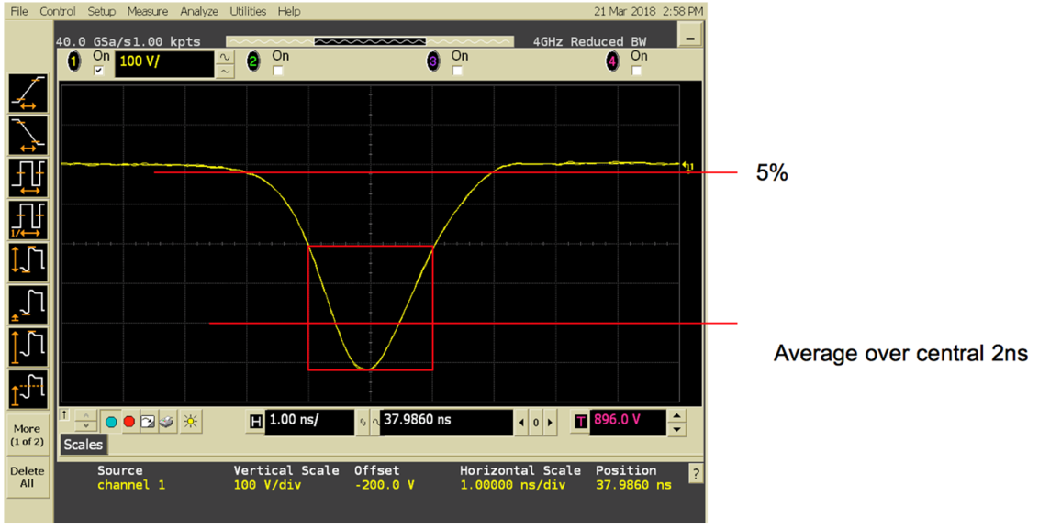
Swap Out Mode Summary
Current prototypes manufactured with Quasi-Gaussian pulses can achieve 0-0 time on the order of 10-20ns with ~20KV Amplitudes
We believe Gaussian waveforms offer advantages in less well highlighted factors (reliability, predictive maintenance etc)
Technology uses summed MOSFETs which could also create switching 0-0 time ~4ns and amplitude of >10KV
Depending on bunch spacings this could also be interesting for Longitudinal Injection
4 ns

Slide 33
So what about Longitudinal Injection…?

Slide 34
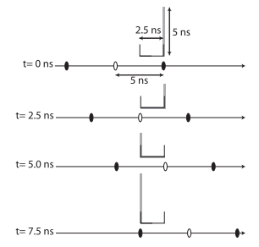
Longitudinal Injection – With short bunch spacing
Different Injection modes proposed such as ‘Longitudinal Injection require even narrower rise and fall times (need to fit between bunches)
Also need to fit into the ‘golf club’
Deflections required seem to be less (i.e. lower amplitude waveforms)
This opens up options for other switching technologies
Still using similar design principles of ‘summing up’
M. Aiba,* M. Böge, PSI
DOI: 10.1103/PhysRevSTAB.18.020701

Slide 35
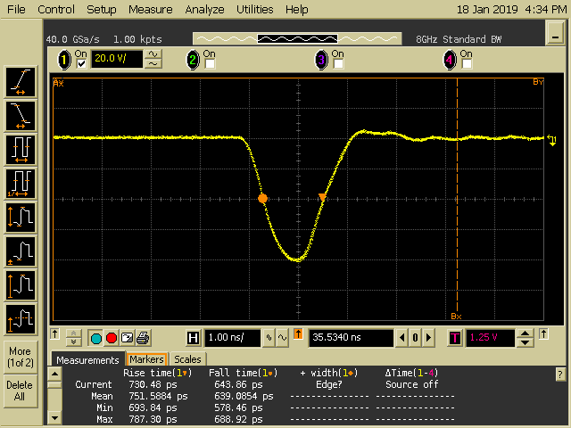
Longitudinal Injection – With short bunch spacing
Very recent investigations have shown configurations with 0-0 time <2ns could be possible with amplitudes of up to 3KV (possibly 5KV….)
2 ns

Slide 36
Longitudinal Injection – Gaussian summary
Anything >5KV needs to be ≥4ns 0-0 times
Anything ≤5KV we think we can achieve ~2ns 0-0 time
  Currently have a proposal for some development work to look into this further

Slide 37
General summary
Gaussian waveforms offer advantages in terms of the electronics reliability and ‘jitter’ / RMS performance
  Closing only switches
  Very smooth
  Non catastrophic failures
  Predictive maintenance
Flat tops may have to be used for multi bunch
  Sydor Kentech can build these (already some nice work at ALS)
  Think about options for graceful failure modes and online diagnostics

Slide 38
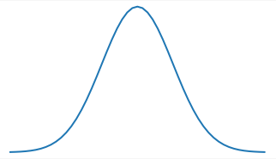
Technology Background – What can we provide
Product | High Amplitude, Fast Pulser (HAFP) | Mid Amplitude, Ultra Fast Pulser (MAUFP)
Performance Factor
Max Amplitudes (Volts) | ~20 KV (more is possible) | 3KV (possibly up to 5KV)
Rise and Fall Times (ns) | ~7ns rise and 7ns fall (less possible with design changes down to ~2ns) | <1ns rise and 1ns fall
0-0 time | ~15ns | <2ns
Burst Mode? | 100’s Hz | Few MHz
Voltage (KV)
~15ns
Voltage (KV)
<2ns
20 KV
3 KV
Time (ns)
Time (ns)

Slide 39
Thank You!
www.SydorTechnologies.com
+1 585 278 1168
+44(0)7917567785
Rob.littlewood@sydortechnologies.com

