Slide 1
PSI-FERMI sub-um WSC test at SwissFEL
G.L. Orlandi
Machine shift: 04.12.2018
Shift participants: Bettoni, Ferianis (ELETTRA), Ferrari, Hermann, Huerzeler, Ischebeck, Lombosi, Orlandi, Ozkan-Loch, Prat
PSI WSC nano-fabrication : V. Guzenko, C. David, LMN, PSI
FERMI Team: M. Veronese, G. Penco, M. Ferianis
FERMI WSC nano-fabrication: Lazzarino, S. Dal Zilio, N. Cefarin, IOM-CNR Trieste, Italy
Shift goal: beam test of free-standing wire-scanners with sub-micrometer resolution
Machine setting:
        0.4 mm diameter of the laser mask;
        beam charge ~1 pC;
        beam energy ~300MeV;
        Emit_Y=~60 nm; 1Hz rep.rate.
        Set of sub-um WSCs installed in SINDI02-DLAC055 (z=89m)

Slide 2
Sub-um free-standing WSC chip
PSI chip: stripe width 800nm and 500nm
FERMI chip
0.67mm
wire width w₁
wire width w₂
Beam clearance 2mm
chip size 6mm

Slide 3
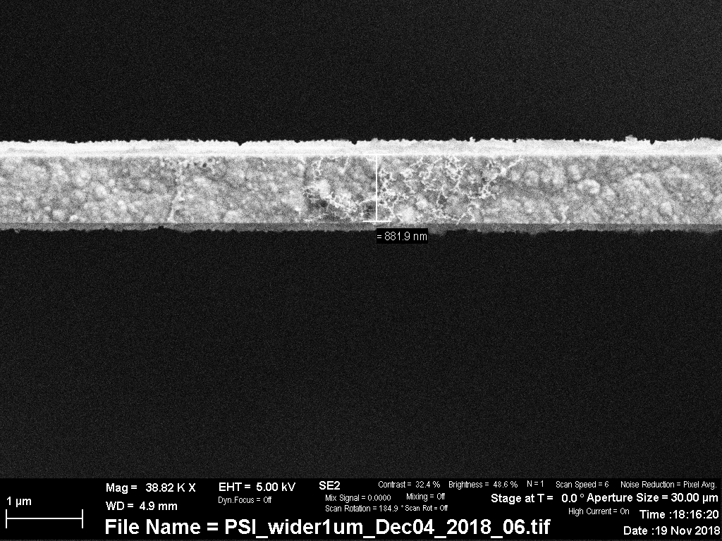
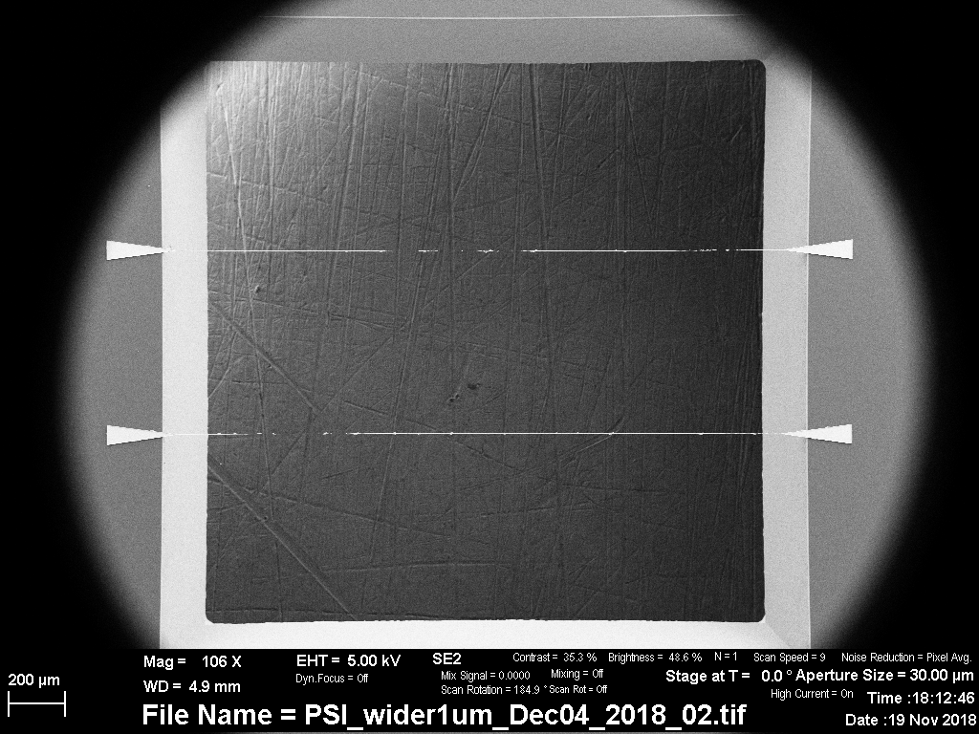
Nano-fabricated WSC structure
900nm
700nm
800um
2mm
WSC nano-fabrication by LMN, PSI,
Laboratory for Micro- and Nano-technology
FERMI WSC nano-fabrication

Slide 4
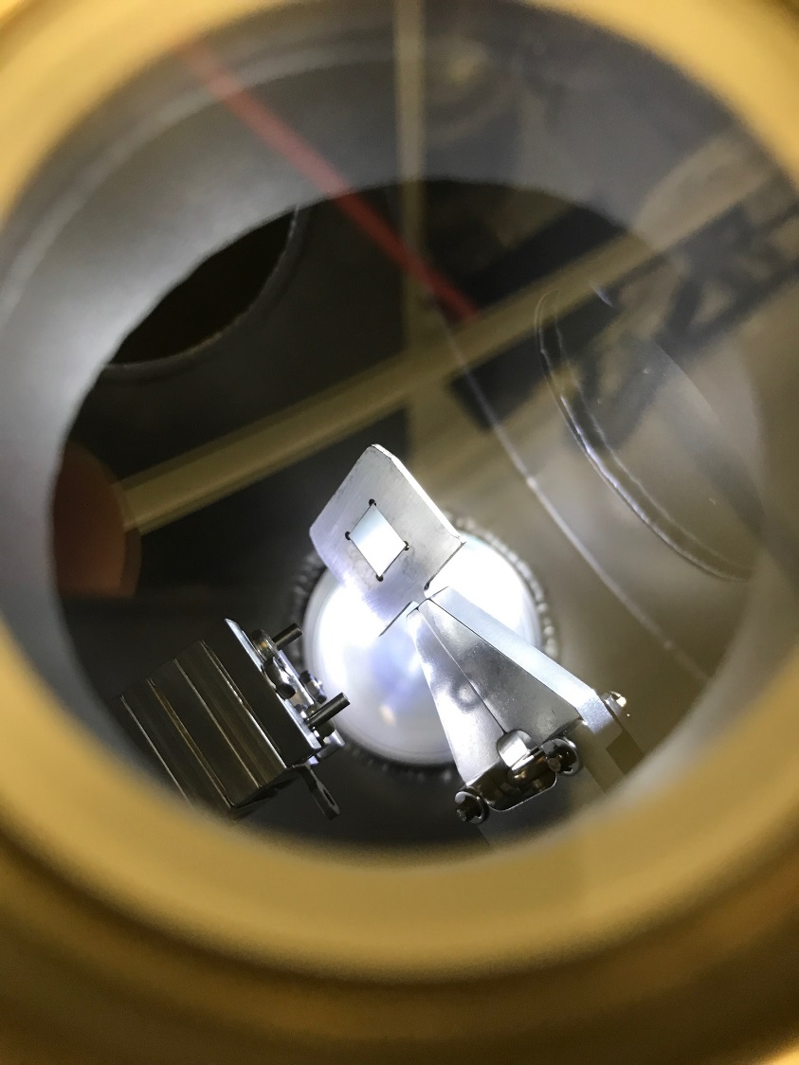
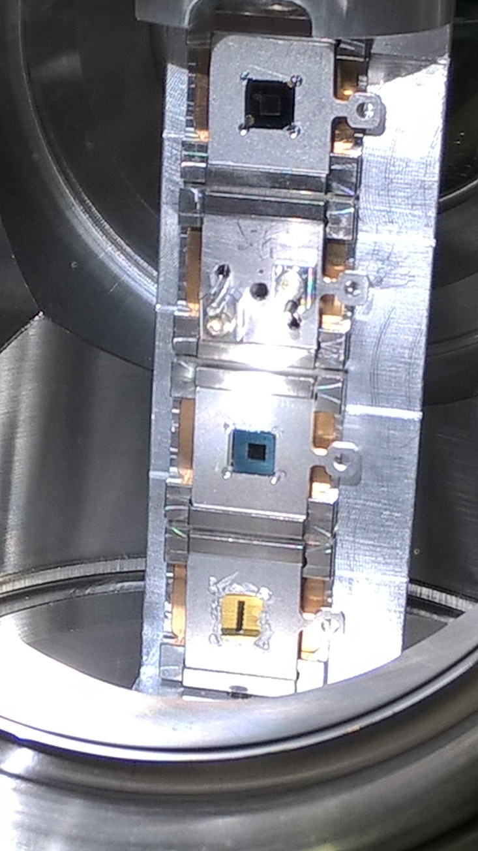
Sub-um WSC experimental set-up at SwissFEL (SINDI02-DLAC055, z=89m)
PSI >1um
5um W wire
(reference)
PSI <1um
FERMI

Slide 5
PSI-FERMI sub-um WSC test at SwissFEL: experimental results
WIRE | FIT | SIGMA (nm) | BEAM-LOSS-DETECTOR
PSI 800nm | ERF fit | 488+/-20 | PMT
FERMI 900nm | ERF fit | 477+/-70 | PMT
PSI 800nm | ERF fit | 498+/-134 | Photodiode
PSI 800nm Au,
PMT signal
[S/N_Ratio(PMT)]/[S/N_Ratio(PHOTODIODE)]~10
PSI 800nm Au,
Photodiode
FERMI 900nm Au
PMT signal

