Slide 1
Neutron Optics enhanced Sample Environment
Marek Bartkowiak :: Sample Environment Group LIN :: Paul Scherrer Institut
1st Workshop on Efficient Neutron Sources, 2.-5. Sept. 2019 PSI

Slide 2
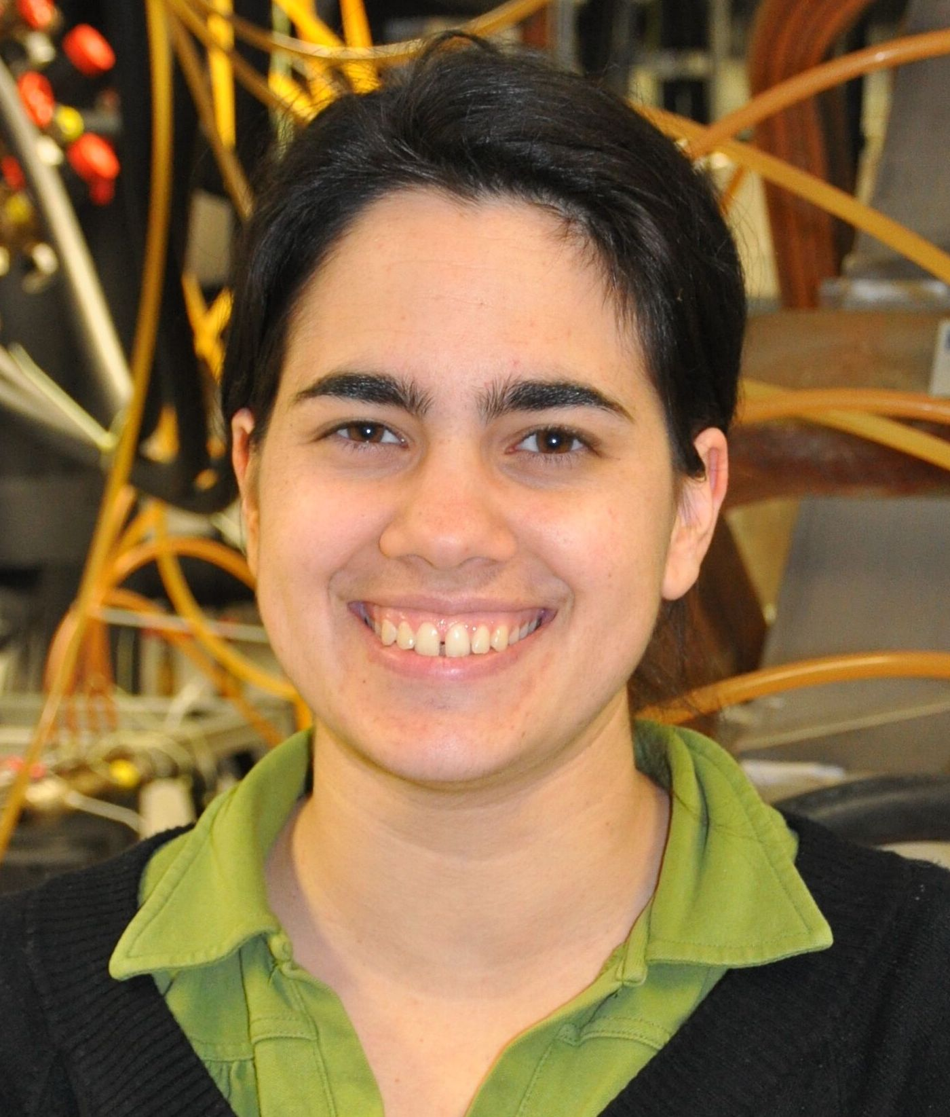


Project Team
Christine Klauser
Emmanouela Rantsiou
Tobias Panzner
Matti Forster
Uwe Filges
Peter Böni

Slide 3
Motivation
Sample
Samples are often very small/tiny (~ 1 mm³)

Slide 4
Motivation
Sample
Neutron beam
Neuron beam has cross-section of ~1cm²
Samples are often very small/tiny (~ 1 mm³)

Slide 5
Motivation
Sample Holder
Sample
Sample Space
Neutron beam
Neuron beam has cross-section of ~1cm²
Samples are often very small/tiny (~ 1 mm³)
sample holder in close vicinity of sample will contribute to background

Slide 6
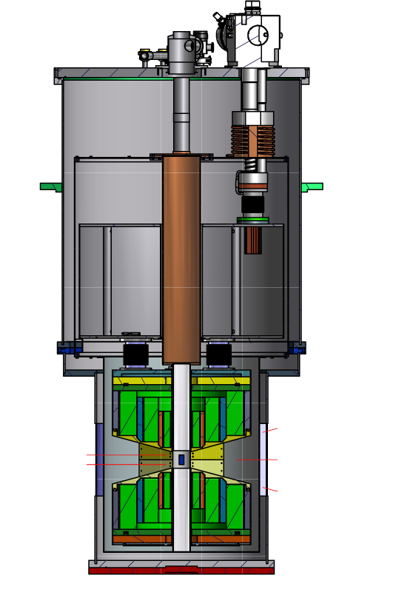
Motivation
Samples are often very small/tiny (< 1 mm³)
Samples are located inside different kind of sample environments (like cryostats)
for complex sample environment focusing elements are far away from sample – large direct beam size

Slide 7
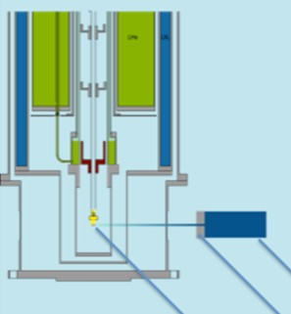
Motivation
beam collimation
minimises parasitic scattering
➔ better signal-to-noise ratio
and
no flux increase on sample
neutron beam
sample
aperture
Seite 7

Slide 8
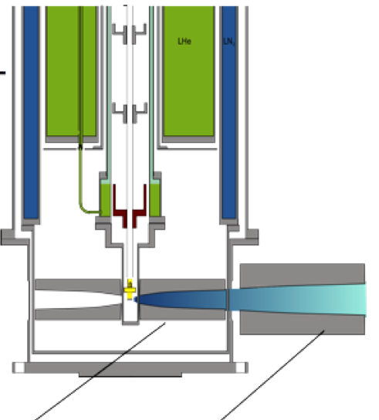
Focusing neutrons on small samples
Focusing important
Maximises beam on sample
minimises parasitic scattering
➔ better signal-to-noise ratio
and
higher flux on sample
neutron beam
cryogenic lens
RT optics
PSI,
Seite 8
PSI,
3. September 2019
3. September 2019

Slide 9
some design considerations
conceived as an addition to existing instruments as add-on
will mix direct beam and reflected beam
will increase divergence
will be limited in length
SE equipment: Paris-Edinburgh press
samples are small
restricted beam access to sample
simple cryostat
Instrument:
suitable for instruments where beam divergence is not critical
PE-press is used
cold neutrons instrument
➔DMC (powder diffractometer)

Slide 10
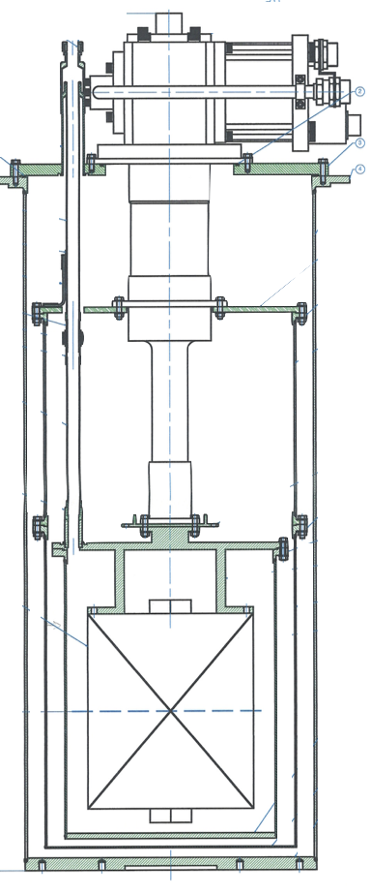
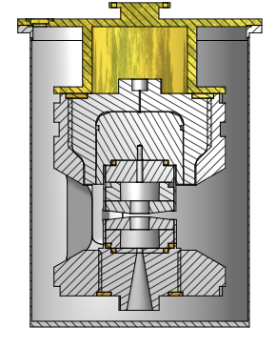
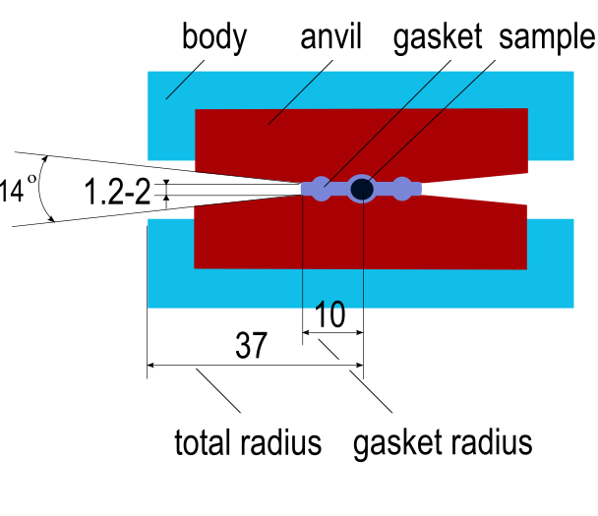
PE-press
sample volume sphere diam. 5mm
pressure cell (vert. opening 2-1.2mm at gasket)
anvil vertical angle +-7 deg
pressure cell 100kbar operated at <5K - 300K
in He exchange gas
diam 227

Slide 11
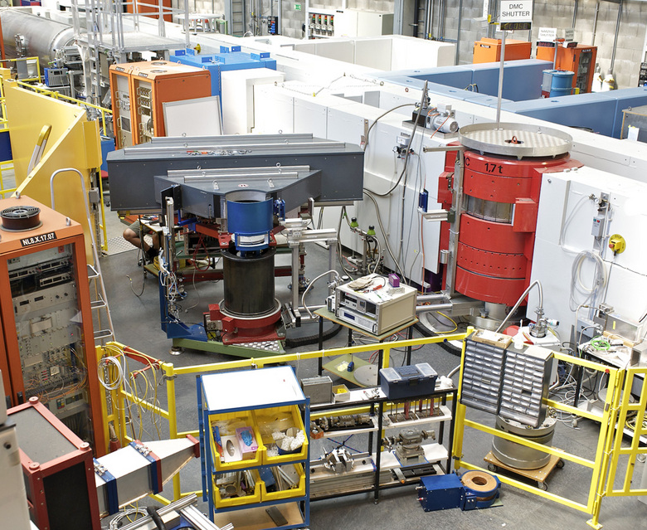
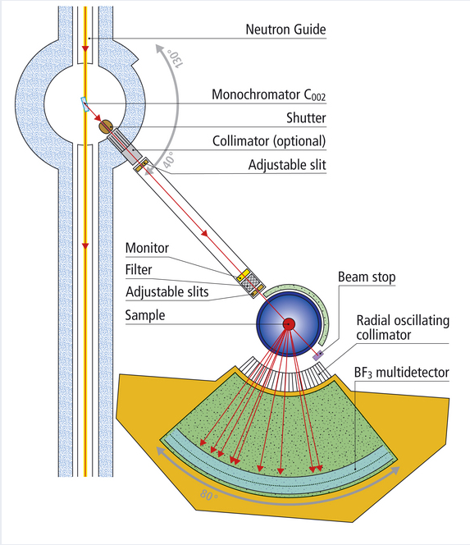
DMC
monochromator: pyrolytic graphite, vertical focusing, 5 crystals of height 25mm
wavelength (selected for the experiment): 2.45Å and 4.5Å
oscillating radial collimator in front of the detector
“Banana” type multidetector 0.2º angular separation
radial coverage 79.8º, vertical acceptance 1.7º

Slide 12
key issues to be addressed
a room temperature pre-focusing optics needs to be made, optimized as part of the full setup
➔ many different focusing types should be available (quasi adapt)
a miniature focusing neutron lens suitable for cryogenic temperatures has to be devised
➔ a project by itself
both elements need to be aligned with respect to the sample
➔needs precision mechanics
➔ needs an alignment procedure

Slide 13
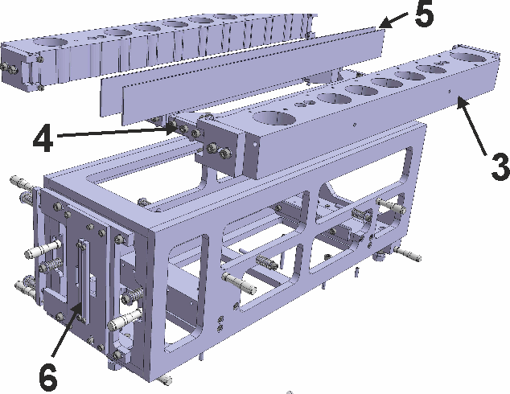
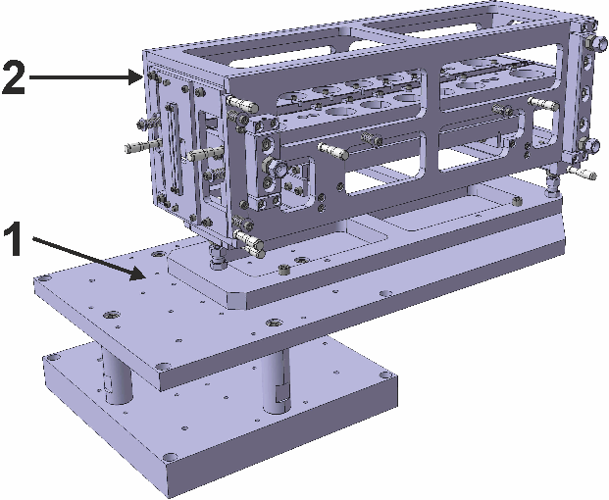
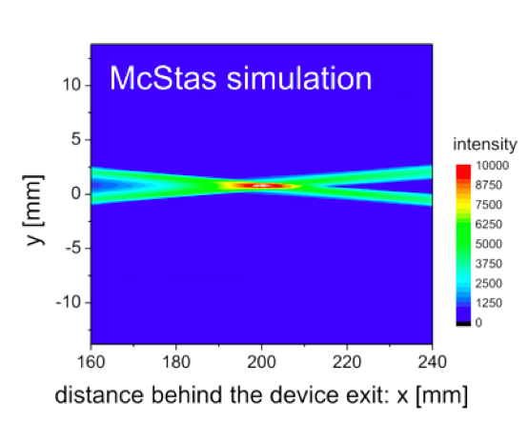
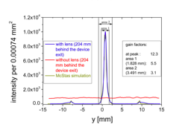
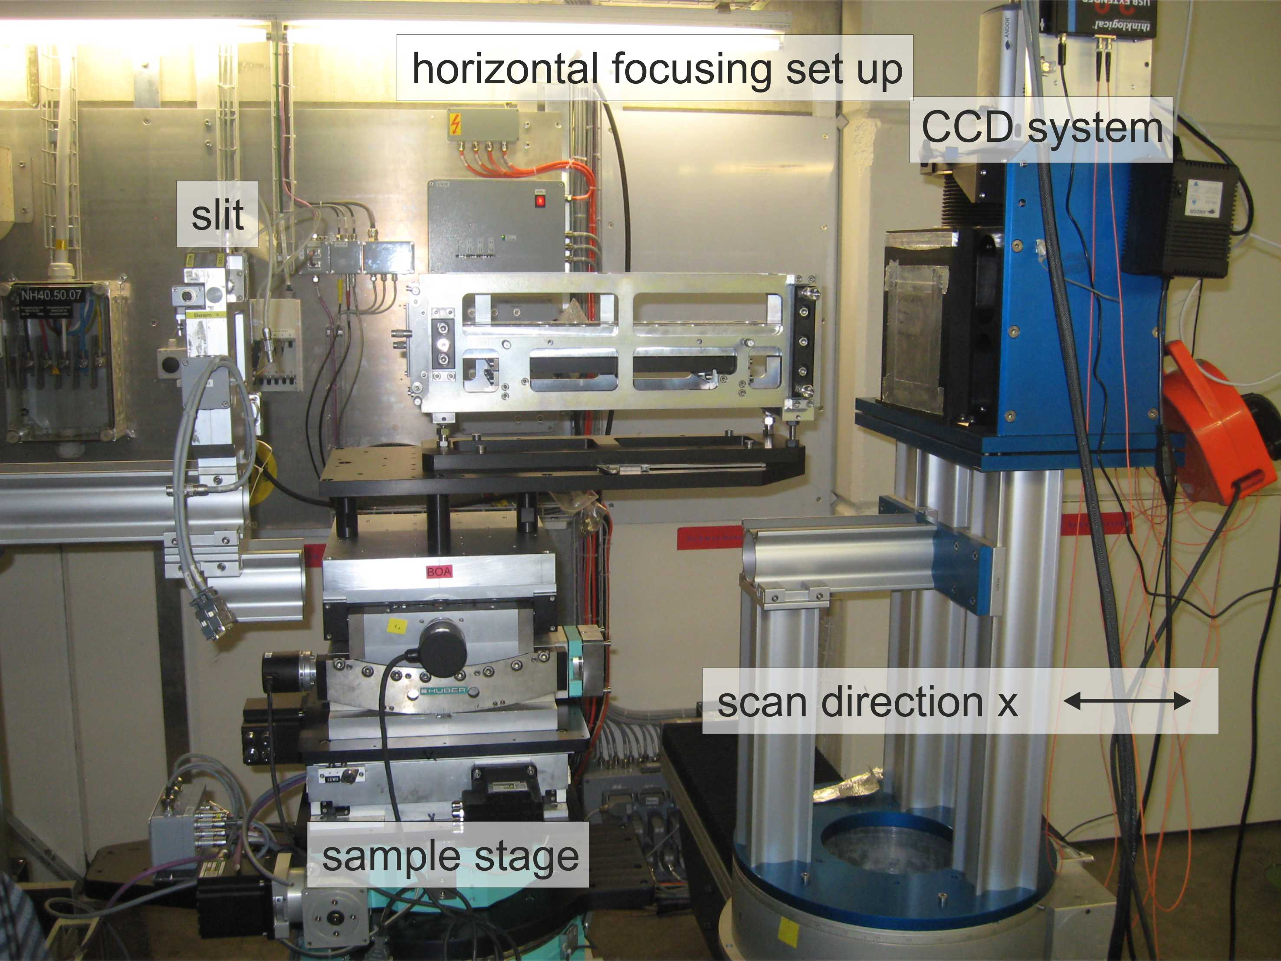
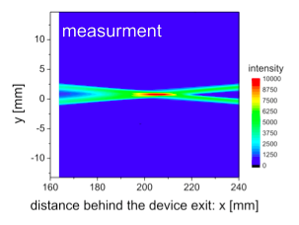
Quasi-adaptive lens system
design without any motor
1- base plate
2 - adjustment box
3 - aluminum frame
4 - adjustment carrier
5 - super mirror coated substrate
6 - beam stop pair
Simple and adaptable system for non-linear guide profiles
experimental set up at BOA
gain factor > 12
peak size (FWHM) < 0.17 mm
Notes:
Profiles are eroded with a precision of 1-2 mum. Turning machine …

Slide 14
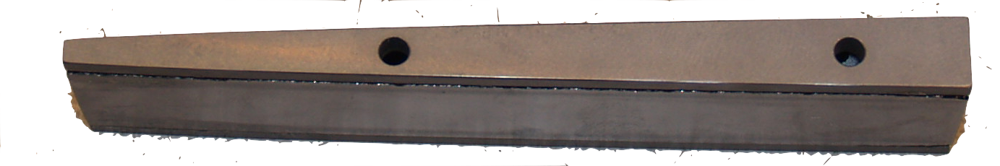
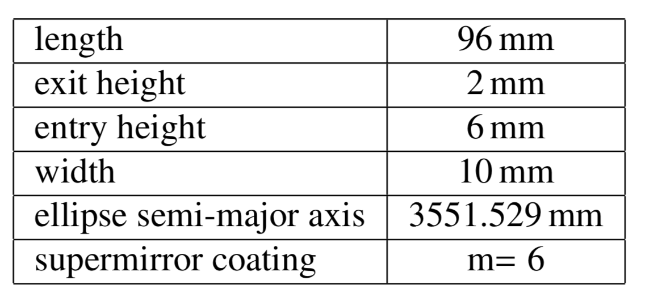
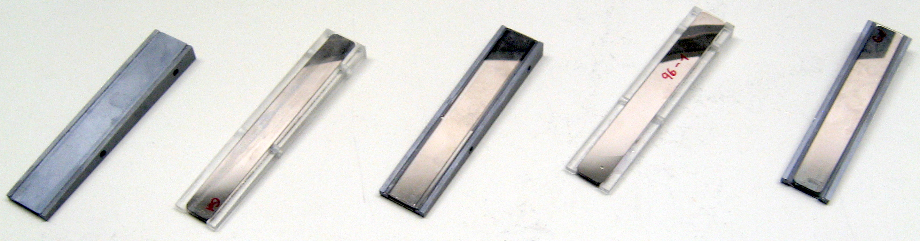
Cryogenic Lens
Investigation of Si, glass optic assemblies
critical points:
assembling of curved super mirrors
choice of glue
precision of the gluing process

Slide 15
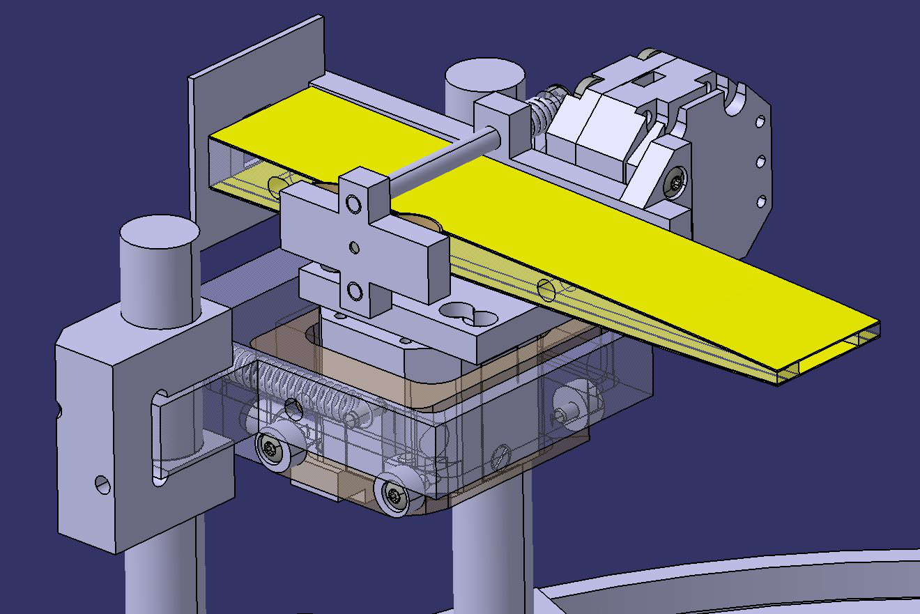
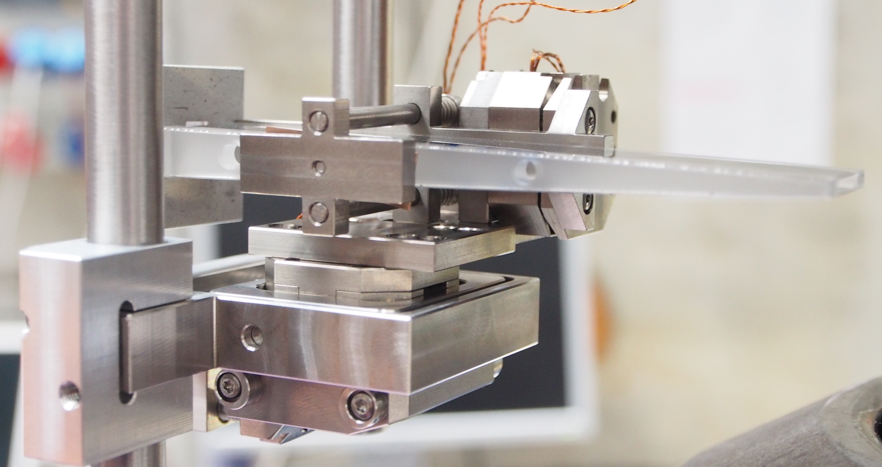
Cryogenic Lens
precision requirements on the lens holder:
0.1mm vertical
tilting < 0.03deg
vertical height and tilt adjustable after installation even at 4K
piezo-drives
tilt around the focal point <1mº precision
vertical height with < 0.1um precision
Lens holder – precision under extreme conditions

Slide 16
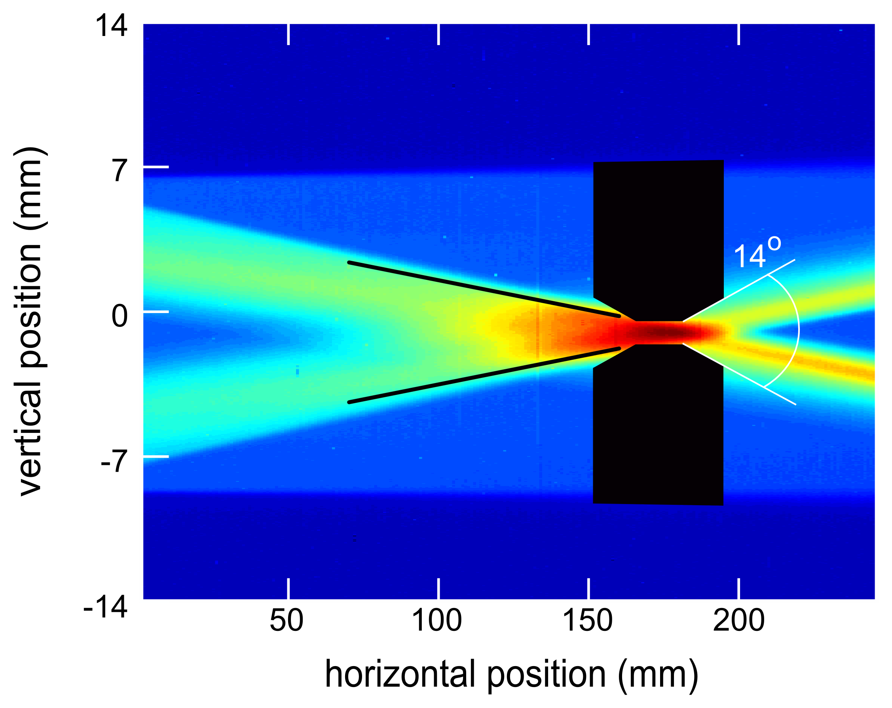
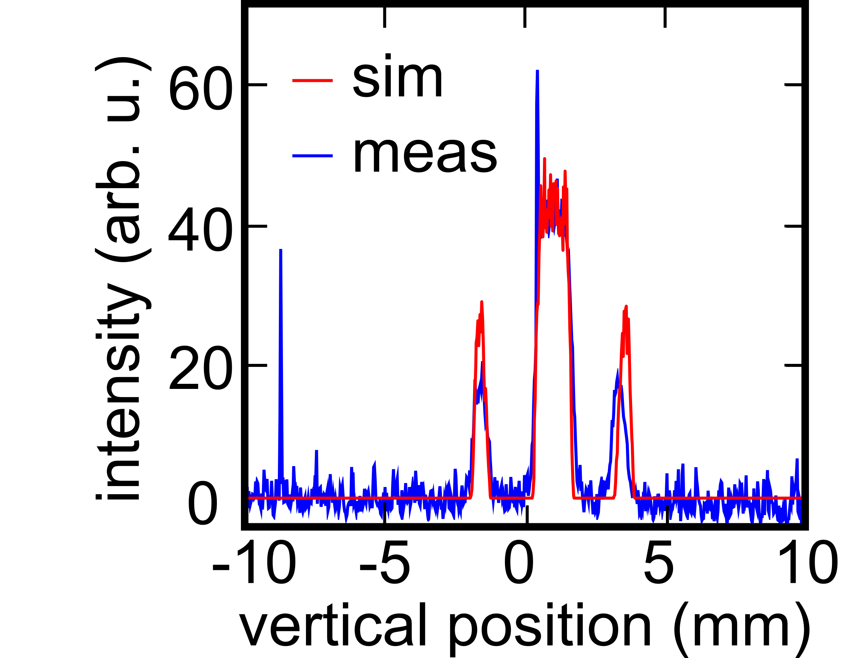
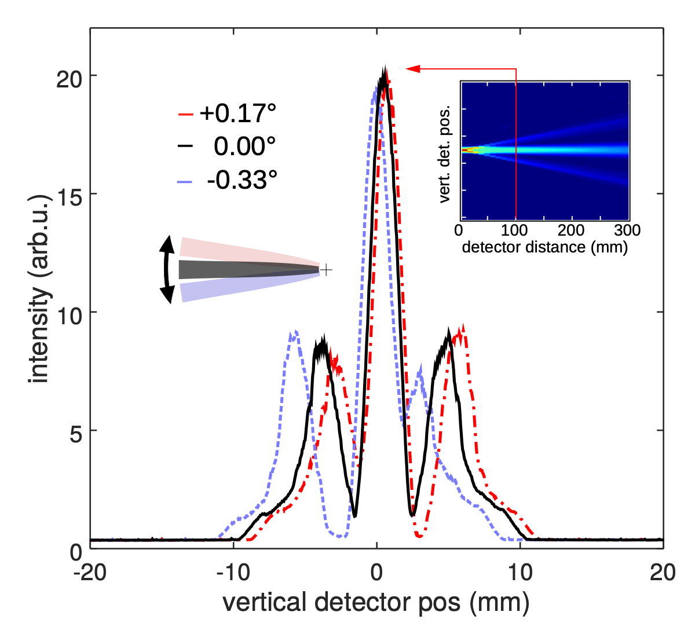
beam profile – phase space
alignment procedure relies on in-situ characterization of the transmitted beam:
align quasi adaptive lens with respect to sample
remove qao
align cryolens
install qao
fine-adjust full setup

Slide 17
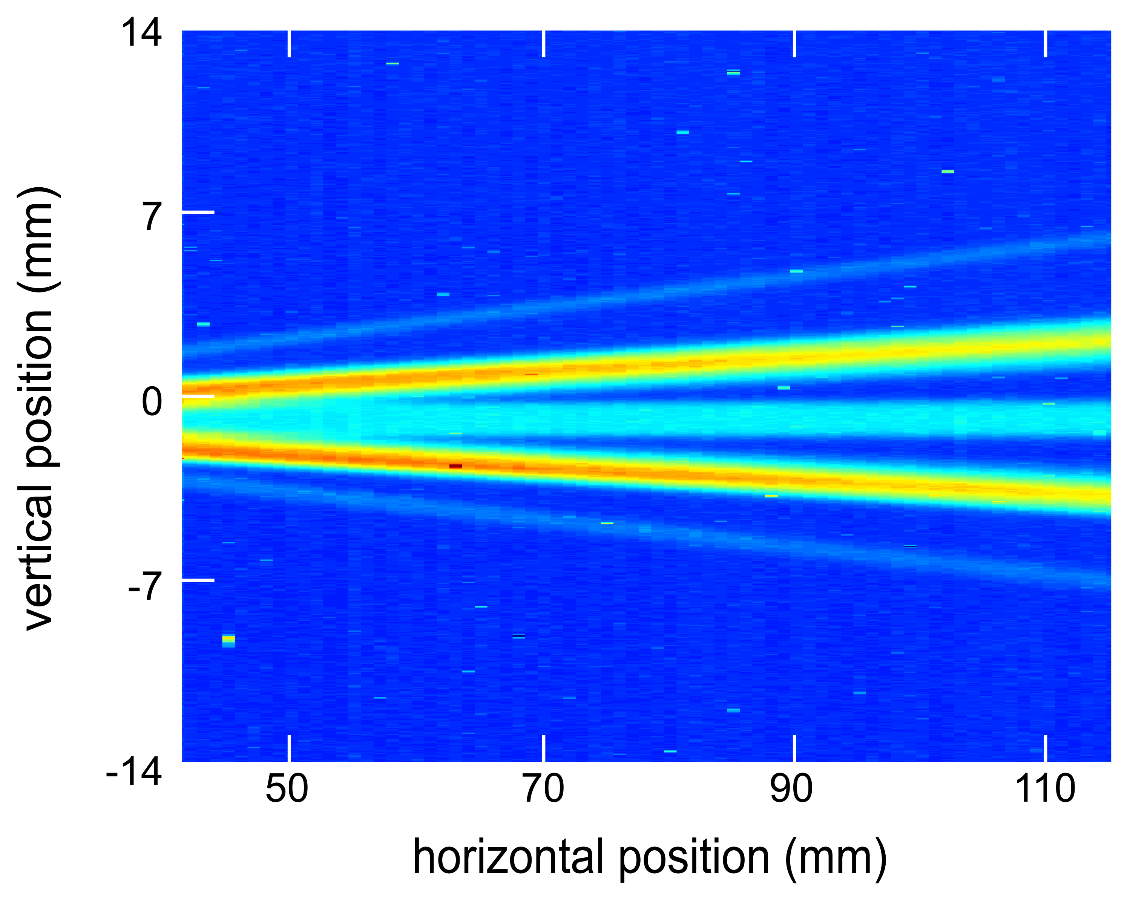
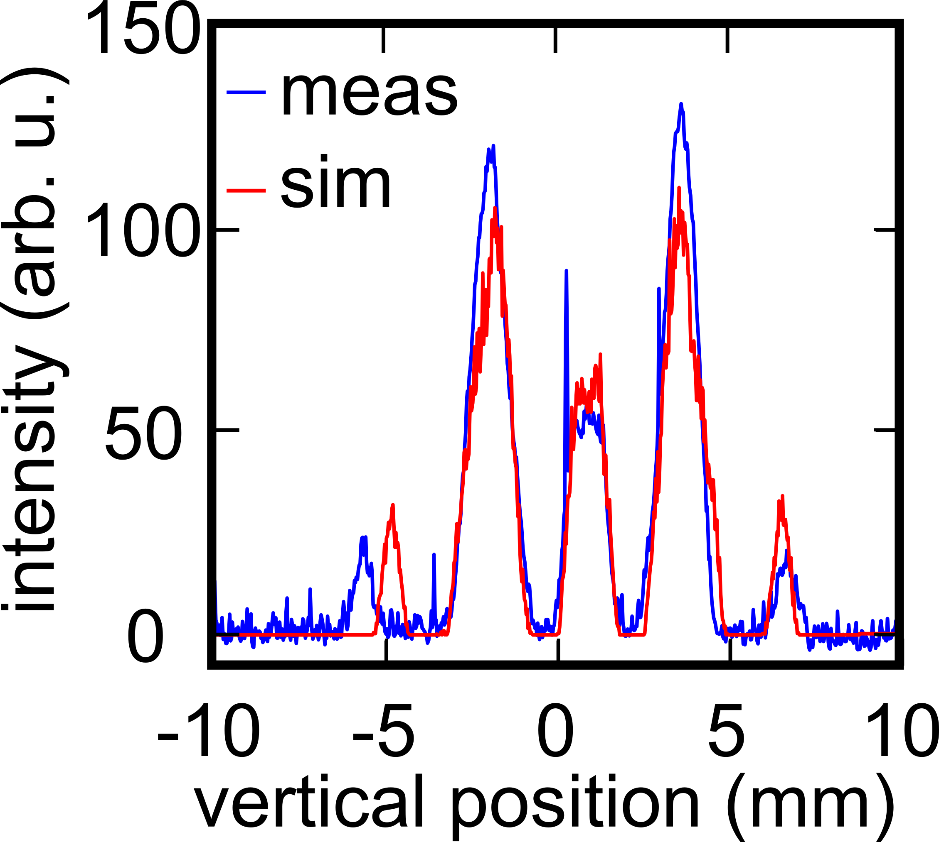
beam profile – phase space
alignment procedure relies on in-situ characterization of the transmitted beam:
align quasi adaptive lens with respect to sample
remove qao
align cryolens
install qao
fine-adjust full setup

Slide 18
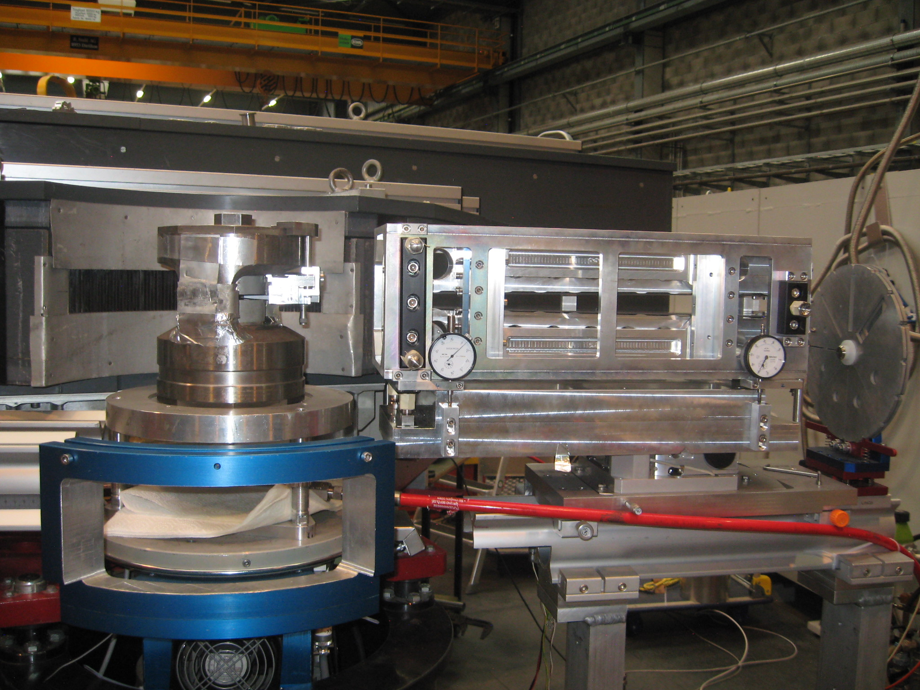
full setup on DMC
DMC radial detector
PE-press
cold optics assembly
quasi adaptive optics
neutron beam

Slide 19
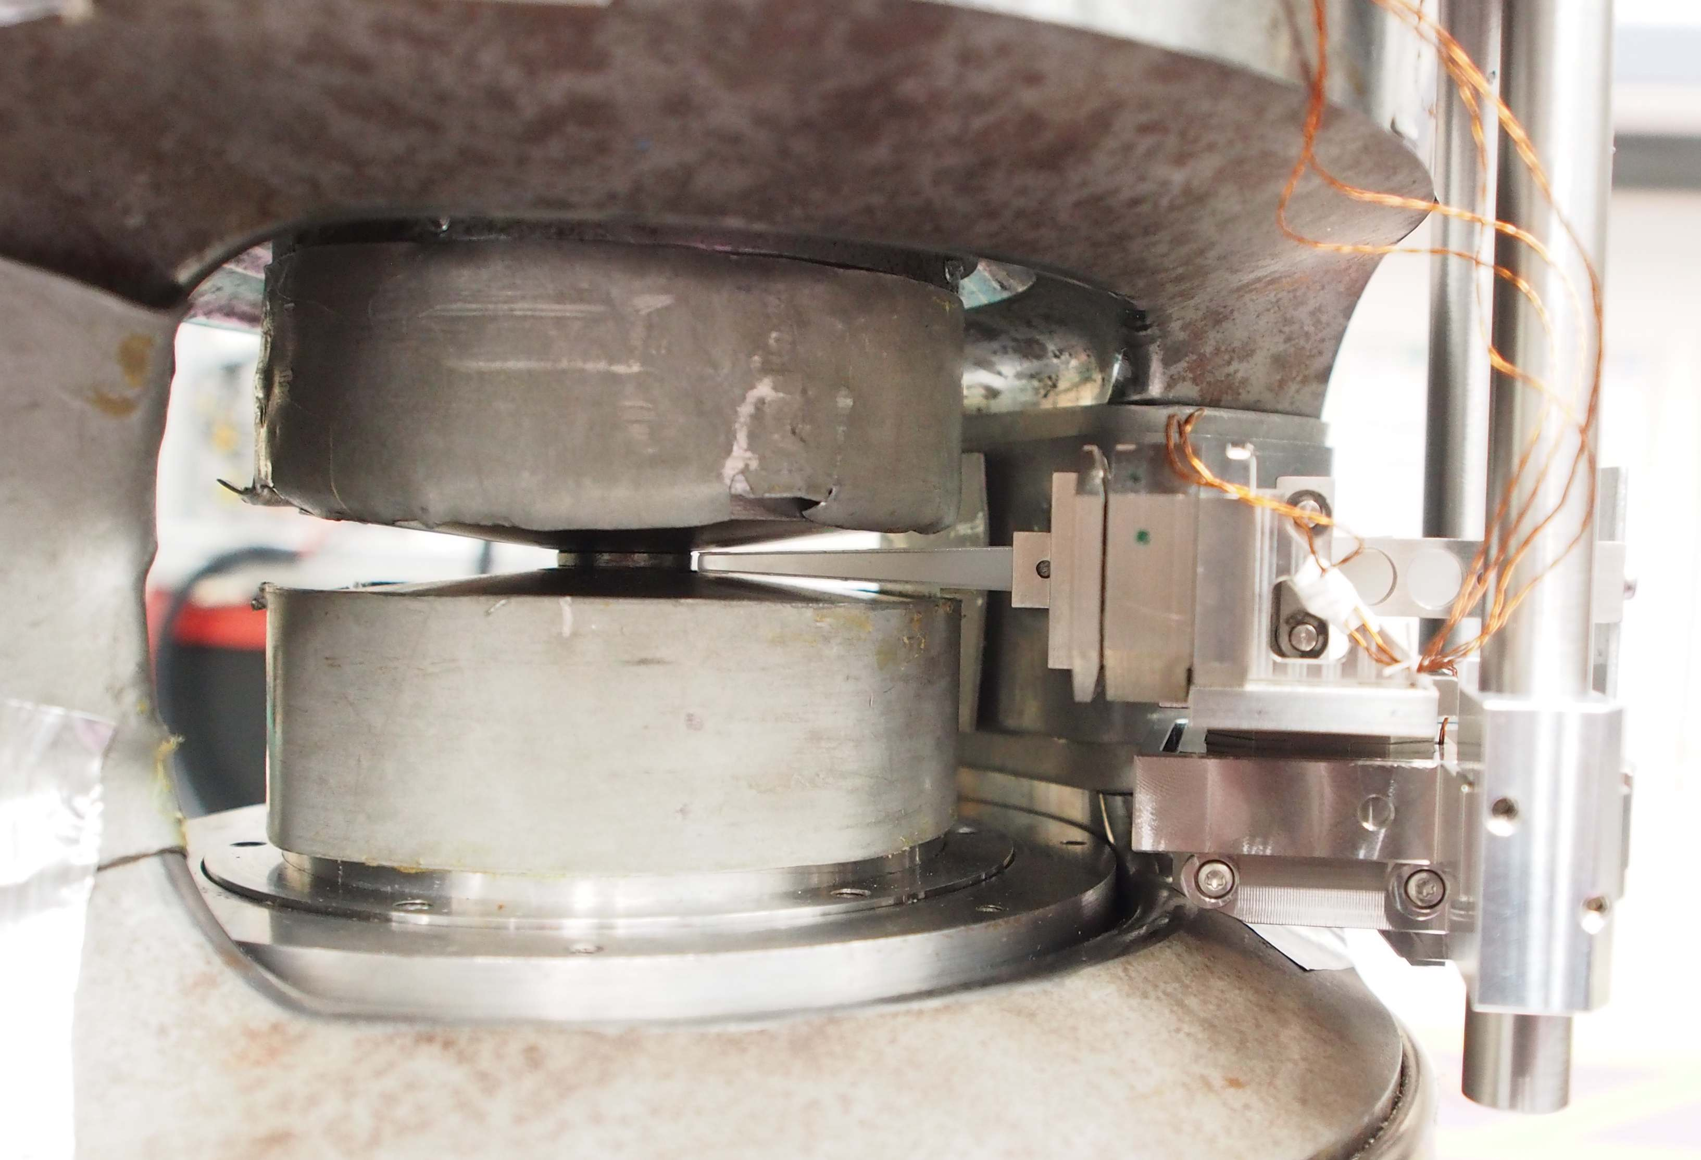
full setup on DMC
DMC radial detector
PE-press
quasi adaptive optics
neutron beam
10GPa Paris-Edinburgh press
Anvil
Gasket
cryogenic Neutron lens

Slide 20
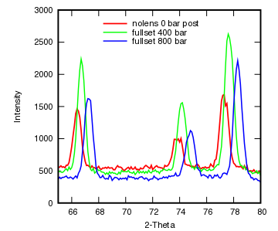
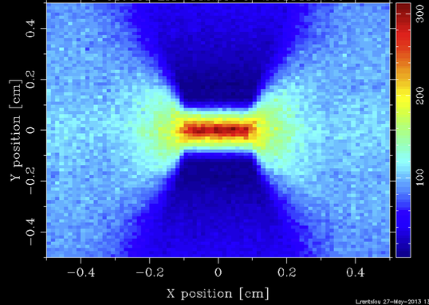
Results in comparison with simulation
McStas simulation were performed
optimal design for the lens setup was found
max length cryolens: 97mm
min gap between both lenses: 70mm
elliptic lens: more defined focal point and higher gain (3.5)
Sample: Mn_{33.3}Ni_{41.7}Si₂₅ at 4.5 A
Measurement was done up to a pressure of 60 kbar.
A gain factor (signal/noice) of 2.5 was measured without a loss in resolution.

Slide 21
Results in comparison with simulation
Sample: Mn_{33.3}Ni_{41.7}Si₂₅ at 4.5 A
Measurement was done up to a pressure of 60 kbar.
However…
A gain factor (signal/noice) of 2.5 was measured without a loss in resolution.
The distance between the focusing monochromator and the first optical element was maximized to reach this gain.
but usually a 77cm shorter distance is used due to the horizontal beam divergence (~1/3 of total dist.)

Slide 22
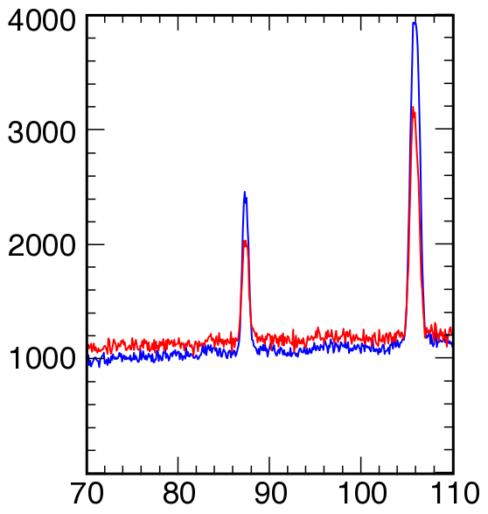
Results – short distance
4.5Å
without optics
with optics
use cold optics only
quasi adaptic optics has no effect
Gain 1.5
Intensity
this is in agreement with simulation
intensity gain at sample: 2.5
reduction in detector du to anvils
(they act as beam restriction)
2θ in deg

Slide 23
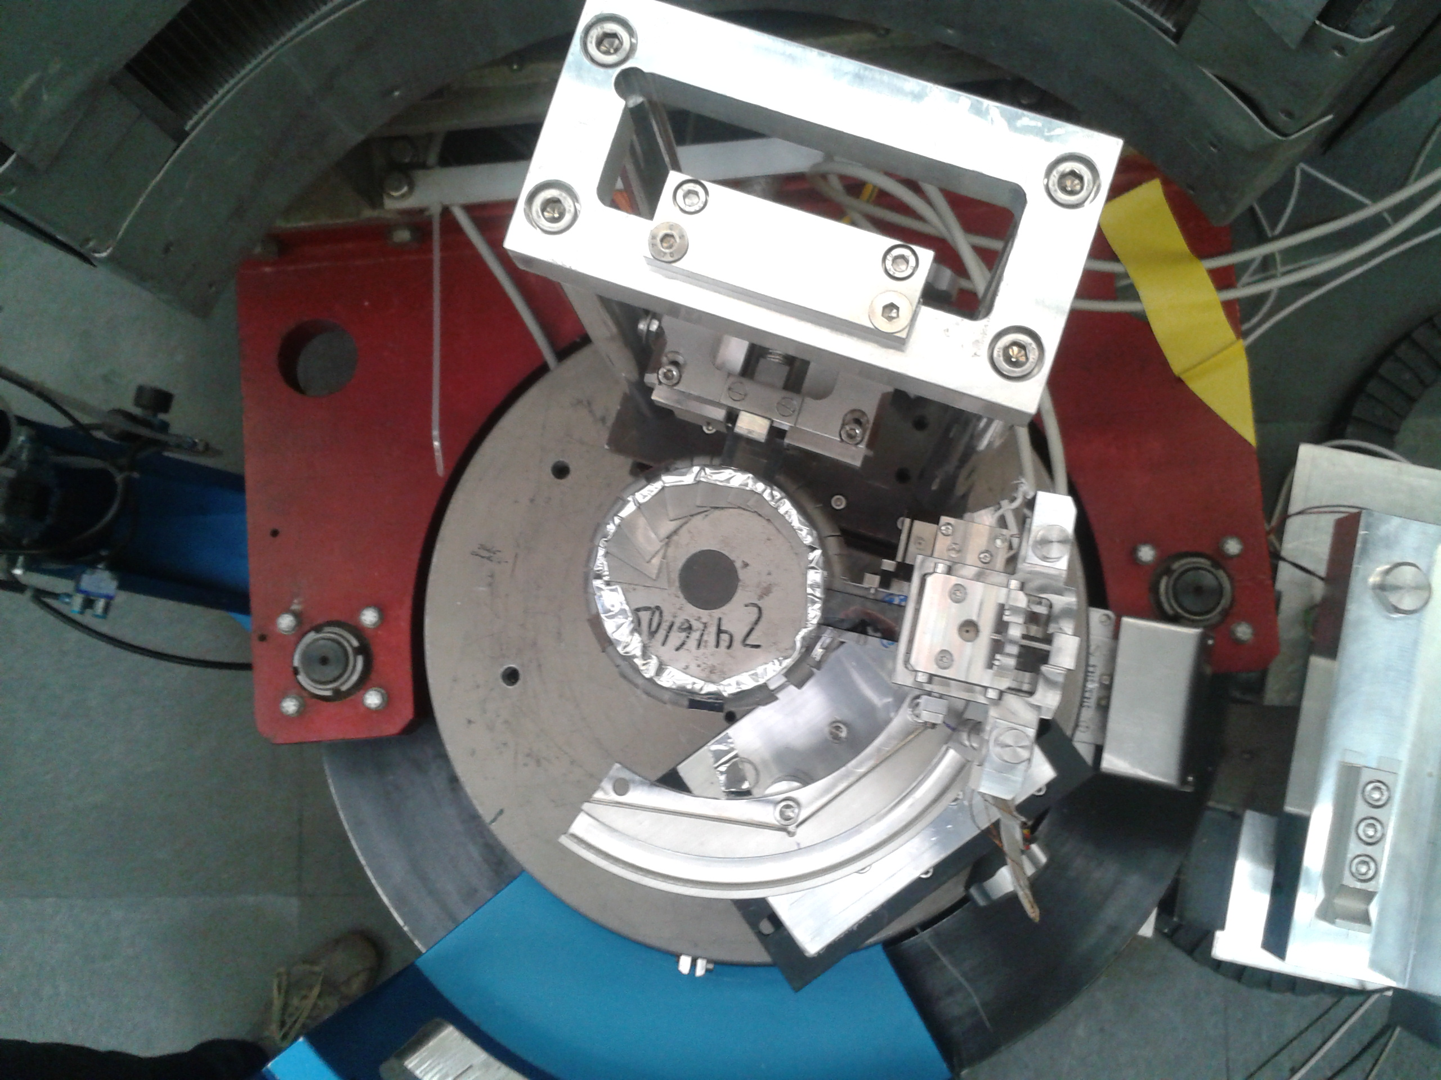
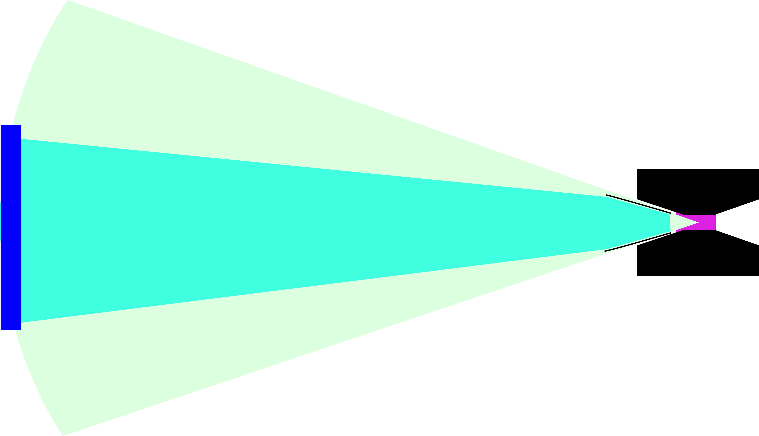
Focus Defocus – a concept for optimization of DMC
defocusing lens
vertical opening of detector
+- 1.7 deg
vert beam divergence of optics
+- 3.5 deg
sample
focusing lens
side view:
pressure cell
detector
scattered beam

Slide 24
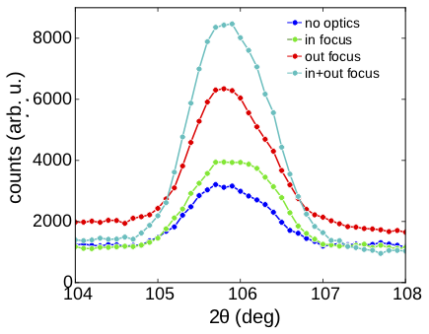
Focus Defocus – a concept for optimization of DMC
defocusing lens
sample
focusing lens
side view:
Gain 4.0
@ 4.5Å
pressure cell
detector
scattered beam

Slide 25
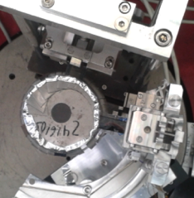
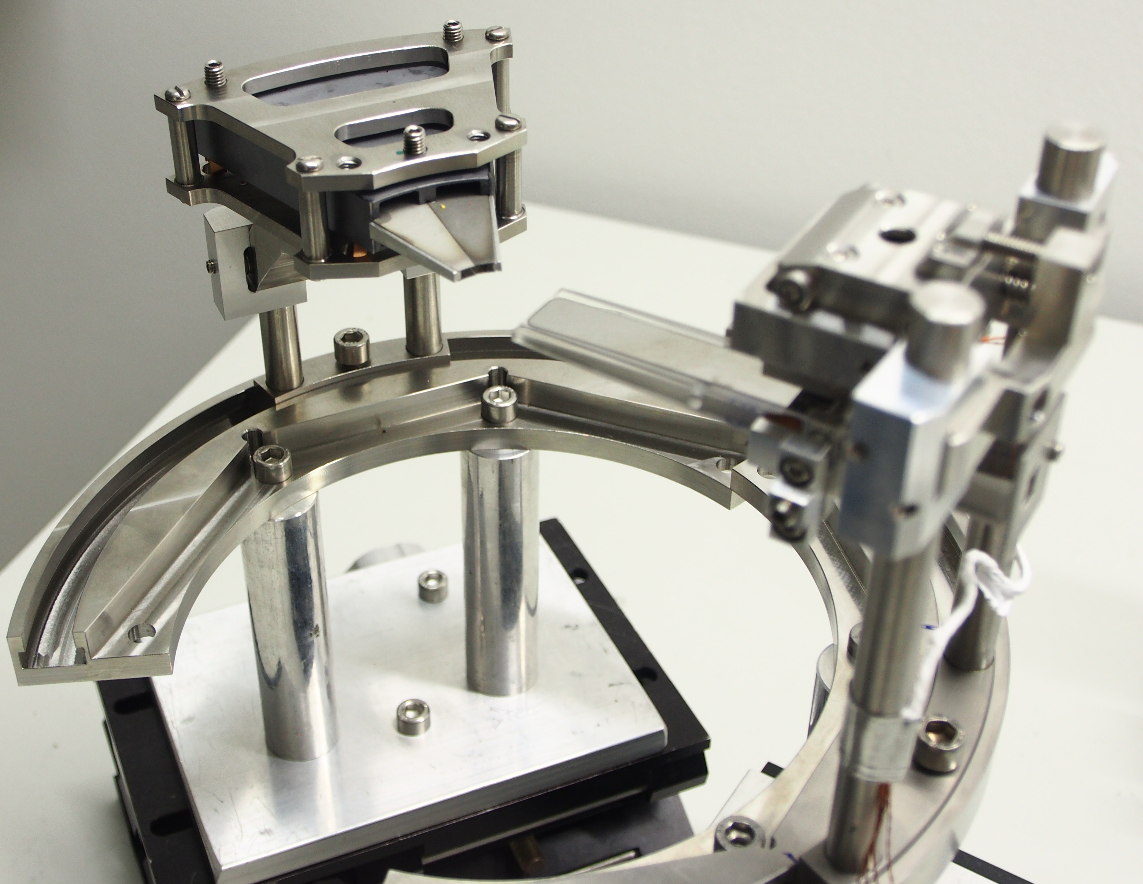
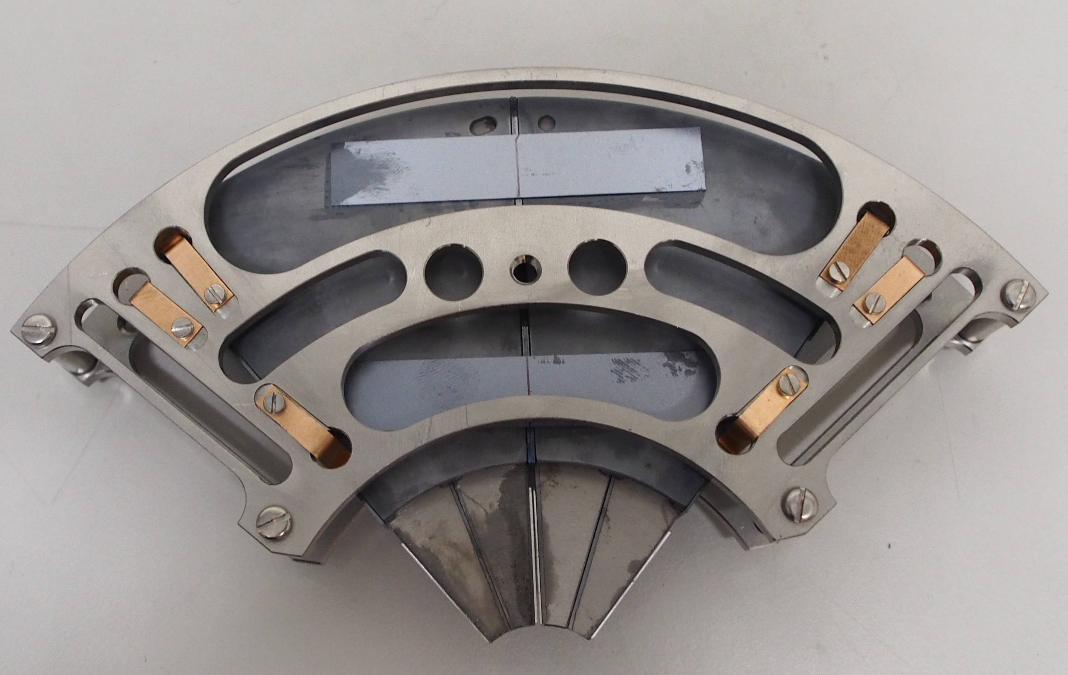
defocus lens development
test setup coverage ~6deg
wide angle optics 1 coverage 2x20deg
wide angel optics 2 coverage 4x20deg
all-silicone made wide angle lenses
made of segments to approximate a conical surface
defocus expected gain: 1.8

Slide 26
open question
3 distinguishable beam portions are observable
Can we use this to numerically reconstruct each individual scattering pattern?

Slide 27
Conclusions:
Neutron optics can be used to increase the beam intensity on the sample
and/or reduce the background.
They can be incorporated in cryogenic sample environment.
To take full advantage they need to be considered in the instrument concept from the beginning.
They can be used to increase the performance of existing devices to some extend.

