Slide 1


CBETA Beam optics based on Field Maps of the FFA-magnets*
N. Tsoupas, F. Méot, D. Trbojevic
* Work supported by the Department of Energy

Slide 2
Outline
What is the CBETA accelerator
  Report on simple but very important ideas we introduced in the design of the CBETA accelerator
Description of the FFA cell
The field maps of the CBETA cell
Beam optics: (François Méot)
  Using the field maps of the CBETA cell
  Using the superposition of the field maps of the individual magnets of the CBETA cell

Slide 3
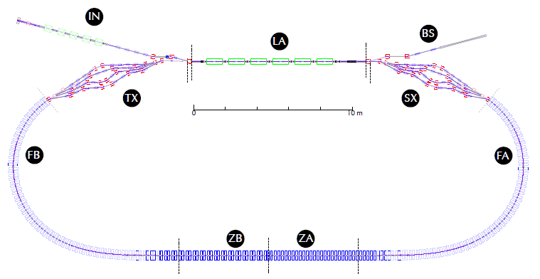

The CBETA project is under commissioning at Cornell University
It may serve as a prototype for the eRHIC project
Injection: 6 MeV e⁻ 100 mA rep-rate 325 MHz
Beam dump
Merger
Splitter
Pass # | Energy
1 | 42
2 | 78
3 | 114
4 | 150
5 | 114
6 | 78
7 | 42
8 | 6
1.3 GHz 16 MV/m E_{max}~80 MeV
At any given time there is an equal number of accelerating
and decelerating bunces inside the ERL.
The Power of the Linac is minimal
Two remarkable concepts:
Energy Recovery Linac (ERL)
Fixed Field Alternating Gradient (FFAG)

Slide 4
The concept of the CBETA FFAG cell
Focusing
Quad
DeFocusing
Quad
41 mm
Each arc-cell bends the beam by 5º
Trajectories of e-bunches with different energy in a cell
The De-Focusing Quad of the ARC is a Combined Function magnet Dipole+Quad
A large energy range (42 MeV to 150 MeV) is confined in a small transverse distance of 41 mm

Slide 5
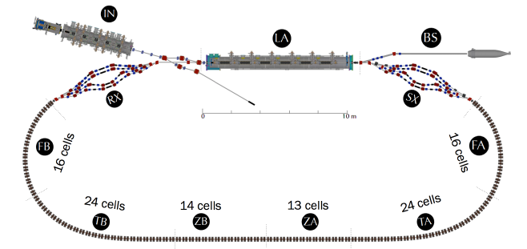
Number of the FFAG cells in the FFAG section of CBETA

Slide 6
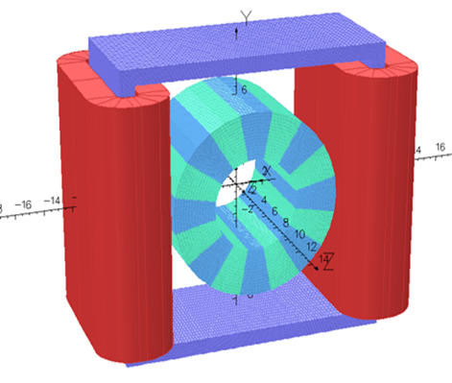
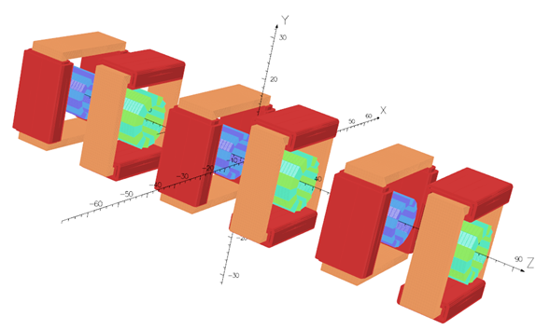
Placement of four FFAG cells on a girder
Single Halbach Magnet
with Corrector
OPERA design of 3 cells
with Correctors

Slide 7

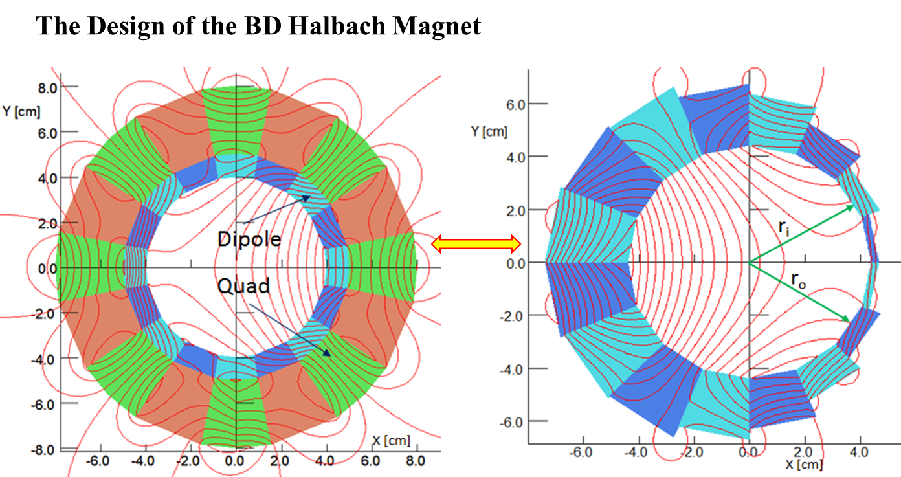
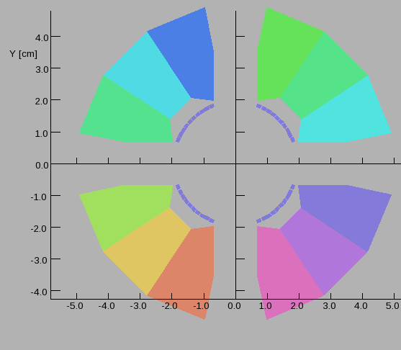
Some Concepts used in the CBETA accelerator
Energy Recovery Linac (ERL)
Fixed Field Alternating Gradient FFAG
Halbach type Permanent Magnets (PM)
Correctors around the PM
Wedges of variable ΔR (S. Brooks)
Correction of Harmonics using
wires with high permeability (μ)

Slide 8
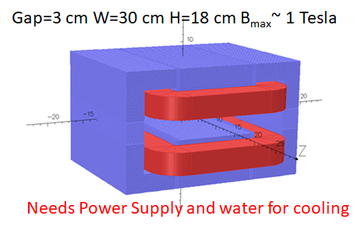
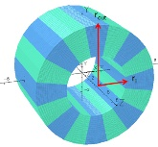
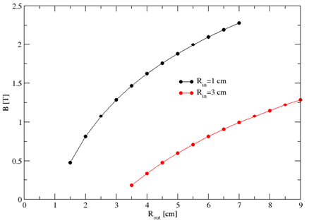
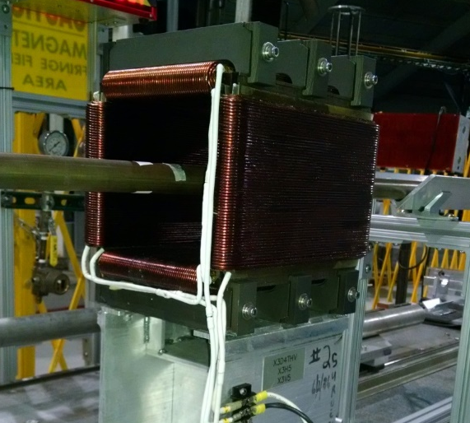
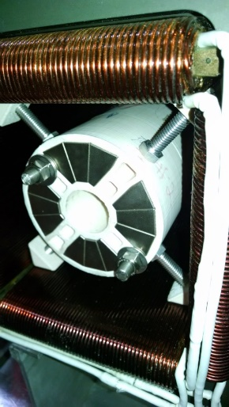
Some advantage of using PM for the FFA
PM are Small size magnets
Strong fields with NO power supplies
Strong fields with NO power supplies
Accepts correctors
Low cost vs. electromagnets.
NO Cross talk between magnets (μ~1.0)

Slide 9
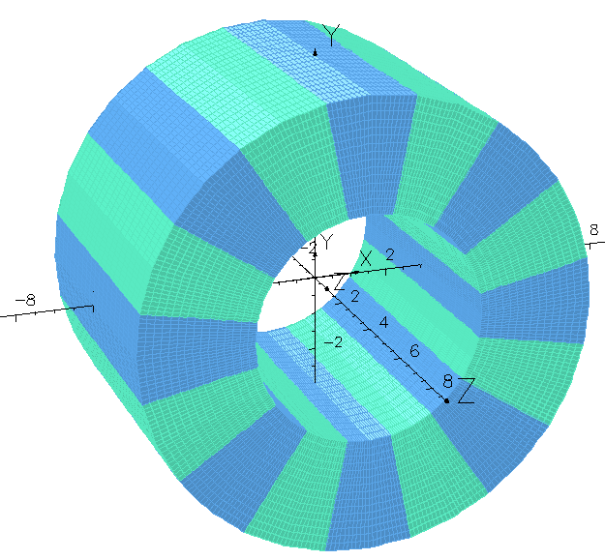
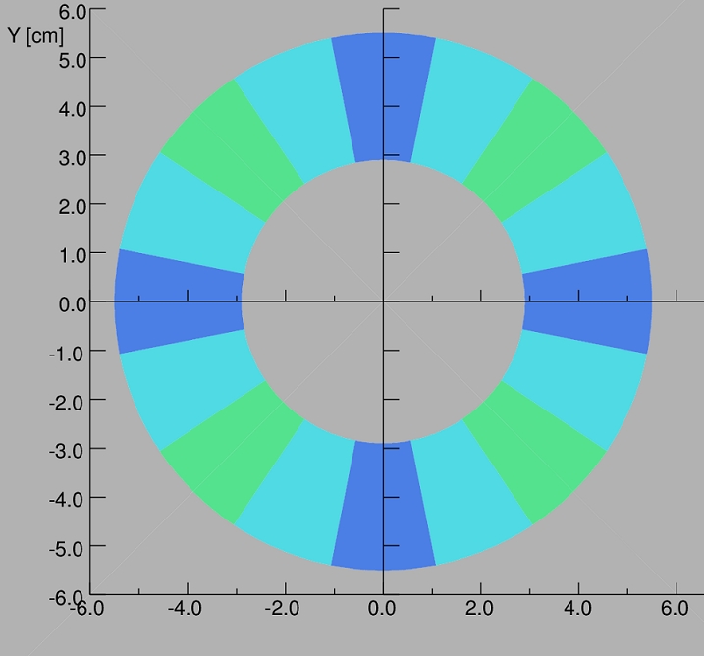
The Halbach Quadrupole
θ
α
Isometric view of Magnetized Wedges
Dipole n=1
Quad n=2
Sext n=3
Direction of the easy axis α=(n+1)θ +π/2
9/11
Cross section of Magnetized Wedges of NdFeB or SmCo

Slide 10
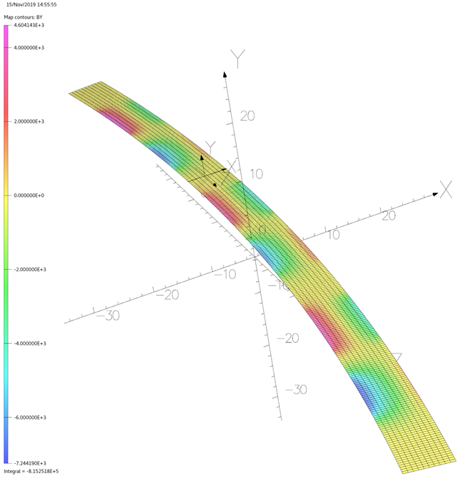
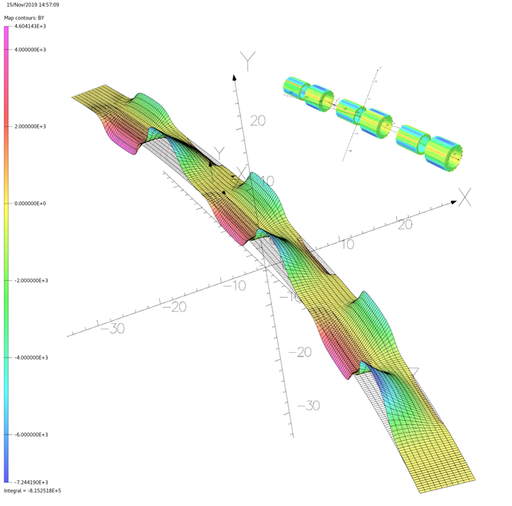
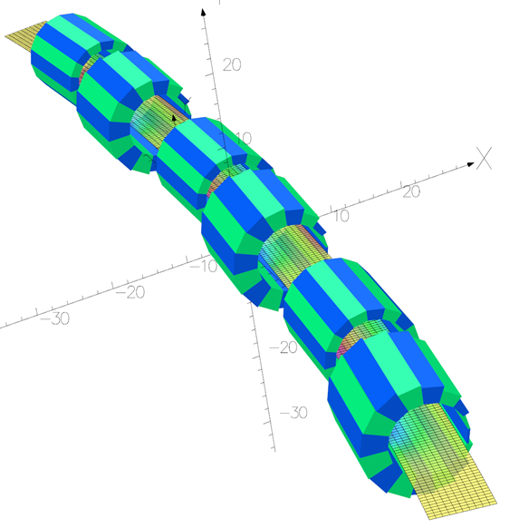
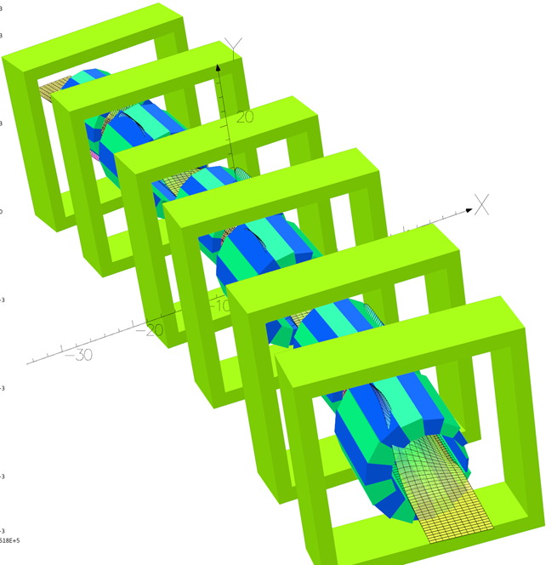
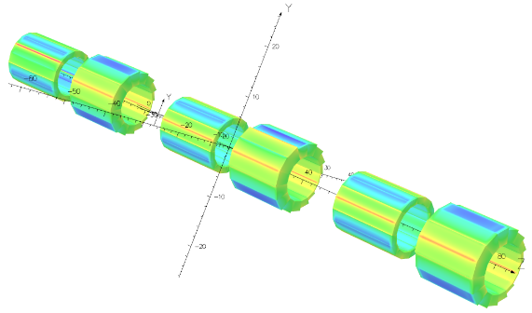

Slide 11
Thank you for your attention

Slide 12
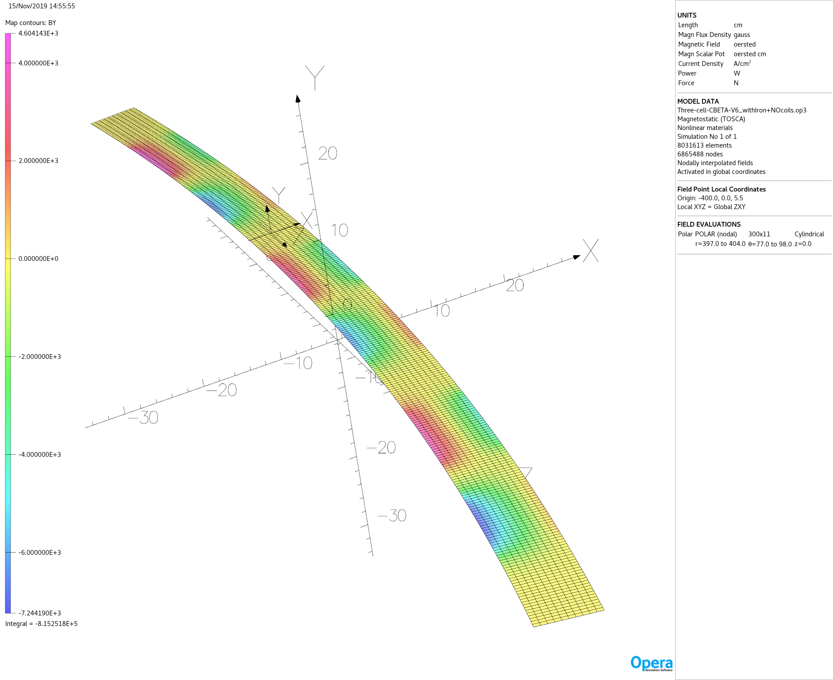

Slide 13
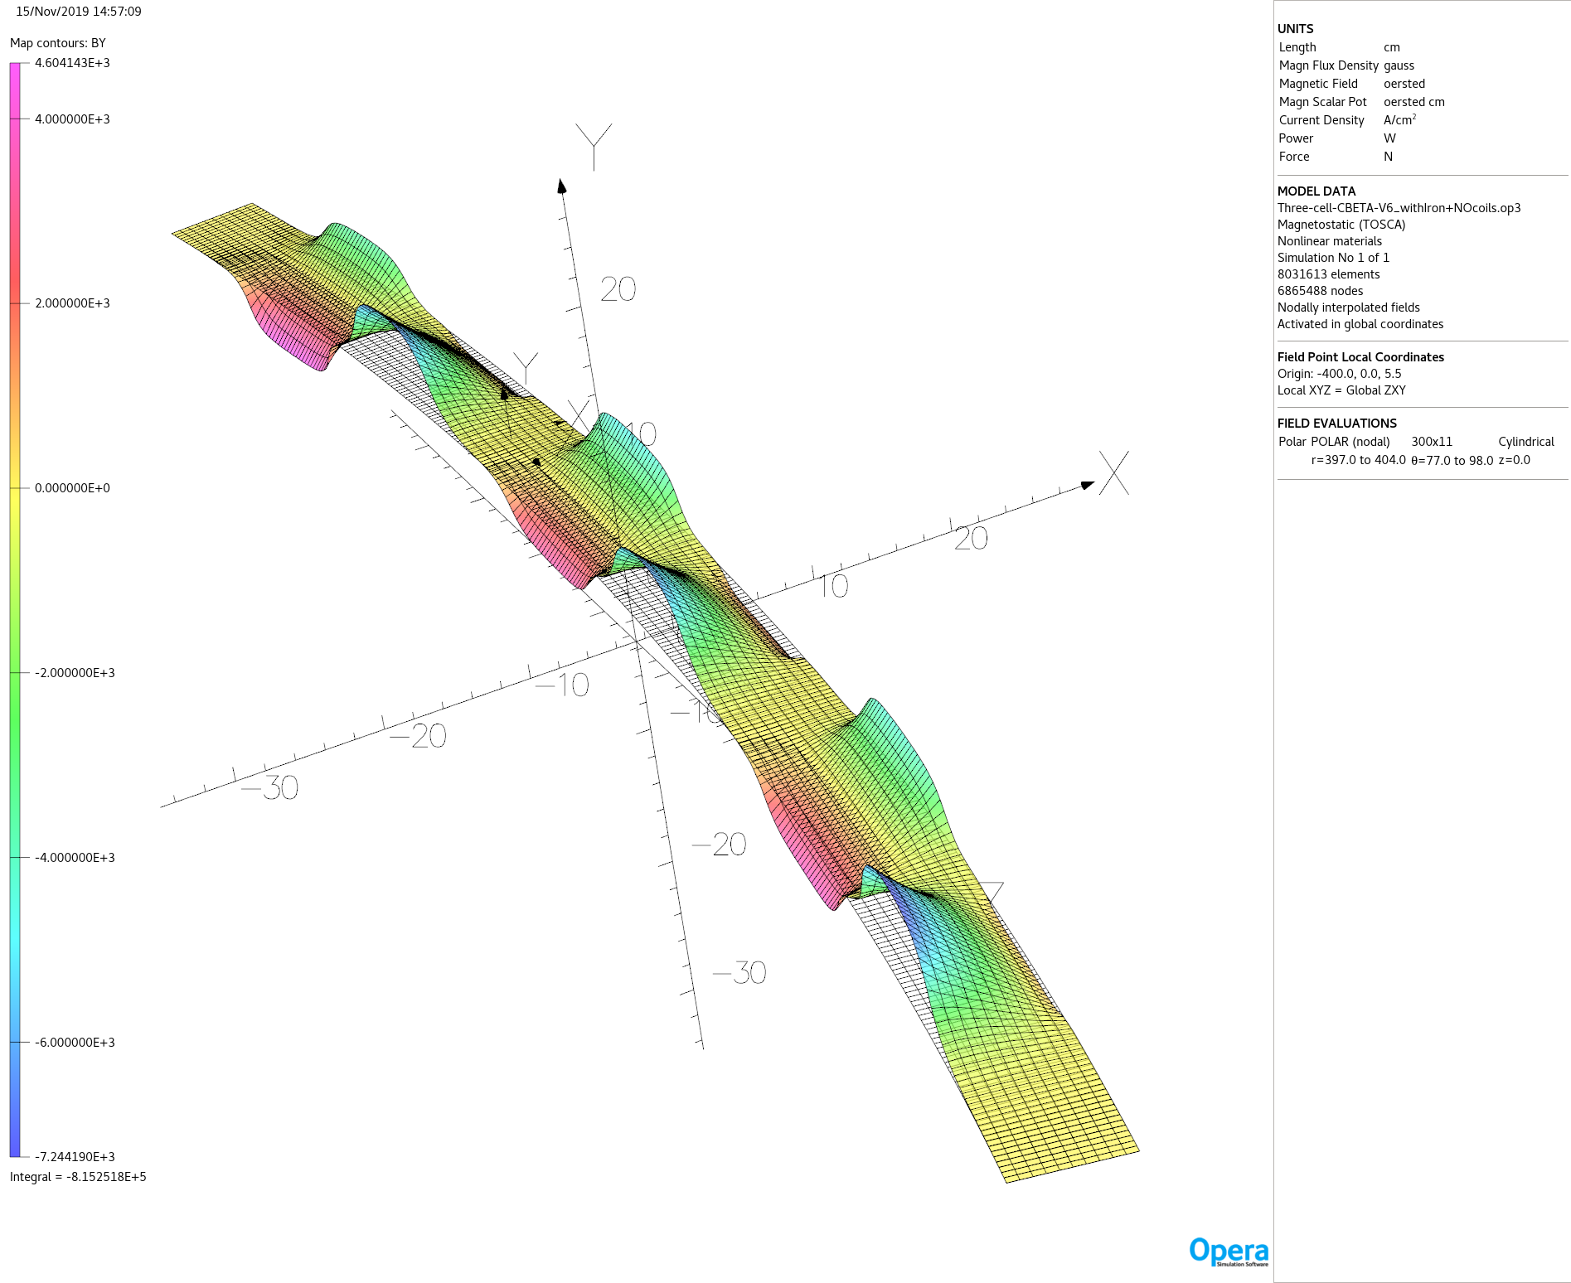

Slide 14
Thank you for your attention

Slide 15
Conclusions
Halbach vs electromagnet
The Halbach magnet occupies smaller volume and can generates higher field in the same aperture.
It costs much less then the electromagnet.
It can be temperature controlled by water cooling.
It is subject to radiation damage.
  This is not a serious problem in the environment of 150 MeV electrons.
  The magnet will also be shielded for radiation damage.

Slide 16
Thank you for your attention

Slide 17
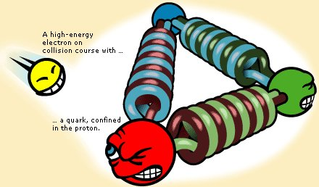


Introduction
Studies are under way at BNL for the design of an 18 GeV electron accelerator for the proposed eRHIC project.
Relativistic Heavy Ion Collider (RHIC)
Blue+Yellow=RHIC
eRHIC
Blue+Yellow+Red=eRHIC
ion
PHENIX
ion
eRHIC Detector
250 MeV polarized protons
100 MeV/u Au-ions or other ions
electron
AGS
5 to 18 GeV electrons

Slide 18
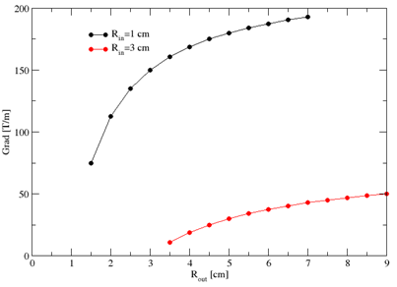
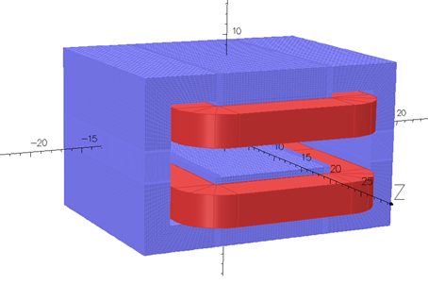

Large fields in small volume magnet
r_{out}
r_{i}
Gap=3 cm W=30 cm H=18 cm B_{max}~ 1 Tesla
Needs Power Supply and water for cooling

Slide 19

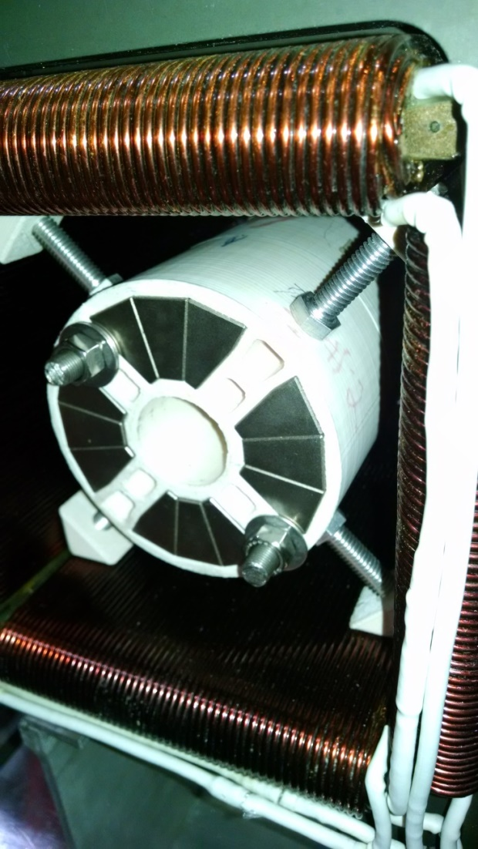
Experimental proof of the field superposition for SmCo material
The superposition is isotropic
CAARI2016
19/17

Slide 20
Large fields in small volume magnet
r_{out}
r_{i}
Gap=3 cm W=30 cm H=18 cm B_{max}~ 1 Tesla
Needs Power Supply and water for cooling

Slide 21


Slide 22
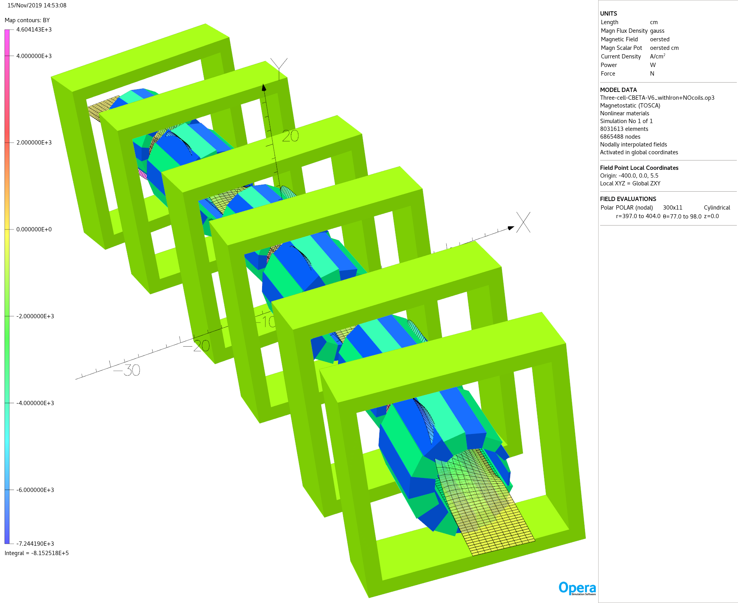

Slide 23
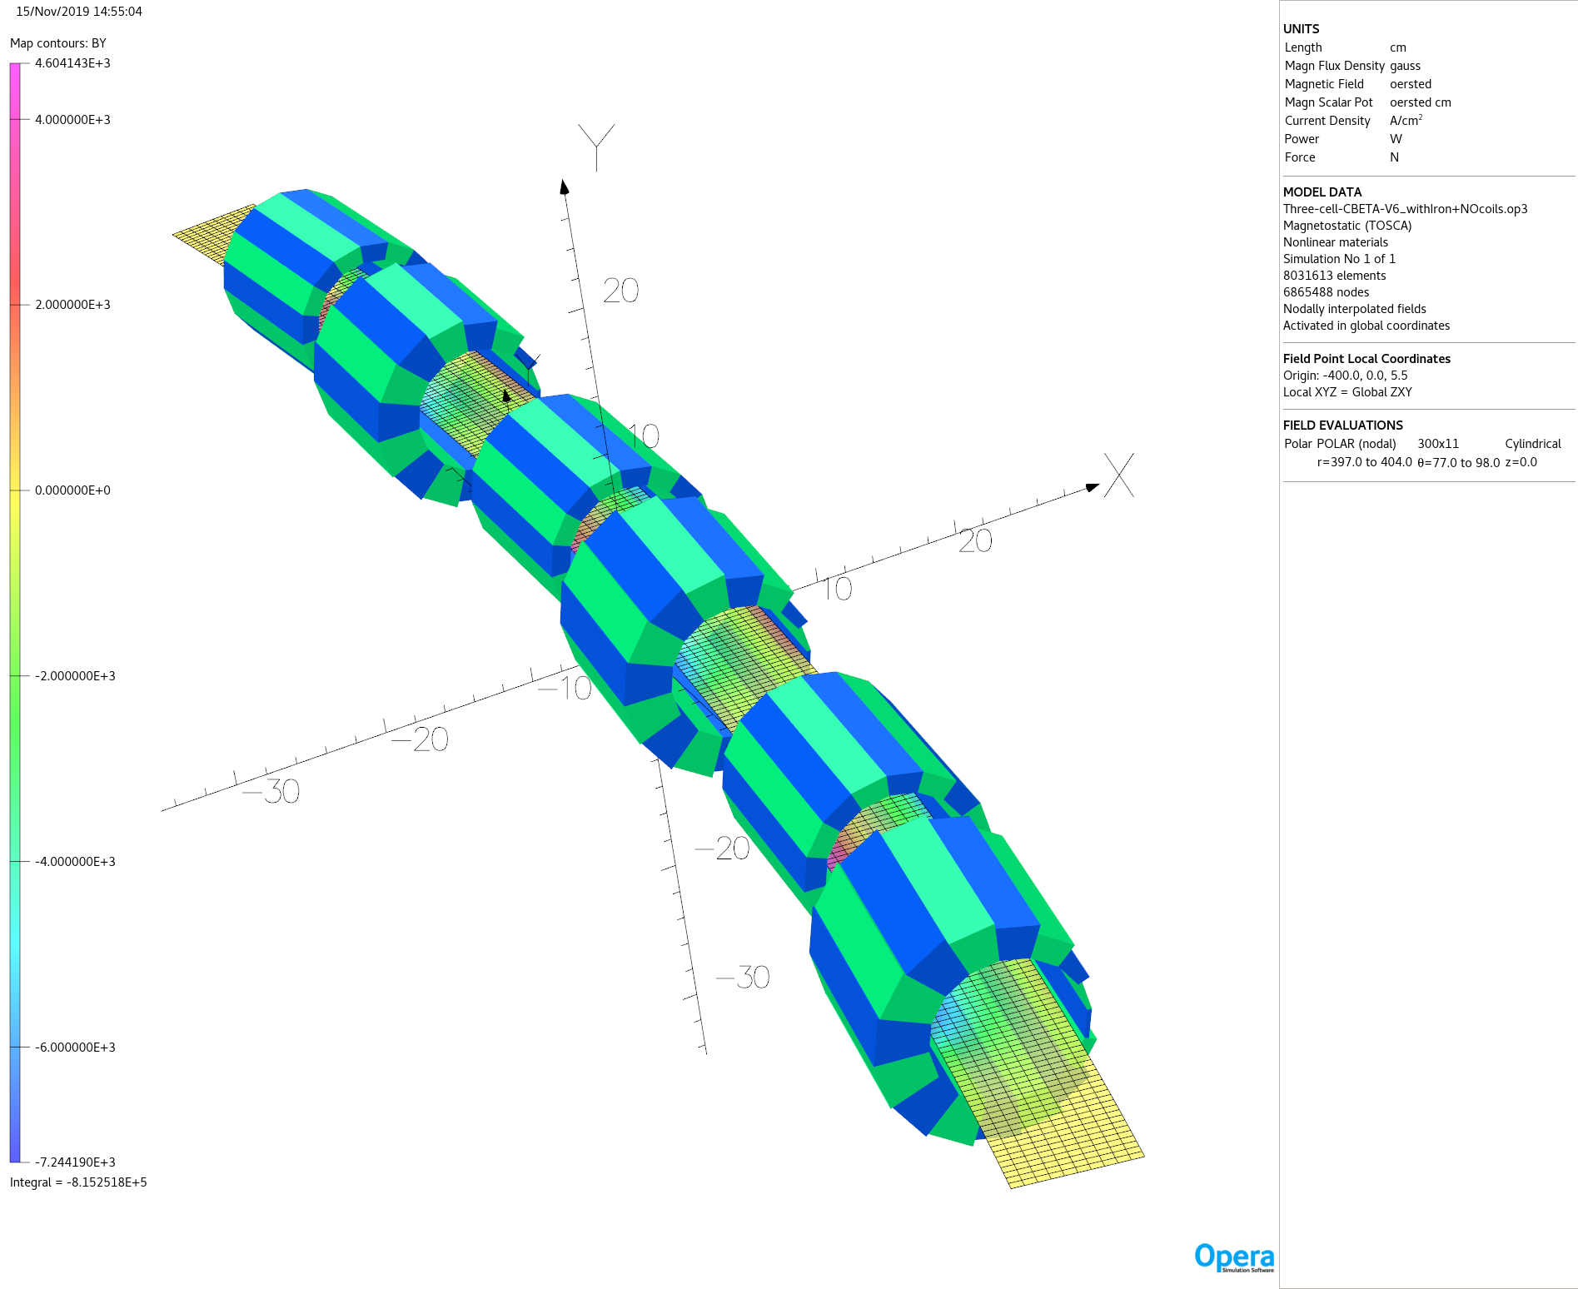

Slide 24
The CBETA project is under commissioning at Cornell University
It may serve as a prototype for the eRHIC project
Injection: 6 MeV e⁻ 100 mA rep-rate 325 MHz
Beam dump
Merger
Splitter
1.3 GHz 16 MV/m E_{max}~80 MeV
Pass # | Energy
1 | 42
2 | 78
3 | 114
4 | 150
5 | 114
6 | 78
7 | 42
8 | 6
Two remarkable concepts:
Energy Recovery Linac (ERL)
Fixed Field Alternating Gradient (FFAG)

Slide 25
The CBETA project is a prototype for the eRHIC project
Injection: 6 MeV e⁻ 100 mA rep-rate 325 MHz
Beam dump
Merger
Splitter
1.3 GHz 16 MV/m ~80 MeV
At any given time there is an equal number of accelerating
and decelerating bunces inside the ERL.
The Power of the ERL is minimal
Pass # | Energy
1 | 42
2 | 78
3 | 114
4 | 150
5 | 114
6 | 78
7 | 42
8 | 6
Two concepts: Energy Recovery Linac (ERL)
Fixed Field Alternating Gradient (FFAG)

