Slide 1
NeXus at SOLEIL
Brigitte GAGEY and Majid OUNSY

Slide 2
Agenda
  NeXus usage
  Success & Difficulties
  CDMA
  Conclusion
Notes:
I will start with the genesis of the cdma project
-
Then I' will respond to this fondamental question : what is...
-
I'll present next the concepts of the CDMA
-
and finally I'll conclude with the current status and the planned roadmap

Slide 3
Agenda
  NeXus usage
  Success & Difficulties
  CDMA
  Conclusion

Slide 4
NeXus usage
On the acquisition side :
  NeXus/HDF5 data format is the “standard” on all our beamlines since the beginning of operations at SOLEIL
  We developed a set of tools (above our Tango control system) in order to write experimental data and metadata
  NeXus is used on all the beamlines :
  At 15 beamlines: systematically
  for raw data, and even for reduced
  data at some of them
  At other beamlines : in a less
  systematic way, depending on the
  context (instrument, etc.)
  Millions of files
  All is fine !
Notes:
To perform the data recording we have developed a set of tools based on the Tango bus.
NeXus is ...
Nexus usage :
- In a systematic way for raw data at 15 Beamlines
- more or less systematically at other BLs, depending on the context : commercial instruments, etc
We already have more than 12 millions NeXus files
So we are happy guys !

Slide 5
NeXus usage
The SOLEIL choice
  SOLEIL chose NeXus/HDF5 in early 2005, and developed an extracting tool in order to produce ASCII files (and also bmp/jpeg for images).
    Pros:
      Using NeXus/HDF5 format is therefore transparent for scientists
      Less resistance to the deployment of NeXus/HDF5 based acquisition tools
    Cons:
      Scientists didn't see the added value of NeXus/HDF5
      It doesn't push to adapt already developed data reduction applications able to read such files
Notes:
SOLEIL choose NeXus/hdf5 and we have developed a extracting. This was easier than redevelop all the data reductions tools used by our scientists
--
The advantages are :
-
-
The disadvantages are :
-
-

Slide 6
NeXus usage
Make NeXus the standard data format at SOLEIL with the largest possible adoption on the field
  Do not loose too many time discussing on the standardisation
    Hide ugly details of internal file organisation through device or API
    Dictionary Standardisation process was a tool long process for our project life cycle
Be ready early on the beamlines to avoid painful and long data format migration

Slide 7
NeXus usage
A set of Tango Devices
(TangoRecorder, RecordingManager, ProjectManager, FileTransfer, NexusExtractor, RecorderProxy)
are in charge of :
  Files creation on the central storage system
  Ownership and rights on the files
    (taken from User portal System)
  Gathering information on the Tango bus
    Store this information in the NeXus files
    Extracting data into other formats (ascii,..)
Client applications
(datastorage, passerelle, Python scripts,...)
interact with the RecorderProxy to create NeXus files
Technical Data
Recorder
Proxy
RecordingManager
Experimental Frame
Tango Recorder
Project Manager
Données expérimentales
GUI
(experiment
control)
TANGO control system
Storage facility
ScanServer
RecorderProxy
Nexus API
data collectors
Experimental data
Referencing
+
Media
database
contextual data
,,,,…
Tango Properties
Recording
Configuration
models
Beam line

Slide 8
NeXus usage
Recording is managed using a Tango device named TangoRecorder
creates NeXus files
  collects and writes metadata from Tango devices and potentially other data source
For each beamline a set of Tango properties defines the mapping between the metadata and the NeXus tree
  Each metadata is mainly defined by a numerical identifier, a name and a content which contains a to a URL-like path
    <content>[tango://name/of/device/attribute]</content>
Data collection is performed through a set of data collector plugins. Currently three plugins
  Tango attributes (scheme 'tango')
  Tango archiving (scheme 'archiving')
  File (scheme 'file')

Slide 9
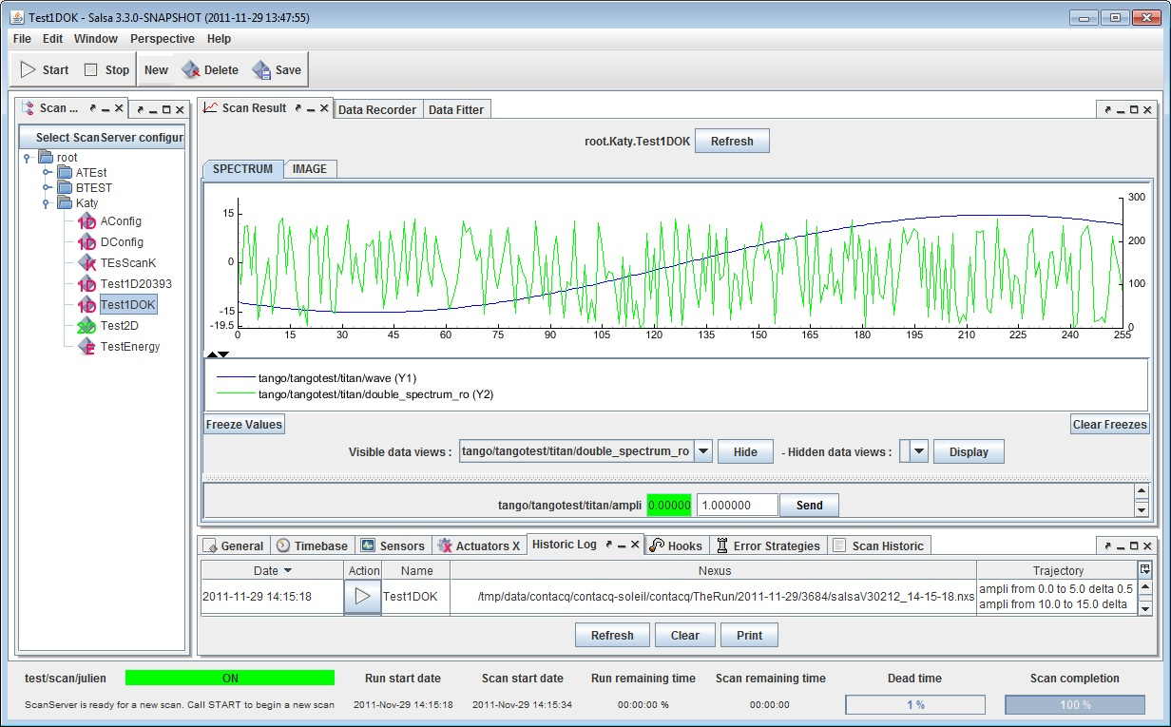



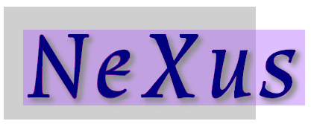

Data recording architecture
SALSA
Tango bus
ProjectManager
FileTransfer
ScanServer
RecordingManager
TangoRecorder
projects & users info
RecorderProxy
Move
files
LDAP database
asynchronous
Metadata
Recording configuration
Scan data
Storage Facility
Spool

Slide 10
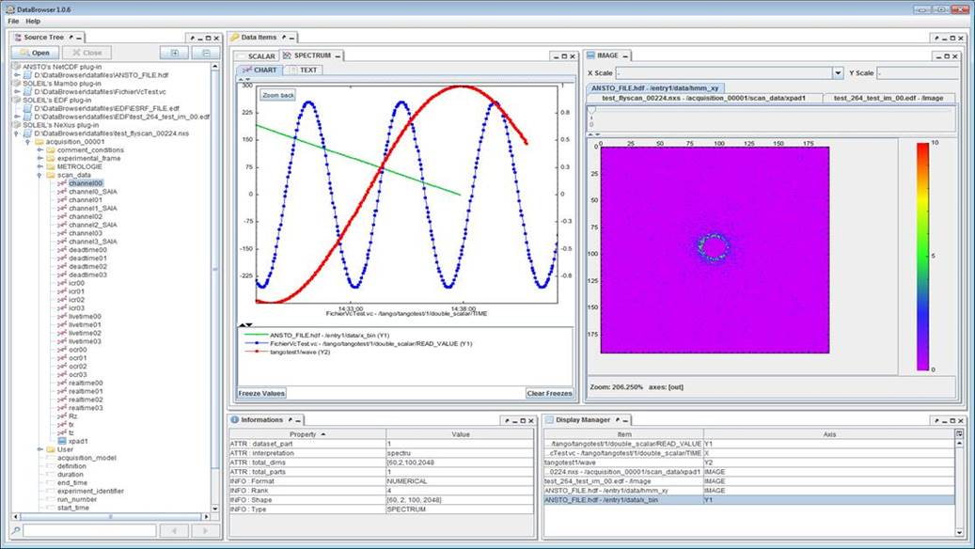
Tools on top of NeXus files
A command-line tool named nxextractor (provided to the nexus community) allows extracting data from NeXus files
  uses a small DSL language in order to describe the output
  can produce ASCII and binary files
  transparently outputs files in the acquisition workflow
DataBrowser
Supported CDMA plugins :
- Nexus/HDF5
- TANGO attibutes
- Tango HDB (Java)
- EDF (ESRF data format (.edf)
- EPICS Process Variables
https://svn.code.sf.net/p/cometeapps/code/DataBrowser/delivery/DataBrowser-1.1.10.zip
More information can be found at: http://wiki.synchrotron-soleil.fr/tikiwiki/tiki-index.php?page=How-browse-dowloaded-Nexus-files

Slide 11
Agenda
  NeXus usage
  Success & Difficulties
  CDMA
  Conclusion
Notes:
I will start with the genesis of the cdma project
-
Then I' will respond to this fondamental question : what is...
-
I'll present next the concepts of the CDMA
-
and finally I'll conclude with the current status and the planned roadmap

Slide 12
Sucess
Nexus implementation is 100% operational
    Connected to the control system in a standard way
    Technical contextual data is automatically gathered during acquisition processes
    Tooling for data treatment available for almost all client environments (Igor, Matlab, Python, Passerelle)
    The Java graphical data reduction environment (ImageReducer) uses Nexus/HDF5 for all its files handling
From the scientists point of view
    Scientists were reluctant at first, but now recognize that it allows them to retrieve old data with their context. This was recognized during a workshop given during a SOLEIL users' meeting in 2015.

Slide 13
Difficulties
Thread (un)Safety of the NeXus API
    Too many problems to fix getting our FlyScan operational
    Not possible to run Data Reduction applications during file production
    Many workarounds to get parallelized workflows (AutoBioSAXS) up and running
Solution
    Change all our bottom level APIs for recording and reading to use directly the HDF5 API.
    Keep File organization as defined by NeXus standards
    Use SWMR mode in client applications

Slide 14
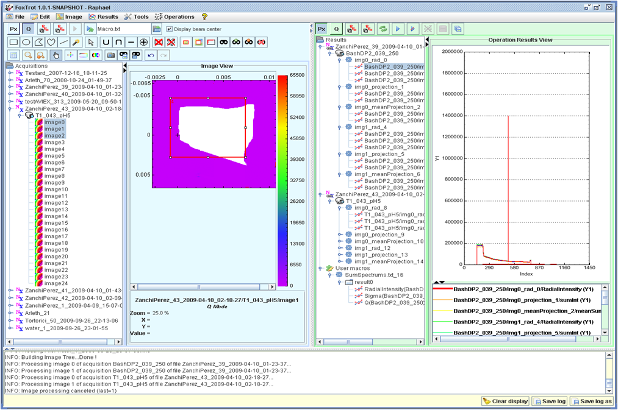

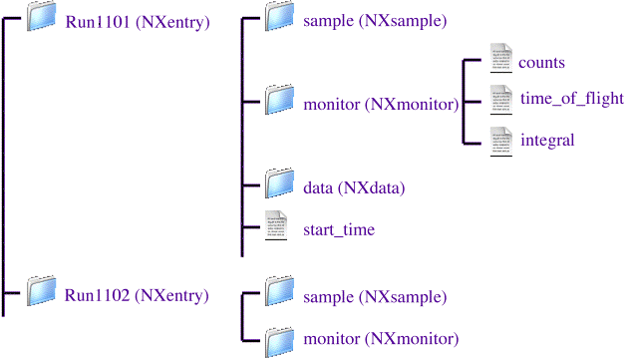
Difficulties
How to exchange data and applications?
At this point (in 2011)
we concluded that
we needed a higher level of abstraction
ImageReducer
NeXus API
On SWING beamline, data organisation had been fixed by a « SAXS oriented » data acquisition sequence
On CRISTAL beamline, data organisation inside the NeXus file had been fixed by a «Powder diffraction oriented » data acquisition sequence
Soleil NeXus file created on CRISTAL
Soleil NeXus file created on SWING
Notes:
Even worse, when we tried to use Foxtrot on data produced by an other beamline at SOLEIL: it simply crash!
just because the data structure of neux s files produce by this other beamline is slightly different than for the SAXS beamline!
clic – We conclude that...

Slide 15
Agenda
  NeXus usage
  Success & Difficulties
  CDMA
  Conclusion
Notes:
I will start with the genesis of the cdma project
-
Then I' will respond to this fondamental question : what is...
-
I'll present next the concepts of the CDMA
-
and finally I'll conclude with the current status and the planned roadmap

Slide 16
What is the CDMA
  An API aimed to provide to programmers a data access layer that is independent of the scientific datasets format
  Key points:
    A plug-in system that allows support of various data sources
    An abstract interface for navigation through data sets
      Concrete classes are provided by data plug-ins
    A dictionary mechanism to retrieve measurements and technical values independently of the data structures
  It is intended to be the data access layer of data reduction apps.
  It is not intended to be yet another data format in place of Nexus or whatever.
Notes:
It's a API...

Slide 17
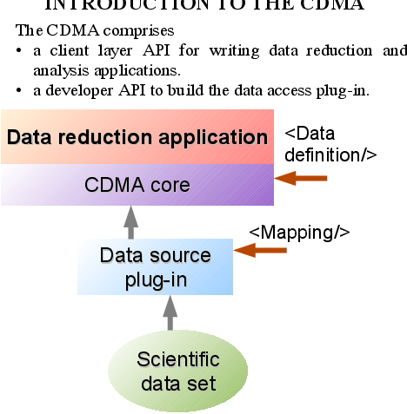
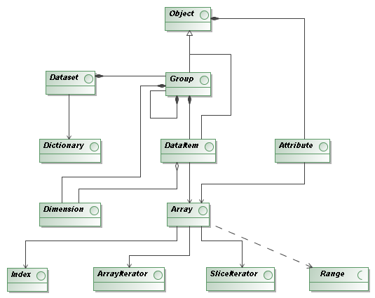
Key concepts
The model - simple
  2 API’s
      Reduction developer
      Plug-in developer
  Separation of concerns!
Notes:
The data model is very simple hierarchy :
a dataset contains the data of a whole experiment
--
it contains a groups hierarchy
each group contains dataitem (array or scalar value) comming with attributes that describes them (units, description string, timestamps, and so on...)
--
The API is divide in two parts :
- one for engine and plug-in developers
- and the other for client applications
--
Thus we propose a clear separation of concern between raw data access and data analysis

Slide 18
Key concepts
Physical navigation interface
    The CDMA abstracts file formats structures using a simple hierarchy
      A dataset (IDataset object interface) refers to a whole experiment
      Data is logically accessed through a hierarchy of group & data items (IGroup and IDataItem objects)
    Code sample
// Get a handle to the data structure
IDataset aDataset = Factory.openDataset(“{data file location}”);
…
// Get a reference to the root group
IGroup rootGroup = aDataset.getRootGroup();
// Go into sub groups
IGroup instrumentGroup = rootGroup.getGroup("instrument");
IGroup monochromatorGroup = instrumentGroup.getGroup("monochromator");
// Get a data item
IDataItem energyData = rootGroup.getDataItem(“energy”);
…

Slide 19
Key concepts
The dictionary mechanism
    The CDMA was originally developed to allow data analysis applications to not care about file formats.
    We found it's not sufficient:
    Applications developers don't have to care about data structures (how data is organized in file)
    A dictionary is mainly a list of commonly accepted physical concepts.
      Each concept has a label (a keyword) and, optionally, some synonyms
      It's equivalent to a CIF dictionary.

Slide 20
Key concepts
Using the dictionary mechanism
  Let the data analysis application developer just focus on data analysis!
// Getting a handle to the data structure
IDataset dataset = Factory.openDataset(“{data file location}”);
…
// Getting a reference to the root logical group, indicating we use the dictionary API
ILogicalGroup root = dataset.getLogicalRootGroup();
// Getting some data from a keyword
IDataItem energy = root.getDataItem(“monochromator_energy”);
// Getting experimental data
IDataItem diffrn_images = root.getDataItem(“diffrn_images”);
…

Slide 21
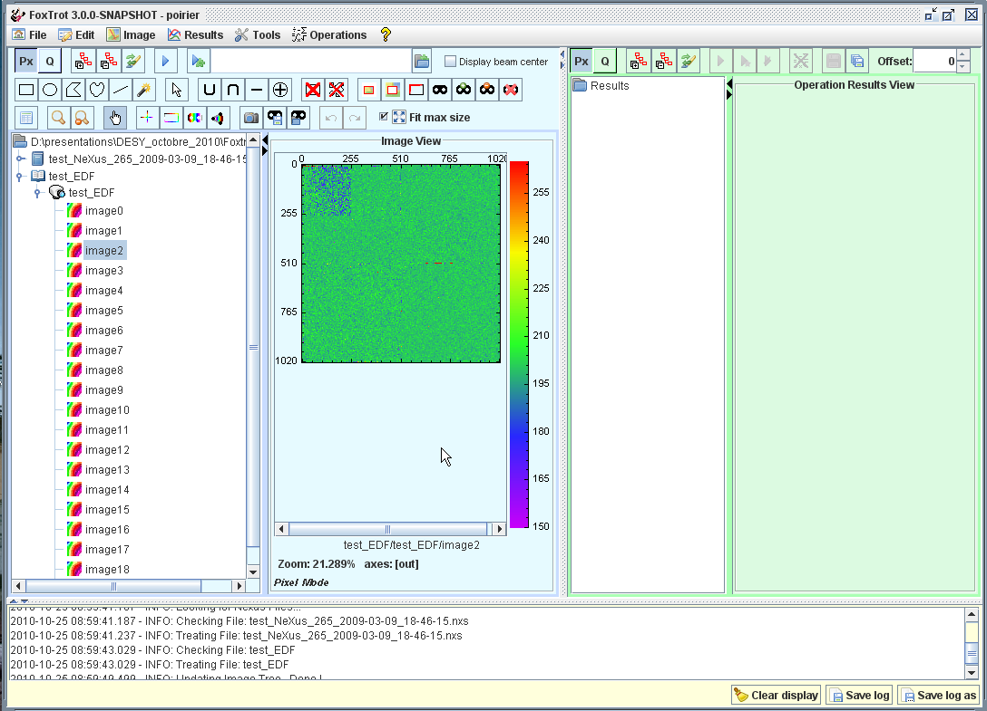
Key concepts
<data-def name="Experiment name"> <!-- ex: EXAFS, SAXS,... →
<item key="mono_energy">
<item key="mono_type">
</data-def>
CDM
Files format plugin
<map-def name="Experiment name">
<!-- ex: EXAFS, SAXS,... -->
<item key="mono_energy">
<path>path/to/user/mono/energy</path>
</item>
<item key="mono_type">
<path>path/to/user/mono/type</path>
</item>
...
</map-def>

Slide 22
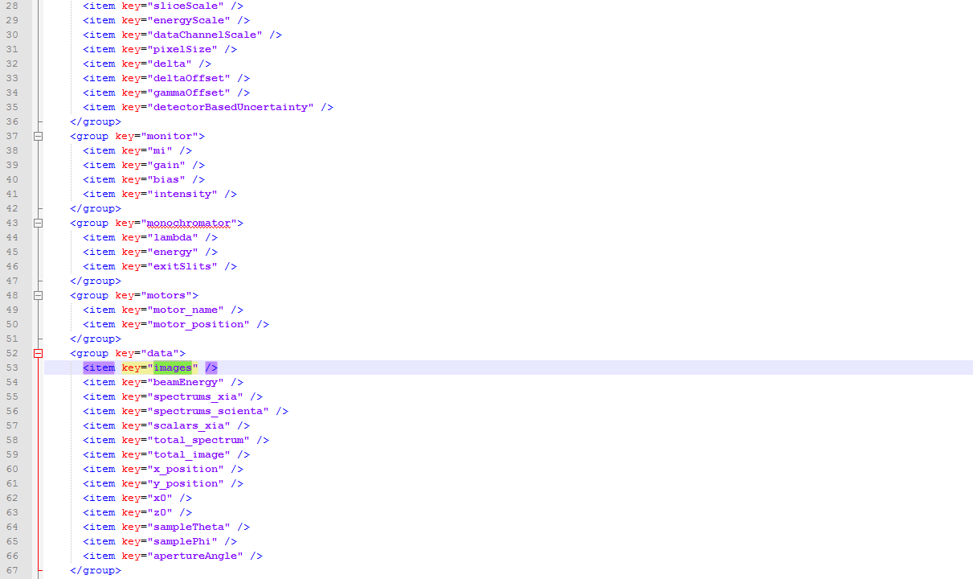
Move from theory to application
This is how ImageReducer wants to view data

Slide 23
Swing mapping file

Slide 24
CRISTAL Mapping File

Slide 25
ImageReducer at SWING

Slide 26
ImageReducer at CRISTAL

Slide 27
Agenda
  NeXus usage
  Success & Difficulties
  CDMA
  Conclusion
Notes:
I will start with the genesis of the cdma project
-
Then I' will respond to this fondamental question : what is...
-
I'll present next the concepts of the CDMA
-
and finally I'll conclude with the current status and the planned roadmap

Slide 28
To sum up
Usage of Nexus/HDF5 proved its usability
    Fits well the need of handling data and metadata alltogether
    Helps on the way of tooling standardization of data life cycle management
    It is more and more widely used in many different scientific communities
But still many open questions
    Interoperability between applications disciplines is not solved by the data format itself
    Does not give a standard for metadata : an effort is done threw Application Definition standards in the Nexus Community (what about sample metadata)
    Need for more software development to cope with large data volumes

Slide 29


