Slide 1
WP24 Demonstrator of a Photon Science Analysis Service (DaaS)
Lead: Mirjam van Daalen (PSI)
Co-lead: Andy Goetz (ESRF)

Slide 2

JRA2 – Objectives 1
Light sources are generators of big volumes of complex scientific data and their users need assistance in analysing these scientific data.

Slide 3
JRA2 – Objectives 2
Build up demonstrators for remote data analysis for typical experiments at light sources on a new platform.
The demonstrators will build on the e-infrastructure used at the different sites (HPC or cloud based platforms).
- A for the users easy to acces web portal will be designed
- Gives users a common user experience to access analysis software
- Access with Umbrella ID
- Future connection to EOSC
3

Slide 4
JRA2 – Objectives 3
For remote data analysis, the system will provide user access through a user portal implementing a standard authentication system.
Building on the UmbrellaID federated identity for the Photon and Neutron facilities for secure access realised through a series of FP7 projects (PaNData, CRISP, EuroFEL, CALIPSO).

Slide 5





JRA2 building on earlier EU FP7 projects
  EuroFEL- ESFRI project Free Electron Lasers of Europe
  Photon and Neutron Data PaNData-Europe
  Photon and Neutron Open Data Service PaNData ODI
  CRISP – Cluster project of different ESFRI projects
  CALIPSO – I3 synchrotron community
  NMI3 – I3 Neutron community

Slide 6
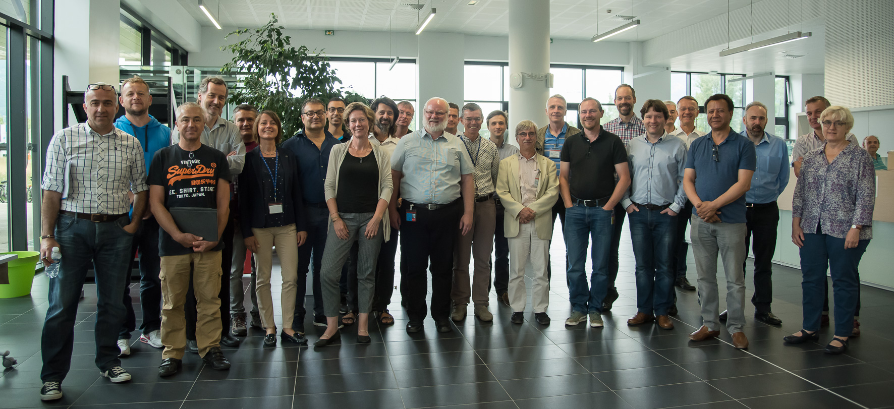
Partners JRA2
Beneficiaries
PSI (leader) Mirjam van Daalen
ESRF (co-leader) Andy Goetz
DESY Frank Schluenzen
DLS Alun Ashton
ALBA Daniel Salvat
Elettra Roberto Pugliese EUXFEL observer
Kick off meeting 24-26 June 2017 ESRF
JRA2 CALIPSOplus / UmbrellaID / LEAPS WG3 IT
Result D24.1 Workshop report on needs of the partners for remote data analysis
6

Slide 7


Current and future related projects
  League of accelerator based photon sources LEAPS
      WG3 IT next generation IT for photon science 2021-2026
  EU commission European Open Science Cloud EOSC
    PANOSC photon and neutron open sci cloud
    ExPaNDs EOSC photon and neutron data services
  BEATS Beamline for Tomography at SESAME
    Harmonised data policy (PaNData; CALIPSOplus)
  FIM4R federated identity management for RI’s

Slide 8
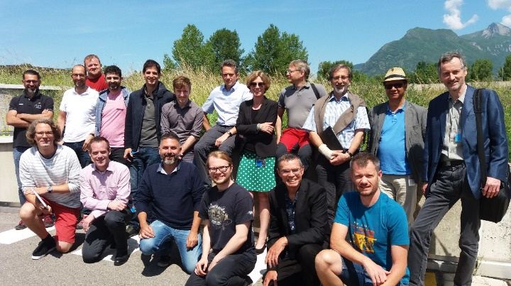
Synergies with other projects
JRA 2 meeting 23-24 May 2018 ESRF
Workshop topics:
Umbrella ID next steps
Blueprint on implementing DaaS platform
at the different sites
Collaboration with LEAPS WG3 IT
JRA2 3-day meeting October 2018 at ALBA
to work on the blueprint and the connection of the data portal with the DaaS services.
JRA 2 as a basis for future projects with strong links involving the same partners
Preparation for the EOSC Photon and Neutron Data Services (ExPaNDS) proposal for INFRAEOSC-5 call.
Synergies between all these projects are used as they are all connected and can inspire each other.
Strong connection between WP2 and WP24 within CALIPSOplus regarding the UmbrellaID.
8

Slide 9

JRA2 – how do we build up DaaS?
Benefit of JRA2 for the users
User platform for Remote Data Analysis as a Service
Suitable analysis software selection
Packaging of software and put on platform in containers ready to use
Secure authentication for users with UmbrellaID
Remote access to platform through portal

Slide 10
Task 24.1 Lead ESRF
Design of a platform for the users for Remote Data Analysis as a Service.
D24.2 Blueprint on implementing a platform and manuals for the implementation at the different sites (M12)
Partners worked on the requirements and architecture of the blueprint for DaaS at meetings in May 2018 and in October 2018.
The design will take into account the current situation at the partner institutes.
Evaluate different container concepts as deployment strategies, like classical installation procedures, shipping of virtual machines and/or Docker containers.
A cloud engineer started working at the ESRF full time in July.
The blueprint was tested at the various sites and will be improved over the course of the remainder of the CALIPSOplus project.
A prototype DaaS at the ESRF was setup to demonstrate the design.
This design was the basis of the blueprint document which resulted in D24.2 “ Blueprint on implementing a DaaS platform.

Slide 11
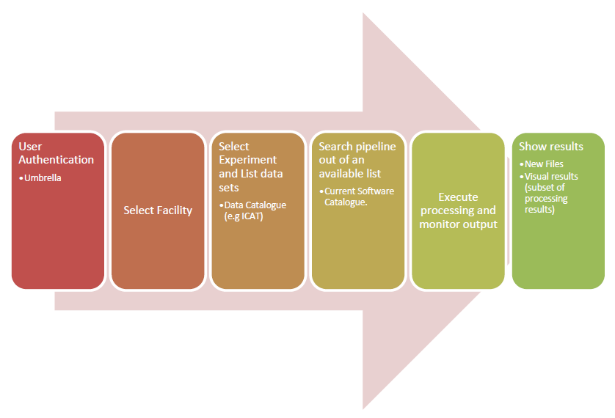
Blueprint D24.2
Common user workflow using the DaaS platform

Slide 12
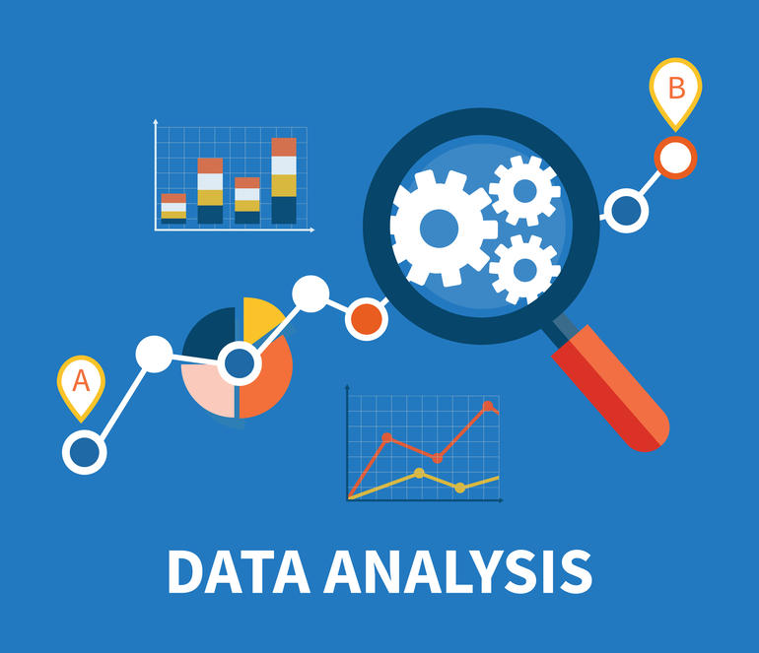
Task 24.2 Lead PSI
      Collect data analysis requirements and existing software solutions
      Analyse which use cases are suitable candidates for providing harmonised solutions which can be transferred from one site to another site.

Slide 13
D 24.3 Cross site use case requirement report including comparison of existing solutions (M12)
 | CrystFEL | Ptycho Shelves | Savu | pyFAI | PyMca
Site | DESY | PSI | Diamond | ESRF | ESRF
Description | Suite of programs for processing diffraction data acquired "serially" in a "snapshot" manner. Technique of Serial Femtosecond Crystallography (SFX) with a free-electron laser source. | Ptycho Shelves is an innovative and conceptually-simple modular framework for ptychography reconstructions | Savu is a Python package to assist with the processing and reconstruction of parallel-beam tomography data. | The software package pyFAI has been designed to reduce SAXS, WAXS and XRPD images taken with detectors into 1D curves (azimuthal integration) | Explore X-ray microscopy datasets - qualitative and quantitative analysis, interactive and batch processing, large variety of data formats support -including HDF5 NeXus-) while being the only free and open source alternative among the reference applications.
Status
The task has been completed and the deliverable D24.3 submitted. The software packages identified in the survey will be installed at the various sites and tested during the remainder of the project.

Slide 14

Task 24.3 ALL
Implement DaaS from blueprint on the local platforms at the each site.
Status
A prototype is existing blueprint was tested at the ESRF.
Intensive development was done over the last months.
Enabling remote access to compute and storage resources using dedicated hardware resources supplied by each site.
Then we expect to deploy it for users for testing until the end of the project.
Testing done at 7 facilities ALBA, ELETTRA, ESRF, SOLEIL, PSI, DIAMOND and DESY.

Slide 15
Task 24.4 ALBA
Design and implement Remote Data Analysis as a Service portal demonstrator.
Status and next steps
Person hired to do this at ALBA, since mid 2017
Portal is linked to the DaaS prototype from blueprint.
Hands on workshop at ALBA last October to test prototype.
Deployment just finished at 7 partner sites.

Slide 16
Task 24.5 DESY
Package and deploy data analysis packages for at least two Use Cases / site
Status
The use cases identified are for most of them already packaged at the partner sites with Docker containers or Linux/Python packages.
D24.4 presents a comparison of different software packaging strategies, their suitability in different compute environments and intrinsic advantages and disadvantages.
We aim to deploy analysis frameworks in distributed compute environment like the EOSC-Hub.

Slide 17
Task 24.6 PSI
Extend and deploy the Umbrella ID system as the standard authentication mechanism.
Status
UID has advanced significantly and will be part of the PaNOSC ExPaNDs projects
Next Umbrella meeting takes place today and tomorrow.
A subcontractor is working on task 24.6.
Fully support of different non-web-based authentication mechanisms to be able to service a broader range of authentication (eduGain + JISC Assent) needed for implementing DaaS for all users.
Sustainable operation and maintenance by GEANT (under discussion).

Slide 18
Status UmbrellaID activities
UmbrellaID (UID) is connected to EduGain super federation.
The EduTeam pilot (GEANT) attribute handling can now be exploited (basis for connection to EOSC).
With the EduGain connection Umbrella can now bridge to various other communities such as: Elixir, Orcid, EGI CheckIn. ALBA is working on connection of UID to the Remote Data Analysis as a Service portal demonstrator.
UID participation in the FIM4R editors group were Umbrella is one of the involved user communities. Paper published at: https://doi.org/10.5281/zenodo.1296031 . Amount of users of UID has grown 16% in the last year.

Slide 19
Status UmbrellaID activities
UmbrellaID (UID) is connected to EduGain.
The EduTeam pilot (GEANT) attribute handling can now be exploited (basis for connection to EOSC).
Umbrella is used as a critical service at PSI and the first company from ParkInnovaare is now connected via Umbrella to use PSI’s infrastructure.
With the EduGain connection Umbrella can now bridge to various other communities such as: Elixir, Orcid, EGI CheckIn. ALBA is working on connection of UID to the Remote Data Analysis as a Service portal demonstrator.
UID participation in the FIM4R editors group were Umbrella is one of the involved user communities. Paper published at: https://doi.org/10.5281/zenodo.1296031 . Amount of users of UID has grown 16% in the last year.
Next Umbrella meeting in Spring 2019. A subcontractor is hired now to do work on task 24.6.

Slide 20
Timeline UmbrellaID activities
J
NA1 D2.13 E-learning tools umbrella and extended tools available on umbrellaid.org (Month 36) | CALIPSOplus | Mai 2020
JRA2 Data analysis, remote access, data catalogue @PSI | CALIPSOplus | April 2019
JRA2 Umbrella access to mini demonstrator at ALBA | CALIPSOplus | February 2019
Creation of technical helpdesk for users NA1 (EOSC EU commission wants to have one AAI (e.i. EGI-checkin) | CALIPSOplus | May 2020
NA1 / JRA2 Organise workshop Umbrella Spring 2019 @ PSI | CALIPSOplus | January 2019
JRA2 Moonshot role out on beam lines different partners of JRA2 (DESY, SOLEIL, Elettra, DLS, ALBA) (first use case at PSI, role out at PSI) | CALIPSOplus | April 2019
JRA 2 Umbrella workshop spring 2019 at PSI so people can see what we did at PSI MX beam line (SLS Shut 16-22 April 2019) | CALIPSOplus | April 2019
GEANT hosting Umbrella | GEANT | December 2019
GEANT EduTEAMS | GEANT | December 2019
Umbrella statistics (Stefan could see with Elixir people for tool. Google ORCID LinkedIN) | Further Activities
Bridging to Elixir | Further Activities
Connection to PaNOSC people, offer help and assistance | Further Activities

Slide 21
Task 24.7 ELETTRA
Test data analysis software for Use Cases with test data and users
Status
ELETTRA has evaluated and tested the platform D24.5
Prototype deployed at 7 sites; followed blueprint D24.2
The system is suitable to serve as a starting-point and demonstrator for EOSC related projects like PaNOSC and EXPaNDS
The feedback from the tests with users is positive and see the portal playing a useful role.
A number of the sites plan to extend the portal into a production ready service for users.

Slide 22
JRA2 Summary of activities - 1
JRA2 Demonstrator of a Photon Science Analysis Service (DaaS)
June 24-26th: meeting @ESRF
  24.06.2017 Future Umbrella
  25.06.2017 Kick off JRA2 (D24.1)
    Division of tasks between the partners
    Organisation and logistics
  26.06.2017 kick off LEAPS WG3
    Preparation for document Brussels LEAPS role out
Deliverable D24.1 accomplished report on kick-off workshop
Deliverable D24.2 accomplished blueprint on implementing a
platform and manuals for the implementation at the different sites
Deliverable D24.3 accomplished cross site use case requirement
Deliverable D24.4 accomplished Software packages for the
selected experiment use cases ready to install and run
5/14/2019
Mirjam van Daalen PSI
22

Slide 23
JRA2 Summary of activities - 2
JRA2 Demonstrator of a Photon Science Analysis Service (DaaS)
Telco‘s every month, 1st telco 29.08.2017 16:00-17:00
LEAPS Initiative: https://www.leaps-initiative.eu
  Current Working Group 3 „LEAPS IT“
Face-2-face meeting SOLEIL to prepare LEAPS WG 3 pilots
and INFAREOSC-5 call proposal
22-24.08.2018 SOLEIL
Meeting with GEANT responsibles to discuss maintenance of
UmbrellaID GEANT August 2018
Face-2-face meeting to discuss and test the blue print prototype
at ALBA in October 2018
  22-24.10.2018 ALBA
5/14/2019
Mirjam van Daalen PSI
23

Slide 24
JRA2 next activities
JRA2 Demonstrator of a Photon Science Analysis Service (DaaS)
Feb - 2019: meeting @ tbd
  Technical meeting for implementation and testing
  UmbrellaID meeting
May / June 2019: meeting @ PSI
  JRA2/Umbrella

Slide 25
Deliverable Report
Del. No. | Del Rel No in Proposal | Title | Lead Beneficiary | Estimated Delivery Date | Status | Comments
D24.1 | D24.1 | Report on kick-off workshop for the CALIPSOplus partners to present their needs for remote data analysis | PSI | 31.07.2017 | Submitted | Submitted by 31.07.17
D24.2 | D24.2 | Blueprint on implementing a platform and manuals for the implementation at the different sites | ESRF | 31.10.2018 | Submitted | Shifted by amendment from 30.04.18 (M12) to 31.10.2018 (M18)
D24.3 | D24.3 | Cross site use case requirement report including comparison of existing solutions | PSI | 30.04.2018 | Submitted | Submitted by 11.05.18
D24.4 | D24.4 | Software packages for the selected experiment use cases ready to install and run | DESY | 31.10.2018 | Submitted | Submitted on time
D24.5 | D24.5 | Report on test and deployment of mini demonstrator on at least six sites | ELETTRA | 30.04.2019 | Submitted | Submitted on time
D24.6 | D24.6 | White paper on suitability of HNScienceCloud and European Open Science Cloud for synchrotron and FEL applications | ESRF | 30.04.2020 | Pending
D24.7 | D24.7 | Organisation of a workshop to present the results of the DaaS demonstrator and obtain feedback from users on how this approach fits the current needs. The output of the workshop will be a white paper on how the remote data analysis needs of the Photon com | ALBA | 30.04.2020 | Pending

