Slide 1
The Single-Shot X-ray Spectrometer at SwissFel (PSSS)
Yunieski Arbelo, Benedikt Rösner, Christian David, Jens Rehanek, Christopher Arrell, Rafael Abela, Luc Patthey and Pavle Juranić :: Paul Scherrer Institut

Slide 2
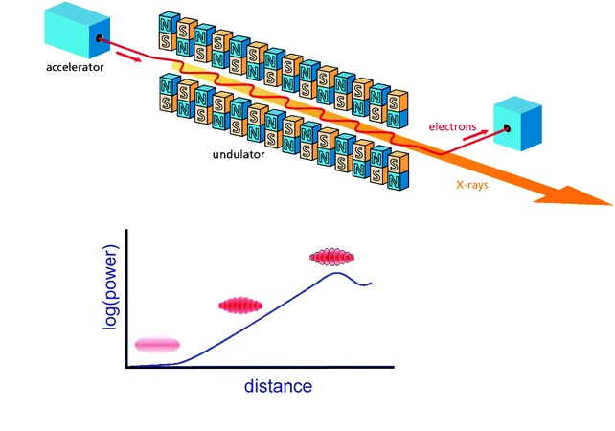
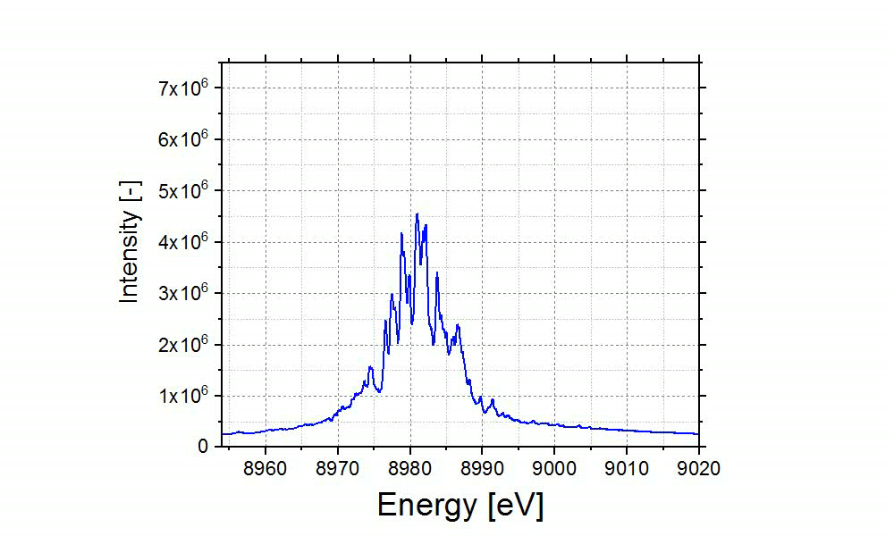
Shot-to-shot SASE spectra fluctuations
“SwissFEL spectra measured with the PSSS!”
variations on intensity and photon energy!
non-destructive shot-to-shot monitoring required
B.D. Patterson et al. Physical Chemistry Chemical Physics, 12 21(2010)

Slide 3
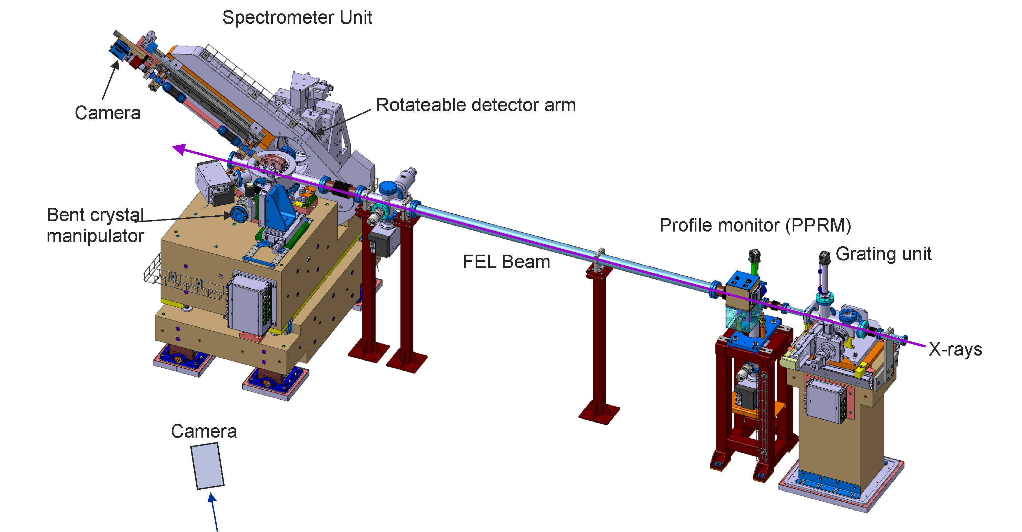
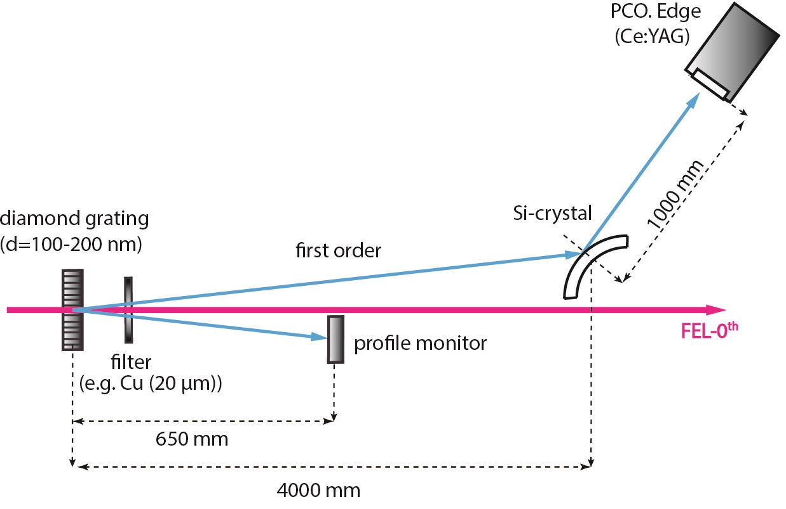
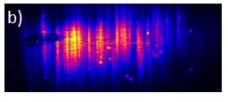
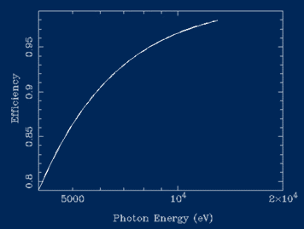
The SwissFEL Single-Shot Spectrometer
Integrated | Aramis beamline (front-end)
Energy range | 4 to 13 keV
Resolution (∆E/E) | 2-5x10⁻⁵
Bandwidth | 0.5 %
Operation | Non-destructive (trans. >90%)
“typical spectrum”
Rehanek, J., et al. Journal of Instrumentation 12.05 (2017): P05024.
M. Makita, et al. Optica 912-916 (2015)

Slide 4
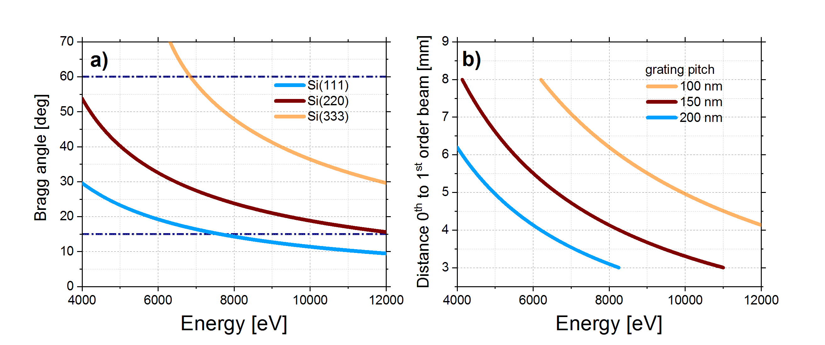
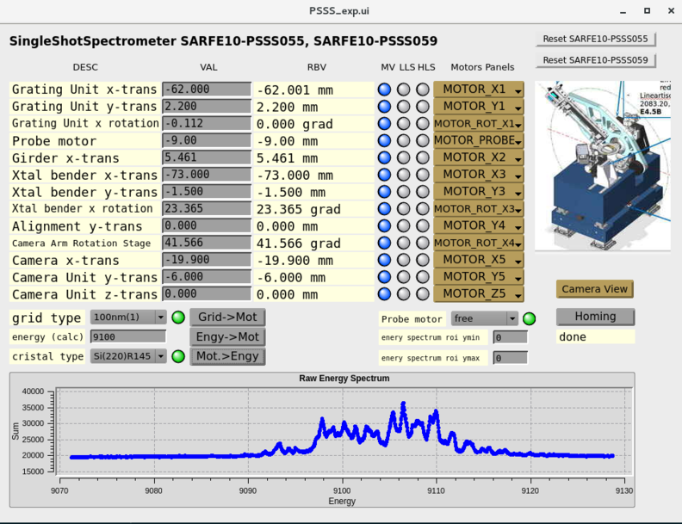
Establishing parameters during commissioning
“enabled energy ranges (crystals)”
“Expert Panel Set Up”
“4 to 12 keV”
“enabled energy ranges (gratings)”
“4 to 12 keV”
A parameters table implemented!
Calibrated shot-to-shot spectra retrieved!

Slide 5
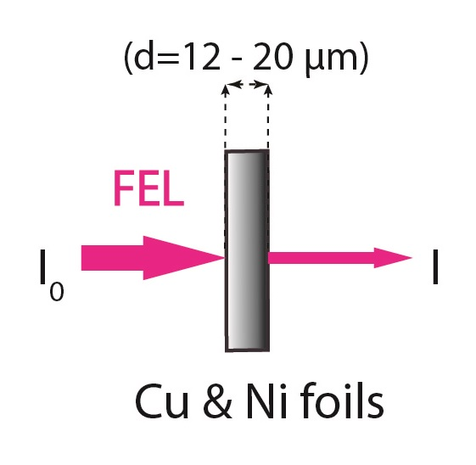
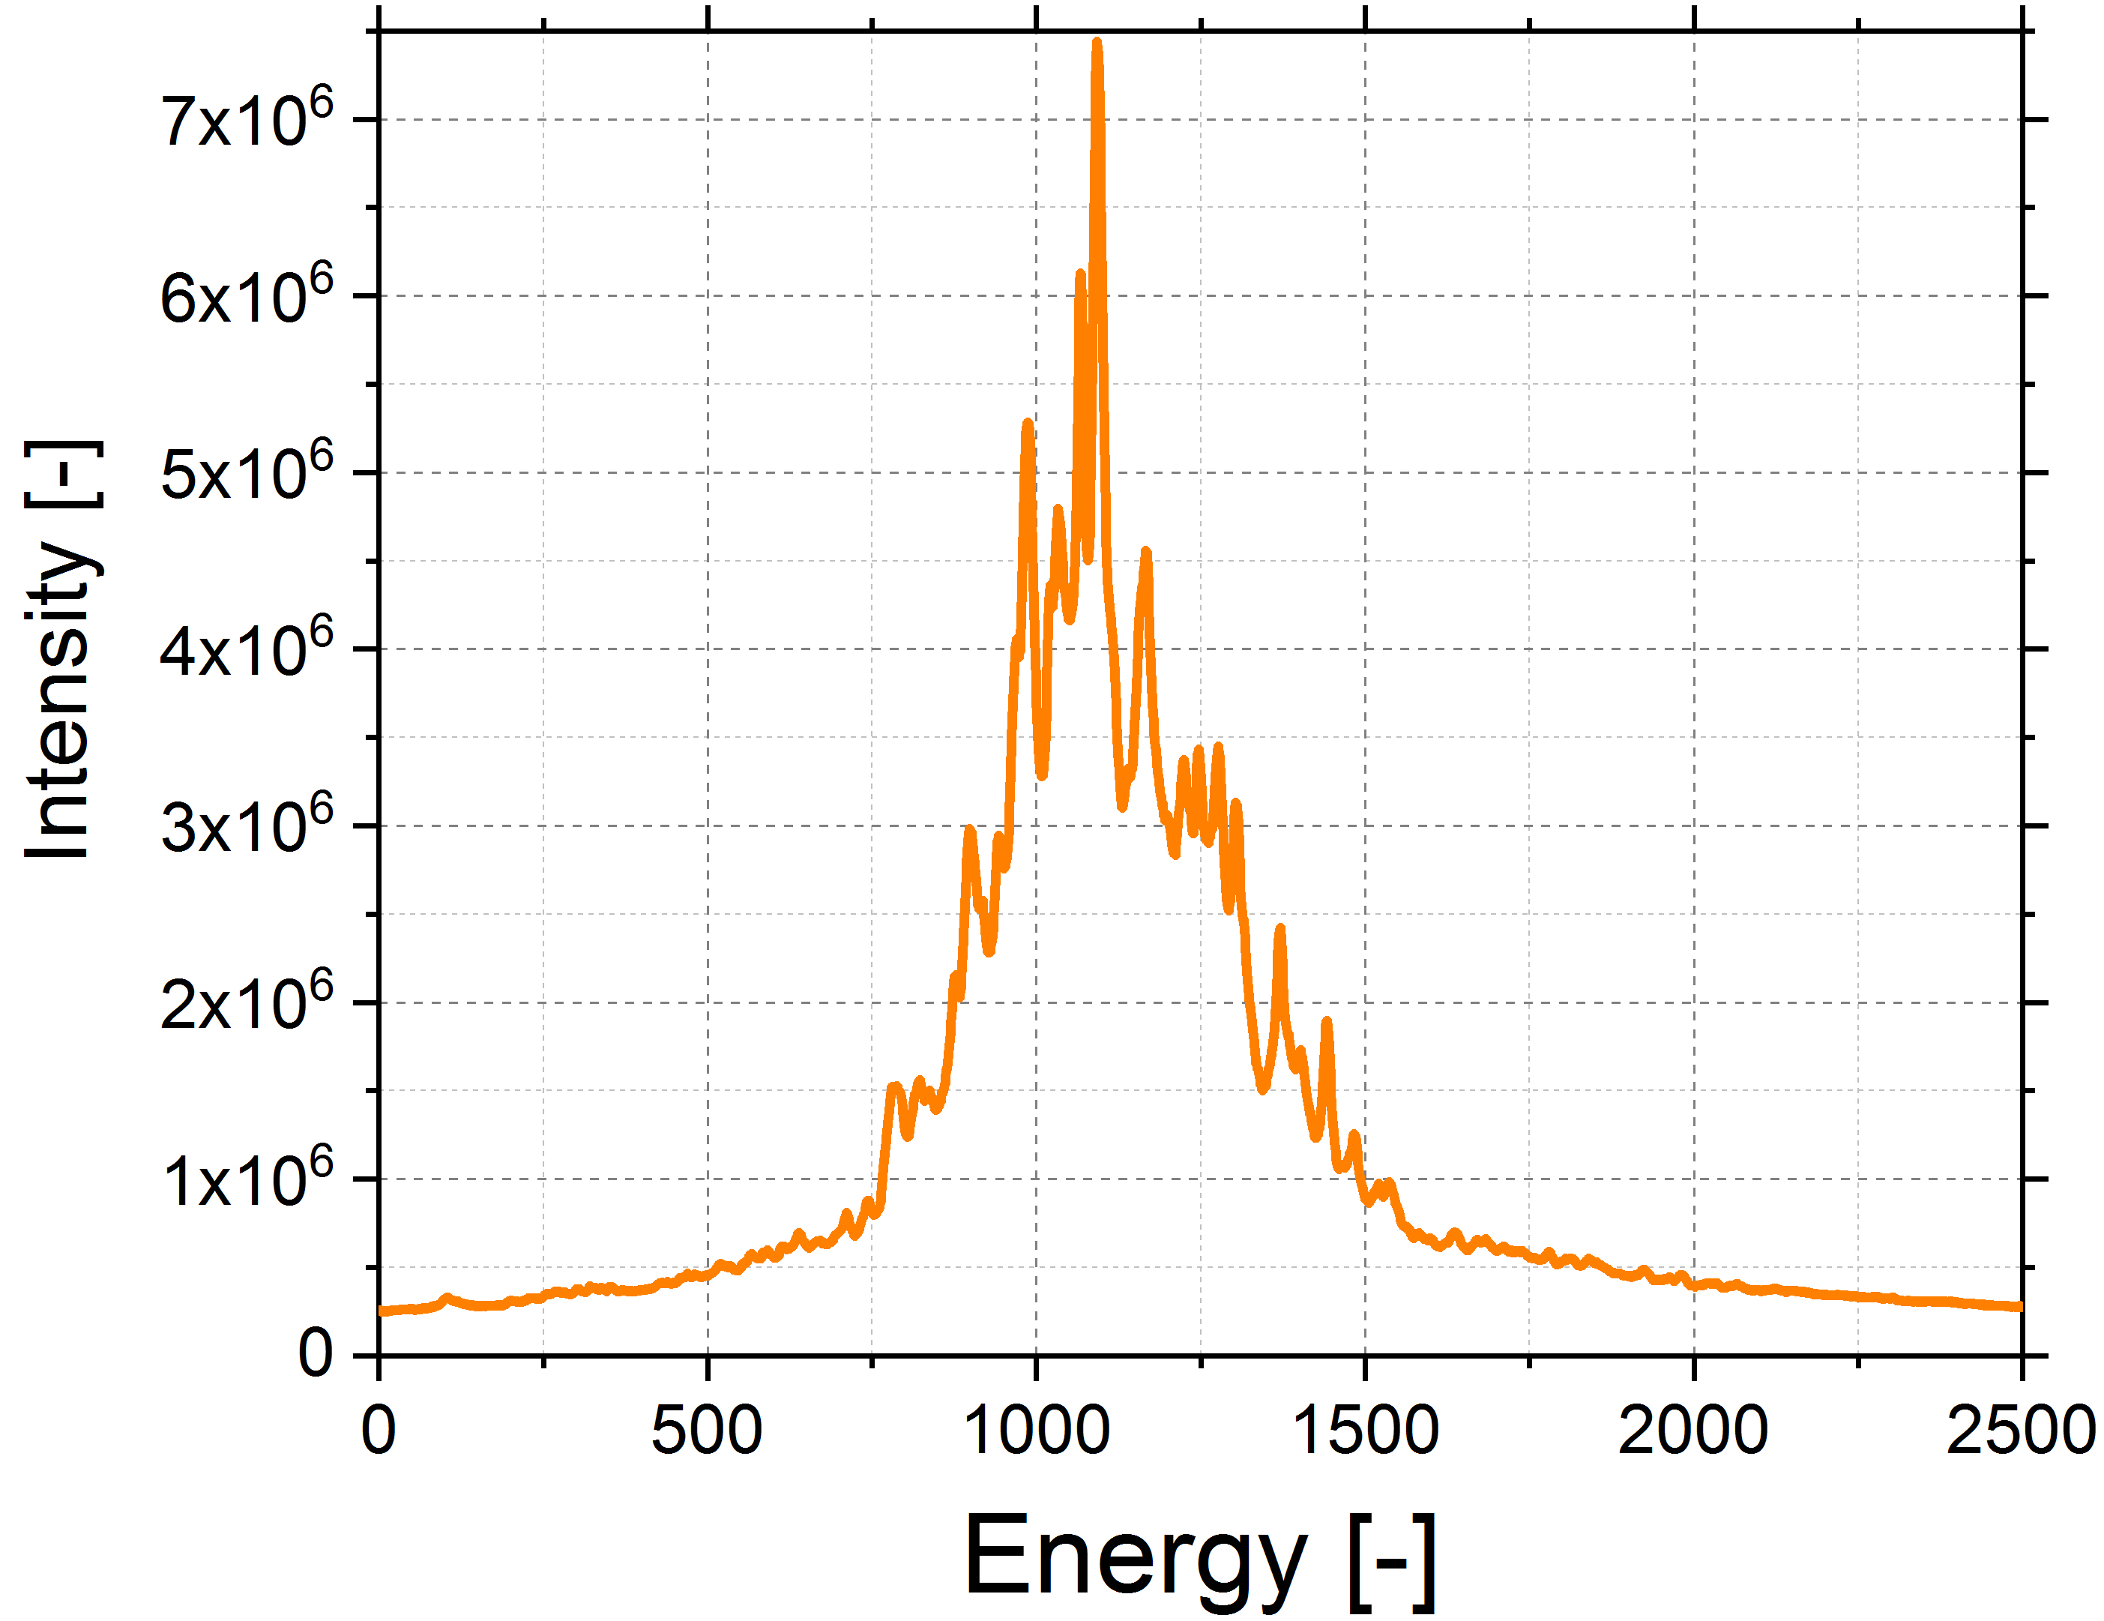
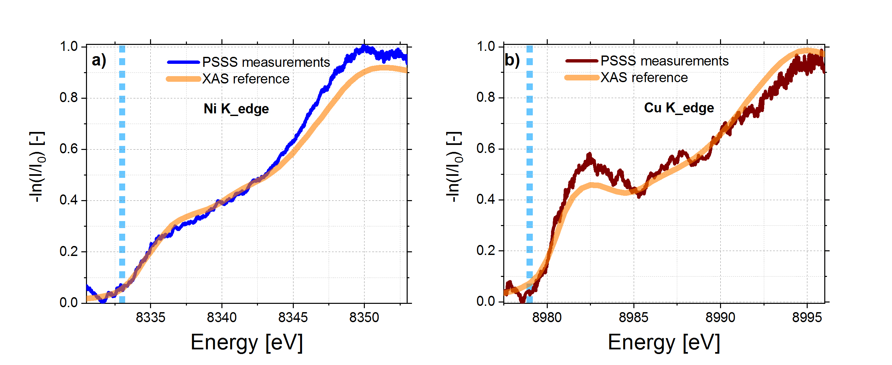
Energy calibration of the PSSS
non-calibrated!
Dev. from Ref. XAS <1%
XAFS Spectra Library (http://cars.uchicago.edu)
http://exafsmaterials.com

Slide 6
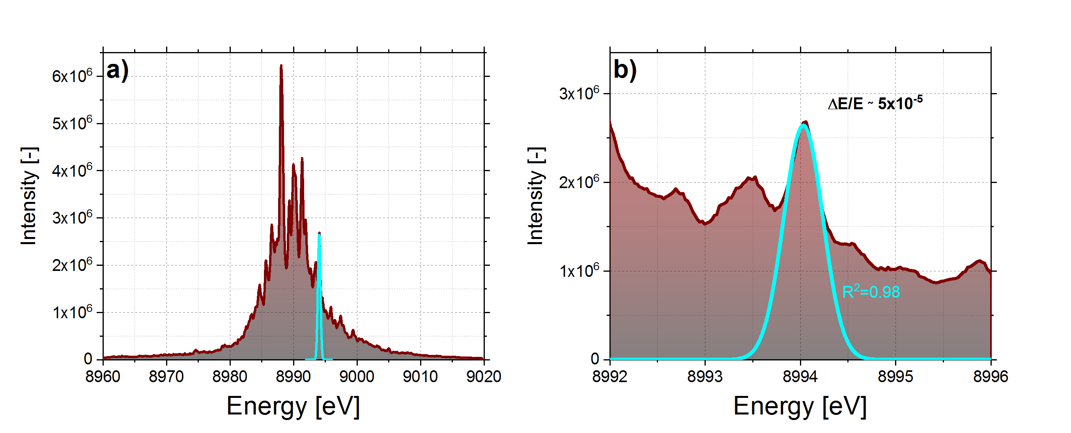
PSSS experimental resolution
Exp. Res
FWHM≈0.48 eV
Rehanek, J., et al. Journal of Instrumentation 12.05 (2017): P05024.
Theor. Res. ∆E/E=2-5x10⁻⁵

Slide 7
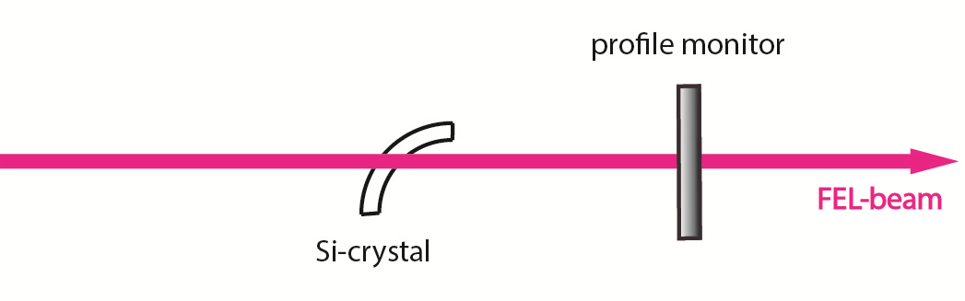
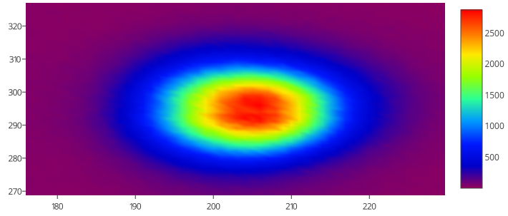
Profile dependence on spectral intensity
“measured pulse profile”
“max. dev 3%”

Slide 8

Limitations
Super important that the position and direction of the beam is preserved. Every 10 mgrad is about 5 eV offset. Bragg angles are very sensitive!
It cannot give large bandwidth. The crystals cannot bend that far.
Very sensitive to beam position. A 50 micron difference in vertical beam position is equivalent to about 0.3 degree offset in Bragg for the 200 radius mm crystal. That would be about 60 eV. Alignment is key!
Current radii between 75 and 200 mm give 0.5% FOV. Need 4 times smaller to get 2% FOV. Not possible.

Slide 9
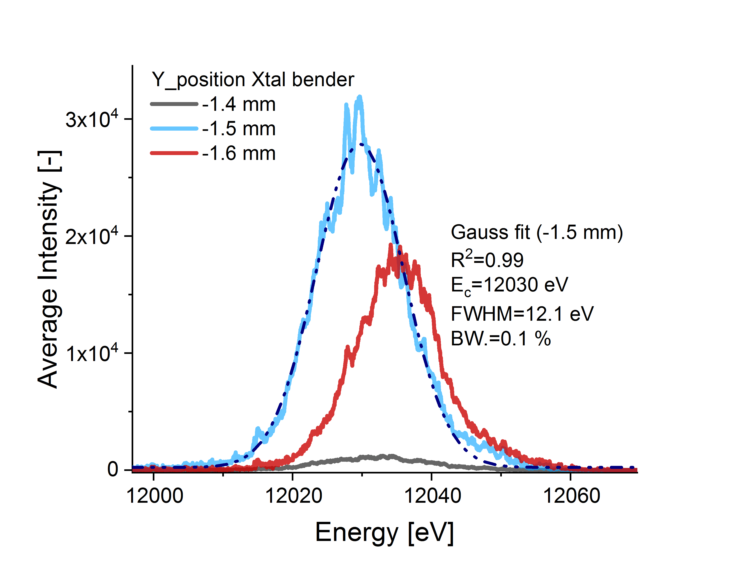
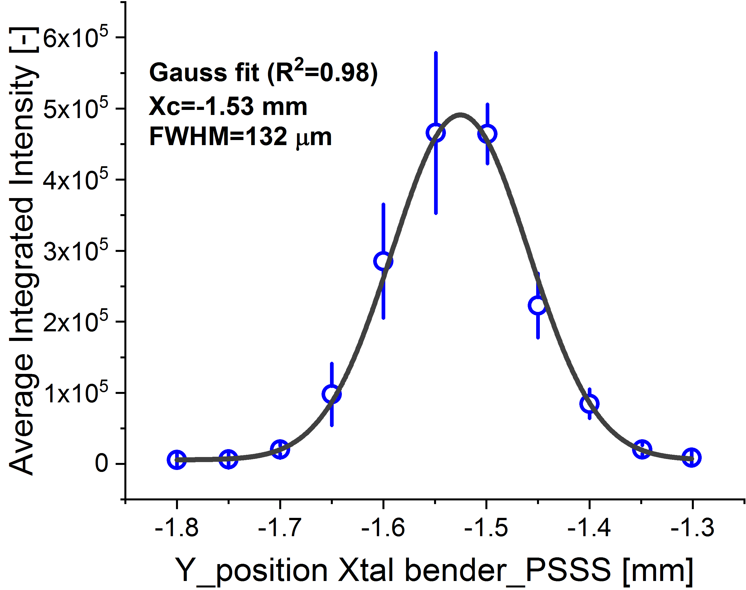
Beam position is important
The spectral intensity and clarity heavily depend on the beam position as well, as the graphs above show. Preserving the beam position is key to making sure both the spectral intensity and spectral energy are delivered well.

Slide 10
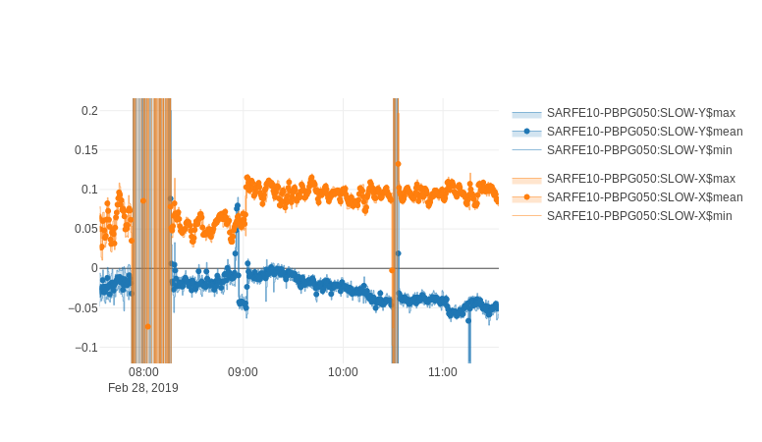
Limitations
That means, when I get a call telling me that the PSSS got misaligned, and I check the slow position measurements on the PBPG and I see this:
The PSSS is not misaligned, and the beam moved. Which means the calibrations we did to make the simple user interface work no longer work.

Slide 11
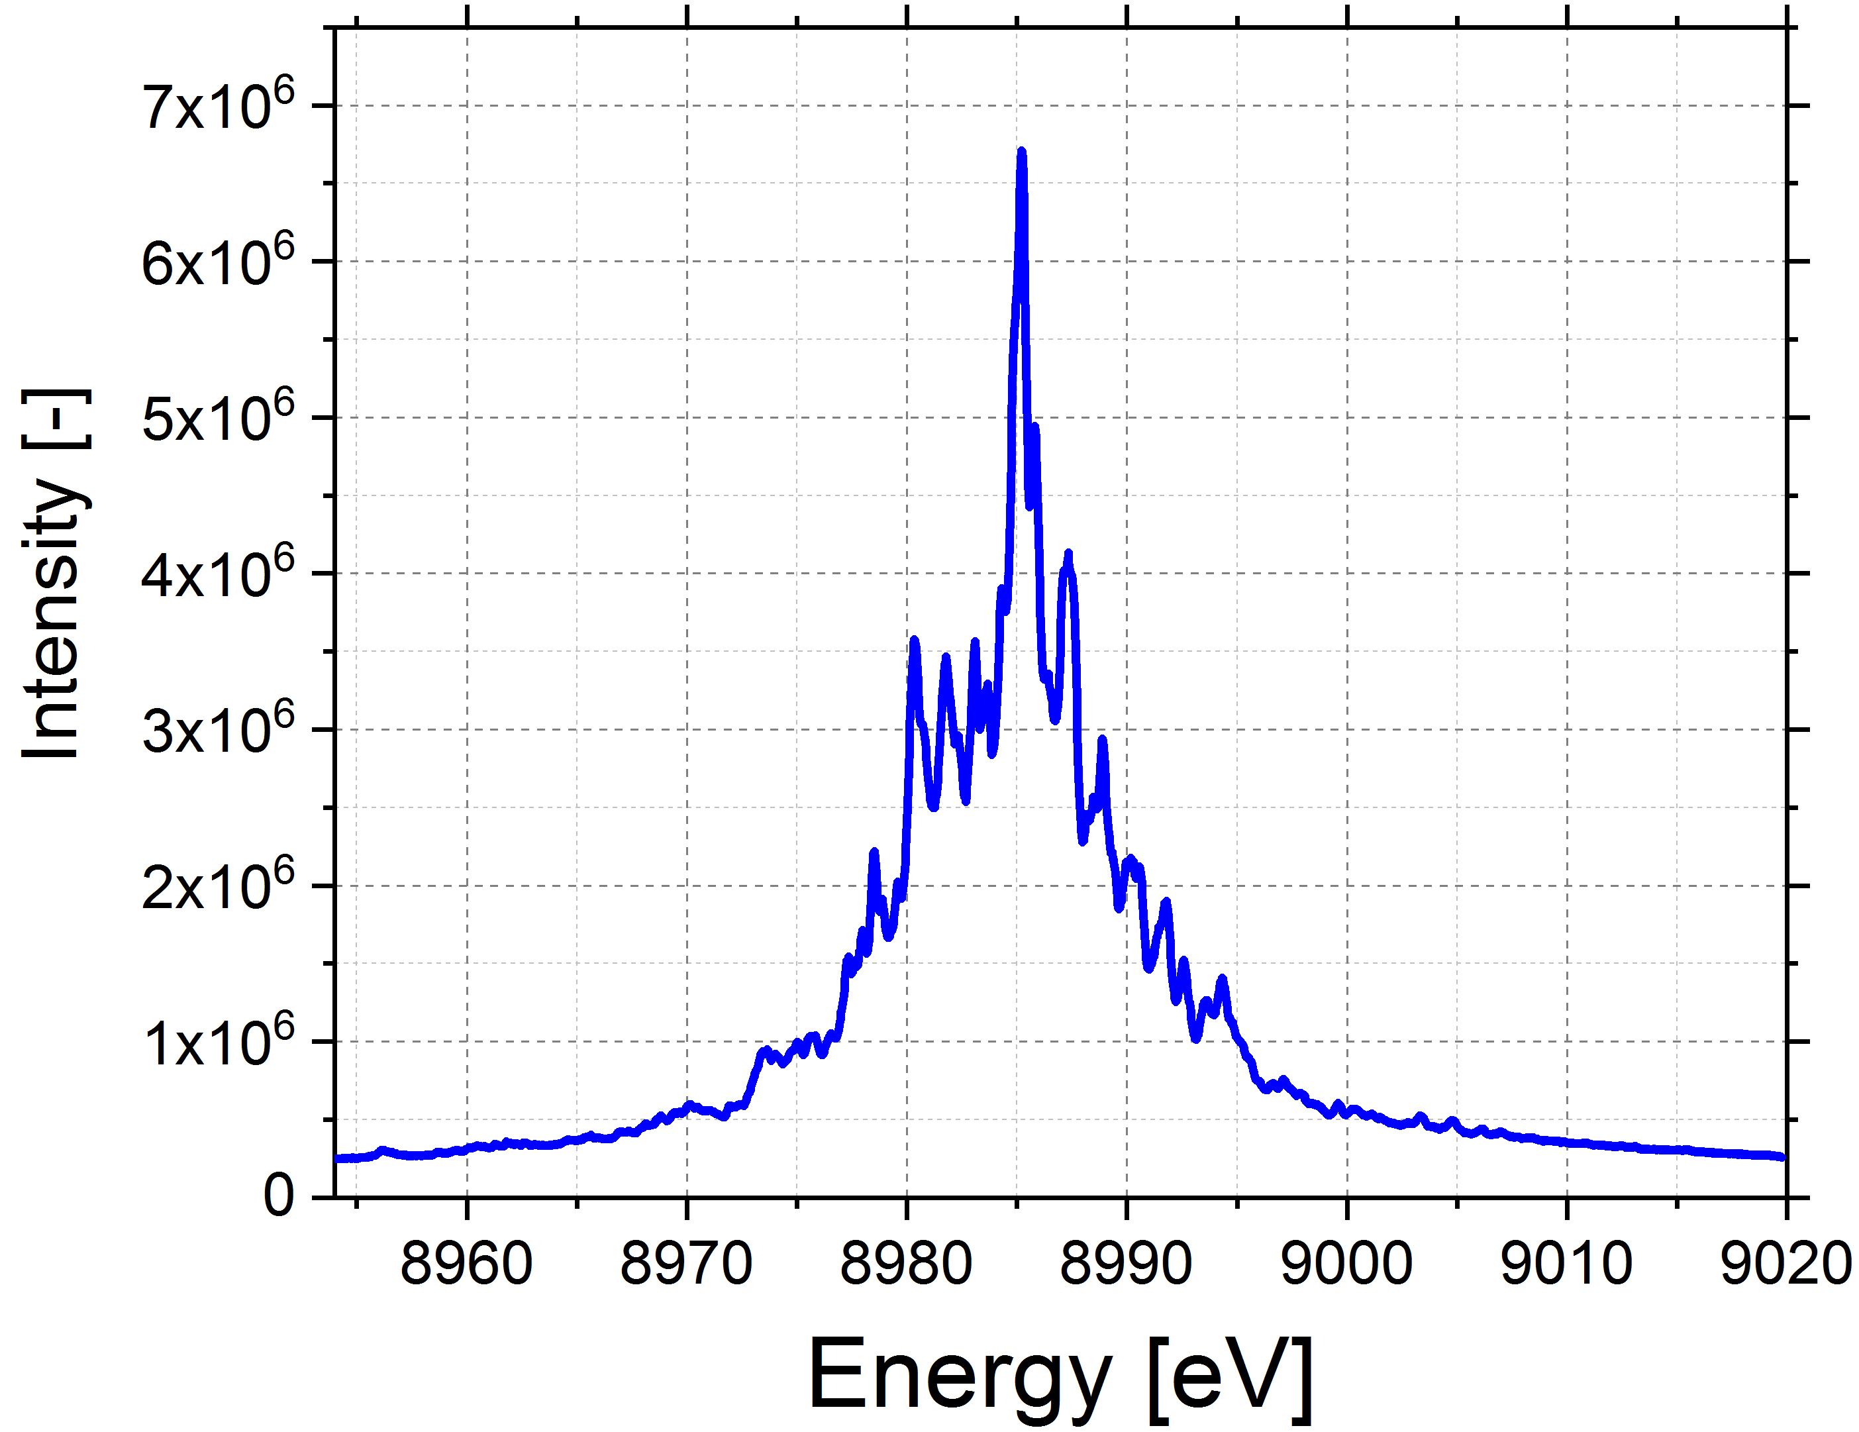
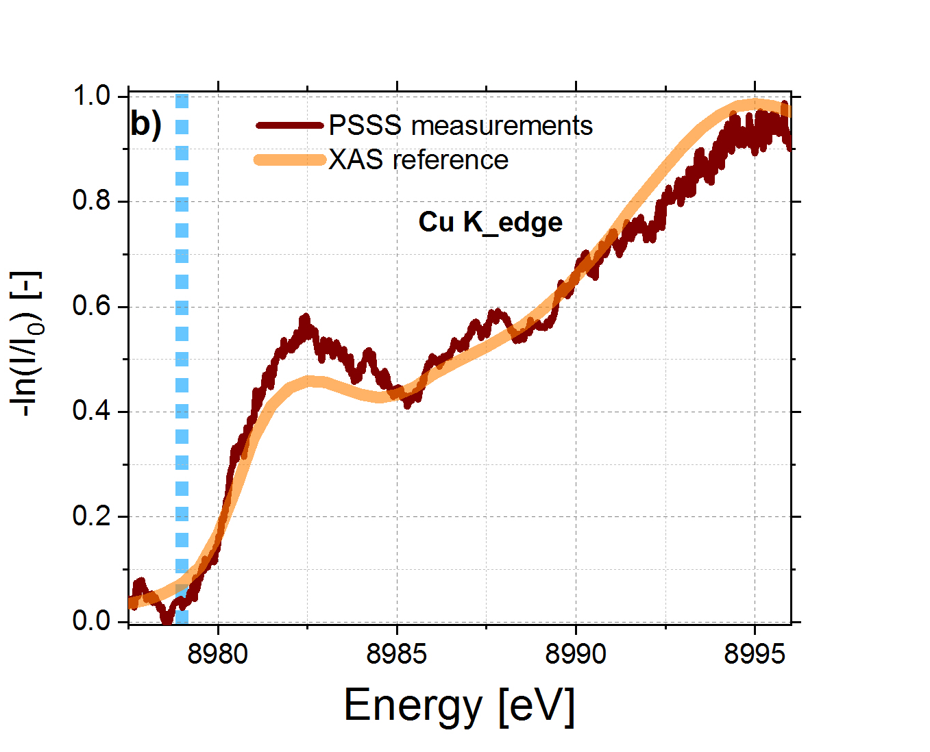
Conclusions
Shot-to-shot spectra were successfully acquired with the PSSS (non-destructive mode!).
XAS measurements enabled an accurate energy calibration of the spectrometer.
A resolution of ∆E/E ≈ 5x10⁻⁵ was experimentally determined for the PSSS.
User-friendly operation mostly implemented.
(Future: implementation as diagnostic tool for machine optimization)

Slide 12
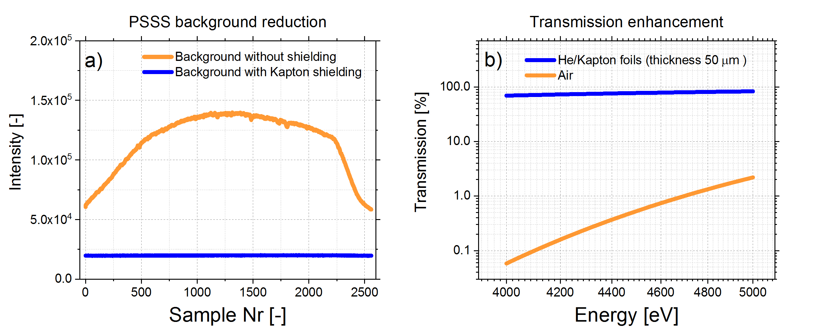
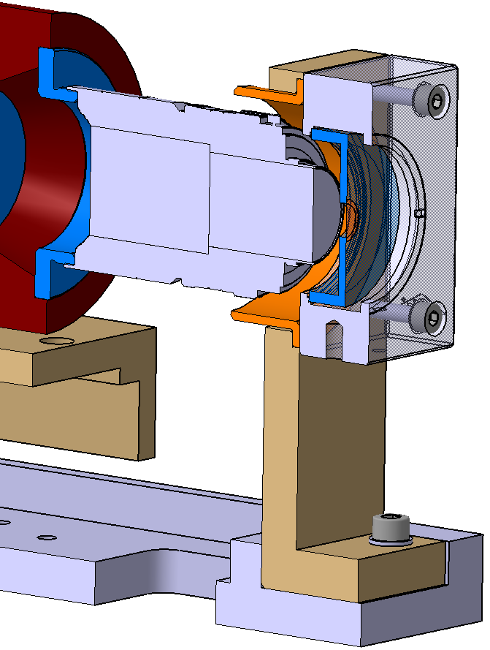
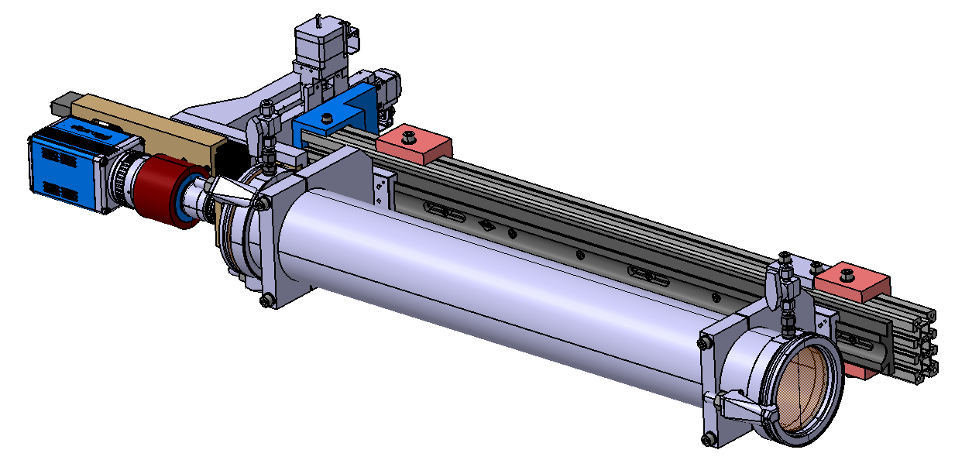
Performance optimization
Kapton shielding
d_{Kapton}= 14 µm
factor x7
reduction
T_{He}≈70 % at 4 keV
L=800 mm
d_{Kapton}= 50 µm
T_{Air}=<1 % at 4 keV

Slide 13
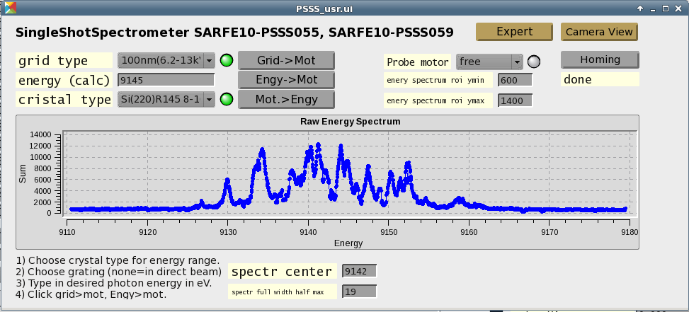
Final work: GUI and processing
Creating a simplified user interface for ‘casual’ users.
Post-processing of data to get rid of noise, give values like the bandwidth and center of the spectrum.
Training—Nicole mentioned wanting to have a course for the operators once it is all polished.

Slide 14
Wir schaffen Wissen – heute für morgen
Thank you very much for your attention!

