Slide 1
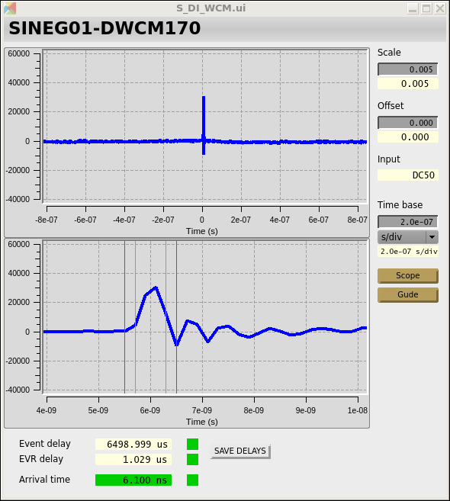
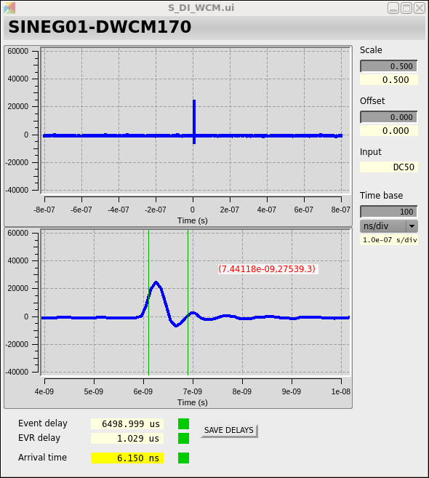
DWCM readout alternatives to the Oscilloscope solution
Purpose: Measure the rough arrival time of the laser pulse on RF and use this to set up the machine every time. Good to localizing within 1ns window and, at some level, if beam skips RF buckets.
Oscilloscope-based readout
Agilent/Keysight scope (4GHz, 20GS/s, 10bit)
Windows based server as softIOC for EPICS
Cons: Scope freezes, IOC unreachable, vertical and horizontal axes uncalibrated, no BSREAD
Pros: Have the ease of using a scope

Slide 2
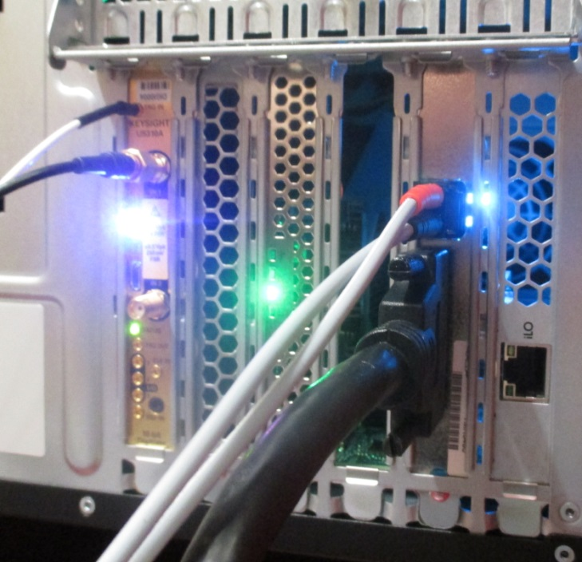
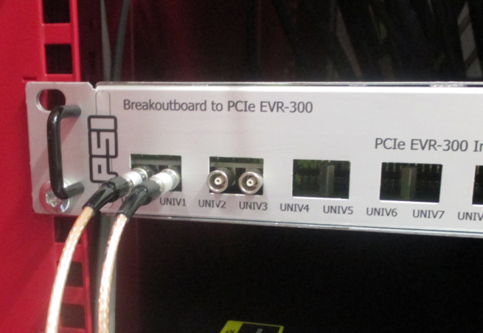
Beam Synchronous Readout High Bandwidth readout: Keysight
KS TRIGGER
Trigger from EVR UNIV0
(NB trigger on Falling edge)
5GS/s 10 bit (U5310A) for PALM (2 systems)
2GS/s 12 bit (U5303A) as general digitizer (3 systems)
RH7 / CentOS PC (setup by Rene)
Epics driver (by Damir)
Beam Synchronous with PCI EVR (Roger)
50Ohm 250mV or 1V pk-pk, DC coupled
External Trigger only
EVR FIBRE
Plug the fibre in to the EVR – the blue/green lights should come on
KS ANALOGUE INPUTS
50 Ohm terminated analogue inputs with SMA connectors. 1V or 250mV full range.
KS TRIGGER – EVR OP 1
Pulser 1 on output 1 can be use to produce a 1Hz test pulse to check that the data arrives in the BS data buffer at the right time.
SCSI CABLE
EVR OUTPUTS
More timing outputs are accessible by installing more TTL modules.
EVR TRIGGERS KEYSIGHT
EVR Breakout BOX
Slide and info from Edwin Divall

Slide 3
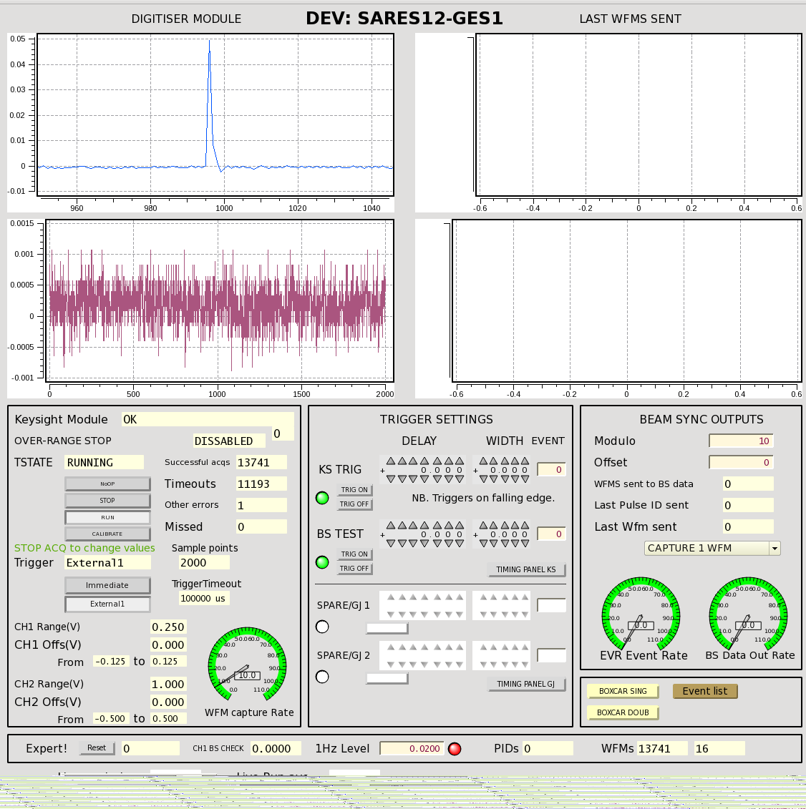
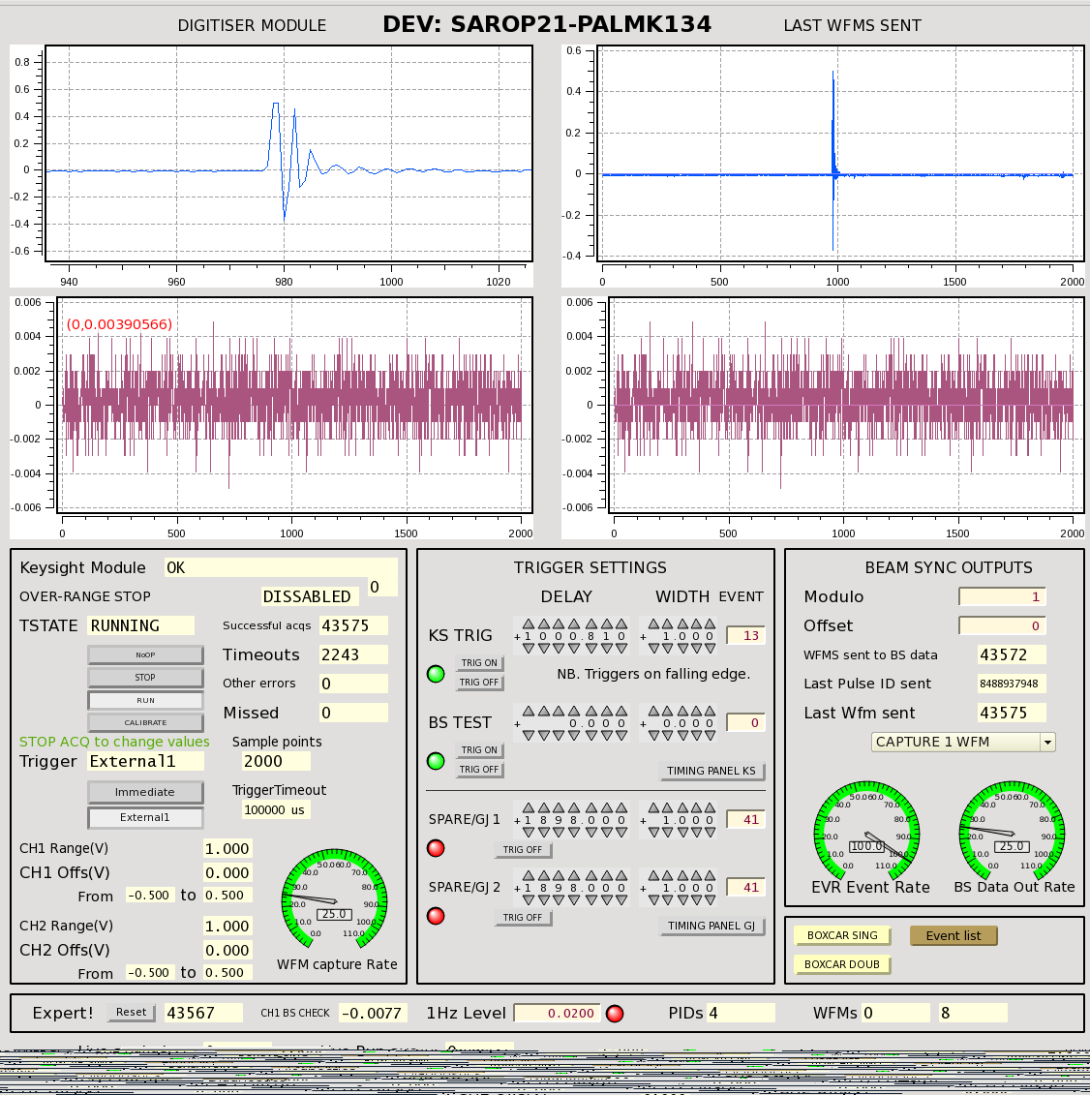
Beam Synchronous Readout High Bandwidth readout
Keysight 2GS/s digitizer, 12 bit
Keysight 5GS/s digitizer, 10 bit
Pro: BSREAD, 2CH/ADC
Con: Need additional attenuation stage before digitizer to fit entire waveform, ~20kCHF
195pC
Pro: BSREAD, 2CH/ADC
Con: Need additional attenuation stage before digitizer to fit entire waveform, >25kCHF
8pC

Slide 4
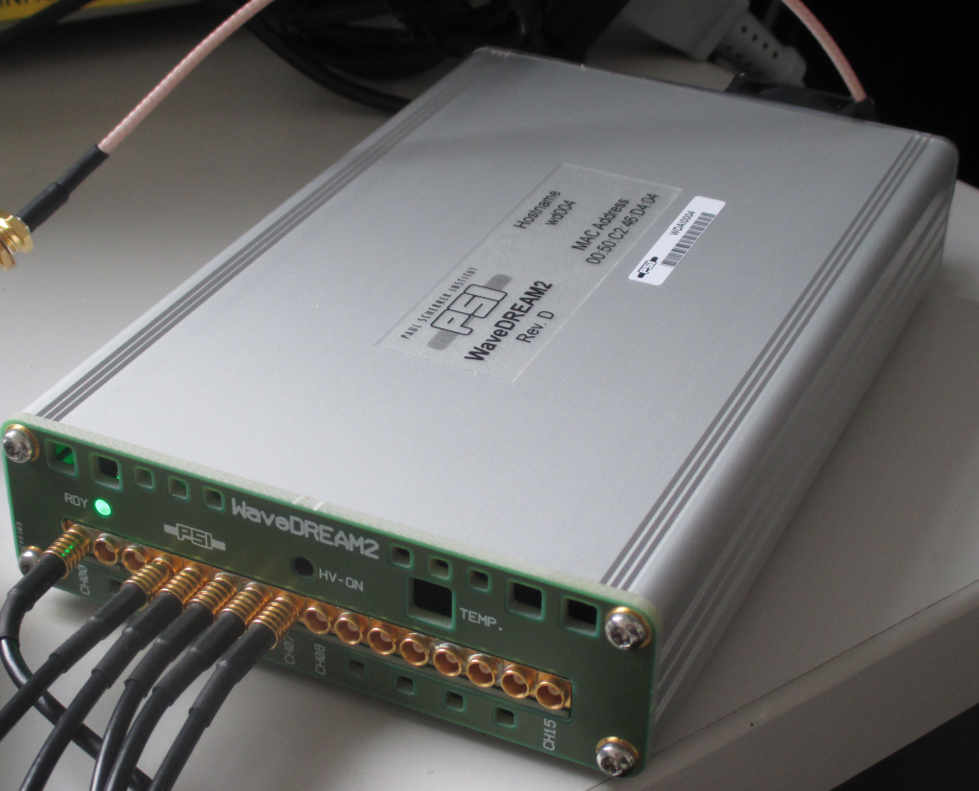
Non-Beam Synchronous Readout High Bandwidth readout: WaveDream ADC / DRS
Used as scope replacement for monitoring laser signals (photodiodes) and making them available in EPICS
16 Channel
1024 samples / channel - fixed
Turn off channels to speed up capture
rate (few Hz to 20Hz)
Trigger on any channel/external trigger or simultaneous events
Typically system has 8-9 bits resolution.
1V pk-pk
50 Ohm AC coupled
10x & 100x gain
Connection via Ethernet
Epics integrated
Stocked item
Slide and info from Edwin Divall

Slide 5
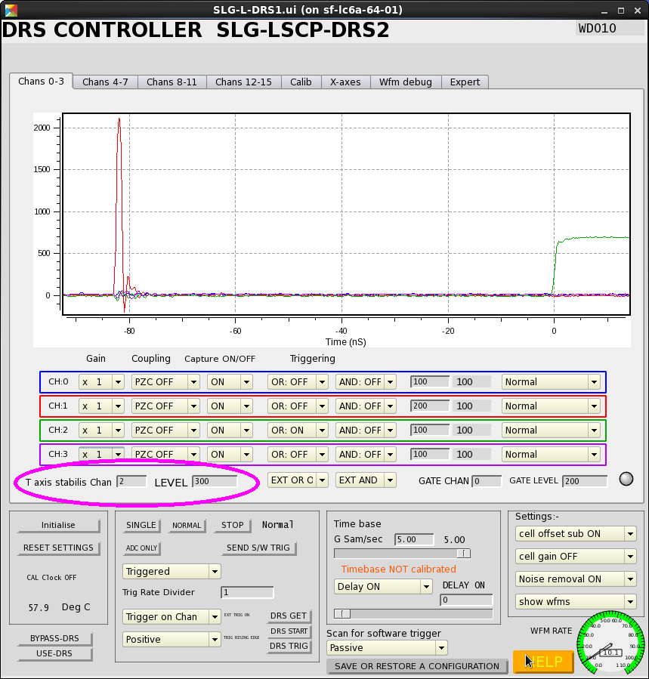
Non-Beam Synchronous Readout High Bandwidth readout
Pro: Practically free, already installed
Con: No BSREAD, vertical and horizontal axes uncalibrated
Q = 200pC

Slide 6
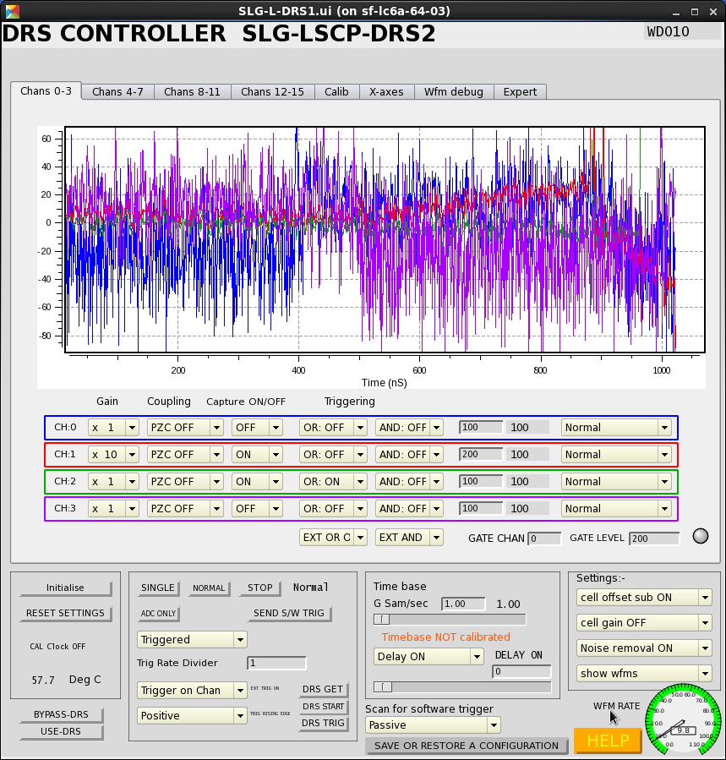
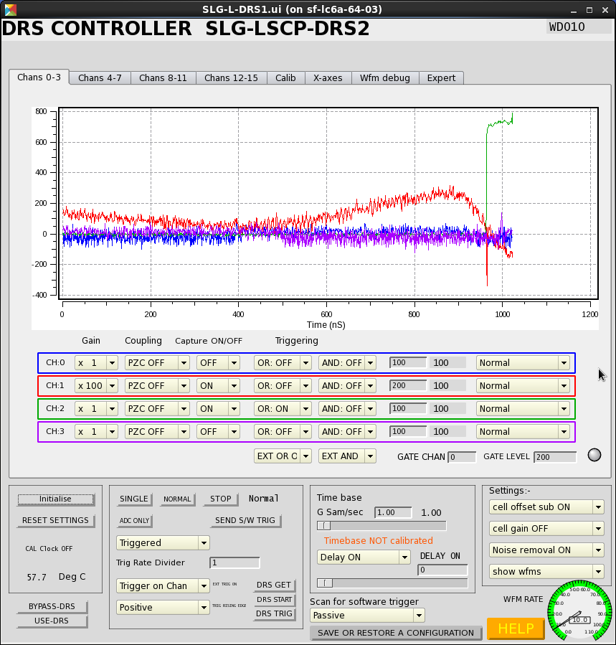
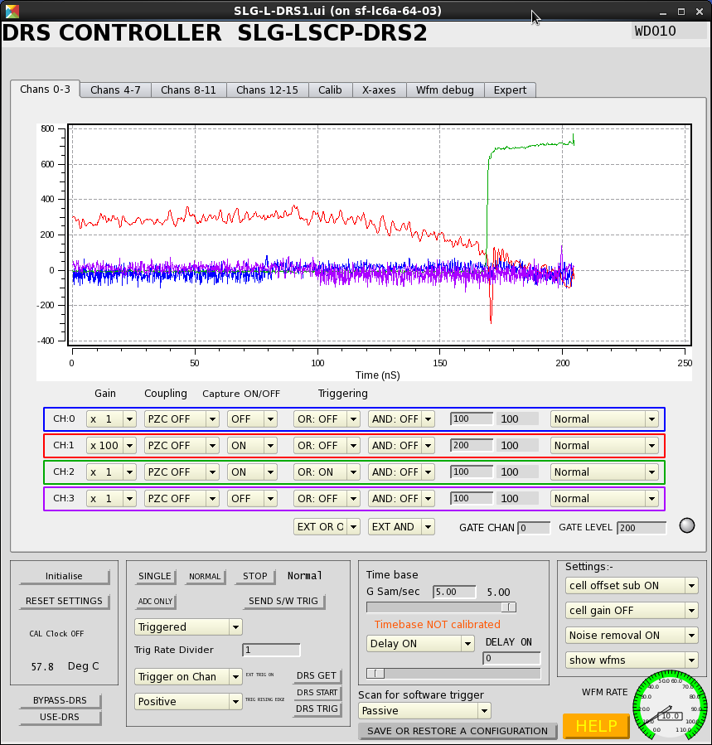
Non-Beam Synchronous Readout High Bandwidth readout
Able to change sampling from 1Gs to 5Gs > see RF clearly

Slide 7

Major THANKS to Edwin Divall for testing these solutions.
Edwin and Damir have already put in all the work for integration
Suggestion:
Time resolution is an important factor
DreamWave2 is there for as long as we want
Test it after Wartungsfenster
Decide on next step

