Slide 1
Zheqiao Geng (on behalf of the SwissFEL RF team) :: LLRF Group :: RF Section
SwissFEL RF Stability and Availability
SPM
28.05.2019

Slide 2
Outline
SwissFEL RF System Overview
RF System Stability
RF System Availability
Summary and Outlook

Slide 3
SwissFEL RF System Overview

Slide 4
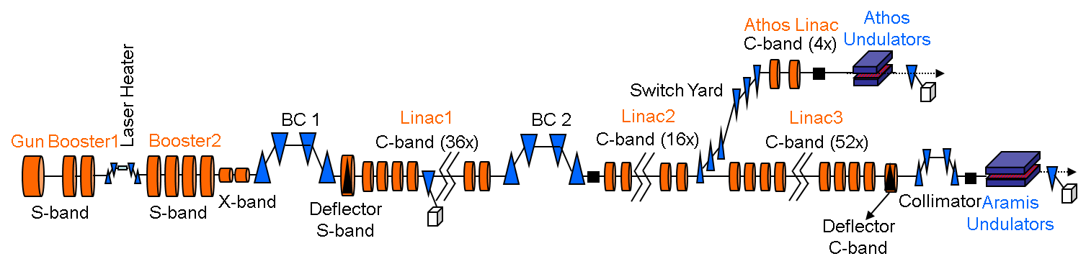
SwissFEL RF System Overview
SwissFEL consists of 6 S-band (2998.8 MHz, 1 for RF Gun, 4 with travelling wave structures and 1 for deflector cavity) RF stations, 1 X-band (11.9952 GHz) RF station and 26 C-band (5712 MHz) RF stations (phase 1 of SwissFEL with Aramis beam line).
Highlight of RF system features:
  Technology: Normal conducting
  RF repetition rate: up to 100 Hz
  RF pulse width: 0.1 ~ 3.0 μs
  Num. of bunch/pulse: 1 ~ 2
RF stability requirements (RMS):
  S-band amplitude: < 1.8e-4
  C-band amplitude: < 1.8e-4
  X-band amplitude: < 1.8e-4
  S-band phase: < 0.018 degS
  C-band phase: < 0.036 degC
  X-band phase: < 0.072 degX
Aramis beam stability requirements (RMS):
  Peak current: < 5 %
  Beam arrival time: < 20 fs
  Beam energy: < 5e-4

Slide 5
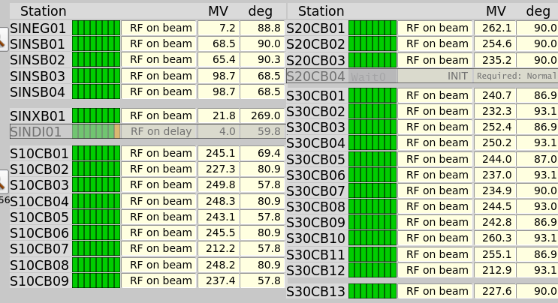
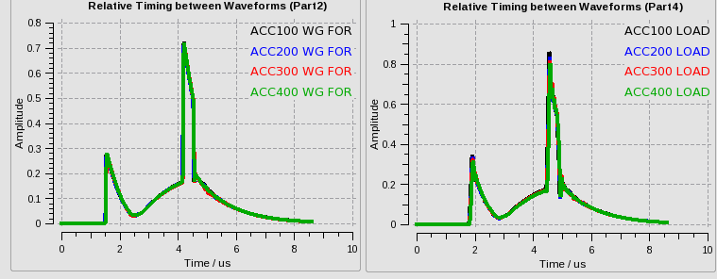
C-band RF Station
Status
25 out of 26 RF stations available on beam
      Linac1: all of the 9 stations
      Linac2: 3 stations over 4
      Linac3: all of the 13 stations
All modules run at 100 Hz
A beam energy of 6.1 GeV is achieved
Nominal beam energy is 5.8 GeV => Linac3 can provide a hot-spare RF station
C-band klystron:
5.712 GHz, 50 MW, 3 μs, 100 Hz
Four 2-m long C-band structures,
240 MeV energy gain per station (nominal)
BOC:
pulse
compressor
9 m

Slide 6


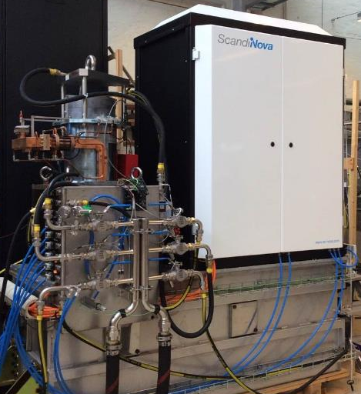
Solid-state Modulators
Two types of solid-state modulators are used in SwissFEL
50 MW / 3µs RF, 370kV / 344A
13 modulators (Linac1, Linac2)
13 modulators (Linac3)
Measured stability pulse to pulse at 100 Hz < 15 ppm

Slide 7
RF System Stability

Slide 8
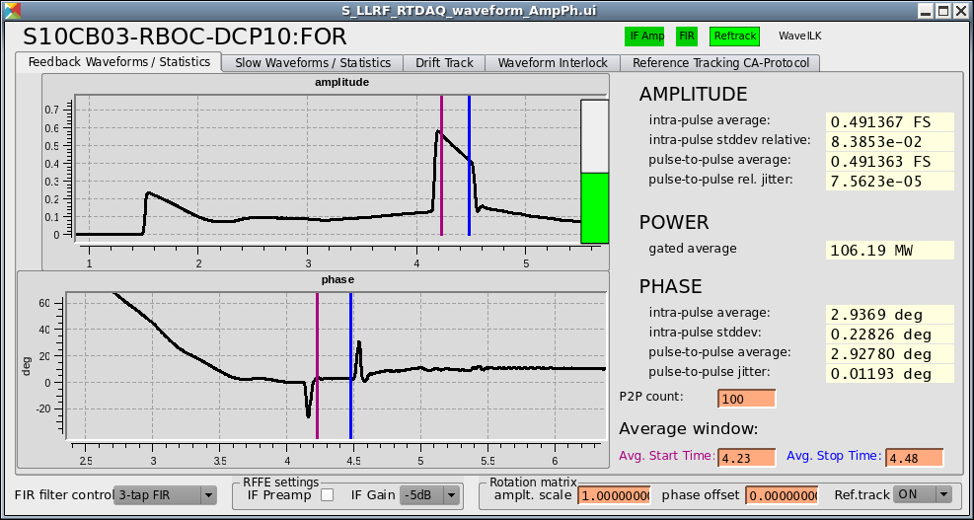
RF Amplitude and Phase Measurements
Amplitude and phase are calculated for each RF pulse by averaging in the filling time of accelerating structures.
The measurement bandwidth is limited by the effective bandwidth of the structures in the table on right side.
The pulse-to-pulse feedback loops can compensate fluctuations slower than 1 Hz.
Cavity / Structure | Frequency (MHz) | Effective Bandwidth (kHz)
RF Gun Cavity | 2998.8 | 330.8
S-band Structure | 2998.8 | 475.8
C-band Structure | 5712 | 1346.5
X-band Structure | 11995.2 | 4219.0
With feedbacks on, the amplitude and phase RMS jitters contain noise power from 1 Hz to the bandwidth of the cavity/structure.

Slide 9
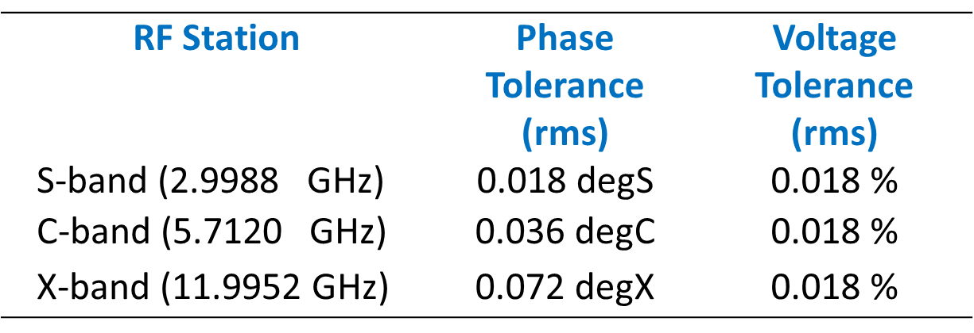
Pulse-to-pulse Amplitude and Phase Jitters
Phase feedbacks were all on
RMS jitters are calculated with 14-min amplitude/phase data
Gun measurement contains high frequency noises (not averaged in pulse) and other passband mode (π/2-mode): beam feels less jitters
Linac1 C-band #5 and #7 phase feedbacks failed
Linac1 C-band #3 and #7 had wideband phase jumps
C-band klystrons worked in saturation and amplitude feedbacks were off; S-band and X-band amplitude feedbacks were on
Data collected from SwissFEL at
Jan. 11, 2019 12:03–12:17

Slide 10
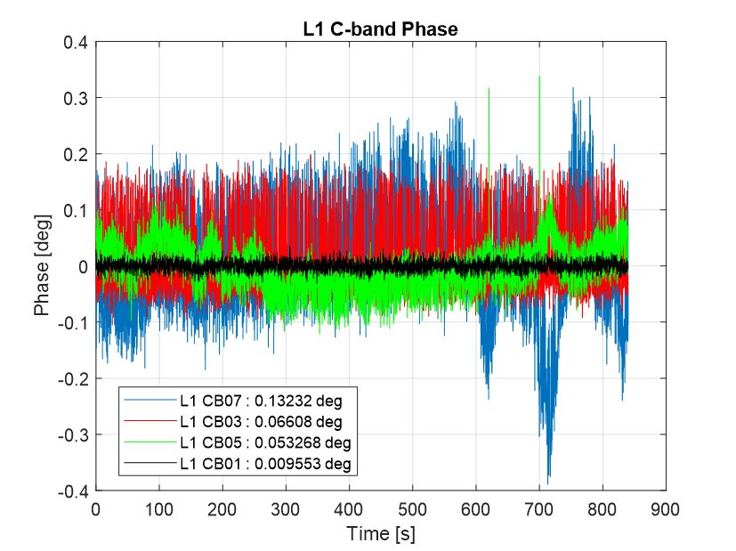
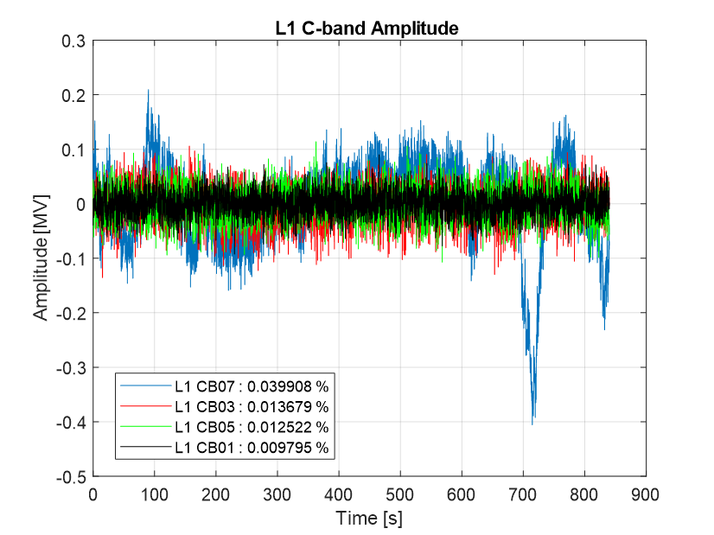
Pulse-to-pulse Amplitude and Phase Jitters (cont.)
Linac1 C-band #1 was well controlled – as a reference
Linac1 C-band #5 and #7 phase feedbacks failed
Linac1 C-band #3 and #7 had wideband phase jumps. Introduced by BOCs
Data collected from SwissFEL at Jan. 11, 2019 12:03–12:17

Slide 11
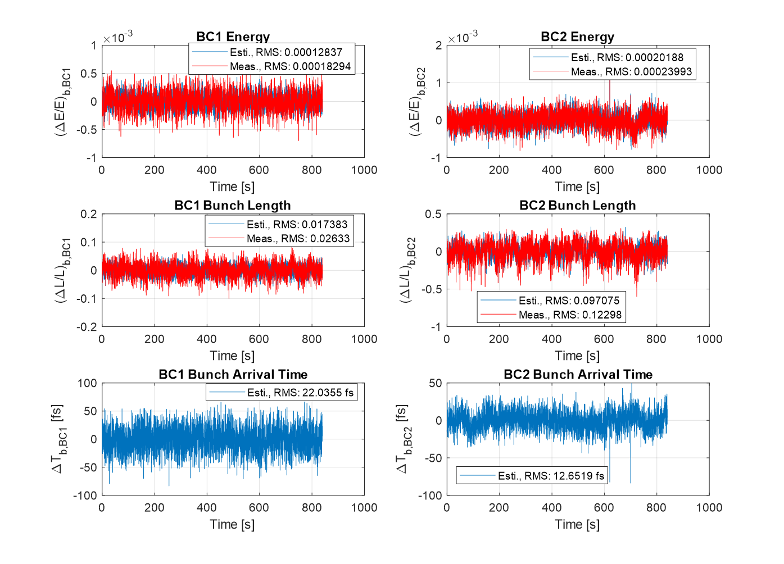
Estimation and Measurement of Beam Jitters
Goal:
< 5e-4
Goal:
< 5 %
Goal:
< 20 fs
Beam jitters can be predicted from RF measurements via the RF-beam response matrix and directly measured with beam diagnostics
When collecting data, all longitudinal feedbacks were off, BAMs were not enabled

Slide 12
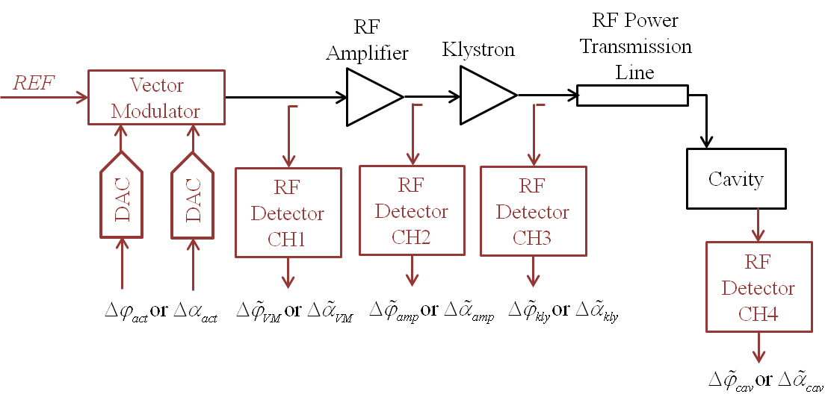
RF Driving Components added Phase Jitters
RMS jitters contain the noise power from 1 Hz to the bandwidth of the cavity/structure.
Data collected from SwissFEL at Jan. 11, 2019 12:03–12:17

Slide 13
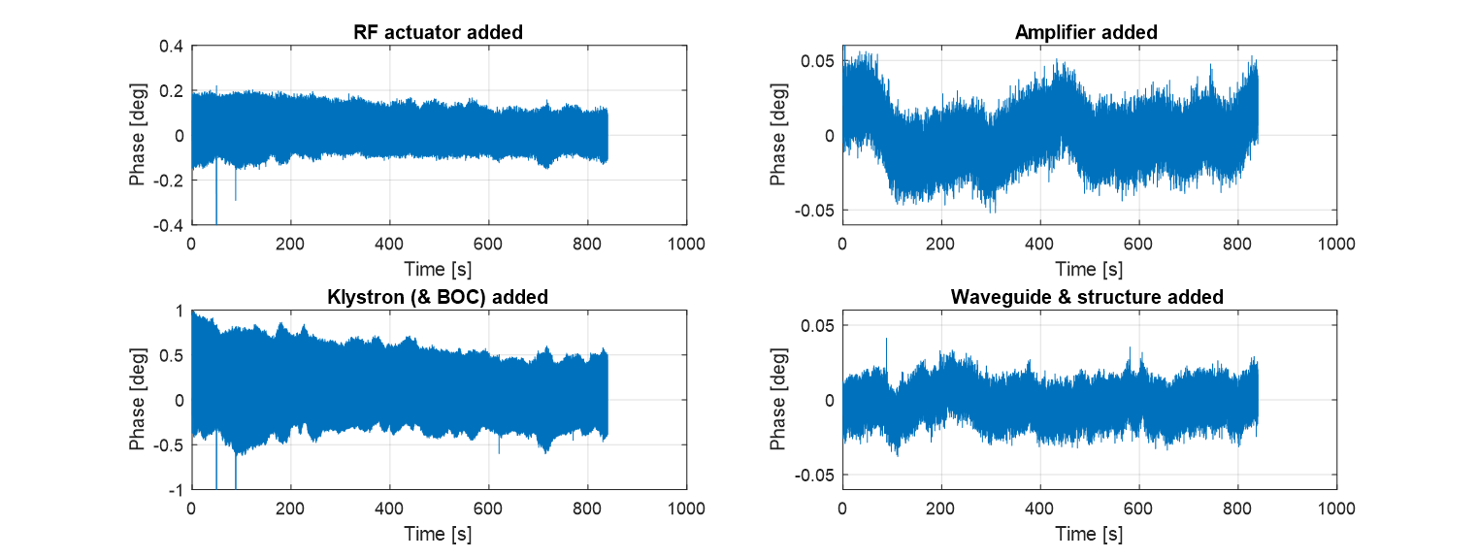
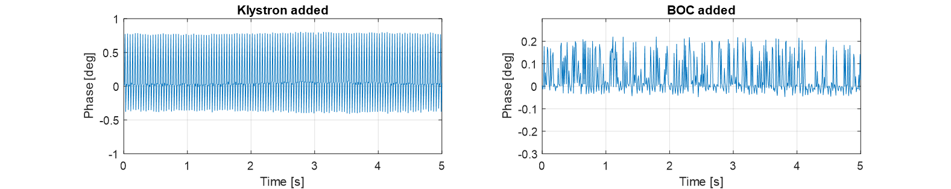
RF Driving Components added Phase Jitters (cont.)
RF components added phase jitter - Linac1 #07
Klystron and BOC added phase jitter (first 5 seconds) - Linac1 #07
Data collected from SwissFEL at Jan. 11, 2019 12:03–12:17

Slide 14
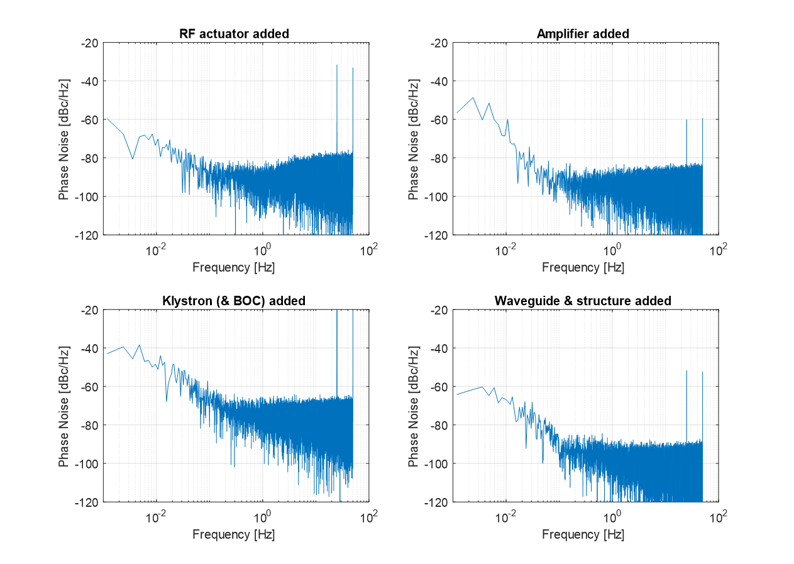
RF Driving Components added Phase Jitters (cont.)
RF components added phase noise - Linac1 #07
Disturbance clearly visible at beam rate (25 Hz when collecting data) and its harmonics
Components downstream from amplifier contribute to low-frequency fluctuations
BOC contributes to high frequency noises due to the random jumps
Noises slower than 1 Hz will be suppressed by LLRF phase feedback!
Data collected from SwissFEL at Jan. 11, 2019 12:03–12:17

Slide 15
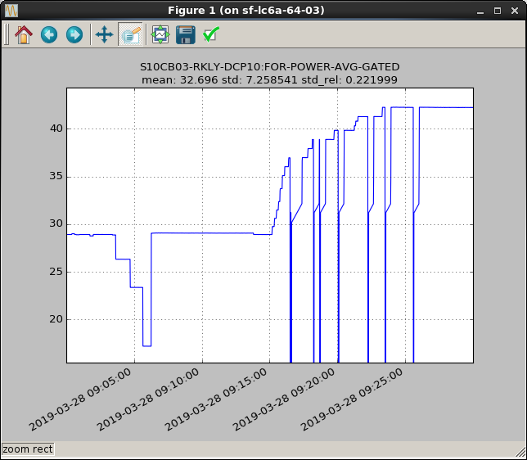
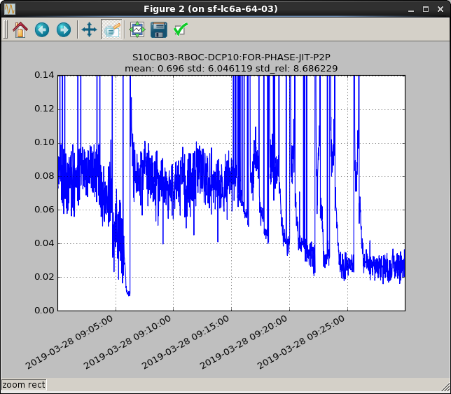
BOC Multipacting
Study of BOC multipacting (Example: Linac1 #3)
BOC Output RMS Phase Jitter (deg)
Klystron Output Power (MW)
Mitigation Methods:
Operate the C-band klystrons at a power level larger than 40 MW.
Based on the test on 28.03.2019

Slide 16
C-band Klystron Multipacting
Multipacting in C-band Klystron (Example: Linac1 #8)
Mitigation Methods:
Operate the C-band RF stations in saturation and adjust the drive power to avoid the multipacting region.
Phases of multiple klystrons in the same Linac section are adjusted to achieve the desired vector-sum amplitude and phase changes.
Courtesy: Roger Kalt

Slide 17
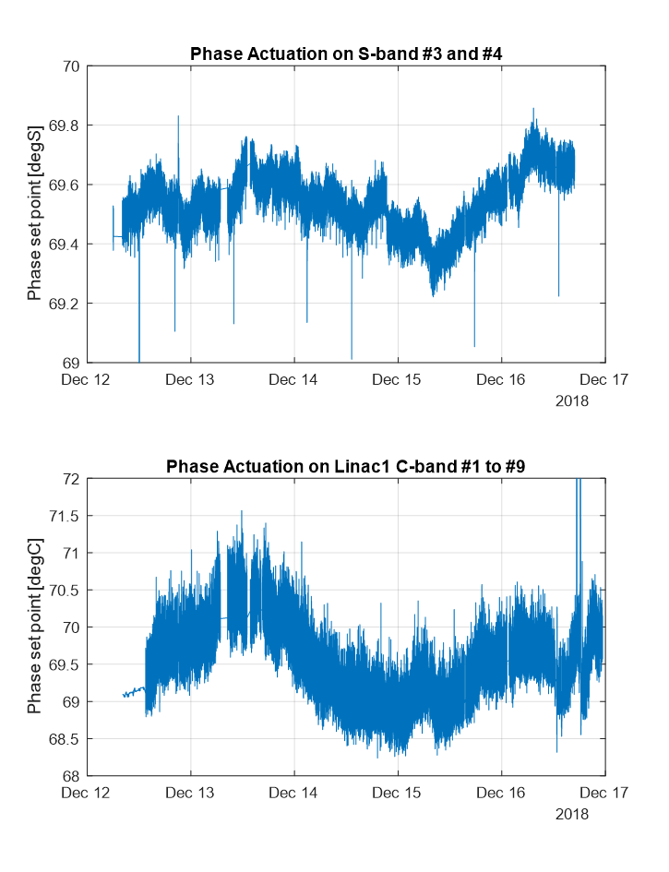
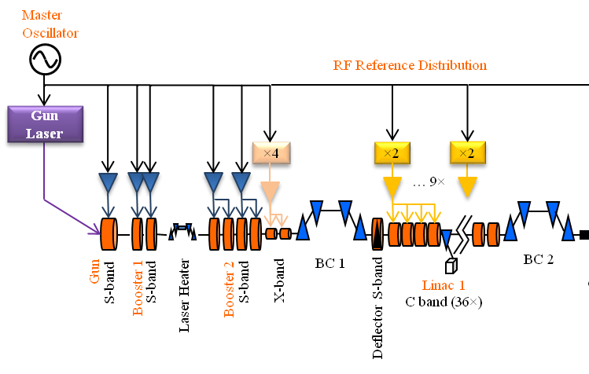
Long-term Phase Drift
Peak-to-Peak: ~0.6 degS
Beam based feedback stabilizes the beam energy and compression at BC1 and BC2 by actuating on the RF phases.
Phase actuations reflect the drifts in the machine.
Possible sources of drifts:
  RF reference distribution system
  Gun laser system
  RF detection in LLRF (pickup cable drifts or RF detector drifts)
The drifts are suppressed by the beam based feedback!
Peak-to-Peak: ~3 degC
Data collected from SwissFEL at Dec. 12-17, 2018 during the polit user experiment.

Slide 18
RF System Availability

Slide 19
Beam Availability during Last Experiment
Data collected during the user experiment (Alvra pilot experiment)
Electron beam energy 5.8 GeV, photon energy 9 keV, 25 Hz
Courtesy: Thomas Schietinger

Slide 20
RF System Faults Statistics and Availability
RF faults which caused a down-time > 1 min are summarized during period 12-Dec-2018 06:00:00 to 18-Dec-2018 06:00:00.
Sources of RF faults:
Reflection at klystron output and structure input
Klystron modulator interlock
Vacuum
Arc in waveguides or klystrons
Software failure
Beam availability: ~ 93 %
RF system availability: ~ 95 %

Slide 21
Summary and Outlook

Slide 22
Summary
SwissFEL RF system has reached its nominal working point: 5.8 GeV energy gain @ 100 Hz. Linac3 can provide a spare RF station in hot-standby.
Most RF stations satisfy the stability requirements except for Linac1 #3, #5 and #7 which require more work to understand and mitigate the instabilities.
The RF system still dominates the down-time and its availability is expected to be increased after a period of running of the high power RF components.

Slide 23
Consolidation Plan of SwissFEL RF System
Availability: Linac1 RF stations will be optimized aiming to have one spare klystron which can be put in use when there are failures in other klystrons
Stability:
  Improve the LLRF phase feedback loop to guarantee the phase regulation
  Understand and mitigate the phase jitter caused by beam firing (e.g. Linac1 #7)
  Understand and mitigate the phase jump caused by BOC (e.g. Linac1 #3 and #7)
  Evaluate the drifts in RF reference distribution system and LLRF system
Reliability and Operability:
  Improve the software (LLRF, modulator, RF station master state machine, beam base feedback …) inter-operability and robustness

Slide 24
Special Thanks to:
SwissFEL RF and LLRF team.
Thank you for your attention!

Slide 25
Backup

Slide 26
Beam Sensitivity to RF Noises
Courtesy: Sven Reiche
Transfer Matrix
Use Cases:
From measurements of jitter sources predict the beam parameter jitters.
From required beam parameter jitters determine the jitter budgets of the jitter sources.

Slide 27
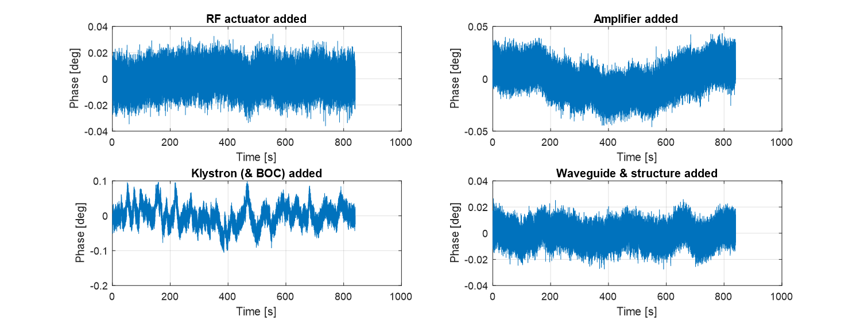
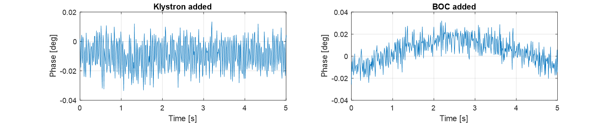
RF Driving Components added Phase Jitters
RF components added phase jitter - Linac1 #01
Klystron and BOC added phase jitter (first 5 seconds) - Linac1 #01
Data collected from SwissFEL at Jan. 11, 2019 12:03–12:17

Slide 28
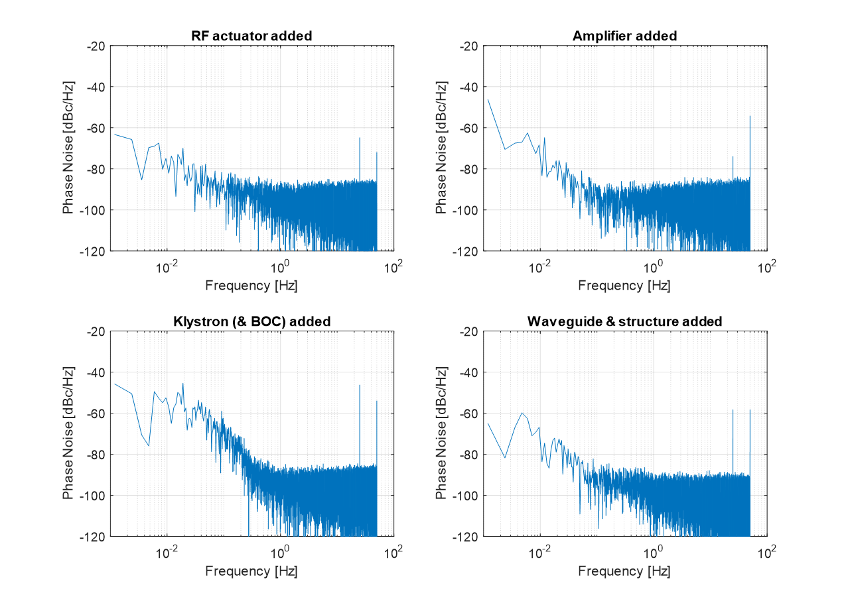
RF Driving Components added Phase Jitters (cont.)
RF components added phase noise - Linac1 #01
Disturbance clearly visible at beam rate (25 Hz when collecting data) and its harmonics, but smaller than Linac1 #07
Components downstream from amplifier contribute to low-frequency fluctuations
Noises slower than 1 Hz will be suppressed by LLRF phase feedback!
Data collected from SwissFEL at Jan. 11, 2019 12:03–12:17

