Slide 1
Initial Studies and Setup for Large Bandwidth Operation
SwissFEL Beamdynamics Group :: Paul Scherrer Institut
SwissFEL Progress Meeting, 25 June 2019

Slide 2
The Basic Idea
In normal operation, the chirp at BC2 (higher energetic electrons in the tails) is removed by wakefields (energy losses increases with position towards the tail)
With over-compression, lower energetic electrons are at the tail and the wakefields adds up. Overcompression is done by going more off-crest in Linac 1
First Linac
Main Linac
Compressor
compression
wakes remove chirp
over-compression
wakes add to chirp
Caution: With overcompression sign in the response matrix for the BCM changes sign
Feedback becomes instable when not adjusted for new settings!

Slide 3
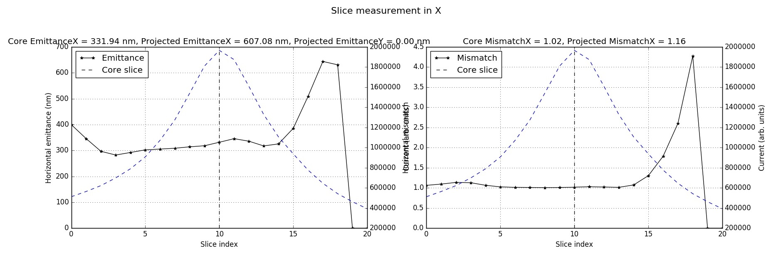
Beam Quality of Overcompressed Beam
Standard mode
FWHM dE/E = 0.15%
LB mode
FWHM dE/E = 1.54%
Overcompression seems rather robust with little degradation in slice emittance
Needs tilt correction for best centroid alignment, different to normal operation (CSR kick)

Slide 4
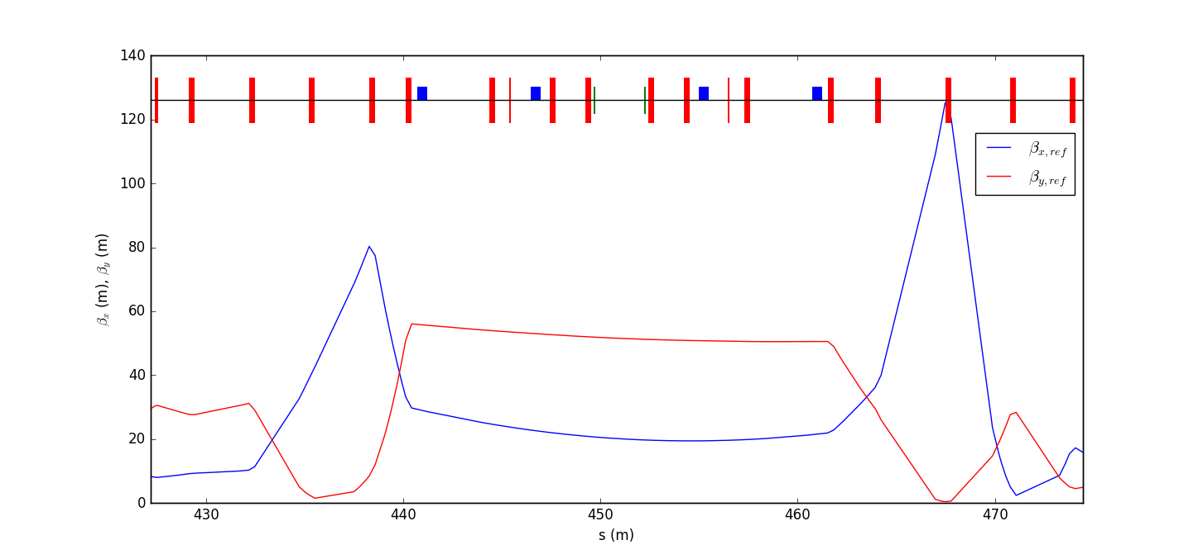
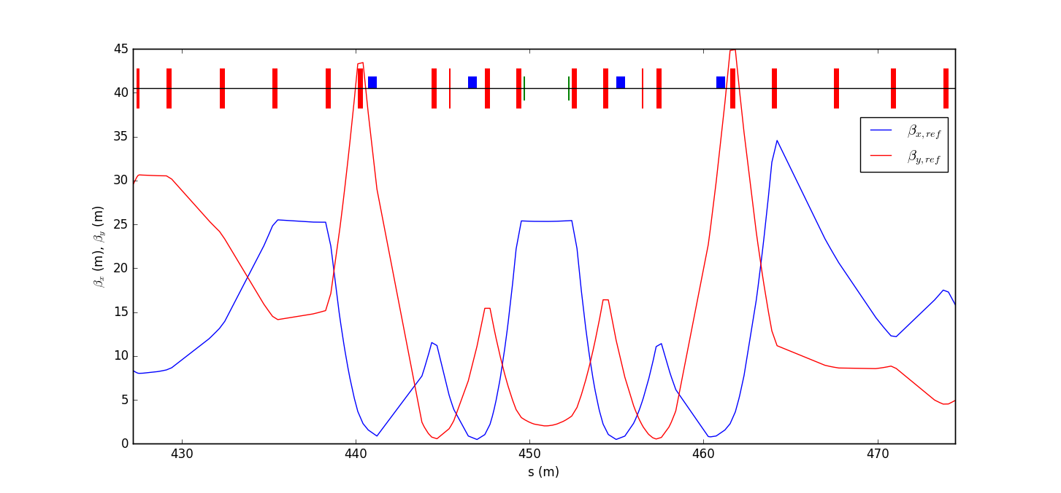
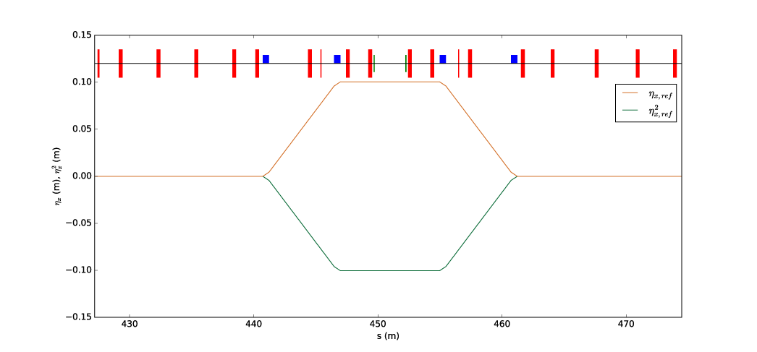
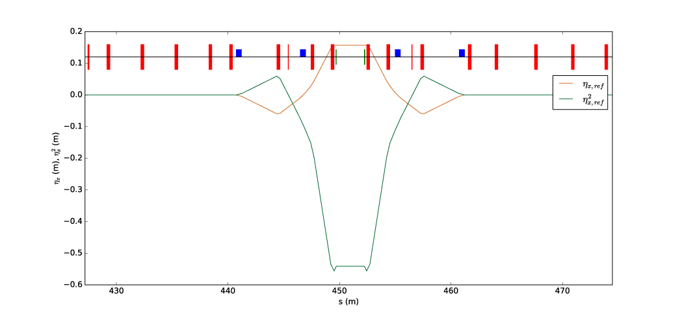
Energy Collimator Optics and Dispersion
Nominal optics has no residual compression (R56=0) but strong quadrupole settings and tighter optics
Collimator as Compressor
Nominal Optics
β_{x}, β_{y}
β_{x}, β_{y}
1st and 2nd Dispersion
1st and 2nd Dispersion

Slide 5
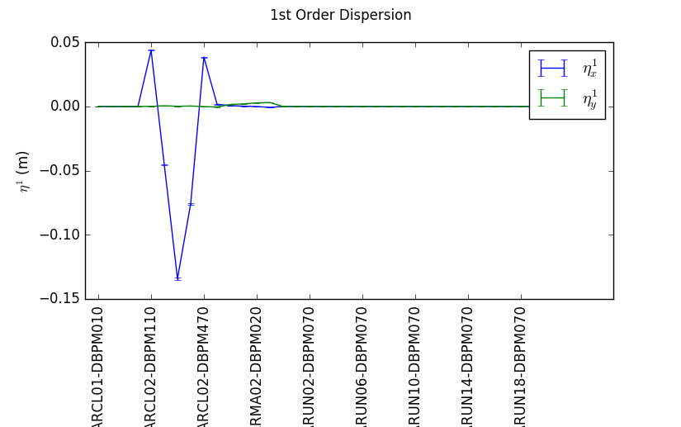
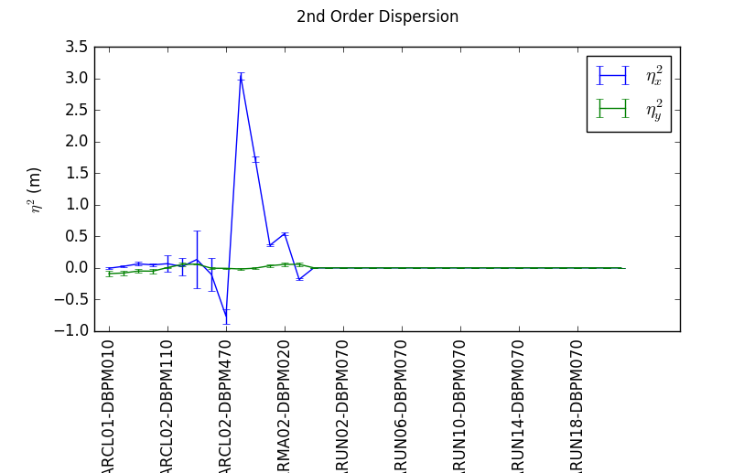
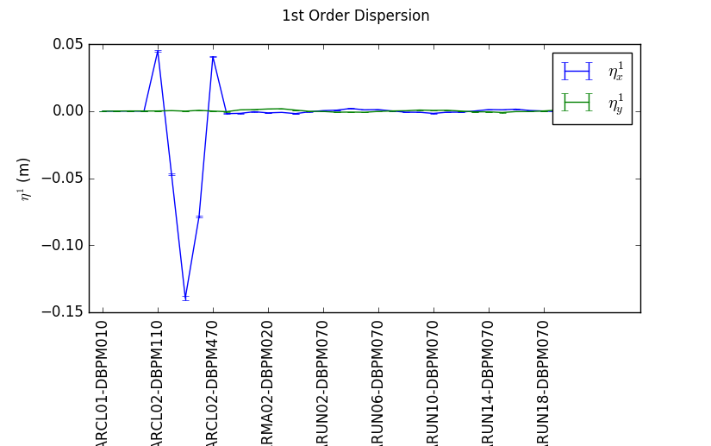
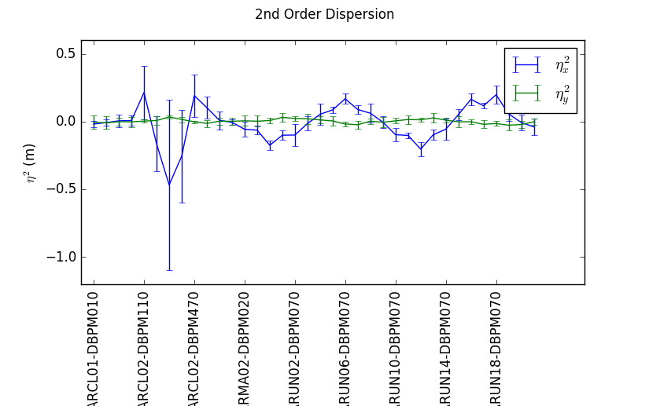
Fine Tuning the Dispersion
Without sextupoles, the 1st order dispersion is ok but the second order blows up
Optimizing the sextupoles (magnet calibration based on design)for 2nd order, scaling quads to close 1st order, align orbit to close 1st order in y!

Slide 6
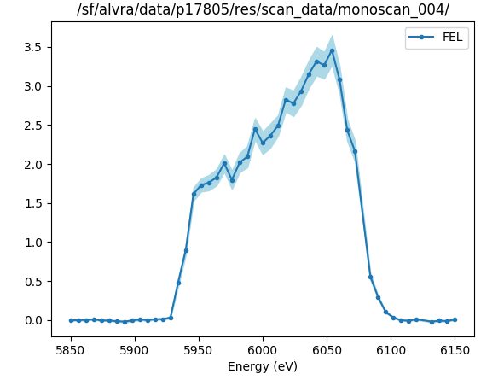
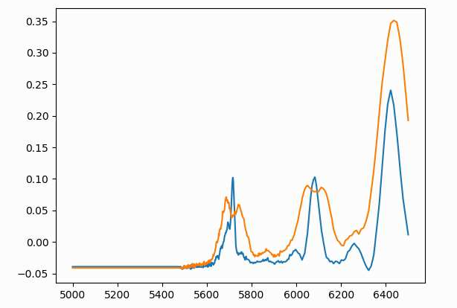
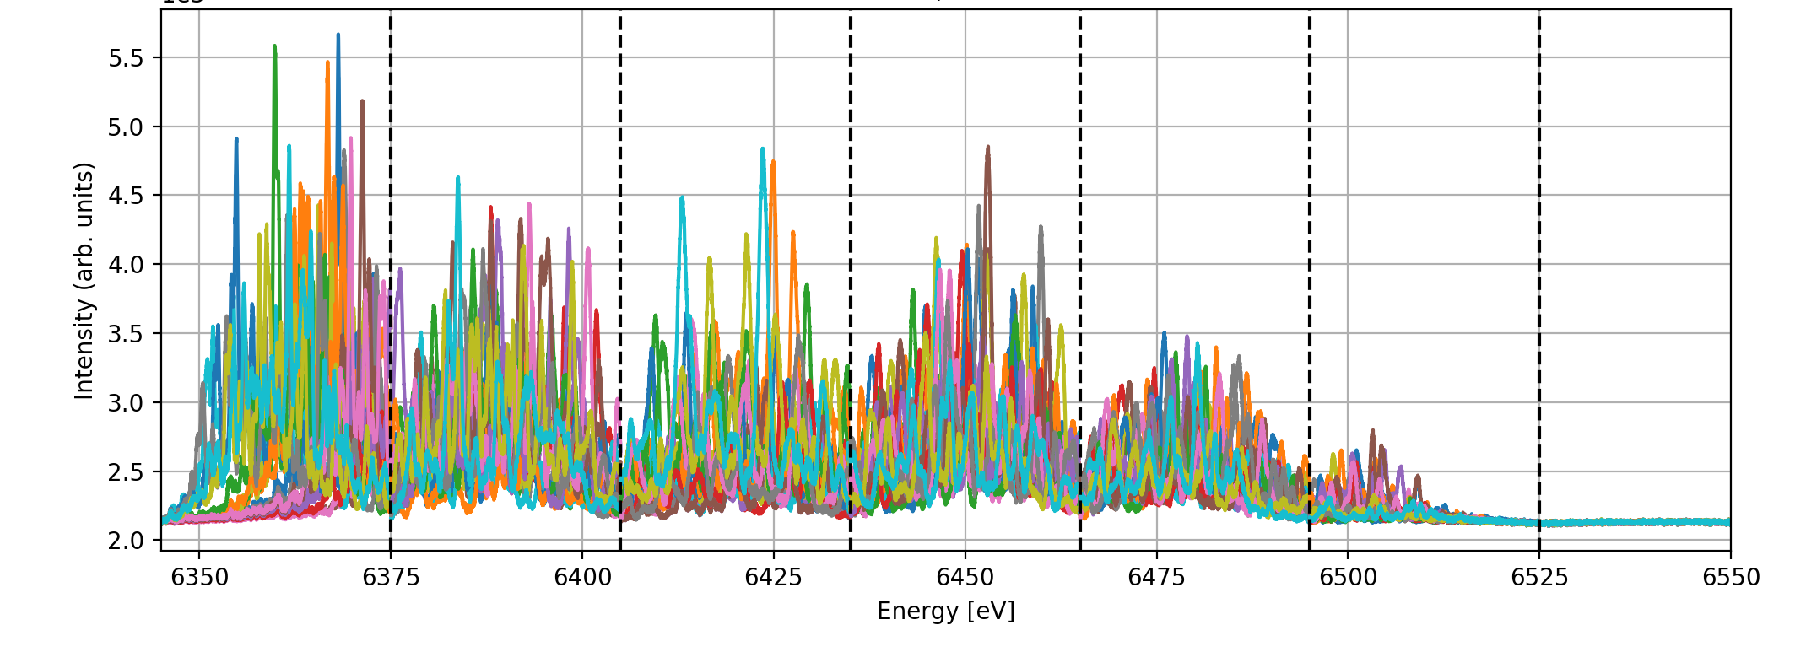
FEL Performance
Alvra Elog 898
Scan with MC
Tuesday
6 keV
eTOF spectra
Orange: LB
Blue: standard SASE
6 keV
X axis not calibrated
User shift:
  2.5% BW
  Up to 400 uJ pulse energy
  Central wavelength: 6 keV
PSSS using 7 windows
Sunday, 6.4 keV

Slide 7
Large Bandwidth Mode – Bandwidth Control
Control of the Bandwidth:
  Leaking Dispersion (Quad in ECOL)
  Laser Heater Notch / Emittance Spoiler Foil
  RF Gun Laser Pulse Shaping
  Post Linac Dechirper (CROSS)
  Unbalance Compression
Demonstrated
Measured spectra
Reduce R56 at BC2 by 50 % (change angle from 2.1 to 1.5 degree) and increase energy chirp by 100 %
50% More Bandwidth
(in theory ☺ )
FWHM tunable from 0.23% to 1.66%

Slide 8
Summary and Outlook
Large bandwidth mode has been set-up and used for first user experiment
Operation aspects:
  Overcompression in BC2 (careful with feedback)
  Zero R56 set-up of energy collimator (needs fine tuning of 1st and 2nd order dispersion function)
  Tilt correction and central orbit different for normal mode and large bandwidth mode (no simple switch between modes)
Work in progress:
  Control the bandwidth
  Increase efficiency (tilt alignment, current profile)
  Foundation of other modes (e.g. some two color modes, spatial, frequency chirp etc)
  Training lesson for Athos switch yard.

