Slide 1
Zheqiao Geng :: LLRF Group :: RF Section
LLRF Tools for Two-bunch Operation
SPM
09.07.2019

Slide 2
Outline
User Requirements
LLRF Knobs for Two-bunch Tuning
Setup procedures
LLRF Tools and Test

Slide 3
User Requirements

Slide 4
Two Bunches in the same RF Pulse
Two bunches are separated by 28 ns!
Cavity / Structure | Frequency (MHz) | Time Constant or Filling Time (ns)
RF Gun Cavity | 2998.8 | 480
S-band Structure | 2998.8 | 910
C-band Structure | 5712 | 320
X-band Structure | 11995.2 | 100
How much can cavity field change within this 28 ns in ideal case?
Gun: 5.6 %, 3.2 degS
S-band: 3.1 %, 1.8 degS
C-band: 8.7 %, 5.0 degC
X-band: 28 %, 16 degX
Tune the second bunch with the 28-ns RF pulse after bunch1 is possible.
Practically, the tuning range is much smaller!

Slide 5
Amplitude and Phase Diff. for two Bunches
Bunch1 time
If delaying the RF pulse by 3~4 clock cycles (12~16 ns) with respect to the beam, the two bunches will see the same accelerating voltage but with larger phase difference.
Around current working points, amplitude and phase differences between bunch 1 and bunch 2:
Gun: 1.0 % 0.4 degree
S-band: 0.3 % 0.7 degree
C-band: 2.7 % 1.3 degree
X-band: 1.6 % 1.6 degree

Slide 6
User Requirements
Requirements - achievable:
Be able to adjust the RF amplitude and phase for the second bunch without affecting the first bunch.
  Scenario 1: Setup the second bunch for transmission – equalize the RF fields for both bunches
  Scenario 2: Fine tune the second bunch to satisfy the bunch parameter requirements
Requirements – NOT achievable:
Measure/set the exact delta-amplitude and phase for the second bunch.
  It is not possible to measure the absolute amplitude and phase seen by a bunch – need to know exactly the field distribution in structure and the transfer function of the RF detector.
Adjust the amplitude and phase for the first bunch without affecting the second bunch.
Functions of LLRF tool for two-bunch operation (tech. constraints considered):
With existing interfaces (RSYS:SET-ACC-VOLT and RSYS:SET-BEAM-PHASE), the amplitude and phase changes will be applied to the entire RF pulse and affect both bunches.
A knob will be provided to tune the amplitude and phase seen by the second bunch without affecting the first bunch. But it is not possible to tell how much amplitude and phase for the second bunch has been tuned from the RF measurements.
The beam diagnostics for the second bunch should be always referred when tuning the RF knob for the second bunch!

Slide 7
User Requirements (cont.)
Procedures for two-bunch setup and regulation:
Setup Gun RF fields for two bunches with the same (or with specified offset) bunch energy and arrival time at Gun exit (and/or minimum energy spread).
Setup injector RF station fields for two bunches with the same (or with specified offset) bunch energy, arrival time and compression at BC1 exit.
Setup Linac1 RF station fields for two bunches with the same (or with specified offset) bunch energy, arrival time and compression at BC2 exit.

Slide 8
LLRF Knobs for Two-bunch Tuning

Slide 9
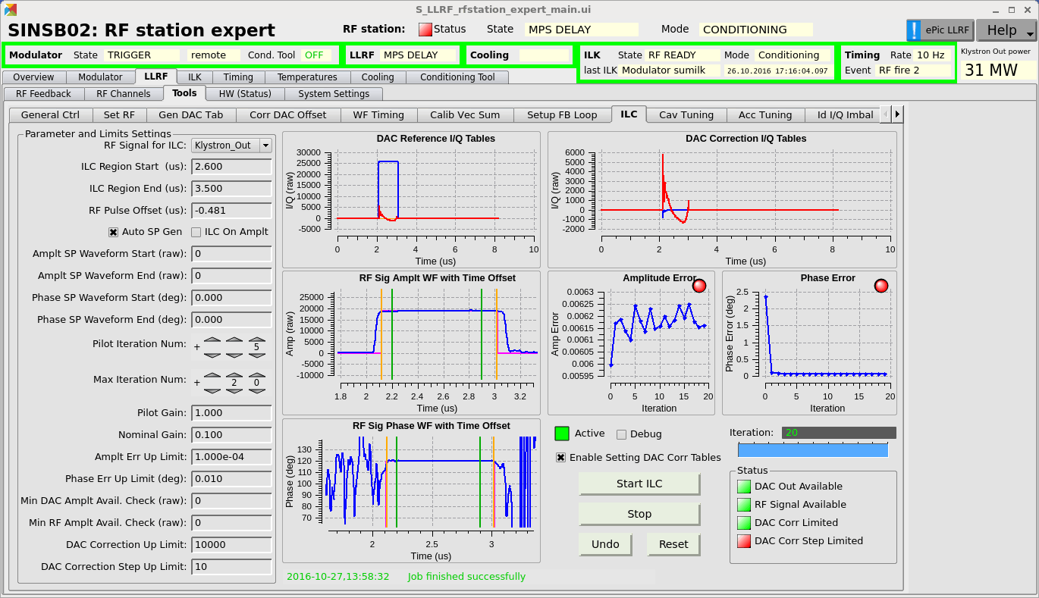
Knobs Affecting both Bunches
Iterative learning control. Flatten the amplitude and phase within the RF pulse. Due to the limited tuning range for the second bunch, flattening the pulse is necessary to roughly equalize the amplitude and phase for both bunches.
  Injector stations (SINSB01-04 and SINXB01): flatten both amplitude and phase
  C-band stations (S10CB01-09): flatten the phase

Slide 10
Knobs Affecting both Bunches (cont.)
Delay adjustment for C-band. After flattening the phase of C-band pulse, the delay of the pulse should be adjusted to roughly equalize the energy gain of both bunches.
Currently the single bunch is placed at the time with maximum acc. voltage.
With two bunches, we lose slightly the energy gain!

Slide 11
Knobs Tuning the Second Bunch
The knobs to fine tune the second bunch after the first bunch is optimized:
Amplitude and phase step in RF pulse. The schematic.
28 ns
This part of pulse can be used to tune the second bunch!
We can generate a step here for both amplitude and phase.
Bunch 1 acceleration
Bunch 2 acceleration
Vector generated by the 28-ns step
RF pulse
Common vector for both bunches

Slide 12
Knobs Tuning the Second Bunch (cont.)
Amplitude and phase step in RF pulse. Amplitude and phase step example in SINSB03/04.

Slide 13
Knobs Tuning the Second Bunch (cont.)
Amplitude and phase step in RF pulse. Tuning range.
Tuning range for step ratio 0 ~ 1.2 and step phase -30 ~ 30 degree:
  Gun: -2.5% ~ 1.5% ±0.9 degree
  S-band: -1.0% ~ 0.5% ±0.4 degree
  C-band: -10% ~ -5% ±0.6 degree
  X-band: -25% ~ 5% ±7.6 degree

Slide 14
Setup Procedures

Slide 15
Setup Procedure for Gun
The first bunch should be optimized by the nominal Gun setup procedure.
Still only with the first bunch, remember the bunch charge and the LH BAM reading.
Move the Gun RF timing earlier by 28 ns and now the first bunch experiences the RF field for the second bunch.
Tune the Gun RF pulse step amplitude and phase to recover the bunch charge and LH BAM reading (or energy and energy spread at Gun spectrometer – need further test) of the first bunch as saved in step 2. After setting this step, the second bunch will experience the same RF amplitude and phase with the first bunch.
Restore the Gun RF station timing as original values.
Enable the second bunch, observe the two-bunch arrival times at LH and tune the timing of second laser to equalize the two-bunch arrival times at LH. (Note: do not change any longer the Gun RF, but only use the delay of second laser as the knob in this step!)

Slide 16
Setup Procedure for Injector
Flatten the RF pulses for SINSB01-04 and SINXB01 via ILC.
The first bunch should be optimized by the nominal injector setup procedure.
Still only with the first bunch, remember the BC1 energy and BC1 compression.
Move the timing of all injector RF stations (SINSB01-04, SINXB01) earlier by 28 ns and now the first bunch experiences the RF fields for the second bunch.
Using the following two loops to restore the BC1 energy and compression (or with a desired offset):
  Step ratio of SINSB01/02/03/04 => BC1 energy;
  Step phase of SINSB03/04 => BC1 compression.
Manually fine tune the X-band RF step ratio and phase to further optimize the second bunch, keep the loops in 5 running to compensate the small influence in compression. (Is it possible to automate the X-band tuning?) After setting this step, we can assume the second bunch will experience the same RF amplitude and phase with the first bunch.
Restore the injector RF timings as the original values.
Enable the second bunch, verify the two bunch BC1 energy, BC1 compression and BC2 BAM.
If the beam diagnostics for both bunches exist, the RF station timing does not need to be moved and the two loops in step 5 can directly refer to the beam diagnostics!

Slide 17
Setup Procedure for Linac1
With only the first bunch, scan the delay of each RF station and find the delay where the first bunch gains slightly smaller energy than the second bunch.
The first bunch should be optimized by the nominal Linac1 setup procedure.
Still only with the first bunch, remember the BC2 energy and BC2 compression.
Move the timing of all Linac1 RF stations (S10CB01-09) earlier by 28 ns and now the first bunch experiences the RF fields for the second bunch.
Using the following two loops to restore the BC2 energy and compression (or with a desired offset):
  Step ratio of S10CB01-09 => BC2 energy;
  Step phase of S10CB01-09 => BC2 compression.
Restore the Linac1 RF timings as the original values.
Enable the second bunch, verify the two bunch BC2 energy, BC2 compression and BC2 BAM.
If the beam diagnostics for both bunches exist, the RF station timing does not need to be moved and the two loops in step 5 can directly refer to the beam diagnostics!

Slide 18
LLRF Tools and Test

Slide 19
What Tools are Needed?
DAC table generation: generate the amplitude and phase step
Iterative learning control: flatten the RF pulse in amplitude or phase
C-band delay optimization: roughly equalize the energy gain of both bunches
DAC step time calibration: find the time to start the step with max tuning to bunch 2 but no affects to bunch 1
RF pulse average window setting: make the average window for amplitude and phase calculation only for the first bunch, so that the changing of the step will not affect the first bunch with RF feedbacks on
Gun setup procedure
Injector setup procedure
Linac1 setup procedure

Slide 20
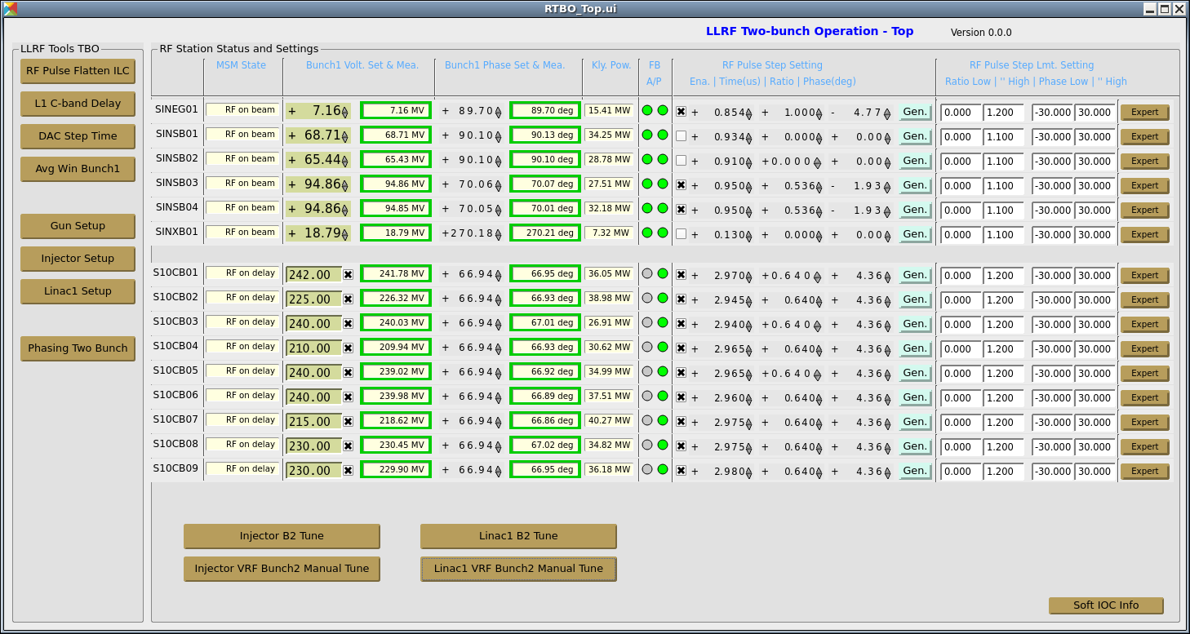
Two-bunch Setting on 14.05.2019
The injector and Linac1 RF stations were set for two-bunch testing. The following settings have been applied and will be kept for the future testing of the second bunch when the first bunch is in operation:
1. The injector RF pulse widths have been changed to the following values:
SINEG01: 0.86 us
SINSB01 - SINSB04: 1.07 us
SINXB01: 0.16 us
Tools for RF experts
Tools for operators

Slide 21
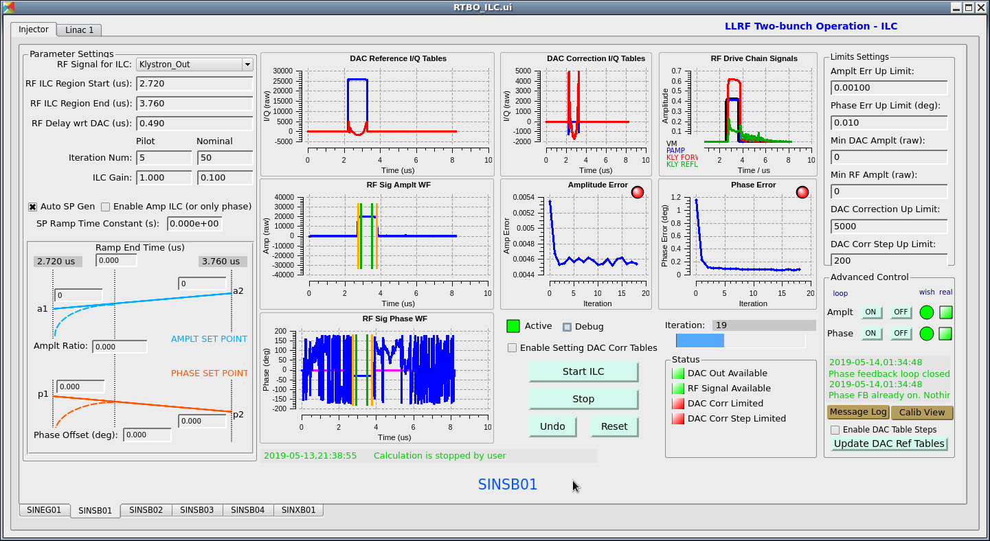
Two-bunch Setting on 14.05.2019 (cont.)
2. The phases of the injector RF stations have been flattened with the Iterative Learning Control (ILC) tool.

Slide 22
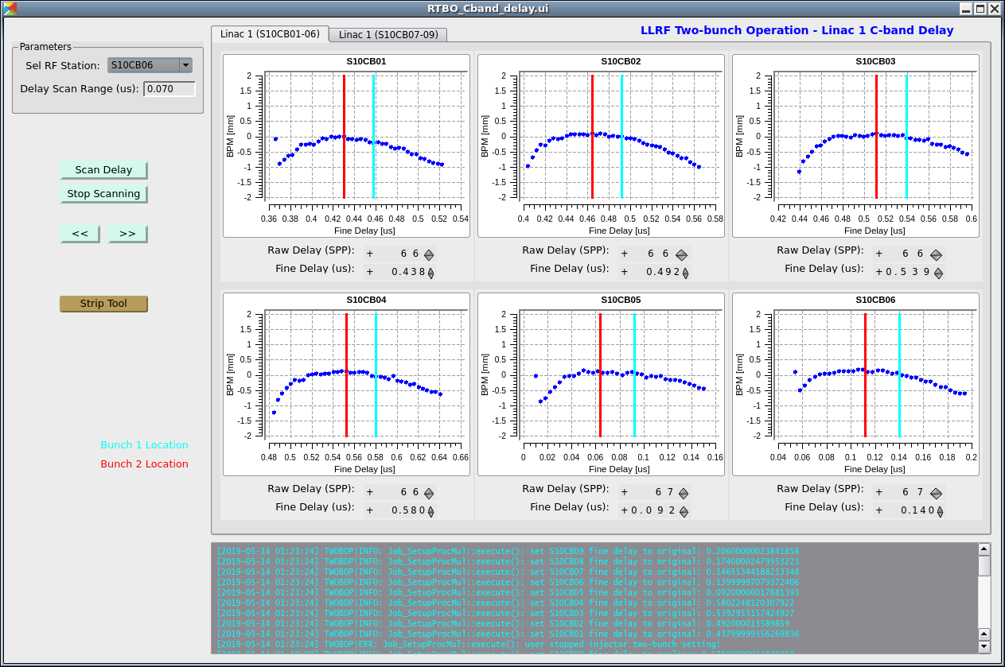
Two-bunch Setting on 14.05.2019 (cont.)
3. The C-and delay has been optimized to get a little more energy in bunch2.

Slide 23
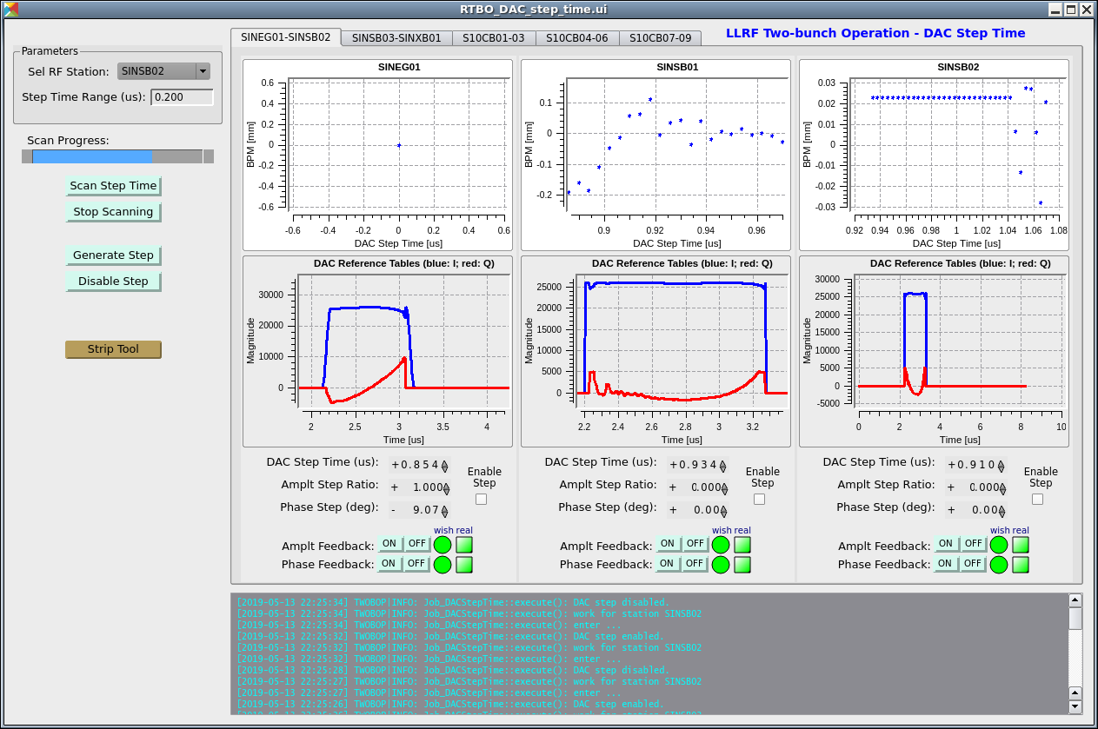
Two-bunch Setting on 14.05.2019 (cont.)
4. The DAC step times of the injector and Linac1 stations have been optimized to allow tuning the second bunch with the RF pulse steps without affecting the first bunch. During operation, the influence from the RF pulse steps on the first bunch should be verified. If it is found that the steps affect the first bunch, please contact us for a correction.

Slide 24
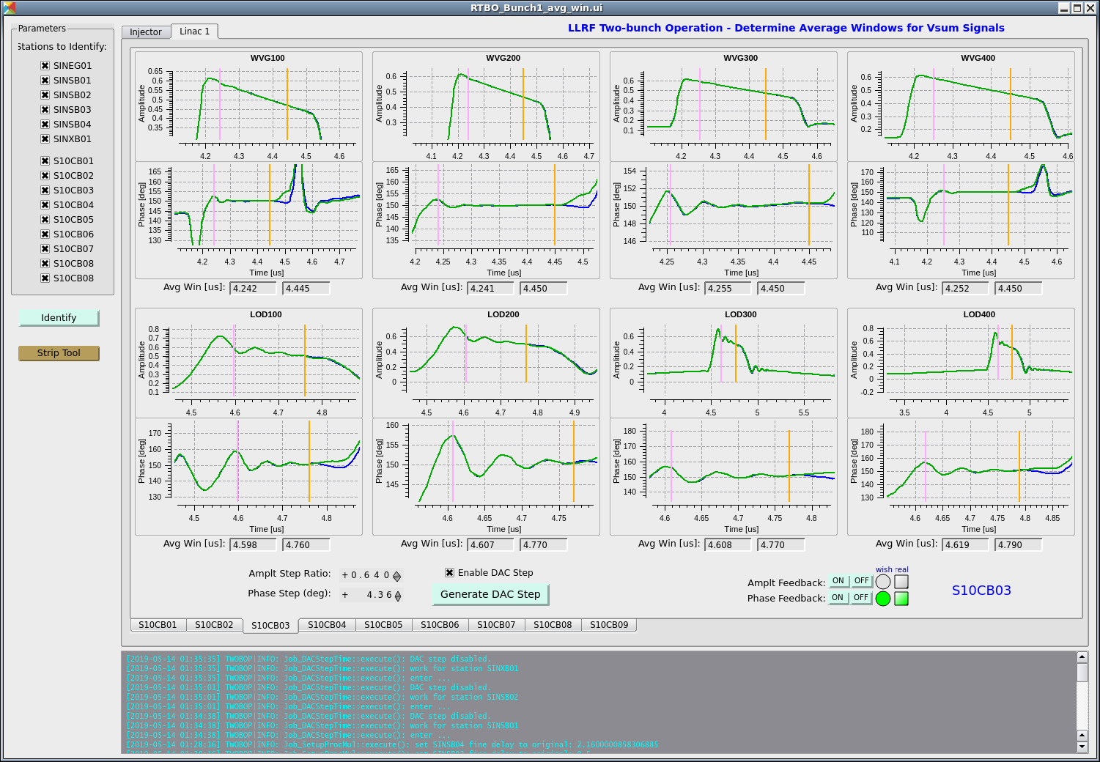
Two-bunch Setting on 14.05.2019 (cont.)
5. The average windows of all RF signals involved in the vector-sum calculation have been changed so that the changes in RF pulse steps will not be transferred to the first bunch with the RF amplitude and phase feedbacks.

Slide 25
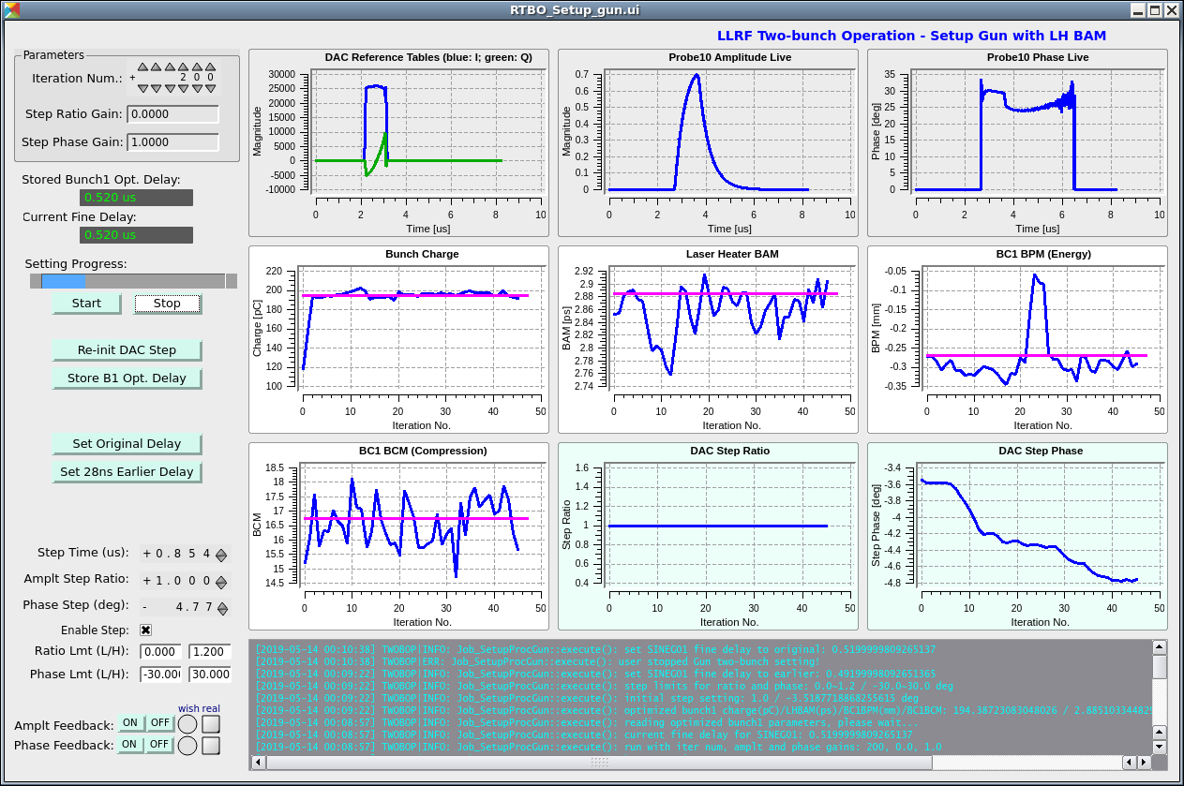
Two-bunch Setting on 14.05.2019 (cont.)
6. The RF pulse steps for the SINEG01 have been set so that the two bunches will experience roughly the same accelerating field.

Slide 26
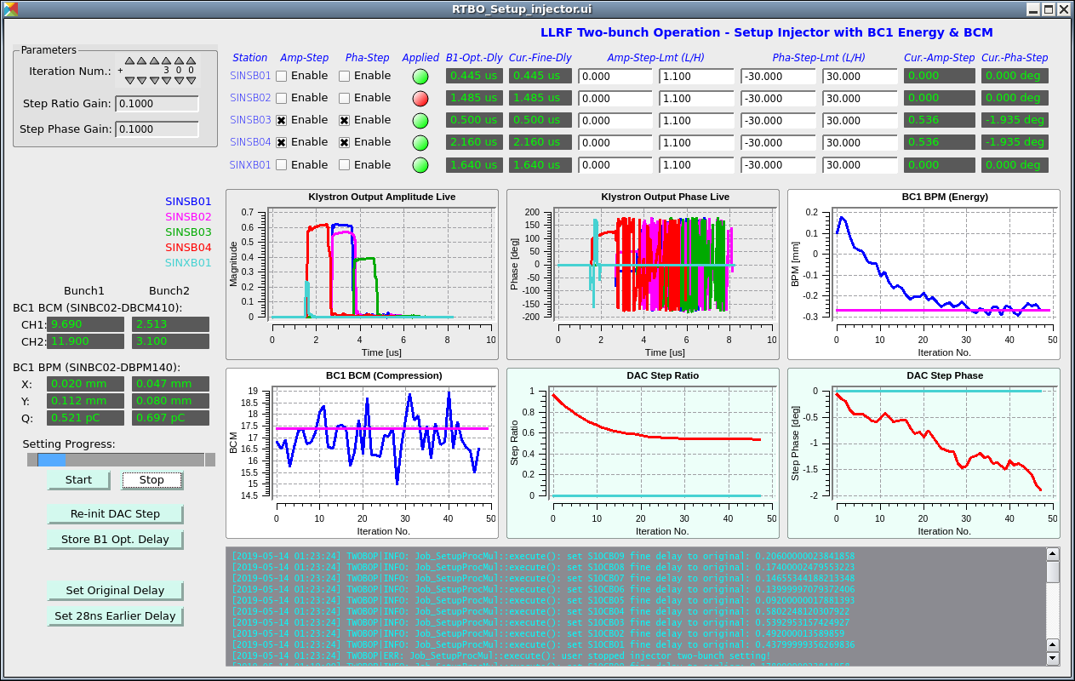
Two-bunch Setting on 14.05.2019 (cont.)
6. The RF pulse steps for the SINSB03/04 have been set so that the two bunches will experience roughly the same accelerating field.

Slide 27
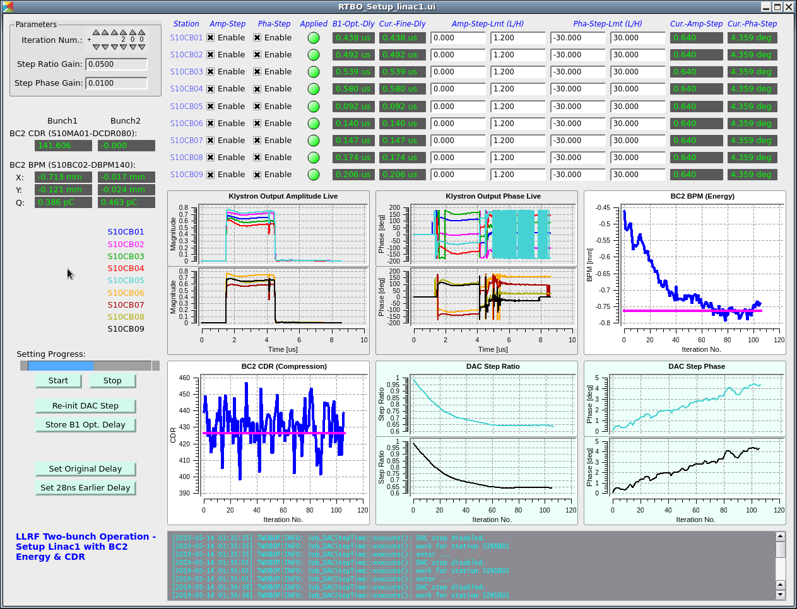
Two-bunch Setting on 14.05.2019 (cont.)
6. The RF pulse steps for the S10CB01-09 have been set so that the two bunches will experience roughly the same accelerating field.

Slide 28
Further Test of Two-bunch Tools (13.07.2019)
Setup the Gun for the second bunch using the screen after the Gun spectrometer.
Test the second bunch setting tool with the second bunch (and diagnostics) available.
Test the two-bunch phasing tool.

Slide 29
Thank you!
Questions?

