Slide 1

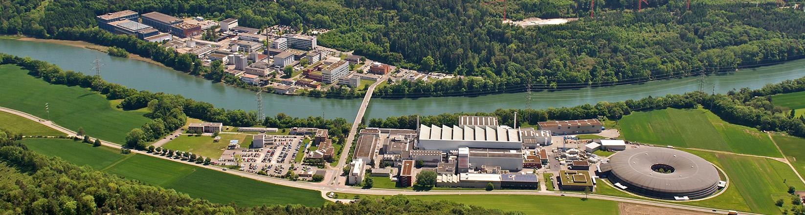
WIR SCHAFFEN WISSEN – HEUTE FÜR MORGEN
Fault Analysis and Statistics Software for the SwissFEL RF Systems
Rebeca Espasandin

Slide 2
Outline
❑ Introduction
❑ Database
API
UI

Slide 3
❑ Introduction
❑ Database
API
UI

Slide 4
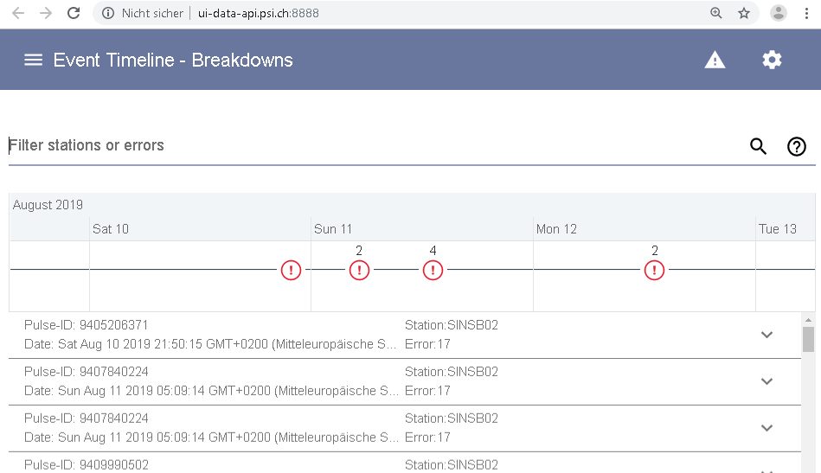
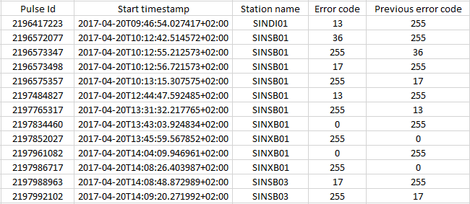

Introduction (old system)
Recording (LLRF waveforms + ILK faults)
Web frontend
Databuffer
Query API
Fault Detection
(runs each hour)
Insert
Query API
Data in one text file

Slide 5
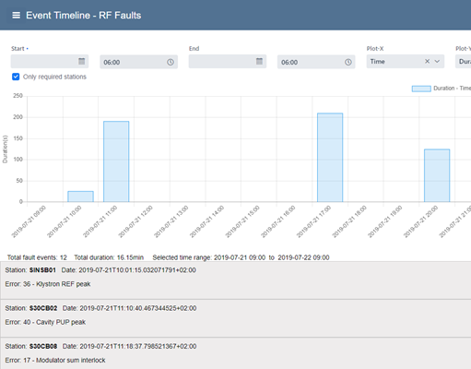
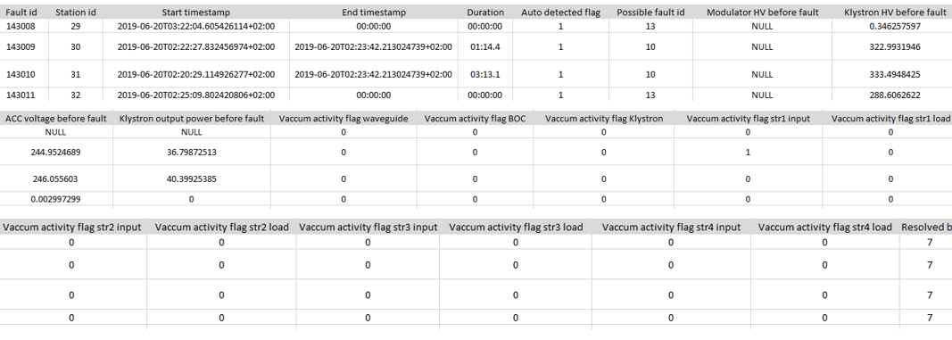

Introduction (new system)
Recording (LLRF waveforms + ILK faults + other PVs)
Web frontend
Archiver + Databuffer
Query API
Fault Detection
+ Fault End Det.
(runs each hour)
Fault Detection
(runs each hour)
Insert + Update
Query API
Data in one sqlite3 database file, several tables

Slide 6
Introduction

Slide 7
❑ Introduction
❑ Database
API
UI

Slide 8
Database
Data from “RF Breakdown viewer” saved in a text file
Changed to a database, adding new fields with more information for every fault.
Increments the speed and gives more information.
Current system takes about 20s to query faults for the last 24h.
New system takes about 0.3s.

Slide 9
Database
Static data:
RF station
Possible fault
RF station type
Resolved by

Slide 10
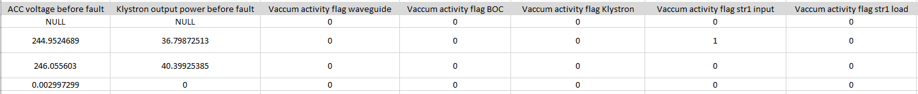
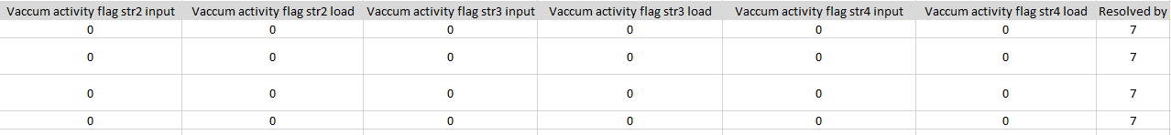
Database
Dynamic data:
Fault event table which contains all the information about the faults. Besides there is a table for the ELOG linked to the fault events.
New column required added. Check if RILK:MODE==3 when the fault happened, if true, the station was required on beam.
Available since 2019-07-18.

Slide 11
❑ Introduction
❑ Database
API
UI

Slide 12
API
API makes the connection with the database and the query funtionality.
Repository: https://git.psi.ch/controls_highlevel_applications/breakdown_detection
Filters:
Station name
Time range
Facility
Duration
Resolved by
Voltages, power before fault
Vacuum activity flags
Error code
Add, edit or delete faults
Add, edit or delete ELOGs

Slide 13
❑ Introduction
❑ Database
API
UI

Slide 14
UI (old versión)
Known drawbacks
Takes long to load (due to text file search)
Can only define query time range via mouse
Shows total number of faults

Slide 15
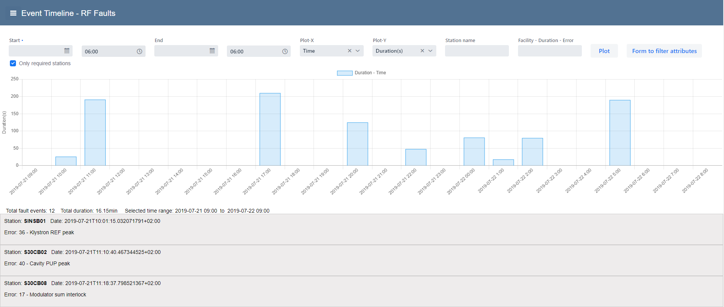
UI
By default the first update shows, duration of the faults in seconds vs the last 24h,
only for stations required on beam when the fault happend.
Shows total number of faults and total duration for the selected time range.
Below shows the detail of the fault for this period of time.
To see the details, click on the fault.

Slide 16
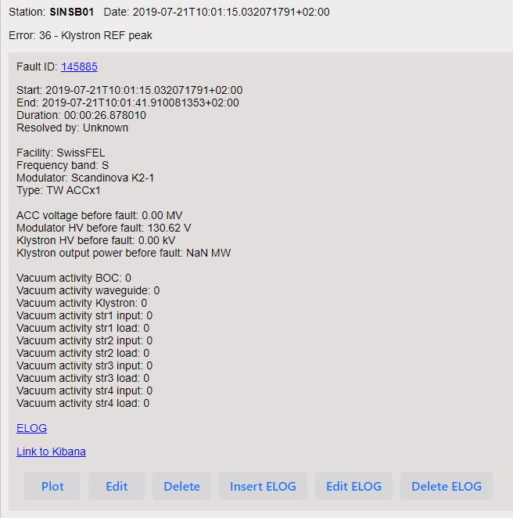
UI
The fault id is linked to the fault details retrieved from the API
Plot PVs for this fault in archiver

Slide 17
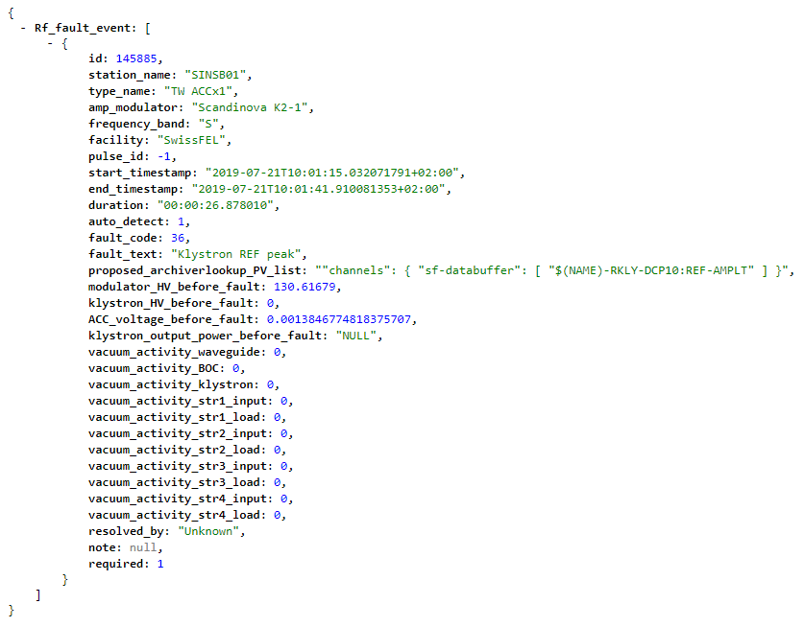
UI
Details retrieved from API to certain fault id

Slide 18
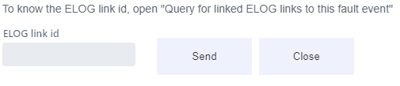
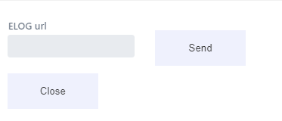
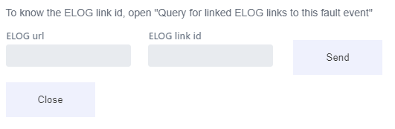
UI
ELOGs can be inserted, edited or deleted

Slide 19
UI
Logstash linked to Kibana. Open Kibana 10 seconds around the fault

Slide 20
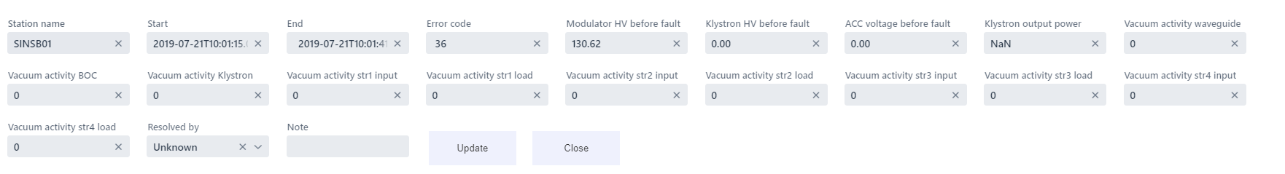
UI
Faults can be edited or deleted

Slide 21
UI
Possible queries: - Time range
- Station name
- Facility
- Duration of the fault
- Error code
Only for stations required on beam, by default. Uncheck button to query for all stations
X-axis: -Time
-Stations
Y-axis: -Duration in seconds
-Number of faults

Slide 22
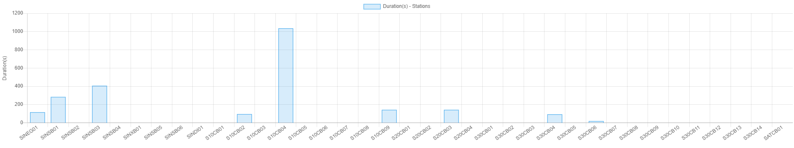
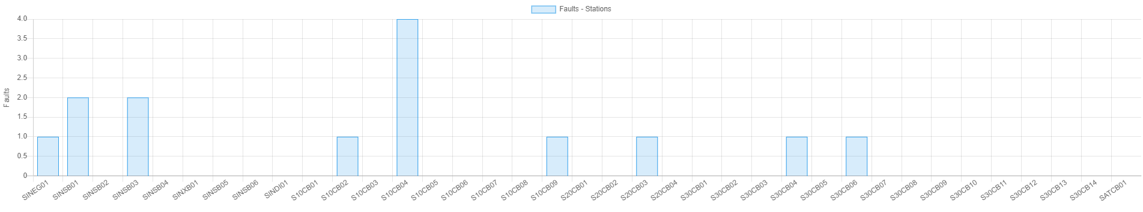
UI
Example Stations vs Duration in seconds
Query appears in the URL to share
http://{host}/#/api/v1/rf_fault_event?start=2019-07-26T06:00:00.000&end=2019-07-29T06:00:00.000&required=1
Example Stations vs number of faults

Slide 23
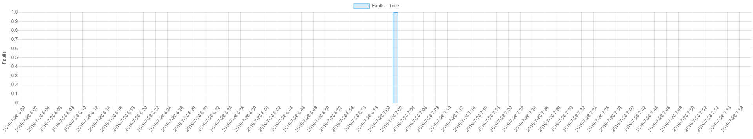
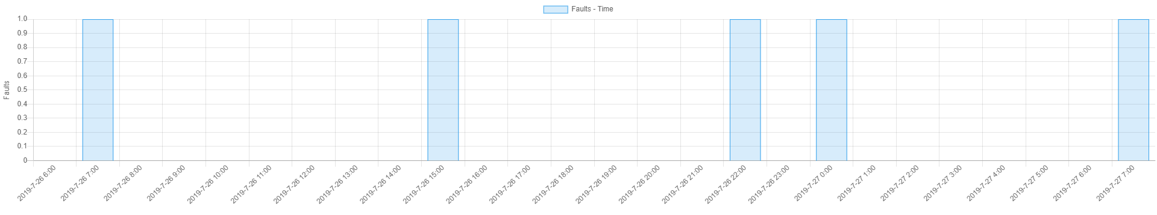
UI
Search time range:
X axis changes dynamically with the selected time range. Makes the system faster.
If the time range is 2h or less the X axis is shown in minutes.
For more until 4 days is shown in hours.

Slide 24
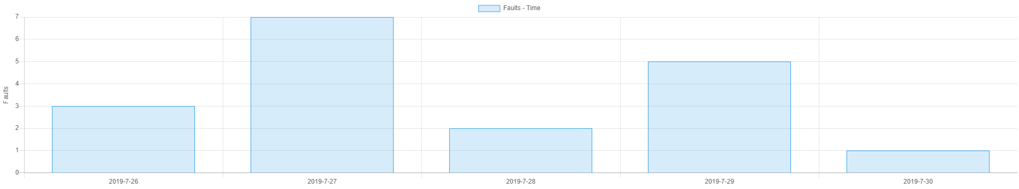
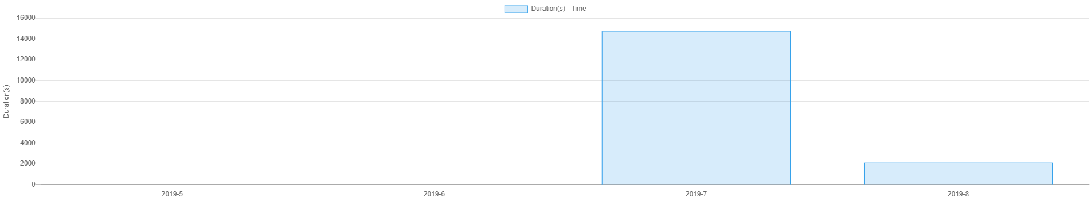
UI
For more than 4 days and less than 31 days, is shown in days.
For more than 31 days is shown in months.

Slide 25
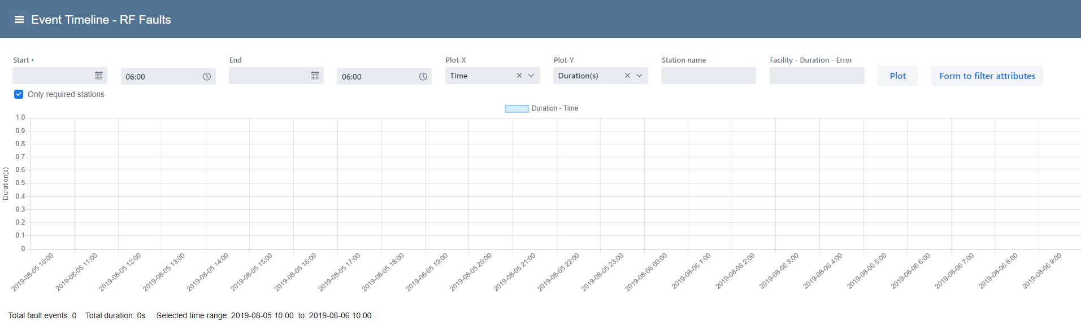
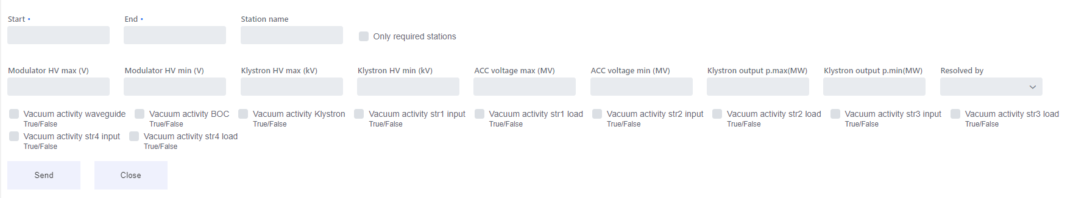
UI
Filters:Vacuum activity, power and voltaje before fault and resolved by.

Slide 26
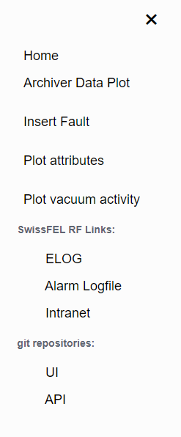
UI
Menu
To plot attributes and vacuum activity, first make the query, then open menu and go to plot attributes or vacuum activity

Slide 27
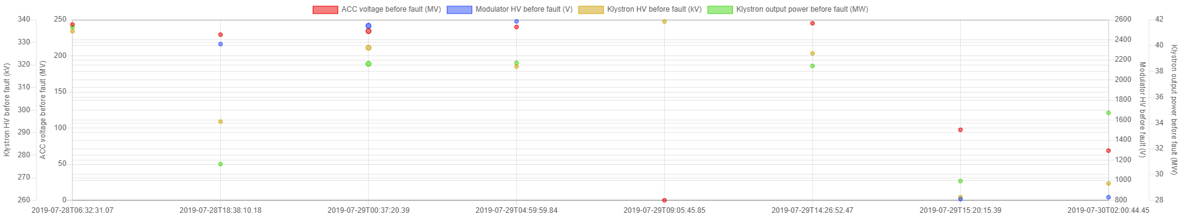
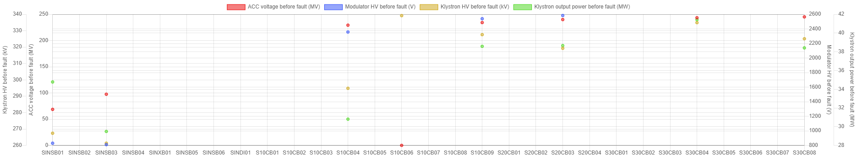
Plot attributes: ACC voltage, Klystron HV, Modulator HV and Klystron output power before the fault
Example x-axis Time
Example x-axis stations

Slide 28
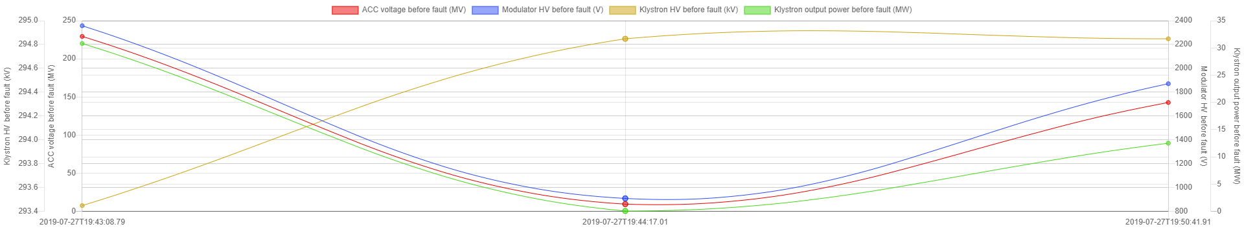
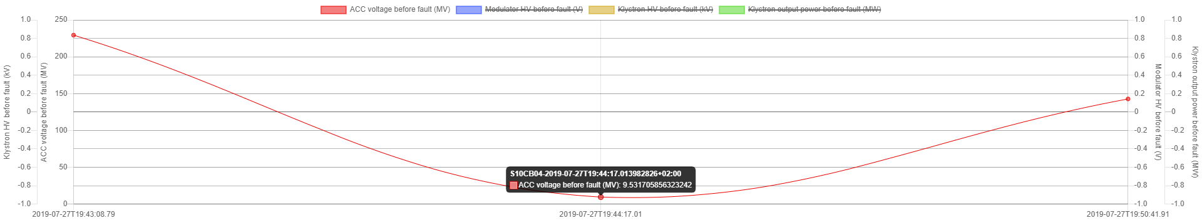
Plot attributes: ACC voltage, Klystron HV, Modulator HV and Klystron output power before the fault
Example x-axis Time, query for only one station
Select the attributes to plot. To see the details put the cursor on the data point

Slide 29
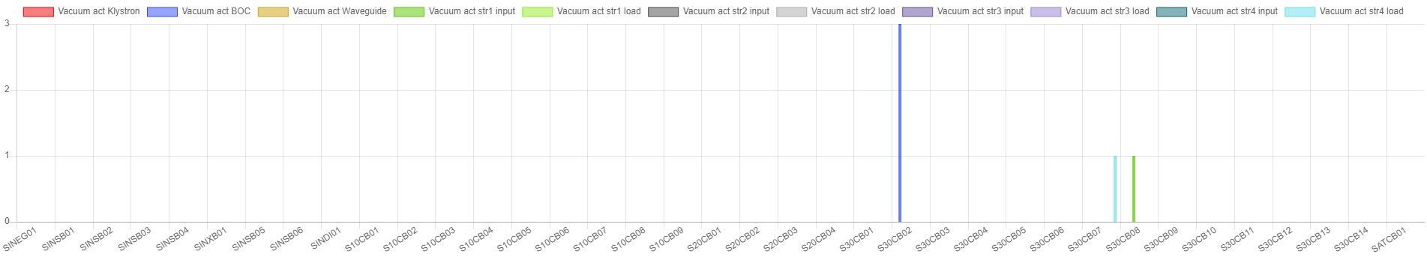
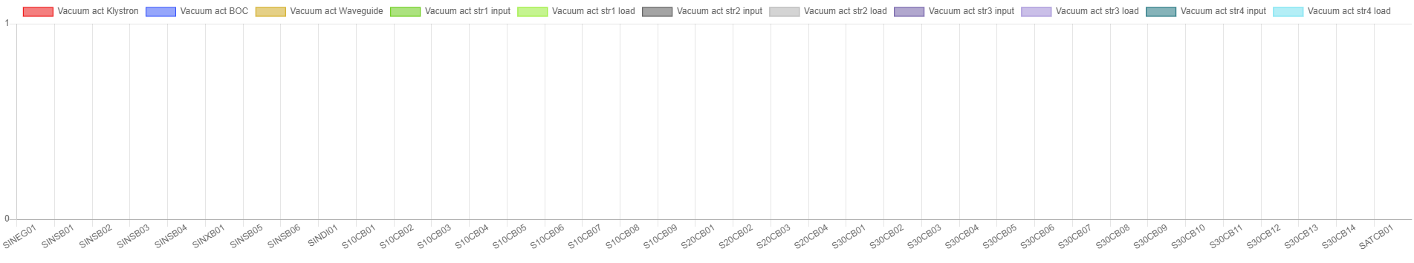
Plot vacuum activity. This plot is the sum of the vacuum activity flags
Example x-axis Stations
3 vacuum activity BOC for station S30CB02,
1 vacuum activity structure 4 load for S30CB07 and 1 vacuum activity structure 1 input for station S30CB08
Example x-axis Stations with no vacuum activity

Slide 30
The End.

Slide 31
API
Detection offline:
The majority of the RF faults shall be auto-detected, this software which runs once an hour, detects faults when the PV in the archiver appliance, “RILK:FIRSTERROR”, change from 255 to any value different to 0, for all the active stations.
Changed from the databuffer to archiver, because archiver is more reliable.
In case the archiver crash, system can not detect faults.
Can be run manually, given the time range from the command line.

Slide 32
API
End detection:
Runs periodically to detect the end of the faults.
The end of the fault is when the station state is 8 again after the fault.
When station is in conditioning, the end of the fault is when RMSM:SM-GET equals RMSM:SM-SET

Slide 33
API
End detection:
If another fault happens before the station reach the state 8, the start timestamp of the new fault, will be the end timestamp of the previous one.
For both cases the duration is calculated automatically.
The end detection can be also run manually from command line.

