Slide 1


2D Beam Profile Reconstruction in the ACHIP Chamber at SwissFEL Using Wire Scanners
Adrian Kirchner :: visiting student from FAU Erlangen :: Paul Scherrer Institute
SwissFEL Progress Meeting, 3.09.2019

Slide 2
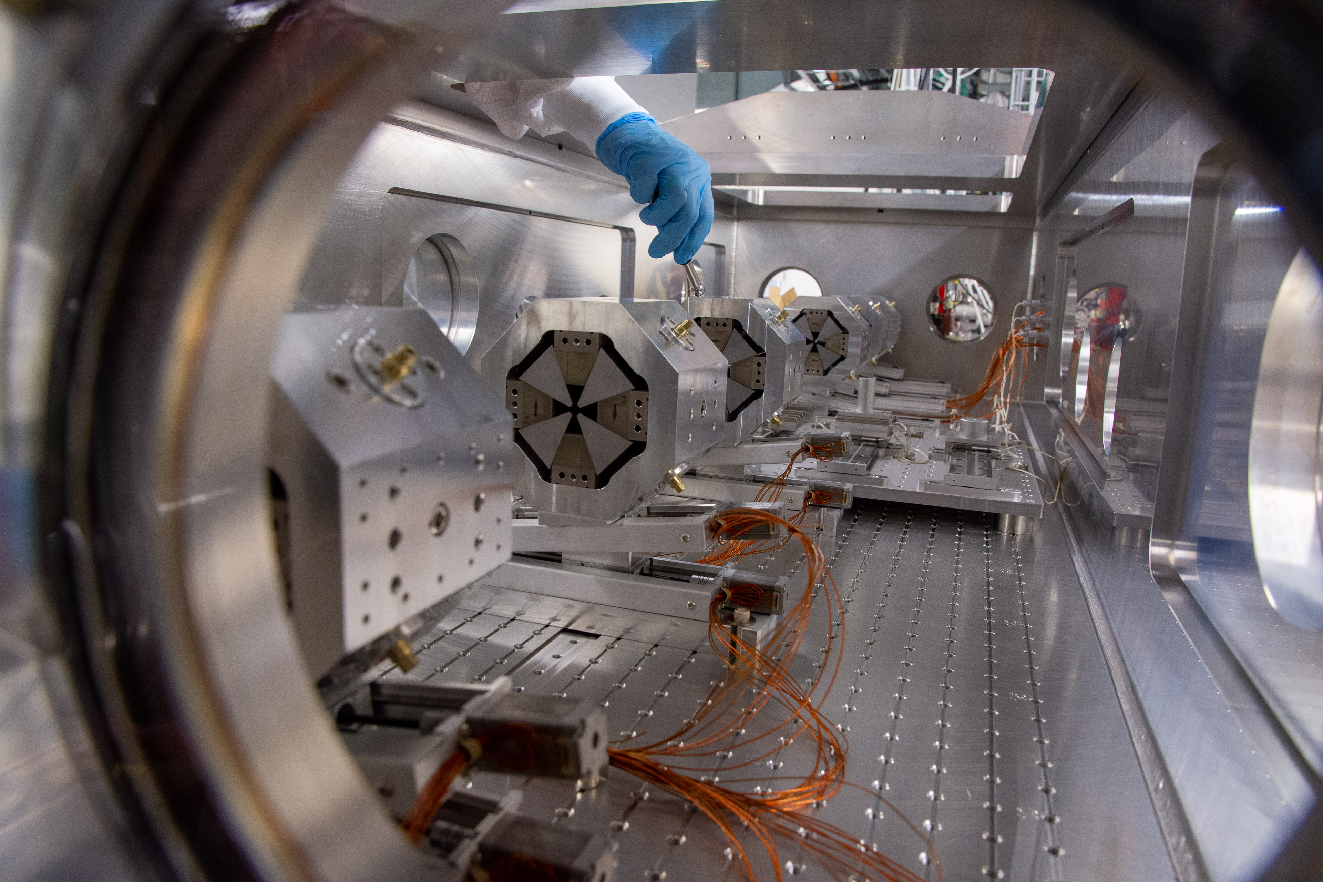
Current Status of ACHIP Chamber
Installed in-vacuum permanent magnet quadrupoles for achieving sub-micrometer beams
Content of this presentation: data analysis of beam size measurements

Slide 3
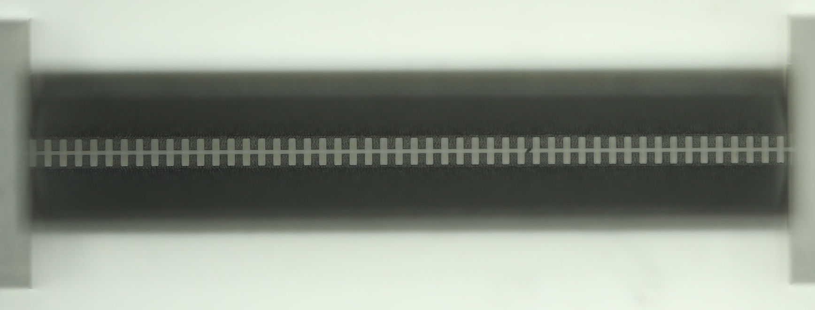
Why Measure with Wire Scanners?
YAG-Screen resolution limit ≈ 10 μm [DOI: 10.1103/PhysRevSTAB.18.082802]
Planned experiments in ACHIP Chamber need sub-μm beams
Wire scanners are better choice for small beams, proven to work for beams with σ ≈ 0.46 μm [DOI: 10.1038/s42005-018-0048-x]
Electrons enter here
Opening of Structure: ~1 μm

Slide 4
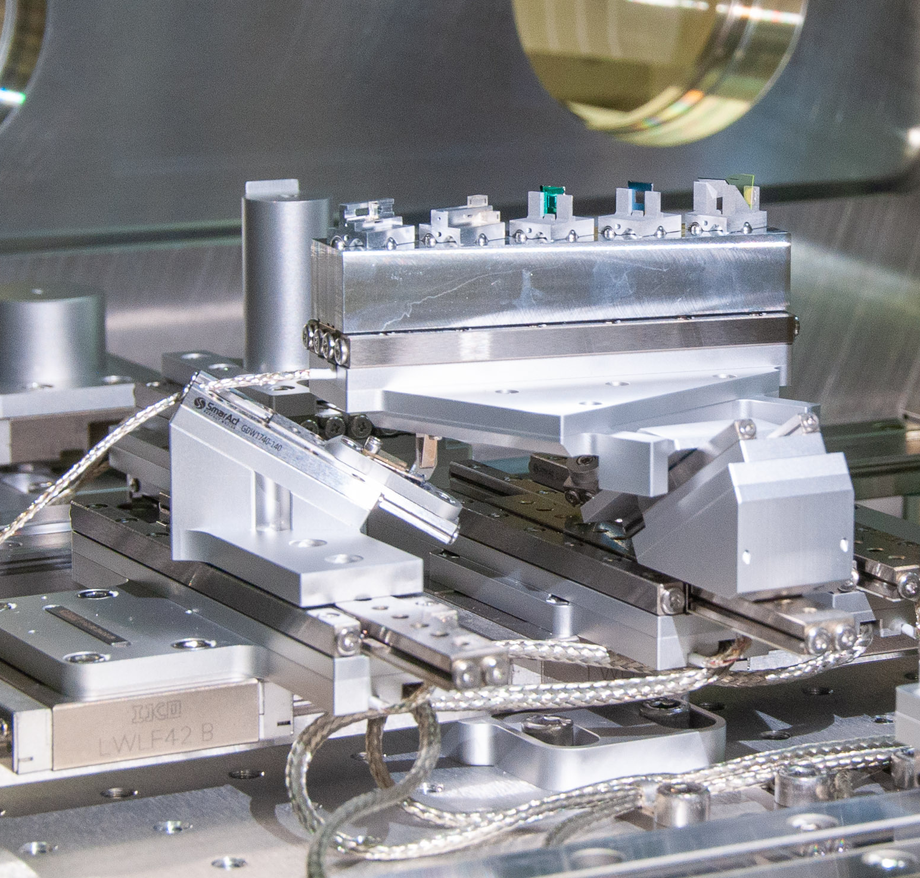
Multi-Dimensional Wire Scanners
Produced by LMN, thanks to Dr. Vitaliy Guzenko!
Mounted on hexapod
Allows measurement of arbitrary projection -> Reconstruct 2D profile

Slide 5
Evaluating the Data: Fit Model
Assumption: Intensity can be described by Gaussian distribution (2D and tilt)
Wire scan = Line integral of the beam intensity along the wire (Radon transform)
Convolution with wire profile
Data from Experiment
2D Gaussian Profile (x_0, y_0, sigma_x, sigma_y,..)
Optimizer
Convolution
Radon Transform
2D Gaussian Profile (x_0, y_0, sigma_x, sigma_y,..)

Slide 6
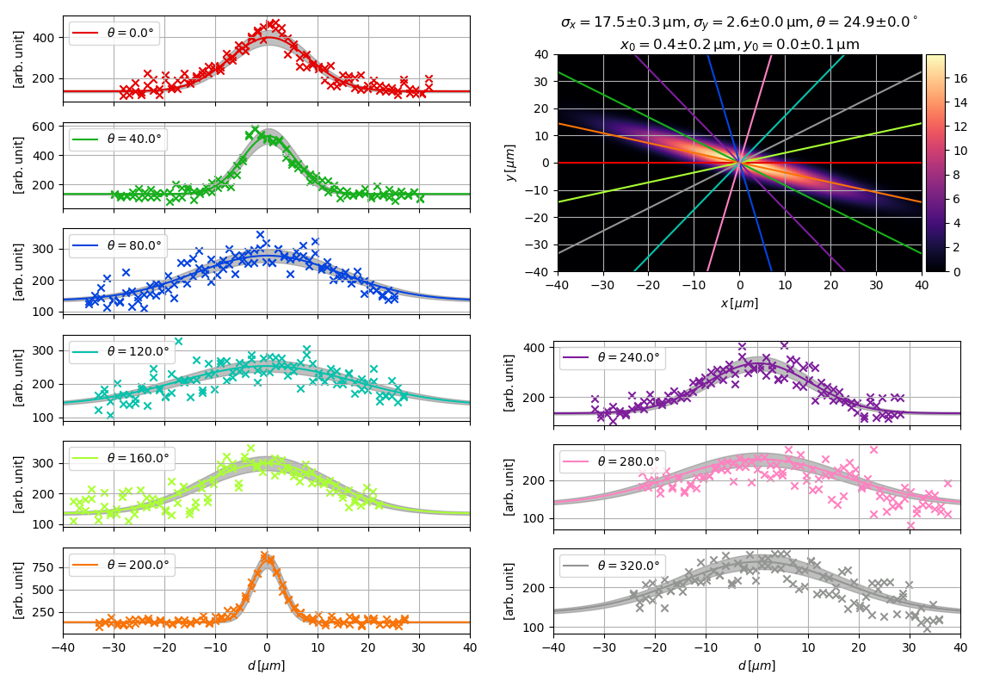
Demo of Fit with Experimental Data
Data obtained with free-standing ‘spider-web’ (July 12, 2019, B. Hermann)

Slide 7
Demo of Fit with Experimental Data
Pro:
Fast
Decent representation of data
Estimation of error
Works as well with less wires
Stable against noise
Con:
Assumption of Gaussian shape
Some details are not reflected

Slide 8
Alternative Reconstruction: Tomography
Reformulate problem, now: Solve system of linear equations
Applied here: Maximum likelihood – expectation maximization (ML-EM)
Let us look at one iteration of Tomographic Reconstruction…

Slide 9
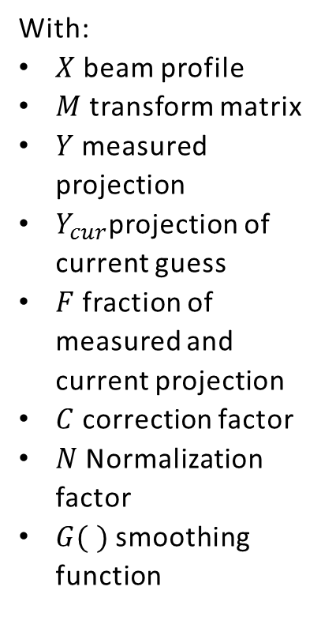
Tomographic Reconstruction – One Iteration
Guess of beam profile $X$
Guess of beam profile 𝑋
Apply matrix transform to get projection of current beam profile:
$$Y_{cur}=M ∙X$$
Apply matrix transform to get projection of current beam profile:
𝑌_𝑐𝑢𝑟=𝑀 ∙𝑋
Compute fraction
measured projection / current profile`s projection
$$F= \frac{Y}{Y_{cur}}$$
Compute fraction
measured projection / current profile`s projection
𝐹= 𝑌/𝑌_𝑐𝑢𝑟
Backprojection step: get correction factor for each pixel
$$C= M^{T} ∙F$$
Backprojection step: get correction factor for each pixel
𝐶= 𝑀^𝑇 ∙𝐹
Normalize calculated corrections, multiply to previous guess of profile
$$X=X ∙\frac{C}{N}$$
Normalize calculated corrections, multiply to previous guess of profile
𝑋=𝑋 ∙𝐶/𝑁
Apply Gaussian kernel to smooth result
$$X=G(X)$$
Apply Gaussian kernel to smooth result
𝑋=𝐺(𝑋)
With:
$X$ beam profile
$M$ transform matrix
$Y$ measured projection
$Y_{cur}$projection of current guess
$F$ fraction of measured and current projection
$C$ correction factor
$N$ Normalization factor
$G( )$ smoothing function

Slide 10
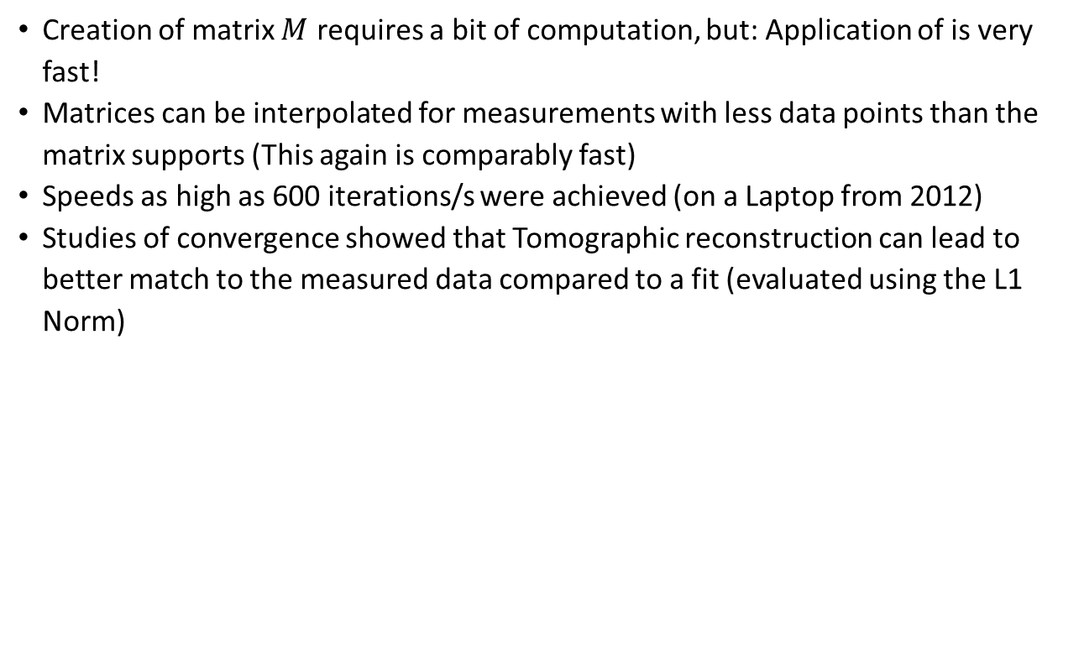
Tomographic Reconstruction - Applicability
Creation of matrix $M$requires a bit of computation, but: Application of is very fast!
Matrices can be interpolated for measurements with less data points than the matrix supports (This again is comparably fast)
Speeds as high as 600 iterations/s were achieved (on a Laptop from 2012)
Studies of convergence showed that Tomographic reconstruction can lead to better match to the measured data compared to a fit (evaluated using the L1 Norm)

Slide 11
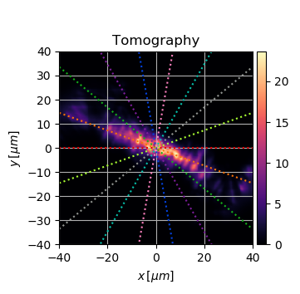
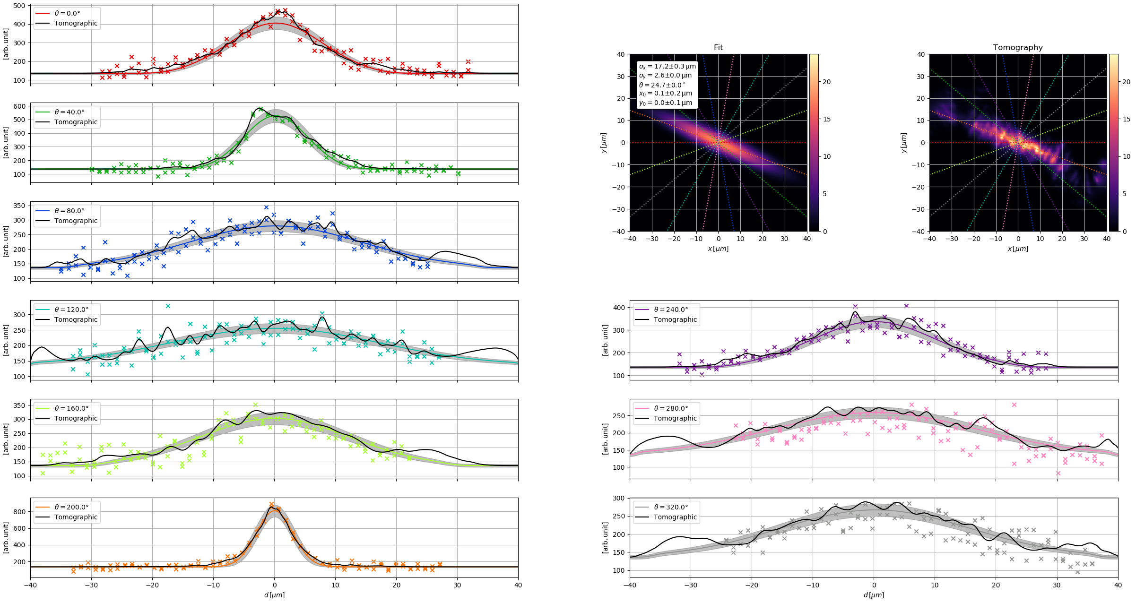
Tomographic Reconstruction - Demo

Slide 12
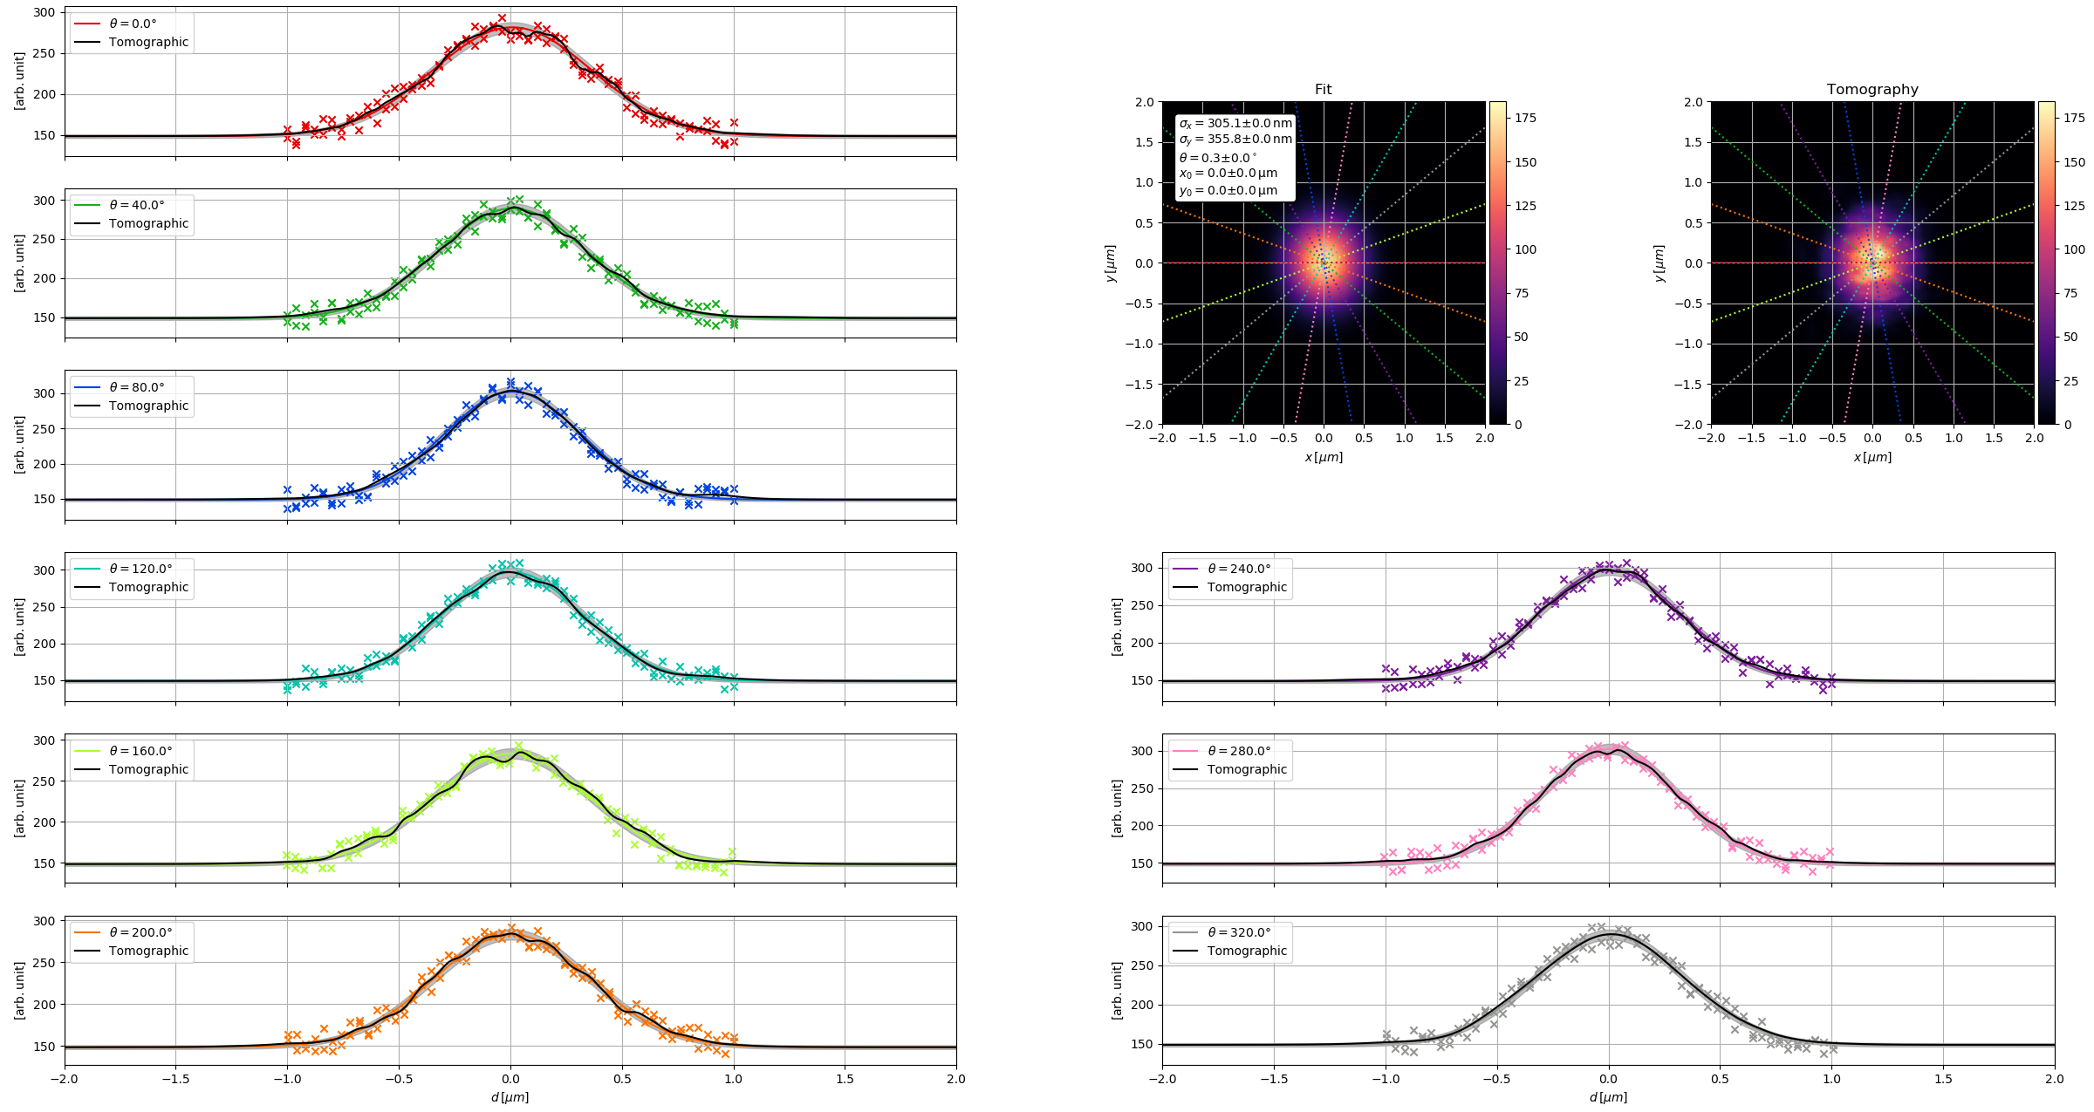
Tomographic Reconstruction – Test for Sub – Micrometer Beams
Beam size here: $σ_{x}=300 nm, σ_{y}=350 nm$

Slide 13
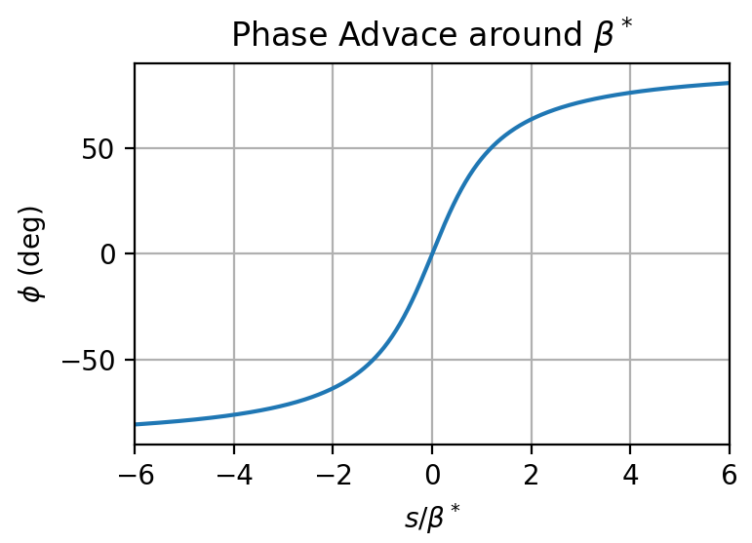
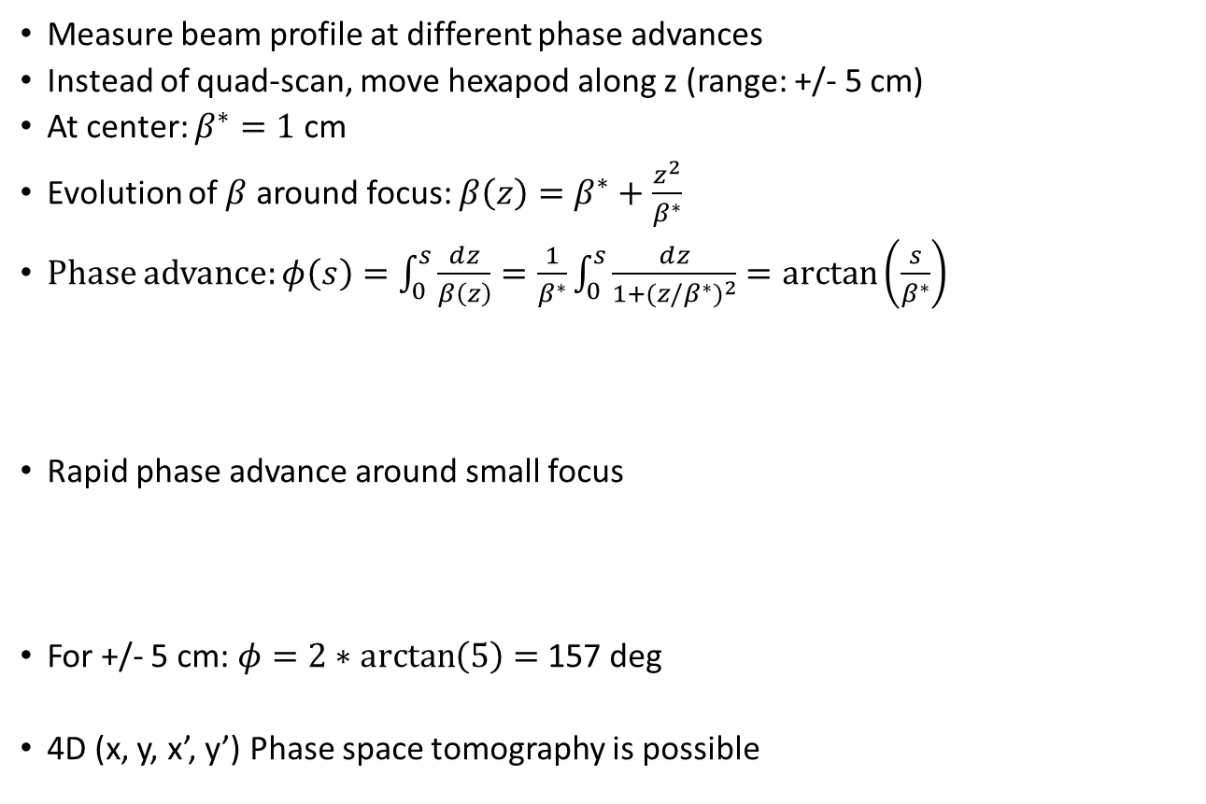
Outlook: Emittance Measurement with Wire Scanner at ACHIP-ATHOS
Measure beam profile at different phase advances
Instead of quad-scan, move hexapod along z (range: +/- 5 cm)
At center: $β^{∗}=1$ cm
Evolution of $β$ around focus: $β\left(z\right)=β^{∗}+\frac{z^{2}}{β^{∗}}$
Phase advance: $φ\left(s\right)=\int_{0}^{s}{\frac{ⅆz}{β\left(z\right)}}=\frac{1}{β^{∗}}\int_{0}^{s}{\frac{ⅆz}{1+{(z/β^{∗})}^{2}}}=\arctan\left(\frac{s}{β^{∗}}\right)$
Rapid phase advance around small focus
For +/- 5 cm: $φ=2∗\arctan\left(5\right)=$ 157 deg
4D (x, y, x’, y’) Phase space tomography is possible

Slide 14
Wir schaffen Wissen – heute für morgen
My thanks go to
Dr. Vitaliy Guzenko (LMN)
Benedikt Hermann
Dr. Rasmus Ischebeck
Prof. Dr. Peter Hommelhoff (FAU)
You, my listeners!

Slide 15
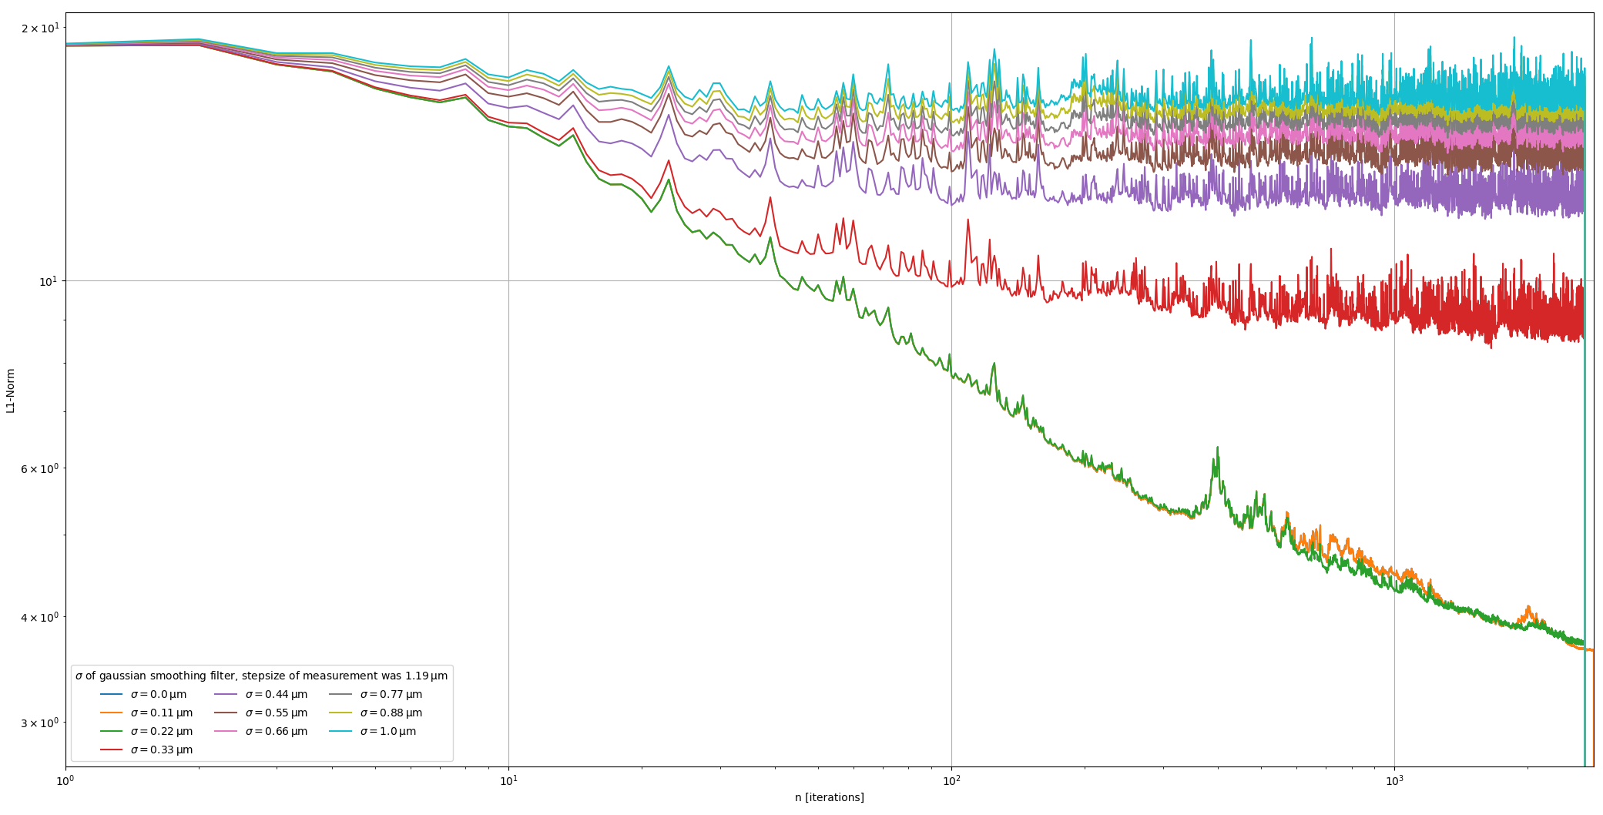
Tomographic Reconstruction – Study of L1 Norm

