Slide 1
Dual Bunch Timing Master Application
Roger Biffiger :: Embedded SW Engineer :: Paul Scherrer Institute
SwissFEL Progress Meeting 2019-09-03

Slide 2
Agenda
What is TMA?
Why is TMA important?
Why do we change TMA?
What do we change?
What does dual bunch TMA do?
What do the new panels look like?
What does it mean for timing users (event receivers)?
What is the further TMA roadmap?

Slide 3
What is TMA?
TMA = Timing Master Application

Slide 4
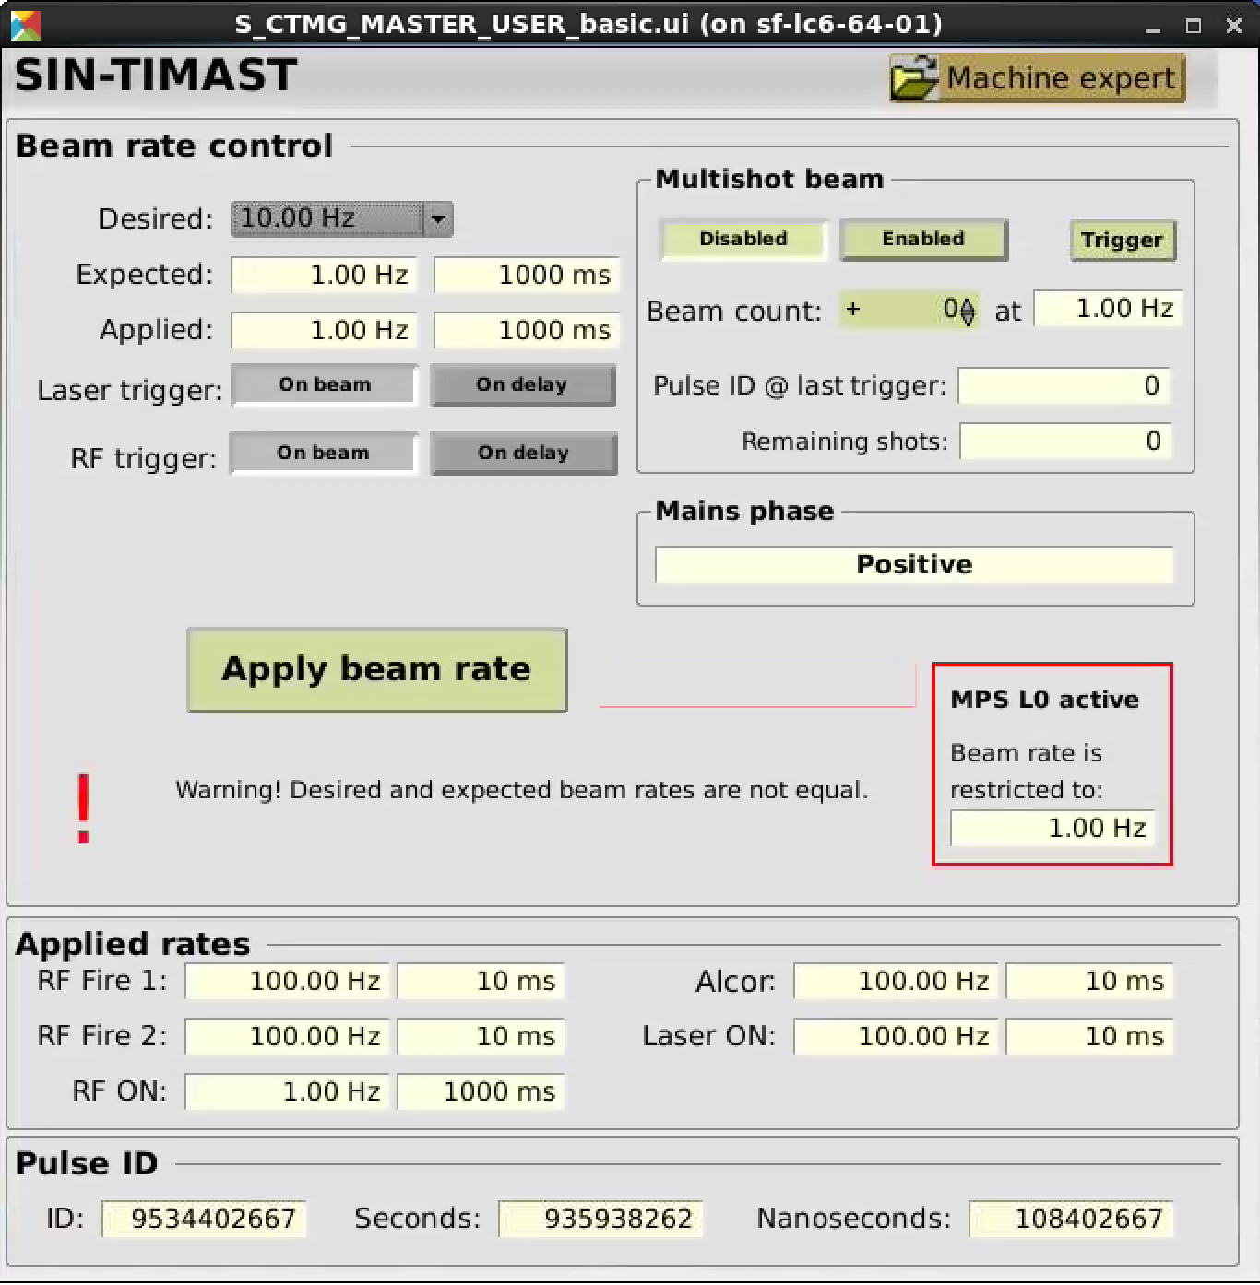
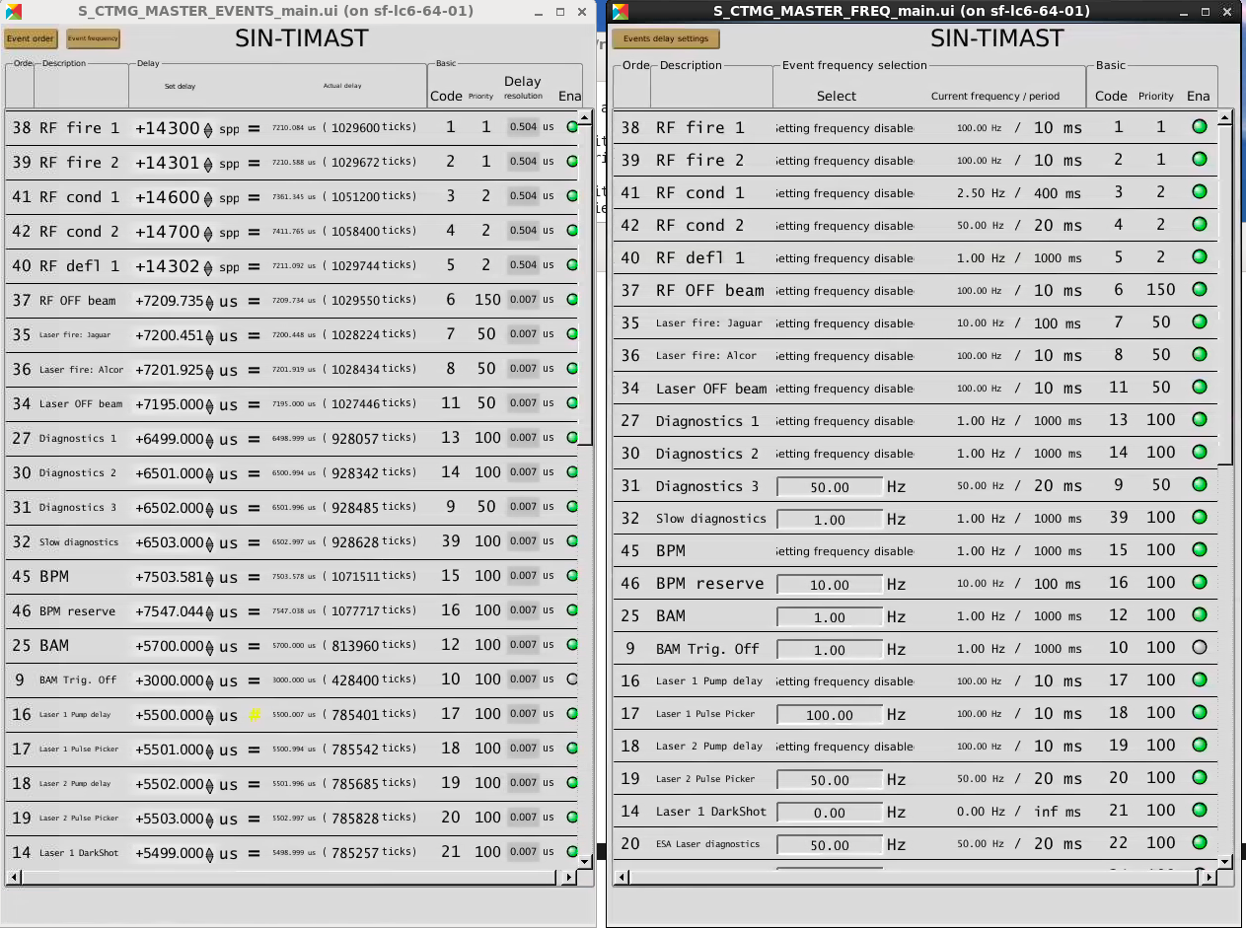
What is TMA?
MPS
L0
MPS
L1
Beam rate control
On beam / on delay
Machine protection
Events can follow the beam rate
User events with user controlled frequency and delay
operator
user

Slide 5
Why is TMA important?
It is a vital machine component. If TMA fails, there is no beam.
It is an important actor for machine protection. If TMA fails, things might break.
It is an important actor to enforce BAG run permission regulations (reduced frequency). If TMA fails, we might breach the rules.

Slide 6
Why do we change TMA?
With the current TMA it is possible to produce two bunches. But their frequency can not be controlled independently.
We need a concept which is scalable so we can use three lasers.
Changing the bunch setup (one bunch <-> two bunches, laser -> bunch) involves some manual work (setting delays) which should be automated to make the changes less error-prone.

Slide 7
What do we change?
RF based beam frequency control is changed into laser based bunch frequency control
The laser to bunch and bunch to destination is user configurable
The BEAMOK flag is replaced by a BUNCH-1-OK and BUNCH-2-OK flag
Event frequency follows beam frequency is replaced by event frequency follows bunch frequency
Three soft MPS L1 PVs are introduced (main, aramis, athos). They can be used to switch off beam by other software components via channel access.

Slide 8
What does dual bunch TMA do?
Bunch frequency control and machine protection is implemented as a series of steps which can reduce the desired frequency. We use the following terminology.

Slide 9
What does dual bunch TMA do?
It maps MPS alarms from different machine sections to the applicable beam generating device (gun lasers, rf), according to the laser to bunch and bunch to destination association.

Slide 10
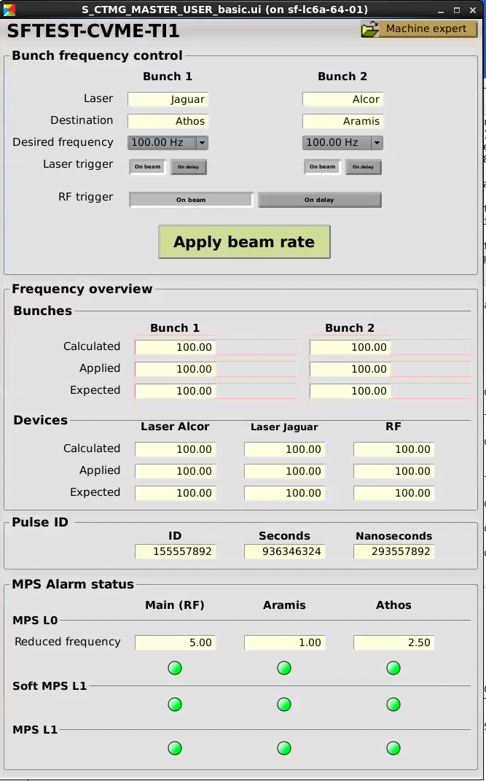
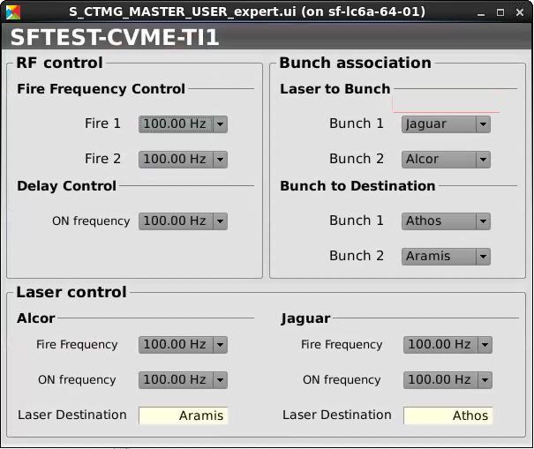
What do the new panels look like?

Slide 11
What does it mean for timing users (event receivers)?
Nothing ☺ (hopefully)
Gun laser group needs to adapt the triggering concept.
RF group needs to set frequency for RF Cond 1, RF Cond 2 and RF Defl in the event frequency control panel.
Use BUNCH-x-OK instead of BEAM-OK

Slide 12
What is the further TMA roadmap?
We still need a better solution to control data acquisition of diagnostics devices.
  Trigger only if there is actually beam
  Do data acquisition with 100 Hz and filter data on IOC based on additional data distributed by the timing system.

Slide 13
Wir schaffen Wissen – heute für morgen
My thanks go to
Didier Voulot
Florian Löhl
Romain Ganter
Tine Celcer
Babak Kalantari
Saso Skube
Alexander Soederqvist
Uros Zezula

