Slide 1
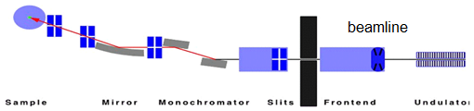
Goal: use photon BPM for FOFB i.e. separate e-beam and opt-elems. instabilities
"standard XBPM"
monochromatic
pinkbeam
whitebeam

Slide 2
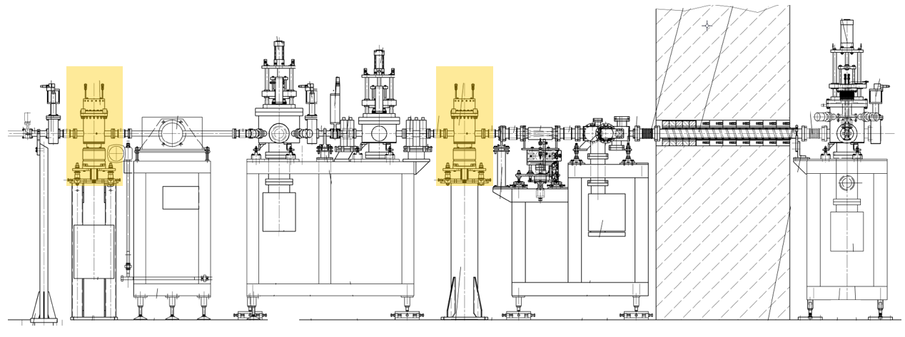
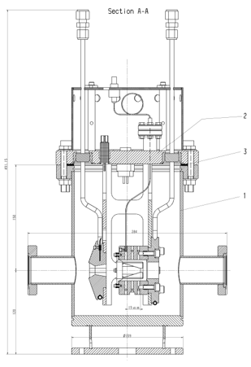
Current installations at PXI (pinkbeam)
9/8/2019 first light on SiC XBPM
Shutter
Pinkbeam
800W (36W)
<1% at 12.4keV
80µm C window
1th BLADE
Whitebeams
2kW (5.2mm gap)

Slide 3
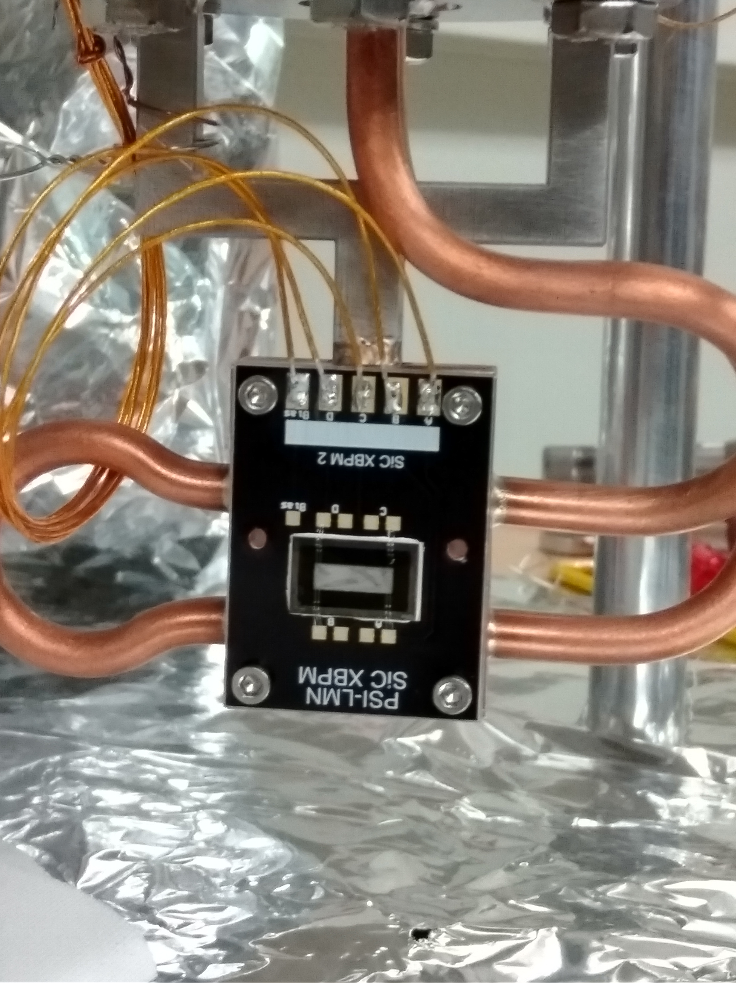
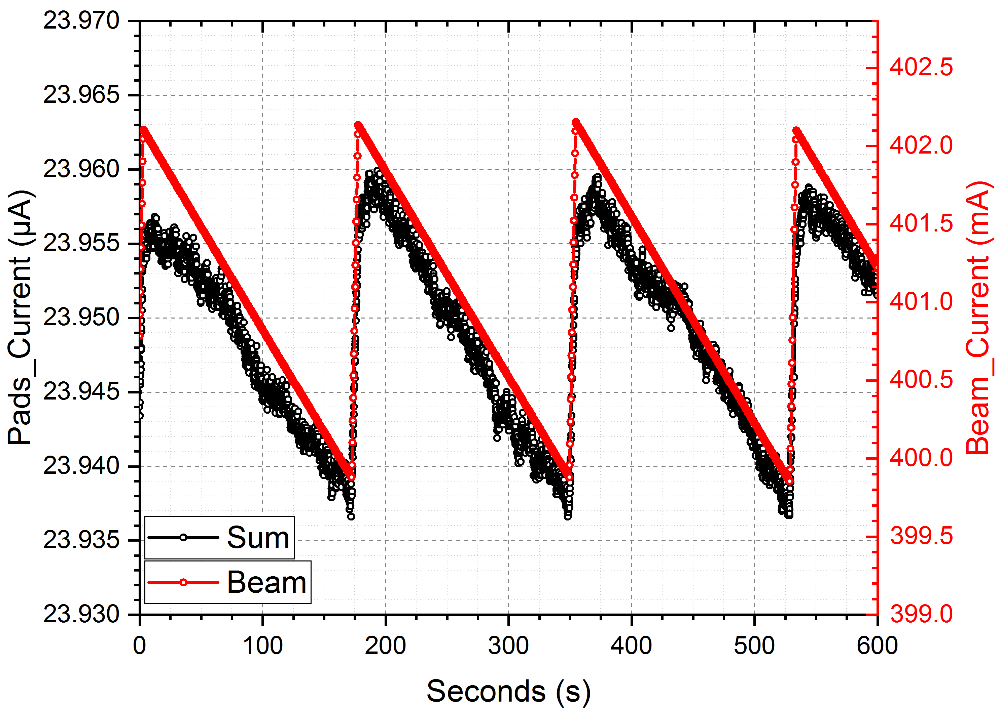
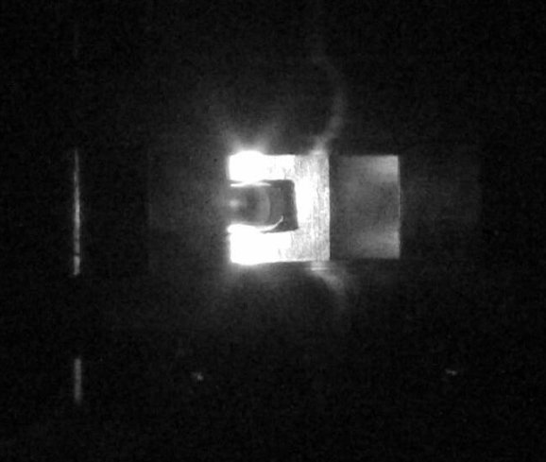
Current installations at PXI (pinkbeam)
2 µm XBPM was installed 1 month ago at PXI pinkbeam (after diamond window).
The measured current is several order of magnitude lower than the expected one.

Slide 4
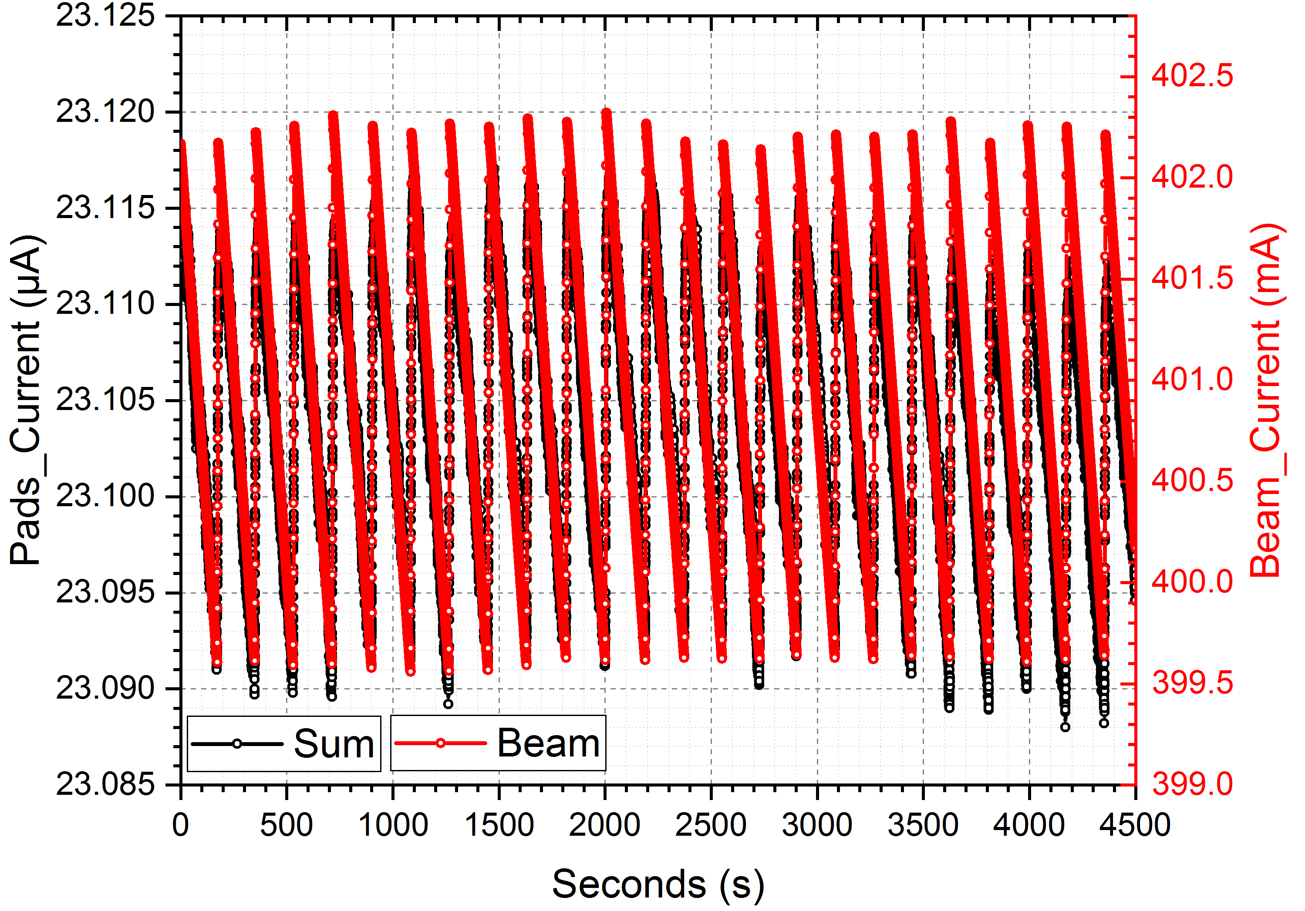
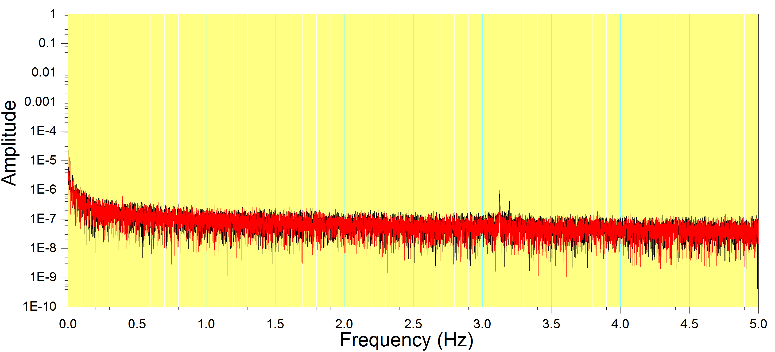
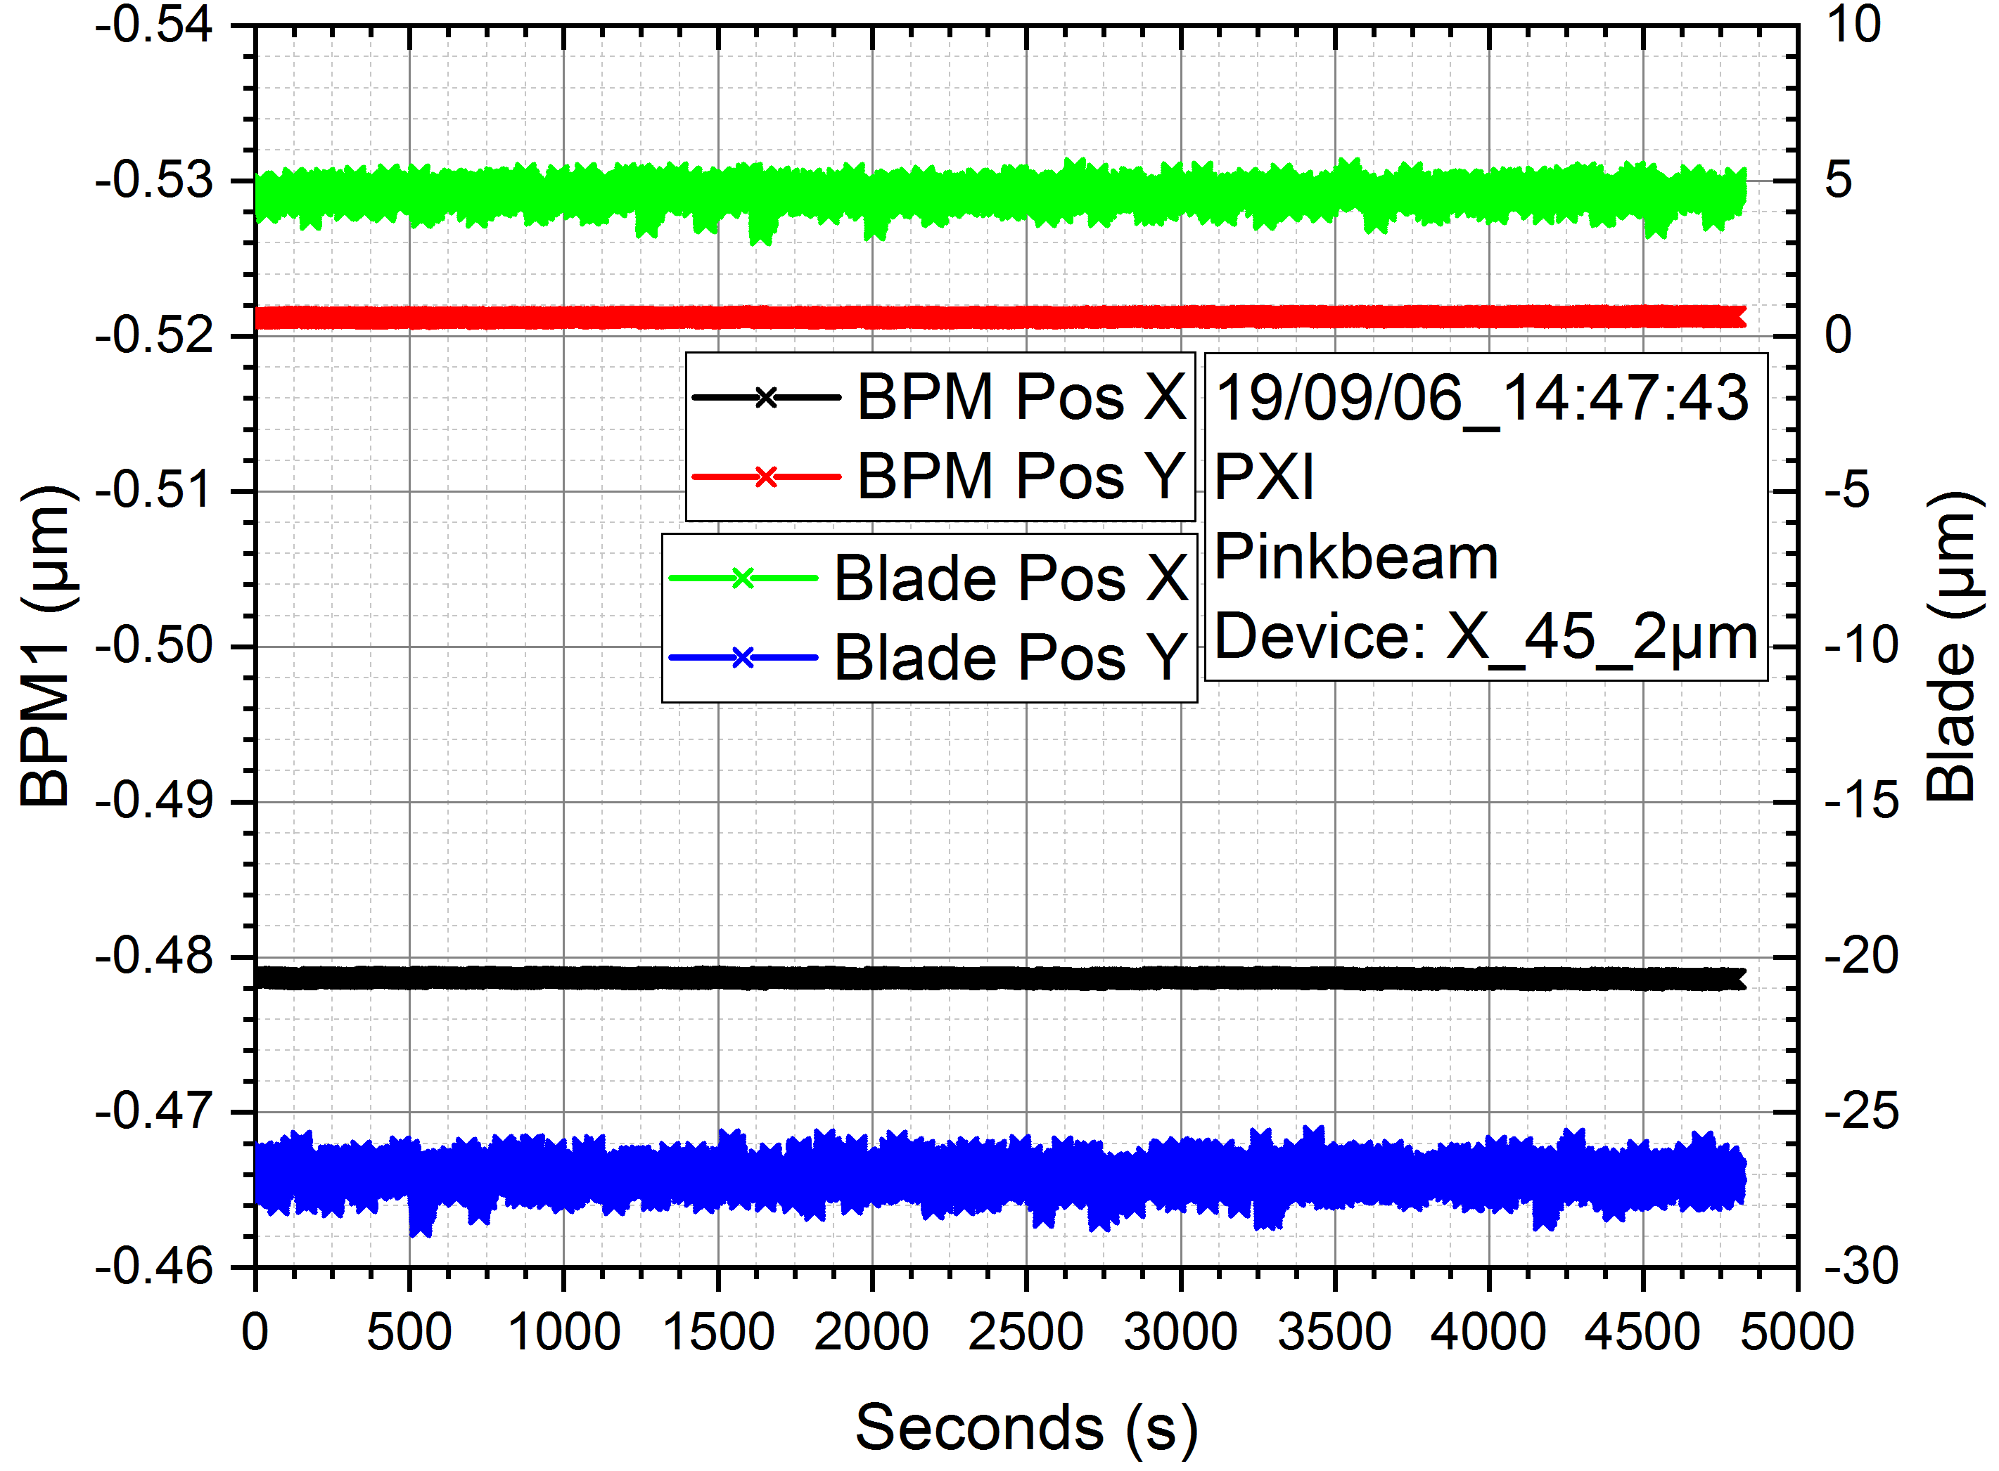
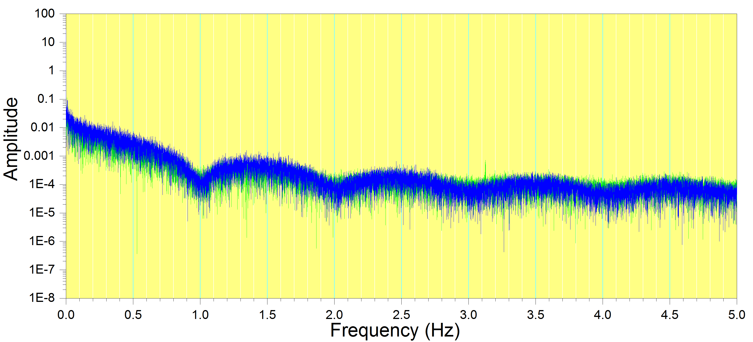
Current installations at PXI (pinkbeam)
PRELIMINARY RESULTS
FFT of SiC XBPM
FFT of Blades
BLADES
SiC XBPM

Slide 5
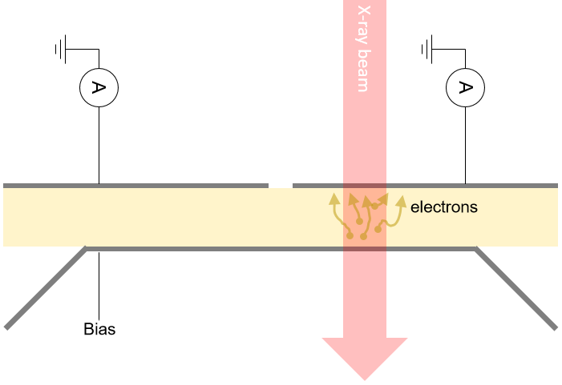
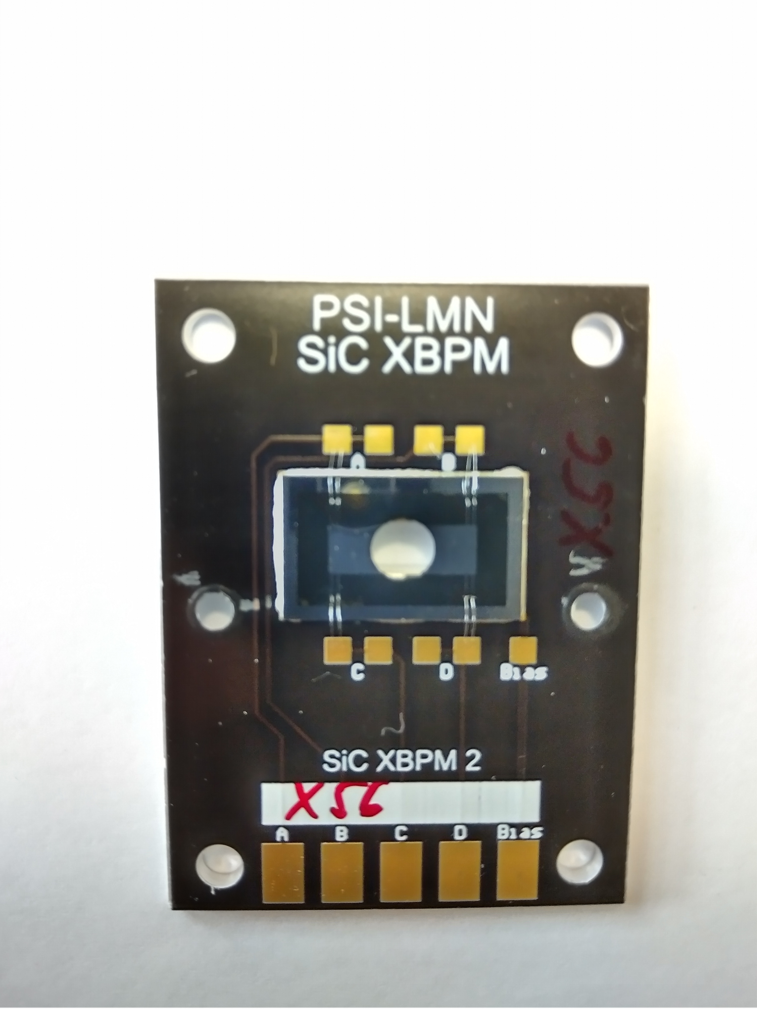
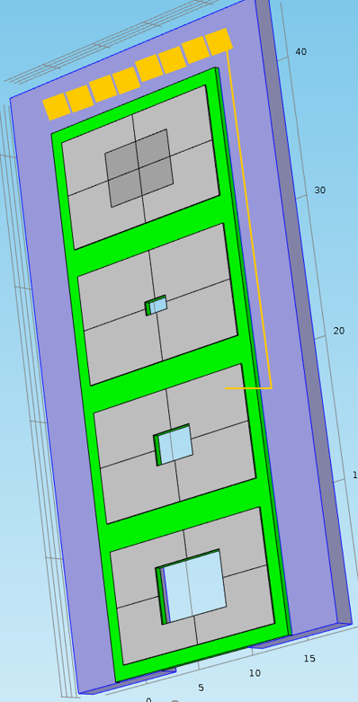
"Long term goal": 1
Development of multifunctional photon XPM
semiconductor based
internal photoemission
array of 4 devices
-- full membrane, -- "high res."
--"small pin-hole": 2.0x1.0mm²
--"blade opening": 3.4x2.2mm²
--"large pin-hole": 6.0x4.0mm²

Slide 6
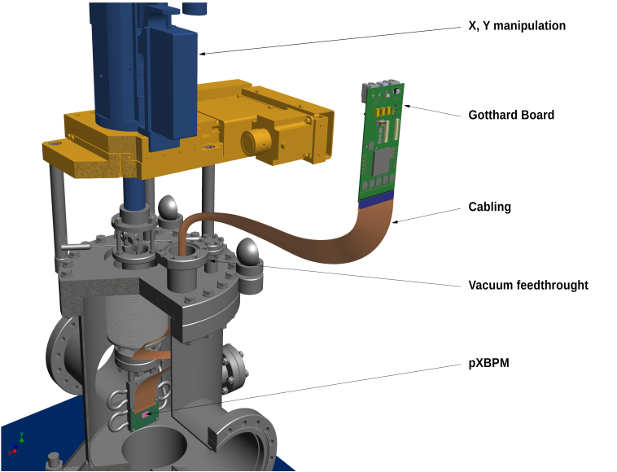
"Long term goal": 2
Development of combined position/profile monitor for pinkbeams
FEMTO AMP
GOTTHARD
copper
PINKBEAM
2x2 XBM
for beam position @ MHz/nm
pixelated XBM
for beam profile at kHz

Slide 7
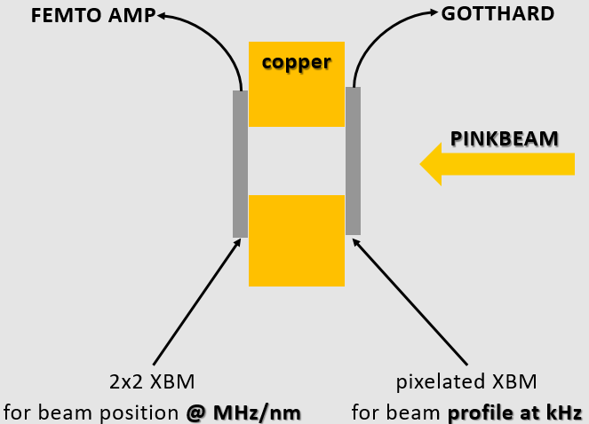

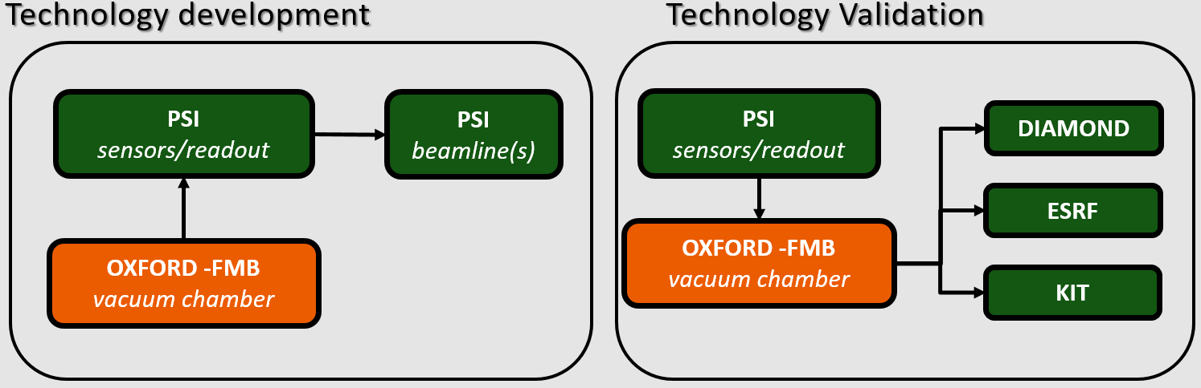

"Long term goal": 2
Development of combined position/profile monitor for pinkbeams

Slide 8
Conclusions & outlook
First successful installation of SiC XBPM in pinkbeam location (800W beam power, PXI)
XBPM can be baked, compatible with UHV (1E-10)
Extension towards simulatenous profile&position presented within the AIRES2 call of proposals
Systematic comparison of SiC XBPM with 1th/2th blades. Establishment/test of FOFB based on SiC XBPM

