Slide 1
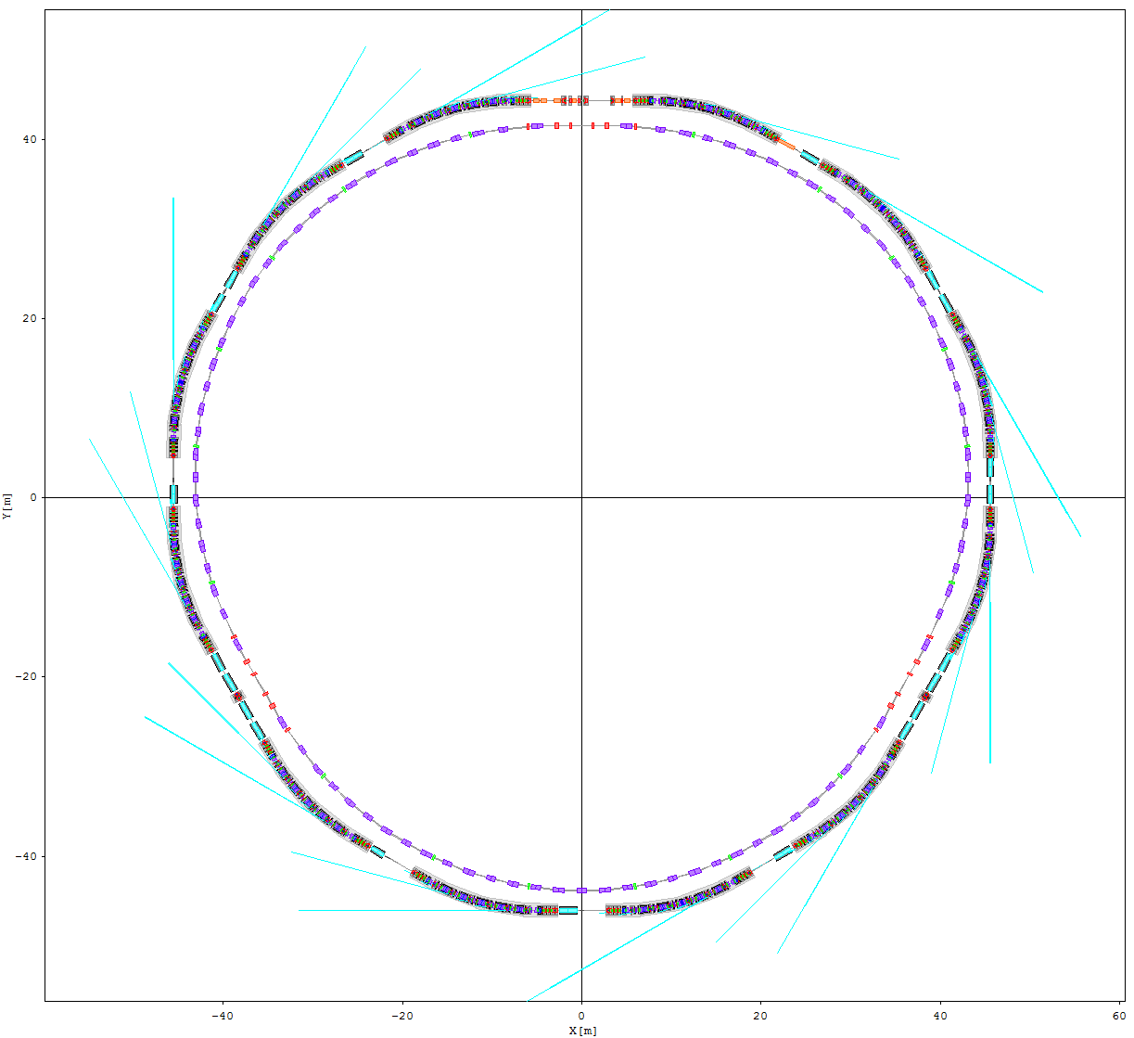
The SLS 2.0 lattice
Andreas Streun Paul Scherrer Institut
SLS 2.0 Information Day
Nov. 8, 2019, PSI
SLS 2.0

Slide 2
Photon Users
Project Management
MAC, external etc.
Vacuum systems
Beam Dynamics
Masamitsu Aiba, Michael Böge
Jonas Kallestrup, Marija Kranjcevic Bernard Riemann, Andreas Streun Johan Bengtsson, Mike Ehrlichman
Impedances &
Instabilities
Magnet Design
Power supplies
Mech. engineering
Pulsed magnets
Alignment
Floor Management
Diagnostics
The Lattice
Infrastructure
RF systems
T e c h n i c a l D e s i g n

Slide 3
Why SLS 2.0 ?
A new generation of light sources
  Performance (brightness) increase by factor 10…100
  Pioneer: MAX IV storage ring (Sweden)
  Key issue: miniaturization of components
  World-wide new facilities and upgrade projects
  SLS upgrade needed to stay competitive

Slide 4
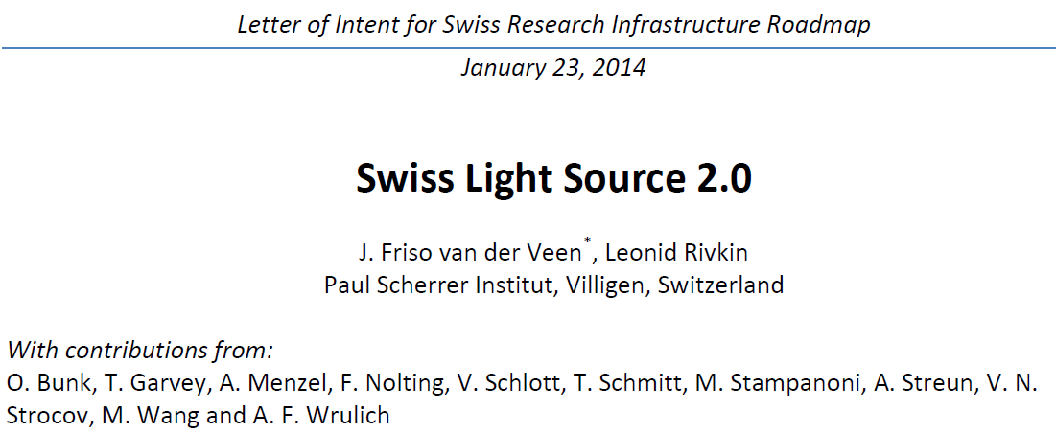
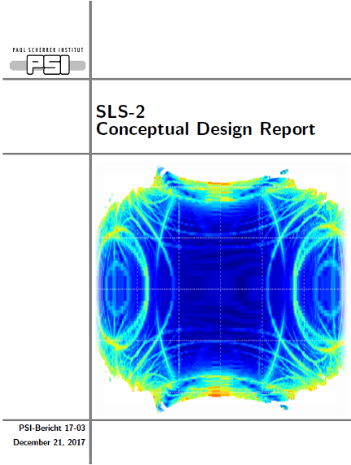
SLS 2.0 History
First thoughts ∼2012
Letter of Intent 1/2014 ⇨
Conceptual Design
Report 9/2017
Submission to SNF 1/2018
ETH board: included in “roadmap” 12/2008
First Machine Advisory
Committee meeting 6/2019
“Final” lattice: 9/2018 (“A”)
→ 3/2019 (“B”)
→ 6/2019 (“B+”)
Final lattice → 10/2019 ✓

Slide 5
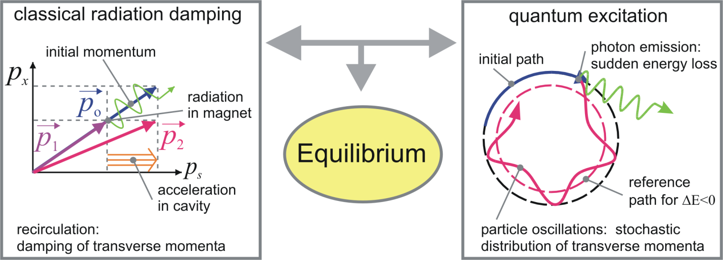
Brightness and Emittance
Brightness ∝ 1/emittance
Emittance = pure lattice property*
Emittance ∝ Ε² φ³ ∝ Ε² / (circumference)³
  Ε = beam energy
  φ = deflection angle per bending magnet
  ∝ (length of unit cell [ = 1 bending magnet + focusing]) / circumference
reduce unit cell length → miniaturization of components:
  small aperture vacuum pipe and small bore magnets
Emittance [m·rad]
size × divergence − correlation
2-D phase space area
angle
position
* in an electron
storage ring

Slide 6
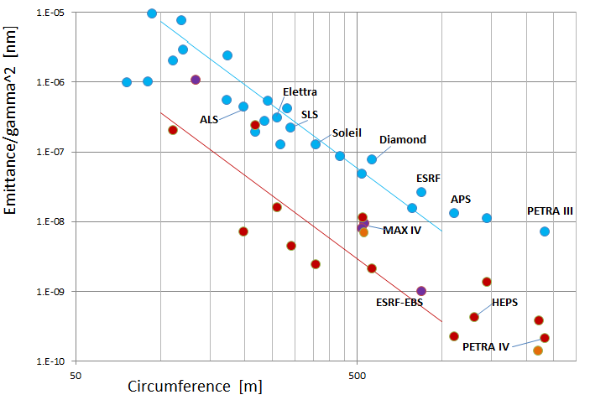
SLS 2.0 and the new light sources generation
Emittance normalized to energy vs. circumference
ε_{x} ∝ (Energy)² / (Circumference)³
“Bartolini plot”
Theoretical
Emittance scaling
ε ∝ γ ² C ⁻³
K ≈ 2 → ≈ −1
improvement ×20
SLS
Emittance / (Energy/mc²)² [nm]
upgrade
projects
operational
commissioning
or construction
SLS 2.0
planned
with damping wigglers

Slide 7
SLS 2.0 design charge
User requirements
  30× higher brightness
  wide spectrum of beam lines: from VUV to hard X-ray
Challenge: comparatively small circumference
  Brightness ∝ (circumference)³
Beam physics feasibility
  Lifetime and injection efficieny → dynamic aperture
  400 mA beam current → impedances & instabilities
Technical limitations
  Magnets and vacuum system
Civil engineering
  limited modifications of building and infrastructure

Slide 8
SLS 2.0 Lattice Solution
Increased number of bending magnets
  12 × 7-Bend-Achromat [SLS: 12 × 3-BA]
Reduced beam pipe aperture
  18 mm diameter [SLS: 65 mm × 32 mm]
Novel low emittance unit cell
  Combination of reverse bends and longitudinal gradient bends
  → optimum suppression of quantum excitation
  Emittance 123 pm [SLS: 5580 pm] ⇨ factor 45 smaller
Maintain total straight length: ≈ 80 m
  3 × long (11.4 m) + 9 × standard (5.4 m)
  [SLS: 3 × long (11.5 m) + 3 × medium (7 m) + 6 × short (4 m)]
  all straights to be split at variable ratio
Avoid tunnel modification
  symmetry-3 footprint but symmetry-12 dynamics by tuning
(7/3)³ ≈ factor 13
+15…20% emittance increase
by intrabeam scattering (IBS)

Slide 9
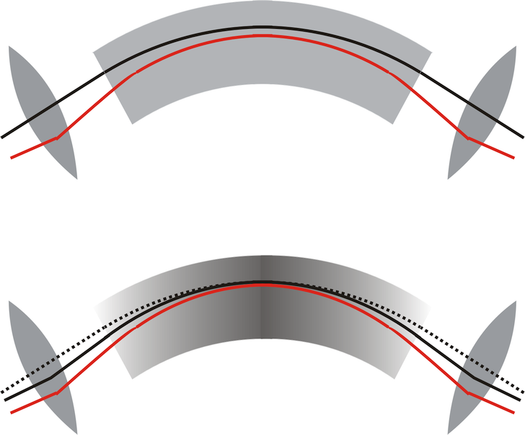
The LGB-RB unit cell for lowest emittance
Standard cell = relaxed TME
quadrupoles to focus dispersion
dispersion at center > 0
LGB-RB unit cell
Step 1:
decouple dispersion from horizontal focusing !
displaced quadrupoles
= reverse bending magnets (RB)
⇨ dispersion at centre → 0 ✓
Step 2:
exploit small dispersion at centre !
longitudinal field variation in dipole magnet:
= longitudinal gradient bend (LGB)
orbit for Δp < 0
B(s)
s

LGB needs RB
to work properly !
 B. Riemann & AS, Low emittance lattice design from first principles: Reverse bending and longitudinal gradient bends,
Phys. Rev. Accel. Beam, 22, 021602 (2019)

Slide 10
Problems which caused design revisions
Space conflicts
  minimum distances between elements
  feasibility of magnets (short, wide, high fields)
  feasibility of mounting (magnets, cables, water pipes)
  free pathways for photon beams
Insufficient brightness
  bad matching of electron phase space to diffraction
    brightness depends on the area of the electron phase space
    (emittance ε_{x} = σ_{x}⋅ σ_{x′} ) and on its aspect ratio ( beta function β_{x} = σ_{x} /σ_{x′} )
  split standard straights in mini-beta optics (“completion phase”)
Insufficient dynamic aperture
  constraints on (dynamic) symmetry and working point
  development of alternative injection schemes
Risk of beam instabilities
  switch from “B” to “B+” (side effect: reduced power consumption)
x′
x
GREEN MACHINE

Slide 11
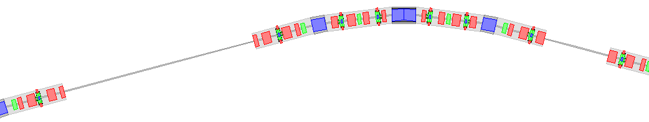
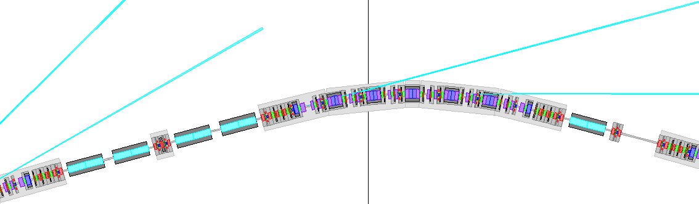
SLS and SLS 2.0 ring sector layout
3BA
SLS sector
7BA
SLS 2.0 sector
long straight
optional
superbend
Optional superbends (5T) in arc centers
3 superbends planned in centers of arcs 2,6,10
Long straights 5L/9L split from beginning
Quadrupole doublets for splitting standard
straights to be used in completion phase

Slide 12
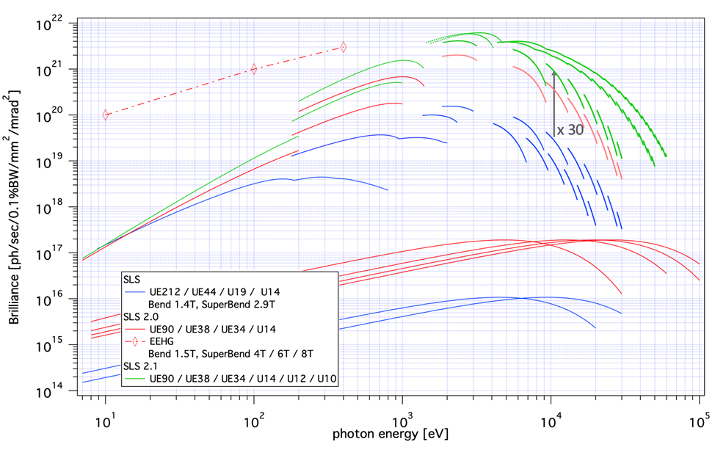
Performance: brightness
SLS now
commissioning phase
completion phase

Slide 13
Lattice Parameters
 | SLS today | SLS 2.0 commissioning | SLS 2.0 completion
Circumference [m] | 288.007'289 | 288.000'177 | 280.000'256
Emittance [pm.rad]*# | 5579 | 123 | 128
Energy spread [10⁻³]*# | 0.874 | 1.016 | 1.053
Radiation loss per turn [keV/turn]* | 539 | 432 | 441
Momentum compaction factor [10⁻⁴] | +6.04 | +1.02 | +1.02
Short straights: number x length [m] | 6 x 3.97 3 x 6.97 | 9 x (2.76+2.11) ª
Long straights: number x length [m] | 3 x 11.73 | 2 x (2 x 5.235) [5L, 9L] 1 x (4.28 + 2.80 + 1.66) [1L]
Working point: tune x/y | 20.43/8.74 | 39.28/15.35 | 45.30/21.20
* without insertion devices but including superbends # without IBS
ª nominal asymmetric split of straights, other splits are possible too.

Slide 14
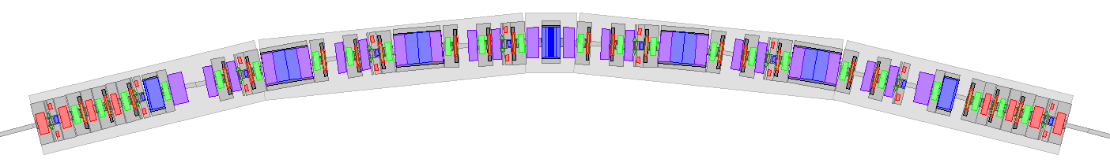
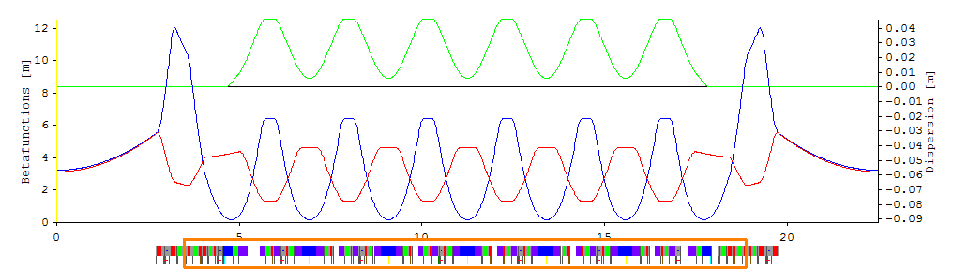

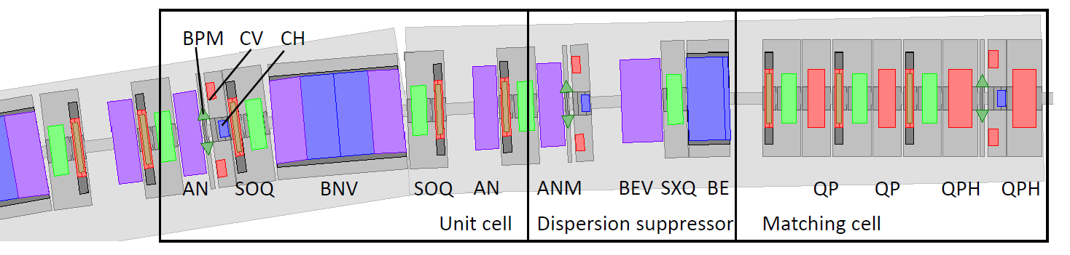
7BA arc
Layout and optics of an arc
containing a central superbend

Slide 15
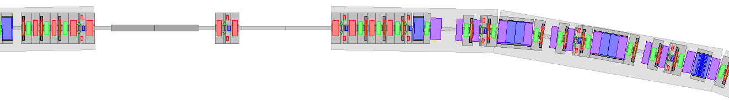
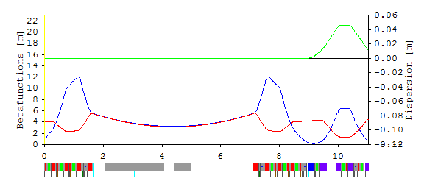
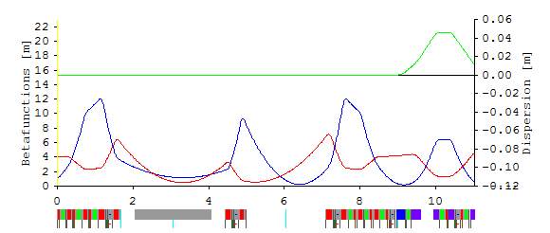
Short straights
Short straight layout and optics
commissioning
completion
straight
Phase 2 nominal split 2.76 + 2.11 m 06, 10, 12 inverse nominal 2.11 + 2.76 m 02, 04
almost symmetric 2.50 + 2.37 m 03, 07, 11
very asymmetric 2.90 + 1.97 m 08

Slide 16
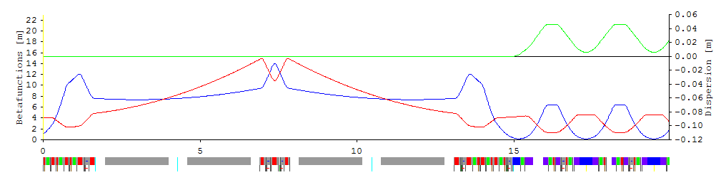
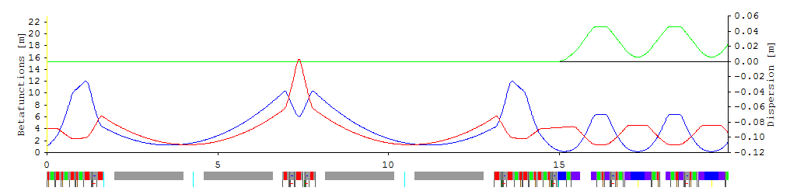
Long straights 5L and 9L
Layout and optics in commissioning and completion phase

Slide 17
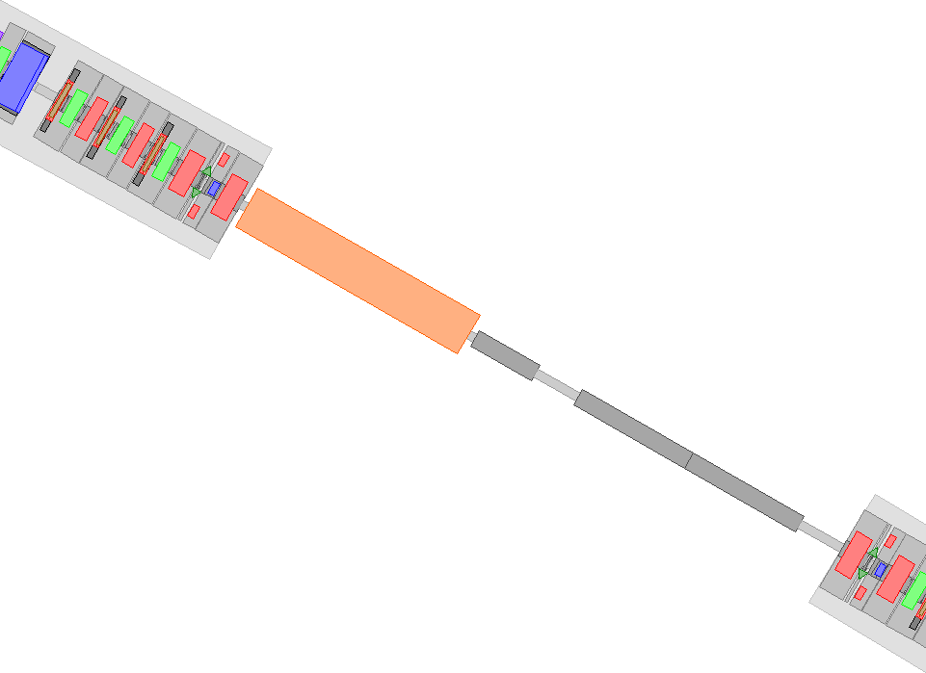
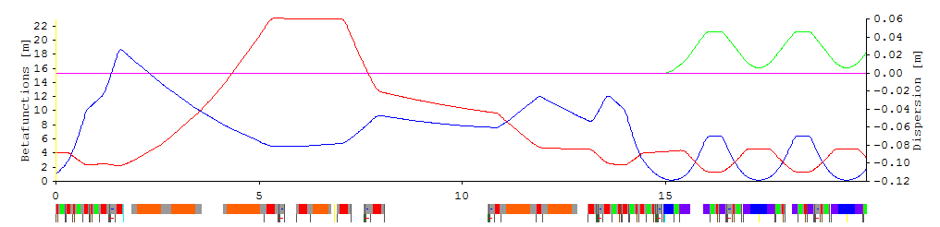
Injection straight 1L
Injection for commissioning phase
Layout  and optics  of injection straight 1L
Vertical injection elements:
4 bump kickers (re-use SLS)
Thick septum and thin (1mm) septum
Fast kicker for pseudo-on-axis injection in 2S 
4 large aperture quadrupoles (re-use SLS)

Slide 18
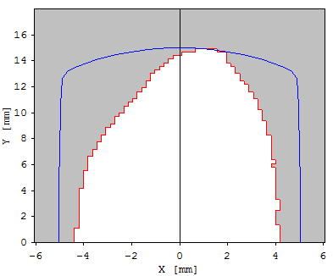
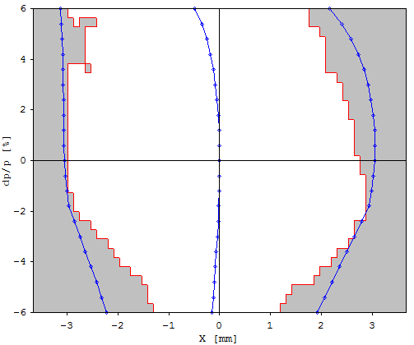
Dynamic aperture (commissioning)
Dynamic aperture (x,y)
physical aperture
from (fake) 10 mm × 15 mm beam pipe
approx. physical
aperture from real beam pipes
including mini-gap undulators
5-sigma beam size of
injected beam from booster
1 mm thin septum
β_{x} = 5 m β_{y} = 26 m
Momentum dependent. D.A.
(x, Δp/p) Range ±6%
× max. initial amplitudes
of Touschek scattered particles
= (H_{max} β_{x})^{½} Δp/p , H_{max} ≈ 0.45 mm
eff. momentum acceptance
⇨ Touschek- Lifetime ∝ (mom. acc.) ³
> ± 4%
⇨ 11 hrs

Slide 19
Magnet and power supply inventory
SLS 2.0 288 m circumference = 80 m straights + 208 m arcs
60 long./trans. grad. compound bends, BNV=[VB|BN|VB] 0 (PM)
24 end magnets BE 0 (PM)
144 reverse bends AN 0 (PM)
106 quadrupoles QP 96
288 sextupoles + 264 octupoles [ incl. quad+skewquad] 2×48 (?) +2×264
114 twin correctors CHV [CH+CV] 2×114
upgrade: +4 superbends BS [+8 VBS] (-4 BNV), +18 high gradient quads QX,
+9 twin correctors CHVX: +39/-4, +39
➔ 739 magnets (228 PM, 4 SC), ≥ ≈ 987 power supplies
SLS 288 m circumference = 80 m straights + 208 m arcs
36 bending magnets BX, BE 2
174 quadrupoles QA/B/C[W] 174
120 sextupoles SR[W] {sext.+{CH+CV}(72),skewquad(36),aux.sext.(12)} 9+2×72+36+12
upgrade: 3 superbends BXS: +3/-3 bends, +6 PS
upgrade: Femto insertion: +3 bends, +4 quads, +1 corr.H/V, +9
➔ 338 magnets, 392 power supplies

Slide 20
Commissioning strategy
Commissioning (end 2024 / early 2025)
small aperture chambers in place (∅ 8 mm)
  small aperture BPMs already installed
reduced gap chambers for superbend (10 mm)
  but PM-bends in place of superbends
undulators in place but open or off
Risk: beam threading with small apertures
First year of operation (2025/26)
installation of 5 T superbends
beam line commissioning and user operation
machine development: optics correction, beam based alignment
installation of high gradient quads to split standard straights
completion: low beta optics and injection

Slide 21
Conclusions & Outlook
 Achievements
  emittance reduced by factor > 40 (bare lattice)
  total straight length maintained: 80 m like SLS
  confidence in beam stability (NEG, 18 mm beam pipe etc.)
  tunnel modifications avoided: shifts < 25 cm
  power consumption reduced (only 2 instead of 4 cavities)
  ∼ 7½ hrs beam lifetime (commissioning phase), ∼ like SLS
  safe injection scheme (vertical, pseudo-on axis)
  brightness increase ×13 in commissioning optics
  brightness increase ×30 in final optics (complete)
⇨ Next steps
  Further development of final optics
  Detailed technical layout
THE
END

