Slide 1
DUO planning in 2020
SPM meeting, Didier Voulot, 12.11.19

Slide 2
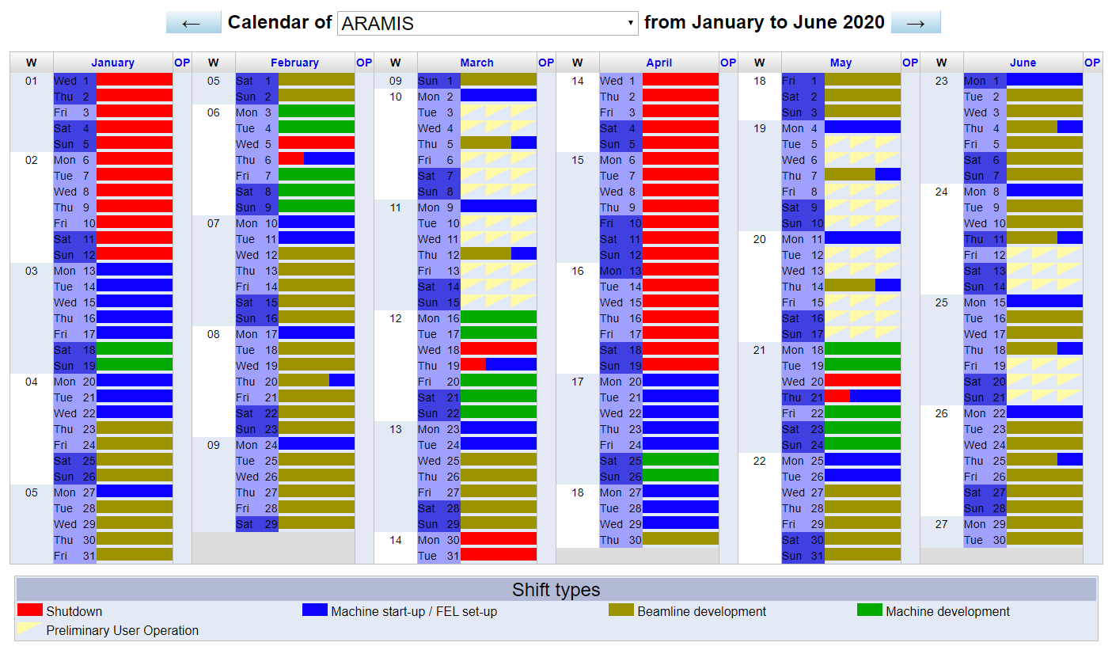
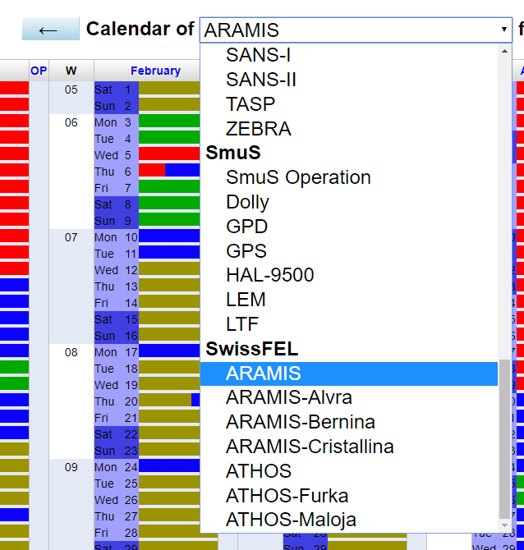
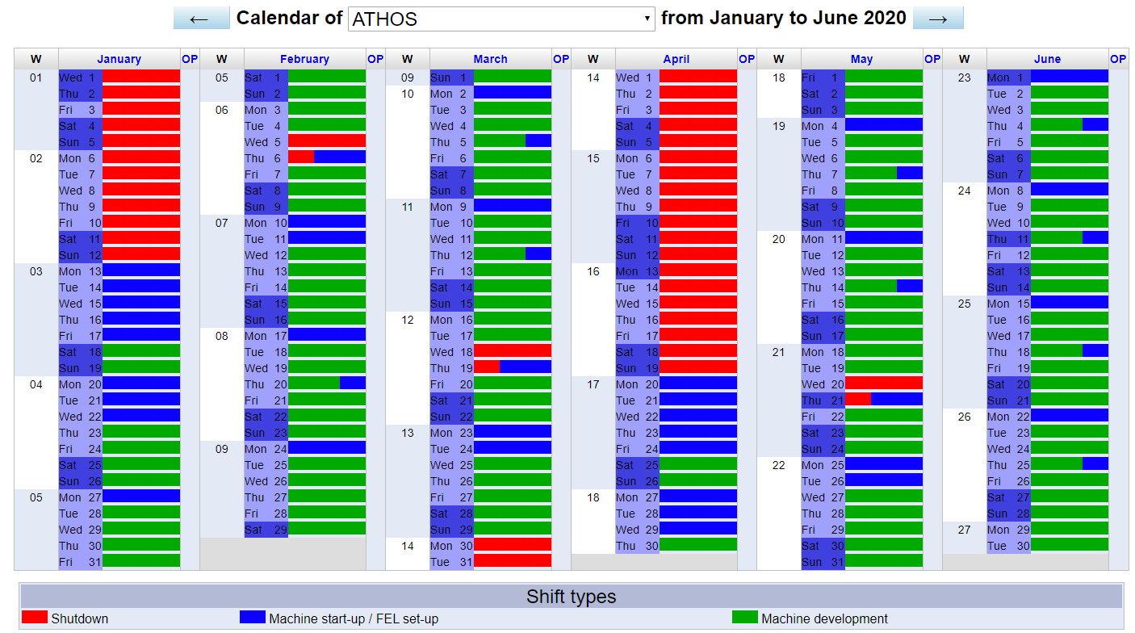
Changes in DUO calendar
https://duo.psi.ch/duo/public_calendar.php?
Separate calendars for ARAMIS and ATHOS
Sub-calendars for end-stations
New categories

Slide 3
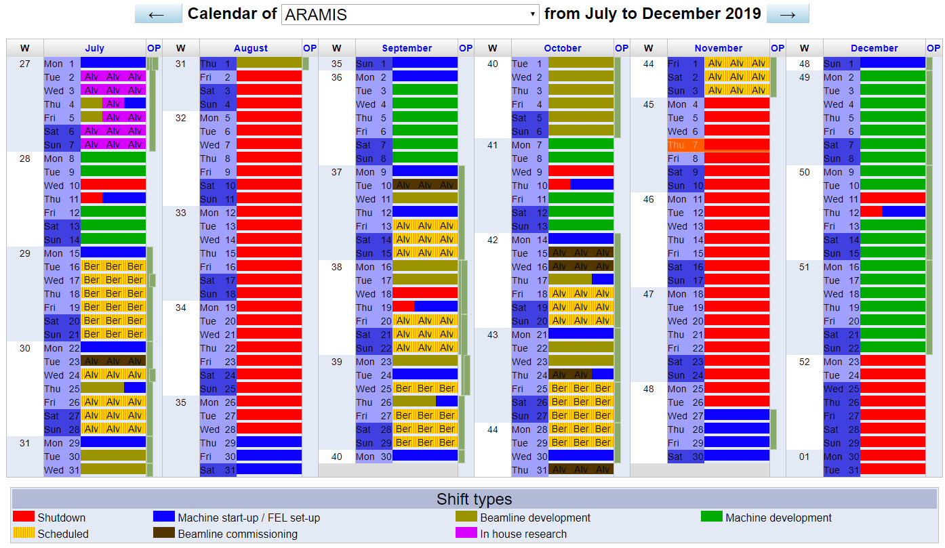
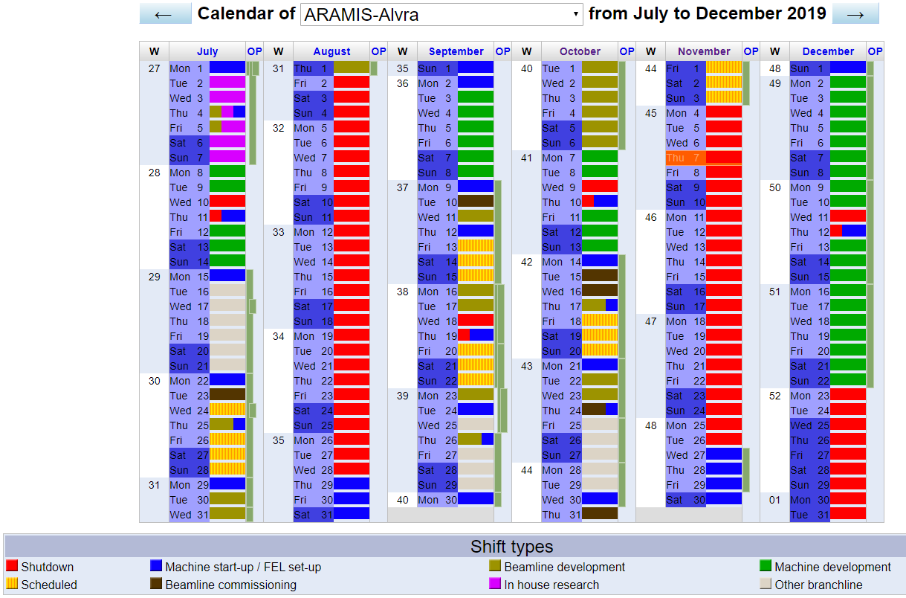
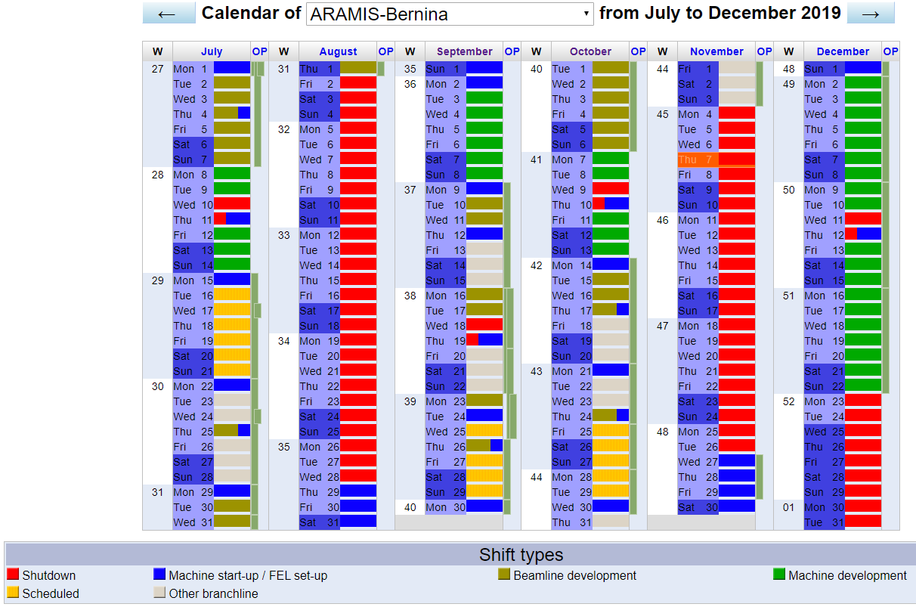
Changes in DUO calendar

Slide 4
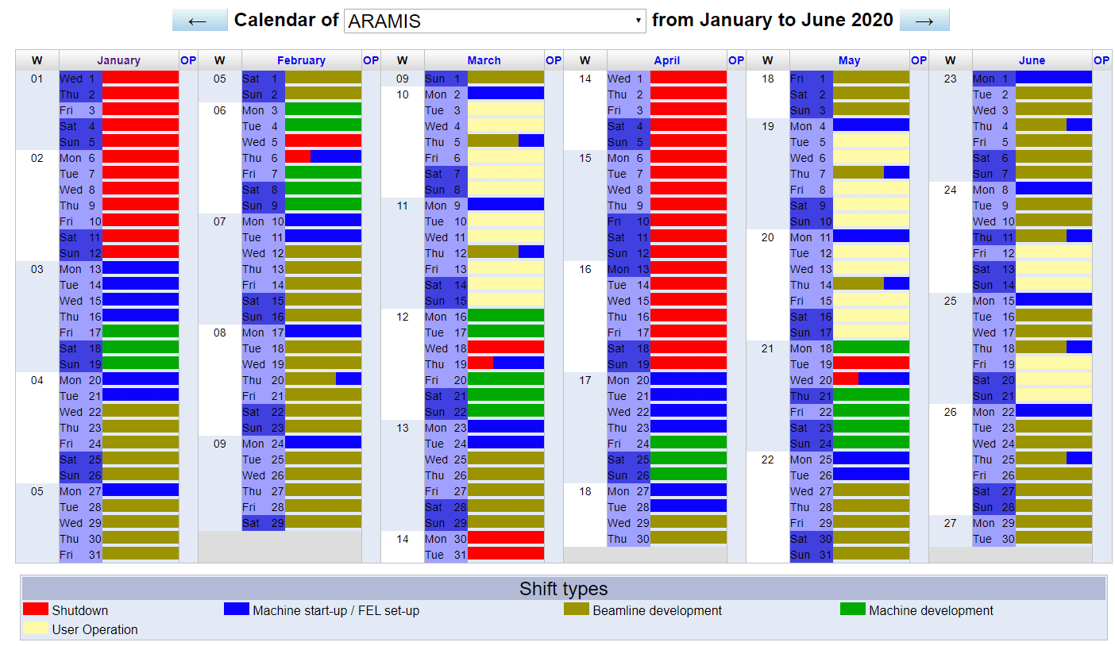
ARAMIS 2020/1

Slide 5
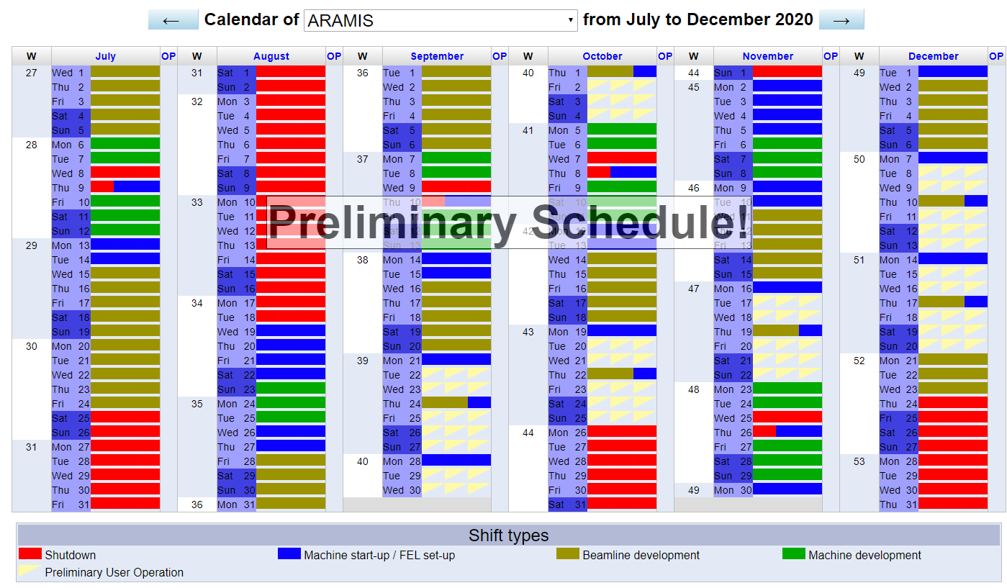
ARAMIS 2020/2 (first draft)

Slide 6
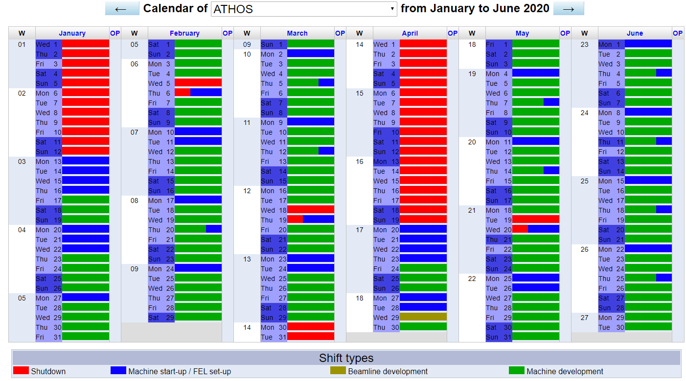
ATHOS 2020/1 (first draft)

