Slide 1
Eduard Prat :: FEL Beam Dynamics :: Paul Scherrer Institut
Athos overview, status and plans
SwissFEL Progress Meeting (SPM), 26 November 2019

Slide 2
Contents
Overview
Special hardware
Modes
Installation
Commissioning
Conclusion
Notes:
2

Slide 3
Contents
Overview
Special hardware
Modes
Installation
Commissioning
Conclusion
Notes:
3

Slide 4
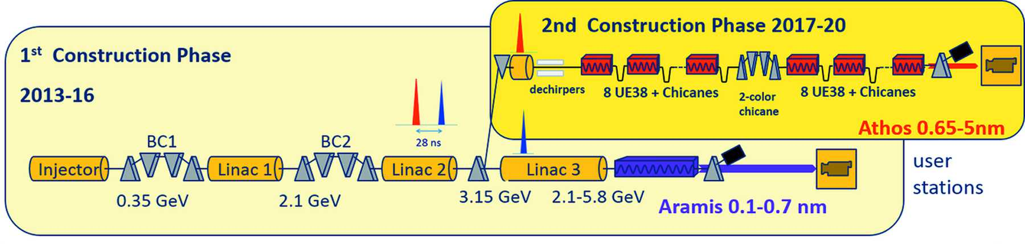
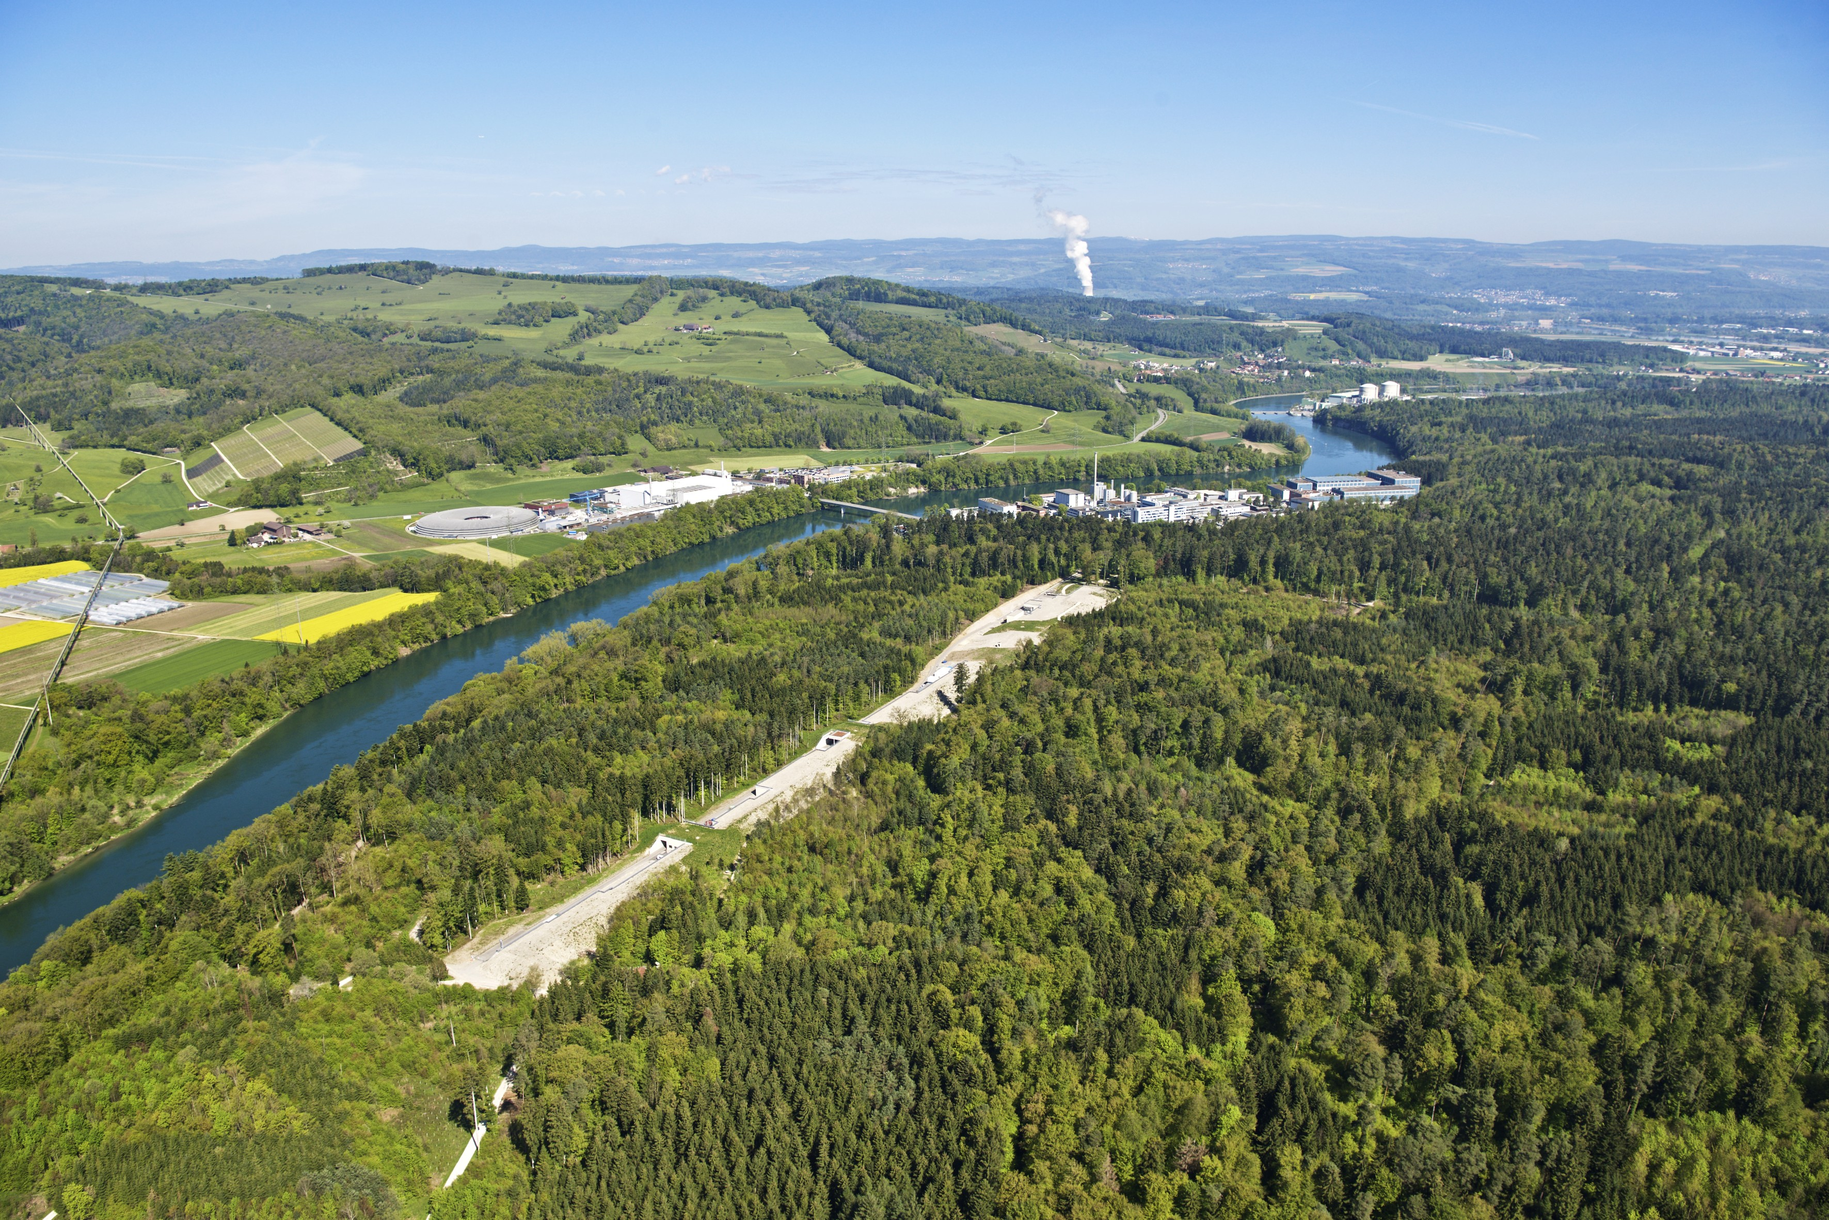
Athos:
Soft X-ray FEL, λ=0.65–5.0 nm
Variable polarization, Apple-X undulators
First users 2021
Overview (I): SwissFEL
Aramis:
Hard X-ray FEL, λ=0.1–0.7 nm
Linear polarization, in-vacuum undulators
First users 2018
Main parameters:
Photon wavelength: 0.1–5 nm
Photon energy : 0.2–12 keV
Pulse duration : 1–20 fs
Electron energy : up to 5.8 GeV
Electron bunch charge: 10–200 pC
Repetition rate: 100 Hz (2-bunches)
Notes:
4

Slide 5
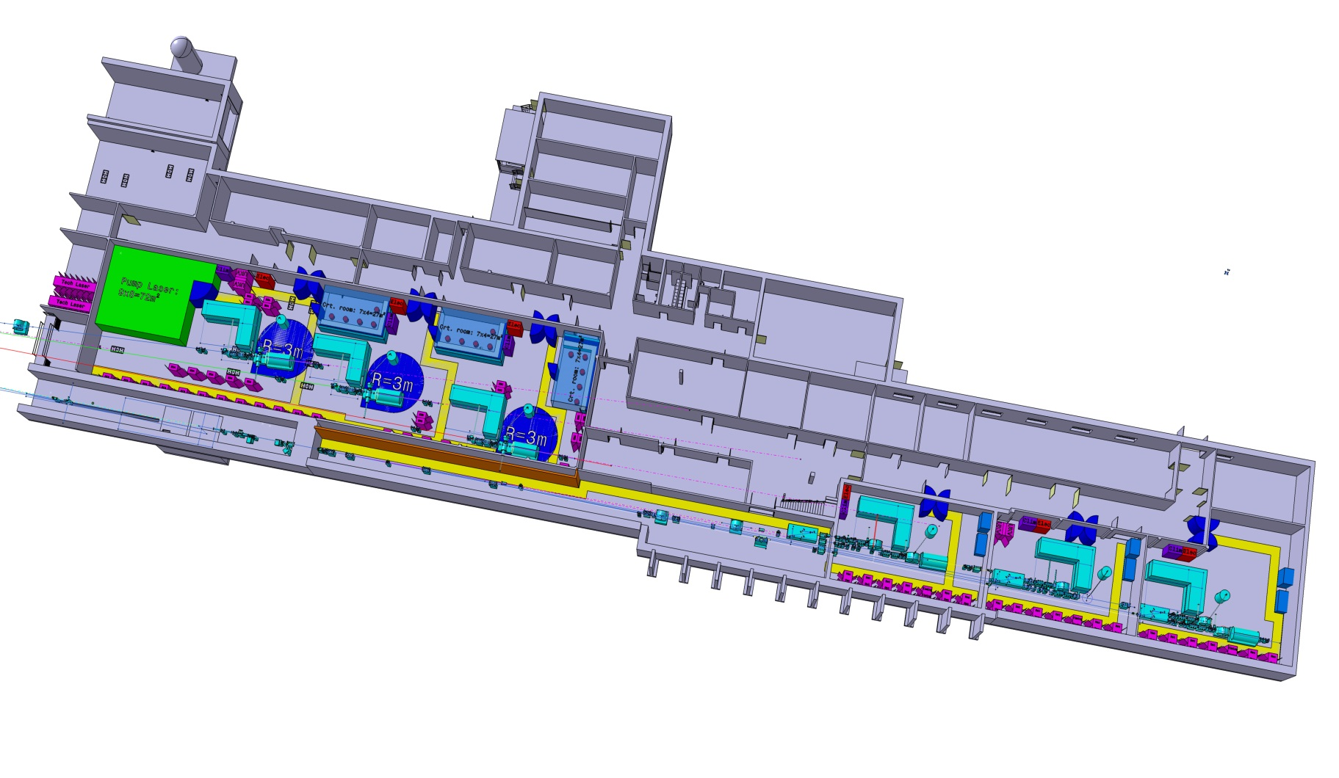
Overview (II): SwissFEL Experimental Areas
(Maloja @ Athos)
Atomics, molecular & optical sciences
(Furka @ Athos)
Condensed matter and quantum materials
(Cristallina @ Aramis)
Coherent diffraction
imaging
(Athos
FEL)
Aramis
FEL
Aramis
front end
Aramis
optical hutch
Bernina @ Aramis
Pump-probe
crystallography
Ultrafast dynamics in solid matter, strongly correlated systems
Structural biology
(MX – macromolecuar
crystallography)
Alvra @ Aramis
Multipurpose
pump-probe
Ultrafast biology
and chemistry
Alvra and Bernina
Pilot experiments in 2018
First users in 2019
Athos stations: first users in 2021
Cristallina @ Aramis: first users in 2022

Slide 6
Overview (III): Athos Special Features
Flexible & short undulator modules
(variable polarization, transverse gradient)
+
Inter-undulator chicanes
new operation modes to control FEL properties:
Long. coherence and bandwidth: high-brightness SASE, large bandwidth.
Multiple colors
Pulse duration and power
With external laser: slicing, phase-locked pulses, EEHG, etc.
Notes:
6

Slide 7
Overview (IV): Athos Schedule
Courtesy of Romain Ganter
1st UE38 in Tunnel
As planned !
On course!
Athos 1st Lasing (uJ) ???
Some milestones on time (e.g. electrons in dogleg, Athos line until dump).
Some milestones delayed but on their way (undulators, X-band TDC)
1st electrons full transmission on schedule
1st light on schedule, maybe some SASE at longer wavelength

Slide 8
Contents
Overview
Special hardware
Modes
Installation
Commissioning
Conclusion
Notes:
8

Slide 9
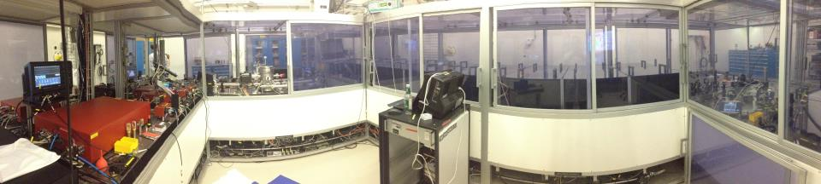
Gun laser
Yb:CaF2 laser (as Alcor) to generate 2nd bunch for Athos.
Status: ready on beginning of 2020.
Until then we will work with Jaguar. Great laser, but not flexible and with some risk of dying soon

Slide 10
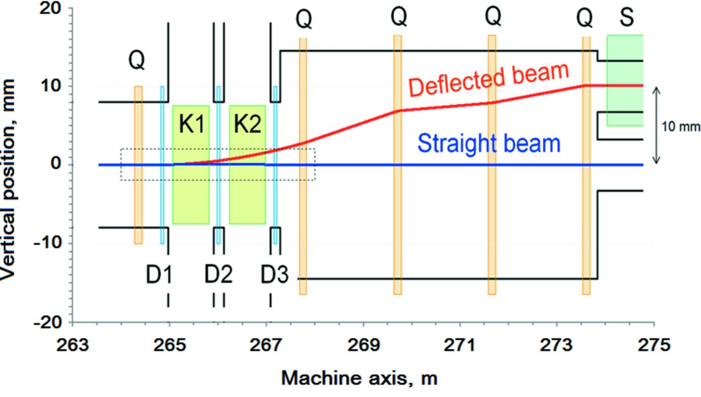
Kicker and septum
Custom-designed resonant kicker magnet and septum to distribute 2 bunches (separated by 28 ns) to Aramis and Athos.
Required to operate Aramis and Athos at 100 Hz
Status: installed and successfully commissioned
Vertical plane beam trajectories in the kicker region

Slide 11
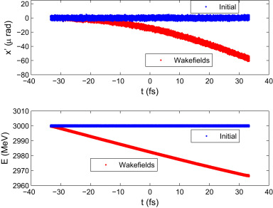
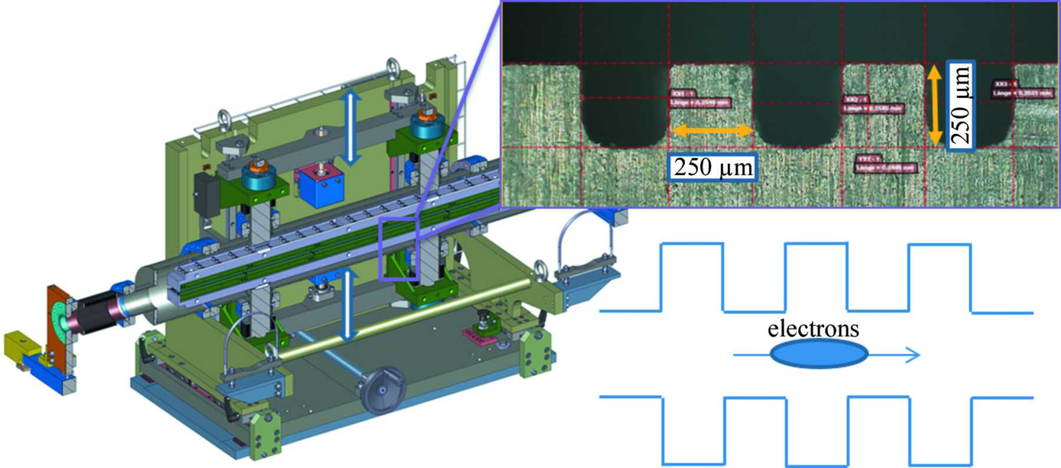
Passive dechirper
8 corrugated plates between switchyard and undulator beamline
Required to:
  Remove residual energy chirp of the electron beam (needed for SASE with low bandwidth, HB-SASE).
  Induce transverse beam tilt to the beam (needed for many modes).
  Measure and monitor FEL performance
Status: 2 structures installed to be commissioned in December, 6 to be installed in 2020.
Dechirper vacuum chamber where two parallel corrugation
plates (insets) can be moved close to the beam trajectory.
Simulation results of the “chirping” and tilt generation using a passive device.

Slide 12
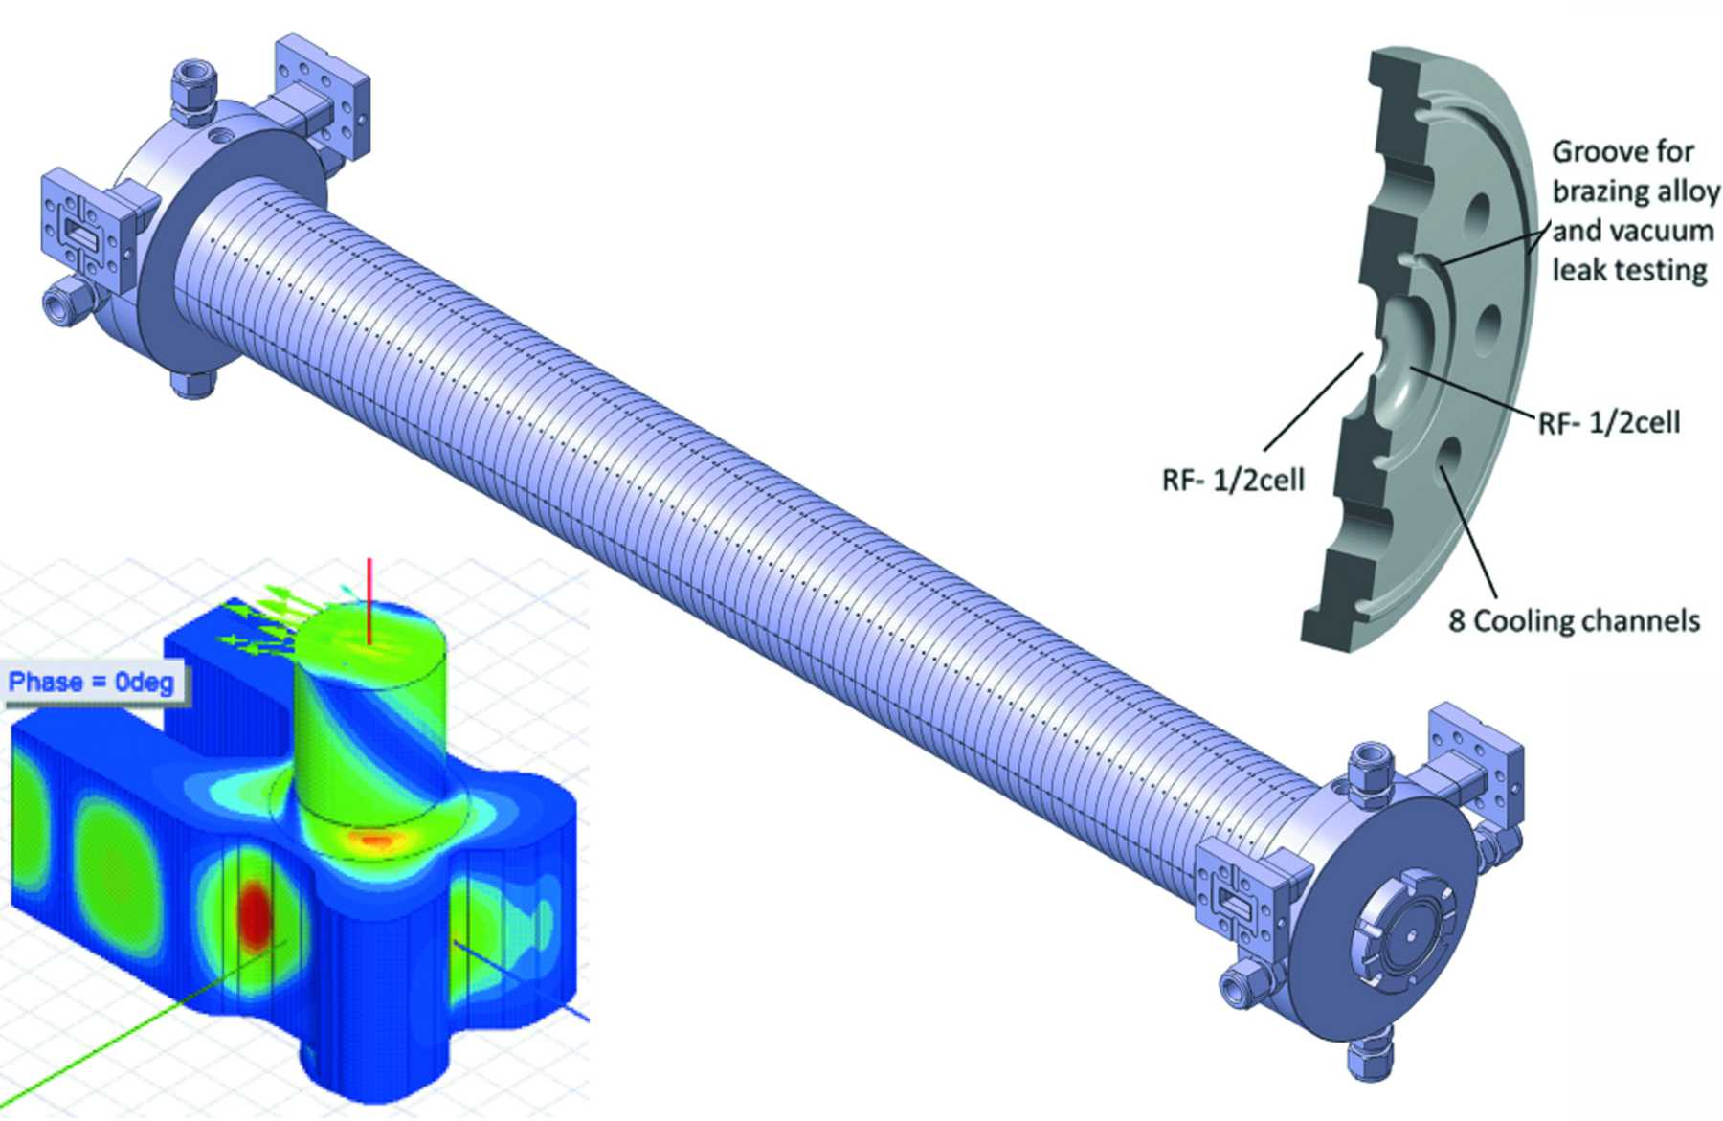
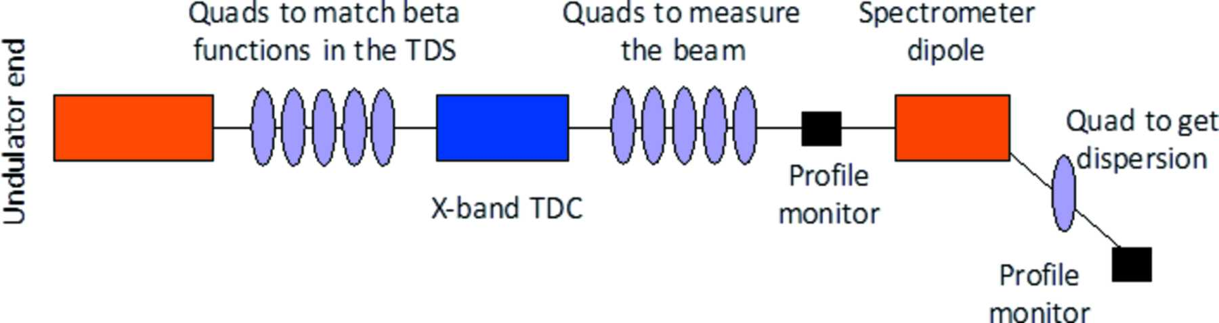
Post-undulator RF transverse deflector
X-band RF deflector after the undulator beamline. Variable polarization (successfully demonstrated at DESY!)
Required to:
  Characterize and optimize the electron beam quality (compression, slice emittance, beam tilt, etc.)
  Measure and monitor FEL performance (power profile)
Status: RF conditioning planned for December 2020.
Concept of the post-undulator diagnostic section
Left: detail of the RF field in the input/output coupler.
Middle: complete TDS prototype. Right: basic disc.

Slide 13
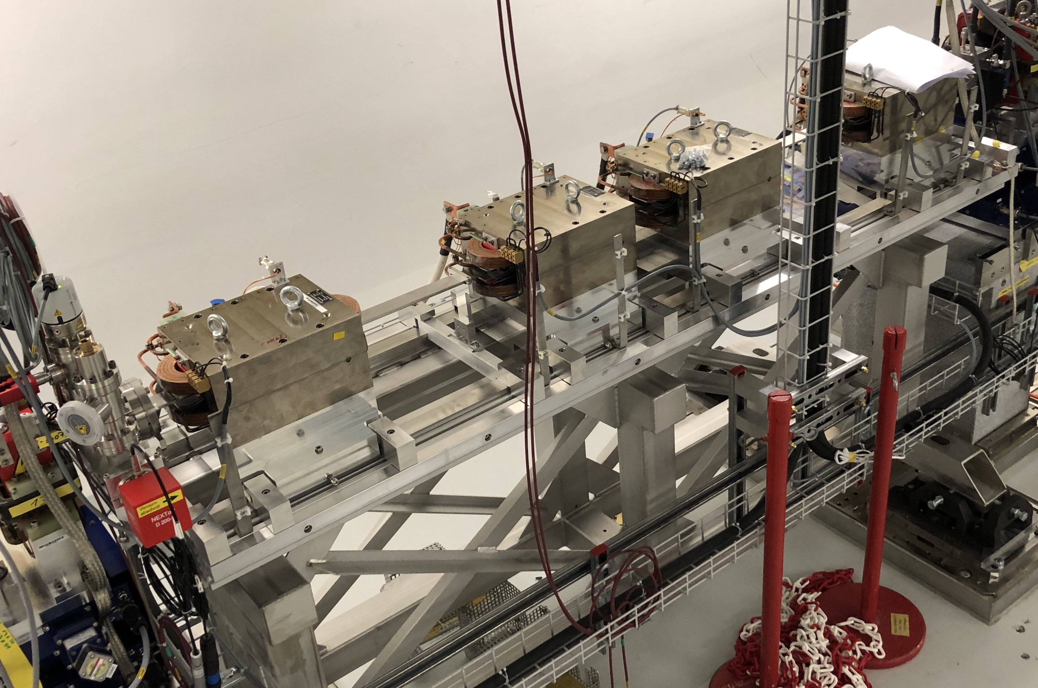
Two-color chicane
4 dipole magnet chicane installed in the middle of the undulator beamline
Required to generate two colors with large tunability (up to 500 fs), using a tilted beam.
Status: installed, to be commissioned in December 2019
2-color chicane: Delay + Alignment
Tilted Beam
Power
profile
Betatron
oscillation
Adjustable Delay
1st pulse
Concept of 2 color generation with tilted beam and chicane
2-color chicane in the tunnel
Spectrum
Simulations

Slide 14
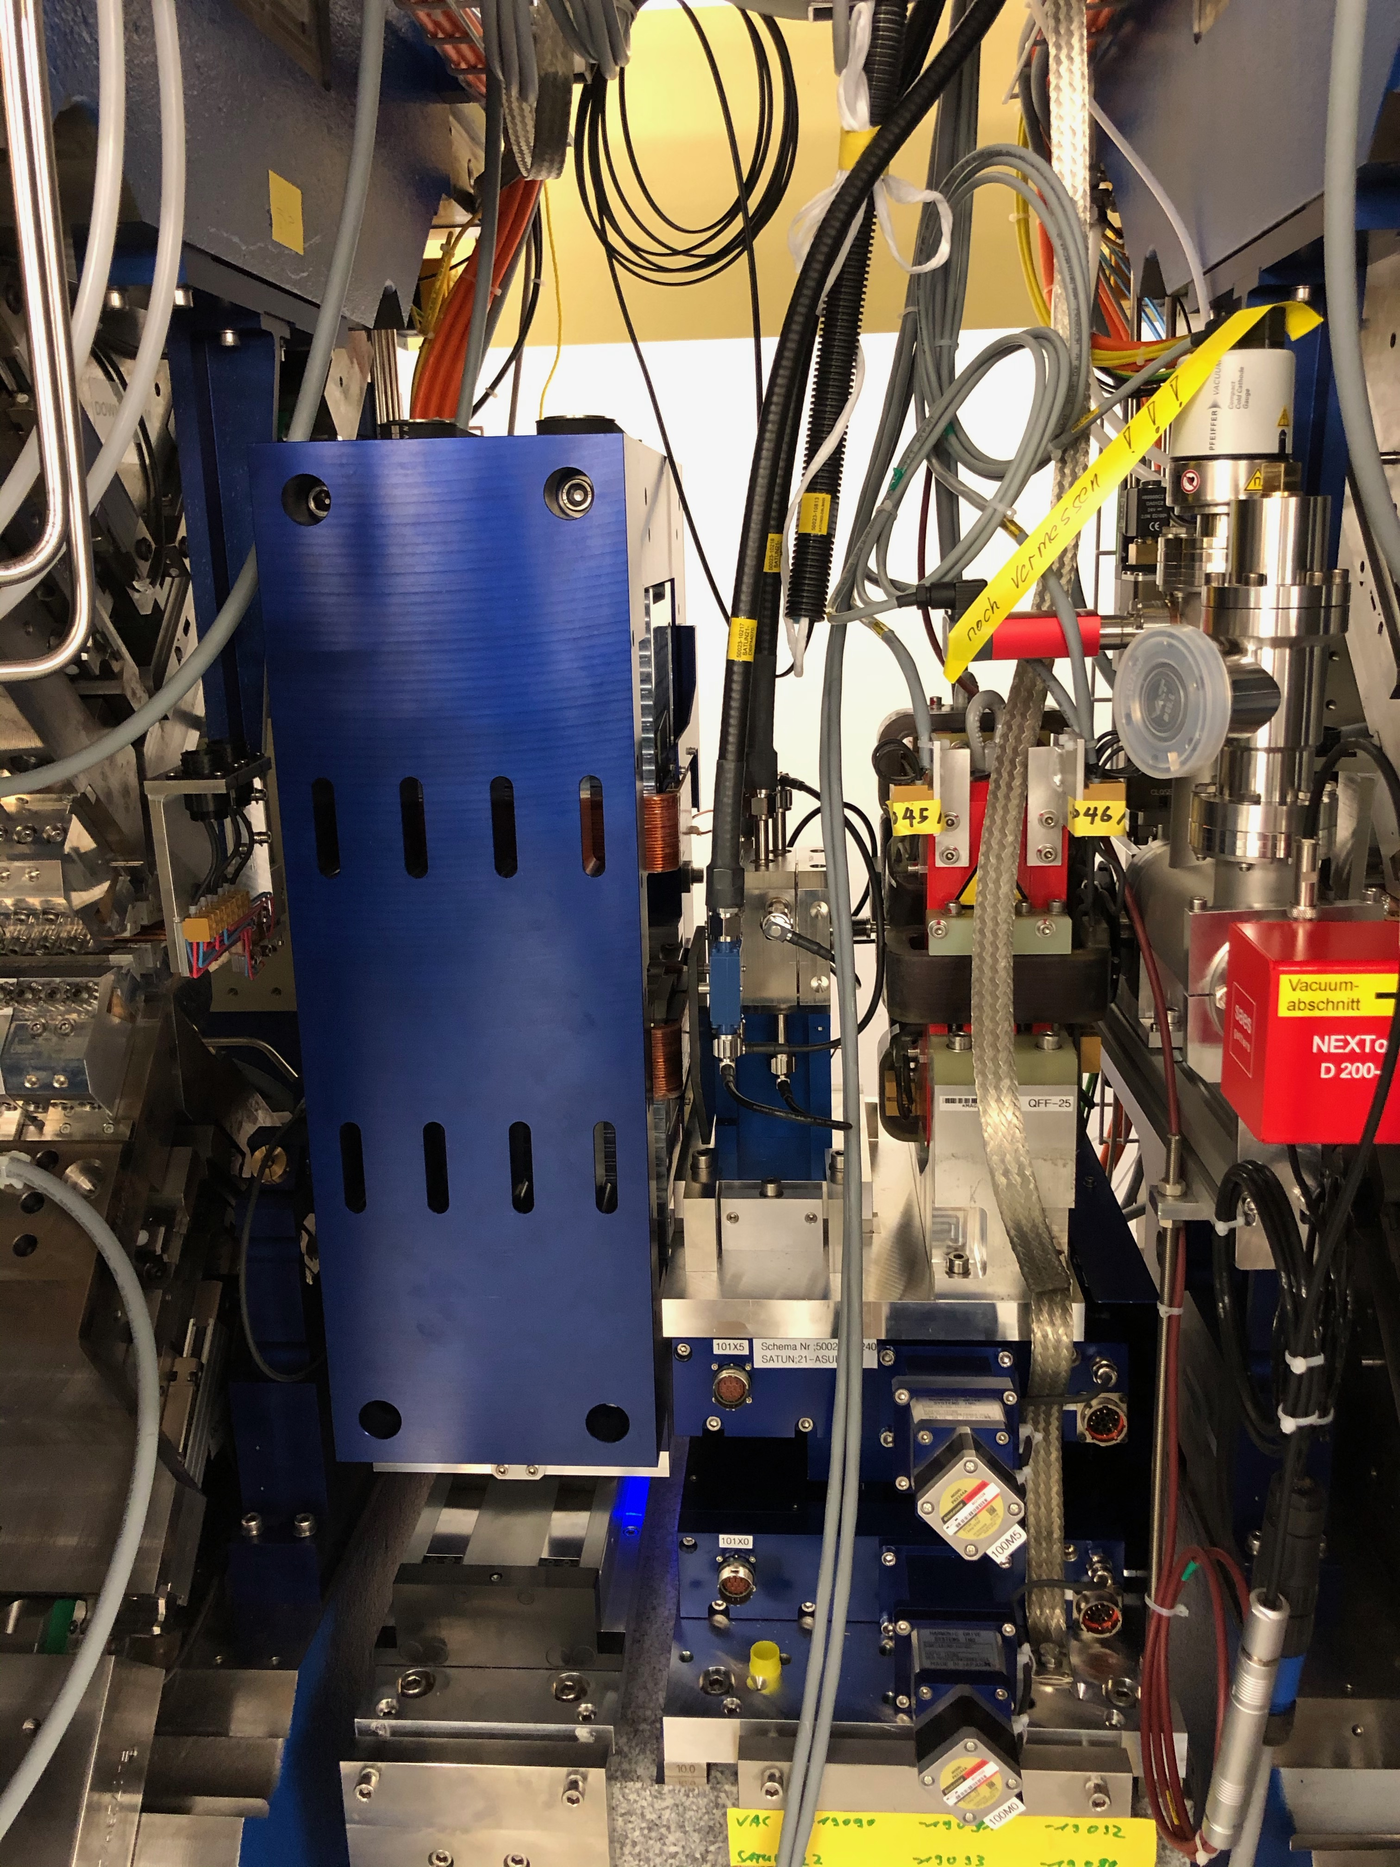
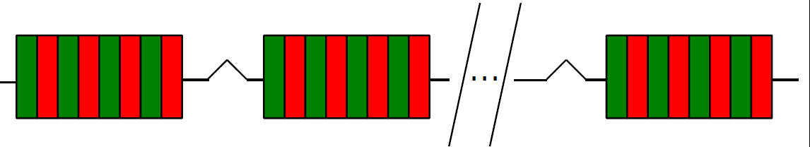
Inter-undulator chicanes
Permanent magnet chicanes placed between the undulator modules
Chicanes have two physical effects: delay and longitudinal dispersion (R₅₆). Ours can also introduce a transverse offset to the beam.
Required to:
  Work as phase-shifters in standard SASE operation (delay)
  Reduce saturation length via optical klystron effect (R₅₆)
  High-Brightness SASE or HB-SASE (delay)
  High-power and short pulse mode (delay + offset)
Status: 1 unit installed, to be commissioned in December 2019. 3 units ready for measurements. Rest to be installed and commissioned in 2020.
CHIC design for Athos
Chicanes for High power and Improved Coherence

Slide 15
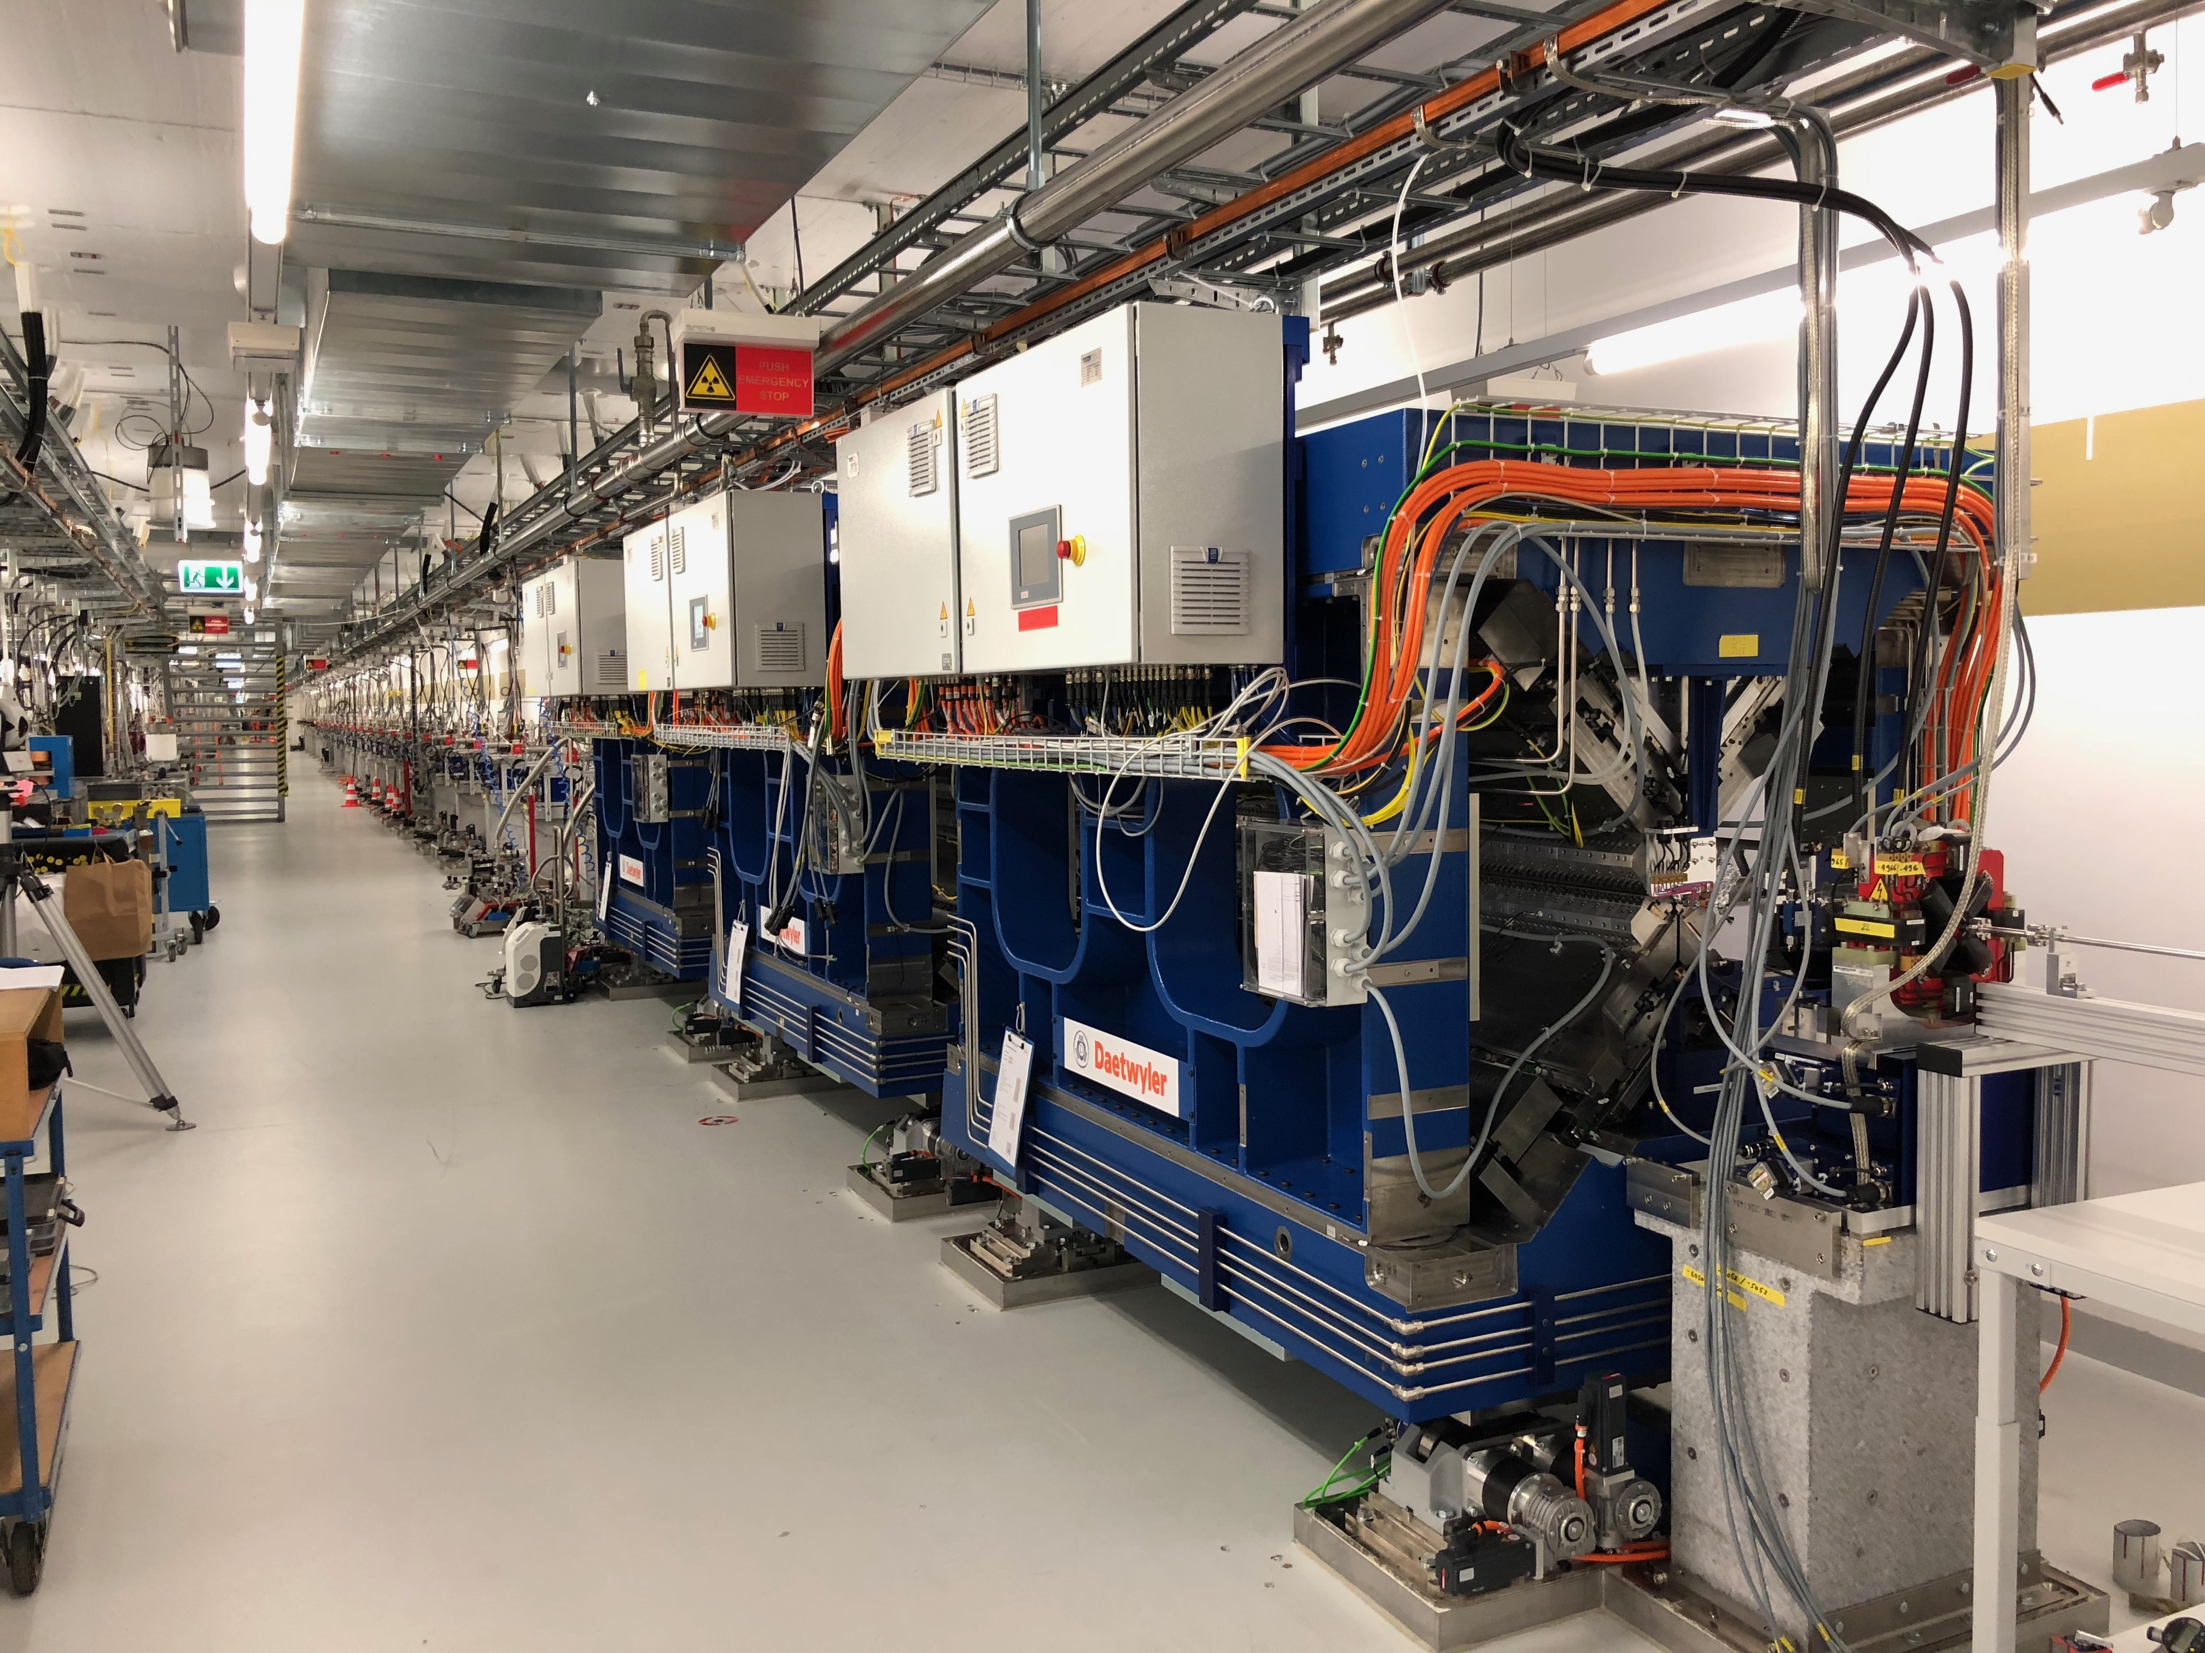
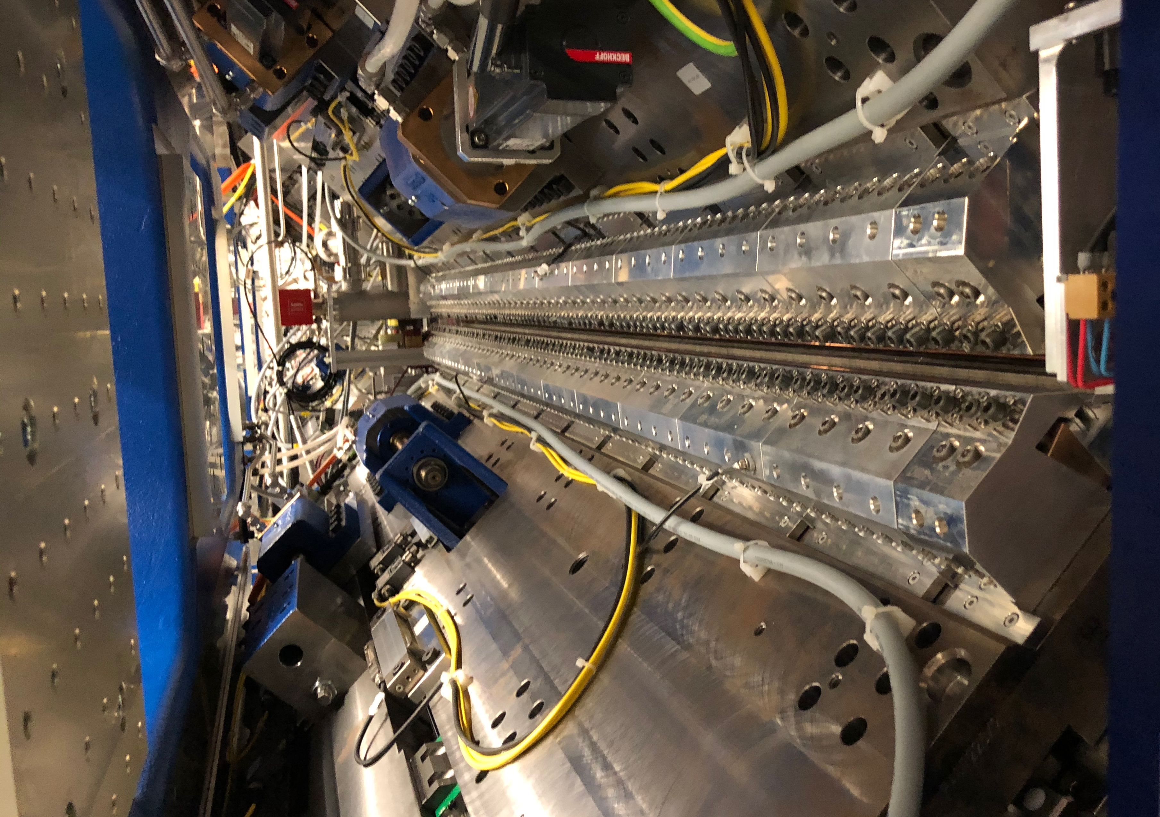
APPLE-X undulators
16 Apple-X U38 undulators (originally 20 planned):
  2 meters long (length optimized for best performance)
  full polarization control
  independent control on K, polarization and transverse-gradient (TGU)
TGU required to generate ultra-large bandwidth radiation.
Status: 2 units installed, to be commissioned in December 2019. 3rd unit maybe installed and commissioned in December 2019. Rest to be installed and commissioned in 2020.

Slide 16

Other components
External laser
Received grant (HERO project) with budget for a laser and a modulator
Required generate trains of short pulses (ESASE scheme), possibly phase-locked (with CHIC)
First step to implement EEHG scheme at Athos (requires an additional external laser)
Status: on progress, to be installed and commissioned in 2021
Electron diagnostics
BPMs: 70% ready to be commissioned, the rest ready in spring 2020
Screens and wire-scanners: ready to be commissioned (but problems with delta-tau with WS)
BAMs: after dogleg in summer 2020, at TDC in autumn 2020
Compression monitor in dogleg: not before 2021 due to budget reasons
Photon diagnostics
Diode, screens, gas detector and foils: ready to be commissioned
Spectrometer: spring-summer 2020
Monochromator: summer-autumn 2020
Time profile measurements by 2021?

Slide 17
Contents
Overview
Special hardware
Modes
Installation
Commissioning
Conclusion
Notes:
17

Slide 18
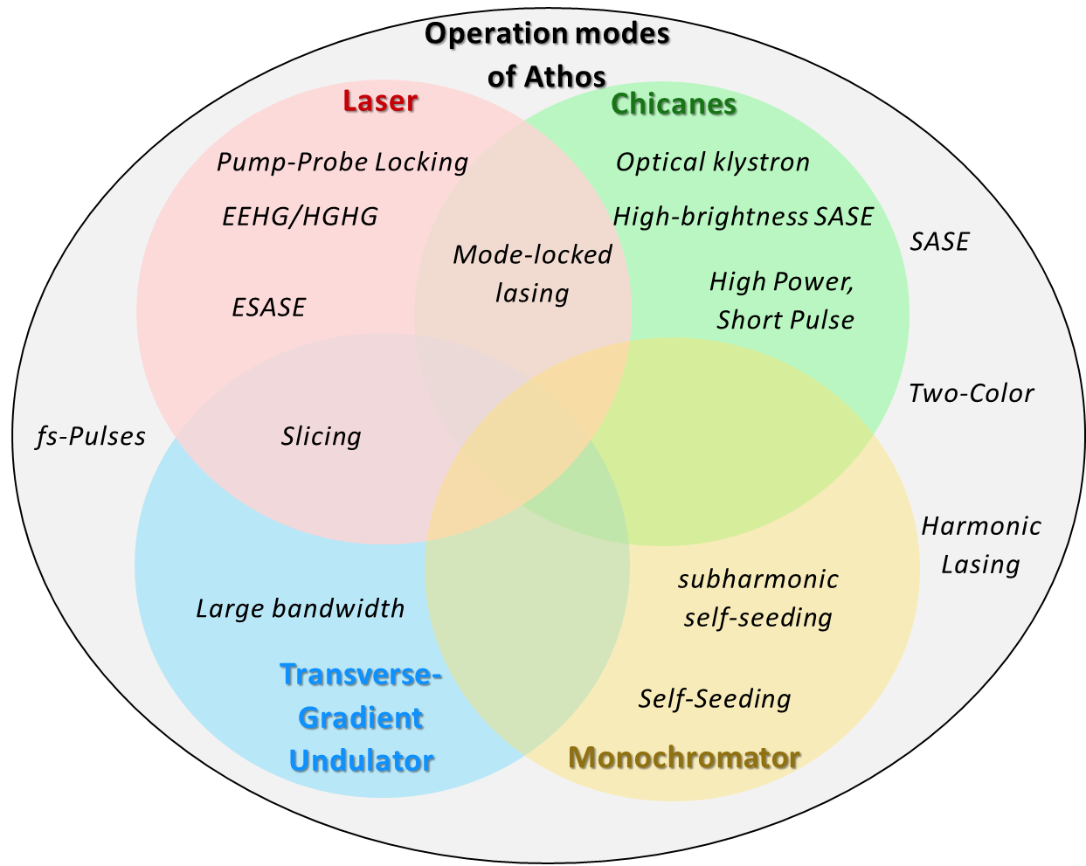
Athos: Operation Modes
2-colors chicane
Laser
Modulator
Additional space for
EEHG/self-seeding
Seeding
chicane
8 Modules + chicanes
8 Modules + chicanes
Many operation modes, some of them unique. Main hardware:
Inter-undulator chicanes
TGU
External laser
Monochromator (not baseline)
Few examples in the next slides
First modes (2020):
SASE
Optical klystron
2 colors with tilted beam

Slide 19
Compact and High-Brightness SASE
Idea: combine both effects of chicanes
  Delay→ high-brightness SASE
  R56 → optical klystron → compactness
Simulation results for 1 nm
SASE
Compact
HB-SASE
In comparison to SASE:
~10 times brighter
30% shorter saturation length
Comparable results for other wavelengths

Slide 20
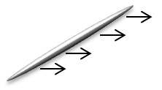


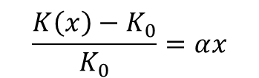
Large Bandwidth with TGU
Simulations (10% bandwidth)
In a TGU there is a dependence of the undulator field on the transverse position
A tilted beam traveling through a TGU will produce broadband XFEL radiation. Easy to tune!
Spectrum
$$\frac{K\left(x\right)−K_{0}}{K_{0}}=αx$$
K₀: on-axis field
α: gradient
Power profile
Tilted electron
beam
Transverse-gradient
undulator
Large-bandwidth
XFEL pulse
XFEL pulses of 20% bandwidth and few GW power can be obtained

Slide 21
Generation of High-Power and Short Pulses
Shift the FEL pulse to fresh electrons for “superradiant” amplification (with chicanes)
The fresh bunch slices are derived from a realignment of a tilted beam
Delay + Alignment
Betatron
oscillation
Simulation results
20 modules, 2 nm, 6 kA, 8 sections
FEL radiation profile after each undulator section for a tilt of 3 mm
Tilt in offset (mm) | Peak power (TW) | Pulse energy (mJ) | FWHM pulse duration (as)
1.5 | 1.62±0.58 | 1.01±0.24 | 460±260
3 | 1.48±0.20 | 0.52±0.05 | 300±10
Concept developed by us and demonstrated at LCLS with 3 sections
CROSS project recently approved to perform single-particle imaging with pulses obtained from this method

Slide 22
Contents
Overview
Special hardware
Modes
Installation
Commissioning
Conclusion
Notes:
22

Slide 23
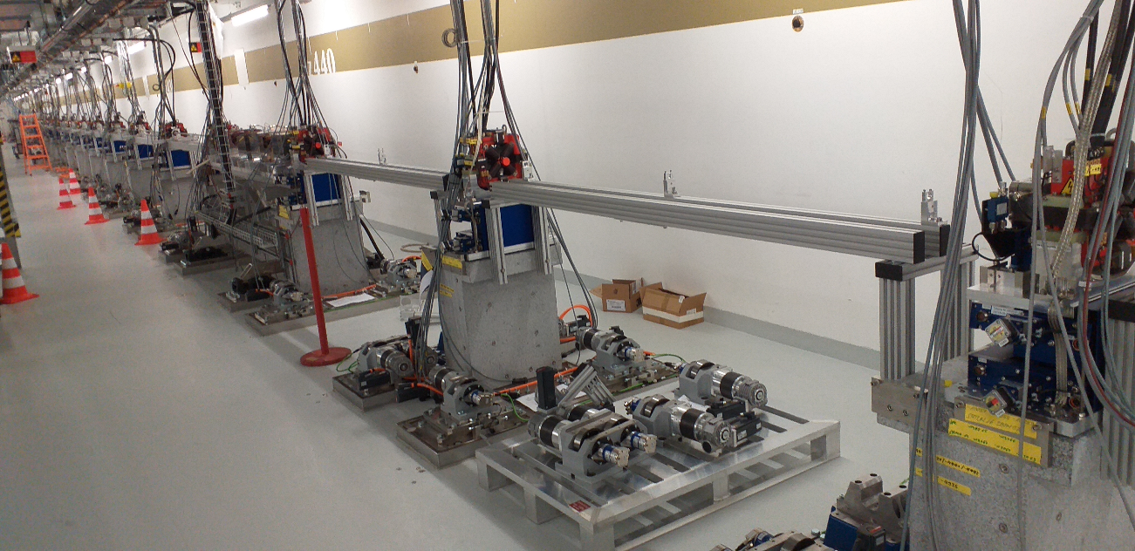
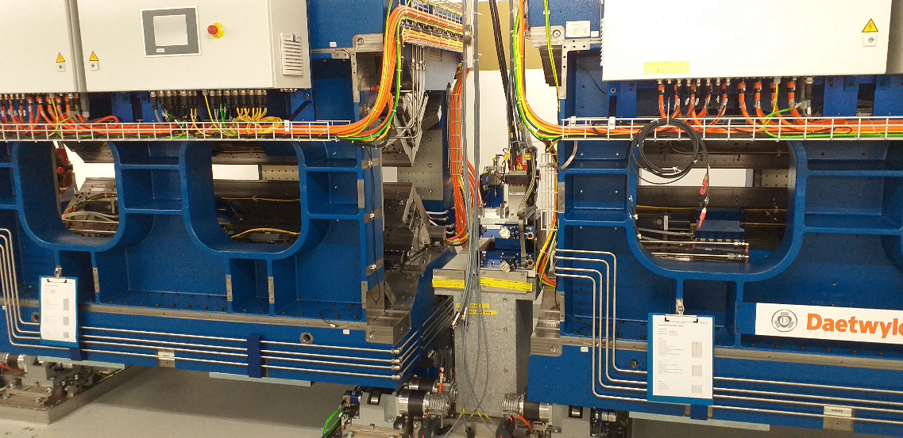
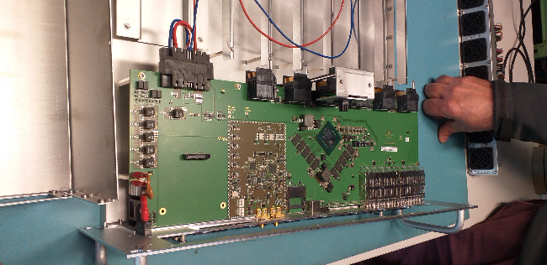
Magnets, BPMs, undulators
Beam Stopper to Bremstrahlung wall:
All magnets ready for Beam
70 % of BPMs ready for beam
Vacuum < 1e-8 mbar whole line
Two undulators ready for beam
22 BPM / Quad motorized stages ready for BBA
One CHIC chicane
Courtesy of Romain Ganter

Slide 24
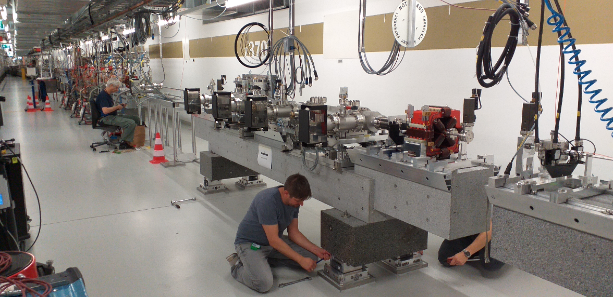
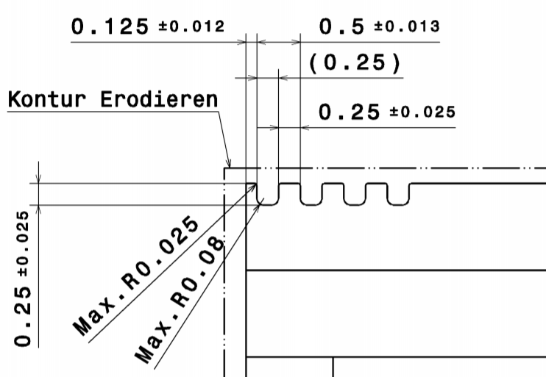
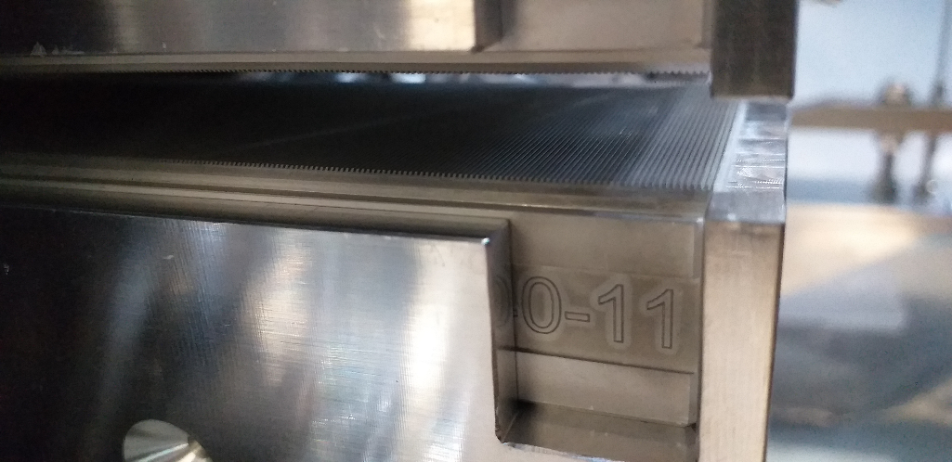
2 dechirpers installed
Ready for beam (EPICS panel)
Min. gap 0.5 mm
Max gap 25 mm
Width: 40 mm
Courtesy of Romain Ganter

Slide 25
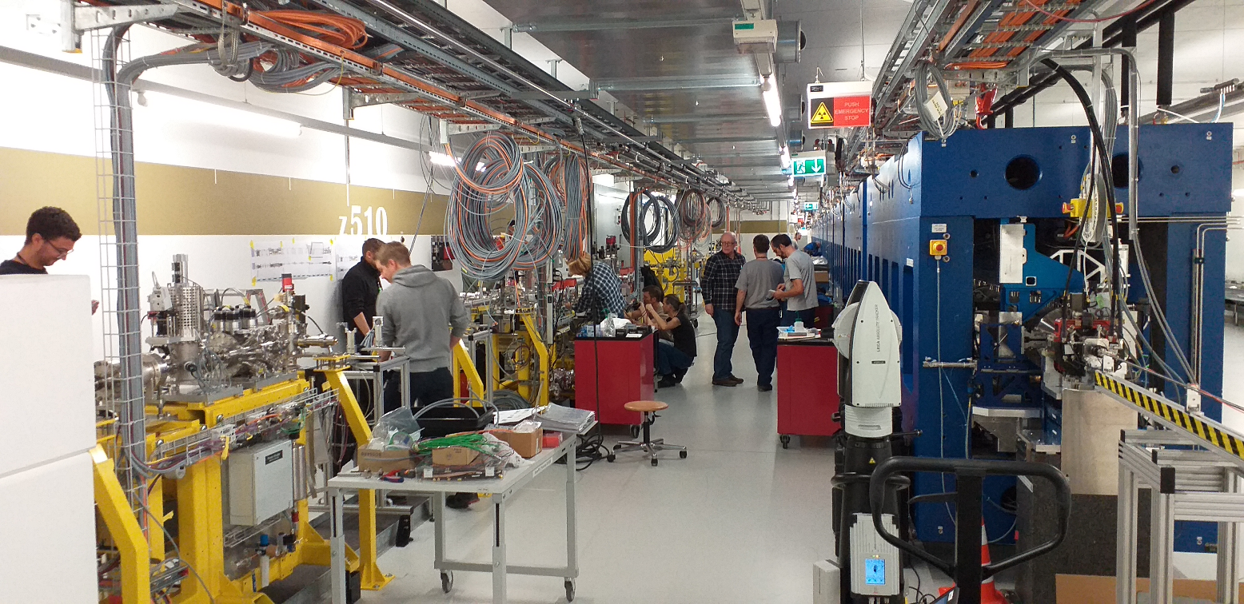
Front end
Ready for beam:
Gas monitor (Intensity and position); Screen; Photodiode
shutters; collimators; slits
K edge absorption filter (Fe, C, …)
Courtesy of Romain Ganter

Slide 26
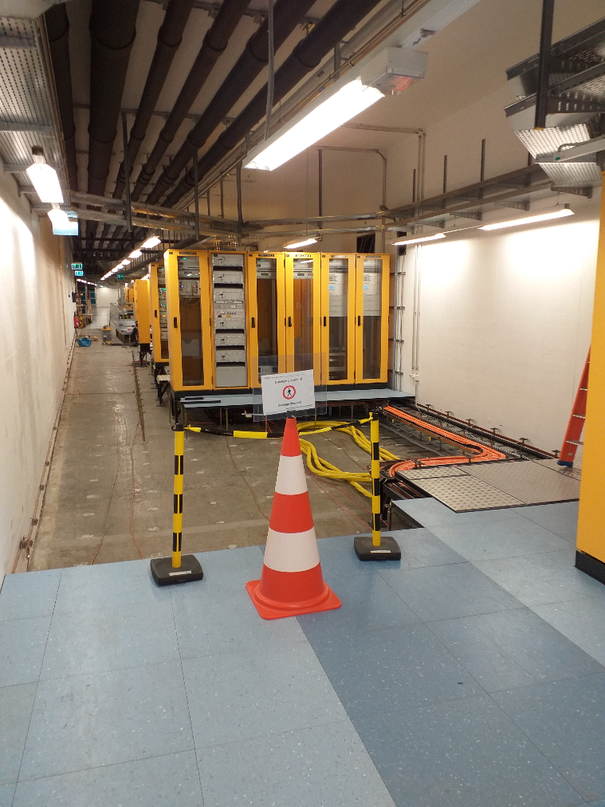
Athos RF gallery
ATHOS X band Modulator
Crane has been ordered
Floor to be covered with epoxy in January
KKV20 under upgrade
X band modulator delayed to Fall 2020
RF in Polarix: December 2020
Courtesy of Romain Ganter

Slide 27
Contents
Overview
Special hardware
Modes
Installation
Commissioning
Conclusion
Notes:
27

Slide 28
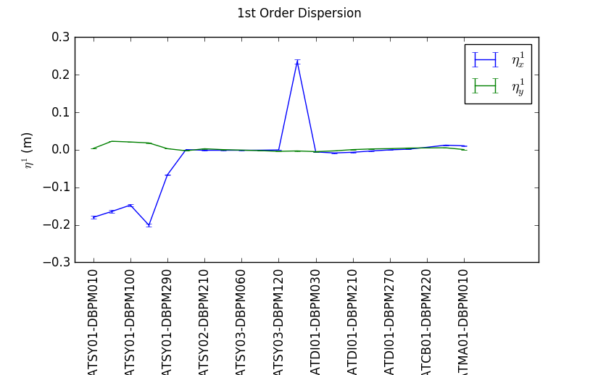
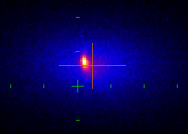
What has been done so far
Successful commissioning of kicker and septum
Transport to beam stopper with design optics and dispersion, no losses,
Work on LLRF, diagnostics, feedbacks, timing, etc.
Main issues:
2-bunch operation in progress but delayed
Projected emittance increase. New lattice optics have been calculated with lower β-function. New measurements at more locations planned to localize the issue.
Halo coming from some obstacle?
Notes:
28

Slide 29
December commissioning
We will have ~3 weeks to commission Athos
Management goals
Establish dual bunch operation as standard operation
Transmission of electron beam until beam dump
Produce first Athos X-ray light, maybe lasing if 3 undulators
Additional (complementary) goals:
Commissioning of several important components (dechirpers, undulator, CHIC, etc.)
Demonstrate beam quality for Athos (proj. emit ~ 500 nm)
Notes:
29

Slide 30

Can we lase with 3 undulator modules (6 m)?
1st reaction
2nd reaction → Well, it depends on the wavelength:
Saturation possible for electron energies of less than 1 GeV and 50 nm
Some FEL amplification possible at ~10 nm
Whaaat??!
Ming-Xie calculations with
I=2kA, ε=300 nm, β=10m, K=3.5
Notes:
30

Slide 31
Safety
BAG permission
Freigabe am 19. Nov. 2019
Two bunches of 200 pC at 100 Hz (also in same FEL line)
Screen can be inserted at any repetition rate (Photon Stopper must be closed)
To be suggested to BAG (R. Scheibl):
- screens will be limited to 1 Hz until clear concept for Photon Beam Stopper
- spectrometer screens could be operated at 100 Hz
DRPS Alarm threshold in z400-500: Factor 3 smaller !
Courtesy of Romain Ganter

Slide 32
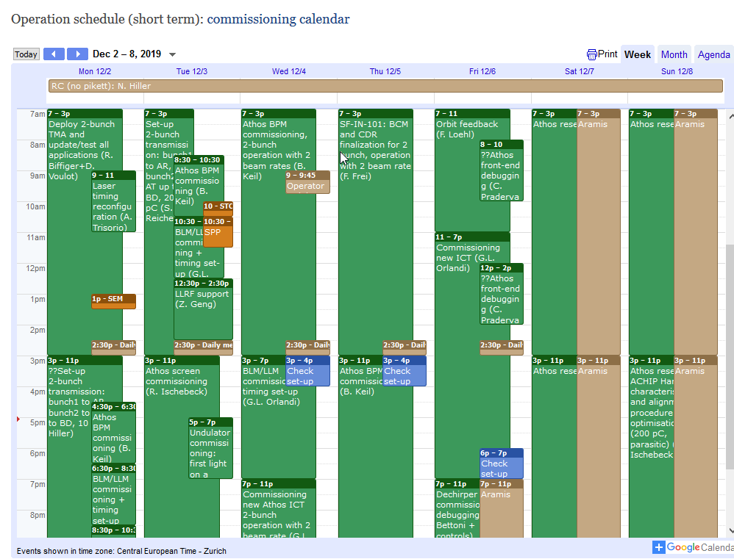
Commissioning plan for December
Detailed plan at https://intranet.psi.ch/Swiss_FEL/SFOperation
Main tasks (in order): 2 bunch operation → systems commissioning → emittance optimization → undulator commissioning and light generation
When possible: parallel beamline commissioning in Aramis
Notes:
32

Slide 33
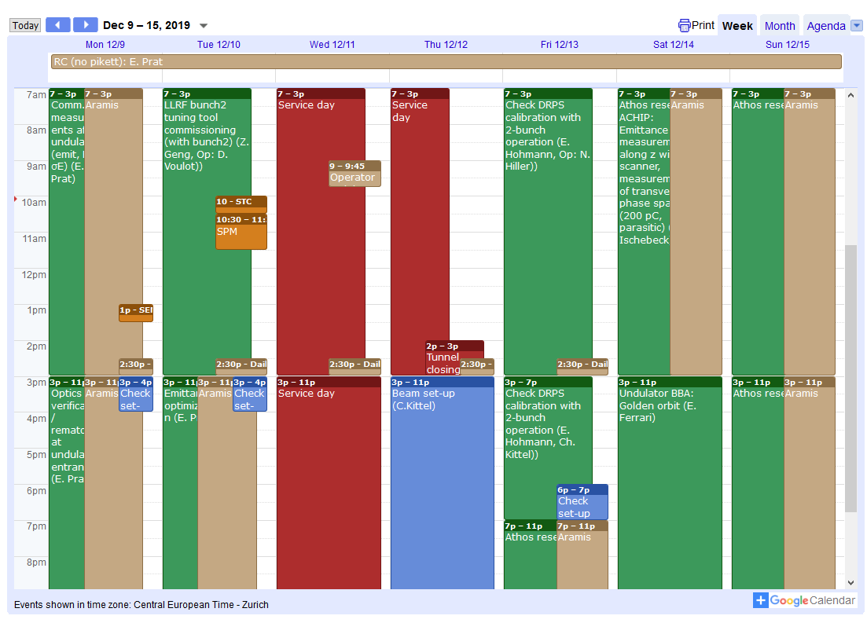
Possible extended shutdown in December
Shutdown on December 11-12 could start one day earlier to allow sufficient time for the installation of the 3rd undulator (it would be 2.5 days instead of 1.5 days).
We would need to reallocate the beam time.
We will know if the 3rd guy can go in in about a week.
Notes:
33

Slide 34
Athos commissioning workshops
First commissioning (1 February 2019) very successful!
Next commissioning workshop on 4 March 2020, save the date!
Notes:
34

Slide 35
Contents
Overview
Special hardware
Modes
Installation
Commissioning
Conclusion
Notes:
35

Slide 36
Conclusion
Athos will be a unique FEL facility offering many new operation modes.
Many components installed and ready to be commissioned, many delayed but on their way.
December commissioning: fundamental for independent 2-bunch operation and some systems (dechirper, undulator, CHIC, etc.)
2020: further commissioning. 2021: first users experiments.
Athos is a very exciting and challenging project requiring the constructive effort of all of us!
Notes:
36

Slide 37
Acknowledgments
Thanks to all the people involved in the Athos project!
Rafael Abela, Arturo Alarcon, Jürgen Alex, Christopher Arrell, Vladimir Arsov, Simona Bettoni, Markus Bopp, Christoph Bostedt, Hans-Heinrich Braun, Marco Calvi, Tine Celcer, Paolo Craievich, Andreas Dax, Philipp Dijkstal, Sladana Dordevic, Eugenio Ferrari, Uwe Flechsig, Rolf Follath, Franziska Frei, Nazareno Gaiffi, Zheqiao Geng, Christopher Gough, Nicole Hiller, Stephan Hunziker, Martin Huppert, Rasmus Ischebeck, Haimo Jöhri, Pavle Juranic, Roger Kalt, Maik Kaiser, Boris Keil, Christoph Kittel, René Künzi, Thomas Lippuner, Florian Löhl, Fabio Marcellini, Goran Marinkovic, Cigdem Ozkan Loch, Gian Luca Orlandi, Bruce Patterson, Claude Pradervand, Martin Paraliev, Marco Pedrozzi, Eduard Prat, Predrag Ranitovic, Sven Reiche, Colette Rosenberg, Stephane Sanfilippo, Thomas Schietinger, Thomas Schmidt, Kirsten Schnorr, Cristian Svetina, Alexandre Trisorio, Carlo Vicario, Didier Voulot, Ulrich Wagner, Hans Jakob Wörner, Adriano Zandonella, Luc Patthey and Romain Ganter
And some more!
Very useful reference: [R. Abela et al, JSR 26, 1073]
Notes:
37

