Slide 1
SwissFEL, Accelerator
Hans Braun, Paul Scherrer Institut
SwissFEL workshop spectroscopic experiments
University of Bern, 12.9.2011

Slide 2
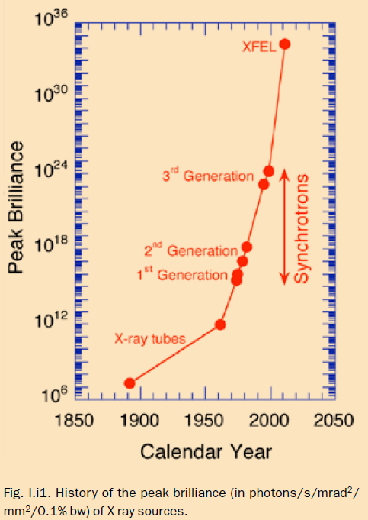
X-ray free electron lasers, XFELs
unprecedented
  time resolution
  beam brilliance
  coherence

Slide 3
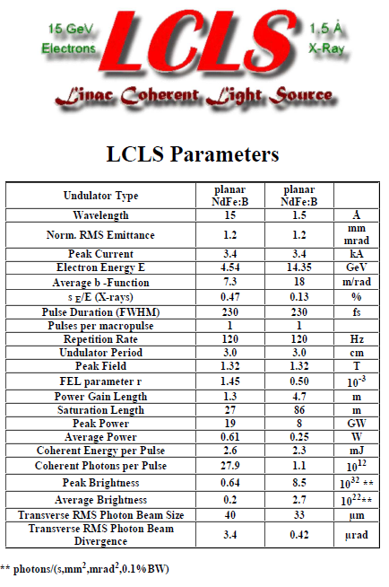
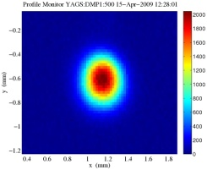
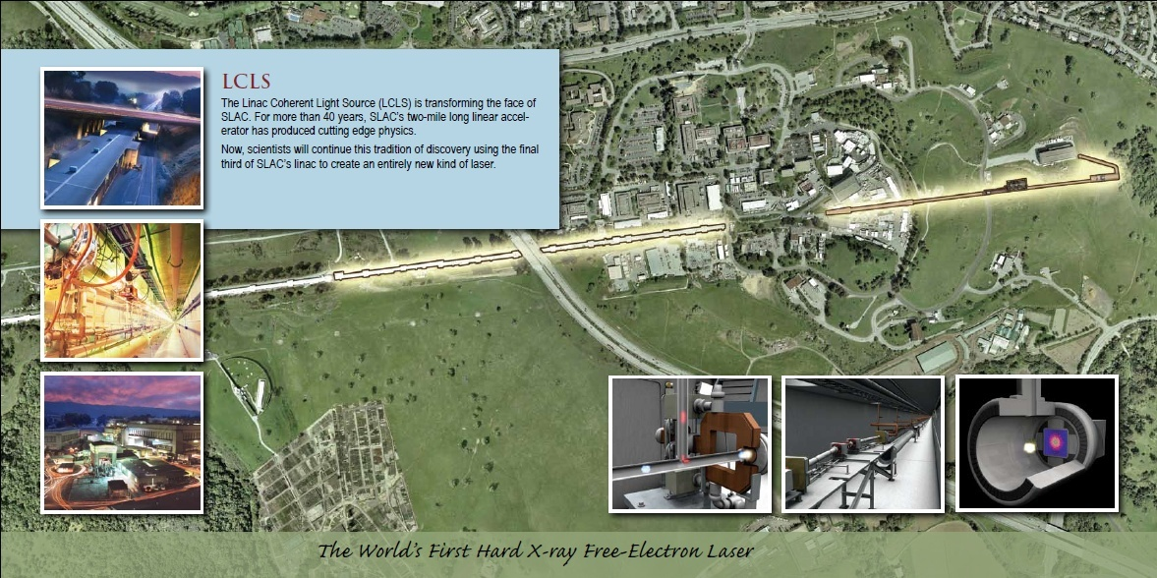
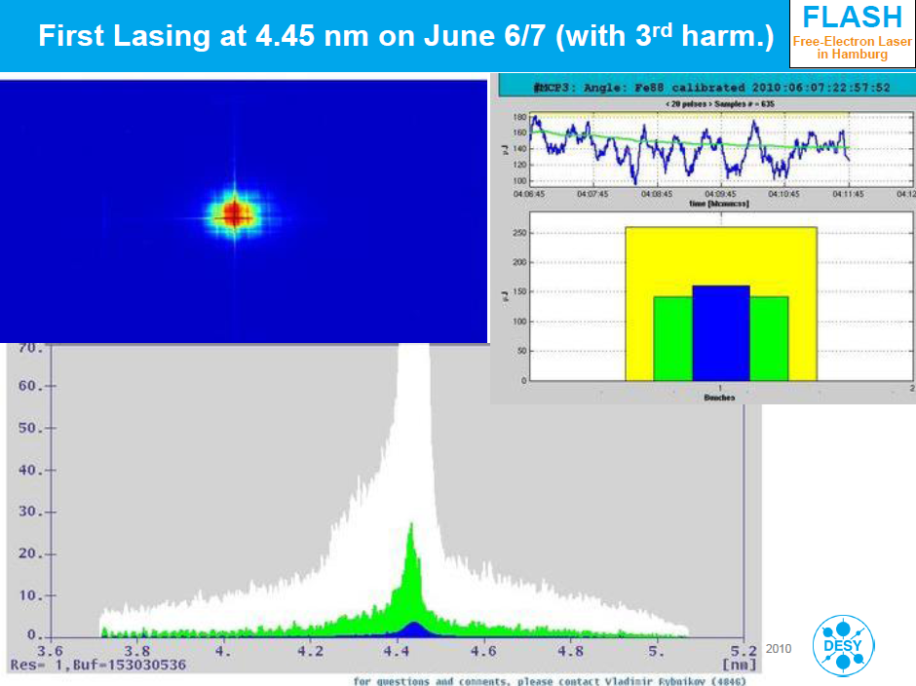
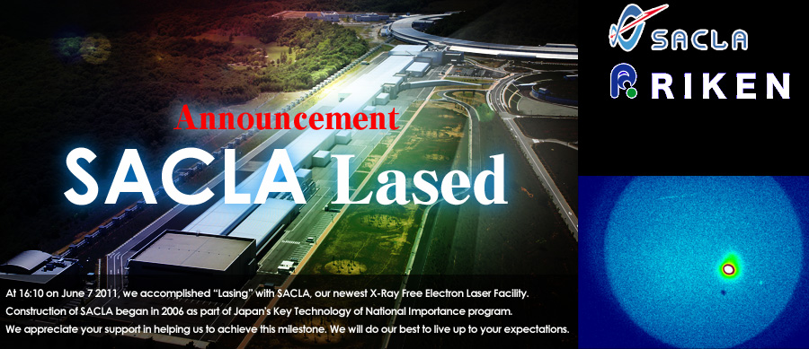
The young history of XFELs
10 April 2009,
first 1.5Å lasing !
6 June 2010
10 June 2011

Slide 4
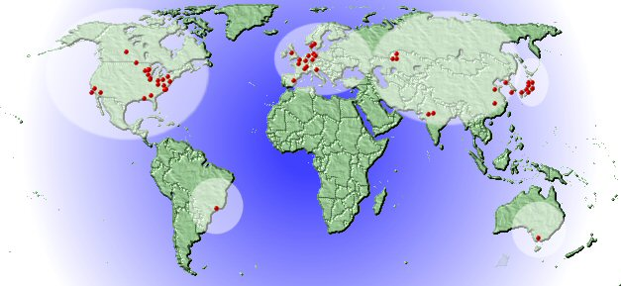
Rational for X-ray FELs
Worldwide >50 synchrotron for photon science
with ≈1000 user stations total
  wide range of applications in natural and material science
  attractive science portfolio of high brightness X-ray sources
Advantages X-FELs vs. synchrotron
  orders of magnitude higher peak brightness
  order of magnitude higher average brightness
  orders of magnitude better time resolution
  almost 100% transverse coherence
  vast scientific potential in uncharted territory
World map of SR storage rings
  Difficulties X-FELs vs. SR storage rings
    less integrated photon flux
    less beamlines/facility
    less stable beam intensity
    much higher cost per user station

Slide 5
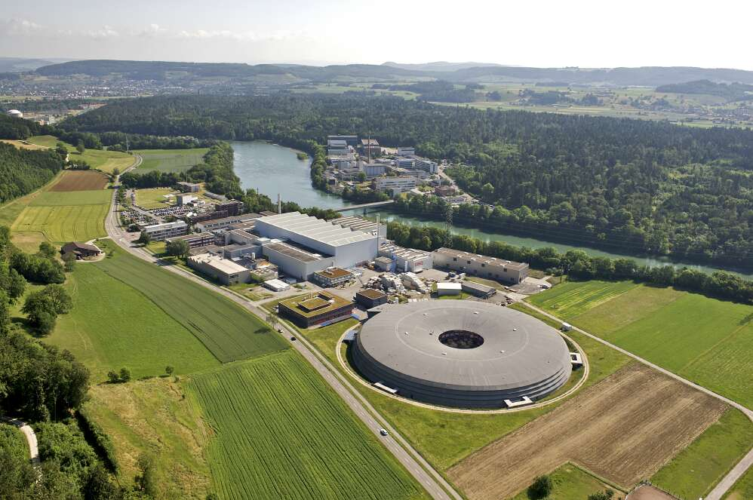
Paul Scherrer Institut
black forest
Hotlab
Energy-research
Nanotechnology
Aare river
Solar concentrator
Radio-Pharmacy, Chemistry
SINQ
spallation
neutron source
Biology
Proton-accelerators
SwissFEL
injector test facility
μ Spin resonance facility
Protontherapy
SLS
synchrotron
light source
Key figures 2009
Staff ≈ 1350
PhD students ≈ 300
Budget ≈ 300 MCHF
Publications ≈ 900/y

Slide 6
SwissFEL Rational
Strong interest in Swiss science community for
molecular ultrafast science and technology
⇒ X-ray FEL provides great research opportunities in uncharted territory
LCLS/Stanford and European XFEL/Hamburg will not provide enough beam time for users in general and for Swiss users in particular
Europe has with FLASH and FERMI@ELETTRA some coverage for soft X-ray FEL’s
X-ray FEL with hard X-rays reach and superb time resolution
λ = 0.1 - 7 nm and σ_{t} < 10 fs
E_{ph}= 0.2 - 12.4 keV
ideal complement of PSI’s existing research facilities!
⇒

Slide 7

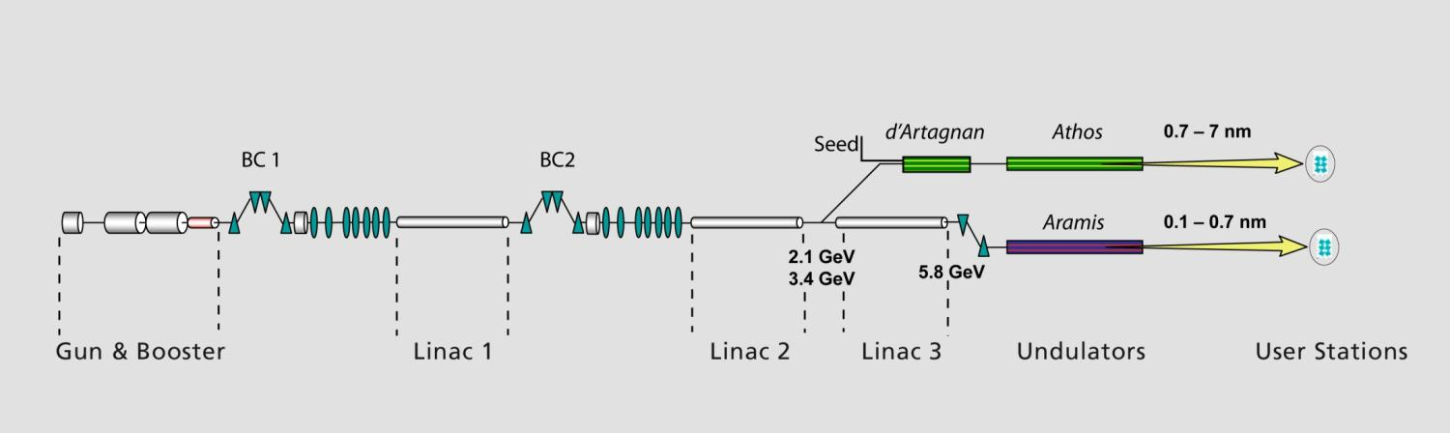
SwissFEL
Phase 1, 2012-16
Phase 2, 2017-19
715 m
  SwissFEL parameters
  Wavelength from 1 Å - 70 Å
  Photon energy 0.2-12 keV
  Pulse duration 1 fs - 20 fs
  e⁻ Energy 5.8 GeV
  e⁻ Bunch charge 10-200 pC
  Repetition rate 100 Hz
Aramis:
1-7 Å hard X-ray SASE FEL,
In-vacuum , planar undulators with variable gap.
User operation from mid 2017
Athos :
(2nd phase)
7-70 Å soft X-ray FEL for SASE & Seeded operation .
APPLE II undulators with variable gap and full
polarization control.
User operation end 2019?

Slide 8
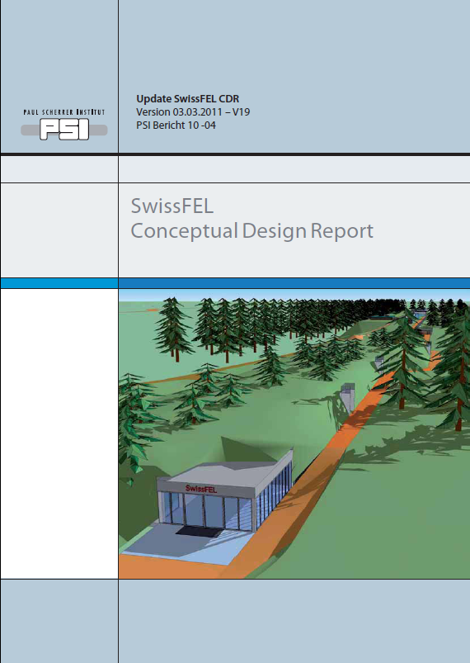
CDR
http://www.psi.ch/swissfel/

Slide 9
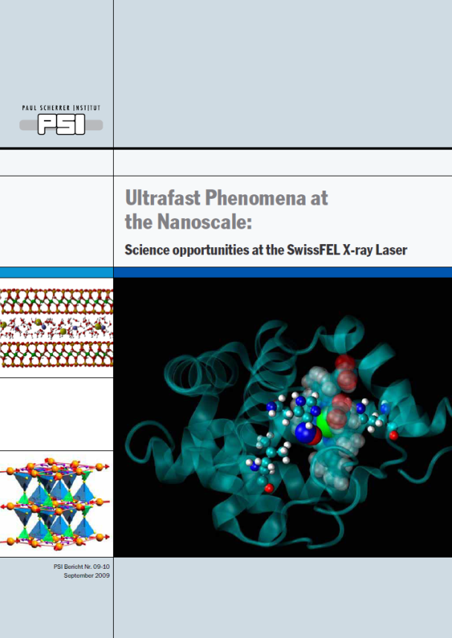
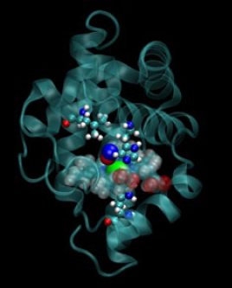
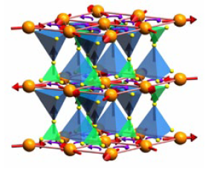
SwissFEL Science Case
Magnetism: materials and processes for tomorrow‘s information technology
Catalysis and solution chemistry: for a clean environment and a sustainable energy supply
Coherent diffraction: flash photography of matter
PDF of science report at
http://fel.web.psi.ch/
Biochemistry:
shedding light on the prpcesses of life
Correlated electrons:
the fascination of new materials

Slide 10
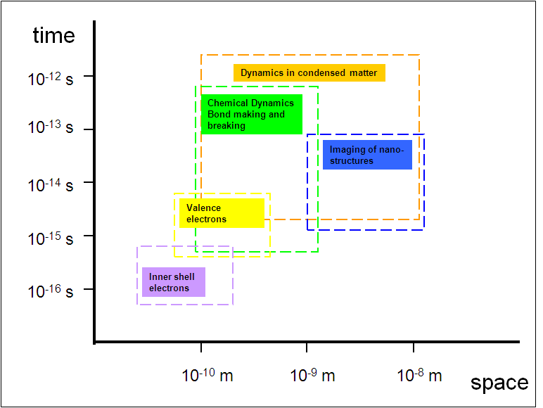
SwissFEL
pulse-
length
range
SwissFEL wavelength range
⇒ X-ray FEL allows for flash images on time scale of fastest chemical processes

Slide 11
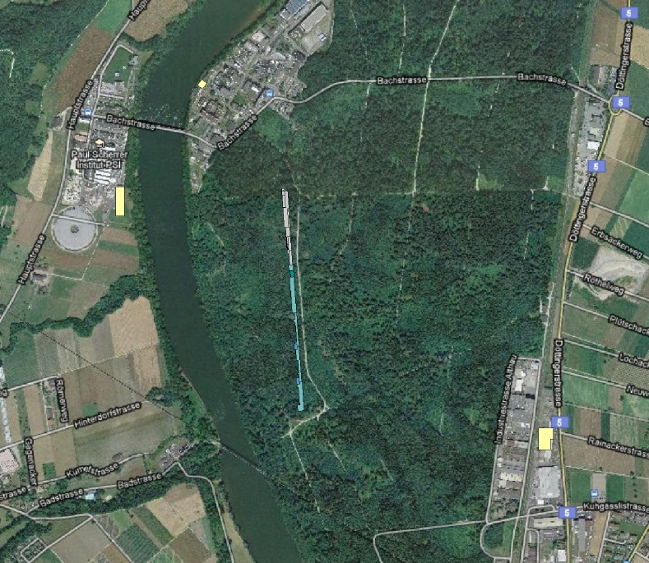
Construction site
PSI-East
PSI-West
SwissFEL
715m
Aare river

Slide 12
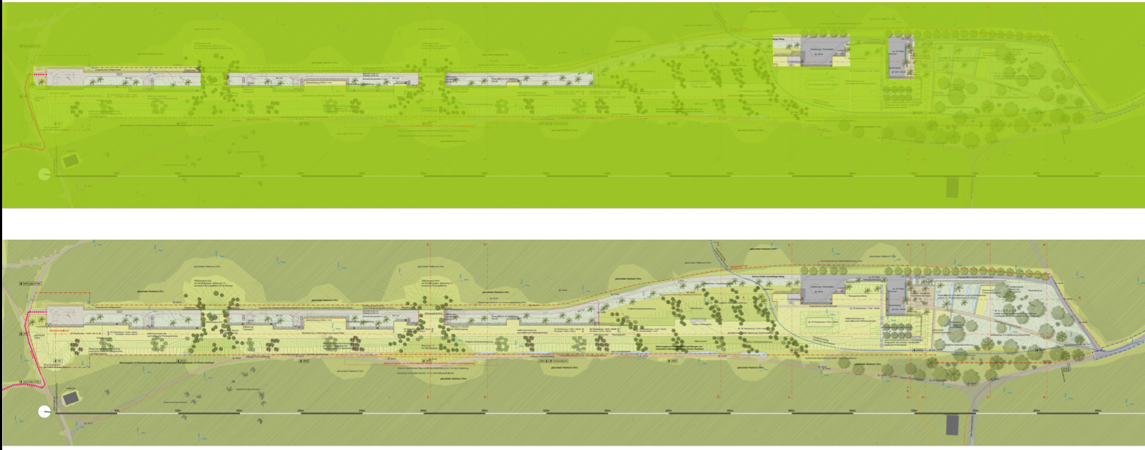
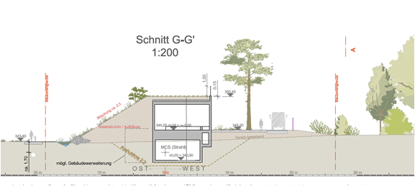
Building cont.
G-G‘
Linac
Injector
Exp.Hall
Undulator hall
Surface areas not accessible by wild game

Slide 13
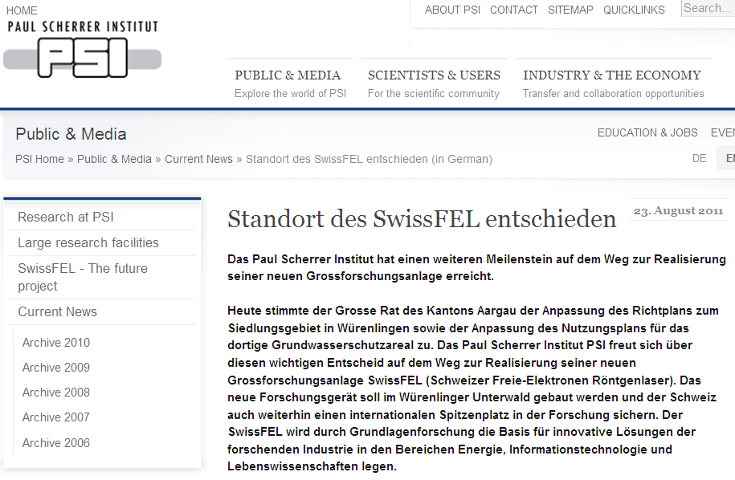

Slide 14
special funds
CH government
and ETH domain
next ETH domain
financing period
postponed 1y
1 year delay
½ year delay
Only critical path components included !

Slide 15
Layout and recent design change
FEL-PM06-121-03

Slide 16
SwissFEL wide range of capabilities in a single facility economic design
 | LCLS | Eu-XFEL | SACLA | FLASH I & II | FERMI | SwissFEL
Shortest wavelength reach (fundamental) | 0.15nm | 0.05 nm | 0.1 nm | 4 nm | 4 nm | 0.1 nm
Soft X-ray circ. Polarization | no | no | no | no | yes | yes
Variable gap | no | yes | yes | yes (FLASH II) | yes | yes
Soft X-ray seeding | no | no | no | yes (FLASH II) | yes | yes
RF Rep. rate | 120 | 10 | 60 | 10 | 10 (50) | 100
FEL pulses/RF pulse | 1 | 2700 | 1 | 2700 | 1 | 2
independent THz source in Exp. hall | no | no | no | no | no | yes
peak current | 3 kA | 5kA | 3 kA | 2.5 kA | 0.75 kA | 2.7 kA
max. bunch charge | 0.25 nC | 1 nC | 0.2 nC | 1 nC | 0.25nC | 0.2 nC
max. electron energy | 13.6 GeV | 17.5 GeV | 8 GeV | 1.2 GeV | 1.5 GeV | 5.8 GeV
No. RF stations | 81 | 29 | 69 | 5 | 15 | 31
Facility length | 1.7km | 3.4 km | 0.8km | 0.32 km | 0.5 km | 0.7km
Start operation | 2009 | 2014 | 2011 | 2005 / 2013 | 2010 | 2016

Slide 17
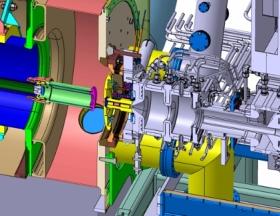
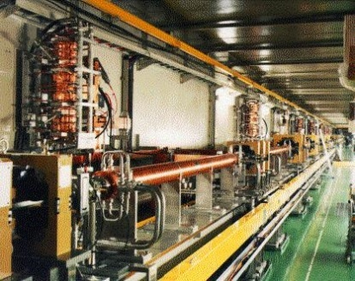
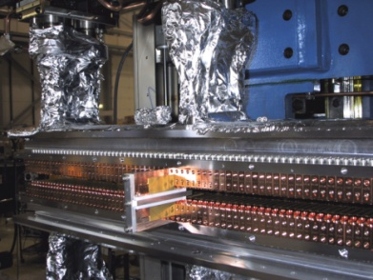
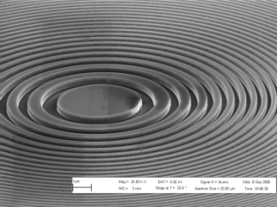
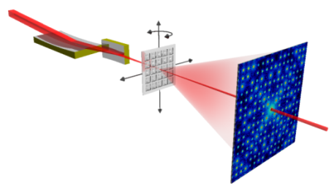
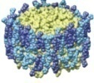

R&D issues for SwissFEL
Generation of
high brightness
electron beam
Electron beam
acceleration
X-ray transport
and focusing
X-ray generation
with FEL process
Electron gun
Linear accelerator
Undulator
Experiments
Maximize
e⁻ beam
brilliance
Minimize
€ / GeV
Minimize
period length λ_{u}
for const. K ∝ B∙λ_{u}
High quality
X-ray optics
in presence of
high power density

Slide 18
R&D activities for SwissFEL
Low emittance injector
Linac technology
In-vacuum PM undulators for ARAMIS hard X-ray FEL
Apple II PM undulators for ATHOS soft X-ray FEL
fs resolution synchronization and LLRF
Electron beam diagnostics on μm scales
TiSa Laser for photo-cathodes and FEL seeding
X-ray focusing
X-ray detector
FPGA boards for high control system performance and fast data pre-processing

Slide 19
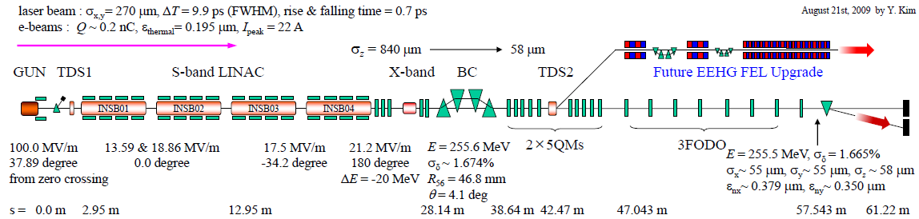
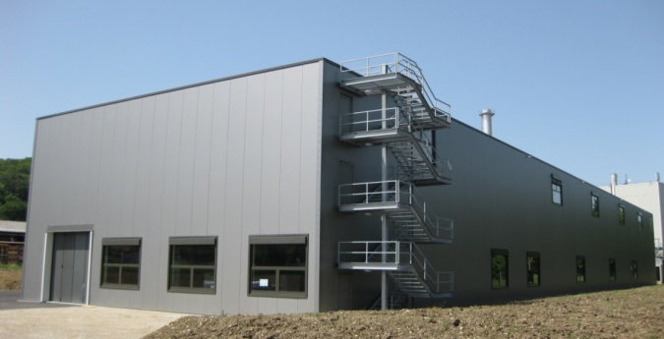
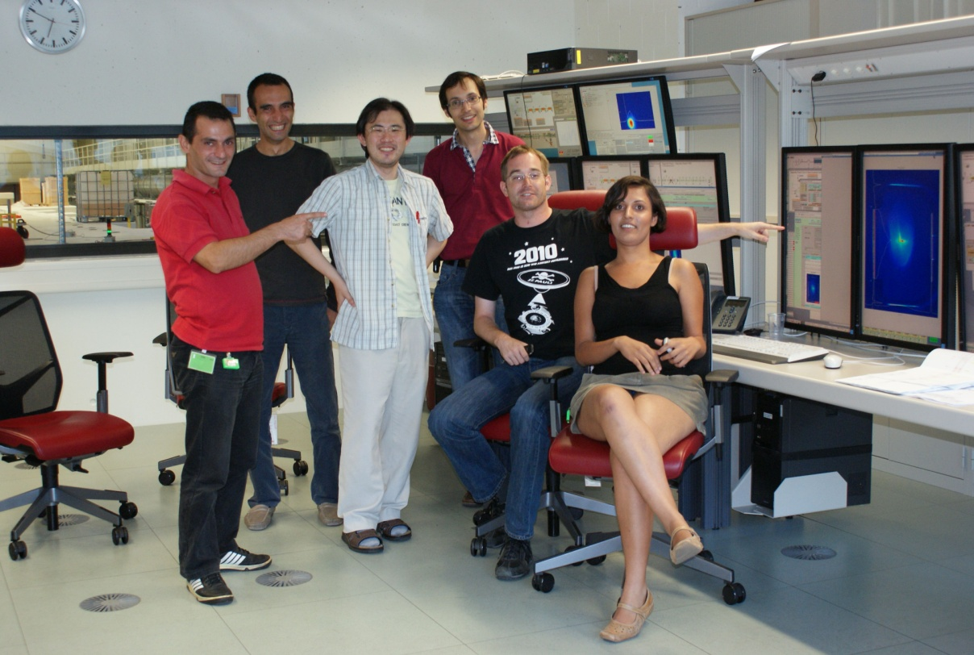
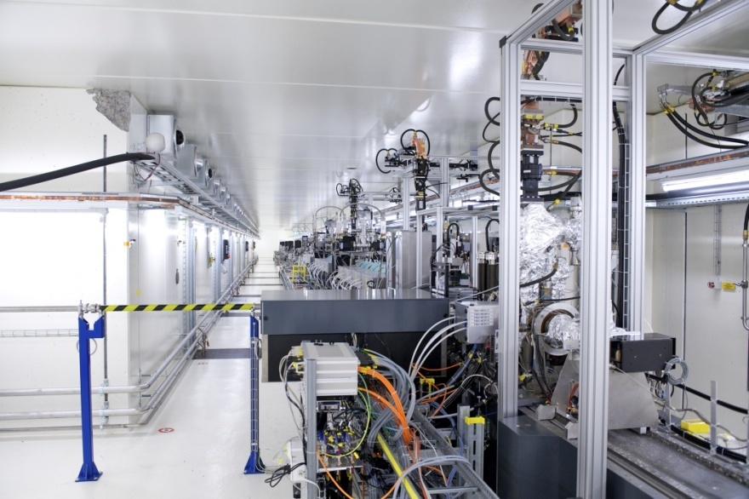
SwissFEL injector, inaugurated 24.8.2010
Injector building
Commissiong crew with first beam
Beamline seen from gun end

Slide 20
SwissFEL injector overview
Phase 1: Electron source and diagnostics
  March 2010 to June 2010
  Characterization of the electron source
Phase 2: Phase 1 + (some) S-band acceleration
  August 2010: inauguration phase
  October 2010 to Summer 2011
  Emittance damping in S-band booster (invariant envelope)
Phase 3: The full machine
  Summer / Fall 2011 (installation bunch compressor and X-band cavity)
quadrupole
BPM+screen
screen
TDC
streak RF cavity
Seeding ?
Phase 4? Seeding experiments?
∙ From 2013?

Slide 21
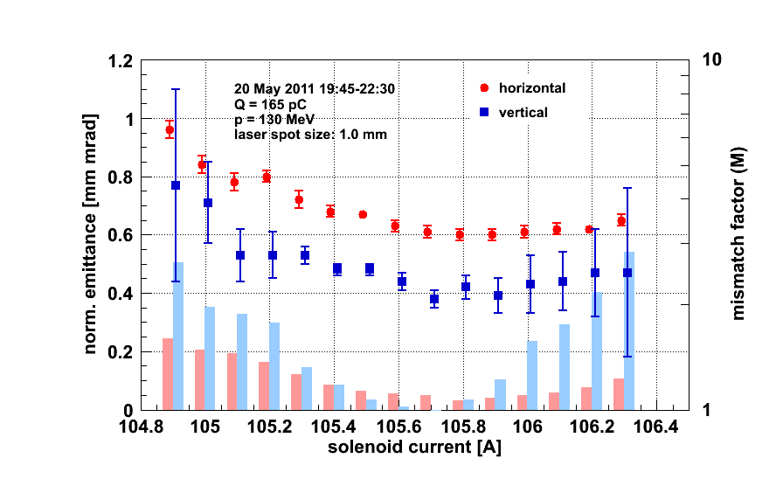
Status emittance from SwissFEL injector
 | achieved | goal
Projected emittance | 0.4/0.6 μm for 165 pC | ≤0.5 μm for 200 pC
Slice emittance | Not measured | ≤0.4 μm for 200 pC
Charge limited by legal not technical reasons !
Asymmetry misalignment + transv. Wakefields ?

Slide 22
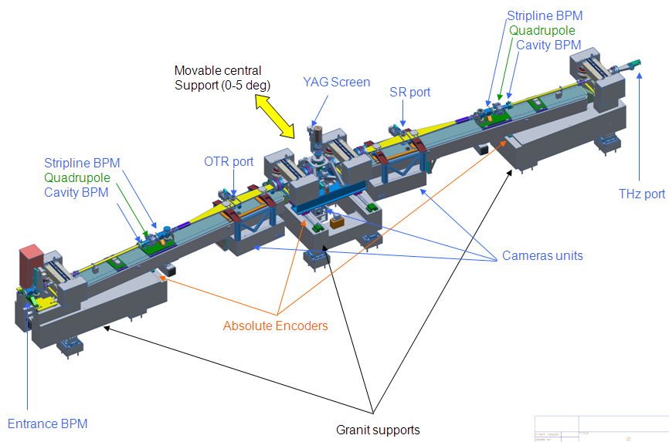
Bunch compressor (installed July-August 2011)
⇒ fs regime e⁻-beam bunches

Slide 23
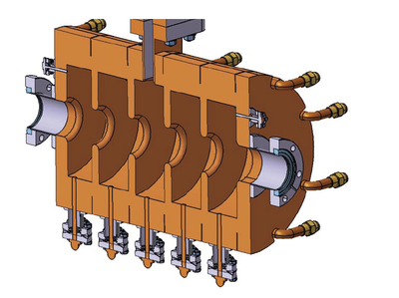
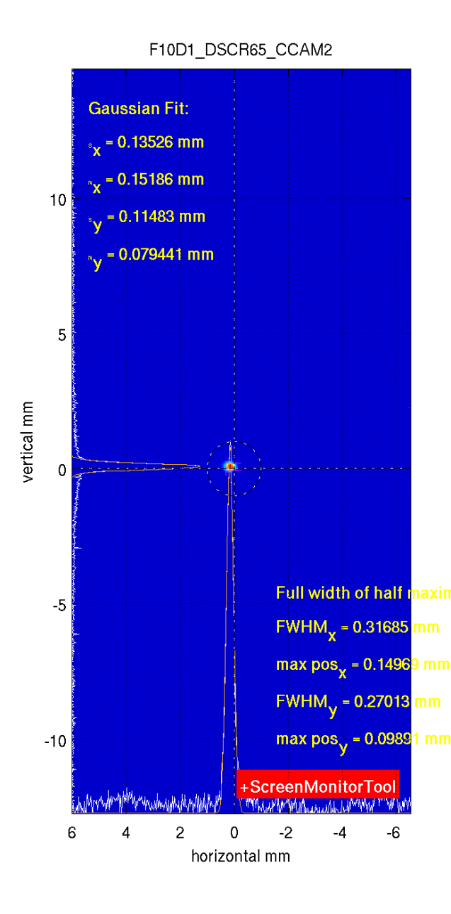

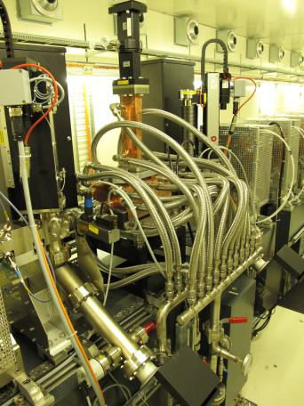
Transverse deflecting streak cavity installed and commissioned
⇒ measuring e⁻ beam in fs regime
TDC-OFF:
TDC-ON (0.13 MW)
TDC
made by INFN Frascati
Beam position (mm)

Slide 24
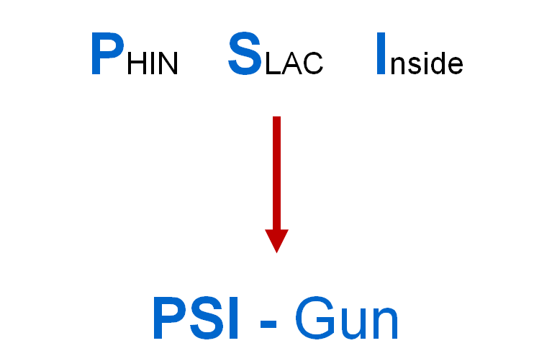
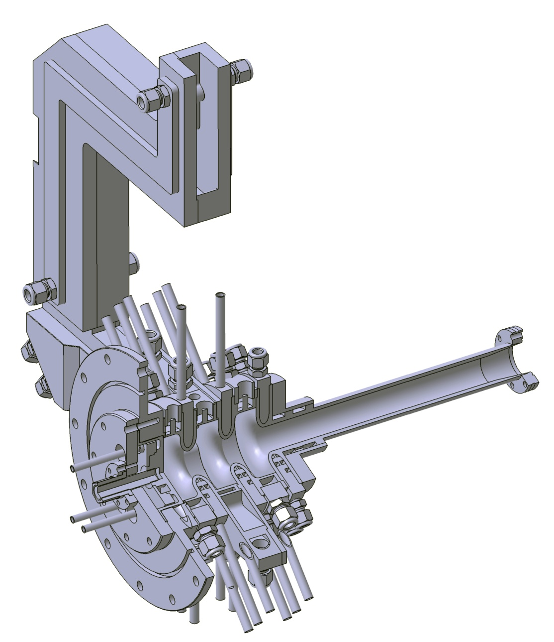
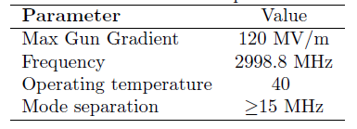
Repetition rate : 100 Hz
Symmetric Feeding in Central Cell
No Cathode Plug – reduce dark current
Racetrack shape – reduce quad components
Elliptical iris – minimize surface fields
Large iris thickness – mode separation

Slide 25
Summary of achieved and projected injector brightness
Diode – RF Photogun:
0.55 mm.mrad at 180 pC; Diode gradient ~ 100 MV/m
Repetition rate limited to 2 Hz; alignment more complex
1 MV pulser would be required for larger anode iris
B_{n}= 7.4 A.mm⁻².mrad⁻²
SwissFEL Current RF Photogun (CERN Gun):
Robust emittance measurement method; 0.5 mm.mrad at 180 pC
Optimization of laser profile and optics setting on going
B_{n}= 14.2 A.mm⁻².mrad⁻²
SwissFEL Future RF Photogun :
2.5 Cell; Racetrack; 100 Hz
Optimization of dimensions, operation scheduled for 2013
B_{n,goal}= 33 A.mm⁻².mrad⁻²
SwissFEL baseline requirement B_{n}= 19 A.mm⁻².mrad⁻²

Slide 26
Seeding experiment ?
Time slot for experiment 2013-14
Goal is an optimized seeding scheme for ATHOS with λ=1nm reach
Ressource conflicts with simultaneous SwissFEL construction
Discussion with DESY on possible participation
Decision needed before Q4, 2011
SwissFEL undulator BPM
Standard motorized undulator quad support
Yag + OTR. High sensitive camera
EEHG (harmonic gen. with e beam)
Seeding modes HHG (harmonics gen. with laser)
hybrid (mixed harm. Gen.)
Demonstrate FEL lasing 52 nm (5th harmonic)
Bunching 5.2 nm (50th harmonic)
Yag + OTR & Photo diode (rough overlap)
SwissFEL undulator quadrupole
Yag & photo diode (rough overlap)
OTR – Wire scan
Yag + OTR
Alignment quads
Yag & photo diode (rough overlap)
In line Beam stopper
Permanent magnet dipole
HHG 50 nm laser port
CSR 5-50 nm
First optic element
260 nm seed laser
260 nm γ Diag.
Laser coupling
Modulator 1
λ_{u}=50mm
(8 periods) horizontal
CHICANE 1
Max 5 deg
Modulator 2
λ_{u}=50mm
(8 periods) vertical
CHICANE 2
Radiator undulator
15mm period
4m (266 periods)
Courtesy of M. Pedrozzi
Chamber
φ=38 mm
SwissFEL linac vacuum chamber internal φ=16 mm
SwissFEL linac Quads - SwissFEL BPM + transv. Monitors
4 Dipoles to be reused for laser heater
Transition to φ=8 mm
Present chamber
Integration in FODO section not mandatory since multi knobs for emittance measurement

Slide 27
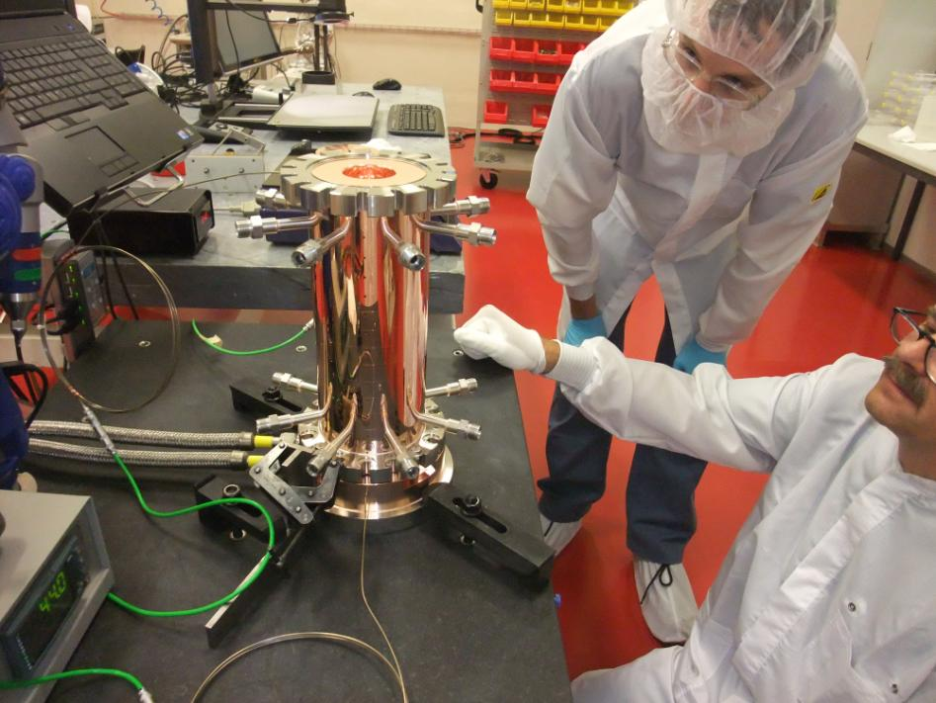
First C-Band short prototype structure in AMI workshop

Slide 28
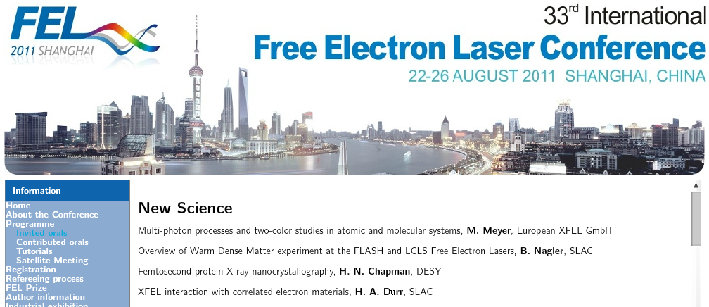

Slide 29
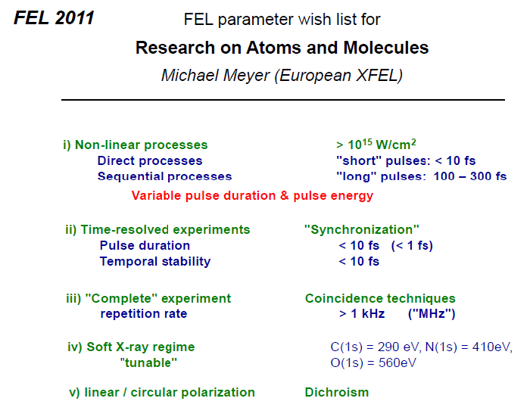
Wish lists from FEL’11 science session I

Slide 30
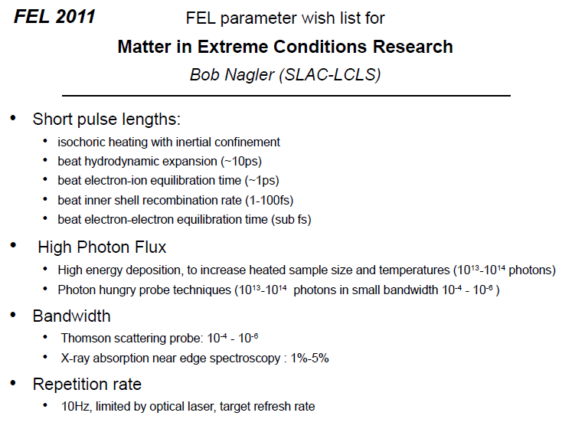
Wishlists from FEL’11 science session II

Slide 31
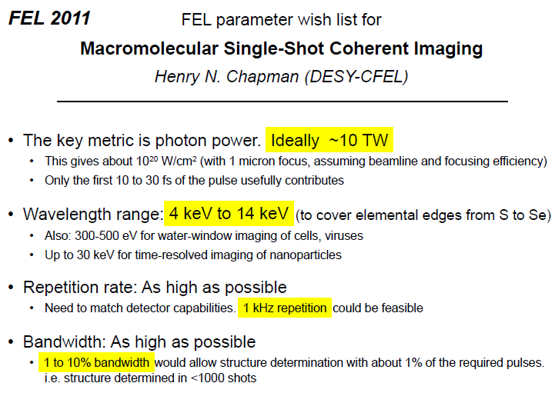
Wishlists from FEL’11 science session III

Slide 32
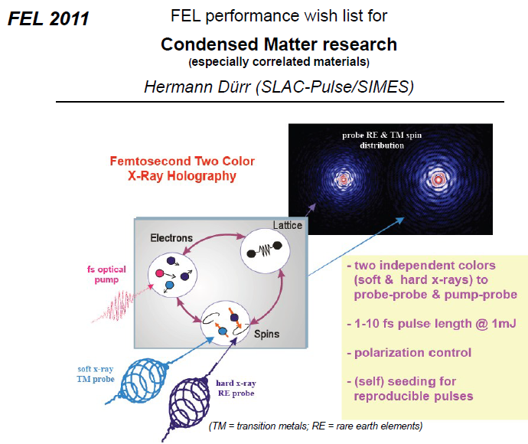
Wishlists from FEL’11 science session IV

Slide 33
