Slide 1

Letter of Intent:
Search for Neutron to Mirror-Neutron Oscillations
Nicholas Ayres
28 January 2020
PSI BV51 Open Users Meeting

Slide 2
Overview
Motivation
Experimental Landscape
Principle of Proposed Experiment
Sensitivity Reach

Slide 3
Motivation: The Mirror World
Proposed by Lee & Yang (1957) to restore Parity in the weak sector
For every left-handed SM particle, add a right-handed mirror particle
Interesting cosmologically
  Viable DM Candidate [1]
  Consequences for high energy cosmic rays [2,3]
Feebly coupled to SM
Mass degenerate with ordinary matter
  Implies maximal mixing in the vacuum
  Search channel: look for anomalous disappearance of neutrons
  Degeneracy can be lifted by magnetic fields and mirror magnetic fields
[1] Z. Berezhiani Int. J. Mod. Phys. A 33, 31 (2018) 1844034
[2] Z. Berezhiani, L. Bento PLB 635 (5-6) (2006) 253-259
[3] Z. Berezhiani, A. Gazizov EPJC 72 (8) 2111 (2012)

Slide 4
Experiments up to 2009
Experiments by PSI nEDM Collaboration[1,2,3] & Serebrov et. al. [4,5]
Initial focus on case B’ = 0 [1,2,4]
Compare storage time with B=0 to large B
  Best limit τ > 448s [5]
Limited consideration of nonzero B’ ≠ 0 [3,5]
  Look for sidereal signal if mirror matter is not bound to Earth
  Look for resonant enhancement at B≈B’
Each experimental collaboration reported a null result
[1] G. Ban et al. PRL 99 (2007) 161603
[2] K. Bodek et al. NIM A 661 (2009) 141-143
[3] I. Altarev et al. PRD 80 (2009) 032003
[4] A.P. Serebrov et al. PLB 663 (2008) 181-185
[5] A.P. Serebrov et al. NIM A 611 (2009) 137-140

Slide 5
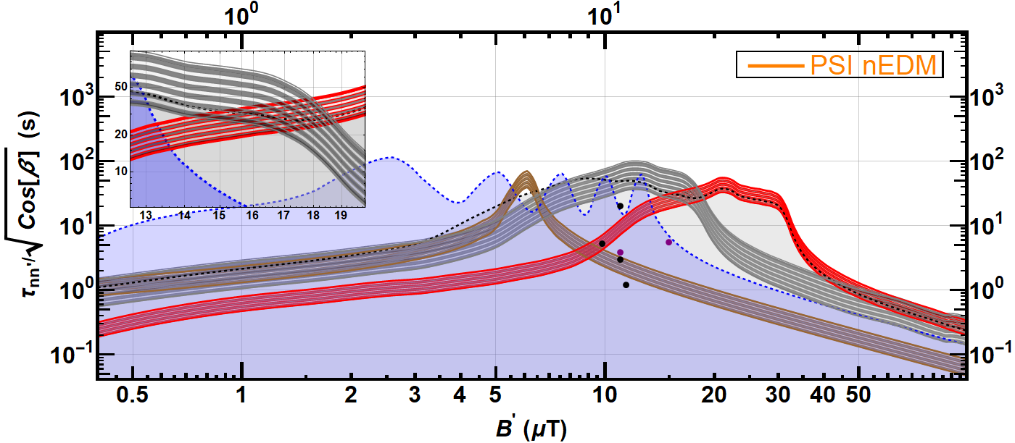
The Berezhiani-Nesti Signal
External reanalysis [1] of data taken using apparatus of [2] revealed 5.2 σ dependence of neutron loss on B direction
  Further consideration of the B field conditions in [2] resulted in revised signal regions [3]
  A further experiment [3] found a 2.5 σ discrepancy
Points indicate 2009 & 2012 preferred regions
Red: 2σ region indicated by original 5.2σ anomaly [2], as revised in [3]
Brown: 2σ region (from [3]) indicated by 3σ anomaly in [4]
Grey: 2σ region indicated by 2.5σ anomaly in [3]
Blue: exclusion by [5] (PSI nEDM)
Figure Courtesy P. MohanMurthy
[1] Z. Berezhiani, F. Nesti Eur. Phys. J. C (2012) 74:1974
[2] A.P. Serebrov et al. NIM A (2009) 611,141
[3] Z. Berezhiani et al. Eur. Phys. J. C (2018) 78:717

Slide 6
The 2017 PSI Measurement
Aim: Test the signal regions proposed in 2012 [1]
45 days of datataking using PSI nEDM Apparatus
  Chamber ~21L volume, t_{s}=180s, 380s, typical 11-14k UCN after 380s
  B = 10 μT tuned to match signal regions, B = 20 μT to capture high B’ with long tail
  Normalisation of initial UCN
Partly excluded several regions of interest [2]
Interesting parameter space remains, including revised and new regions of interest [3]
[1] Z. Berezhiani, F. Nesti Eur. Phys. J. C (2012) 74:1974
[2] PhD Thesis P. MohanMurthy; C. Abel et al. EPJ Web of Conferences 219, 07001 (2019)
[3] Z. Berezhiani et al. Eur. Phys. J. C (2018) 78:717

Slide 7
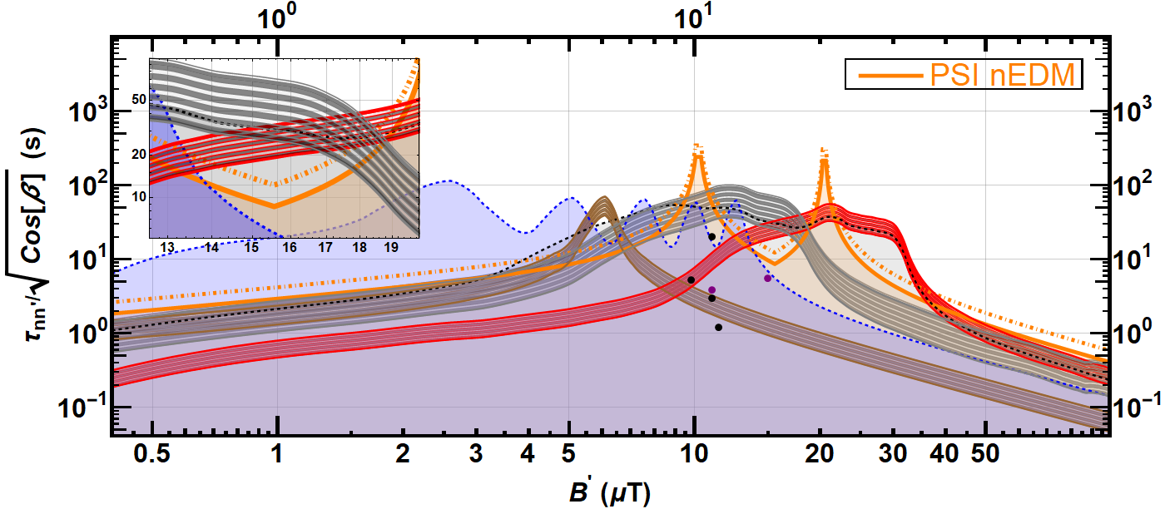
What are the remaining interesting regions?
Orange: exclusion from PSI nEDM 2017 Measurement [1]
Region (from [3]) from 3σ anomaly in [4]
Overlap region still allowed
Region from original 5.2σ anomaly [2], revised in [3]
Region from 2.5σ anomaly in [3]
Excluded [5]
Original “signals” excluded [2]
[1] PhD Thesis P. MohanMurthy; C. Abel et al. EPJ Web of Conferences 219, 07001 (2019)
[2] Z. Berezhiani, F. Nesti Eur. Phys. J. C (2012) 74:1974
[3] Z. Berezhiani et al. Eur. Phys. J. C (2018) 78:717
[4] G. Ban et al. PRL 99, 161603 (2007)
[5] I. Alterev et al. PRD 80 (3) (2009) 032003
Figure preliminary, from PhD Thesis P. MohanMurthy, updated from LOI fig 1

Slide 8
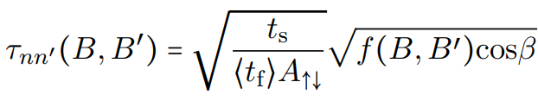
Principle of Experiment
Initial sensitivity goal: exclude τ<100s up to B’=100 μT
Store UCN in a material trap in known magnetic field
Compare loss rate with B up versus B down
Storage time
Angle between B’ and B
Oscillation time
Lineshape, peak at B’=B
Mean free time
Asymmetry B up vs down

Slide 9
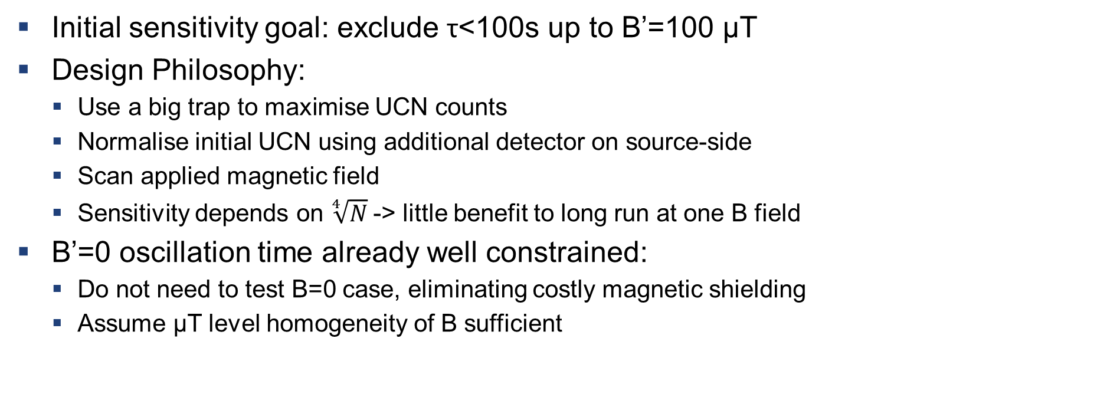
Principle of Experiment
Initial sensitivity goal: exclude τ<100s up to B’=100 μT
Design Philosophy:
  Use a big trap to maximise UCN counts
  Normalise initial UCN using additional detector on source-side
  Scan applied magnetic field
  Sensitivity depends on $\sqrt[4]{N}$-> little benefit to long run at one B field
B’=0 oscillation time already well constrained:
  Do not need to test B=0 case, eliminating costly magnetic shielding
  Assume μT level homogeneity of B sufficient

Slide 10
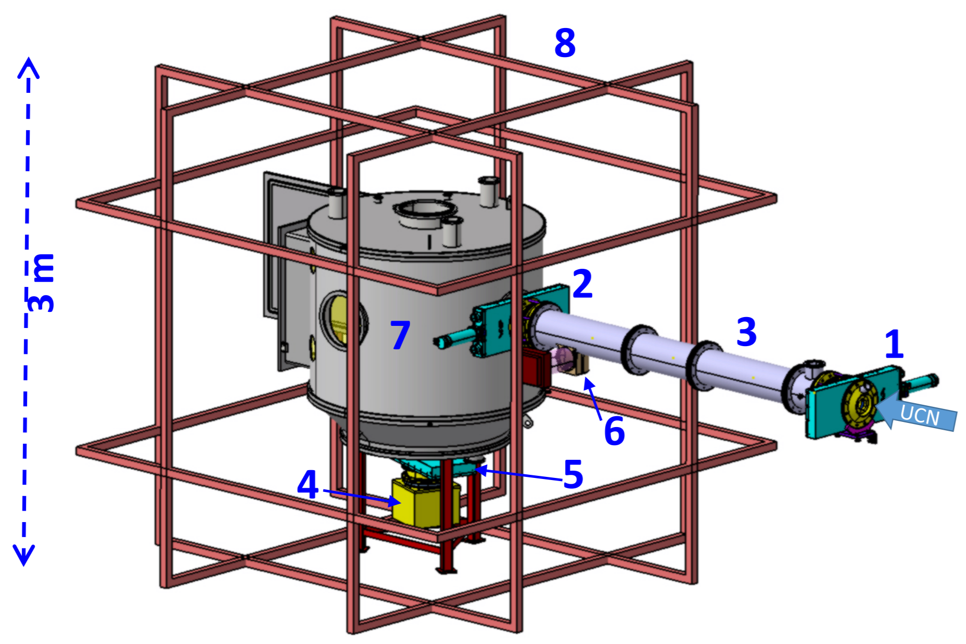
Principle of Experiment
Vacuum Tank Containing Storage Vessel
Coil System
UCN monitor detector to normalise initial counts
Shutters
Detector

Slide 11
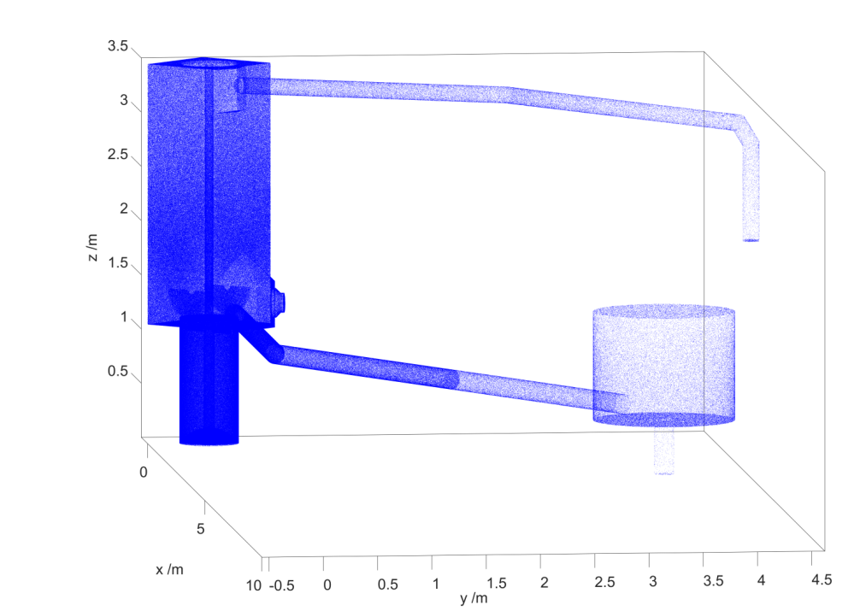
MC Simulations
Simulation of source & experiment with MCUCN [1]
  Benchmarked & calibrated against many measurements
  Conservative assumptions of loss rates
800’000 UCN after 400s storage
Also get <t_{f}> as input for analysis
[1] G. Zsigmond NIM A 881(2018)16-26

Slide 12
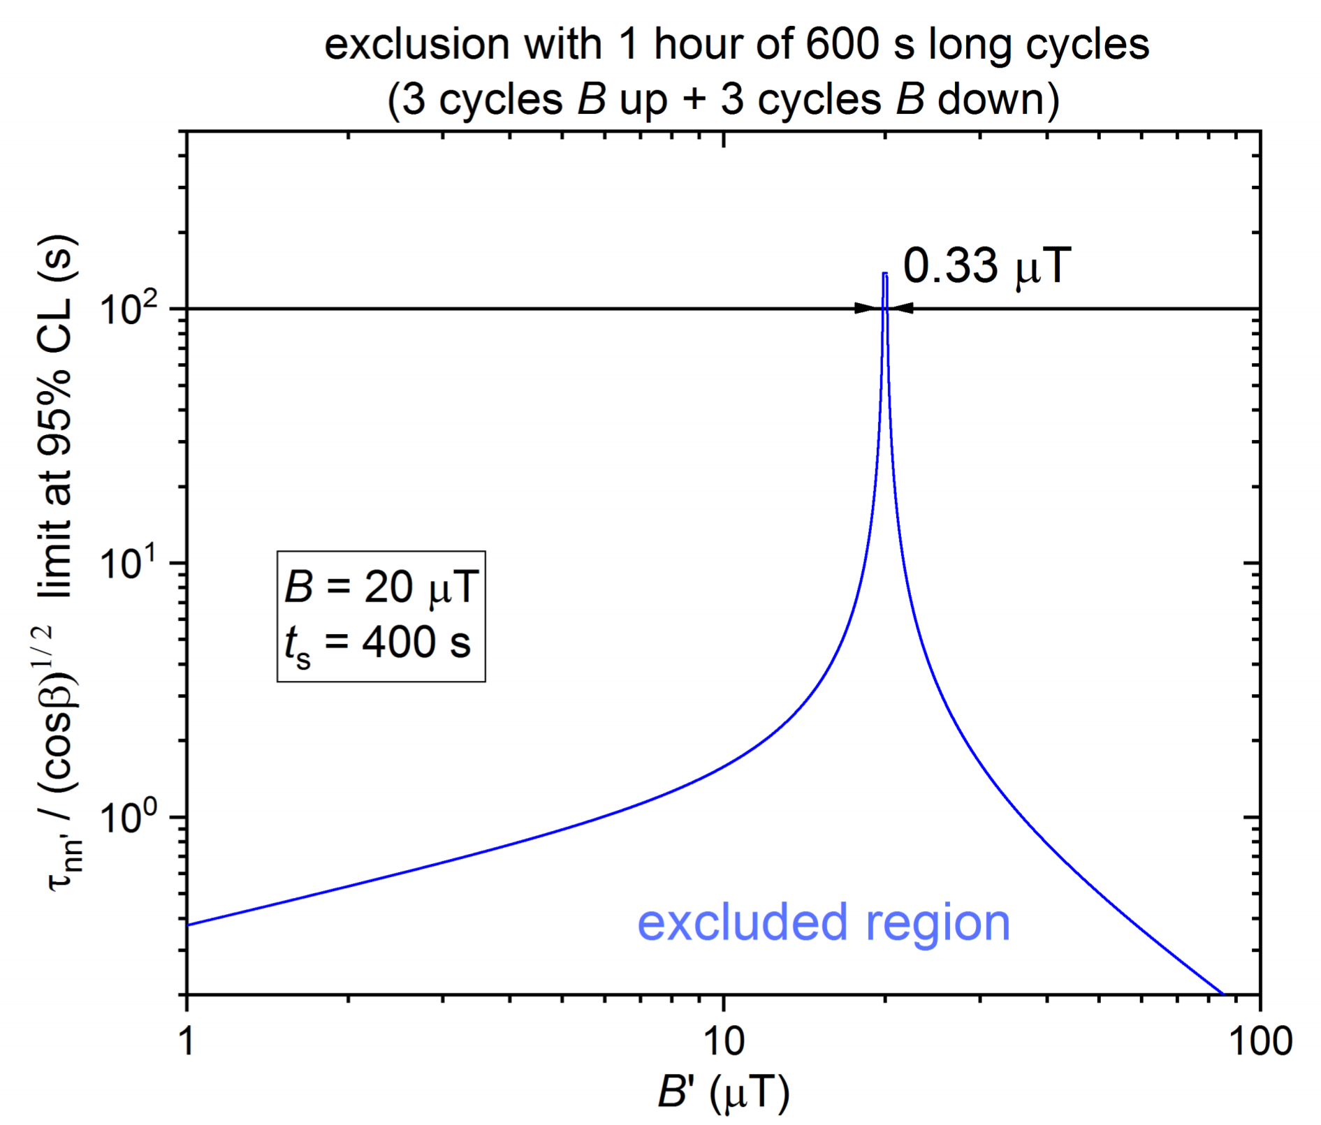
Sensitivity Reach
Goal: exclude τ_{nn’} <100s from B’=0 to B’=100 μT
Right: Computed exclusion for one hour of running at one B
Concept: perform many measurements and scan B from 1-100 μT
  Can cover 50 μT in 152 hours datataking

Slide 13
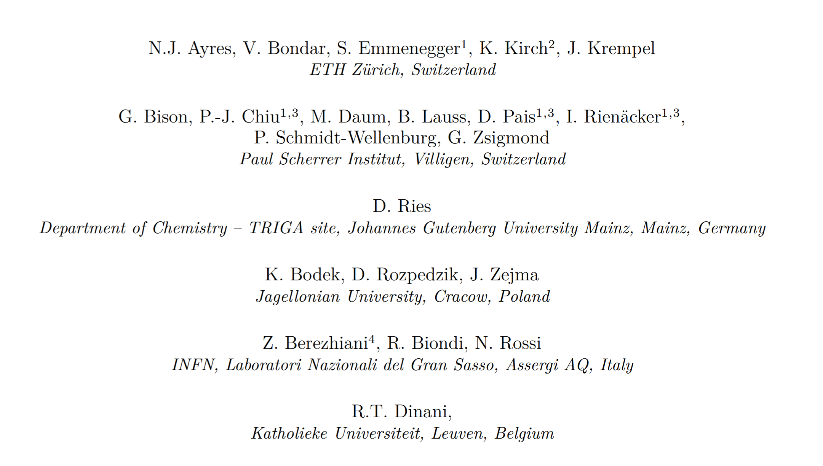
The Collaboration
Substantial overlap with nEDM collaboration
  Experience with similar experiments
  Much hardware already exists

Slide 14
Summary
Mirror particles can explain several physical phenomena [1-3]
Statistically significant anomalies found in previous experiments [4,5]
Simple experiment using existing technology can exclude or confirm claimed signals
[1] Z. Berezhiani Int. J. Mod. Phys. A 33, 31 (2018) 1844034
[2] Z. Berezhiani, L. Bento PLB 635 (5-6) (2006) 253-259
[3] Z. Berezhiani, A. Gazizov EPJC 72 (8) 2111 (2012)
[4] Z. Berezhiani, F. Nesti Eur. Phys. J. C (2012) 74:1974
[5] Z. Berezhiani et al. Eur. Phys. J. C (2018) 78:717

Slide 15
Backup

Slide 16
Mirror Neutrons & Neutron Lifetime puzzle
Long standing discrepancy between neutron lifetime measured by beam vs bottle experiments
Beam: Start with known neutron flux, count decay products
Bottle: Count neutrons surviving after different storage times
In some scenarios oscillation of neutrons into mirror neutrons could explain the discrepancy
  Tension with recent measurements of g_{A} [e.g. Czarneki et al. PRD 100, 073008 (2019)]

Slide 17
Competing & Complementary Experiments
Neutron Regeneration Experiment discussed: search for n->n’->n [1]
Many experiments to measure the neutron lifetime
  New experiments using conventional and magnetic traps, and beam-type experiments
Ongoing study of neutron decay parameters
[1] L.J. Broussard et al. EPJ Web of Conferences 219, 07002 (2019)

Slide 18
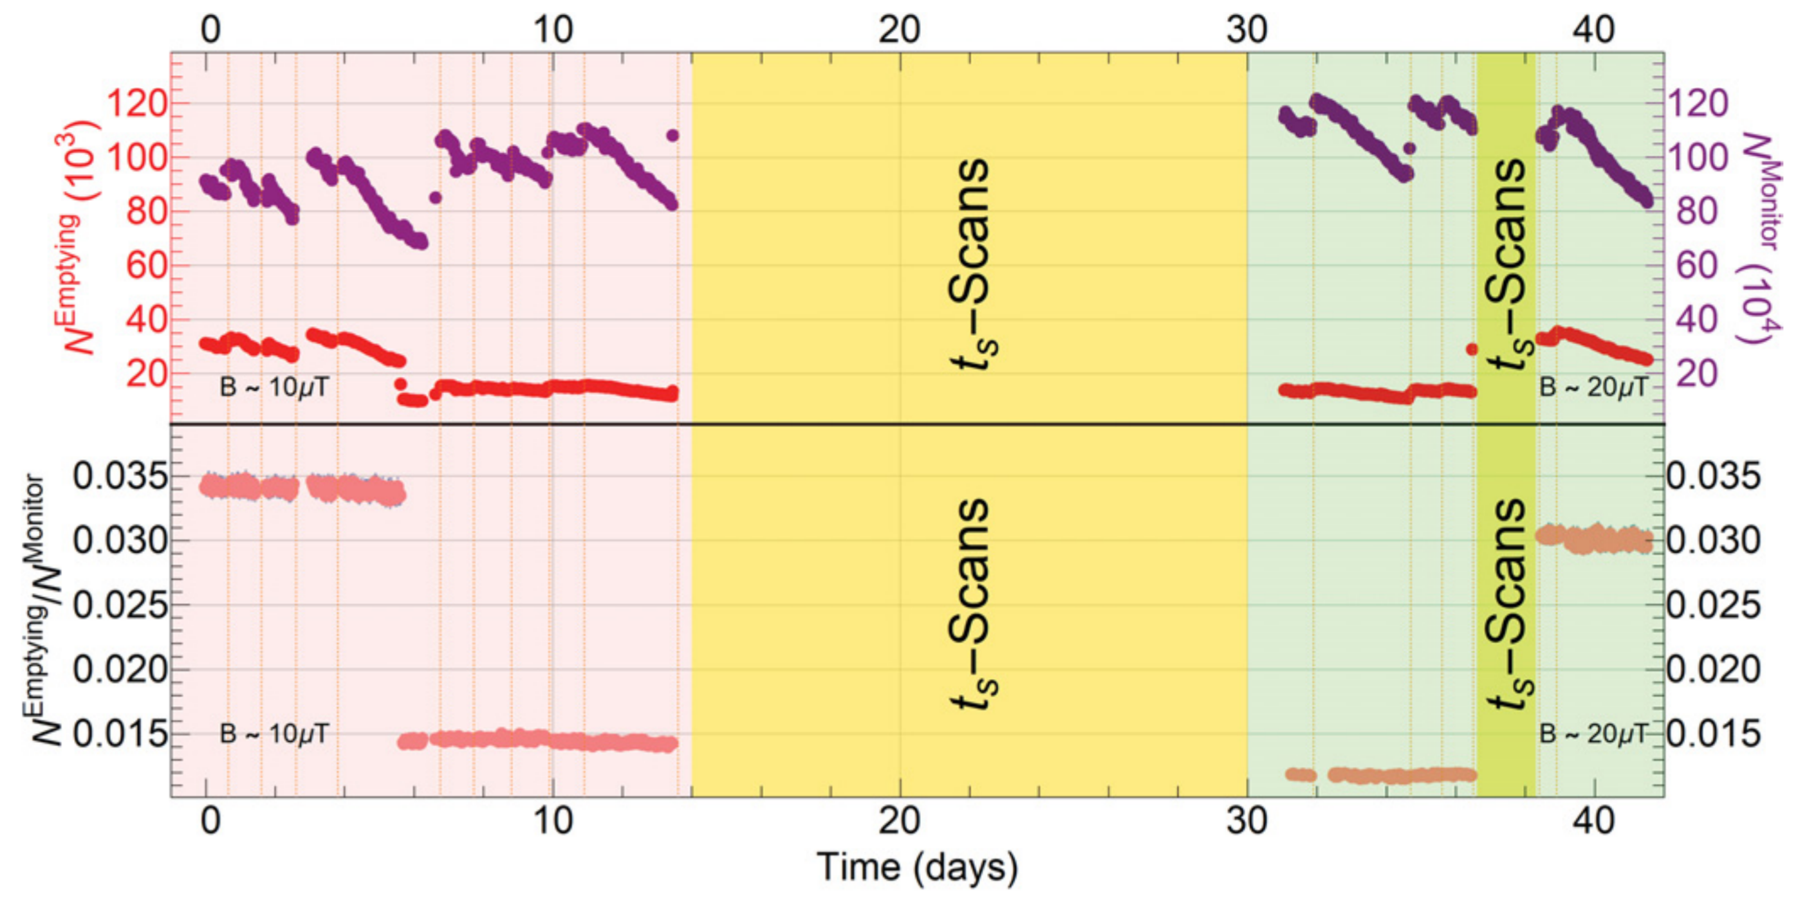
The 2017 PSI Measurement

Slide 19
What are the remaining interesting regions?
Orange: exclusion from PSI nEDM 2017 Measurement [1]
Brown: 2σ region (from [3]) indicated by 3σ anomaly in [4]
Regions indicated in 2009/2012 well excluded
Red: 2σ region indicated by original 5.2σ anomaly [2], as revised in [3]
Grey: 2σ region indicated by 2.5σ anomaly in [3]
Blue: exclusion by [5] (PSI nEDM)
[1] PhD Thesis P. MohanMurthy; C. Abel et al. EPJ Web of Conferences 219, 07001 (2019)
[2] Z. Berezhiani, F. Nesti Eur. Phys. J. C (2012) 74:1974
[3] Z. Berezhiani et al. Eur. Phys. J. C (2018) 78:717
[4] G. Ban et al. PRL 99, 161603 (2007)
[5] I. Alterev et al. PRD 80 (3) (2009) 032003
Figure preliminary, from PhD Thesis P. MohanMurthy, updated from LOI fig 1

