Slide 1
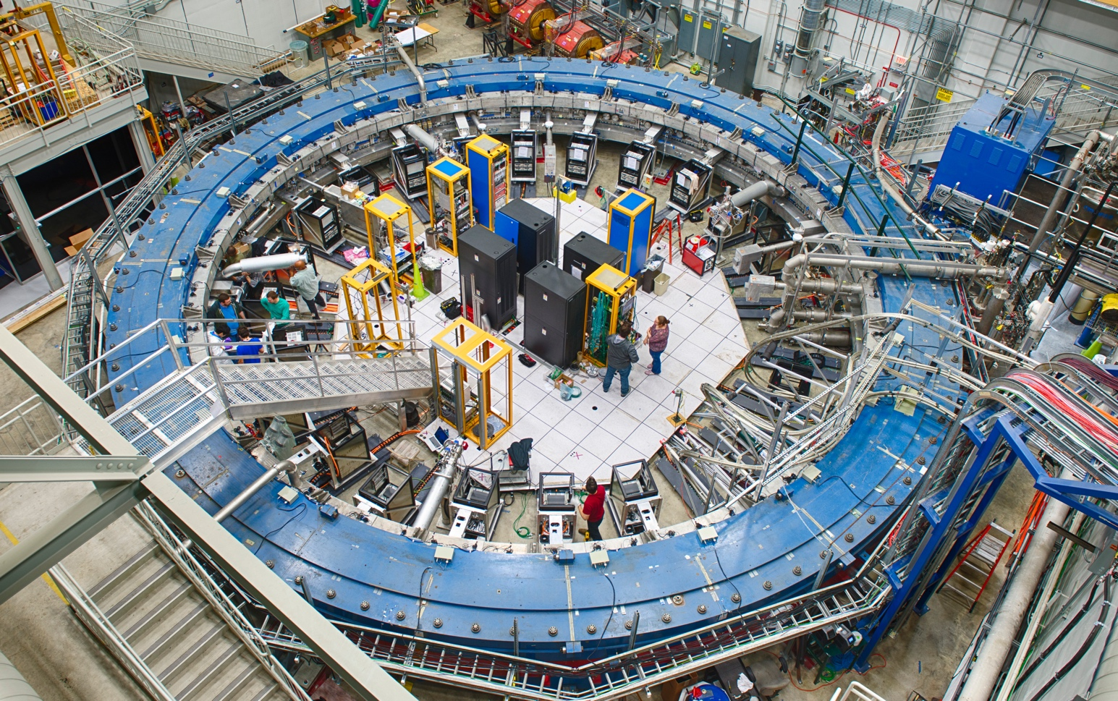
The magnetic field measurement for the Muon g-2 experiment with precision NMR
drhgfdjhngngfmhgmghmghjmghfmf
Peter Winter
High Energy Physics Division
Argonne National Laboratory

Slide 2
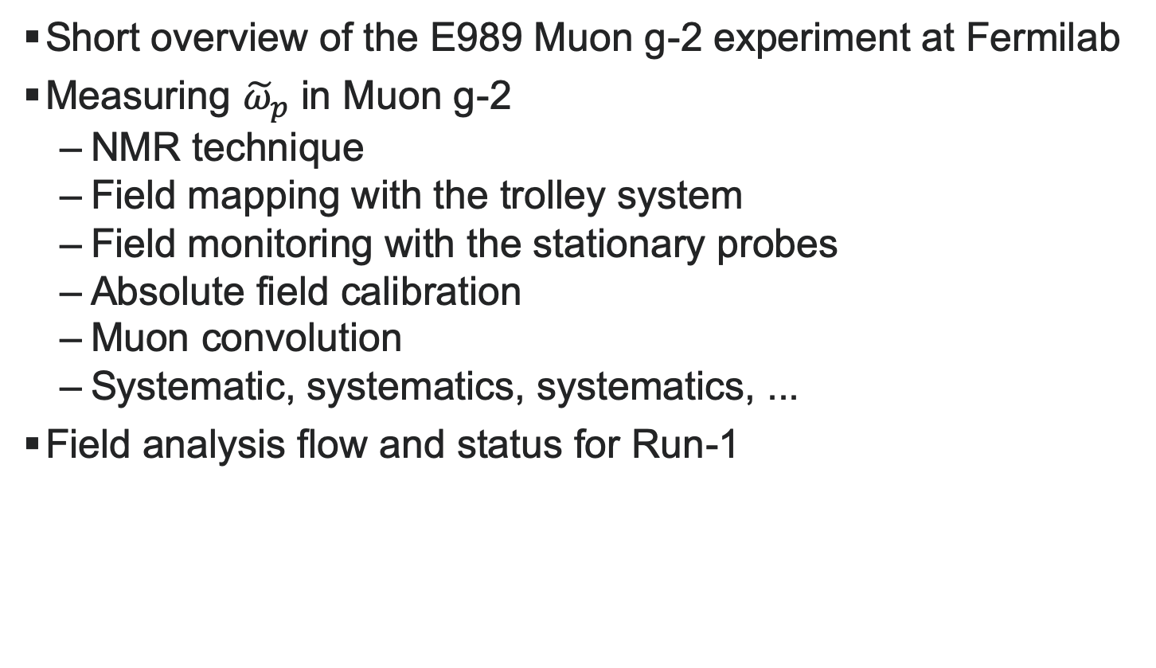
Overview
Short overview of the E989 Muon g-2 experiment at Fermilab
Measuring ${\tilde{ω}}_{p}$ in Muon g-2
  NMR technique
  Field mapping with the trolley system
  Field monitoring with the stationary probes
  Absolute field calibration
  Muon convolution
  Systematic, systematics, systematics, ...
Field analysis flow and status for Run-1

Slide 3
Short overview of The e989 g-2 experiment at fermilab

Slide 4
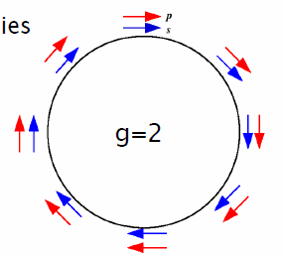
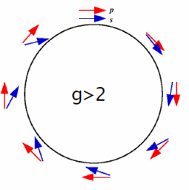
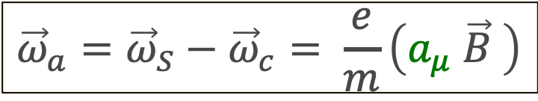
Muons in a storage ring (no e field yet)
Cyclotron frequency:
Spin precession frequency:
Larmor + Thomas precession
$${\vec{ω}}_{a}={\vec{ω}}_{S}−{\vec{ω}}_{c}= \frac{e}{m}\left(a_{μ} \vec{B} \right)$$

Slide 5
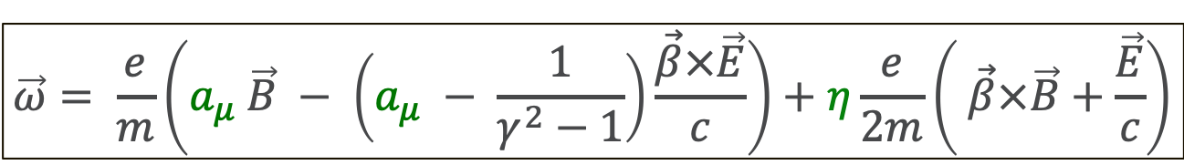
Muons in B & E fields with EDM
Assuming β∙B = β∙E = 0:
$$\vec{ω}= \frac{e}{m}\left(a_{μ} \vec{B} − \left(a_{μ} − \frac{1}{γ^{2}−1}\right)\frac{\vec{β}×\vec{E}}{c}\right)+η\frac{e}{2m}\left( \vec{β}×\vec{B}+\frac{\vec{E}}{c}\right)$$
Magic momentum (γ = 29.3)
E field for vertical focusing
CERN-III, BNL E821, Fermilab E989
No E field: E = 0
Weak magnetic focusing
J-PARC E34
NO ω_{a} oscillation (E ≃ a_{μ}Bcβγ²)
Only radial E field needed
PSI muonEDM

Slide 6
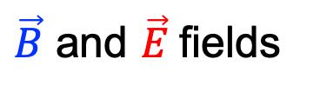
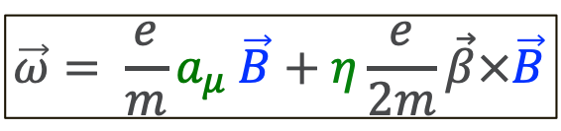
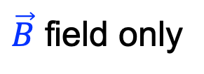

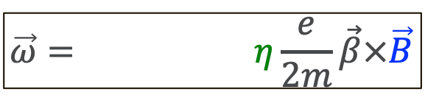
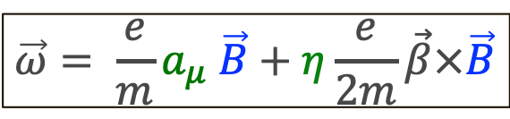
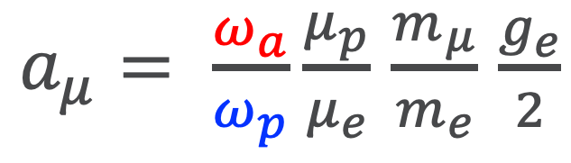
Muons in B & E fields with EDM
Assuming β∙B = β∙E = 0, induced electric field $\vec{β}×\vec{B}≫\frac{\vec{E}}{c}$:
Fermilab E989
$$\vec{ω}= \frac{e}{m}a_{μ} \vec{B}+η\frac{e}{2m}\vec{β}×\vec{B}$$
$\vec{B}$ and $\vec{E}$fields
J-PARC E34
$$\vec{ω}= \frac{e}{m}a_{μ} \vec{B}+η\frac{e}{2m}\vec{β}×\vec{B}$$
$\vec{B}$ field only
PSI muonEDM
$$\vec{ω}= η\frac{e}{2m}\vec{β}×\vec{B}$$
$\vec{B}$ and $\vec{E}$fields
Measuring the anomalous moment a_{μ} (neglecting the EDM) requires both a precision measurement of:
  the anomalous spin precession frequency ω_{a}
  the magnetic field B
$a_{μ}= \frac{ω_{a}}{ω_{p}}\frac{μ_{p}}{μ_{e}}$ $\frac{m_{μ}}{m_{e}}$ $\frac{g_{e}}{2}$
ω_{a} = e/m a_{μ} B

Slide 7
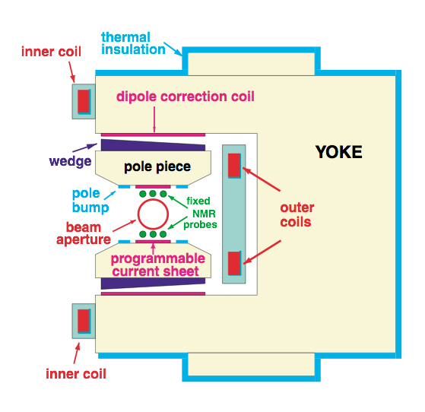
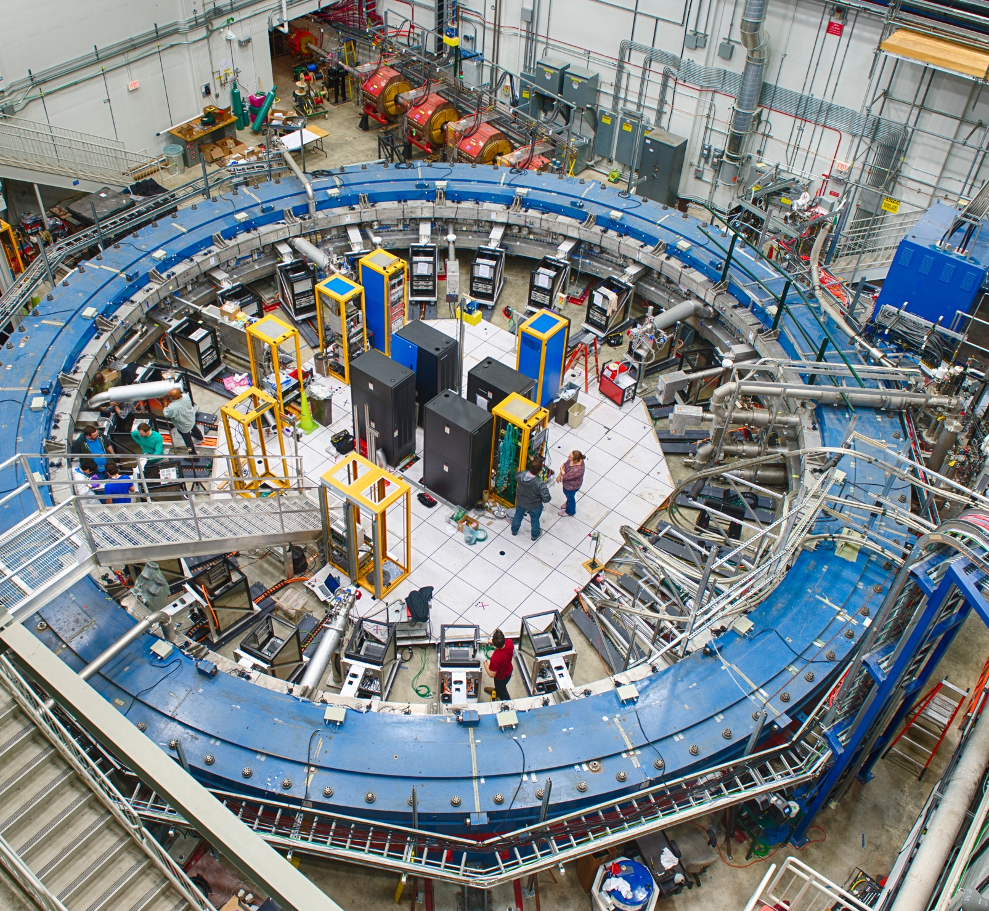
muon injection & storage:
Storage ring magnet
μ
Superconducting coils, C-shaped yoke, 1.45T field strength
Shim toolkit:
  48 top / bottom hats to tune dipole
  800 wedge shims to tune dipole
  edge shims to tune quad and sextupole
  ~9000 iron foils to fine tune field
Power supply feedback to stabilize dipole
~200 tunable coils to shim average higher multipoles

Slide 8
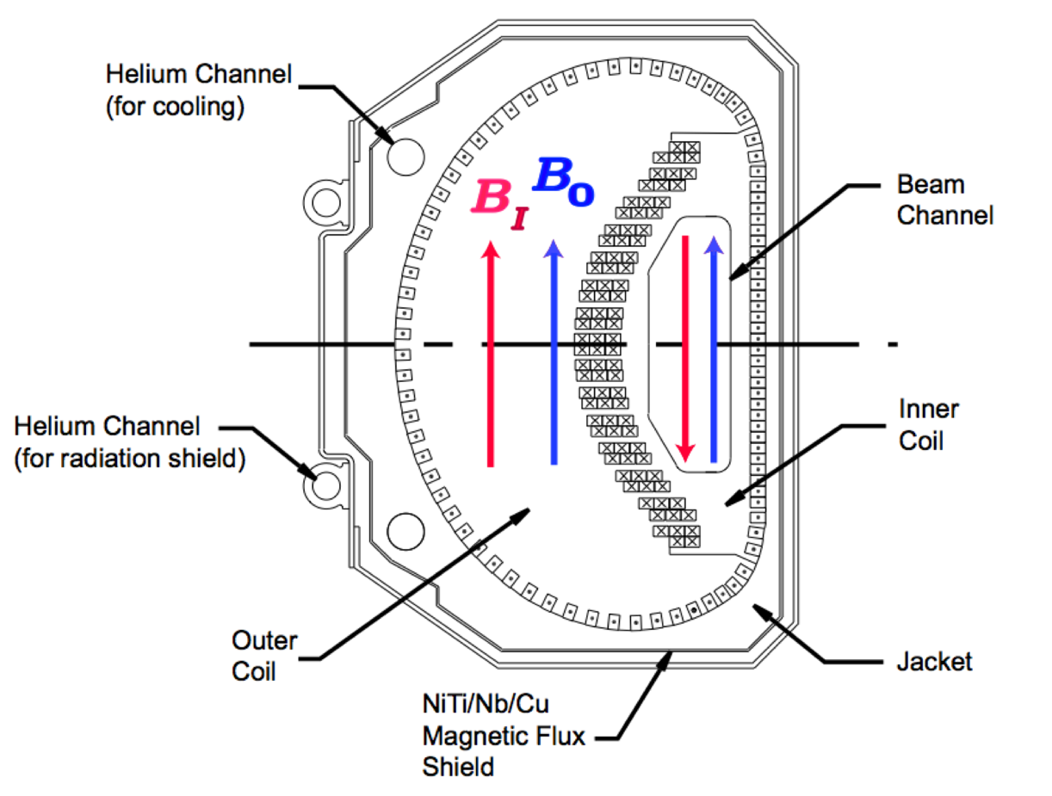
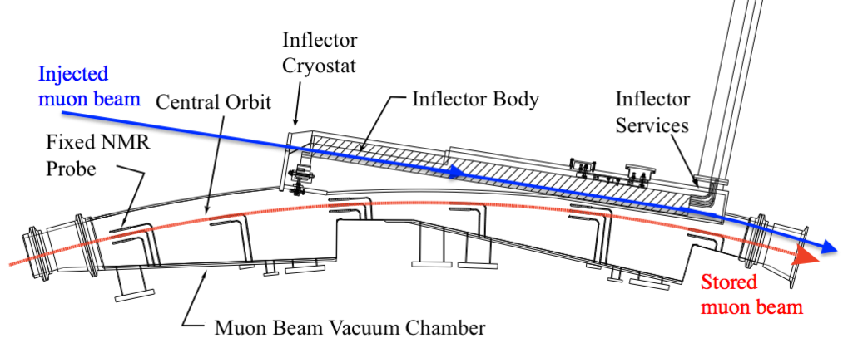
muon injection & storage:
Inflector magnet
Inflector magnet cancels main field for muon injection through yoke
Small aperture limits muon flux
Muons injected with 77mm offset from ideal orbit
μ
Inflector cross section
Inflector top view

Slide 9
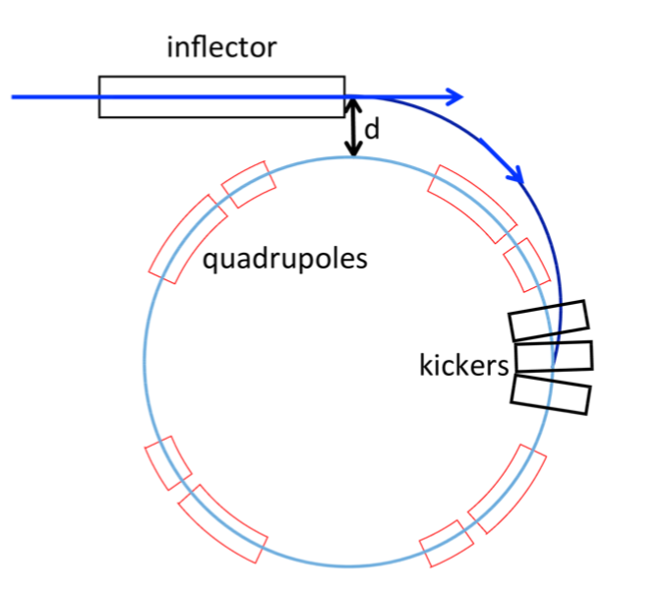
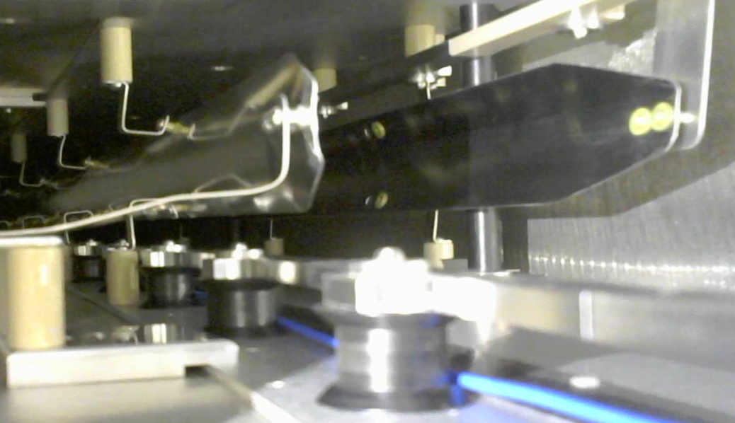
muon injection & storage:
Kicker magnet
3 kicker magnets changes muon angle to bring closer to ideal orbit
Deliver pulse in <149 ns (muon revolution time)
μ
Kicker plates

Slide 10
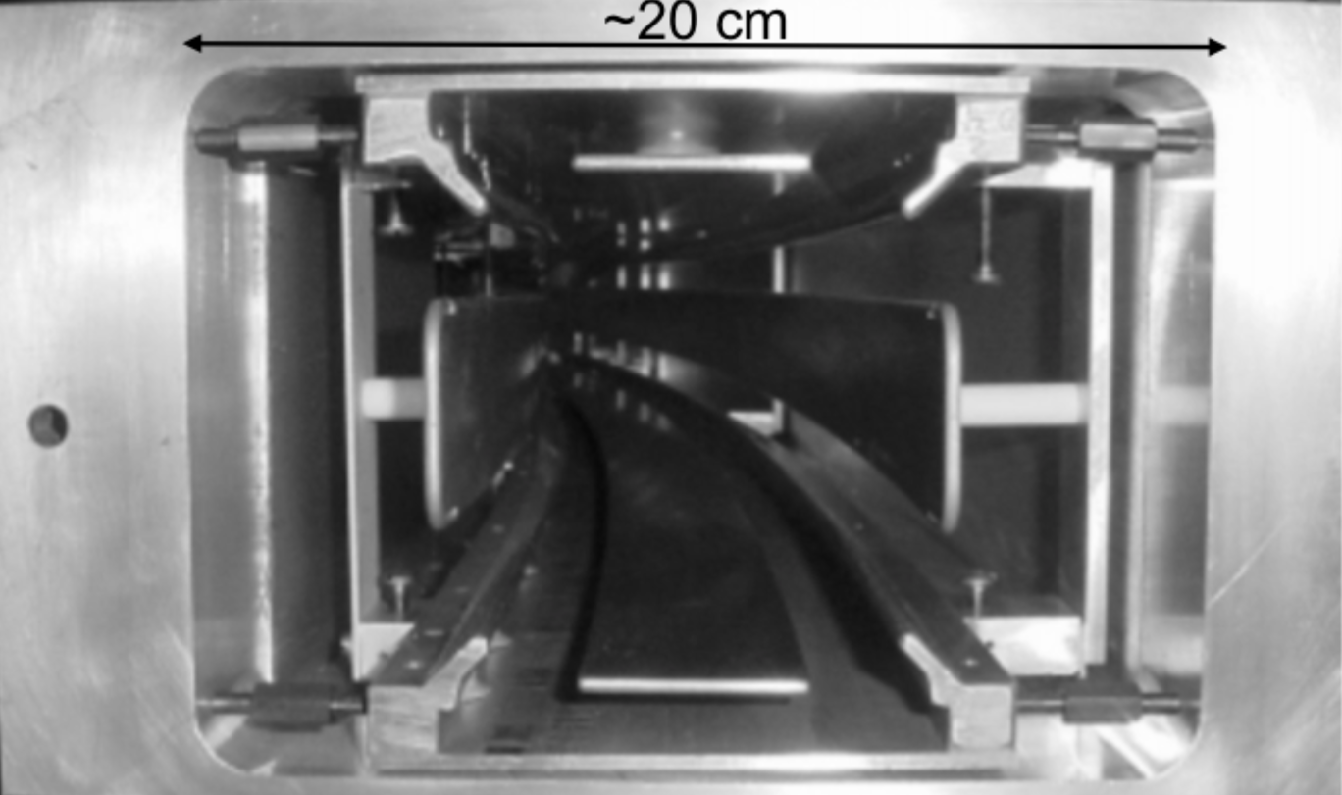
muon injection & storage: electrostatic quadrupoles
Main B field provides radial focusing
Four electrostatic quadrupoles cover 43% of the storage ring for vertical focusing
Also used to scrape the beam after injection with circular collimators
μ
+
-
-
-
-
+
Quadrupole plates

Slide 11
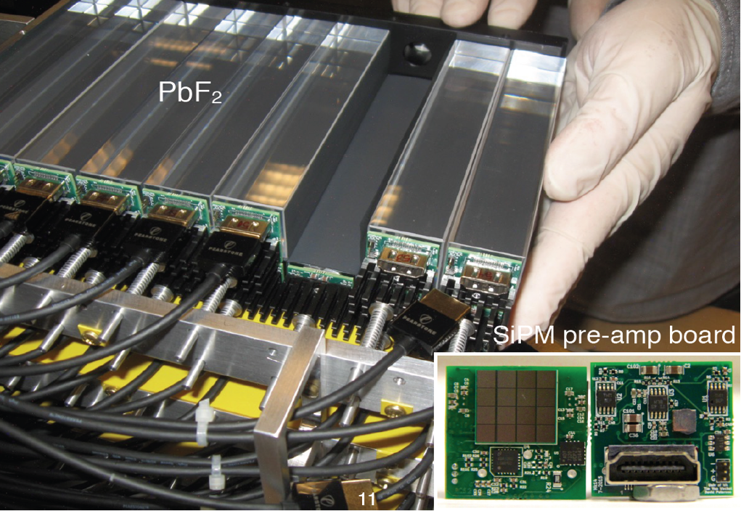
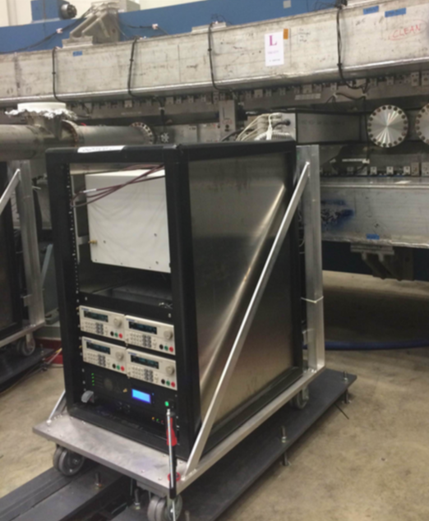
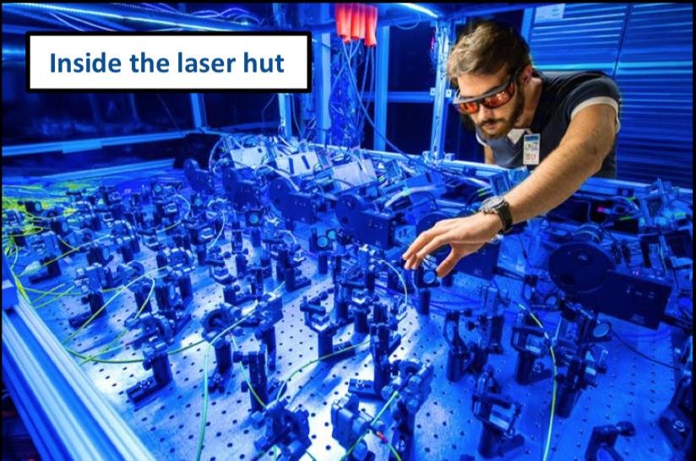
Measuring ω_{a}: calorimeter & Laser calibration
μ
24 calorimeter stations:
  54 PbF2 crystals per station
  SiPM readout for each crystal
  800 MSPS signal digitization
Laser calibration system:
  Each crystal receives laser pulse
  Several monitors to correct for laser fluctuations
  Demonstrated gain corrected to 10⁻⁴/h

Slide 12
Precision goals for ω_{a} AND ω_{p}
Key upgrades for ω_{a}:
  Segmented calorimeters
  New laser calibration system
  Better kicker and quadrupoles
  In-vacuum straw trackers
  New fast digitization & DAQ
  ...
ωa goal: Factor of 3 Improvement
Category | E821 (ppb) | E989 Goal (ppb)
Gain Changes | 120 | 20
Lost Muons | 90 | 20
Pileup | 80 | 40
Horizontal CBO | 70 | < 30
E-field/pitch | 110 | 30
Quadrature Sum | 214 | 70
Key upgrades for ω_{p}:
  New fixed NMR probes with signal digitization
  Upgraded field mapping trolley with signal digitization
  Improved calibration probe
  Better magnet homogeneity
  ...
ωp goal: Factor of 2.5 Improvement
Category | E821 (ppb) | E989 Goal (ppb)
Field Calibration | 50 | 35
Trolley Measurements | 50 | 30
Fixed Probe Interpolation | 70 | 30
Muon Convolution | 30 | 10
Time-Dependent Fields | – | 5
Others | 100 | 50
Quadrature Sum | 170 | 70

Slide 13

Measuring ${\tilde{ω}}_{p}$ in muon g-2

Slide 14
Measuring ω_{p}: How the pieces come together
How do we measure the magnetic field?
ω

Slide 15
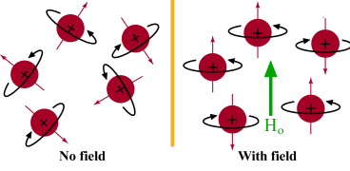
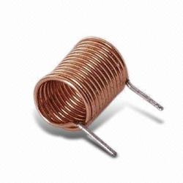
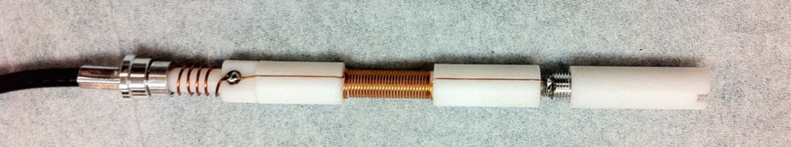
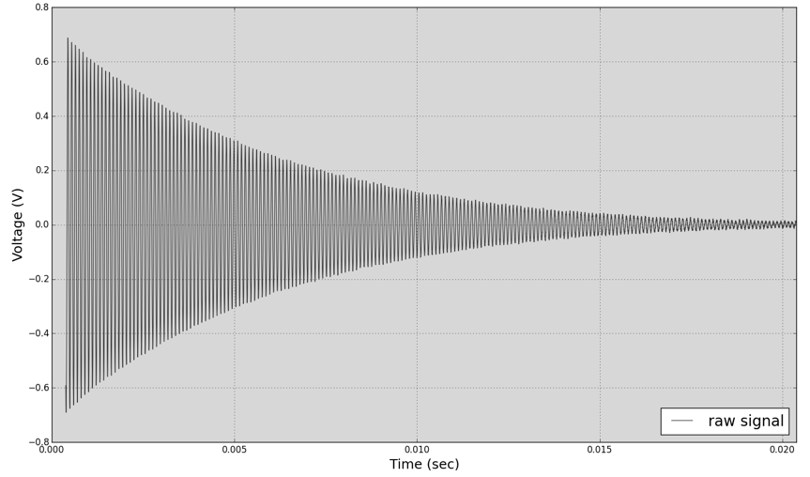
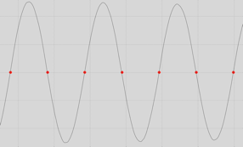
How do we measure the field: NMR
Nuclear Magnetic Resonance (NMR)
  Extremely precise (~1 ppb)
  Can be very accurate (<35 ppb)
  Measures only the total field B
Use a proton-rich sample...
...in a magnetic field
RF pulse tips proton magnetization by π/2
Precessing protons induce EMF in same coils
H
RF
Muon g-2 NMR probe w/o shield
Voltage (V)
Time (ms)

Slide 16
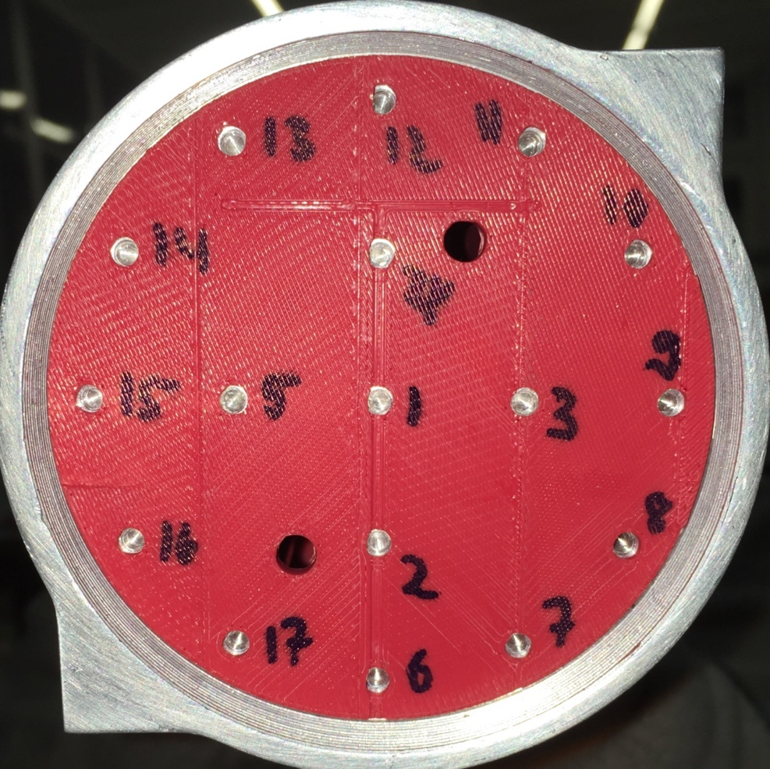
Measuring ω_{p}: How the pieces come together
How do we measure the magnetic field where the muons are?
ω

Slide 17
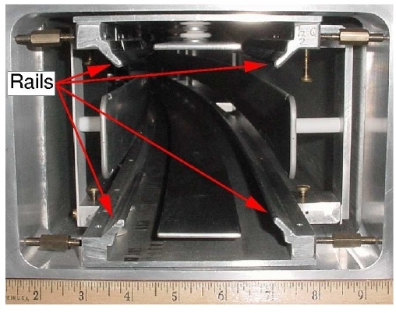
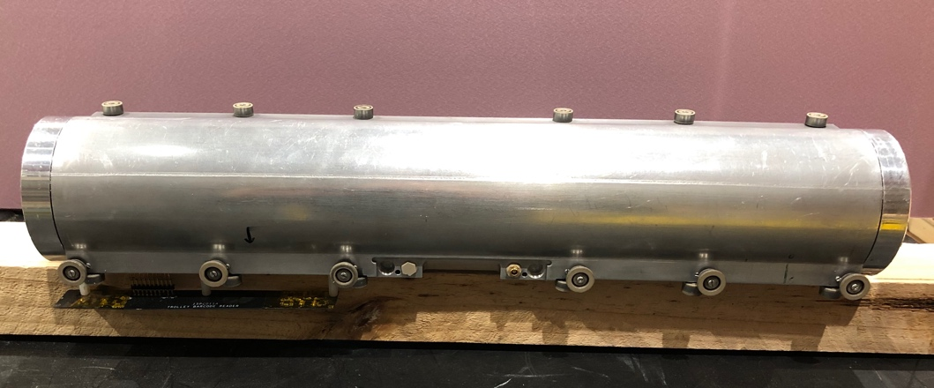
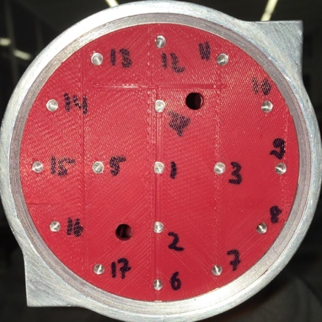
The trolley: in-vacuum field mapper
Electronics
NMR probes
The trolley is equipped with 17 NMR probes with the main goal:
Provides the magnetic field B₀ averaged over the muon storage region with a precision of 30 ppb. This is used to calibrate the fixed probe.
Position determination requirement: ±0.5 mm transverse, ±5mm longitudinal

Slide 18
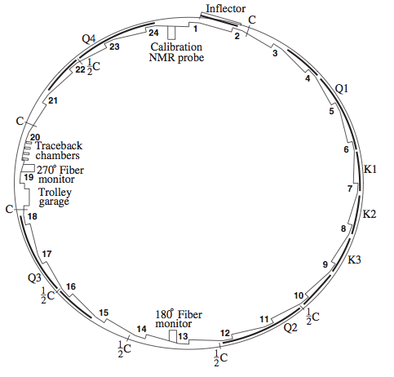
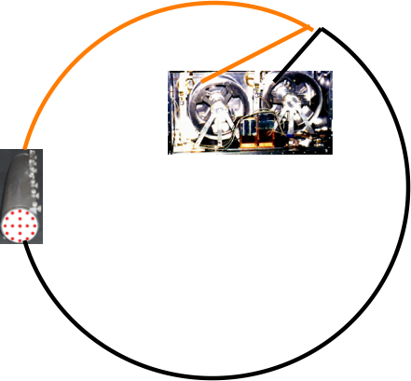
The trolley: in-vacuum field mapper
Coax cable
delivers power,
receives NMR
signals
Two motors /driver pull trolley through muon storage region
17 probes measure at 9000 locations around the ring
This provides a fine field map of the magnetic field B

Slide 19
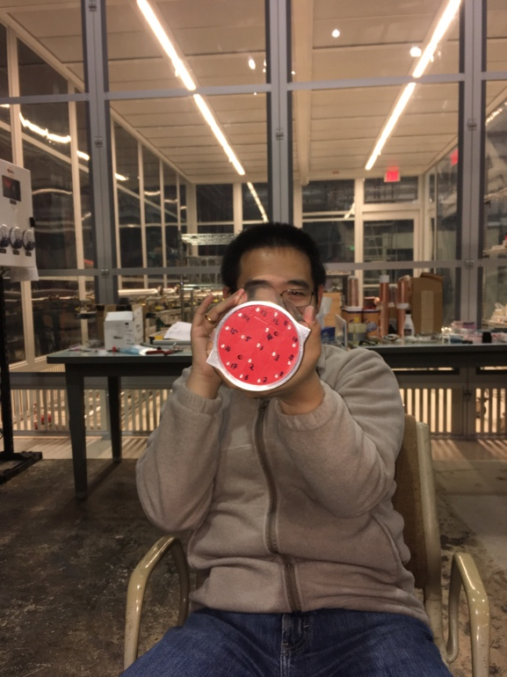
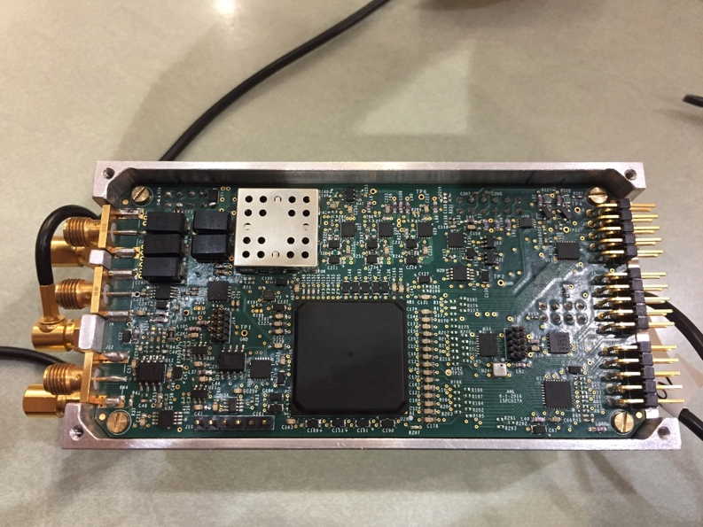
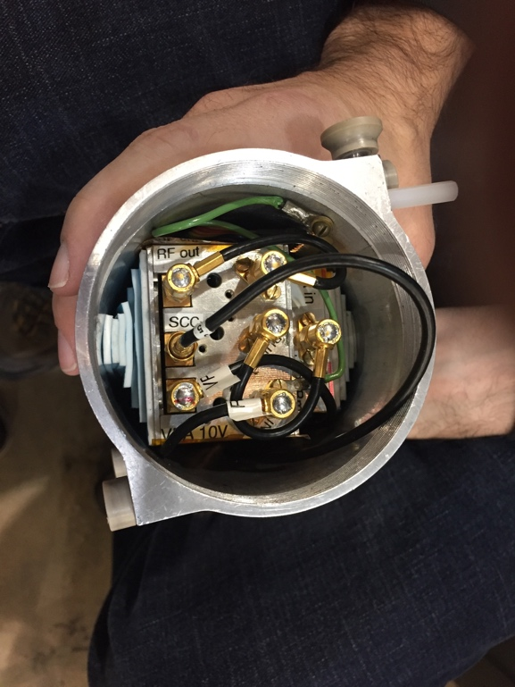
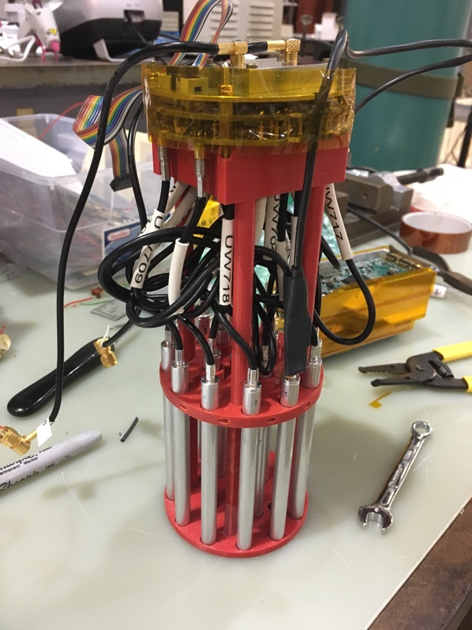
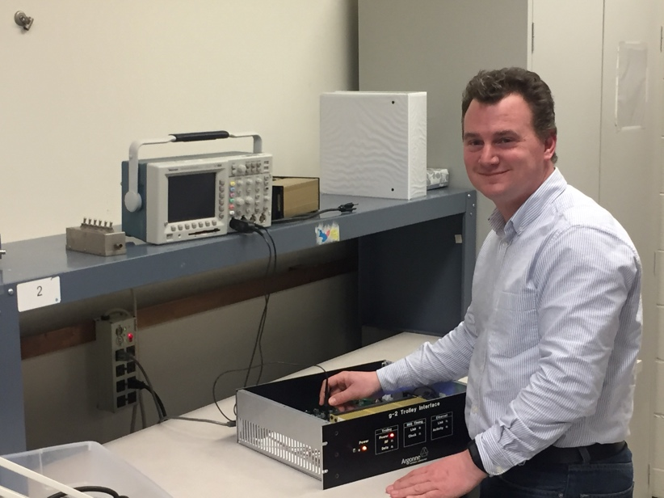
New trolley assembly
Trolley electronics centered around low-power SmartFusion chip which has an integrated ARM processor and FPGA
Total power <1 W including new barcode reader

Slide 20
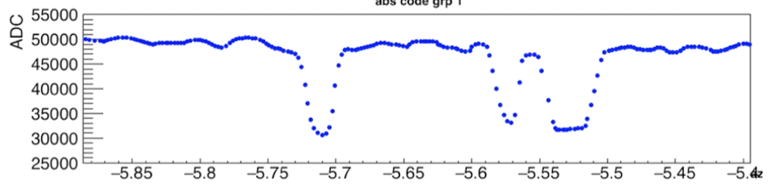
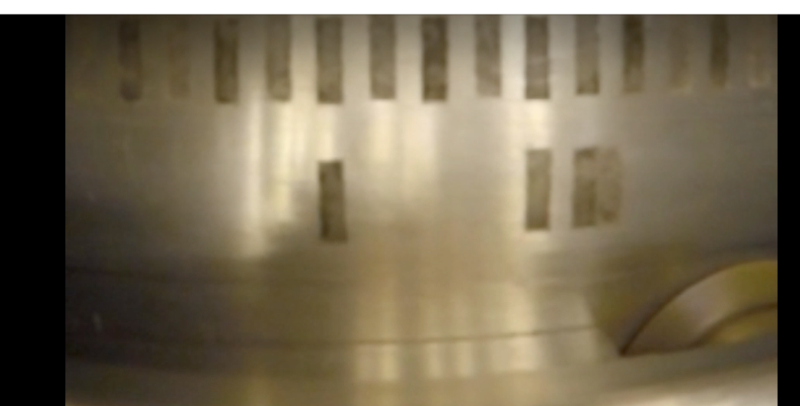
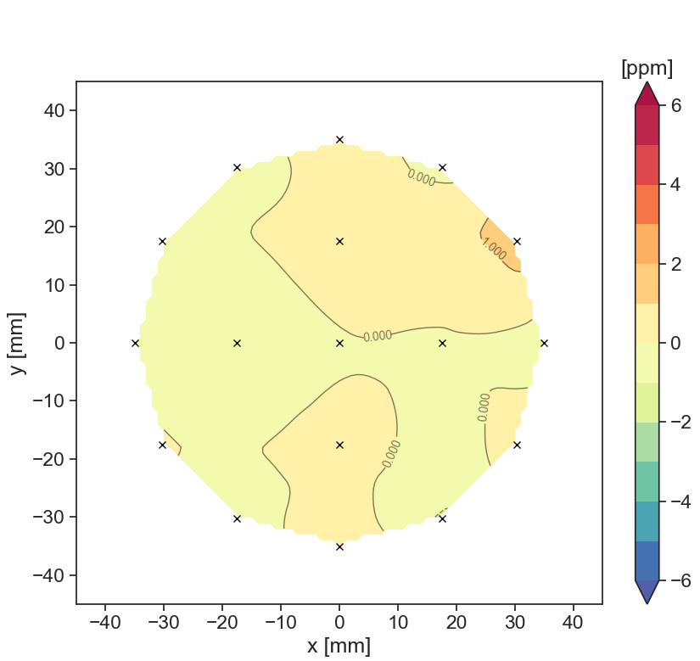
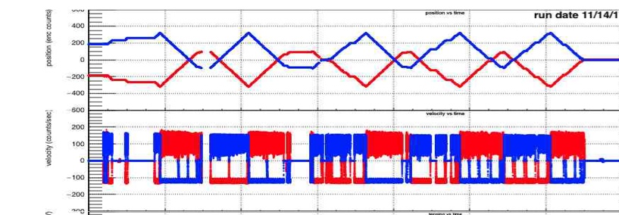
The trolley: in-vacuum field mapper
Trolley NMR, new motion control and barcode reader all working well
100+ successful trolley field maps
NMR precision is <1 ppb (goal <20 ppb)
Azimuthally averaged B(x,y) [ppm]
High-precision
field measurements
Successful and repeatable motion

Slide 21
Measuring ω_{p}: How the pieces come together
How do we measure the magnetic field while muons are stored?
ω
μ
μ
μ
μ
μ
μ
μ
μ
μ
μ
μ
μ
μ
μ
μ
μ

Slide 22
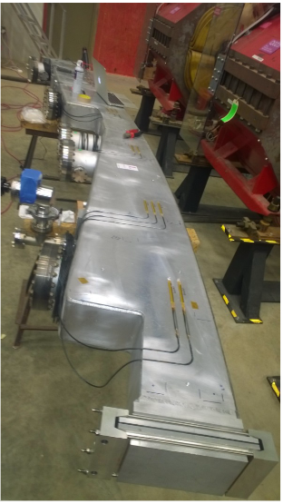
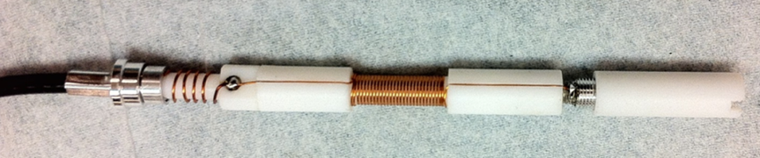
The fixed probes:
Field monitoring at all times
378 NMR probes in fixed locations
Constantly monitor the field with ~1Hz
Each probe readout by ADC (10 MSPS)
Most probes have uncertainty < 30 ppb

Slide 23
Measuring ω_{p}: How the pieces come together
How do we calibrate the magnetic field measurement?
ω
μ
μ
μ
μ
μ
μ
μ
_{p}
μ
μ
μ
μ
μ
μ
μ
μ
μ

Slide 24
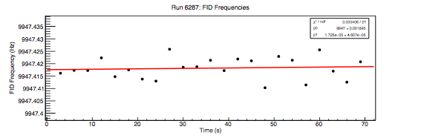
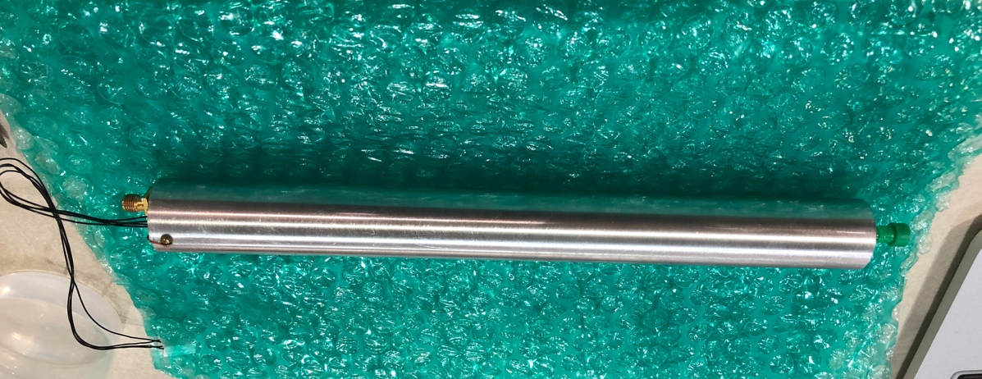
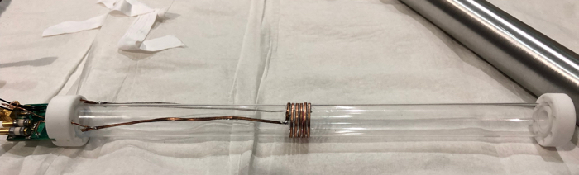
Water-based NMR calibration probe
Special water probe(s) deliver the absolute calibration in terms of the free proton precession frequency ω_{p}
Shift from field felt by free protons compared to protons in water. Goal to have an accuracy of <35ppb
Calibrates the trolley probes with a precision of 30 ppb
Minimal effect from materials and other sources: δ_{s} = -5.5 ± 12.9
Very high resolution of 100 ppt / shot
1 ppb
24

Slide 25
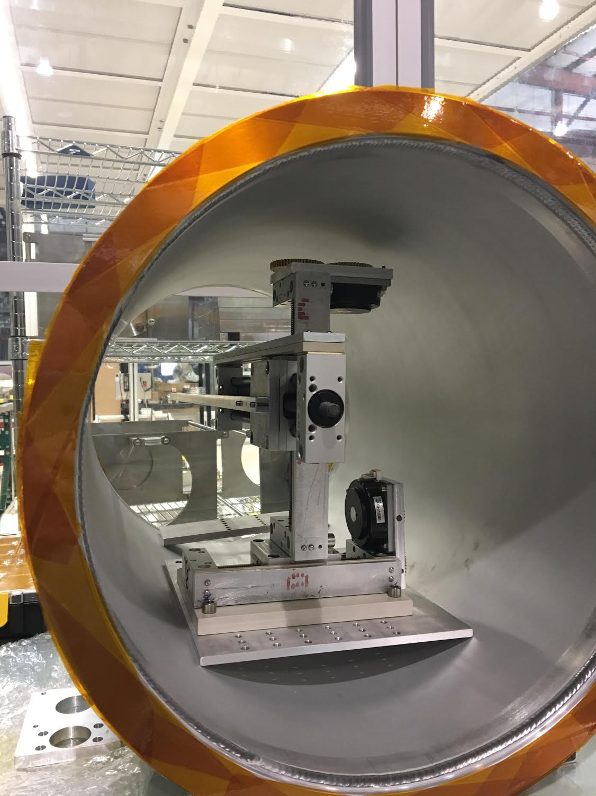
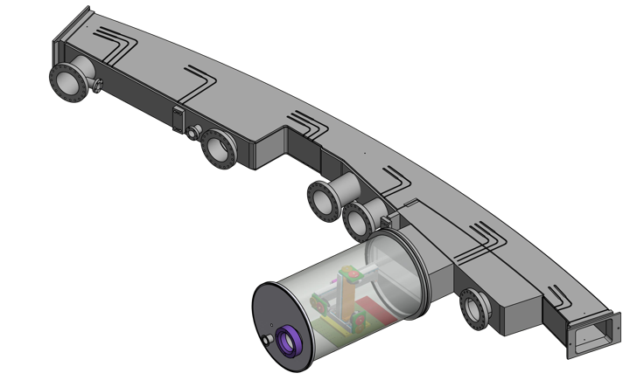
Water-based NMR calibration probe
3D translation stage with non-magnetic materials for in-vacuum operation
The calibration inside the storage ring requires probe position accuracy ≤ 1 mm
25

Slide 26
Measuring ω_{p}: How the pieces come together
∼
How do we fold in the muon distribution?
ω
μ
μ
μ
μ
μ
μ
μ
_{p}
μ
μ
μ
μ
μ
μ
μ
μ
μ

Slide 27
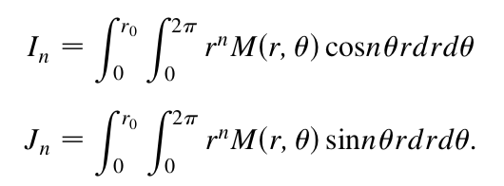



Averaging over the muon distribution
The field B(r,θ,φ) measured in the storage region needs to be convoluted with the muon distribution M(r,θ,φ)
Method 1:
Average over φ and express B(r,θ) and M(r,θ)
in terms of multipoles and moments:
Method 2:
Track the muons M(r,θ,φ) in the full field map B(r,θ,φ) with GEANT4 simulation to determine the effective field.

Slide 28
Measuring ω_{p}: How the pieces come together
∼
dB/dx
Systematics, ...
ω
μ
μ
ΔB_{calib}
μ
μ
Systematic uncertainties
μ
μ
μ
_{p}
μ
ΔB(T)
μ
μ
μ
μ
μ
μ
μ
μ

Slide 29


MAIN Systematics for the Calibration:
Field Gradients, DRIFT, and position
We want:
But:
Systematics
gradients
position
stability
calib. time
(gross exaggeration)
Calibration in MRI magnet and specially shimmed region in g-2
Trolley calibration uncertainty in E821: 90 ppb
Goal for FNAL: 30 ppb
g-2 pole

Slide 30
relative Probe alignment:
ΔB method with linear gradients
Measure with the first probe the bare field B_{bare}(x₀)
Add a linear gradient B₀ + B_{g}*x and measure B_{g}(x₀) = B_{bare}(x₀) + B₀ + B_{g}*x₀
The difference ΔB(x₀) = B_{g}(x₀) - B_{bare}(x₀) = B₀ + B_{g}*x₀ is unique for each location x₀
Repeat steps 1-3 with second probe and reposition until you find the same ΔB(x₀).
Probe
B_{g}(x₀)
B_{bare}(x₀)
ΔB(x₀)
x

Slide 31


TEST solenoid at ANL for calibration
Installed a former MRI magnet (0-4 Tesla) at ANL
Achieved superb homogeneity and stability:
  1 ppb/mm local gradients
  Drift ~10 ppb / hour
Can impose linear gradients in x, y, z
Magnet used for:
  Systematics for g-2 NMR measurement
  Cross-calibration for g-2
  Hall probe calibration (Mu2e)
  Detector tests
  ...

Slide 32
Measuring ω_{p}: How the pieces come together
∼
dB/dx
Systematics, systematics, ...
ω
μ
μ
ΔB_{calib}
μ
μ
Systematic uncertainties
μ
μ
μ
_{p}
μ
ΔB(T)
μ
μ
μ
μ
Radial field
μ
μ
μ
μ
Shimming
Field
stabilization

Slide 33


Homogeneity is key to reduce FIELD systematics
Azimuthally Averaged
Field vs r,z
Field vs. Azimuth
Bennett et al. 10.1103/PhysRevD.73.072003
Goal: +/- 25 ppm
Goal: +/- 0.5 ppm

Slide 34



SHIMMING TOOLS
Multipurpose instrument
  25 NMR Probes for field
  4 capacitive gap sensors
    Measure pole alignment
    70 nm resolution
    Few micron reproducibility
Laser-tracked with μm resolution

Slide 35

Passive SHIMMING FOR azimuthal homogeneity
Precision alignment to reach shimming goal:
  72 poles
  840 wedge shims
  9000 thin iron foil laminations
Shimming completed with ΔB < ±25 ppm ✓
10 months of improving the dipole field in 1 minute...
Calibrations Poles Wedges Laminations

Slide 36


ACTIVE SHIMMING FOR transverse homogeneity and drift stabilization
Azimuthally averaged B(x,y) [ppm]
200 continuous current traces around the ring individuall tunable between +-2A
Used to cancel higher multipoles
Power supply feedback stabilizes main dipole field to ±15 ppb
kHz

Slide 37
Measuring ω_{p}: How the pieces come together
∼
dB/dx
Systematics, systematics, systematics ...
ω
μ
μ
ΔB_{calib}
μ
μ
Systematic uncertainties
μ
μ
μ
_{p}
μ
ΔB(T)
μ
μ
130 s
μ
μ
60 Hz
Radial field
μ
μ
μ
μ
Fast transients
Shimming
15Hz
Field
stabilization
1 kHz

Slide 38

Measuring transient fields:
Fluxgates
Fast detectors for signals up to 10G with bandwidth 1 kHz
Monitors fast field transients not measured by slow NMR
Very helpful in hunting various spikes in the dipole field (malfunctioning strain gauges)

Slide 39


Measuring transient fields:
Vibrating quadrupole plates
Electrostatic quadrupole plates are being pulsed with the muon arrival
Pulsing of plates causes mechanical vibration which generates a magnetic field
Field is seen by the muons and fixed probes but not by the trolley (quad pulsing is turned off)
Dedicated development of new NMR probe that can measure field inside the quads

Slide 40
Measuring ω_{p}: How the pieces come together
∼
?
dB/dx
Systematics, systematics, systematics, systematics, ...
?
ω
μ
μ
ΔB_{calib}
Consistency checks
μ
μ
Systematic uncertainties
μ
μ
μ
_{p}
μ
³He
ΔB(T)
μ
μ
130 s
μ
μ
60 Hz
Radial field
μ
μ
μ
μ
Fast transients
Shimming
15Hz
Field
stabilization
1 kHz

Slide 41



Cross-calibration efforts:
3He NMR and US/japan collaboration
Consistency check of the water-based NMR calibration:
  Use a very homogeneous and stable 1.45T field at Argonne
  Collaborators at University of Michigan have developed a 3He NMR probe with different systematics
  3-years effort to cross-calibrate E989 pulsed-NMR probe with J-PARC Muon g-2/EDM cw-NMR probe (1.45T, 1.7T, 3T)
US/Japan cross-calibration in 2019
³He NMR signal

Slide 42
FIELD analysis flow and run-1 status

Slide 43





Magnetic field flow summary
Trolley relative calibration
Absolute calibration
inside g-2 ring
Precisely
measured
Precisely known for probe
Minimized
for probe
inside MRI solenoid
Trolley calibrates fixed probes, measures Bμ.
Fixed probes monitor field
drift during
muon storage
Vacuum chamber cross section
Field homogeneity, stability critically affect uncertainty in these processes

Slide 44








360°
180°
0°
t₀
t
B₀(t₀)
dipole: B₀
normal quad: B_{1n}
skew quad: B_{1s}
normal sext.: B_{2n}
skew sext.: B_{2s}
normal oct.: B_{3n}
skew oct.: B_{3s}
B_{1n}(t₀)
B_{1s}(t₀)
B_{2n}(t₀)
B_{2s}(t₀)
B_{3n}(t₀)
B_{3s}(t₀)
44

Slide 45





Typical Run-1 trolley field map
Trolley maps the field every 2-3 days
very uniform
RMS ~20ppm

Slide 46

360°
180°
0°
t₀
t₁
t₂
t₃
t₄
t₅
t
B₀(t₀)
B₀(t₁)
B₀(t₂)
B₀(t₃)
B₀(t₄)
B₀(t₅)
B_{1n}(t₀)
B_{1s}(t₀)
B_{1n}(t₁)
B_{1s}(t₁)
B_{1n}(t₂)
B_{1s}(t₂)
B_{1n}(t₃)
B_{1s}(t₃)
B_{1n}(t₄)
B_{1s}(t₄)
B_{1n}(t₅)
B_{1s}(t₅)
B_{2n}(t₀)
B_{2s}(t₀)
B_{2n}(t₁)
B_{2s}(t₁)
B_{2n}(t₂)
B_{2s}(t₂)
B_{2n}(t₃)
B_{2s}(t₃)
B_{2n}(t₄)
B_{2s}(t₄)
B_{2n}(t₅)
B_{2s}(t₅)
B_{3n}(t₀)
B_{3s}(t₀)
B_{3n}(t₅)
B_{3s}(t₅)
46

Slide 47


Field monitoring between trolley maps
Trolley maps the field every 2-3 days
In between trolley field maps, the 72 fixed probe stations track the lower order multipoles (mainly the dipole field). Some of the challenges include:
  Trolley footprint removal to tie fixed probe reading to trolley map
  Limited tracking of higher multipoles by the fixed probes
trolley runs
PRELIMINARY
Blinded Dipole Moment [ppm]
Fixed probe tracking

Slide 48
360°
180°
0°
t₀
t₁
t₂
t₃
t₄
t₅
t
B₀(t₀)
B₀(t₁)
B₀(t₂)
B₀(t₃)
B₀(t₄)
B₀(t₅)
B_{1n}(t₀)
B_{1s}(t₀)
B_{1n}(t₁)
B_{1s}(t₁)
B_{1n}(t₂)
B_{1s}(t₂)
B_{1n}(t₃)
B_{1s}(t₃)
B_{1n}(t₄)
B_{1s}(t₄)
B_{1n}(t₅)
B_{1s}(t₅)
B_{2n}(t₀)
B_{2s}(t₀)
B_{2n}(t₁)
B_{2s}(t₁)
B_{2n}(t₂)
B_{2s}(t₂)
B_{2n}(t₃)
B_{2s}(t₃)
B_{2n}(t₄)
B_{2s}(t₄)
B_{2n}(t₅)
B_{2s}(t₅)
B_{3n}(t₀)
B_{3s}(t₀)
B_{3n}(t₅)
B_{3s}(t₅)
ω_{p}
48

Slide 49


Run-1 absolute calibration
Trolley maps the field every 2-3 days
In between trolley field maps, the 72 fixed probe stations track the lower order multipoles (mainly the dipole field)
A few times, the calibration probe is used to determine the absolute frequency offsets of the trolley probes. Calibration must also account for probe material effects
Trolley Probe

Slide 50



360°
180°
0°
t₀
t₁
t₂
t₃
t₄
t₅
t
B₀(t₀)
B₀(t₁)
B₀(t₂)
B₀(t₃)
B₀(t₄)
B₀(t₅)
B_{1n}(t₀)
B_{1s}(t₀)
B_{1n}(t₁)
B_{1s}(t₁)
B_{1n}(t₂)
B_{1s}(t₂)
B_{1n}(t₃)
B_{1s}(t₃)
B_{1n}(t₄)
B_{1s}(t₄)
B_{1n}(t₅)
B_{1s}(t₅)
B_{2n}(t₀)
B_{2s}(t₀)
B_{2n}(t₁)
B_{2s}(t₁)
B_{2n}(t₂)
B_{2s}(t₂)
B_{2n}(t₃)
B_{2s}(t₃)
B_{2n}(t₄)
B_{2s}(t₄)
B_{2n}(t₅)
B_{2s}(t₅)
B_{3n}(t₀)
B_{3s}(t₀)
B_{3n}(t₅)
B_{3s}(t₅)
ω_{p}
⊗
⊗
⊗
⊗
⊗
⊗
~
~
~
~
~
~
ω_{p}
ω_{p}
ω_{p}
ω_{p}
ω_{p}
ω_{p}
50

Slide 51
Run-1 analysis status: ω_{p}
Trolley maps the field every 2-3 days
In between trolley field maps, the 72 fixed probe stations track the lower order multipoles (mainly the dipole field)
A few times, the calibration probe is used to determine the absolute frequency offsets of the trolley probes. Calibration must also account for probe material effects
Multiple analyses ongoing for trolley calibration, fixed probe-trolley interpolation, and systematic uncertainties

Slide 52
Run-1 analysis status: ω_{p}
Trolley maps the field every 2-3 days
In between trolley field maps, the 72 fixed probe stations track the lower order multipoles (mainly the dipole field)
A few times, the calibration probe is used to determine the absolute frequency offsets of the trolley probes. Calibration must also account for probe material effects
Multiple analyses ongoing for trolley calibration, fixed probe-trolley interpolation, and systematic uncertainties
Additional effort to study if we can extract more information from the spatially dense B-field map to deduce the vector components (toroidal harmonics as a solution to Maxwell’s equations for storage ring geometry)
...

Slide 53


Overall status and outlook
Without data-quality cuts (DQC)
Run-1:
  Analysis ongoing (~1.1 BNL statistics)
  First publication expected in the next months
Run-2:
  Collected ~1.8 BNL statistics (after data quality cuts)
  Analysis efforts starting now in parallel with Run-1 analysis
Summer shutdown 2019:
  Performed several upgrades over the summer (kicker, hall cooling, ...)
Run-3:
  Started in November 2019 to May 2020
  Expected to collect >10 BNL statistics, already >2 BNL on tape
Proposed Run-4:
  Would share beam with mu2e commissioning
Run-4
Run-3
Run-1
& 2
Thank you and stay tuned for the first result...

