Slide 1
Introduction: Workshop Goals & Athos Timeplan Overview
Romain Ganter
Athos Commissioning Workshop - FHNW - 04.03.2020

Slide 2
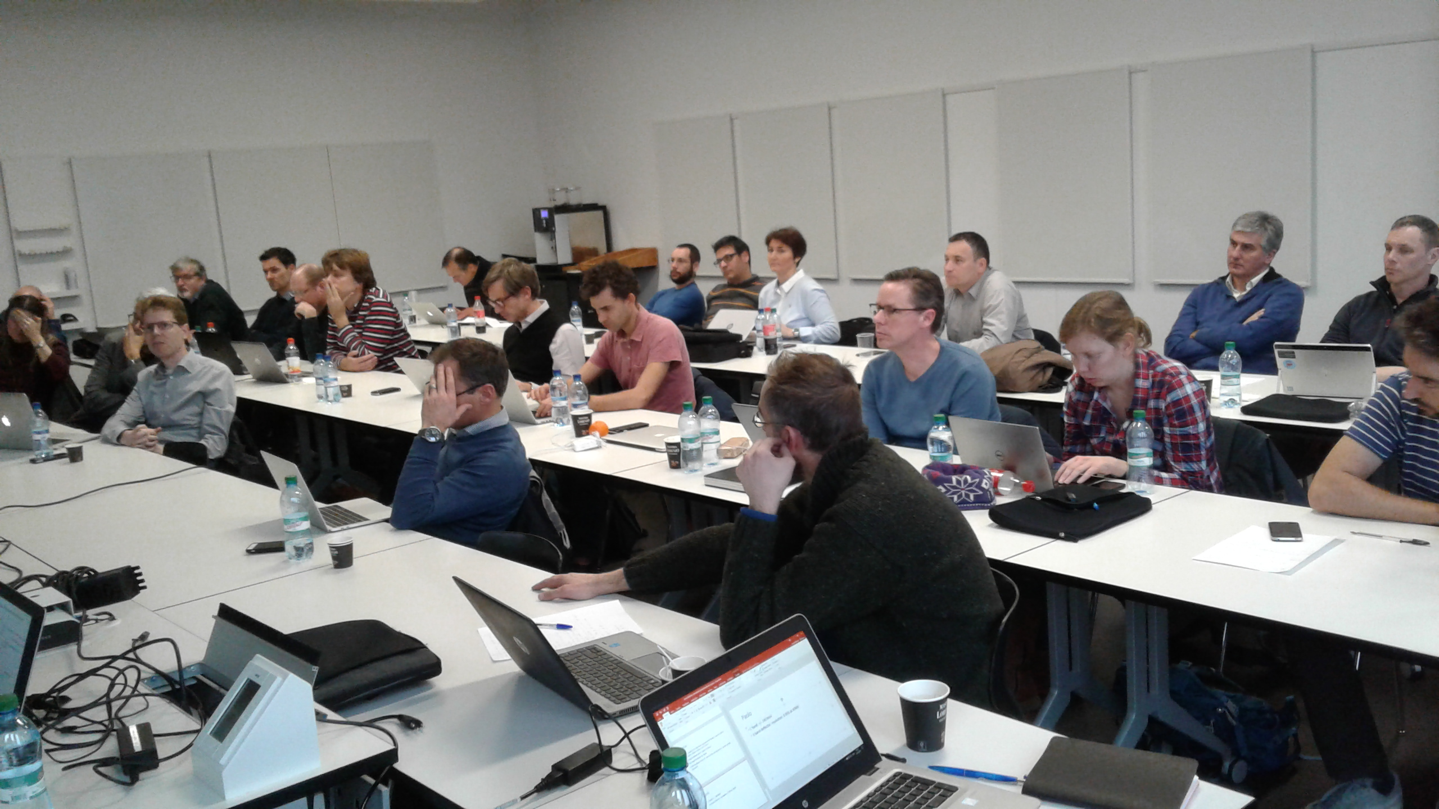
Athos Machine Commissioning Workshop 2019
01.02.2019
Today: “Athos Commissioning Workshop 2020”

Slide 3
Last Athos Commissioning Workshop 01.02.2019
Summary
Ideal Experiment: Short pulses of few fs; 2 colors pulses
Shifts Until April: 4 LLRF; 1 BD (Sven); diagnostic BCM (parallel to LLRF);
Parallel Operation: lessons from other labs (CERN)
Beam dynamics First Athos Mode= 2 Color Mode; TW mode in Dec20
Wire scanner preferred than screens in Dogleg (more DRPS compatible?)
Dechirpers: priority for production and installation Aramis / Athos is required !
Undulator commissioning: metal foil for K-shell measurements; CHIC
1st lasing laser will be the jaguar; November SD might be too short for Mizar acceptance test
LLRF: 3-4 shifts required before april! Interface for step amplitude and phase control acting on bunch2
Timing: minimum requirements to have independent MPS Athos / Aramis feasible; Discussion on timing events with photonics is required ! BPM5 and BPM8 electronics on critical path ! Priorities ?
Some Diagnostics shifts require dedicated machine shifts
DRPS: we loose a factor 2 or more in respect to current situation
Switchyard Orbit feedback: special tools due to dispersion
X & C band for spring 2020; 0.8 fs resolution expected for X band; no mover for alignment
UE38 series: will be limited by magnet production
Control Photonics Diagnostics: maybe ressources issues; no new camera server
Photon Diagnostic Pulse duration: not for day 1; we should rely on PolariX
Undulator K calibration: what diagnostic ? spontaneous radiation divergence/ aperture? Pump laser Beam Dump Screen at 100Hz !
Front End: Aperture for pumping stages ? 6 mm ?
DCR003: exchange pair of offset mirrors with a rollable half spherical mirror; add a mirror near FURKA for horizontal propagation
AMO: Requirements: <5fs; tunable duration; >10uJ; 2colors; C,N,O
AMO Spectro Day1: pulse duration estimation
Last Athos Machine Workshop 01.02.2019 – FHNW
=> Goal: Commissioning steps for 1st Lasing

Slide 4
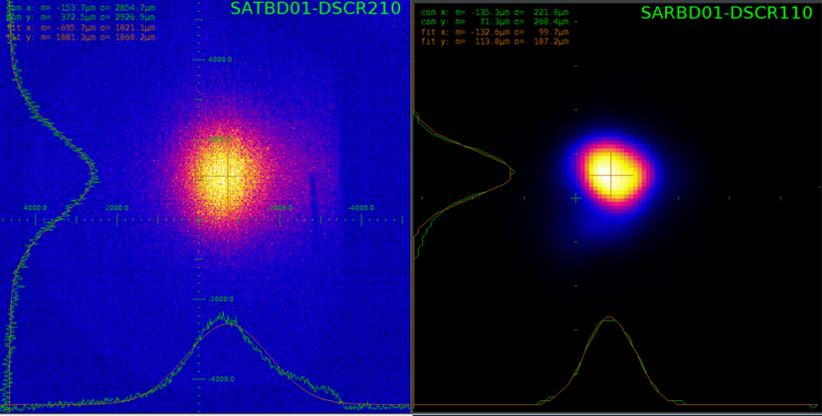
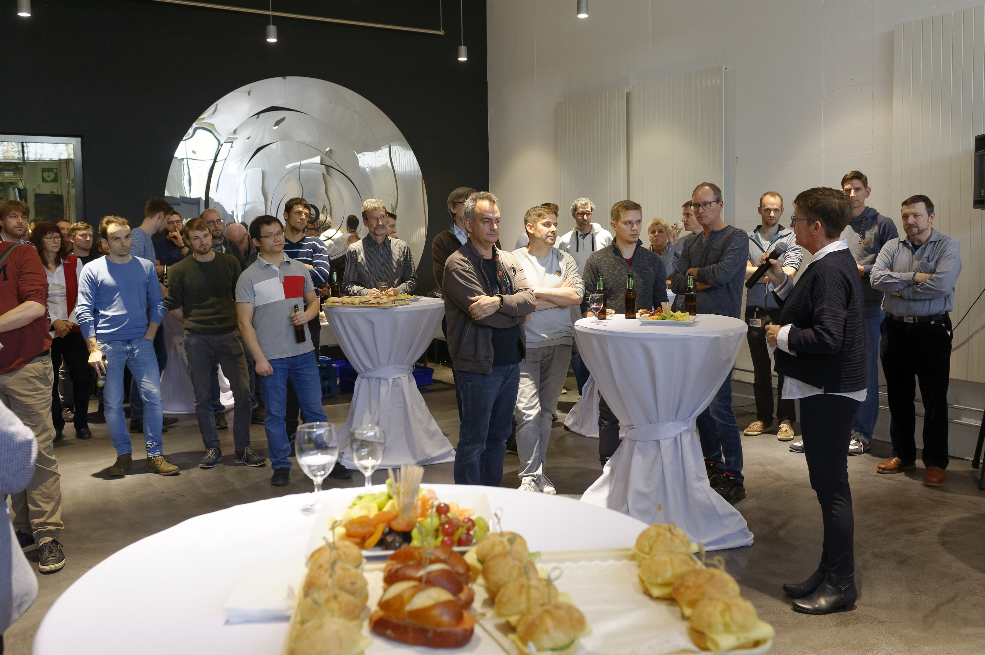
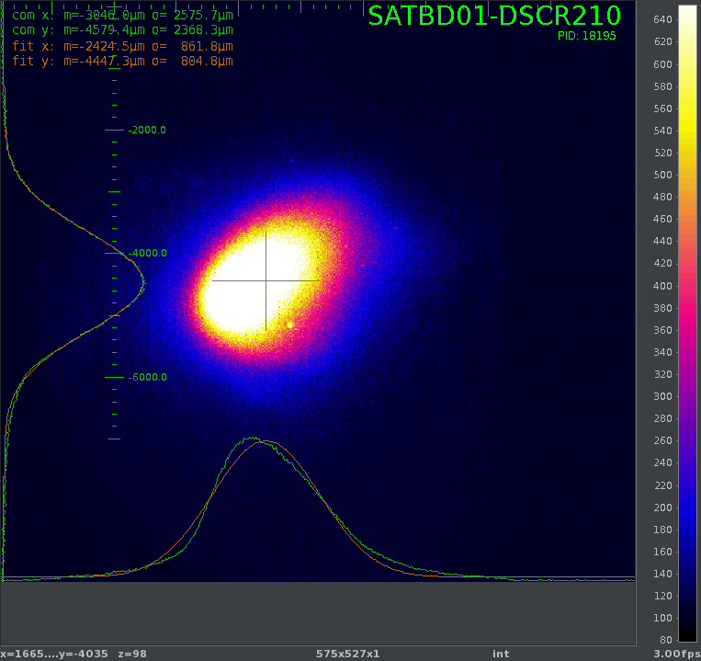
Athos 1st Lasing
Athos: Circular Polarisation
4 nm 310 eV
3 GeV; 200 pC; 2.5 Hz
CHIC chicane at maximum compression R₅₆=5um (9fs)
Undulator K=3.66
Aramis: 10.4 keV 200 uJ
This year, much more Photonics Commissioning Tasks
=> Goal: 1st Test Experiment in Maloja
PSI December 17th, 2019
PSI March 3rd, 2020
PSI December 18th, 2019

Slide 5
Workshop goals
Establish a commissioning plan until mid 2021
          Common Overview Commissioning Plan
          List of Commissioning Tasks (machine and photonics)
          Number of shifts required per group / task
          Distinguish tasks that are independent of Aramis operation
          Synchronize tasks with hardware and available manpower & Aramis Operation
Integration of shifts (Task + Responsible) in DUO Plan (Didier)
Identify issues when parallel operation Aramis / Athos
    Technical issues: how to setup parallel operation fast and reliably?
    Manpower issues: how to share manpower efficiently ?
… why not so successful until now

Slide 6
Agenda
Introduction: Workshop Goals & Athos Timeplan Overview (Romain) (15’)
Athos Photonics Overview including Commissioning plan Front End and Optical Hutch (Luc) (20’)
Maloja: description and commissioning plan (Kirsten) (20’)
Furka: description and commissioning plan (Christian) (20’)
    Coffee Break
Athos Beam Dynamics commissioning status & plan (Eduard) (20’)
Athos / Aramis parallel operation: status, issues (Didier) (20’)
Lessons Learn from Aramis Commissioning + Automated Operation (Florian) (20’)
DRPS: Status and possible improvements (Markus) (15’)
    Lunch Break
Mizar Laser & Pump Laser Commissioning plan (Alexandre) (15’)
PolariX Status & 2 bunch acceleration setup procedure status (Paolo) (15’)
Diagnostic Status & BCM for Athos (Gian Luca) (15’)
Photon Diagnostics: description and commissioning plan (Chris) (20’)
    Coffee Break
Undulator and CHIC chicanes: commissioning with beam (Marco C.) (20’)
Control Commissioning Plan for Athos (Tine) (20’)
Scientific Computing, DAQ (Alun) (20’)
HERO: Description and Time Plan (Romain) (15’)
Photonics
Machine Aspects
Components
varia
Program Committee: Bostedt Christoph; Follath Rolf; Ganter Romain; Nolting Frithjof; Patthey Luc; Prat Costa Eduard; Schietinger Thomas; Voulot Didier.

Slide 7
Athos Milestones
C band linac ready for conditioning: after august shutdown
First Light in Maloja Experiment Chamber -> electron spectrometer (Photon Energy and Bandwidth)
Delay in X Band Modulator (expert manpower issue, delivery delays)

Slide 8
Time Plan
Last Undulator in Tunnel: Jan. 2021
UE38 Delivery in tunnel
Test experiments and UE38 installation interleaved (1 shutdowns/month)

Slide 9
Commissioning Overview 2020
New Hardware:
Mizar Laser
2 meters dechirper
7 to 9 UE38 with chicanes
1st mirror & 100 m Optic Line
Maloja KB Mirrors
Maloja Chambers & Spectrometers
New Hardware:
11 to 15 UE38 with chicanes
4 meters dechirper
Athos C band linac
Pump laser
Mirrors for Furka
Maloja Jungfrau Detector
Photon Spectrometer
New Hardware:
Monochromator
16 UE38 + chicanes
PolariX; BAMs
BCM in Dogleg
Photon wavelength
New Hardware:
3 to 5 UE38 with chicanes
Tasks (Aramis dependent):
Prepare Pilot Exp.
CHIC modes setup procedures
Tasks (Aramis dependent):
Parallel Lasing Ar / At consolid.
Emittance; BBA
DRPS Calibration
PSYS Optical Hutch
Tasks (Aramis dependent):
BBA/ UE38 alignment
Tasks (Aramis dependent):
BBA / UE38 alignment
Tasks (Independent):
Dechirper
Jungfrau commissioning
C band Commissioning
CHIC Modes:
  2 Colors & Short pulses
Test Experiments Maloja
  Polarization Changes
  2 colors (around 800 eV)
Tasks (Independent):
Prepare Pilot Exp.
PolariX commissioning
Feedback on BCM
CHIC modes setup procedures
Pump / Probe tests
1st FEL in Furka
Tasks (Independent):
BPM commissioning
Feedbacks
Gas Monitor / Photodiode
UE38 K Calibration
Athos Front End (screens, …)
Tasks (Independent):
Mizar Commissioning
Dechirper
UE38 K Calibration
CHIC modes tests
KB commissioning
1st FEL in Maloja
e- spectrometer (Maloja)
  BW of FEL; Pulse duration
Shifts in parallel to Aramis Beamline Development Shifts

Slide 10
Many thanks for your attention

Slide 13
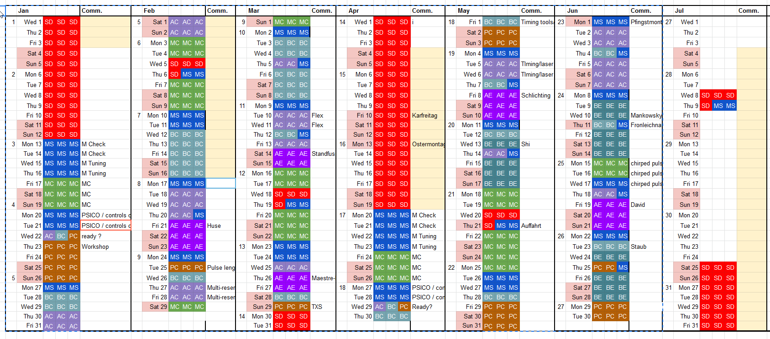
Photonics Time Plan Aramis

