Slide 1
DREAM
HR-Imaging of
Local structures
and bonds
LEAPS
LENS
Operando
3D-Imaging
Ultrafast Analysis
Insitu scattering and
Spectroscopy
European
Analytical Facilities
for a
sustainable society
EMFL
LASERLab
HF-Analysis
of Materials
Light Spectroscopy
of Materials
Radiate
EMFL
Depth
Profiling

Slide 2
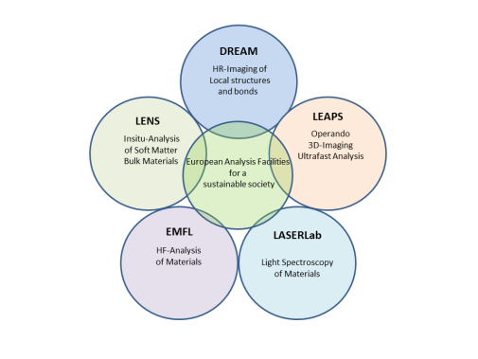
EAF Working 1
Adaption
to Climate Change
EAF Working 2
Cancer
EAF Working 3
Soil, health
food
EAF Working 4
Climate neutral
Smart cities
EAF Working 5
Heathy oceans
seas, water
Members:
Nn
Nn
Nn
Nn
nn
Members:
Nn
Nn
Nn
Nn
nn
Members:
Nn
Nn
Nn
Nn
nn
Members:
Nn
Nn
Nn
Nn
nn
Members:
Nn
Nn
Nn
Nn
nn
Role of EAF for each HE Mission
Key technologies
Specific Contribution/s
Cooperation partners

