Slide 1
Eddy currents analysis @ quench
3rd version
P. Testoni
04 June 2020

Slide 2
Three analyses performed
3D analysis: current in the coils is varied with an exponential law and 0.2s time constant
3D analysis: current in the coil obtained closing the coil ends in a dump resistor R=0.136 Ohm
2D analyses to assess the eddy currents in the cryostat (also by changing the thickness of the Al shell from 7 to 3 cm)

Slide 3
3D analyses

Slide 4
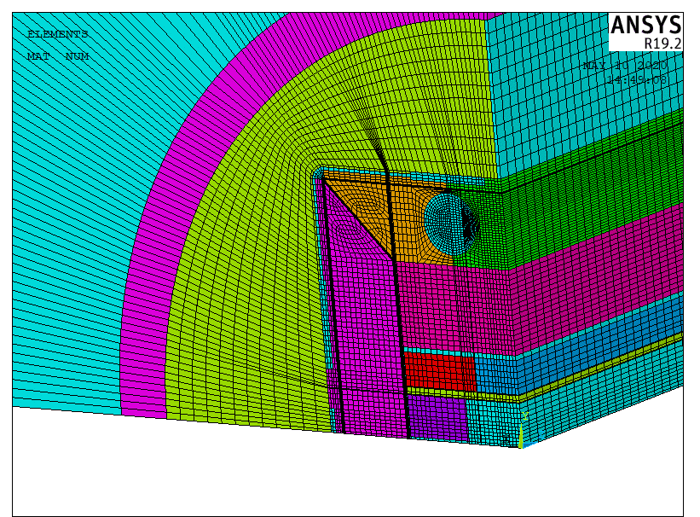
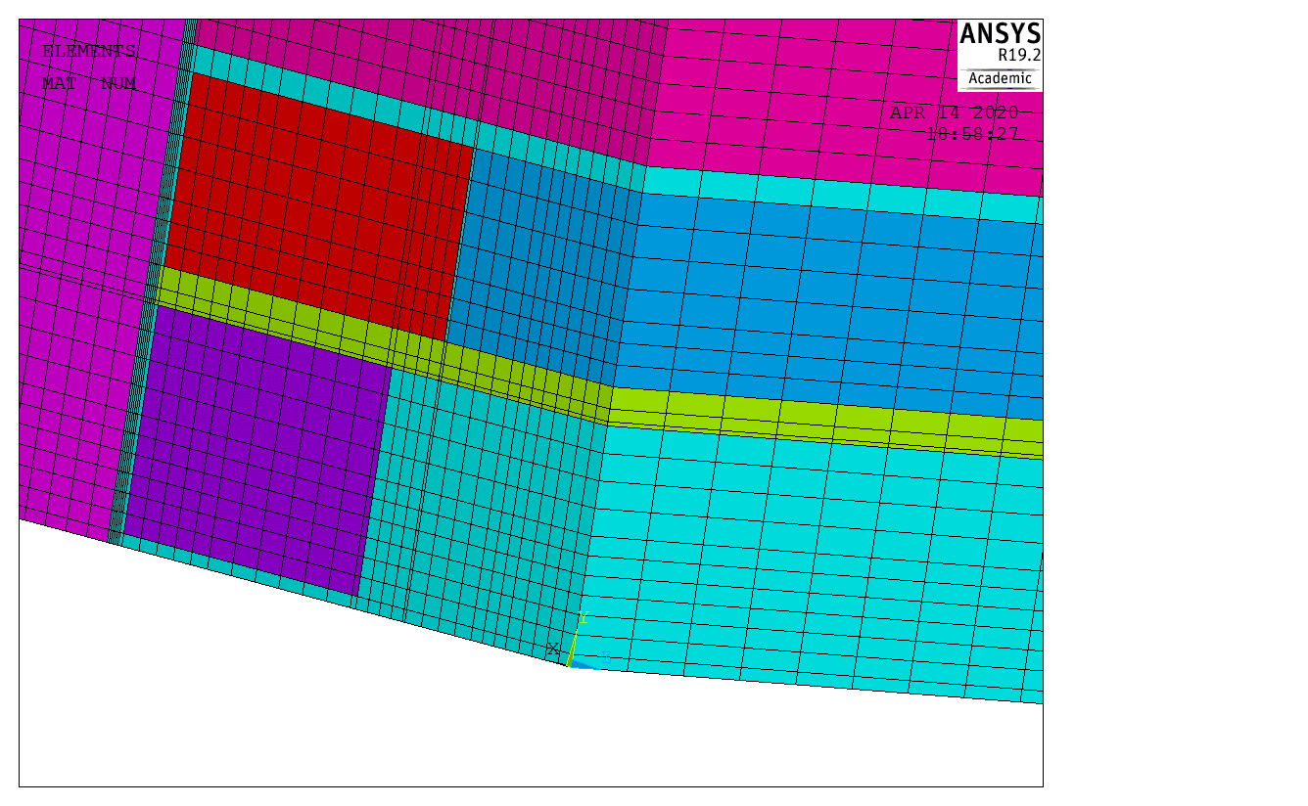
Finite element model
iron RSVX
0.5000000E-06
SS RSVX
0.4960000E-06
Al RSVX
0.5760000E-08
Resistivity Ohm m

Slide 5
Formulation
ANSYS element SOLID236 is used. It is an edge element and it allows to appropriately manage eddy current analyses with non linear materials. Analysis 2 is performed with the “stranded coil” option.

Slide 6
First analysis
Current in the coils is varied with an exponential law and 0.2s time constant

Slide 7
Loading
Current in the coils is varied with an exponential law and 0.2s time constant

Slide 8
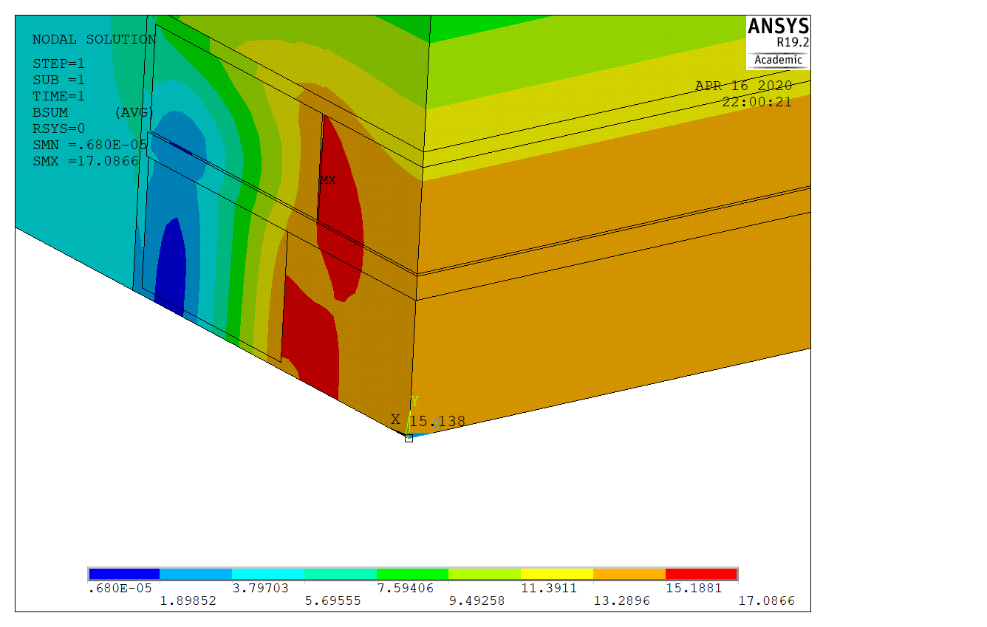
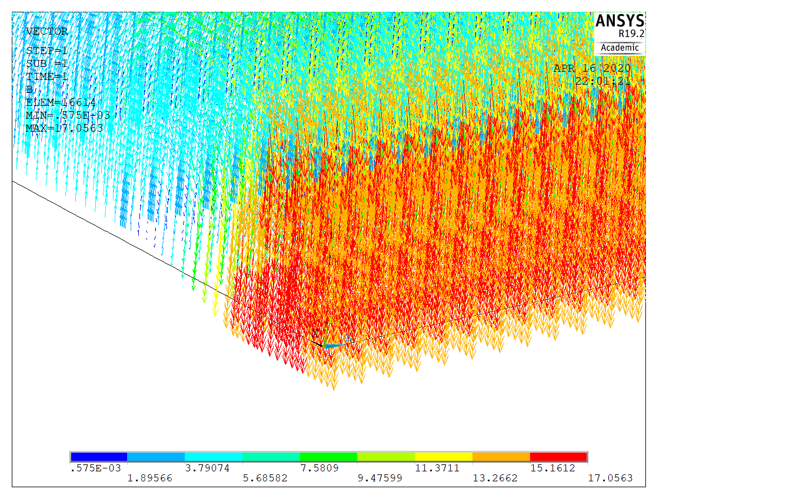
Initial conditions

Slide 9
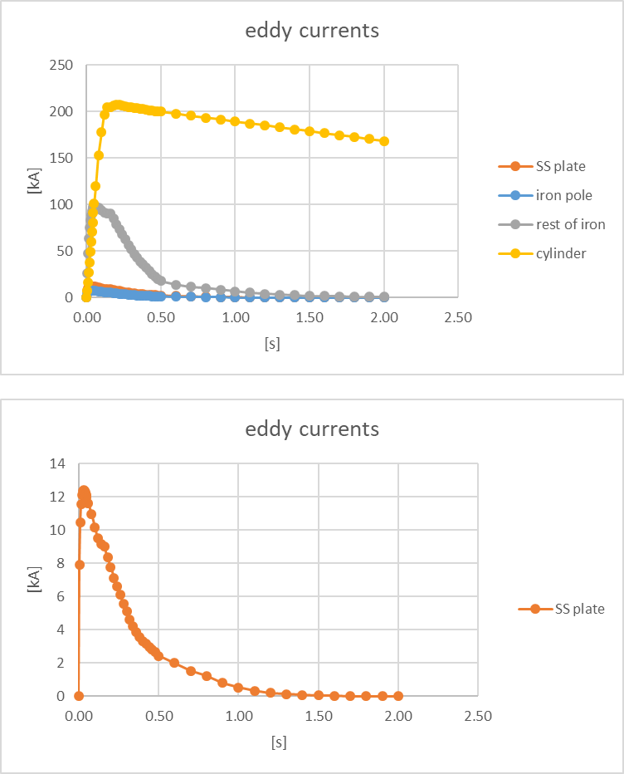
Evolution of eddy currents in 2 s

Slide 10
Evolution of eddy currents in the first 0.25 s

Slide 11
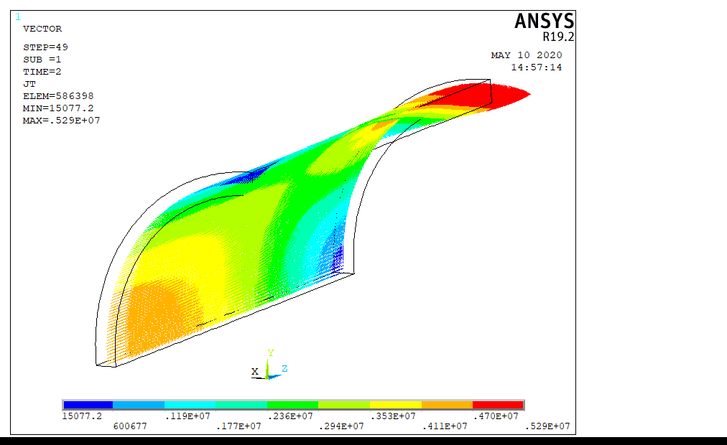
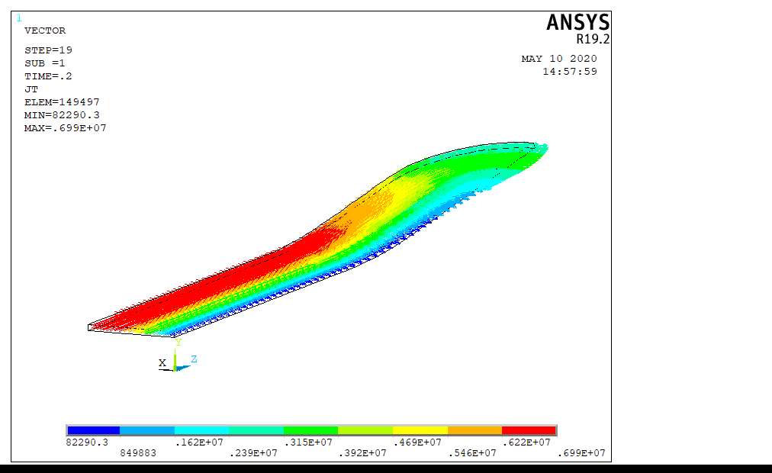
Eddy currents
t=2s
t=0.2s

Slide 12
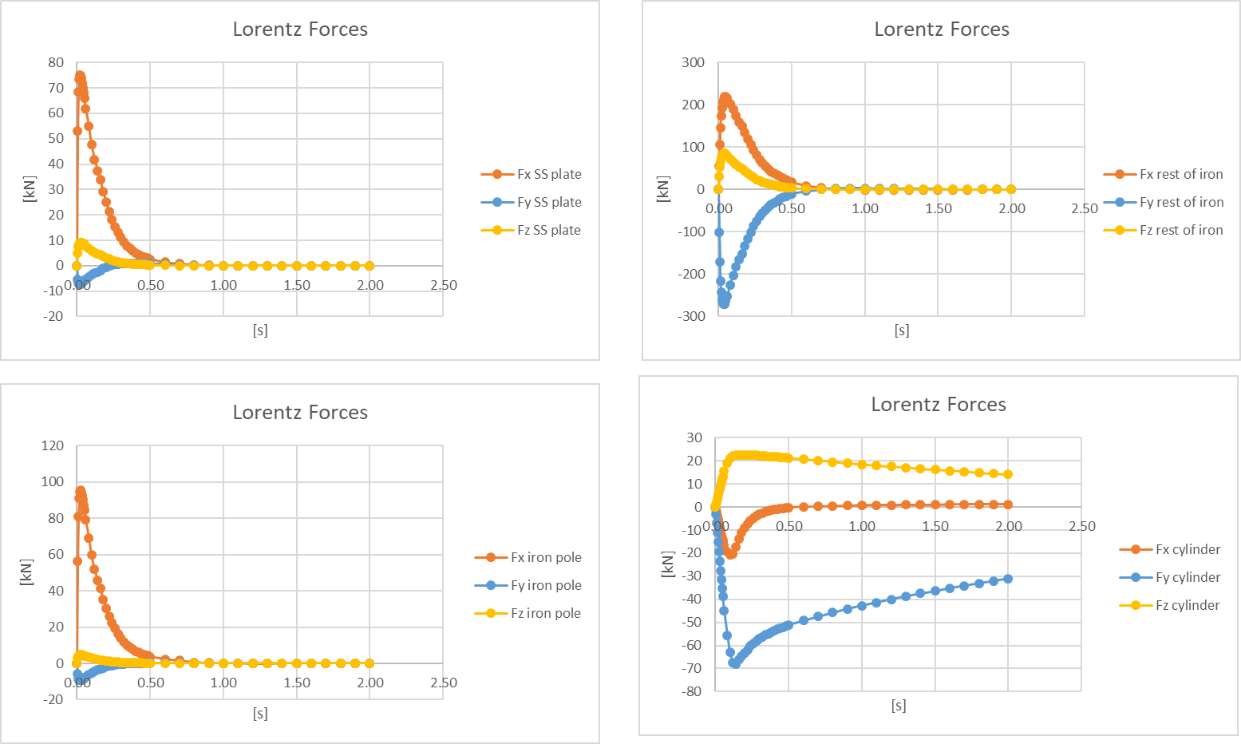
Evolution of Lorentz forces for 1/8 of the magnet

Slide 13
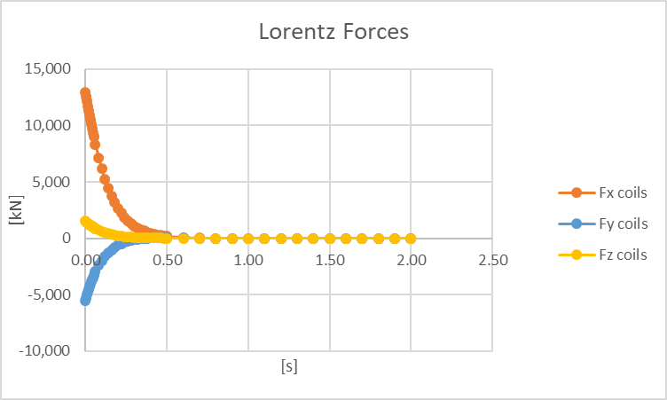
Evolution of Lorentz forces for 1/8 of the magnet

Slide 14
Evolution of power loss for 1/8 of the magnet
Total Energy loss (for the entire magnet)= 460 kJ

Slide 15
Second analysis
Current in the coil obtained closing the coil ends in a dump resistor R=0.136Ohm

Slide 16
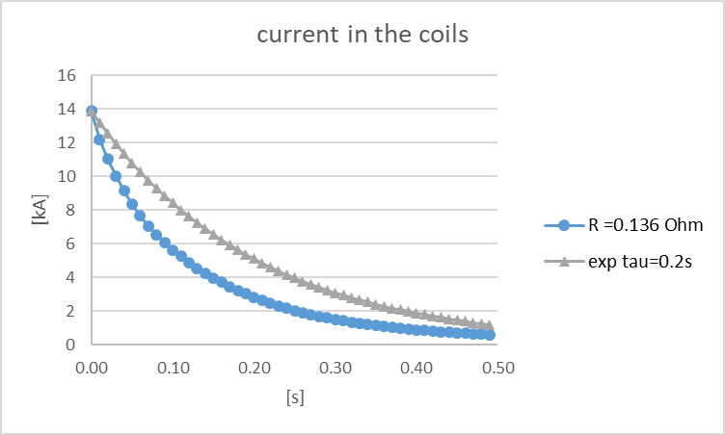
Current in the coil

Slide 17
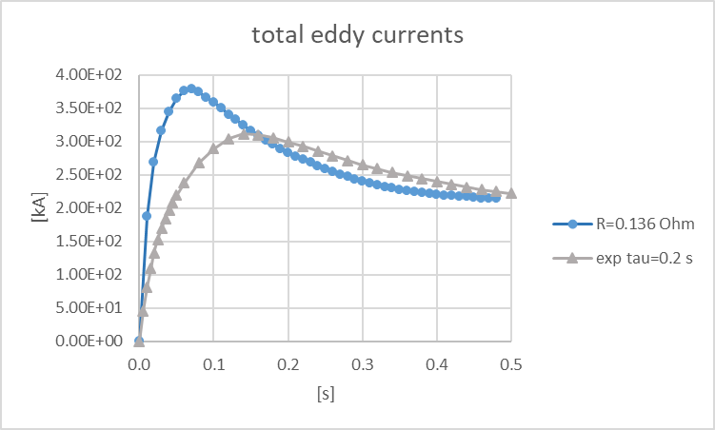
Evolution of eddy currents

Slide 18
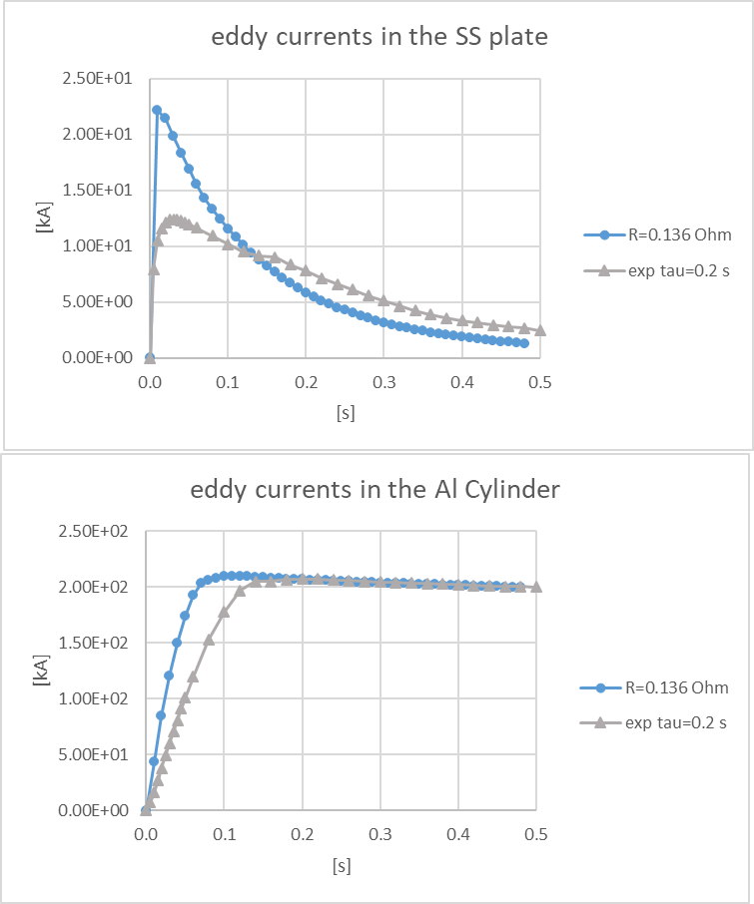
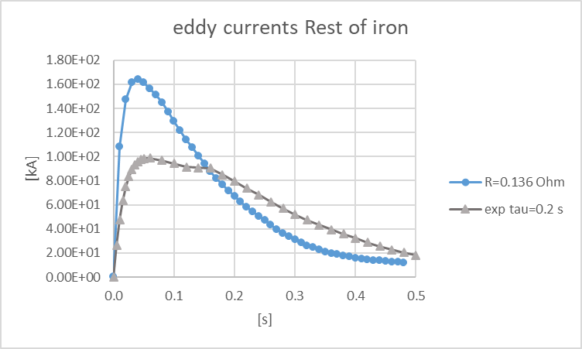
Evolution of eddy currents

Slide 19
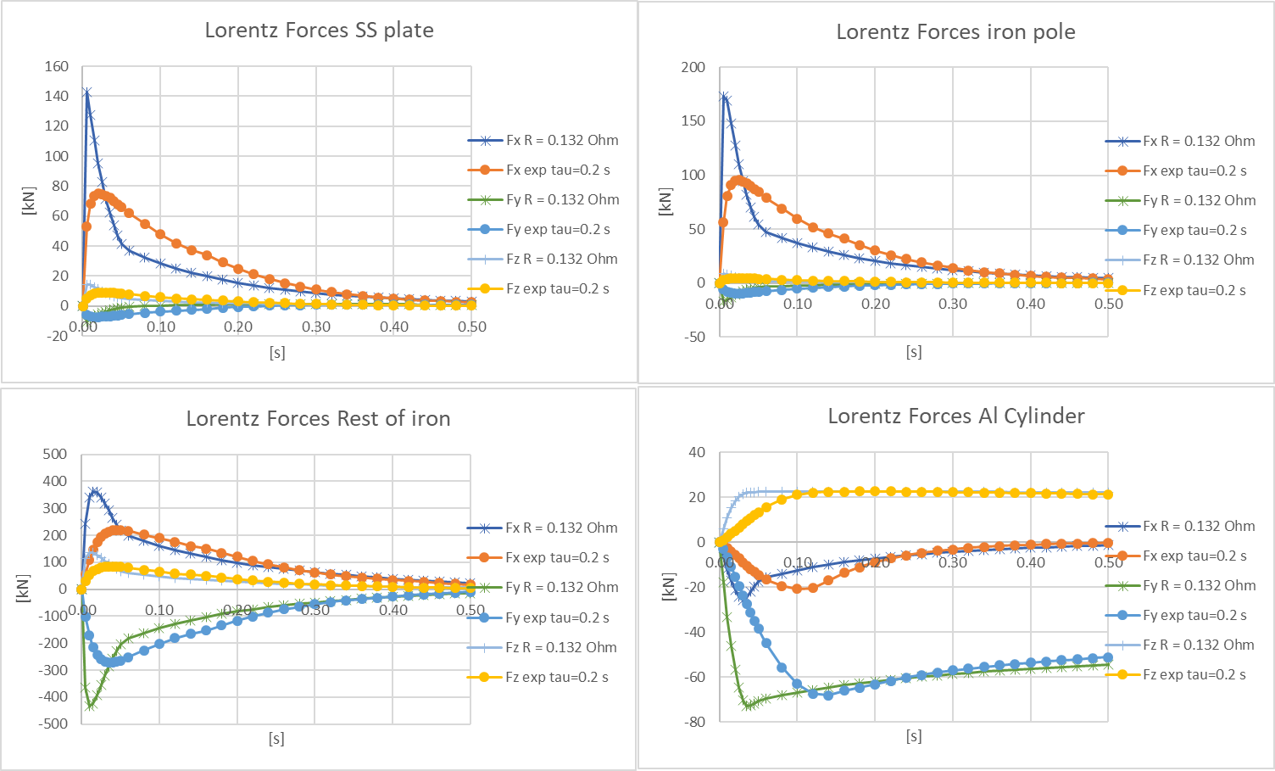
Evolution of Lorentz forces for 1/8 of the magnet

Slide 20
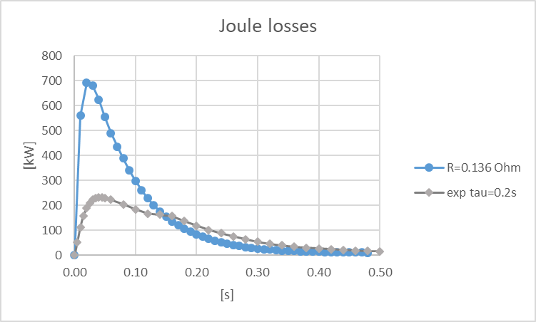
Power loss

Slide 21
Conclusions
The real evolution of the current in the coil during the quench is faster then the exponential trend with t=0.2 s
This produces more eddy currents and highest forces in almost all components of the dipole.

Slide 22
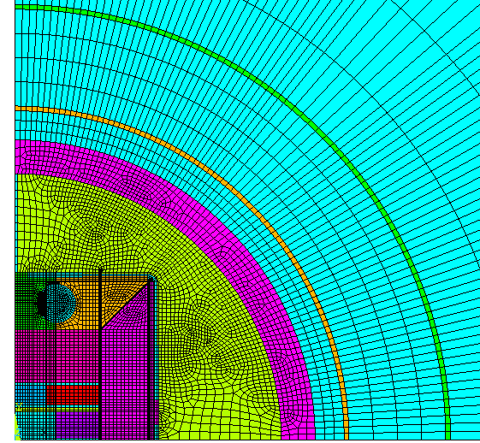
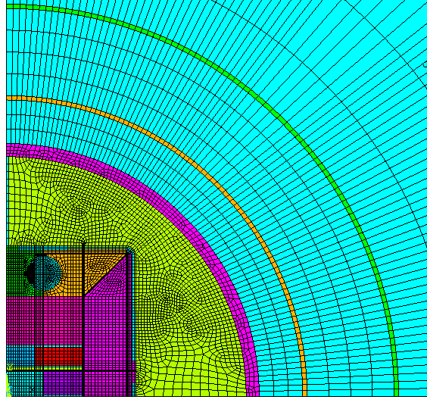
Third analysis
2D analyses to assess the eddy currents in the cryostat (also by changing the thickness of the Al shell)

Slide 23
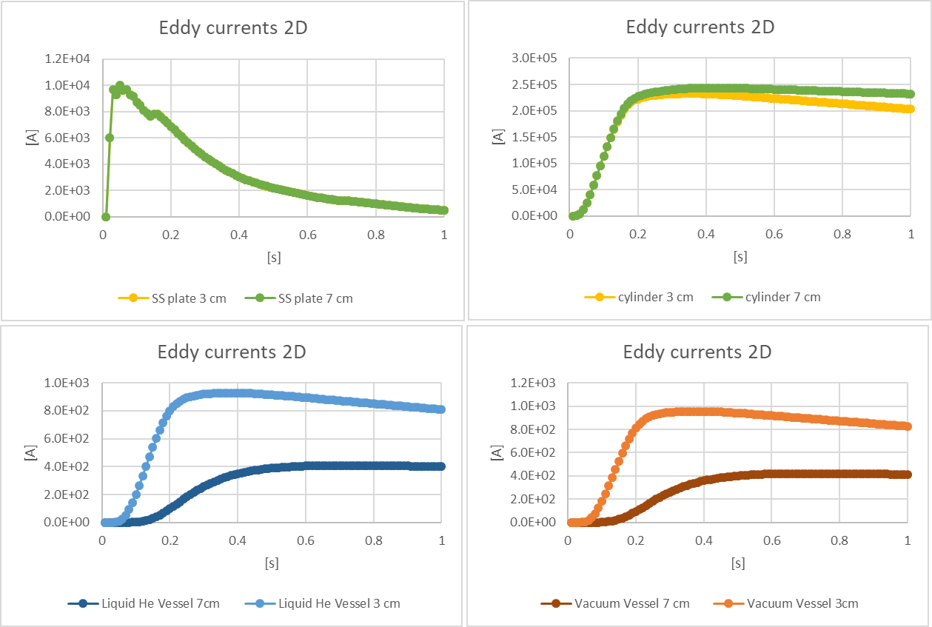
Evolution of eddy currents

Slide 24
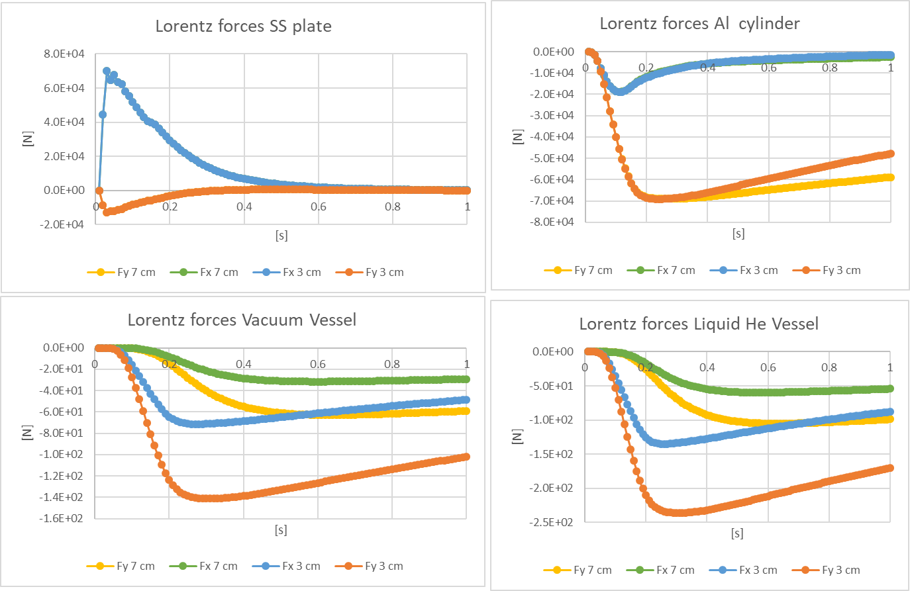
Evolution of Lorentz forces (p.u.l.) for 1/4 of the magnet

