Slide 1
SwissFEL Exchange Meeting
Machine report
Week 27/2020
Didier Voulot
SEM, 6 July 2020

Slide 2
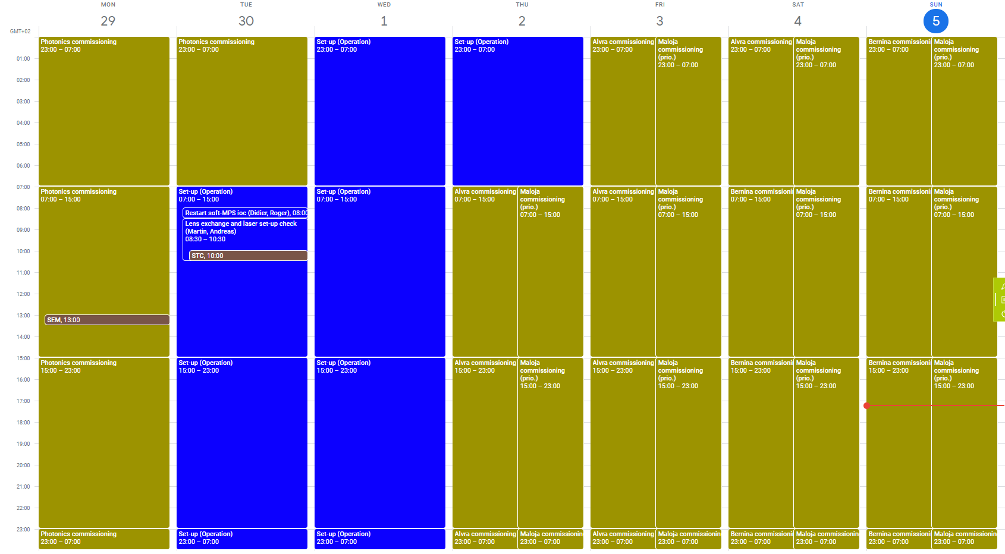
Week overview
Maloja week, Athos first prio.

Slide 3
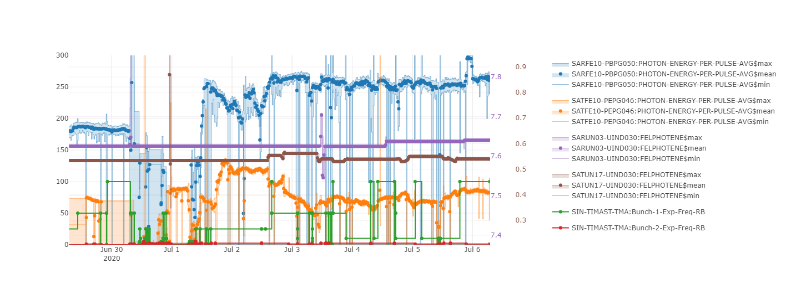
Set-up
Set-up
Beam drifting after energy change
Difficulties setting-up 2 bunch
Both beams available Wednesday mid-day
Parallel operation most of the week
Partly 100 Hz operation on AR (limited to spare Alcor)
Max. 2.5 Hz on Athos, undulator losses
Athos undulator motors getting stuck (PLC reset)

Slide 4
Beam set-up Tues-Wed
Capillary optics changed, clear improvement on laser profile and electron beam
Tried a clean 2-bunch set-up (Tue)
  Did not manage to get correct compression for both bunches
  Seems that the Jaguar delay was wrong (compensated with the gun RF step)
  SINXB01 step timing was set wrongly (probably by accident), the step affected bunch-1
Correct gun set-up and Jaguar arrival time (Wed)
  Same bunch length, both bunches < 40 fs rms
  Not a clean set-up: some energy error in BC1 and BC2 for bunch2
Still need to improve 2-bunch set-up procedure
  Be more systematic
  Only use RF step for fine tuning

Slide 5
Parallel operation
Worked well, beam delivery on Aramis and Athos for most of the week
Tuning is possible without affecting the other line (many alarms are transparent to the other line)
Photon energy changes possible for both lines
  ECOL energy with optics feedback for Aramis
  K scaling for Athos without scaling CHICs (small changes 10-20 eV)
  Athos undulators K controls periodically gets stuck, need hard reset of PLC in the gallery
Did not use PSICO, Athos had priority
  Need to investigate what can be optimized without perturbing Athos
  Athos PSICO?
The machine was reasonably stable, not much drift, though not optimal lasing
  A drop in energy (120 -> 80 uJ) after an energy change in Athos could not be recovered

Slide 6
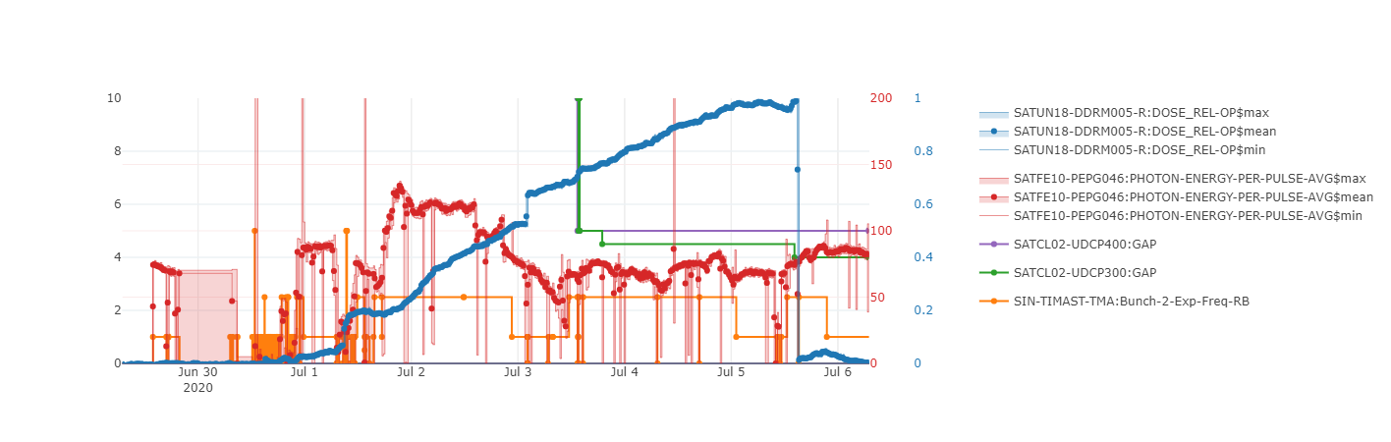
Losses in undulators
Losses in Athos undulators can be mitigated with correct optics/orbit
Difficult to tune down with DRMs (BLMs at zero)
Max rep. rate 2.5 Hz
Dark current comes from the gun (vanishes totally for a gun phase change of 180 deg)
Gun dark current was measured on the FC (Paolo): 10-20 pC, consistent with previous measurements, expect < 1 pC to be accelerated through the C-band
Close Athos dechirper and increase rate
DRM reset
Losses in SATUN18 after beam tune-up

Slide 7
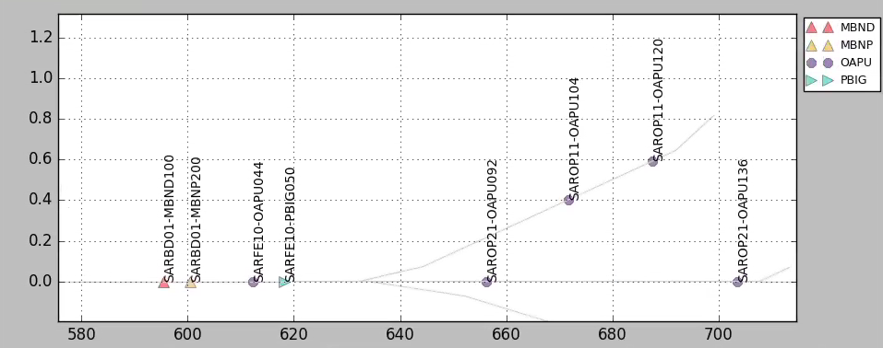
Aramis pointing
Several alarms due to changing aperture position
  OAPU044 and OAPU092 are reference points for Aramis
  Is this still relevant? Should we keep these alarm?
  OAPU092 not relevant for Alvra
The position and width of the first slit OAPU044 influence the readings of the GD
Pointing feedback should be disabled before changing OAPU044

Slide 8
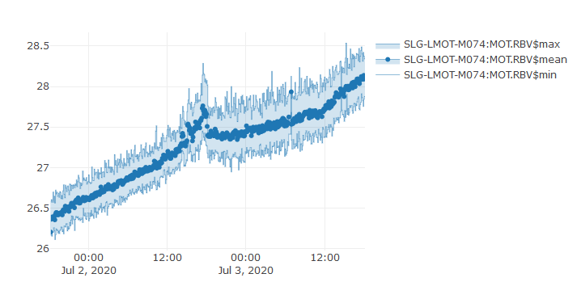
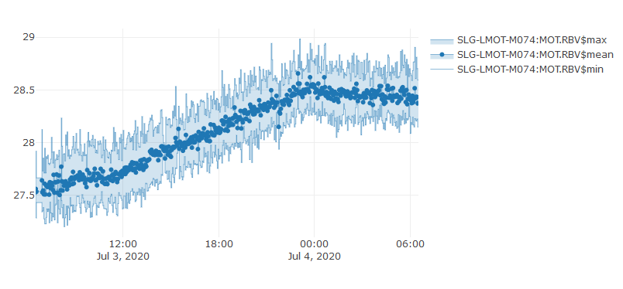
Alcor driftig during the weekend
Alcor power drifting up, due to damaged optics
Reduced laser fire rate whenever possible during the weekend to extend life time
Is 100 Hz sustainable?
Alcor Fire 100 -> 10 Hz

Slide 9
Conclusion
Gaining experience with parallel operation
100 Hz routine operation for Aramis
Need to address losses in Athos undulator
Need to consolidate 2-bunch set-up (mostly operation problem)

