Slide 1
Alvra Commissioning days
July 2nd & 3^{rt}, 2020

Slide 2
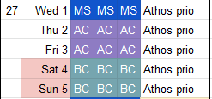
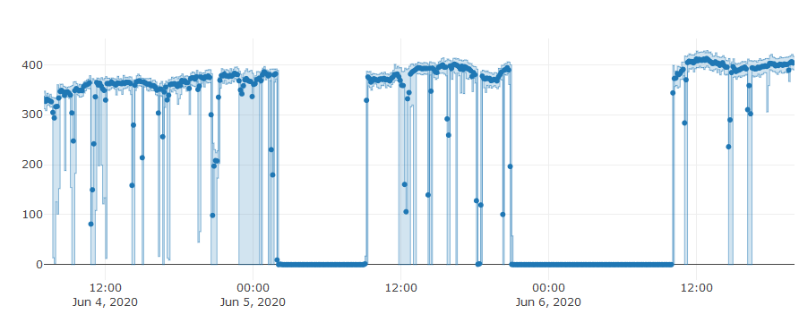
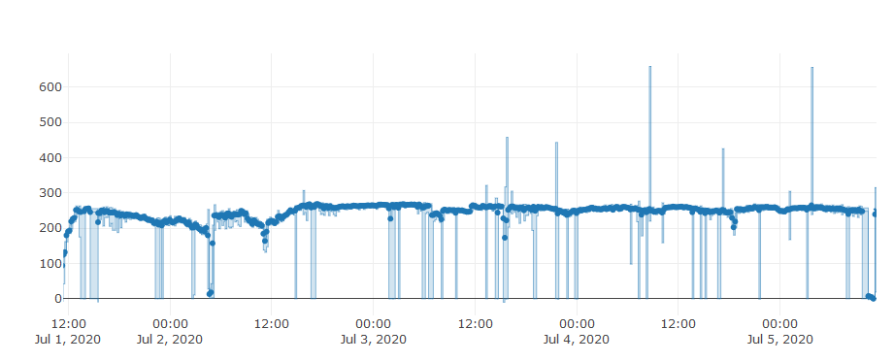
Schedule KW27
Machine stable at ~ 250 uJ / 7.5 keV (was 400 uJ / 8 keV last time…)
Xray pulse duration 50 fs rms (70 fs fwhm)
Thu: Mono beam (re-) alignment (Rolf)
Fri: Timing tests with 2 timing tools

Slide 3
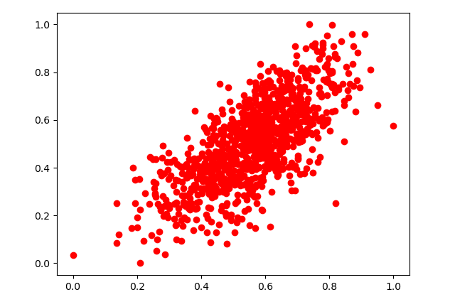
JF correlations
Izero intensity (PBPS117) [arb.u]
@ Dima
Total intensity of JF4M [arb.u]
Good intensity correlation between JF (measured at 50 Hz)
Mysterious «31 pulses» (reported last week) offset disappeared
One night of «continuous» measurements (basically each pulse ID requested) resulted in a long (few hours) backlog to retrieve data

Slide 4
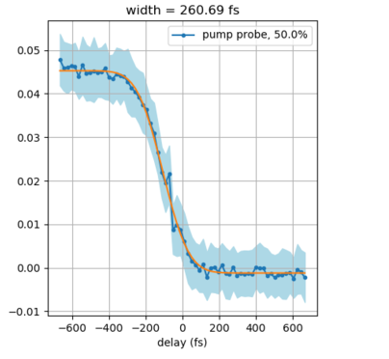
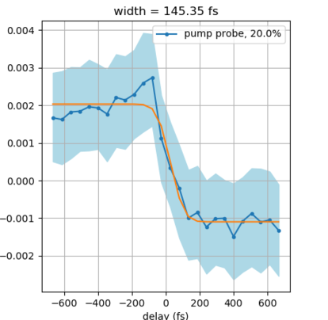
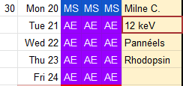
Timing tests
50 um YAG
2 um Si₃N₄
We need shorter pulses, possible to repeat these tests on July 20th?
(200 uJ / ~10 fs rms / 12 keV)
Sample response (thin SiN window)
Laser pulse: < 40 fs fwhm (800 nm)
Xray pulse duration: <120 fs fwhm (<50 fs rms e-bunch)
Xray / laser jitter (no drift): < 50 fs fwhm

