Slide 1
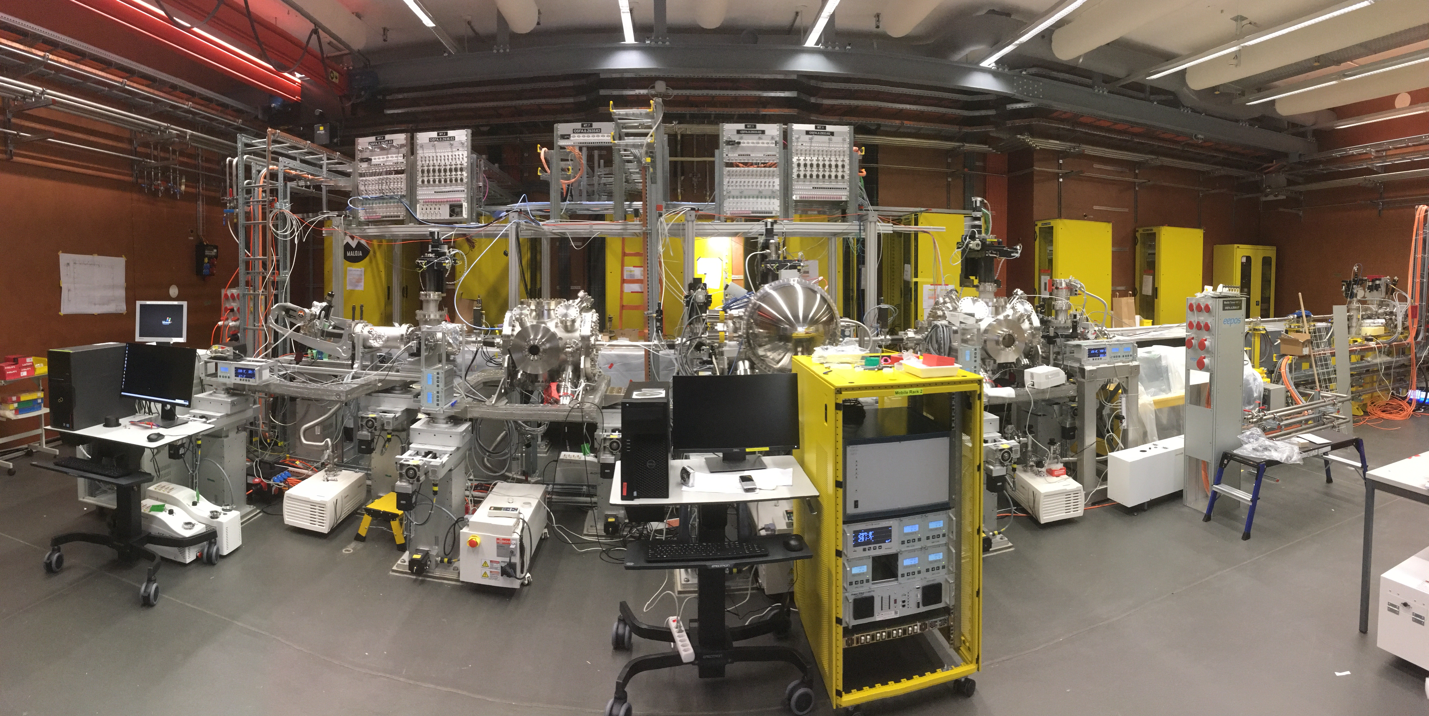
Maloja Setup
Photon spectrometer (SLS, T. Schmitt)
Ion Time-of-Flight spectrometer
Beam manipulation and zone plates
Electron analyzer

Slide 2
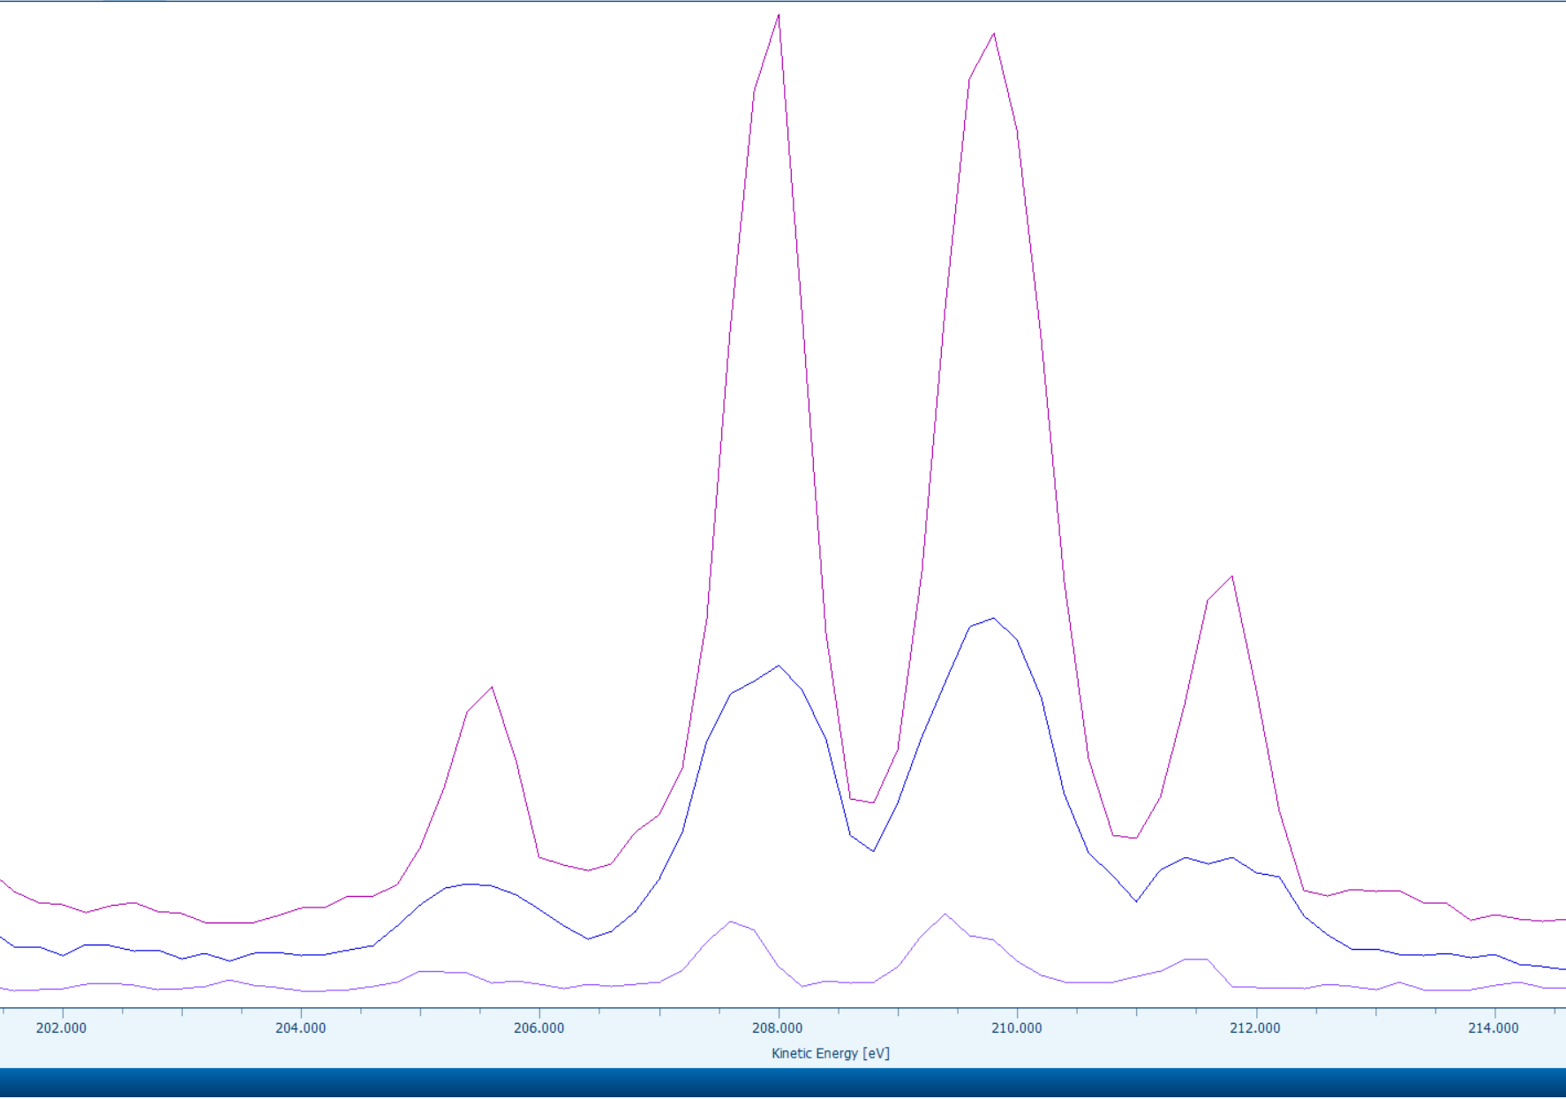
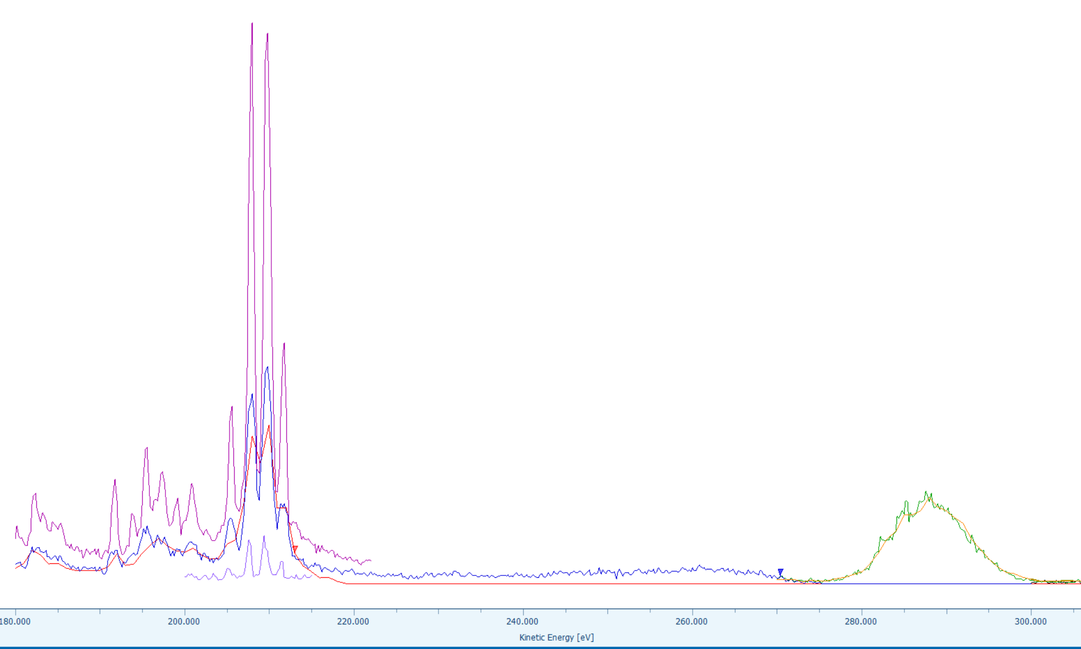
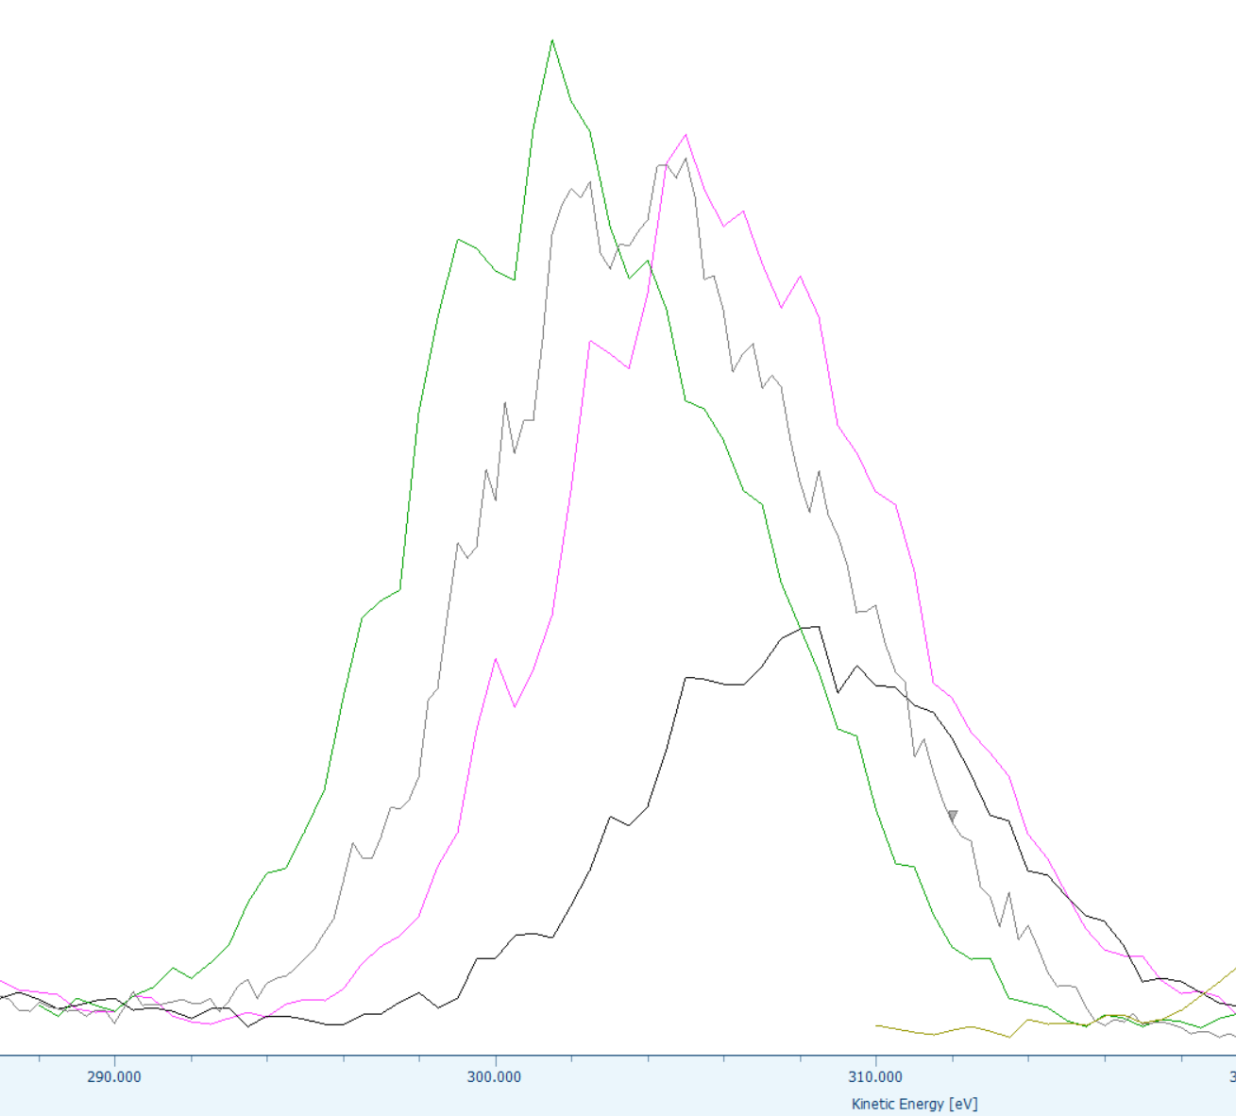
Photon Energy Calibration with Electron Spectrometer
Ar(2p⁻¹) Auger electrons
Photo electrons
Energy scan 2 eV increment
Ar(2p) photo electrons at 540 eV

Slide 3
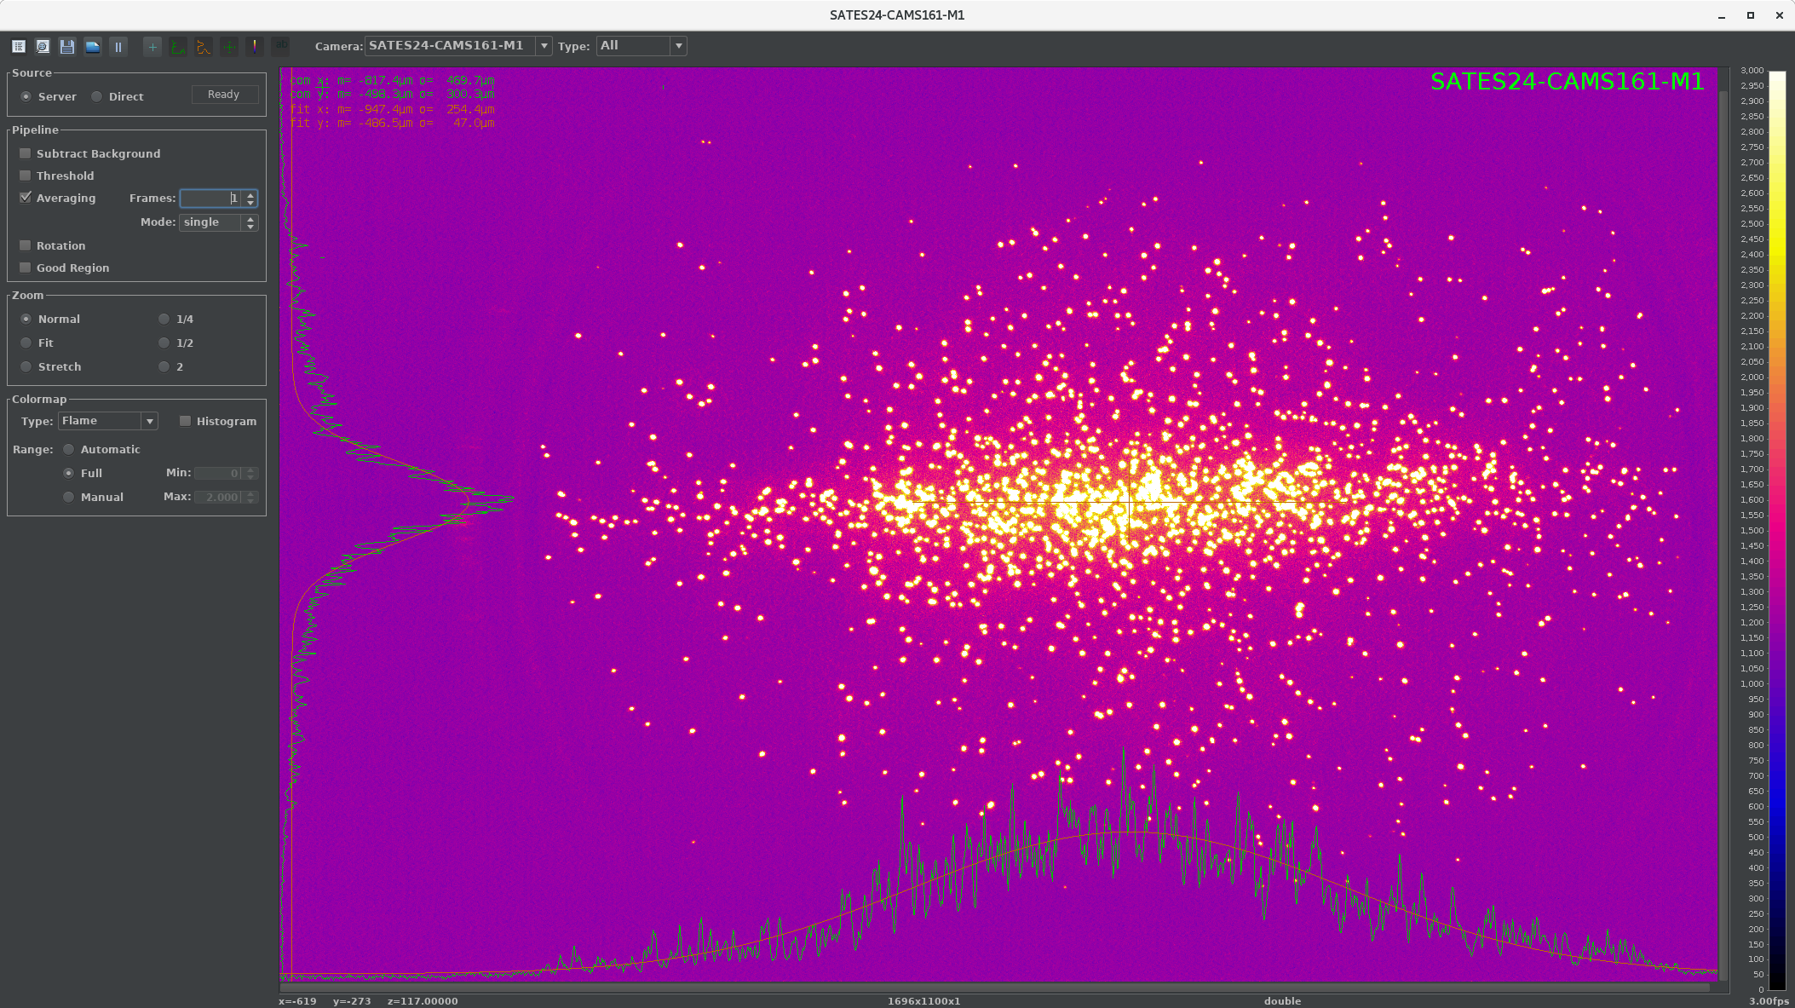
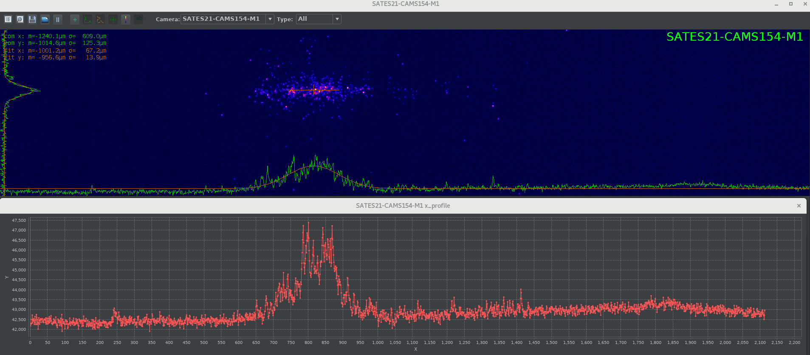
Single Shot Spectra
Photo electron spectrum Ne(2s)
Photon spectrum

Slide 4
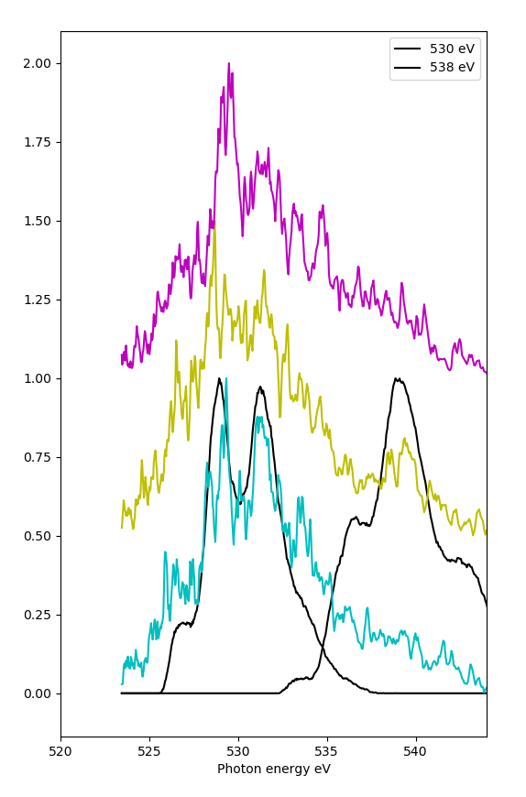
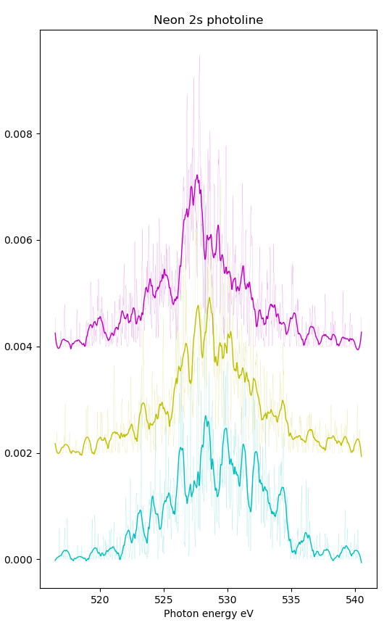
Single Shot Spectra
Photons
Photo Electrons

Slide 5
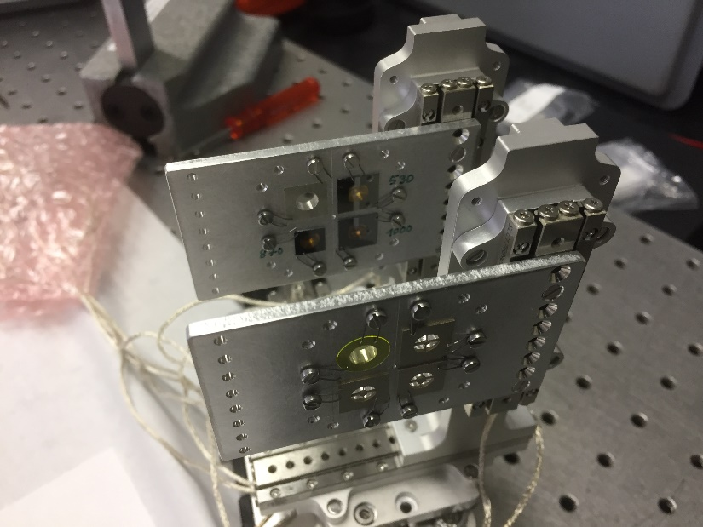
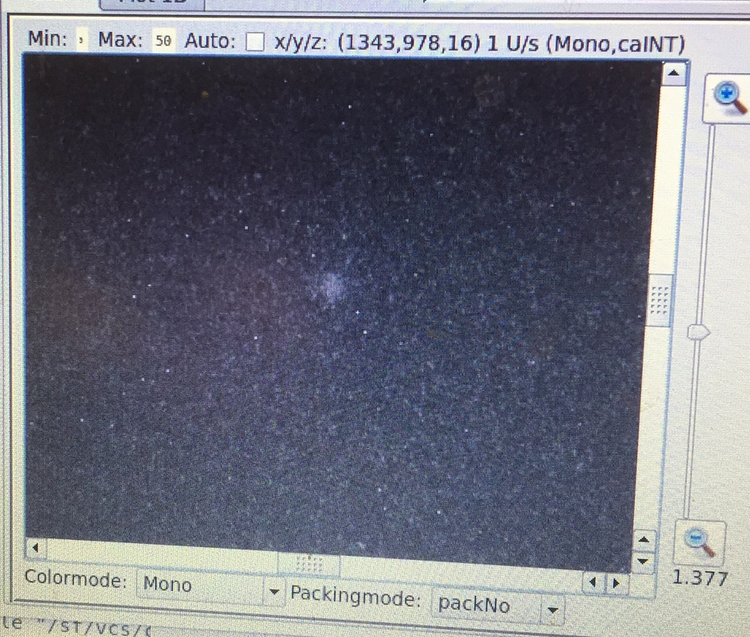
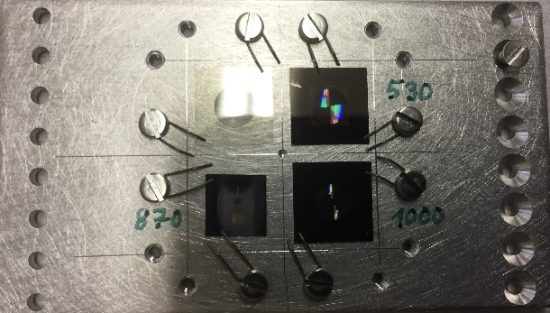
Zone Plate Focus for Electron Spectrometer
Electron spectra were greatly improved with focused beam
No multi-photon signal yet
Zone plate focus in chamber
XFEL
YAG, 10 mm x 10 mm,
20 um thick
Zone plate
for 530 eV
ca 30um
~12 mm
~12 mm
Zone plates: Florian Doering, Christian David
Zone plate
for 870 eV
Zone plate
for 1000 eV

Slide 6
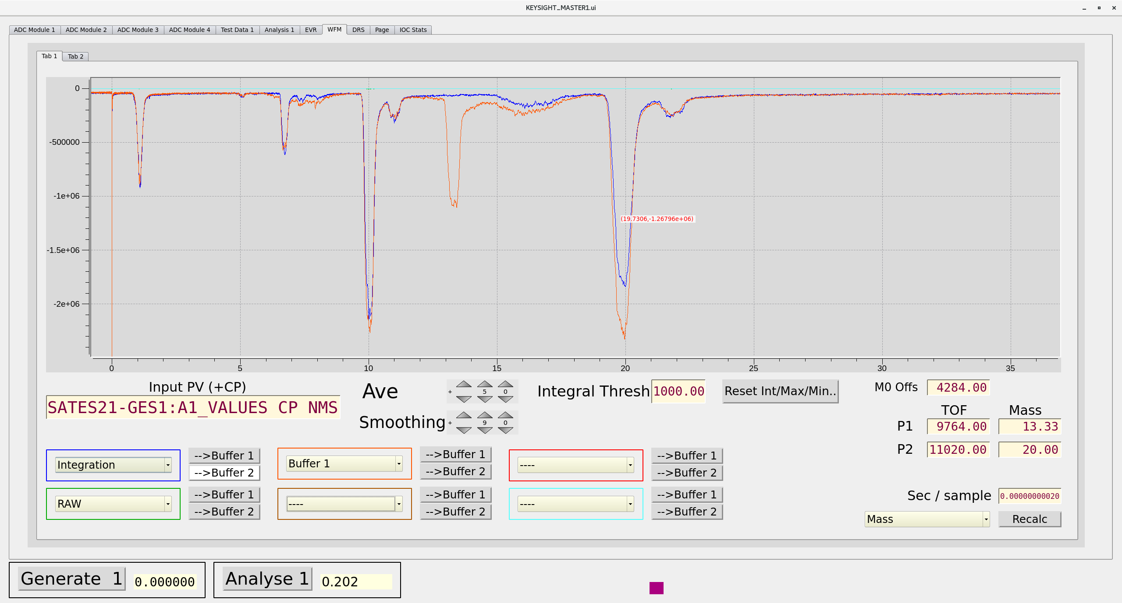
Harmonic Content!?
Neon photo ion spectrum at 540 eV
Ne³⁺
Only Ne^{+.} expected!
Ne⁺
Ne²⁺
Attenuation with aluminium foil indicates that beam contains significant amount of 3rd harmonic

Slide 7
Beam Feedback Capabilities
Photon energy absolute via electron spectrometer
Photon spectrum relative (width, shape and shift) over multi-shot average and single shot with photon and electron spectrometer
Pulse energy arriving at endstation and behind sample with all spectrometers
Harmonic content in beam

