Slide 1
Coherently driven electro-orbitons in a quantum spin liquid
Bernina experiment Mankowsky

Slide 2
Coupled excitations
Elecromagnon: coupled optical phonon and magnetic excitation
use THz electric field to control magnetism
Kubacka et al., Science 343, 6177

Slide 3
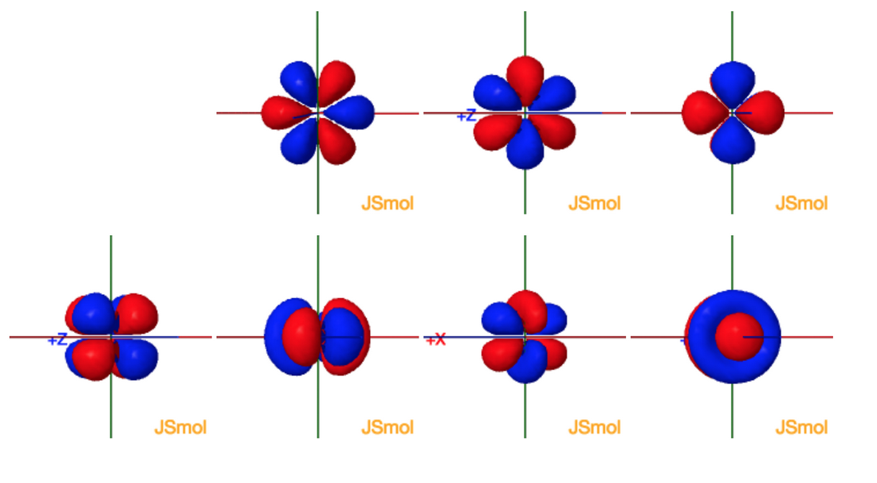
Coherent orbital excitation
use THz electric field to coherently control orbital occupation
New type of coherent control, orbital occupation influences
electronic and magnetic properties of solids

Slide 4
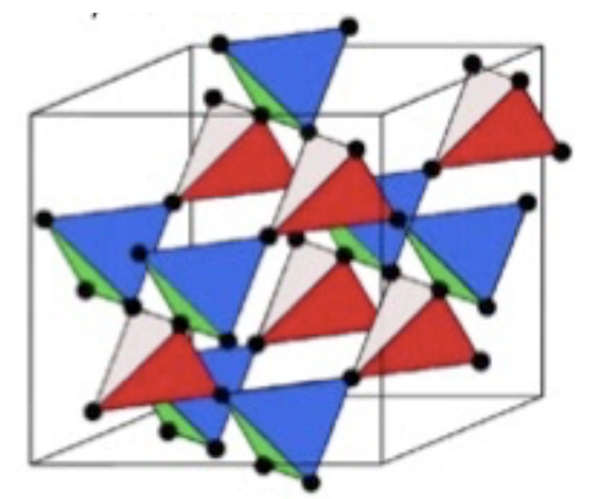
Coherent orbital excitation
use THz electric field to coherently control orbital occupation
New type of coherent control, orbital occupation influences
electronic and magnetic properties of solids
Tb2Ti2O7

Slide 5
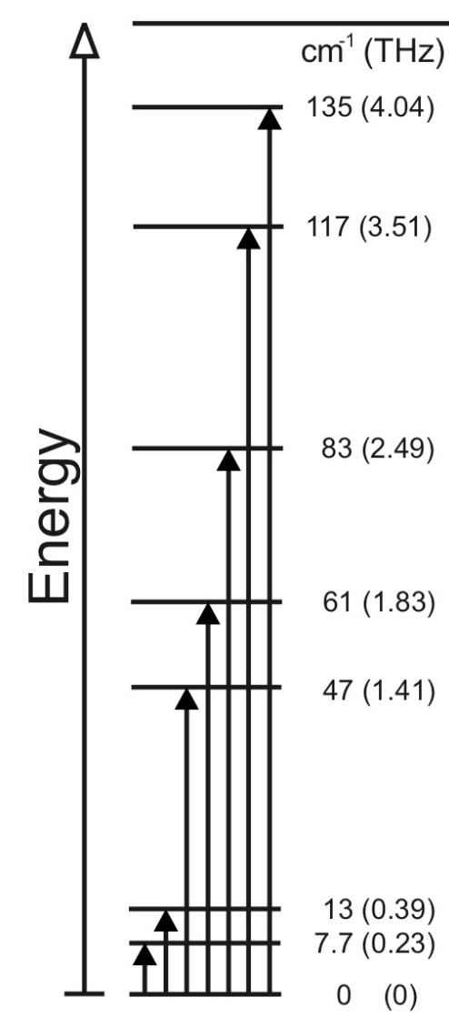
Coherent orbital excitation
use THz electric field to coherently control orbital occupation
New type of coherent control, orbital occupation influences
electronic and magnetic properties of solids
Tb2Ti2O7

Slide 6
Coherent orbital excitation
use THz electric field to coherently control orbital occupation
New type of coherent control, orbital occupation influences
electronic and magnetic properties of solids
Tb2Ti2O7

Slide 7
Coherent orbital excitation
use THz electric field to coherently control orbital occupation
Experimental Plan:
Drive crystal field excitation with THz pulse
Measure changes in structure (non-resonant diffraction)
Measure changes in orbital order (resonant diffraction)

Slide 8
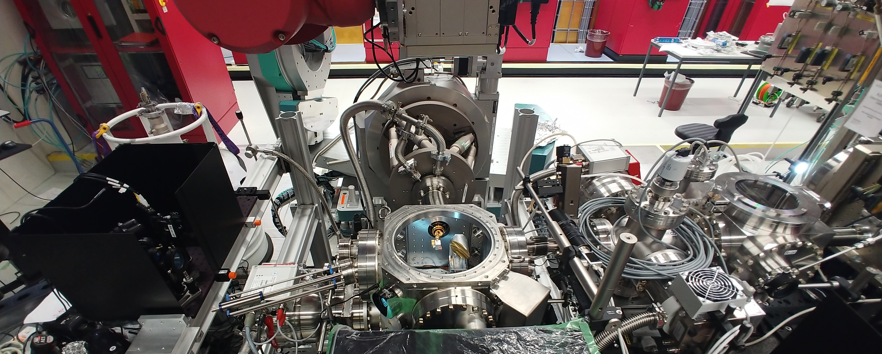
Experimental setup
Setup with diagnostic chamber, laser incoupling for THz diagnostic, experimental chamber and electrooptic sampling setup for THz diagnostic
THz diagnostics
Experimental chamber
time
tool
laser incoupling
THz incoupling

Slide 9
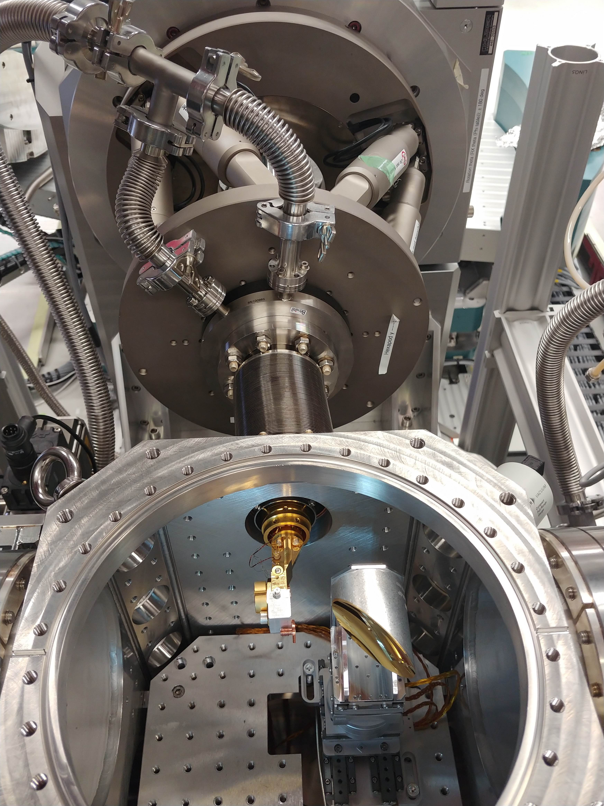
Experimental chamber
Orbitals have to be empty to be excited
Very large THz fields
5K sample temperature
Design of high Field THz chamber
Previous commissioning Jan-Feb 2020:
In-vacuum JF detector
Cold temperature < 10K (7K at the time)
New in this user beamtime
High THz fields

Slide 10
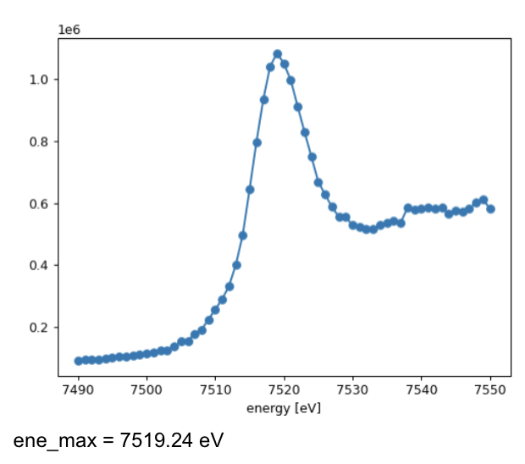
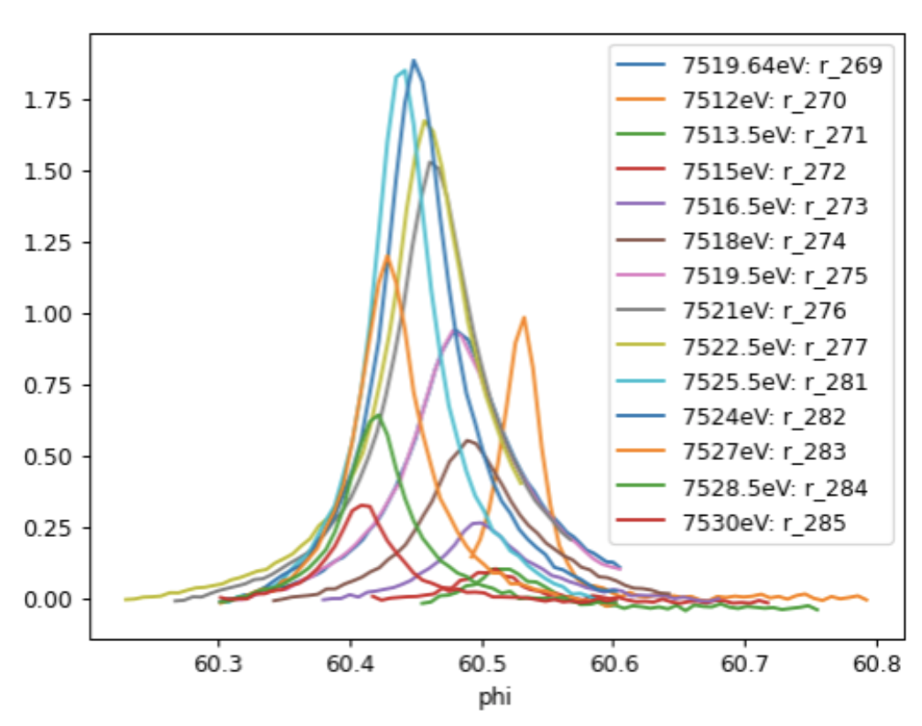
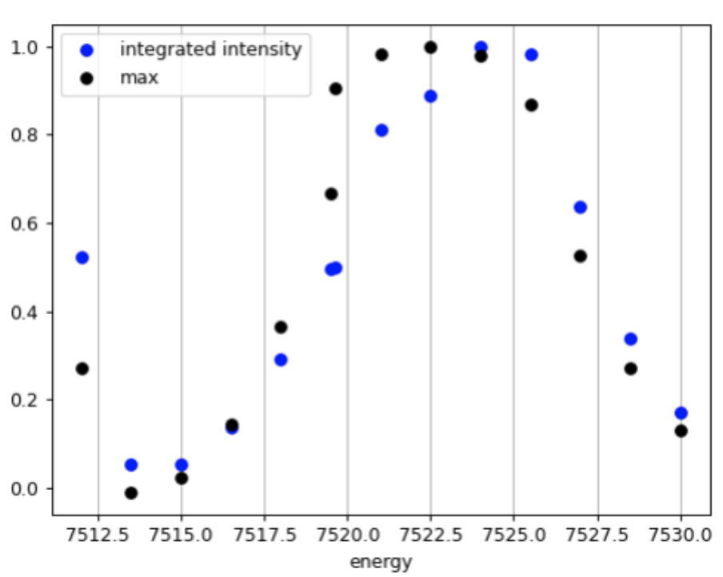
Commissioning results
Found time tool signal with Si(111) monochromator
Measured fluorescence on sample and found resonant peak

Slide 11
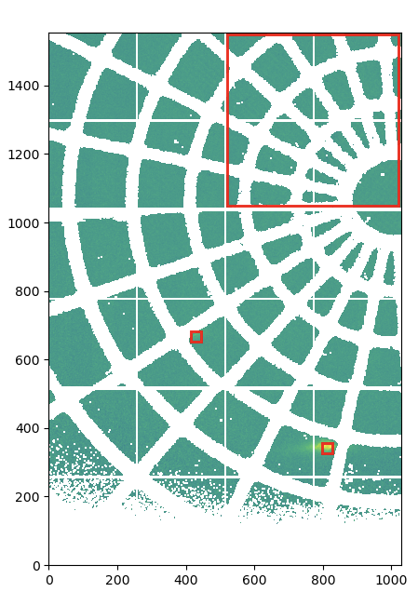
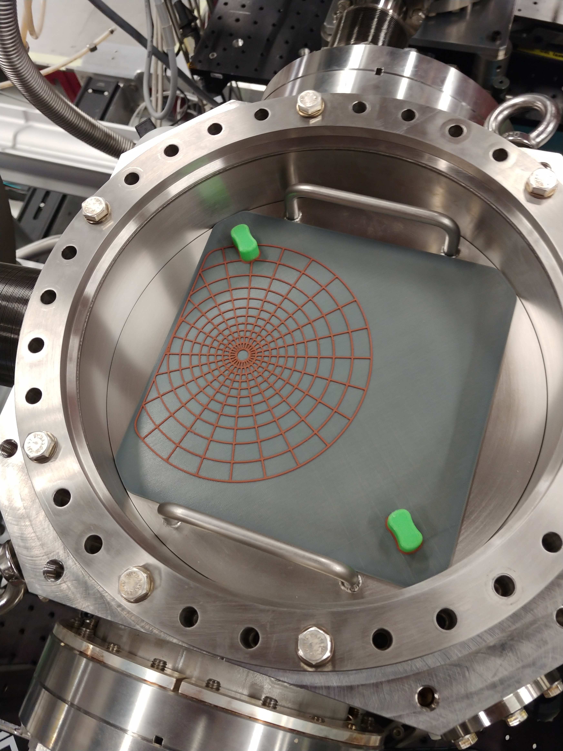
Commissioning results
Found time tool signal with Si(111) monochromator
Found structural peaks and used new spider web for JF angle calibration Thanks to Rasmus!

Slide 12
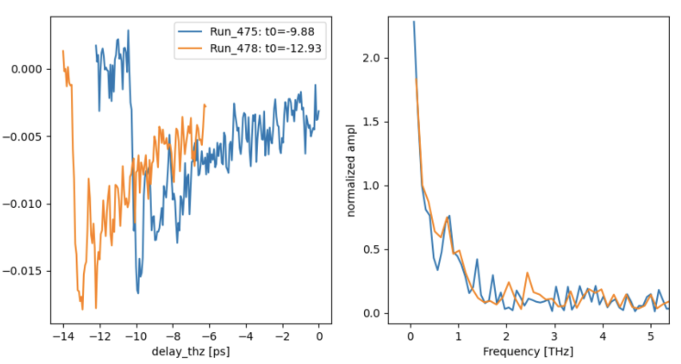
Commissioning results
Found time tool signal with Si(111) monochromator
Found optical pump probe signal on sample
→ THz and temperature should be ok, can be used to check from time to time

Slide 13
Commissioning results
Ideal x-ray parameters:
25fs rms
bandwidth < 0.15%
pulse energy > 200uJ

