Slide 1
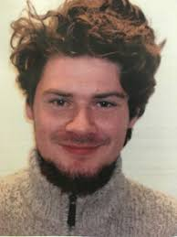
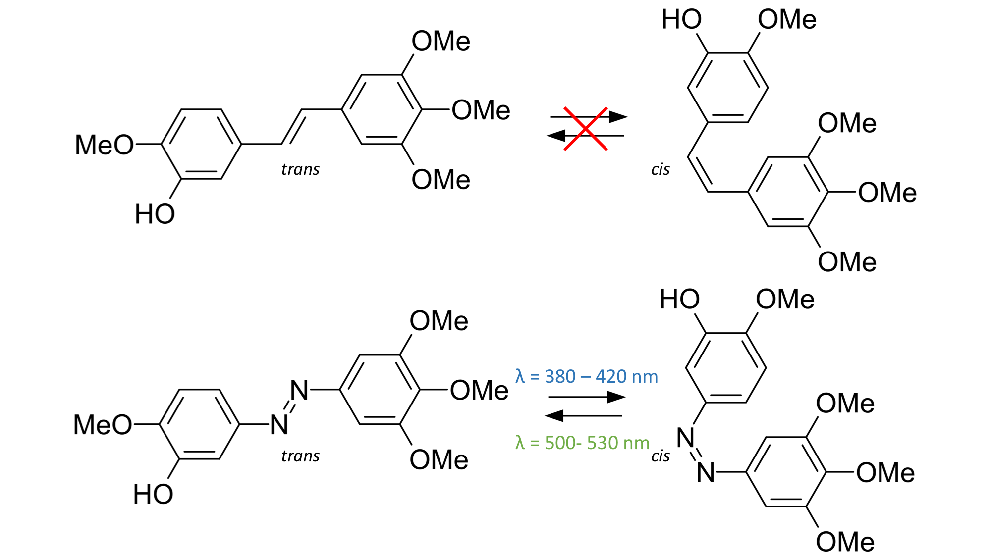
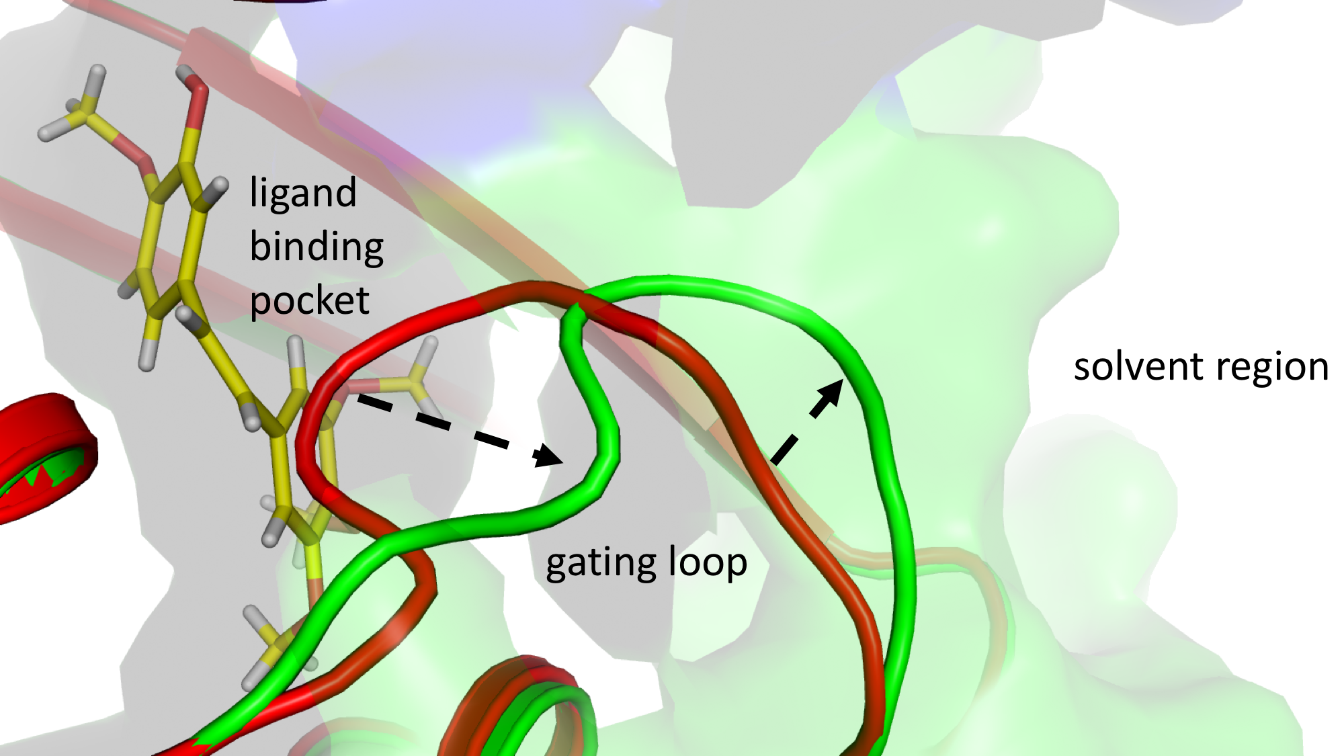
Synthetic photoswitch used in Photopharmacology
Time-resolved crystallography not limited to native photoactivateable proteins
Photoswitchable azo-compound
Structural changes upon binding
Maximilian
Wranik
trans-cis isomerization increases
efficiency 100 fold
Binding of the cis form induces
significant structural changes
unpublished results

Slide 2
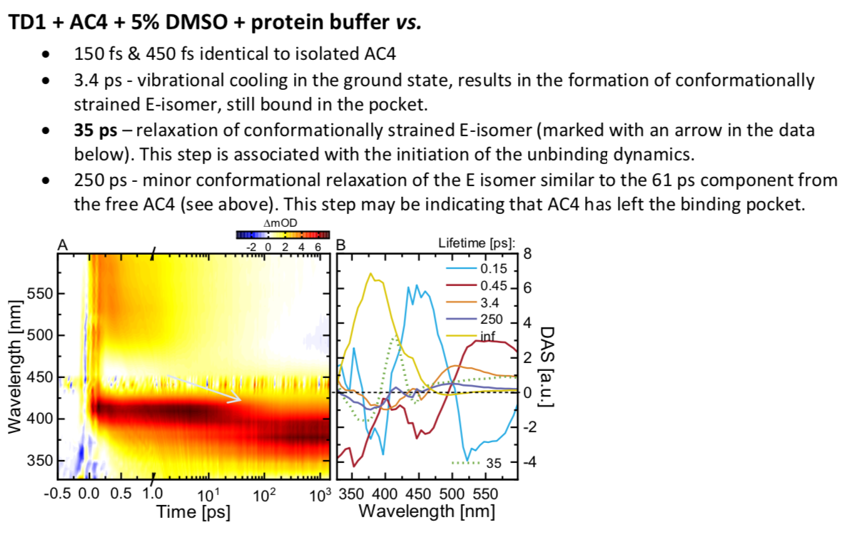
Results from ultrafast spectroscopy
Proposed time points for crystallography:
@ 250 fs, 1.2 ps – monitor the ES relaxation – relevant to the mechanism of isomerization
@ 9.4 ps– observe the isomerized, cooled down but conformationally strained in the binding pocket AC4
@ 81 ps – conformationally relaxed, still bound AC4 (the binding pocket should show significant difference from the previous points.)
> 500 ps – further conformational relaxation of AC4
Optional:
@ 600 fs and 5 ps –might give us some further insight into the isomerization steps.
Collaboration J. Wachtveitl, University Frankfurt

Slide 3
Beamline settings
i.e. basically the same as in TD1 beamtime march 2020
SFX Settings
Beam: 12 keV @ 200 µJ
Rep rate: 50 Hz
Spot size: 5x5 µm²
Detector: 4M Jungfrau (0.5 bar He)
Nozzle: 50 or (75 µm need catcher)
Flow rate: 1.5 or (3.35 µl/min) depending on nozzle
Laser Settings
Wavelength: 475 nm
Rep rate: 50 Hz (1:1 or 4:1 mode)
Spot size: 40 μm FWHM, (along LCP), 95
(y), 70 μm 1/e²
Pulse length: ~300 fs
Pulse Energy: 10 μJ
Time delays: 250fs, 1 ps, 100 ps,
10 ns, 20 ms (shift), (600 fs), (10 ps),
(100 ns)
-> ShotToShot: 253 µm (test 150 µm if sample amount is critical)
-> Runtime per injector: 80 min for 50 µm nozzle, 35 minutes for 75 µm nozzle
-> 50k indexed patterns: 208 min at 10% indexing rate 24 hours for all seven delays
-> Injectors needed: 41 each with 120 µl prepared sample
-> Start with 1 ns or 1 μs and when maps are ok switch to faster delays.

Slide 4
Experimental goals
Scientific goals:
Demonstrate the use of synthetic photoswitches in TR-SFX
Visualize isomerization of an azo compound commonly used in
photopharmacology and other applications
Visualize ligand release from tubulin and reorganization of the
cholchicine binding pocket
Time delays:
-> azo-CA4 isomerization -> 250fs, (600 fs) 1 ps, (10 ps), 30 ps, 100 ps
-> azo-CA4 release -> 1 ns, 10 ns, (100 ns), 1 us, 1 ms, 20 ms
Bold targets Sept 2020, in brackets stretched goals,
Rest collected March 2020

Slide 5
Experimental team
Spokesperson: Joerg
Sample Team
Max
Natacha
Robin
Hannah
Demet
xxxx
Data Team
Tobias
Steffen
Petr
Spectroscopy
Chavdar, Sepp
Alvra
Claudio
Karol
Dmitry
Philip
Camila
Chris
Injector Team
Dan (night-to morning for shutter)
Dardan
Antonia
Tubulin Biology
- Michel

