Slide 1
Run coordinator report
August 31 – September 7, 2020
Florian Löhl :: Paul Scherrer Institut
SwissFEL Exchange Meeting, 7.9.2020

Slide 2
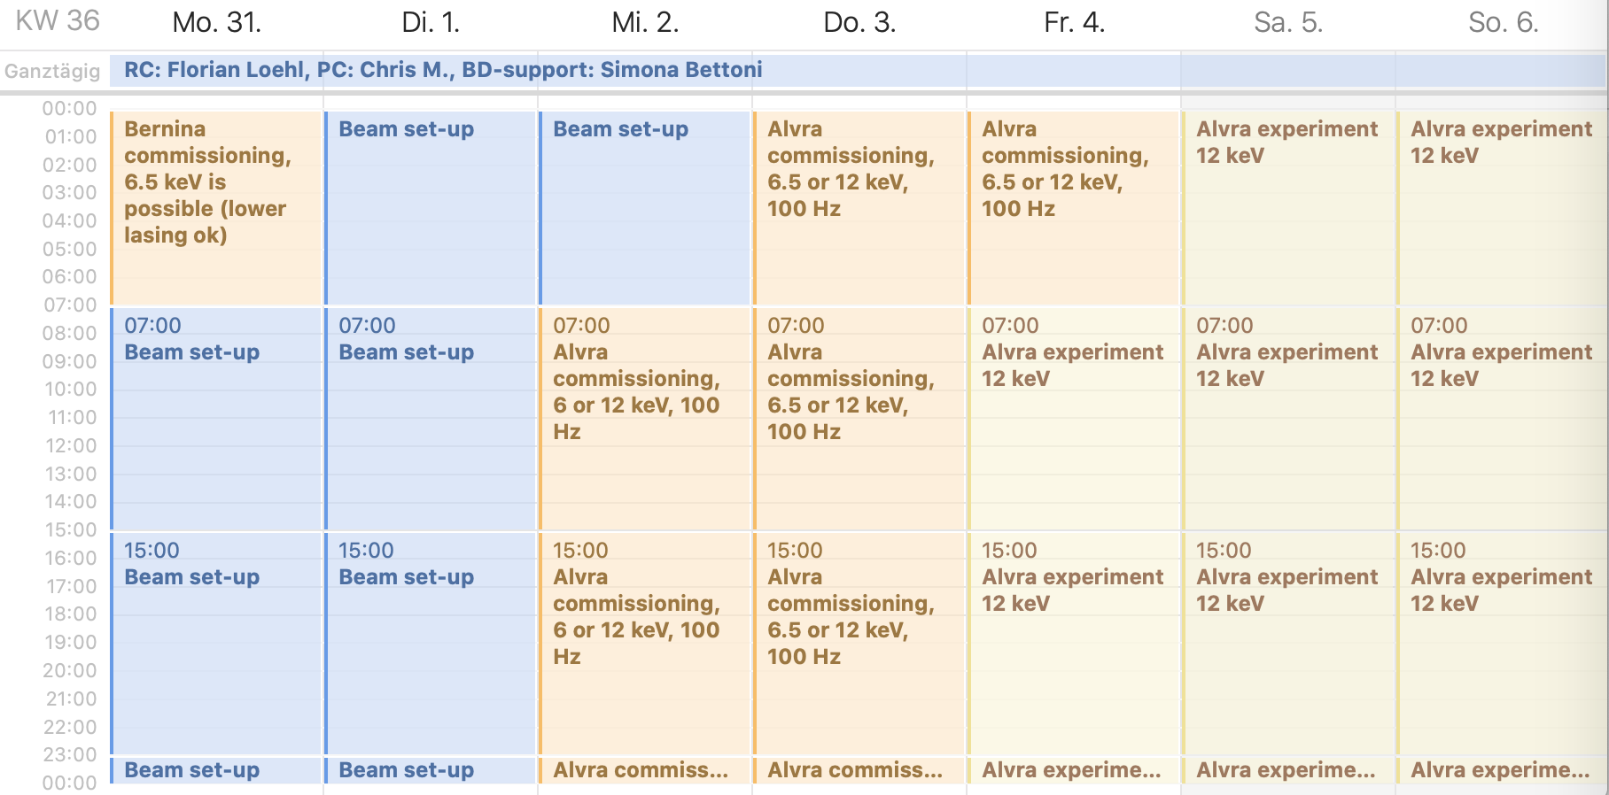
Program

Slide 3
Aramis summary
Beam setup on Monday (S. Bettoni, N. Hiller, F. Loehl, C. Kittel)
Recovered decent machine setup at 12.05 keV
Went again to a short pulse duration for the e-beam (25 - 30 fs rms)
Re-arranged schedule: utilized Tuesday and Wednesday for further machine tuning due to bad vacuum in mirror chamber (users could not take the beam)
Skipped switch to 6.5 keV and stayed at 12 keV the entire week
100 Hz operation during the entire week
PSICO optimization during the entire week with basically all parameters (currently 166)
Quite stable performance during the week
Reached a new pulse energy record at 12 keV: 570 µJ

Slide 4
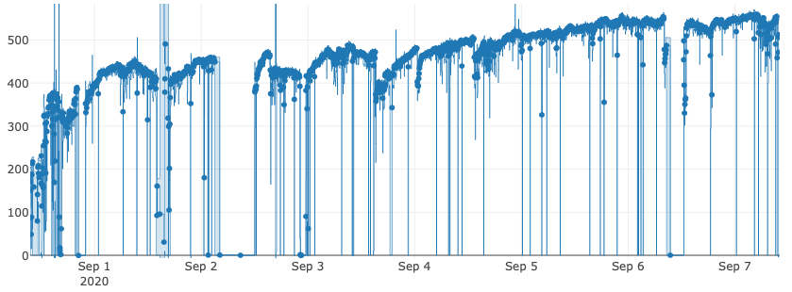
Photon pulse energy in Aramis during the week
Photon pulse energy in Aramis (µJ)

Slide 5
Athos summary
Restored lasing in Athos (200 µJ level at 540 eV) on Monday after Aramis setup
Parallel operation
  Managed to maintain Athos lasing at the 170 – 200 µJ level while optimizing Aramis with PSICO Aramis – also in the common path.
  In parallel to PSICO Aramis, PSICO Athos was running to compensate for some of the pulse energy loss due to the Aramis optimization.
  Initially limited to 10 Hz due to losses in the Athos line
SATUN12 & SATUN13 brought into operation on Wednesday (E. Prat, E. Ferrari, S. Reiche)
  Reached 1 mJ @ 350 eV for a short time at 10 Hz
  Reached 650 µJ @ 540 eV at 10 Hz

Slide 6
Athos summary - continued
Thursday, Friday: PSICO Athos tuning and manual tuning (E. Prat)
  Reached 1 mJ @ 540 eV at 10 Hz
Friday evening: Added CHIC parameters into PSICO Athos
  Started optimization at 700 µJ @ 540 eV, 10 Hz
Weekend
  Optimized on losses and pulse energy in Athos with PSICO Athos
  Step wise increased repetition rate during the weekend as losses improved
  Reached 100 Hz both in Aramis and Athos at the same time
  Reached 1.75 mJ @ 540 eV (while having record values in Aramis)

Slide 7
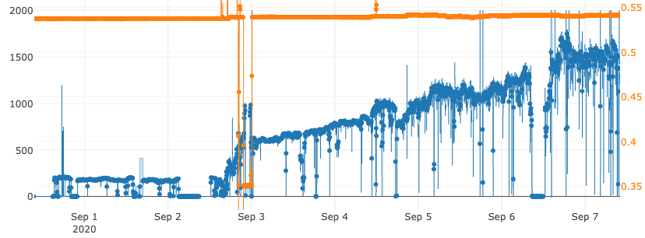
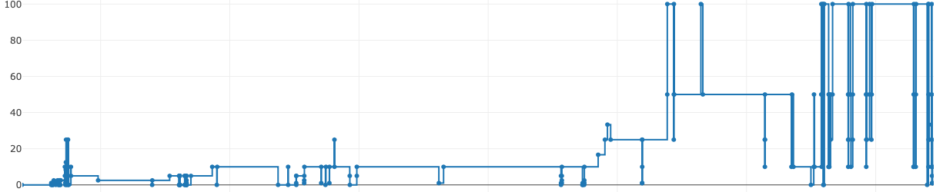
Photon pulse energy in Athos during the week
Photon pulse energy in Athos (µJ)
Photon energy in Athos (eV)
Repetition rate in Athos (Hz)

Slide 8
Main problems during the week
Alvra mirror chamber repair (influenced schedule)
Monday
  20:00 DRPS detector 803 underflow
  ~1.5 h down-time
Wednesday
  3:00 PSYS alarm. Door contact in undulator hall failed.
  ~8 h down-time
  11:00 Problem with trigger rates of diagnostics (set to zero by TMA)
  22:00 Aramis gun laser jumped by one RF bucket
  (restoring: S. Bettoni, E. Prat, F. Loehl)
  0:00 All vacuum valves in SwissFEL closed after screen was moved into
  1 mJ beam

Slide 9
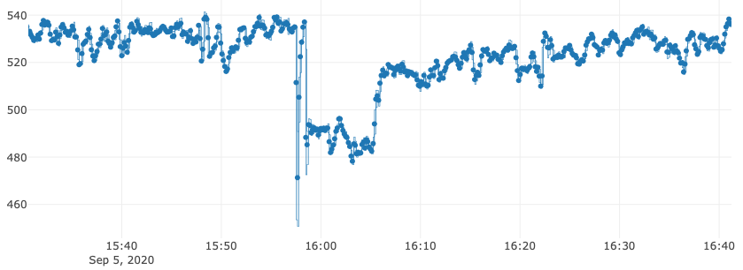
Main problems during the week
Sunday
  8:30 DRPS detector 801 – communication failure
  ~4 h down-time
  Afternoon Athos gas detector was saturated – big thanks to Pavle for fixing this!
Frequent jumps in injector, possibly in Alcor laser, lead to drop in pulse energy
Can be recovered by running PSICO 30 minutes in gun group. Source still unclear.

Slide 10
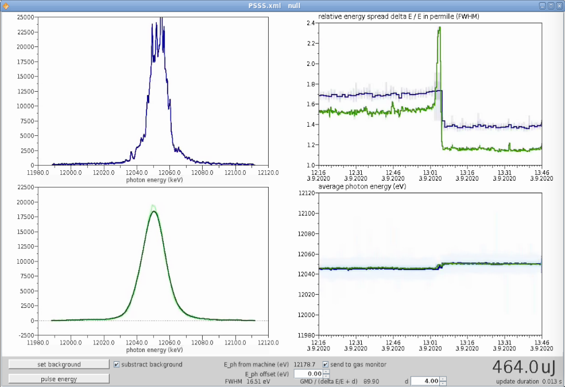
Main problems during the week
PSSS – different results depending if crystal or membrane is in

Slide 11
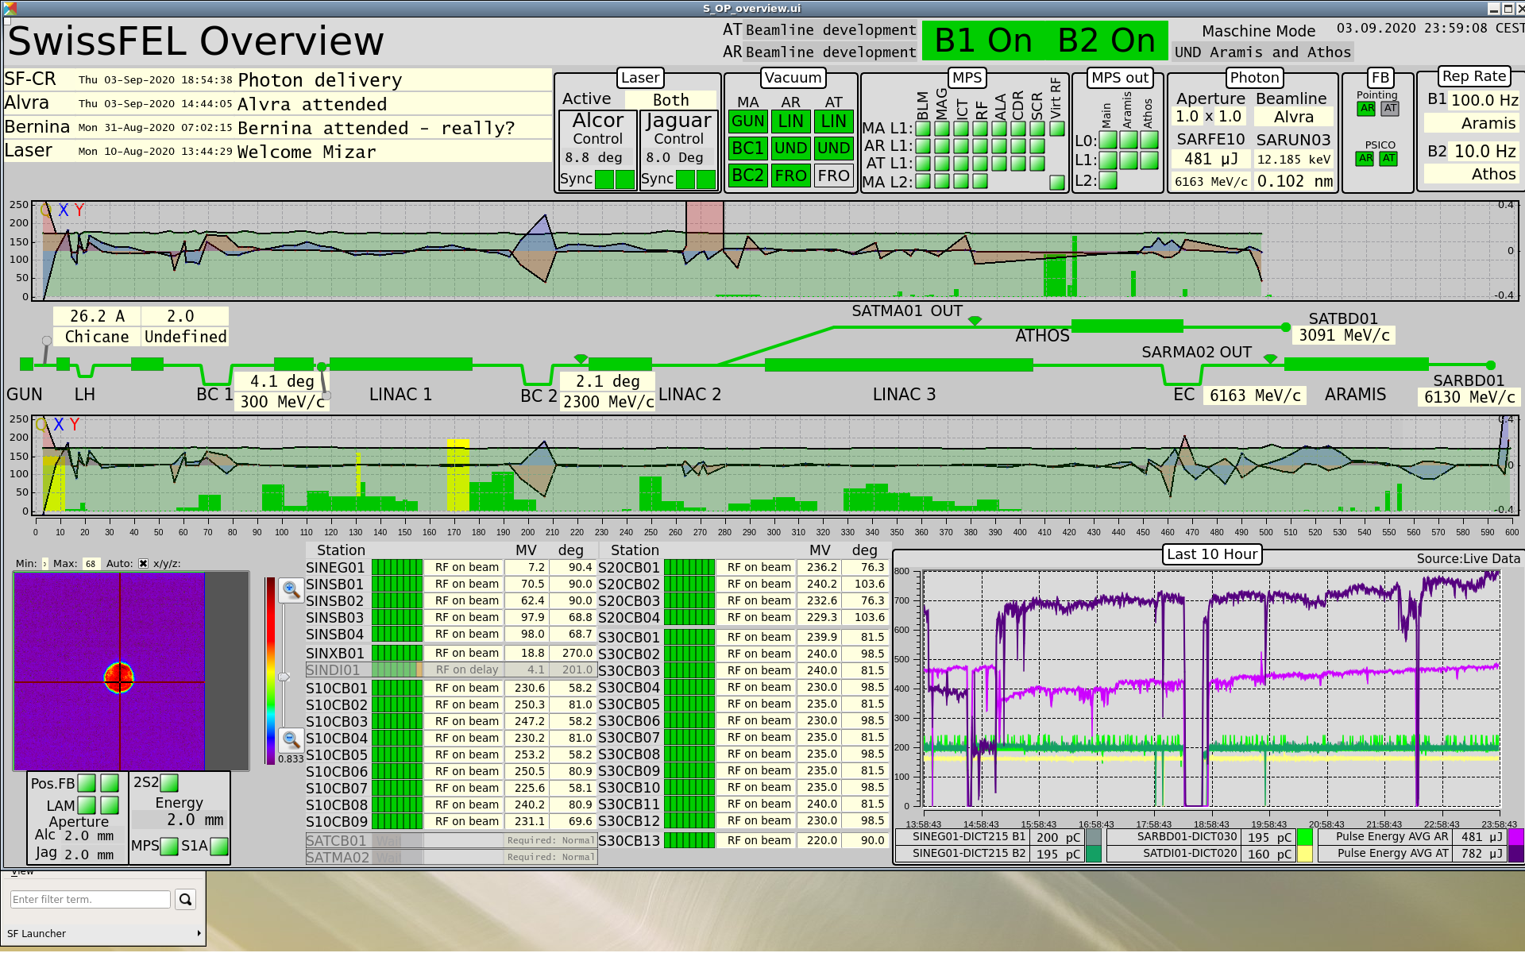

Slide 12
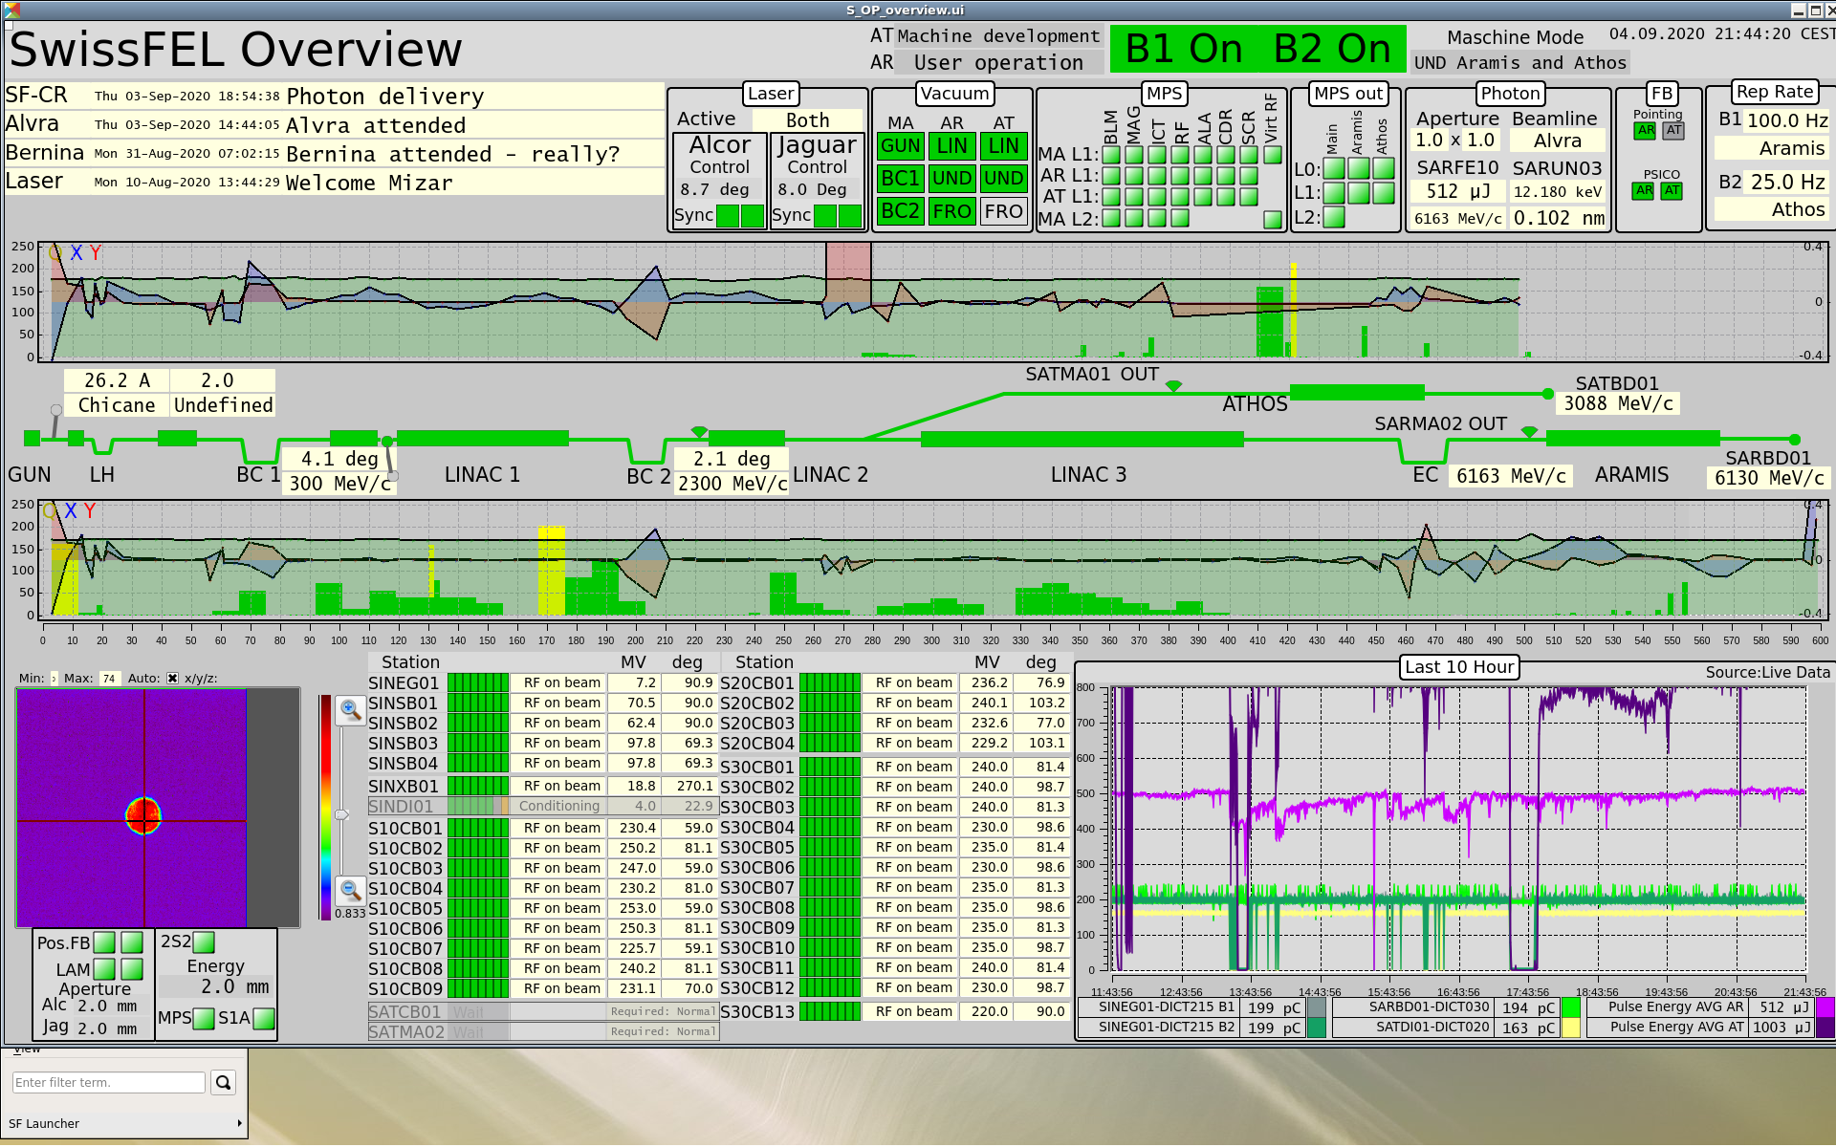

Slide 13
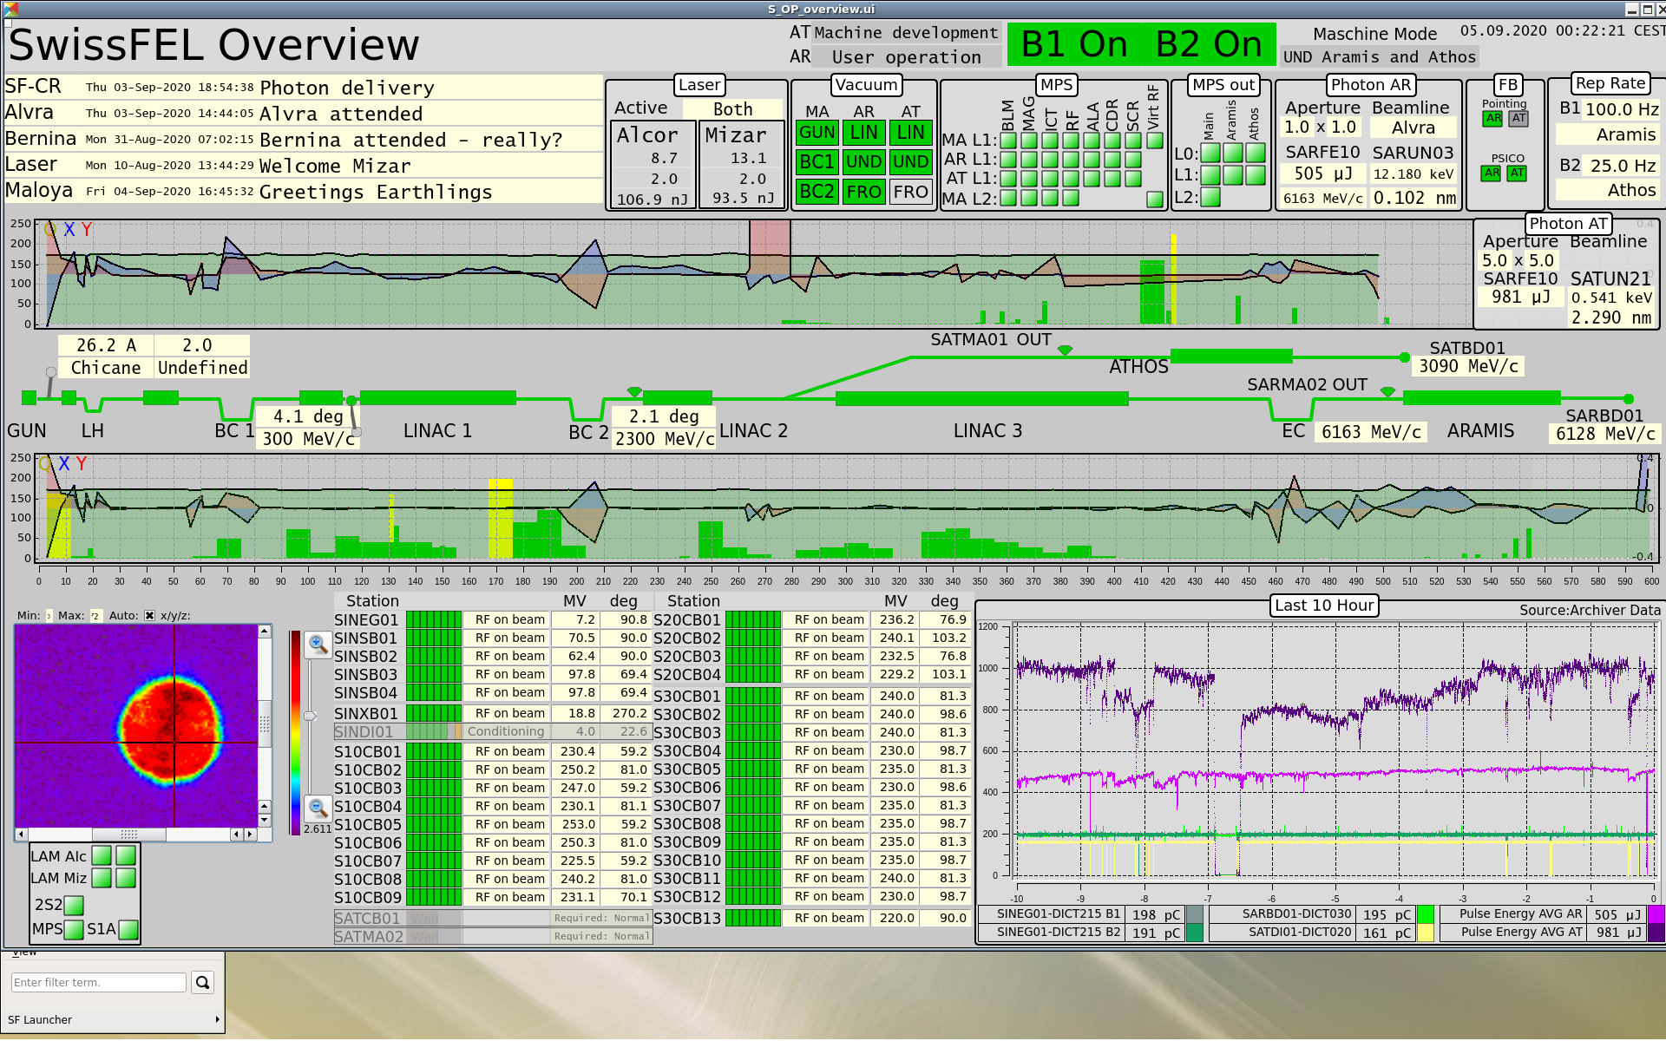

Slide 14
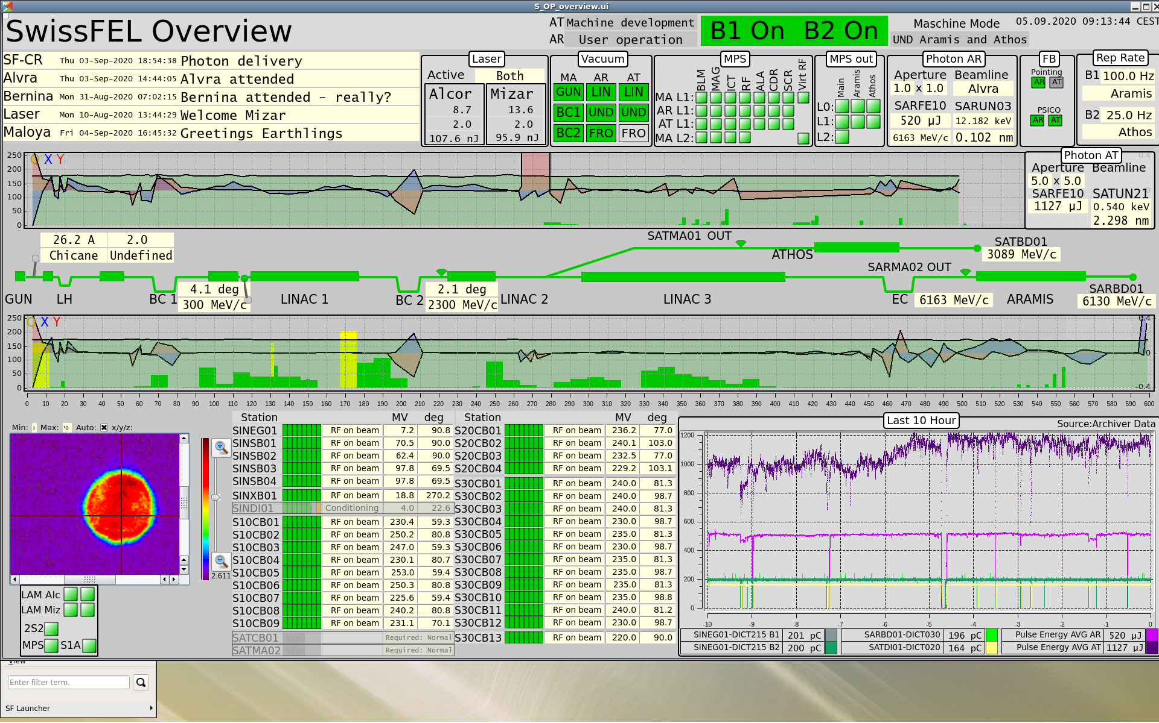

Slide 15
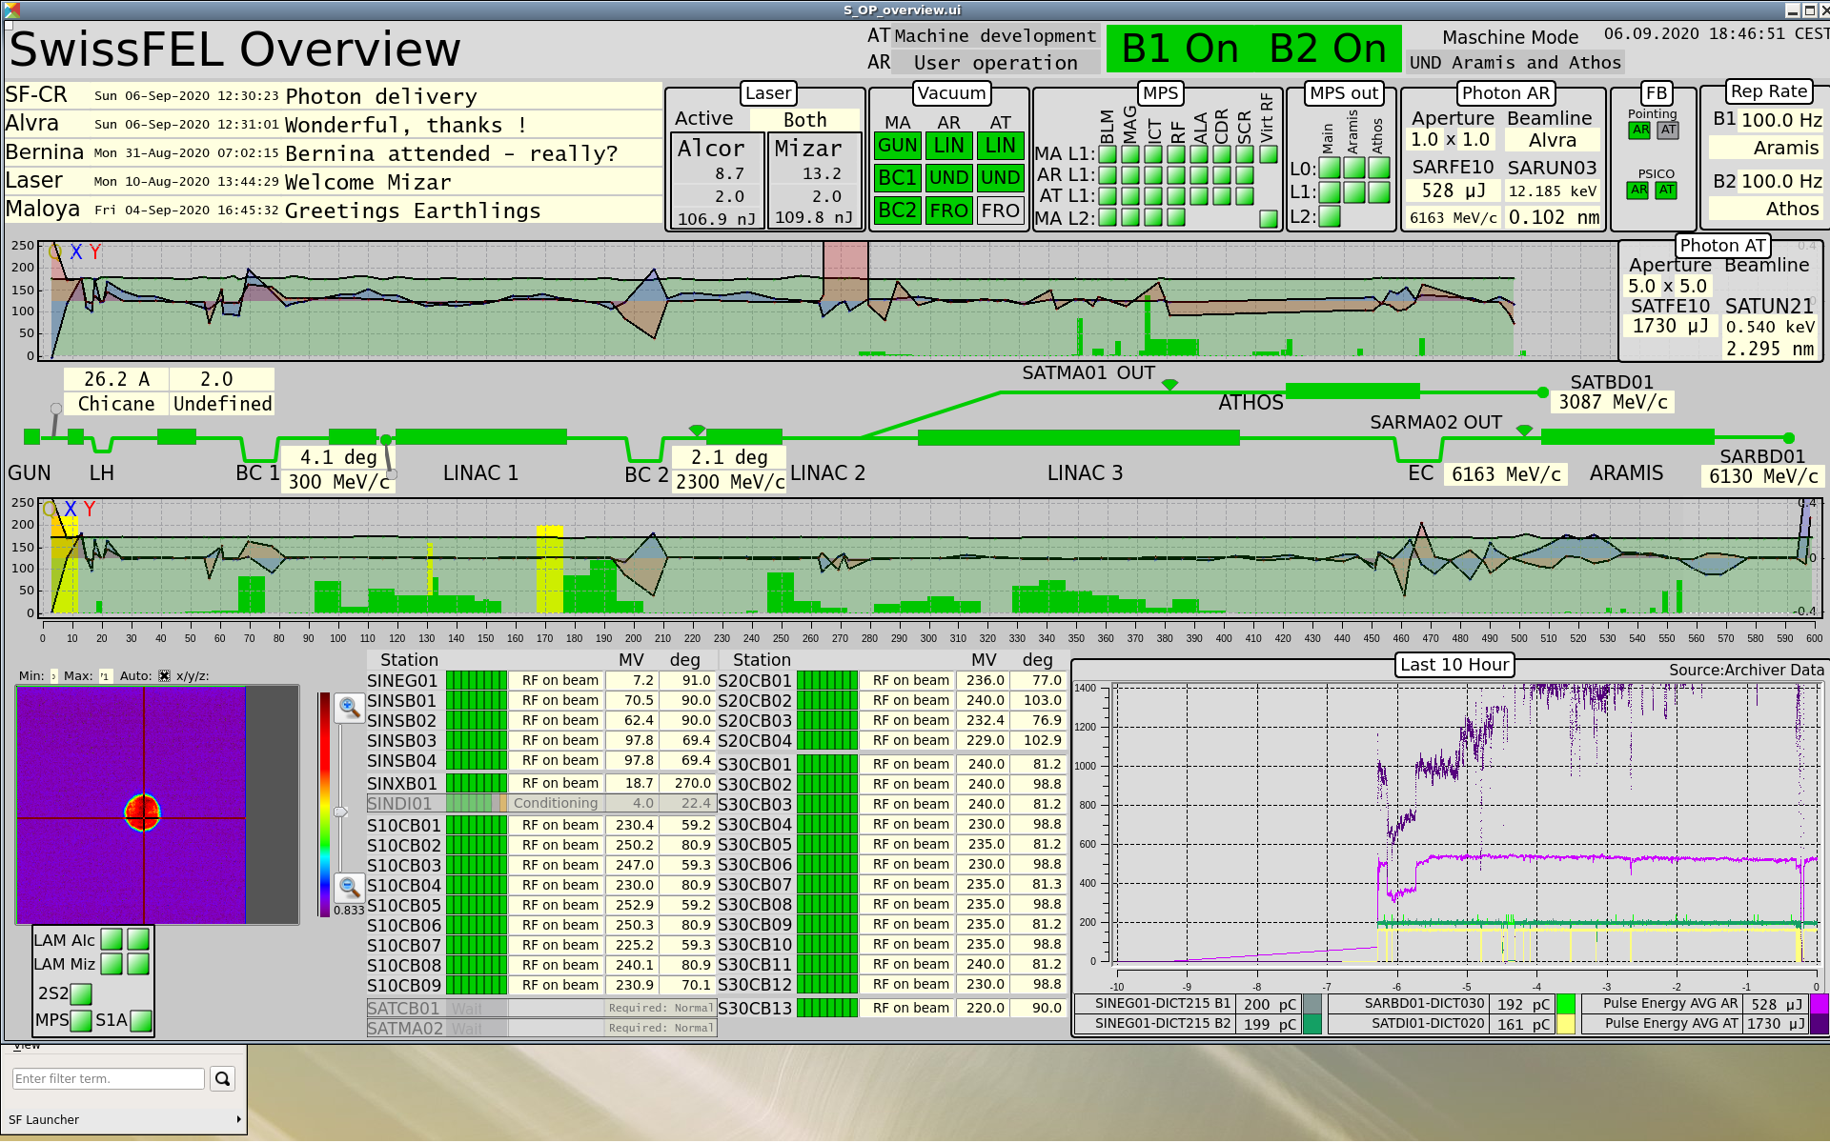

Slide 16
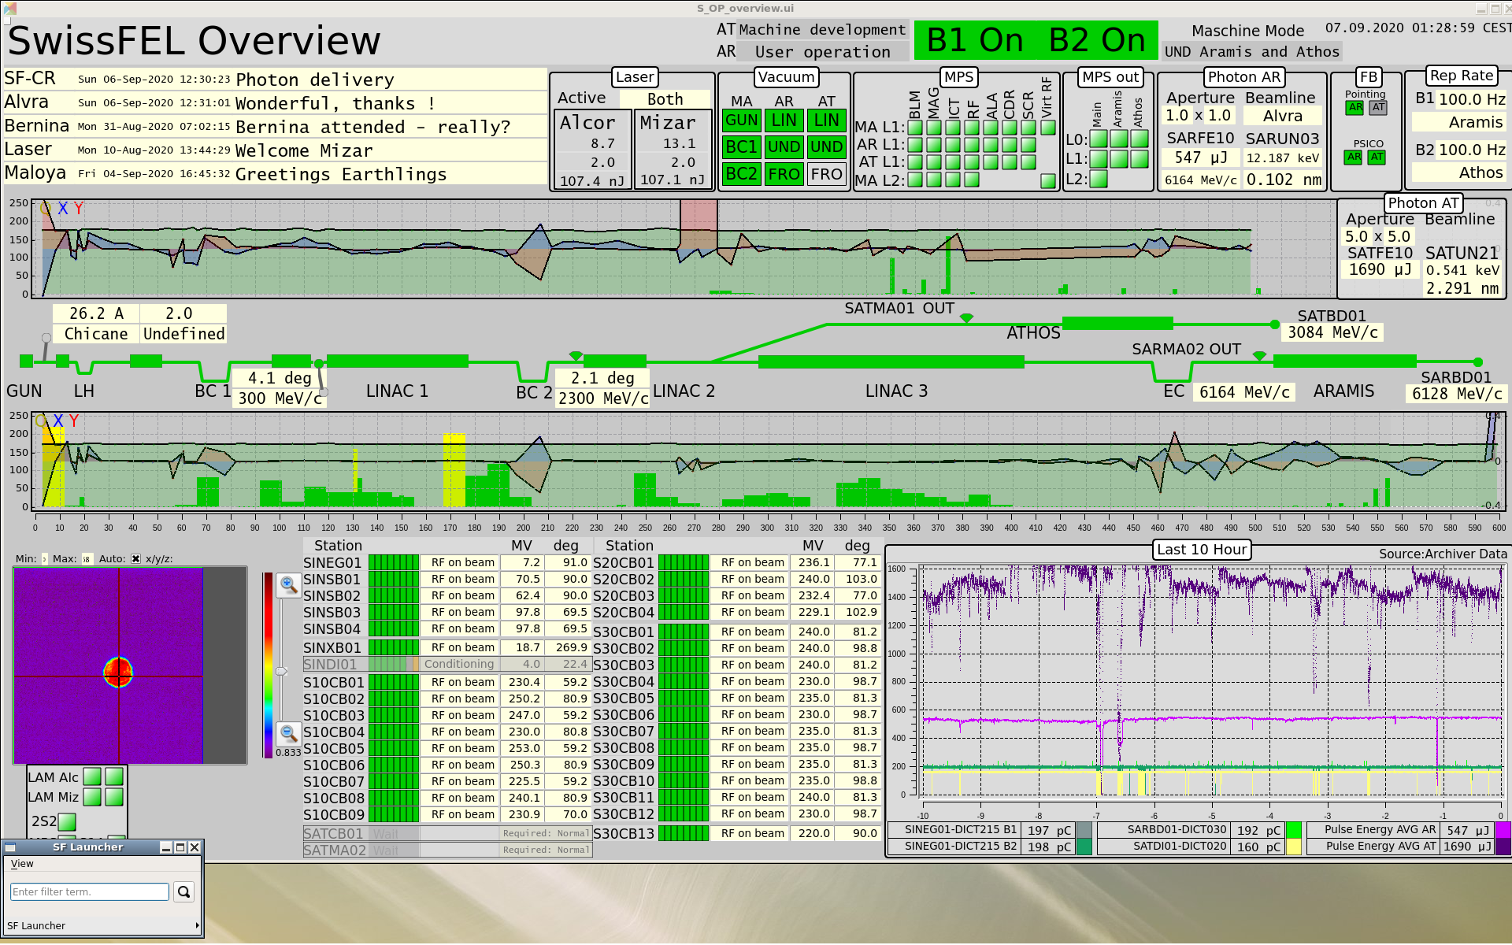

Slide 17


