Slide 1
Andreas Dax
Impact of the photocathode laser on the arrival time jitter at the SwissFel injector
SPM SwissFel- November 10th 2020

Slide 2

Agenda
Time jitter and drift today
Technical improvements
Amplitude jitter and drift at a later time
Time jitter performance in collaboration with T&S division

Slide 3
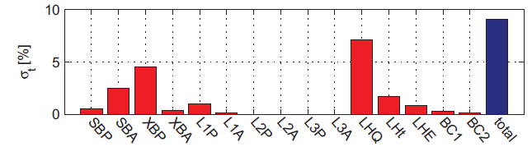
Arrival time jitter tolerated at cathode
Refs: B.Beutner, S.Reiche
Proc.FEL2010, WEPB17, 437-
440 Malmoe Sweden (2010)
∆t[fs] | Ipeak[%] | ∆E[%]
20 | 5 | 0.05
in front of 1st
undulator
Roger Kalt & Zheqiao Geng,
RF and Beam Stability at
SwissFEL,LLRF2019 Workshop,
Chicago, USA 2019
Measured values at BC2 Exit:
Beam energy jitter:
2.3e-4 RMS
Bunch length jitter:
11.8 % RMS
Arrival time jitter:
13 % RMS
200 pC 3kA (B.Beutner,Proceedings FEL2012 TUPD28,297-300,Nara,Japan(2012)
Time jitter tolerance
drawn for laser at
cathode: 40 fs rms
Bunch
length
Impact of photocathode laser

Slide 4
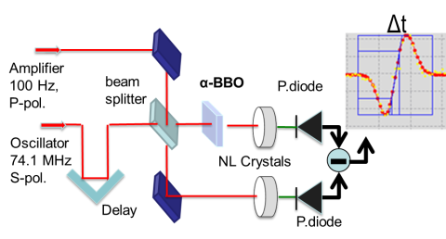
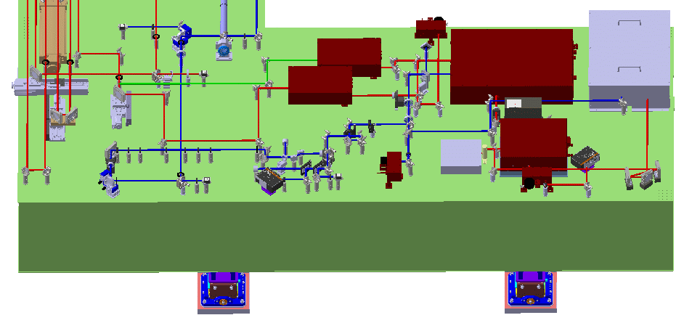
LAM layout
LAM setup
α-BBO
amplifier
LAM corrects drifts
between amplifier
and oscillator
1.2 km
opt.path
LAM
Pulse picker +
transl. stage
oscillator
Alcor

Slide 5
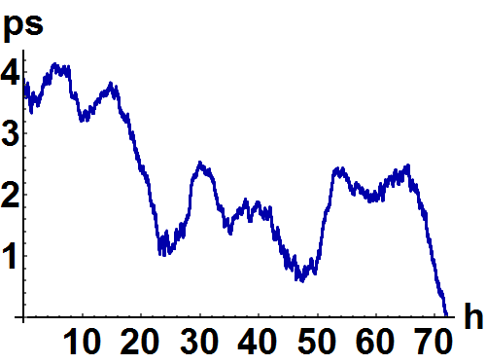
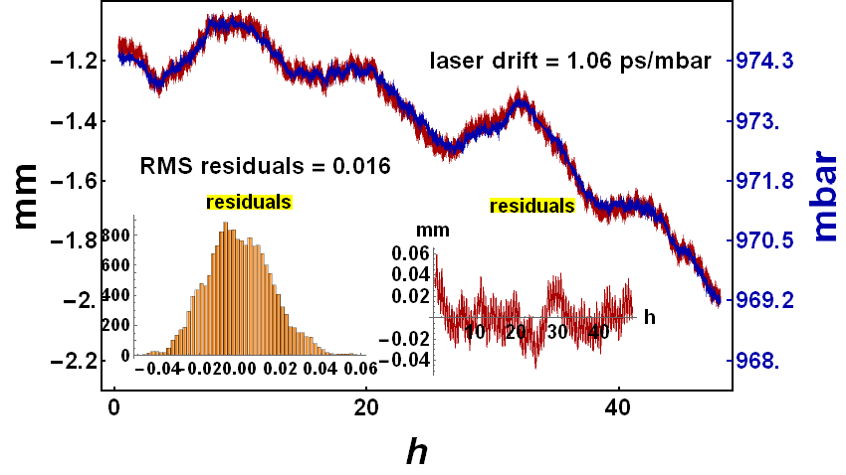
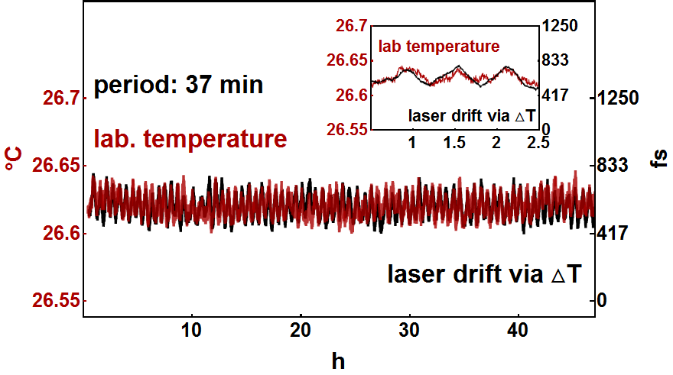
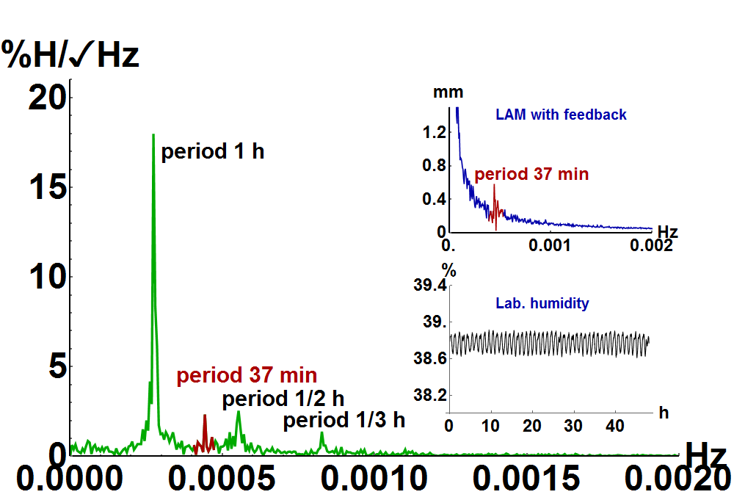
drift Alcor, no feedback
drift 1.06 ps/mbar
drift: 9.2 ps/°C
zero drift/% humidity @1042 nm
Laser drift: 233 fs pp @ ∆T =0.025°C pp

Slide 6
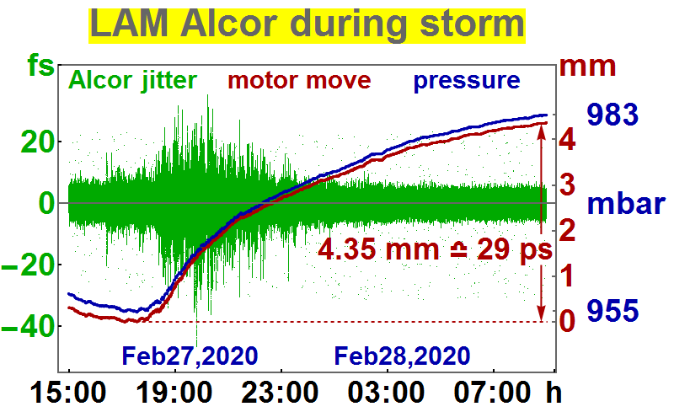

Slide 7
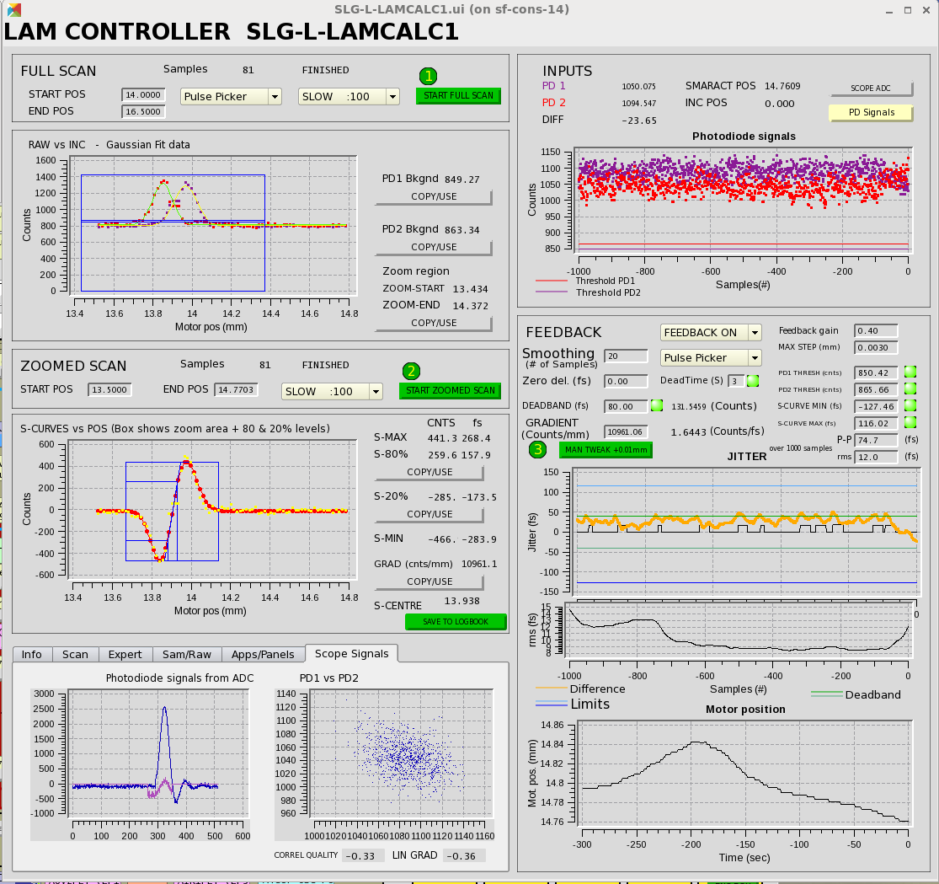
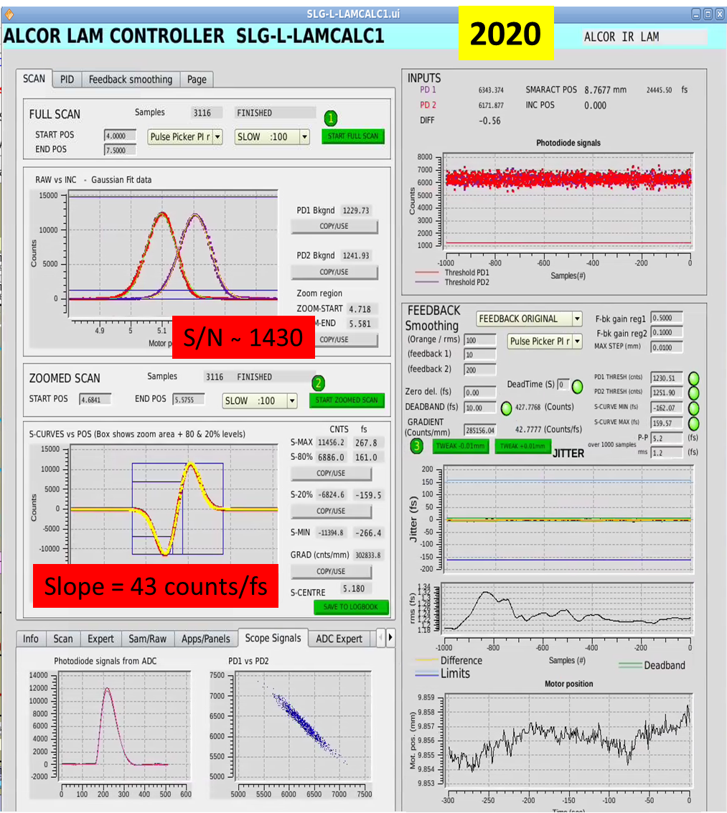
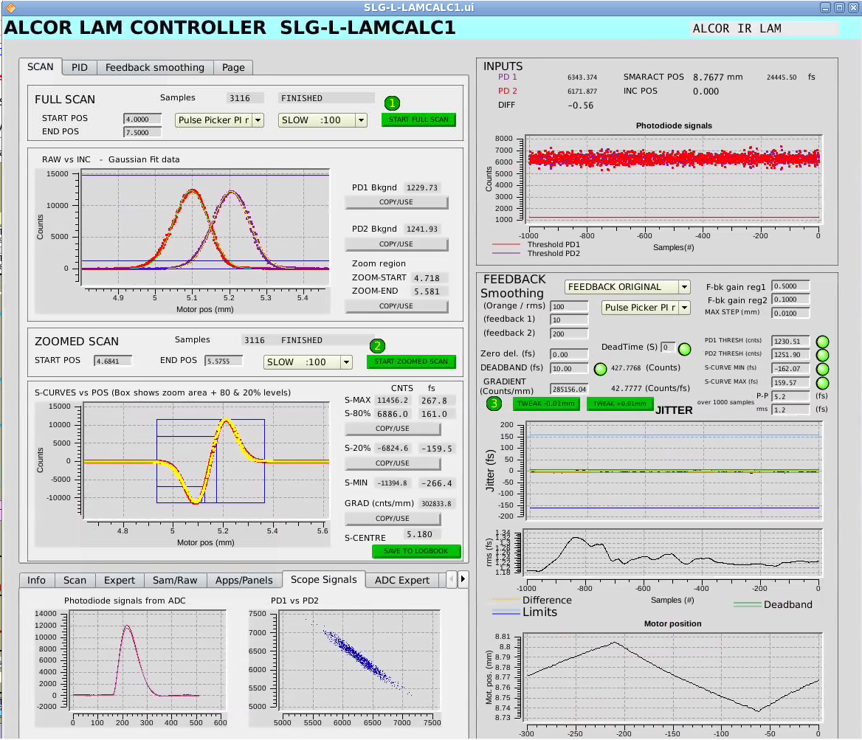
Improved Performance
S/N: 50x
background:
->0.3fs rms
slope:27x
well balanced
stability: 7x
2020
2016/17

Slide 8
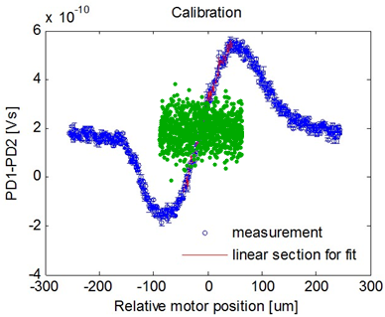
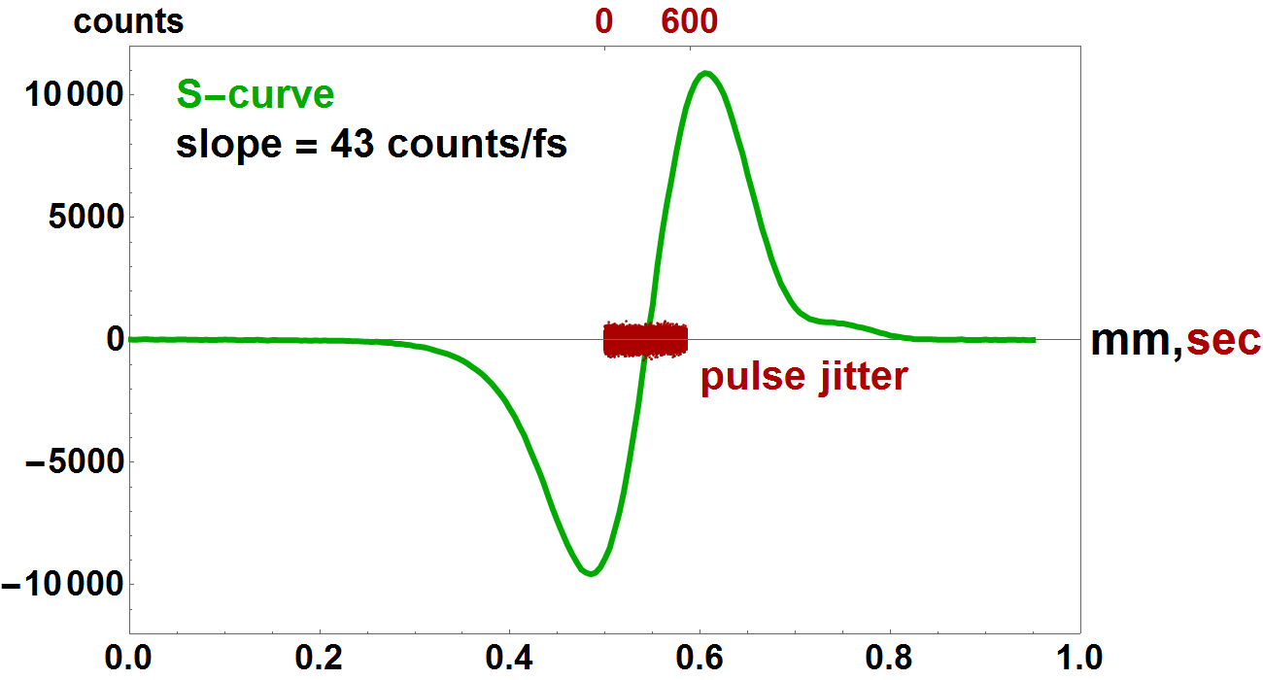
Improved Performance
S-curve and jitter 2016-2017
S-curve and jitter 2020
pulse jitter
Martha Sep.2016: jitter 32 fs rms

Slide 9
Improved Performance
Laser shot synchronous data taking:
jitter(channel 1) - jitter(channel2) = 2*jitter(channel1)
and not
= √2 … 2*jitter(channel1)

Slide 10
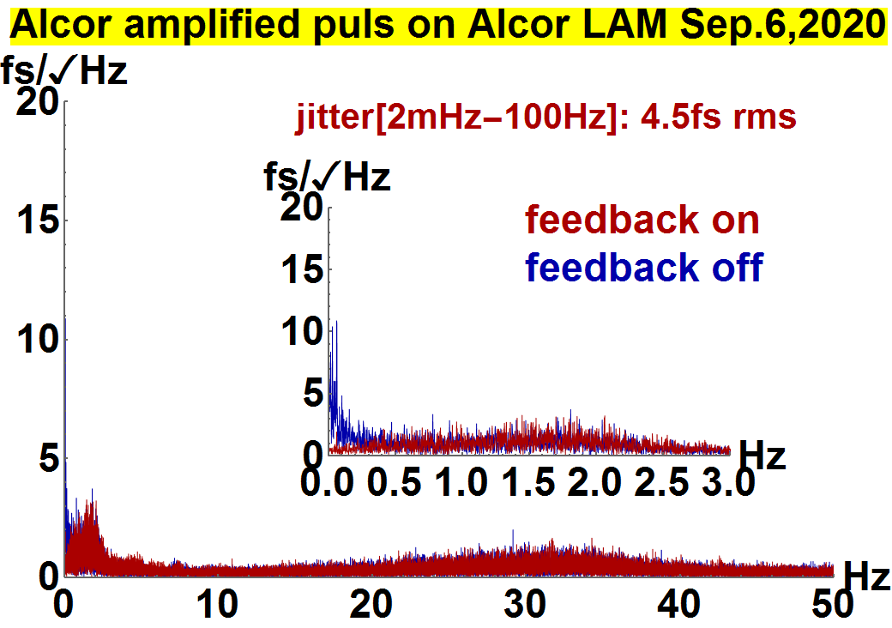
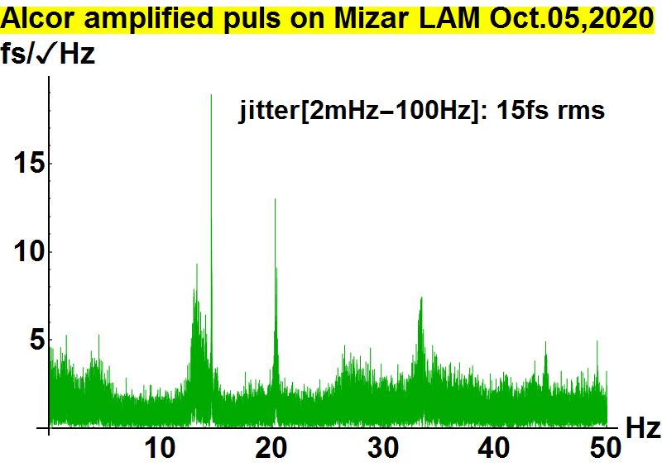
What is the total time jitter of Alcor ?
Alcor amplifier jitter [2mHz – 100 Hz] : = 4.5 fs rms
Oscillator jitter [2mHz – 100 Hz] : $\sqrt{({15}^{2}−{4.5}^{2})/2}$ = 10 fs rms
Alcor total jitter [2mHz – 100 Hz] : $\sqrt{({10}^{2}+{4.5}^{2})}$ = 11 fs rms

Slide 11
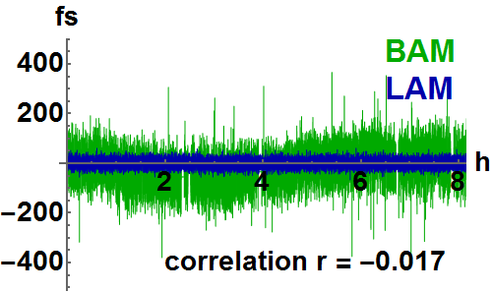
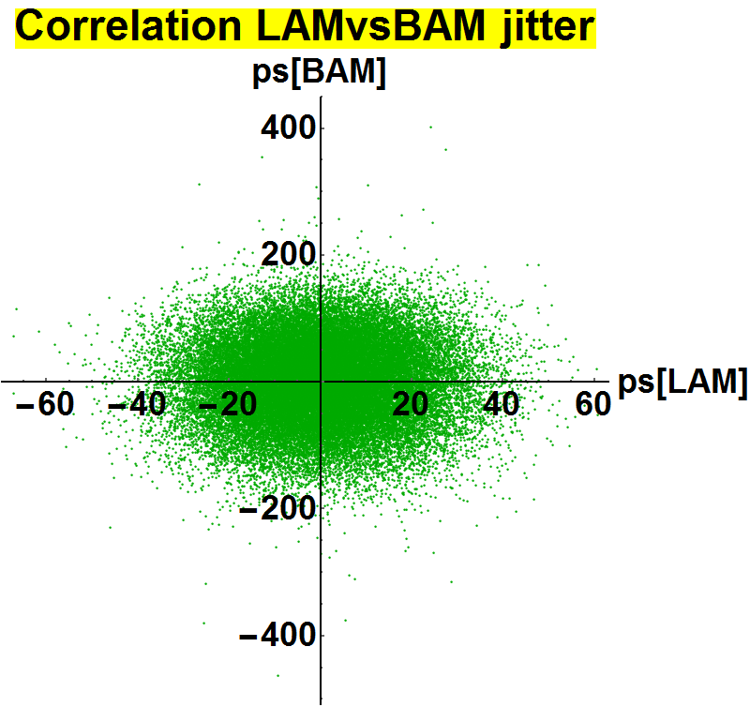
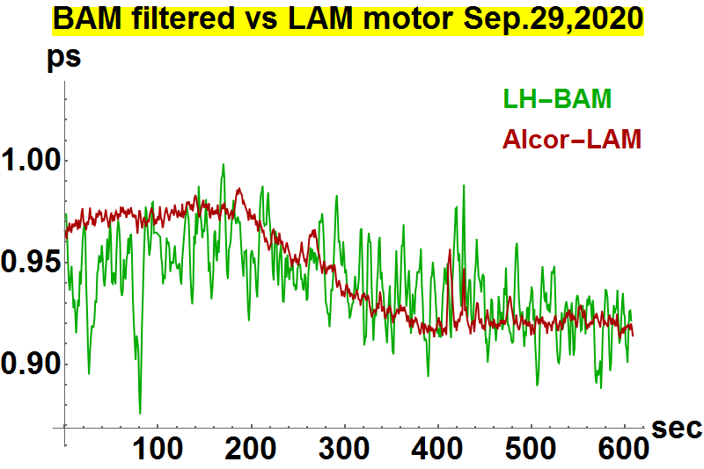
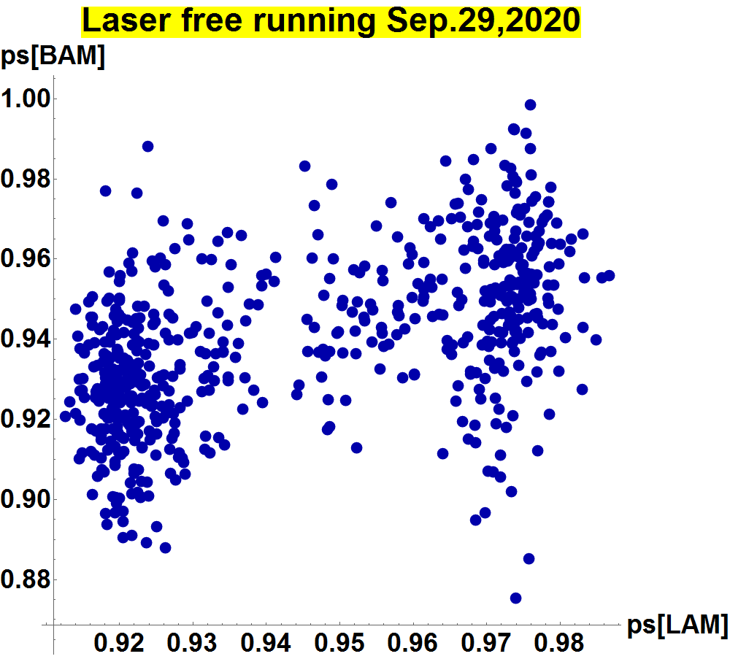
There is no correlation between LAM and BAM if the LAM is in lock
LAM in lock
LAM free running

Slide 12
Technology and reliability

Slide 13
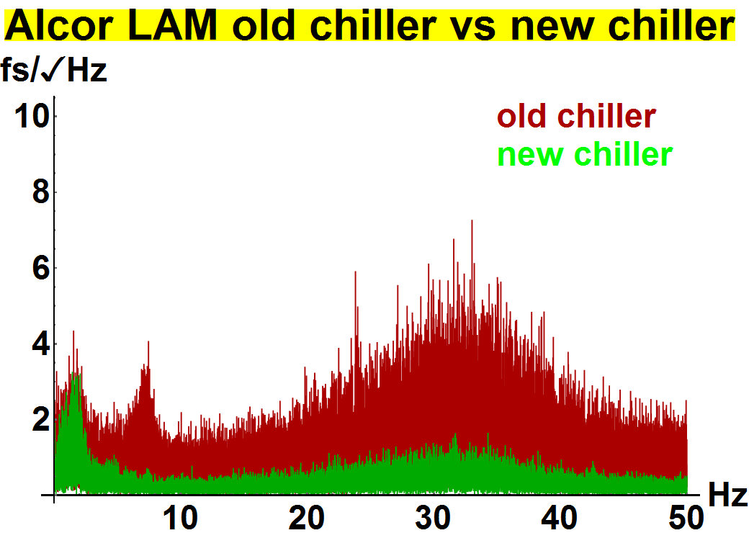
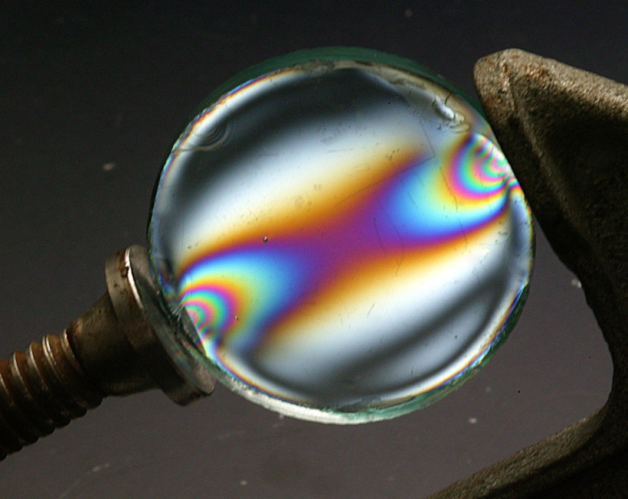
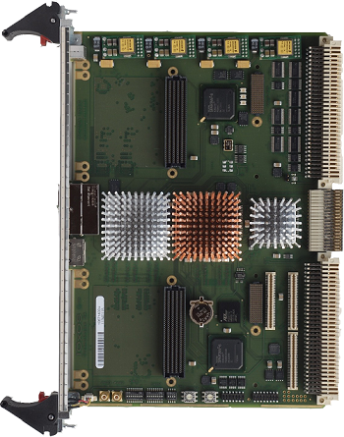
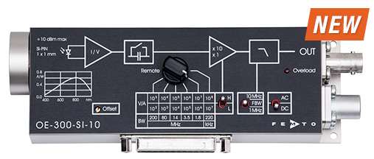

Important background reduction methods
SMC-original chiller
ThermoTec chiller
Avoid stress birefringence
Variable gain low noise photo-receiver
Replacement of water chiller -> centrifugal pump
16-bit ADC

Slide 14
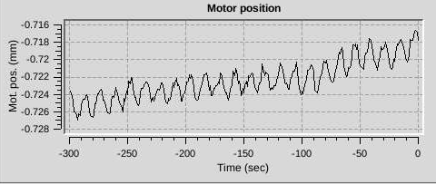
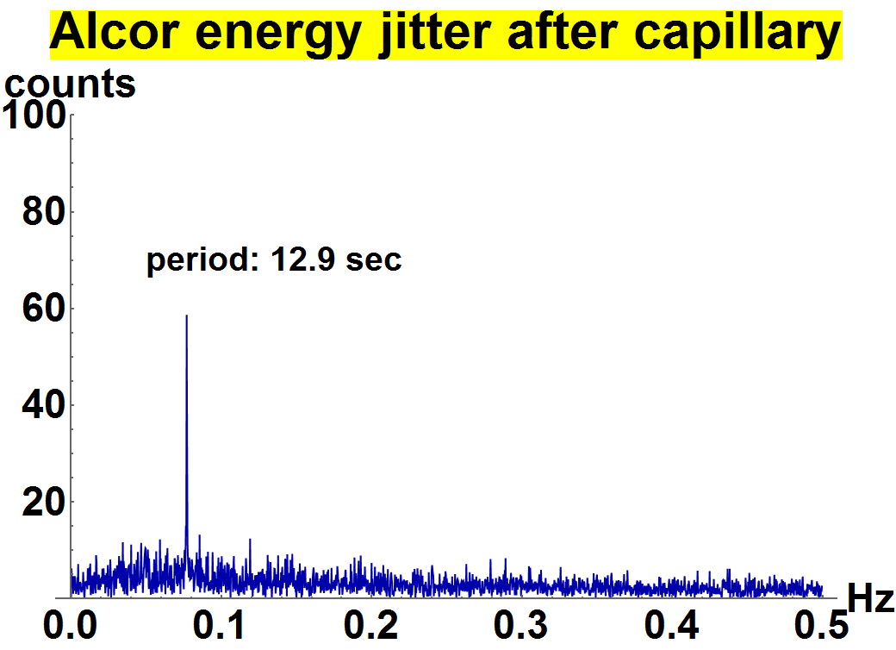
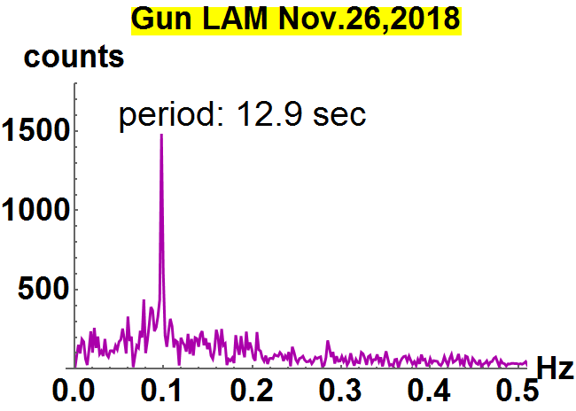
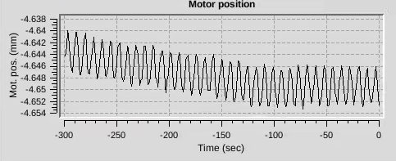
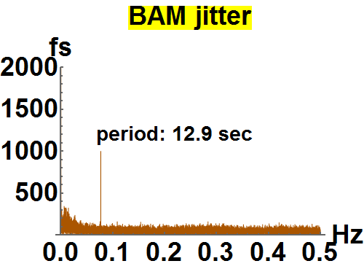
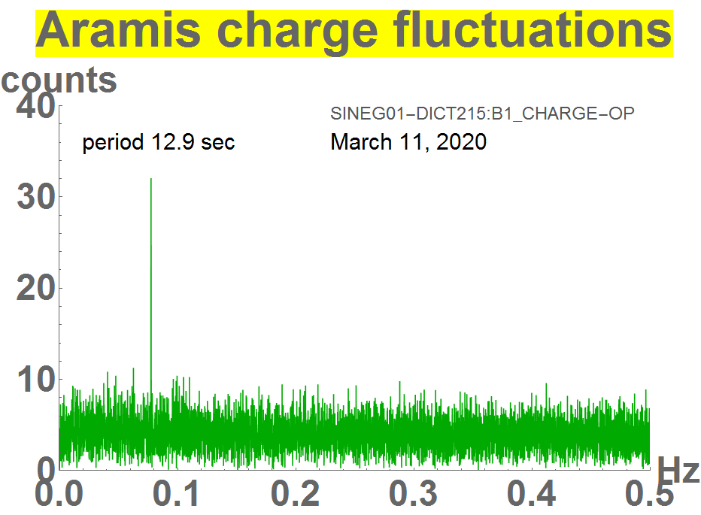
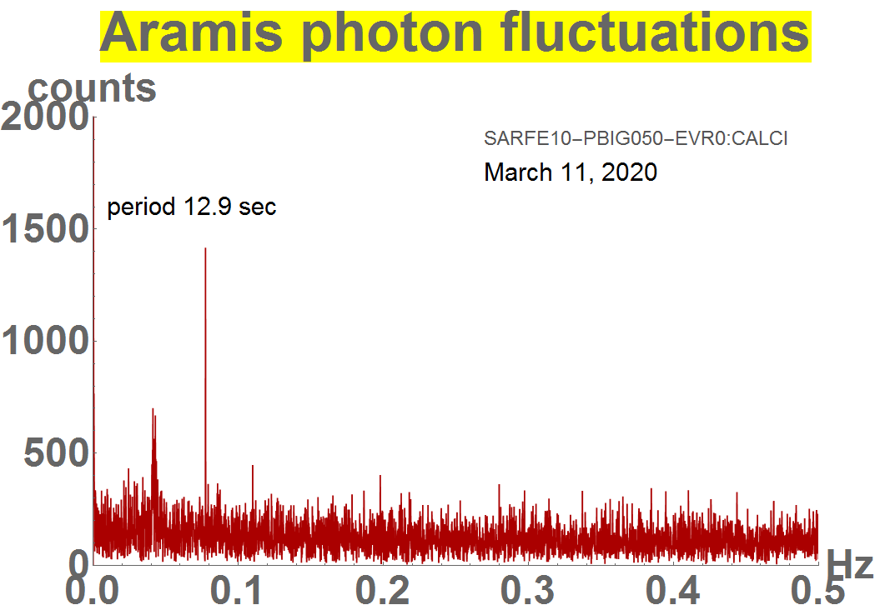
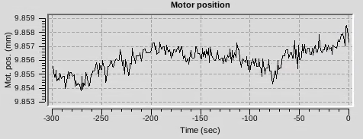
The 12.9 second oscillation problem: not fully understood but gone
Alcor July 2020
Mizar July 2020
gone since Sep. 2020

Slide 15
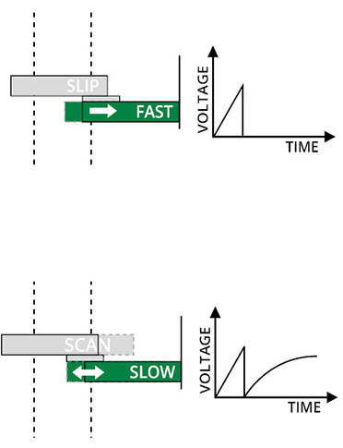
Much better translation stage
Slip-Stick technology
Lifetime 1y 24/7
Piezo-Walk technology
Lifetime >3y 24/7
SLIP
SCAN

Slide 16
Conclusion LAM performance
Alcor arrival time stab. is 4x better than demanded in the CD-Report
Impact on SwissFel arrival time is negligible
IOC crash -> controls
Trans. stage controler crash -> controls +
manufacturer + us

Slide 17
Wir schaffen Wissen – heute für morgen
Thank you for your attention.
Acknowledgements:
Controls:
Edwin Divall
Gun laser:
Martha Divall (left)
Martin Huppert
Carlo Vicario
Alexandre Trisorio
T&S:
Albert Romann †
Vladimir Arsov
Cezary Sydlo
Florian Loehl

