Slide 1
Martin Huppert :: SwissFEL gun laser group :: Paul Scherrer Institute
Laser Heater Shaping Interferometer
SwissFEL Progress Meeting (SPM) 10.11.2020

Slide 2
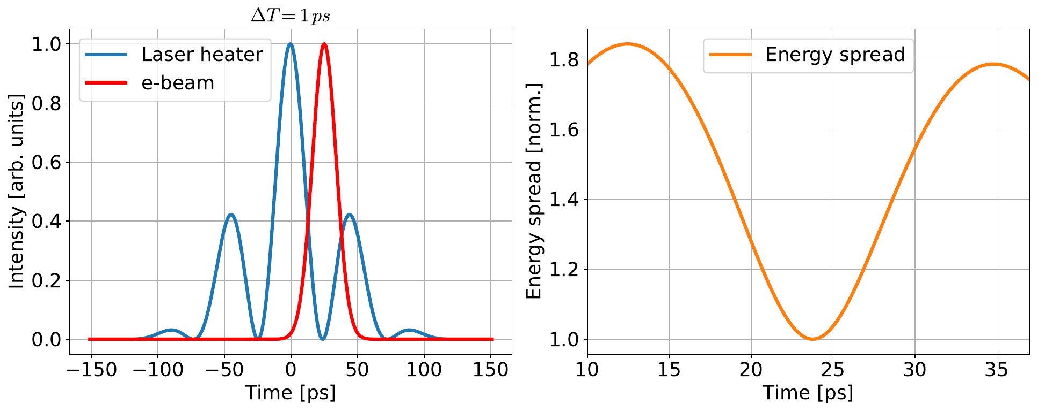
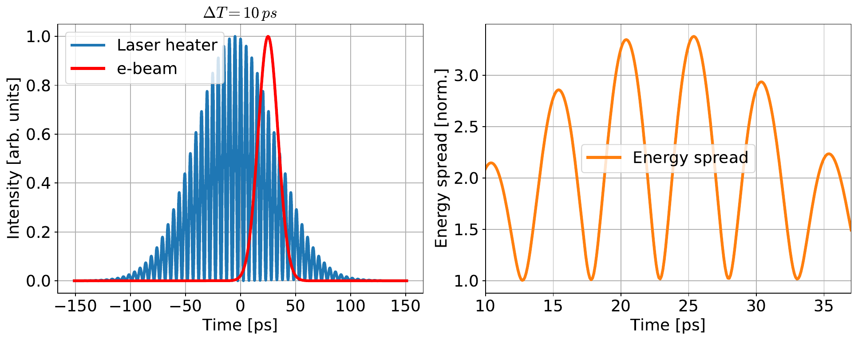
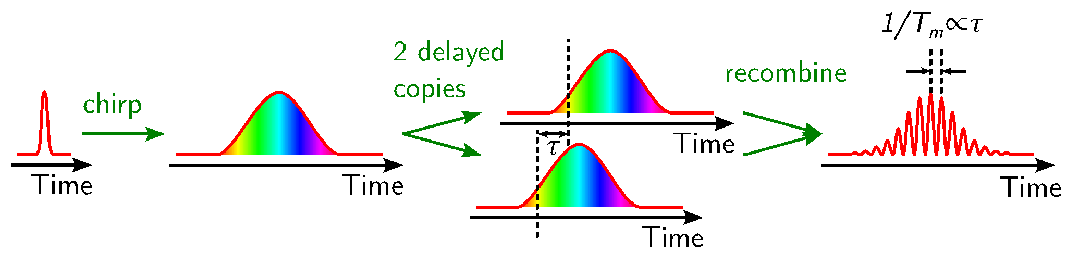
Motivation
Temporal modulation of the LH effect
Selective spoiler → shape the e-beam properties
Generate phase locked FEL pulses
Laser pulse is structured via
interferometry
Page 2

Slide 3
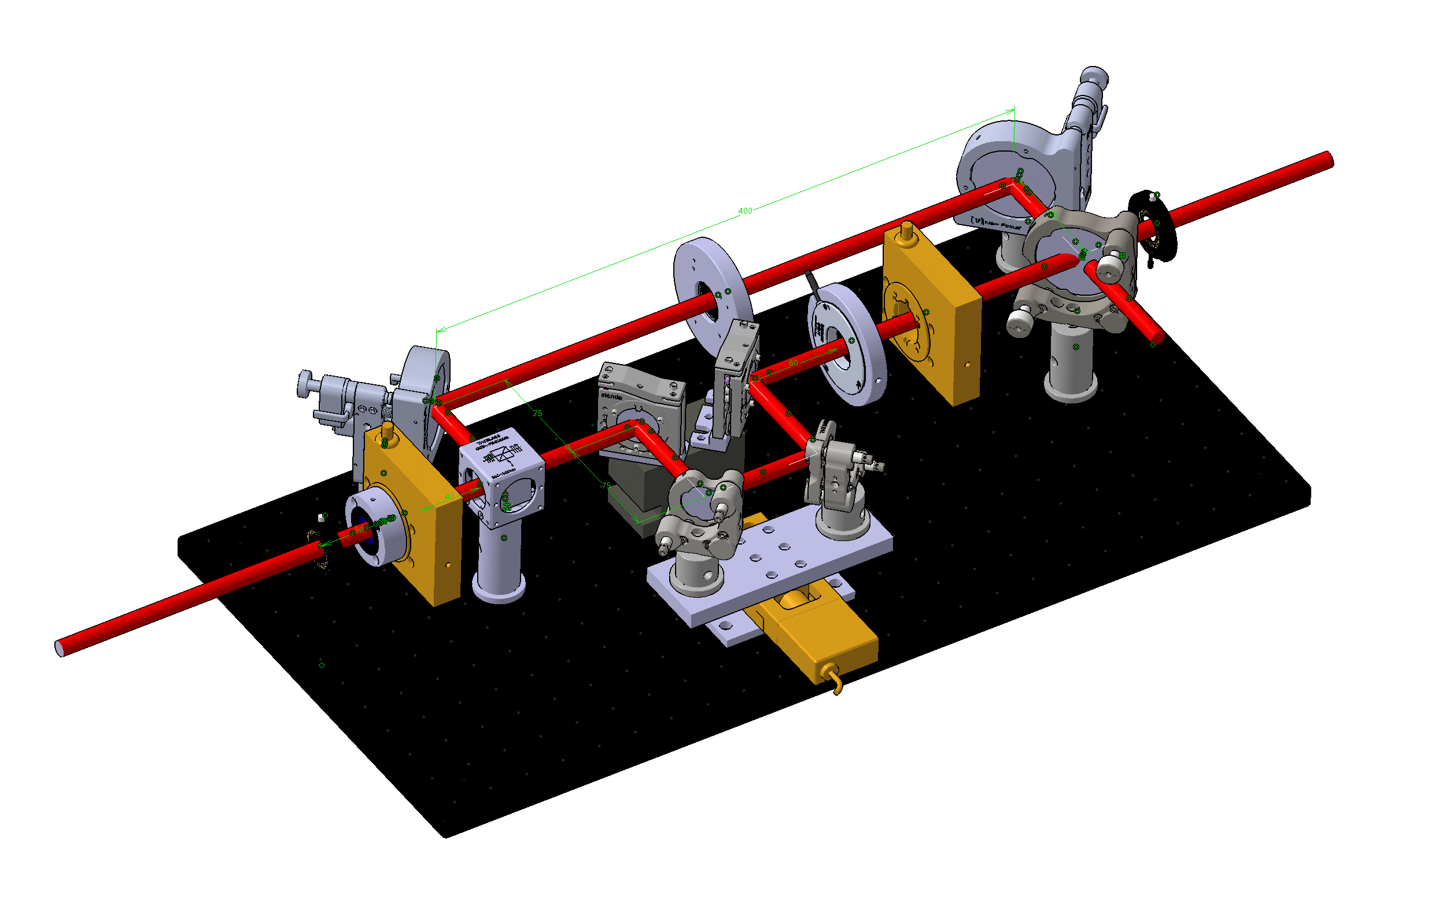
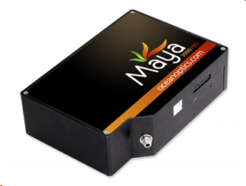
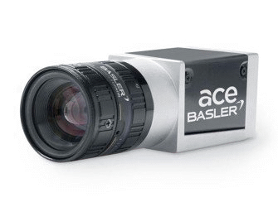
Optical Setup
to LH
λ/2 waveplate:
Adjust fringe contrast
Shutter 2
Spectrometer
Shutter 1
Camera
Alcor Laser s-pol
Delay Stage (25 mm, 80 ps)
Polarizing Beam Splitter
λ/2 waveplate:
Adjust splitting ratio
Page 3

Slide 4
Implications on the LH setup
2
Beam path changes
Additional beam path: 150 mm (500 ps)
50 % pulse energy loss due to recombination
Each beam path is equipped with a shutter
«Normal» operation
Path one only can be used for “normal“ LH operation
Path two only can be used and gives additionally control over polarization and fine delay stage (Newport MFA-PPD, min. inc. motion: 100 nm, 0.6 fs)
Features of the interferometer
Spatial overlap can be adjusted with motorized mirrors mounts in path one.
There is a camera behind the recombination mirror and several cameras far away.
Temporal overlap can be checked with a spectrometer.
1
1
Page 4

Slide 5
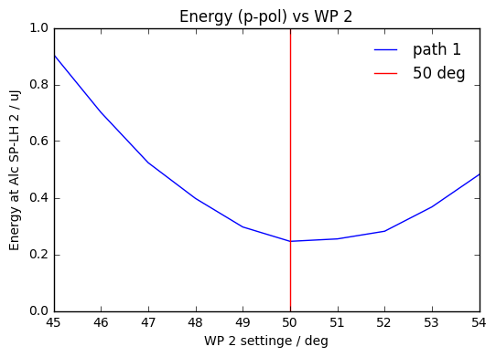
Setting of the second wave plate (s-pol)
BS
E
Polarization is properly set
Page 5

Slide 6
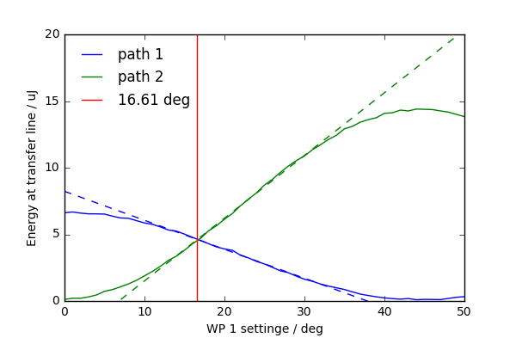
Setting of the first wave plate (splitting ratio)
2
1
Splitting ratio
is properly set
Page 6

Slide 7
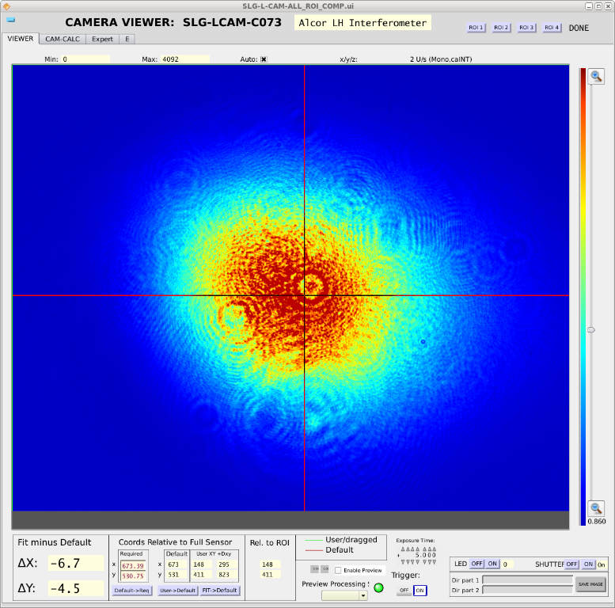
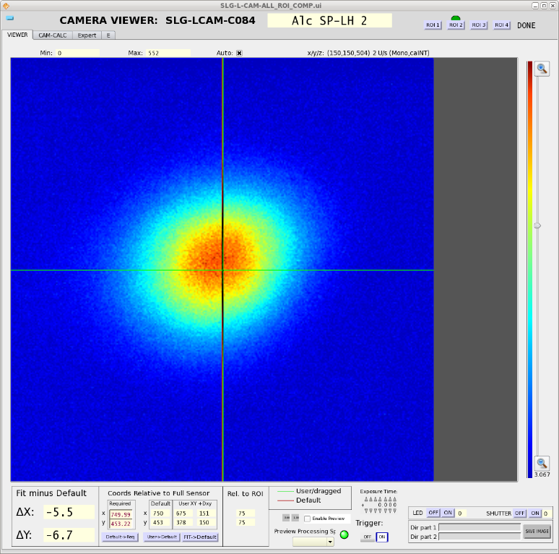
Spatial Profiles
Interferometer output
Transfer line input
Spatial overlap is properly set
Page 7

Slide 8
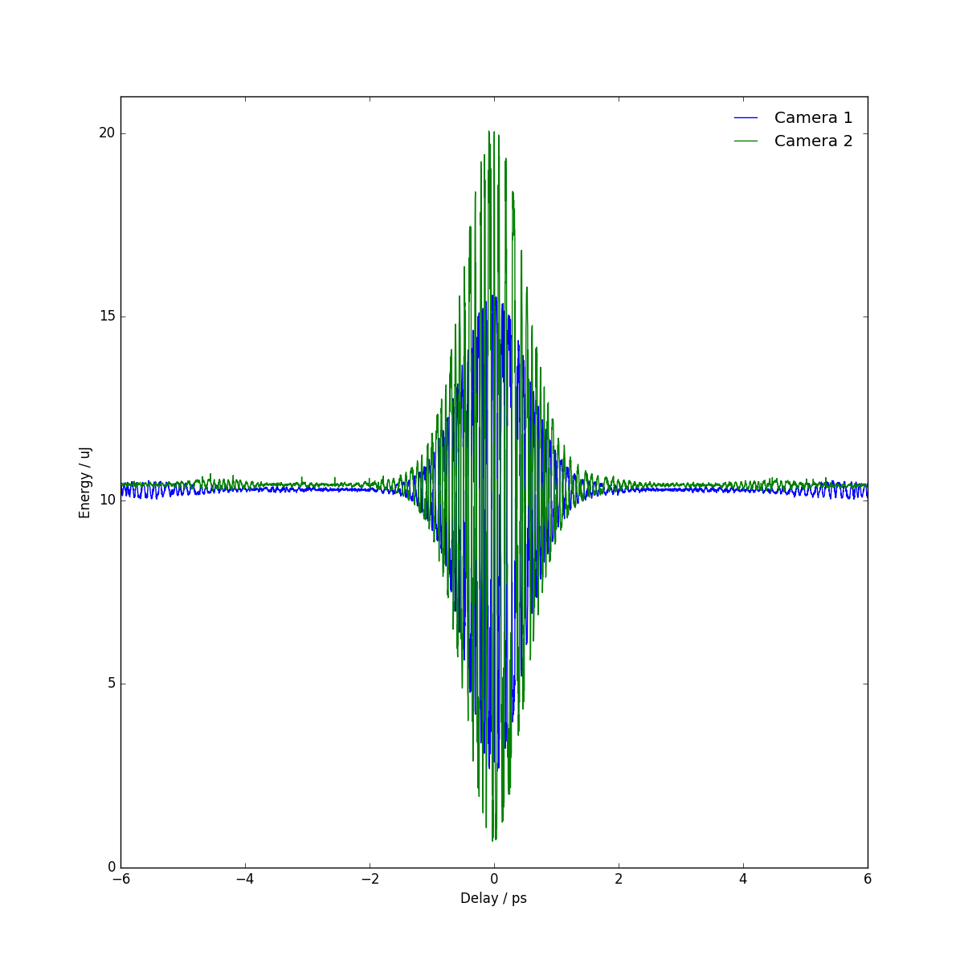
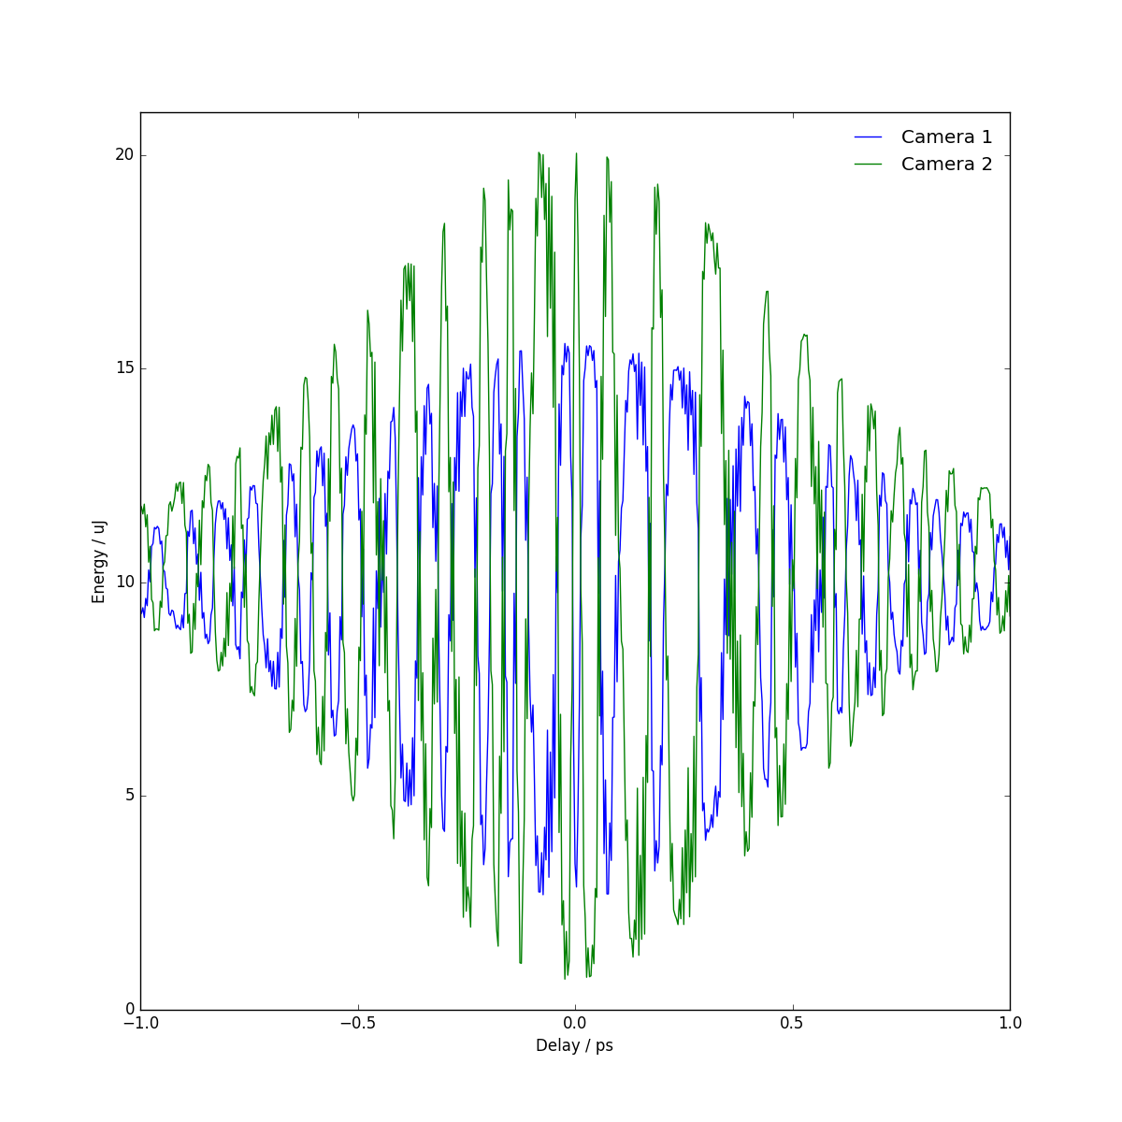
Intensity on cameras (Integral)
Fringe contrast close to 100 % for shorts delays
Delay stage has sufficient resolution
Page 8

Slide 9
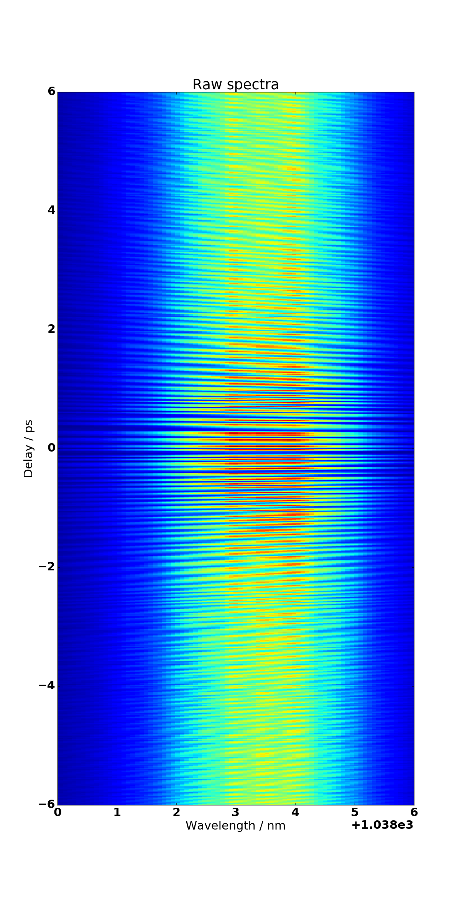
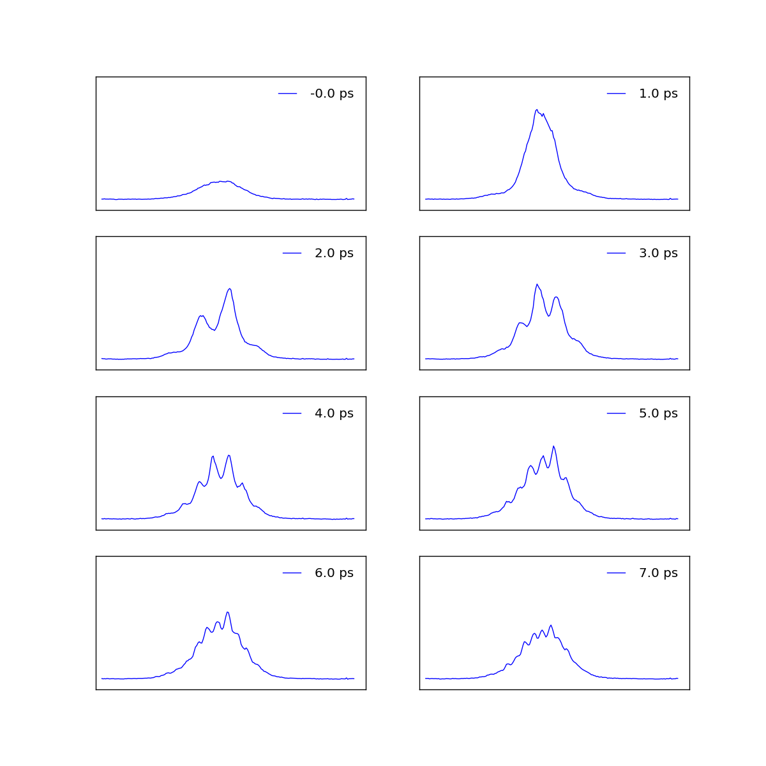
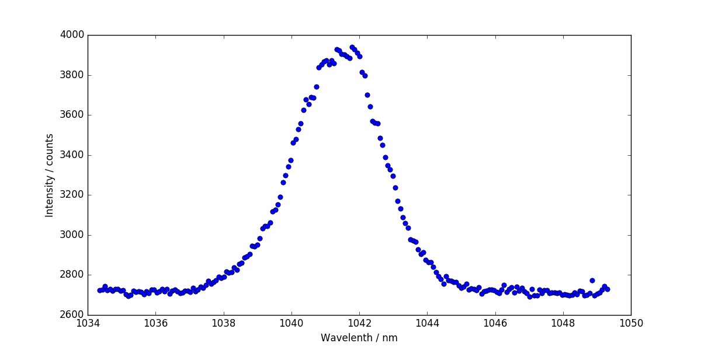
Spectrum vs. Delay
Spectral fringes as function of delay
IR spectrum, no modulations
Resolution of the spectrometer limits the modulation depth of the fringes
For long delays it has to be tested how the chirp affects the fringe contrast
Page 9

Slide 10
Wir schaffen Wissen – heute für morgen
This work is a cross-functional collaboration between the Gun Laser Group and the Beam Dynamics Group.
Hardware is installed and ready to use on Alcor laser system.
Hardware is permanently installed, but can be bypassed for «normal»
LH operation modes.
Machine beamtime can be scheduled with the Beam Dynamics group.
Acknowledgement:
Laser Group:
Alexandre Trisorio
Carlo Vicario
Andreas Dax
Beam Dynamics:
Eugenio Ferrari
Page 10

