Slide 1
Photocatalytic mechanism of covalent bond formation in LOV flavoprotein
PI: Przemyslaw Nogly (ETHZ)

Slide 2

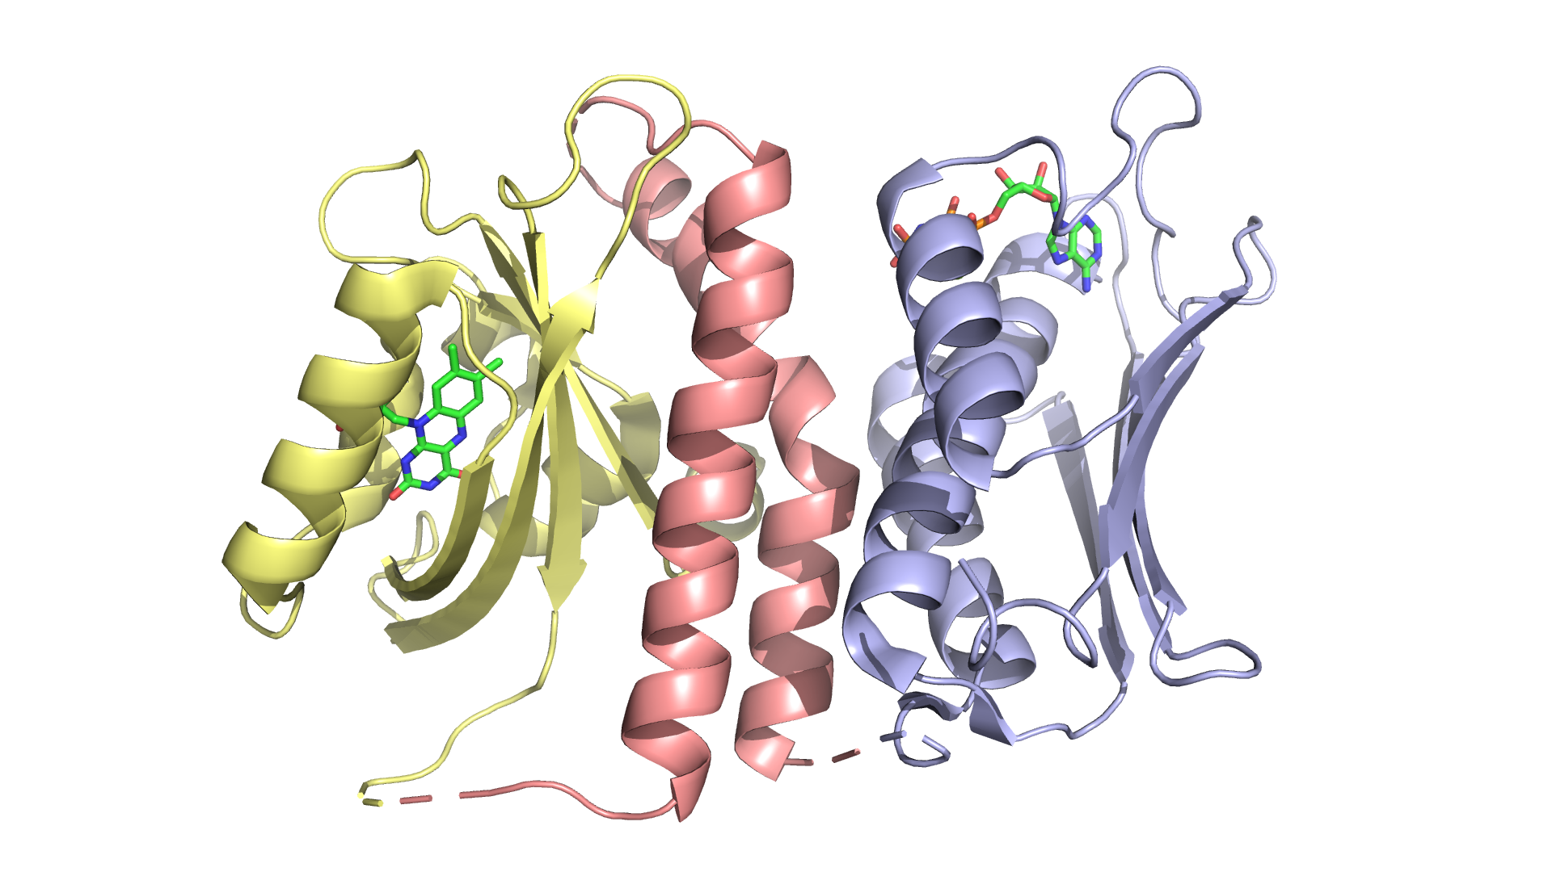
LOV is a blue light sensor protein module
LOV = light-oxygen-voltage
Environment
Cytoplasm
wall
membrane
Flavin (FMN/RF/FAD)
Blue light
LOV (Sensor)
Effector
Two components systems
6700 proteins in databases
119 functional clusters
Intracellular signal
Notes:
LOV stands for light-oxygen-voltage. It's a 14kDa protein module bearing a flavin molecule that will act as the translator of an incomming light signal into structural changes that will be transmitted to an effector module propagating the signal into the cell.
In general it happens through the release of an inactive form in the dark which then becomes active upon light illumination.

Slide 3
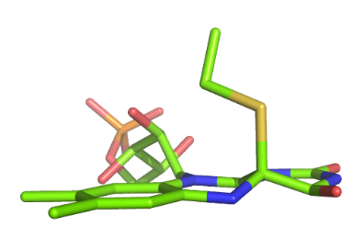
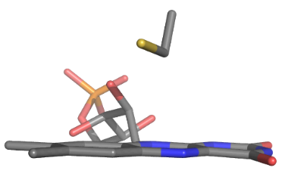
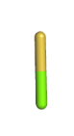
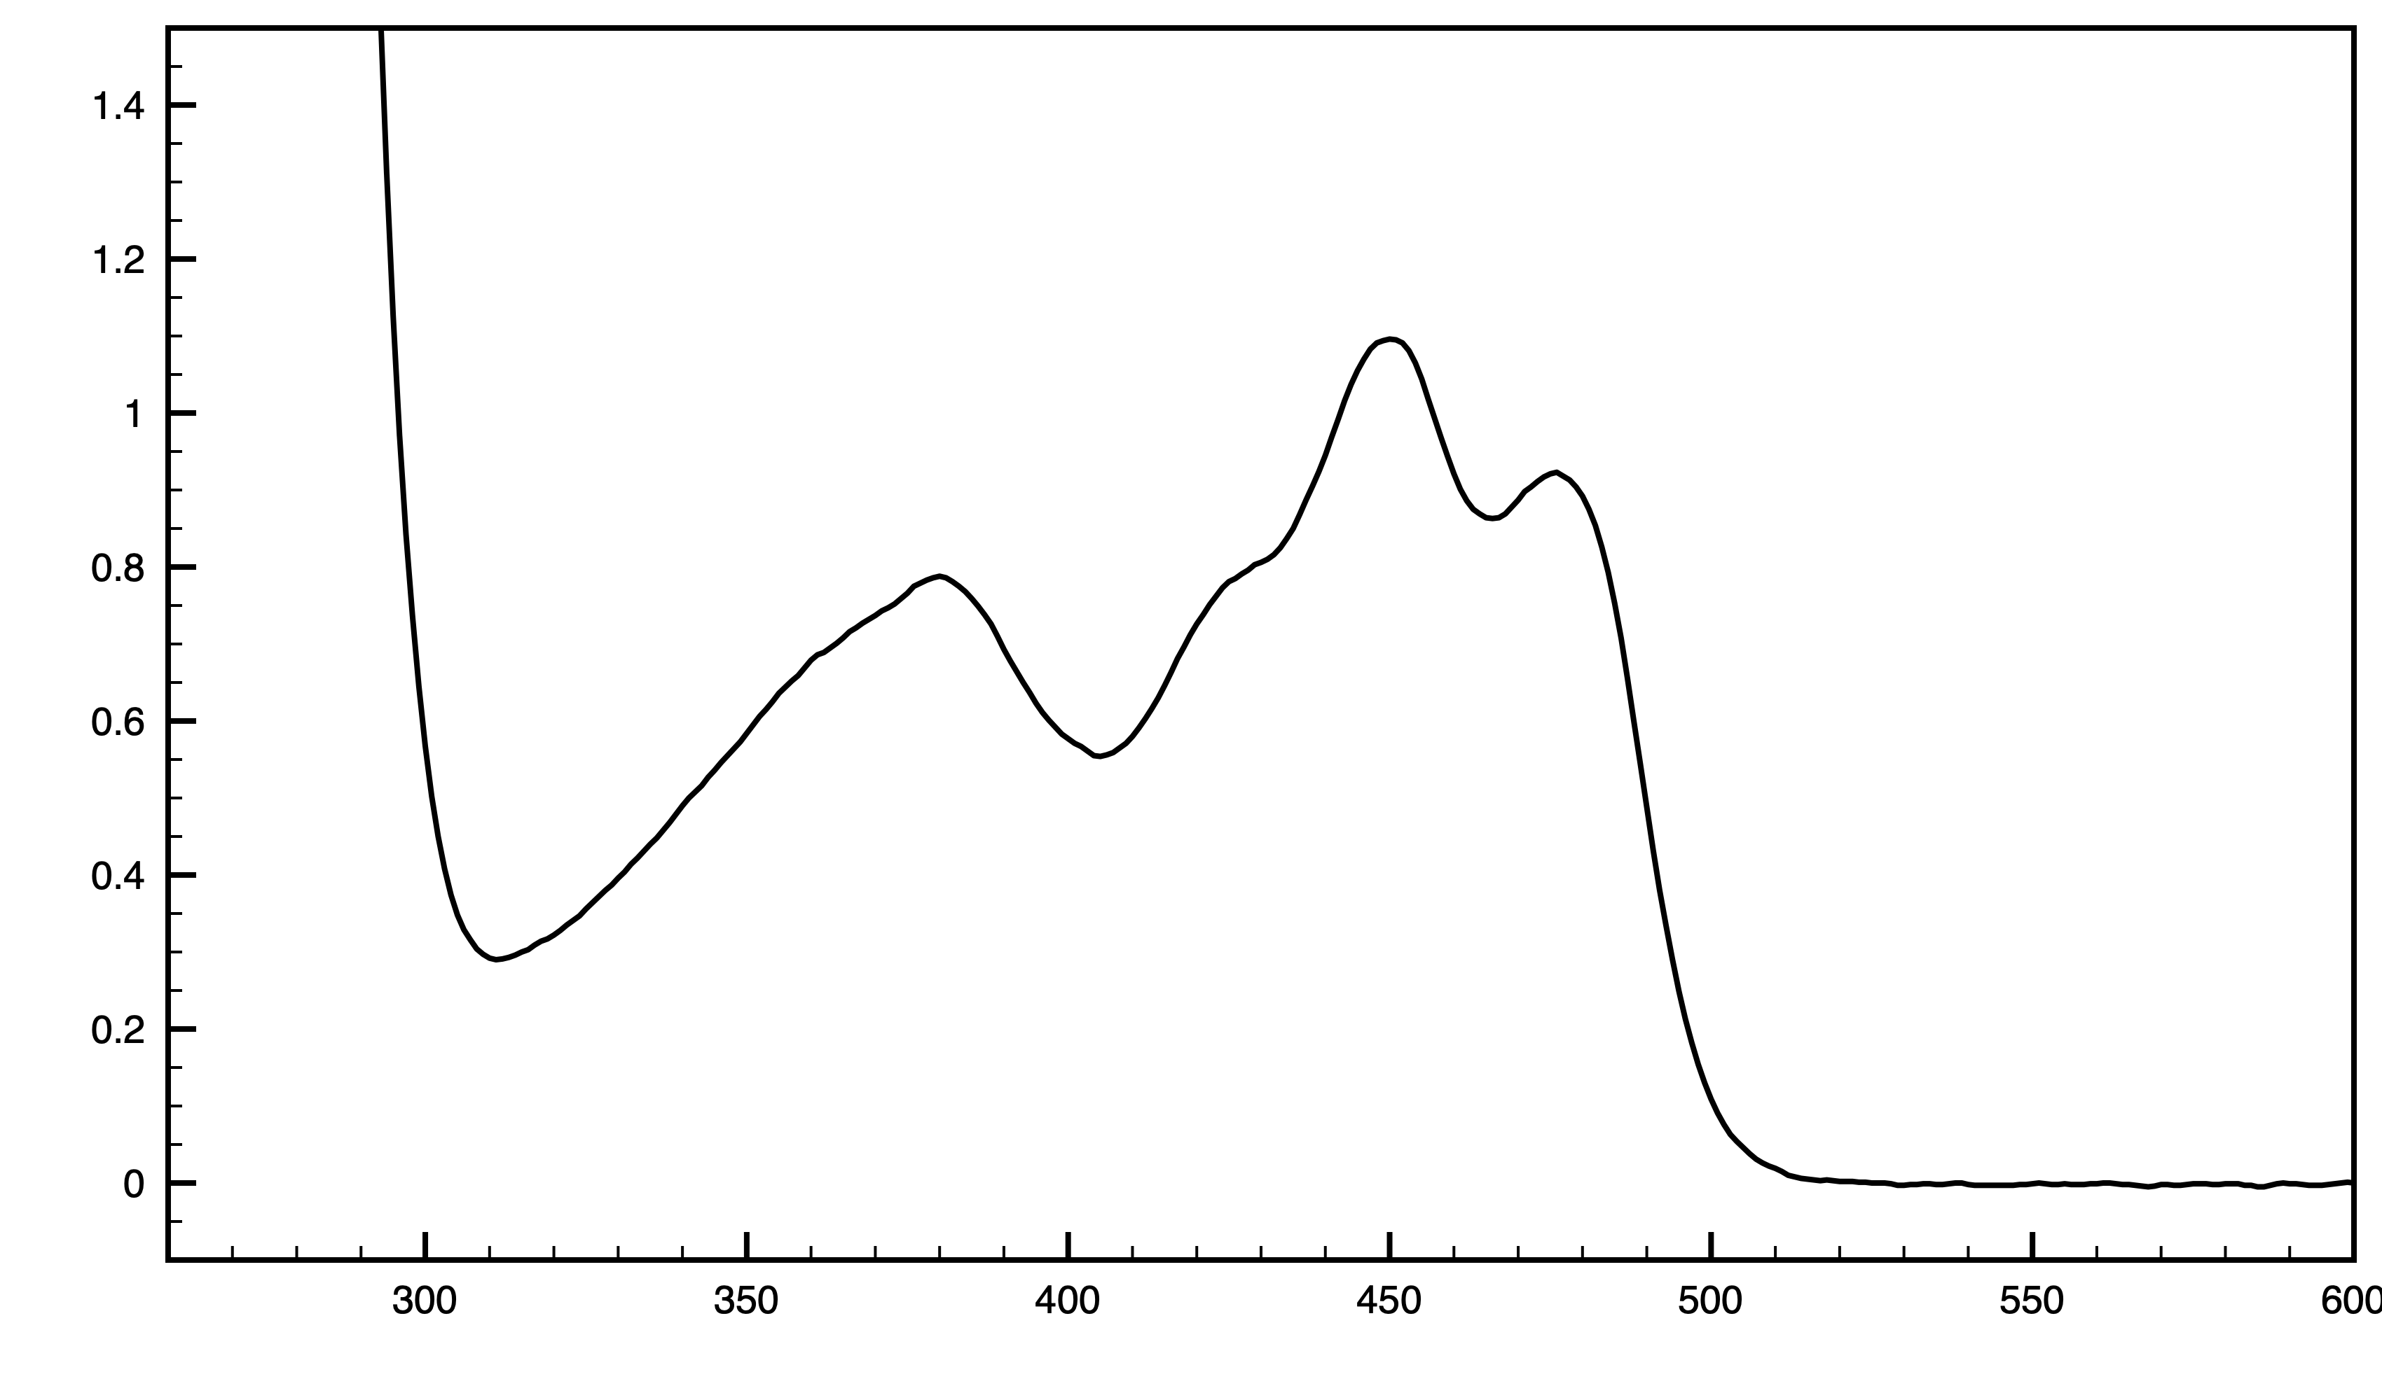
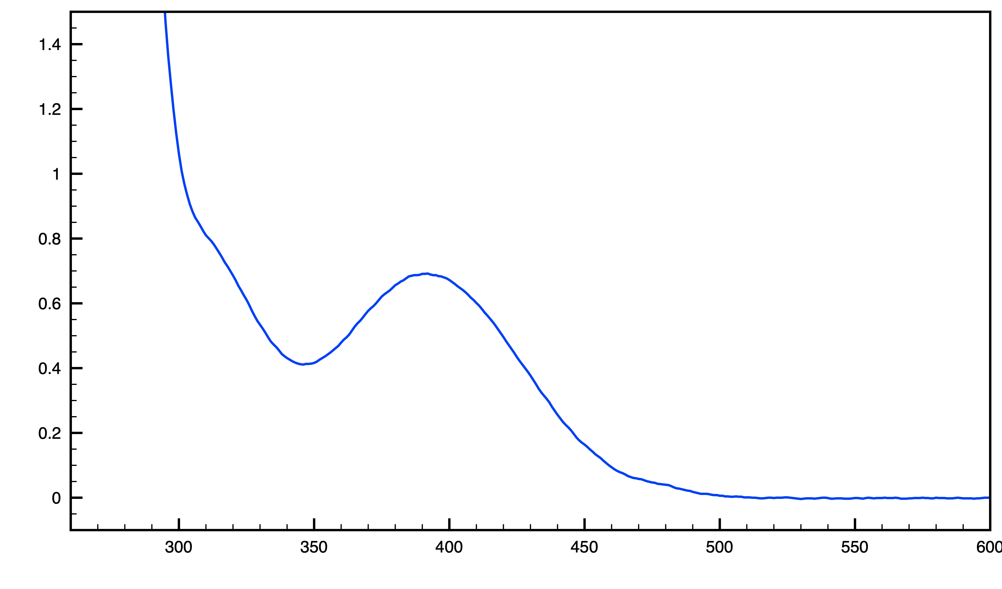
Photocatalytic bond formation
How protein guides the reaction?
Cys
S_{γ}
hν
¹FMN
???
C_{4α}
LOV-447
LOV-390
hν
𝜏 ~ 4 µs
FMN
C_{4⍺}
S_{ɣ}
𝜏 ~200s
C57

Slide 4
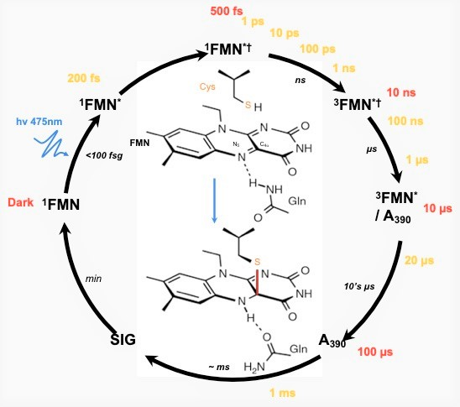
Beamline settings 7th (4 pm) - 9th September
_{LOV}
SFX Settings
Beam: 12 keV @ 500µJ
Rep rate: 100Hz
Spot size: 5x3 µm²
Detector: 4M Jungfrau (0.5 bar He)
Injector nozzle: 75 µm
Flow rate: 6.7 ul/min@100Hz
Laser Settings
Wavelength: 475 nm
Rep rate: 100 Hz (4:1 mode)
Spot size: ~40 μm FWHM
Pulse length: ~800 fs
Pulse Energy: ~5.0 uJ (titration 2.5-10 uJ)
Time delays: 200 fs - 1 ms
-> Shot-To-Shot: 250 um @100Hz
-> Runtime per injector: 18 min per injector
-> 30k indexed patterns: 60 min at 30% hit rate
(diluted sample due to 80% hit rates)

Slide 5
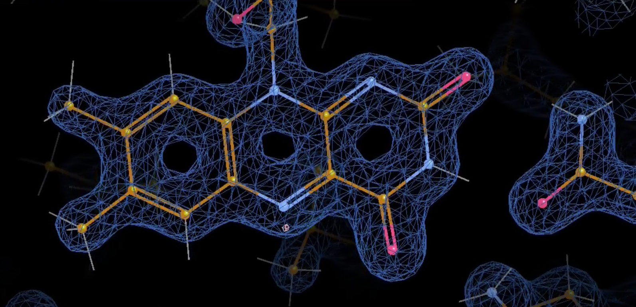
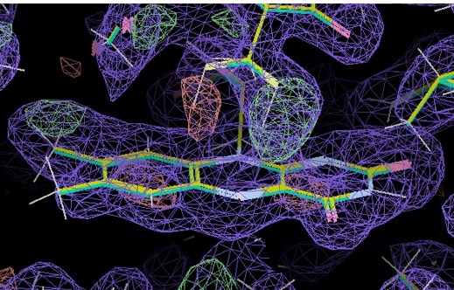
Summary 7th - 9th September (40 hours)
_{LOV}
FMN - 1.50 Å resolution
- Total indexed diffraction images: 1 016 114 (hit rates 25%-80%)
- Pump laser power titration @ 2.5 µJ, 5.0 µJ, 7.5 µJ, 10 µJ
- 17 datasets @ 11 Δt from 10 ps to 1ms
Cys
Covalent
bond
500 ns
FMN
Δt = 20 µs; covalent thioether bond formation
& deformation of FMN planar geometry
11 Δt from 10 ps to 1ms

