Slide 1
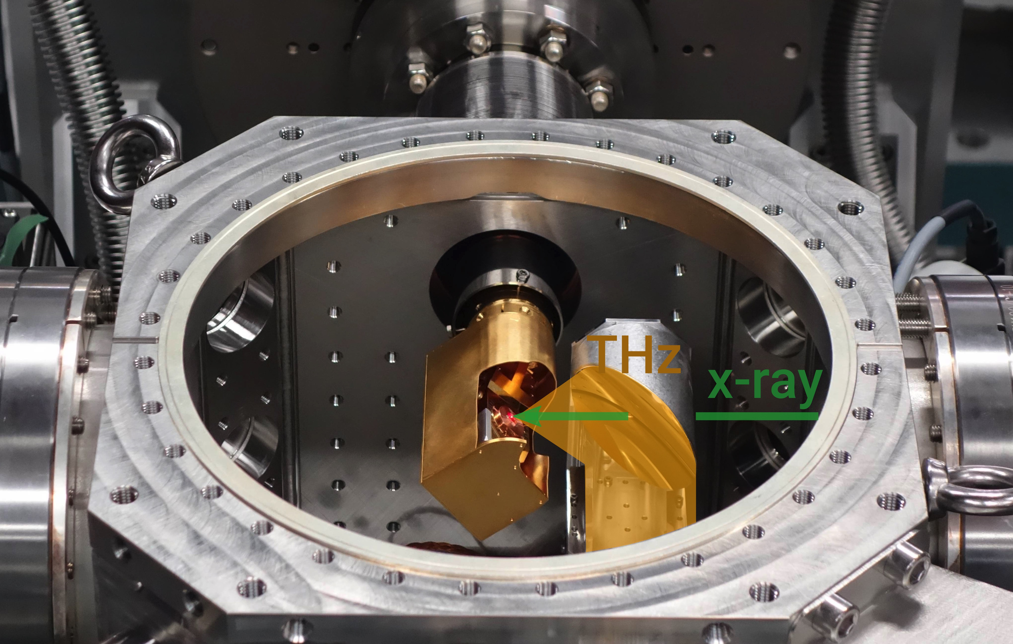
Bernina Commissioning (Staub exp. prep)
New laser parameters
First time THz pump with LiNbO3 (0.5THz, 100fs 800nm for generation)
Commissioning
techniques for finding spatiotemporal
overlap of THz and x-ray
spectral time tool performance
Requirements
7522.5eV
Bernina monochromator can be
used for tuning
<0.2% bandwidth
>100uJ pulse energy
<50fs FWHM electron bunch
Notes:
Low cycle THz pump, X-ray probe experiment to detect directly the orbital motion (orbiton) in real time, (DAST approx. 1-4 THz pump)
Tuning to an x-ray absorption resonance probes directly the orbitals, away from resonance the reflection is forbidden but the ultrafast E field breakes the symmetry making it allowed. Results in the direction detection of phonon modes, which allows a direct comparison into the coupling between the orbiton and phonons.
As data are taken in July, no deep understanding exists yet, but beautifully shows that Bernina works now excellent allowing to make new physics.
SwissFEL 100Hz, very short pulses allowed to resolve frequencies up to 11 THz (not shown in this figure)

