Slide 1
SOLEIL MOTIVATIONS FOR ITS PARTICIPATION IN JRA
Alain BUTEAU : Software for Controls and Data Acquisition group leader

Slide 2
SOLEIL MOTIVATIONS AND SKILLS FOR A PARTICIPATION IN JRA
SOLEIL‘s current developments to provide Remote Data Analysis facilities to its users : The AutoBIOSAXS project
SOLEIL skills for a participation in this JRA

Slide 3

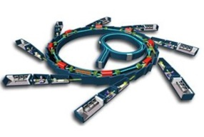
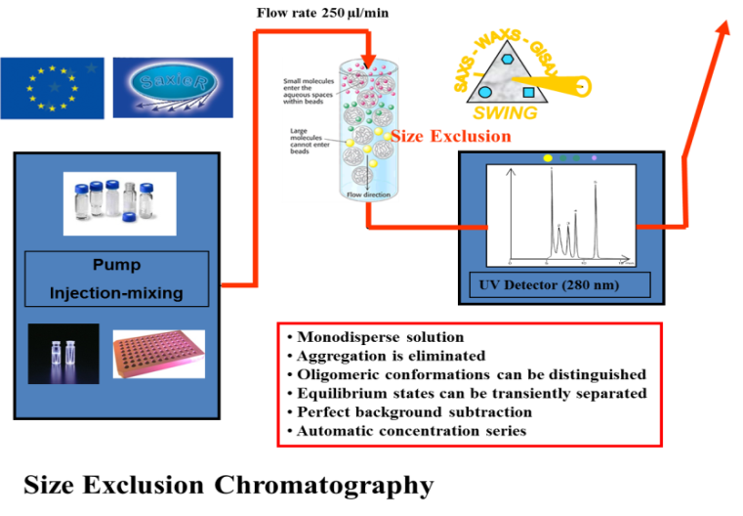
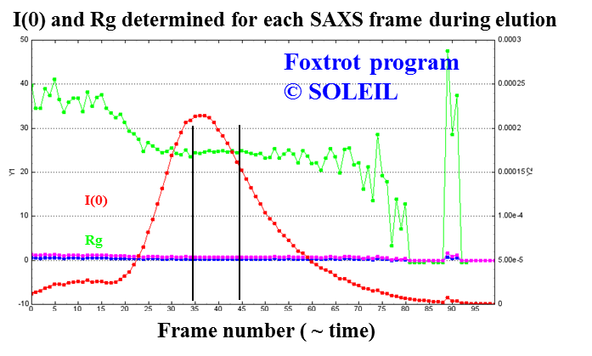
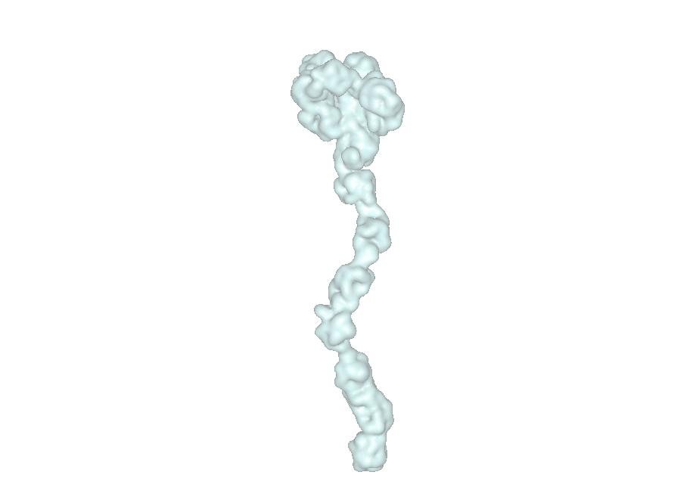
Automatic Data Treatment workflow required for BioSaxs
SAXS - WAXS - GISAXS
Data Acquisition
SWING
Detected : I(Q)
I₀, λ
I_{T}
2θ
Radial average
+
buffer subtraction
(Foxtrot application)
2D detector
Ln ( I )
(ATSAS suite of programs)
Q=4π sinθ / λ
Data Reduction
Data Analysis

Slide 4
Overall Architecture

Slide 5
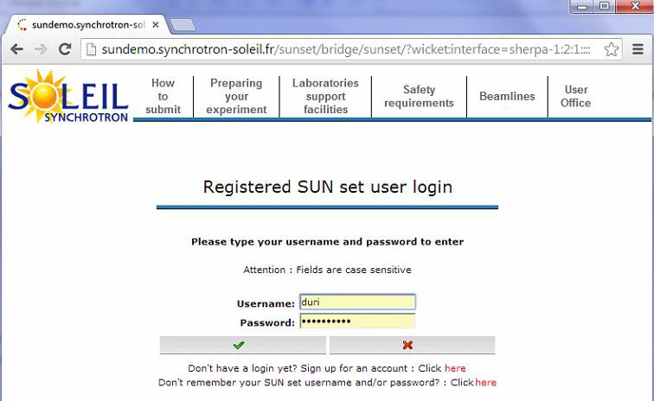
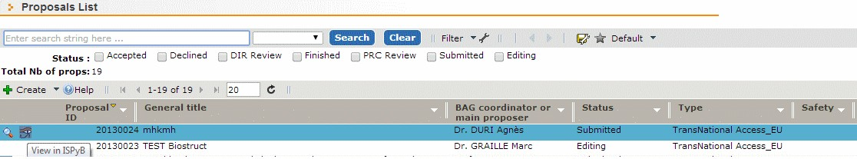
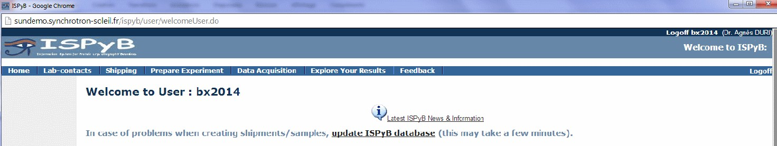

Login from Sunset to access ISPyB
Log in to ISPyB with user credentials instead of proposal one
1. log into SUN set with user credentials
2. click on proposal that you want in ISPyB
3. automatic redirection to ISPyB
1
2
3

Slide 6
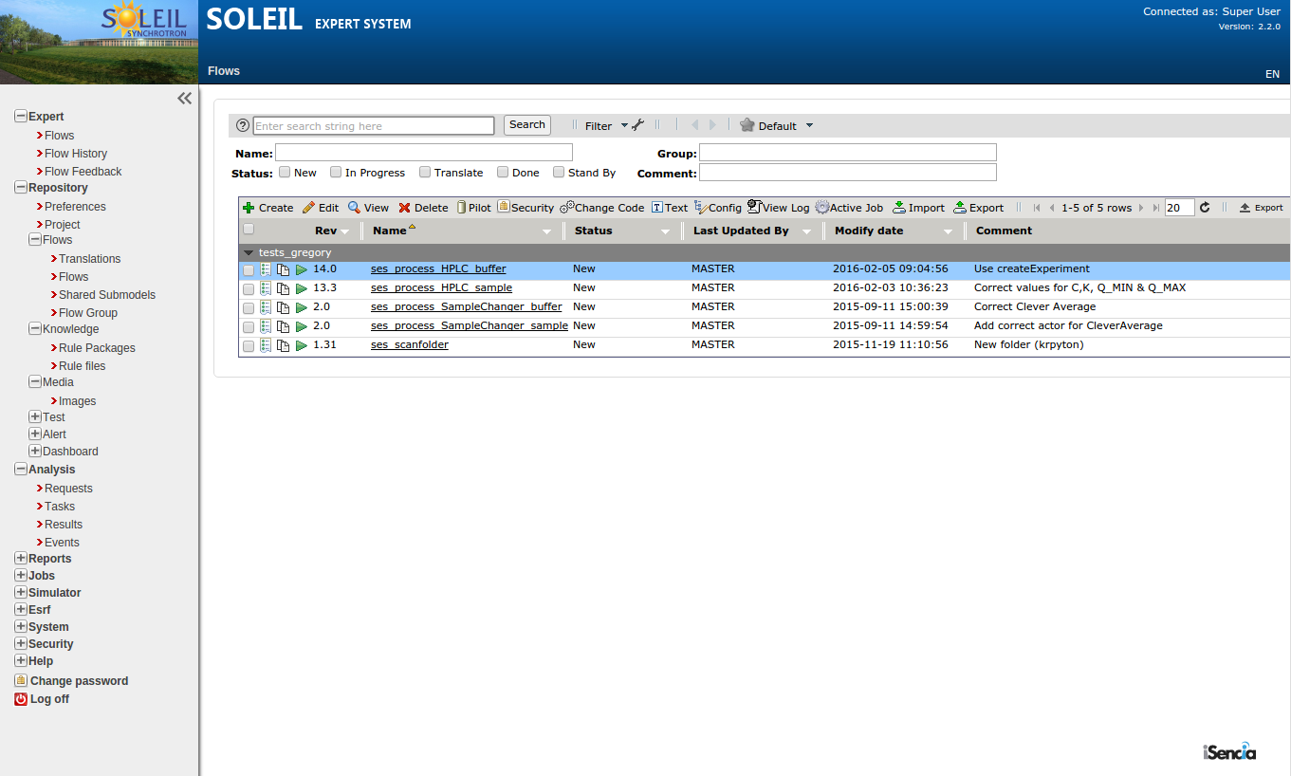
Data Analysis portal

Slide 7
Technologies used for this project
IspyB (ESRF)
Remote Experiment Declaration
Sample Tracking
Remote Experiment Results Visualization
  Based on Java Web Development Standards
  Collaborative Work with ESRF
Passerelle EDM (Isencia)
Data Reduction and Analysis Automation Engine
  Based on Java Web Development Standards
  Easy integration with IspyB through remote Web services
  Parallel Workflow Execution
  Multiple Data Source Handling with CDMA

Slide 8
Technologies used for this project
Data Reduction algorithms :
  Are based on SOLEIL Image Processing JAVA framework
Data Analysis algorithms
  Are based on the ATSAS suite of programs developped by EMBL
I.T resources
  SOLEIL cluster is used to host data intensive calculations
  SOLEIL long tem file storage is used for file handling
SOLEIL Users portal is the main entrance point for end users
  It manages the users authentication

Slide 9
Status of the project
Commissioning phase beginning 2016
Expert users Q2 2016
Open to users : Q3 2016
Then :
  Gain experience in operating such a « Data As a service » (organisation of Helpdesk, ..)
  Next scientific scenario to be defined

Slide 10
SOLEIL MOTIVATIONS AND SKILLS FOR A PARTICIPATION IN JRA
SOLEIL‘s current developments to provide Remote Data Analysis facilities to its users : The AutoBIOSAXS project
SOLEIL skills for a participation in this JRA

Slide 11
I.T Skills of SOLEIL Computing team
Depending on the JRA organisation and workpackages responsabilities SOLEIL can provide expertise within the following fields
Software engineers : 5 people
  For software integration of data analysis algorithms within workflow engine
  For integration of results within a « data display portal » (such as ISpyB)
  With experience in the CommonDataAccessModel API which can help managing insitiutes particularities in file data format and data organisation
I.T sysadmins : 2 very experienced système administrators: S. Lé , P. Martinez
  With strong experience in virtualisation technologies : (OpenVZ is used on all SOLEIL Control systems which runs on more than 200 Virtual Machines)
  With strong experience in file storage architecture
  SOLEIL new cluster installation is also an opportunity to host data intensive computation as it has GPU and CPU capabilities
Authentication : I. Chado
  Particiaption in the previous Umbrella phases within PanData
Projet Management : A. Buteau

Slide 12
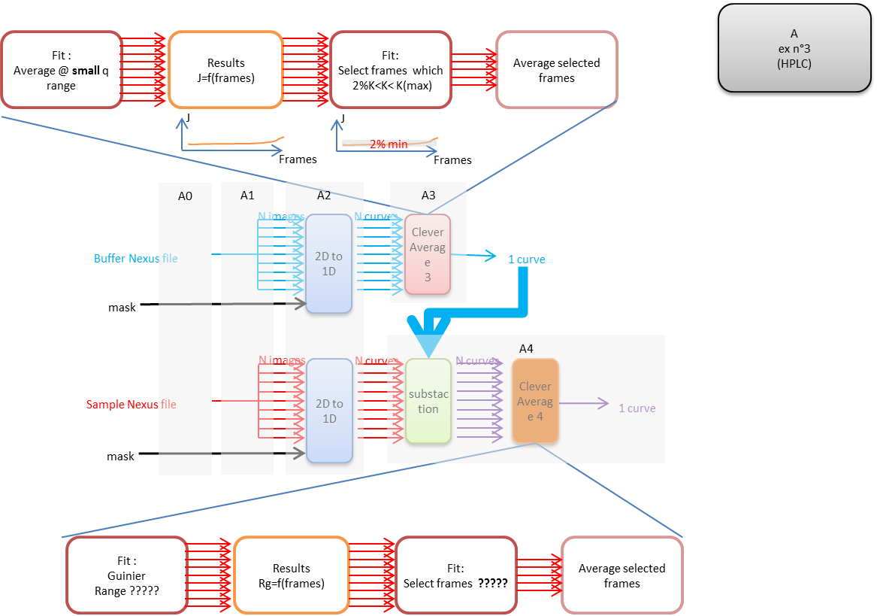
Data Reduction Workflow
Similar buffer frames are averaged
identical protein frames are selected and averaged to obtain only protein curve

Slide 13
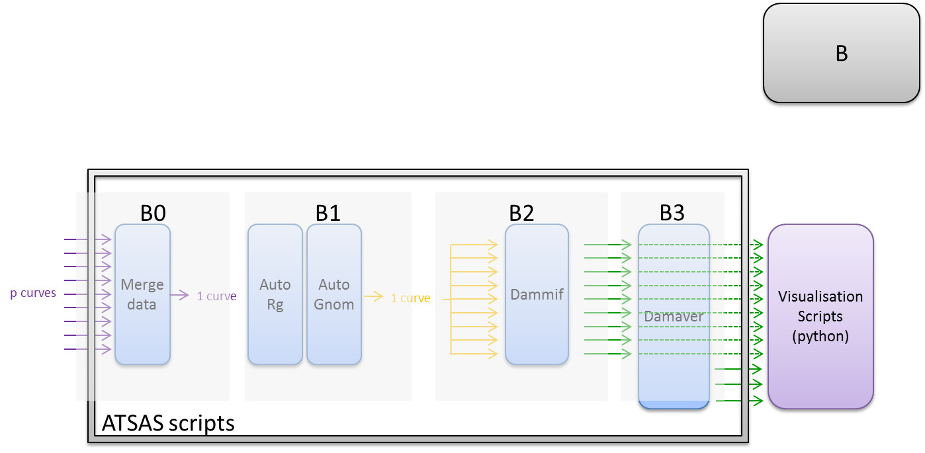
Data Analysis Workflow
Guinier Fit to obtain Rg value
Ab initio generation of multiple shape models
Generation of P(r), Distance distribution curve
Ranking of shape models

Slide 14
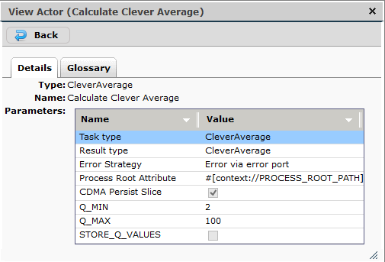
Workflow Actors Configuration
Clever Average Actor Configuration
GUI Panels for parameter configuration are autogenerated
by Passerelle EDM

