Slide 1

Remote Data Analysis Service for Photon Science
Calypso+ - JRA2

Slide 2
List of expertise
Project Coordination + workshops (PSI/ESRF obviously)
By the way: Workshop at ALBA Synchrotron: HTCondor / ARC CE Workshop
29 February to 4 March 2016 - https://indico.cern.ch/event/467075/ (registration open till 22/2)
Use (science) case definition and collation (multiple disciplines, facilities and user/industry) (Scientists)
Packaging for applications (SysAdmins)
- Linux rpms – Extensive experience packaging – HPC analysis examples: autoproc, ccp4, xds-viewer,...
- Docker – Experience in container management & packaging
- KVM VM image-analysis applications packaging experience on PBS/MAUI
- Distribution generation experience: Yocto distro (embedded), Debian based distro.
Cloud setup and deployment (SysAdmins)
Some experience in private & public cloud (AWS, OpenStack, OpenNebula)
Configuration of site and test sites (DevOps)
- Experience with EGEE SA3 with Condor Cream testing.
- Experience configuring HPC clusters with SaltStack, LCGng, Puppet, Ansible and Quattor (Queue systems: Slurm, HTCondor, PBS, TorqueMAUI)
i.e. Alba HPC Slurm Cluster deployed & managed with SaltStack & Cobbler.
Port and package applications and examples (Software engineer)
Integration of existing applications and packages such as MxCube, EDNA (ESRF)…
Umbrella authentication (AAI+security)
Under testing. Un production shortly in the User Office Portal at ALBA.
User portal development (Web engineers)
Django-AngularJS and webservices (REST) expertise and other Javascript frameworks. Twitter Bootstrap (responsive) websites expertise as well.
Definition, development and distribution of mini demonstrator platform to test sites (DevOps)
Interested to collaborate in definition. Not in development. In distribution as part of the testbed sites.
Report on results and links to HNSciCloud + EOSC (IT Engineer+SysAdmin+Software+Scientists)
No experience in HNSciCloud + EOSC

Slide 3
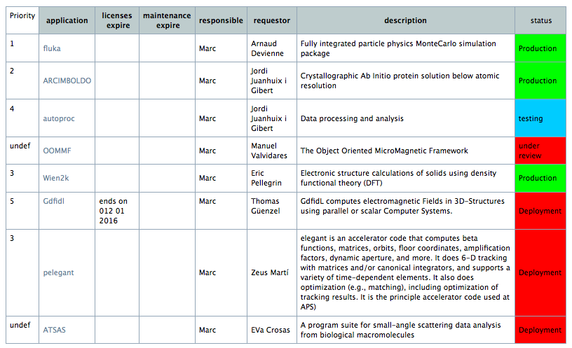
HPC, HTC Cluster

Slide 4
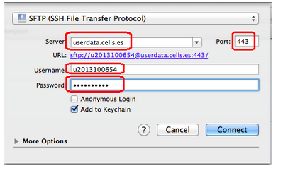
Remote access… (today…)
NX enterprise (remote operation)
Citrix
Data repatriated via SFTP…
  …or disks at the BL.

Slide 5
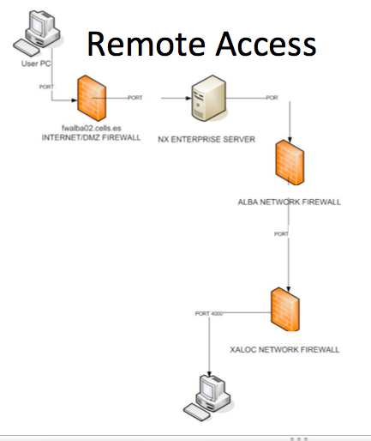
NX ENTERPRISE
BL REMOTE OPERATION
1st design.

